Slide 1


Advanced Research Computing & data at USC
Center for advanced research computing (CARC)
Hao Ji
Data scientist
CARC

Slide 2
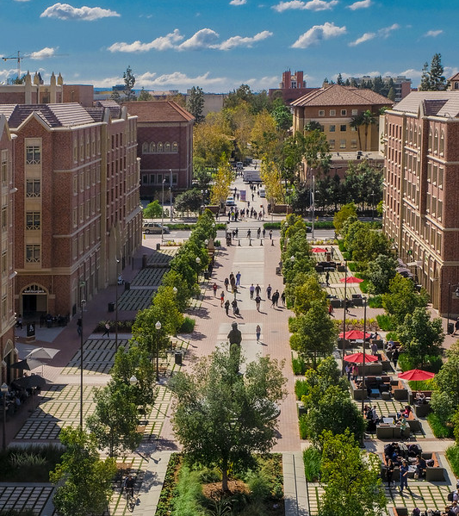
About CARC
https://www.carc.usc.edu/
The computational expertise in high-performance computing of the USC Center for Advanced Research Computing (CARC) has been a vital resource in USC research community and contributes to improved research productivity and superior outcomes, driving USC’s research excellence forward.
CARC aims to be an institutional resource enabling scientific breakthroughs at scale.
Main Service Areas:
Advanced Computing
Data Solutions
Research Support
Education

Slide 3
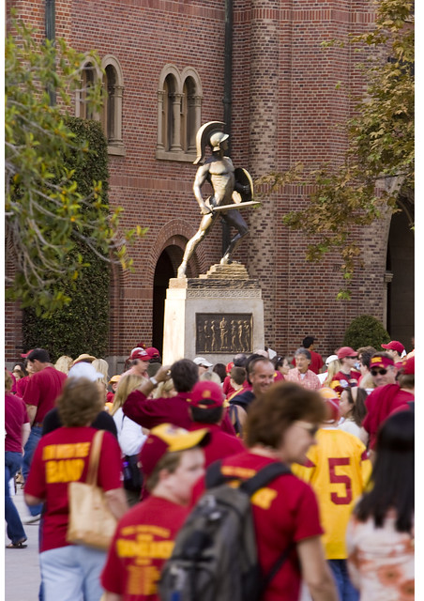
CARC highlights
The resources, services, and achievements that set us apart.
Advanced Cyberinfrastructure:
Discovery shared HPC cluster system & Endeavour Condo cluster program
Artemis: virtual computing platforms and cloud solution (NSF Funded)
High-performance HPC network upgrade to 200Gbps
10+PB data storage capacity
Education & Outreach:
More than 25 workshop classes and summer bootcamp
TAC 450: High-Performance Computing for Applied Machine Learning
NSF CyberTraining project ($300K) – collaboration with AME faculty for development of computational science coursework at Viterbi
Research Collaborations:
NSF Campus Compute ($400K) - Hybrid Computing System Development
NSF Regional Network ($1M) - Science DMZ R&E Network Deployment
NSF Regional Computing ($1M) – Leading Research Computing Alliance in SoCal
Cryo-EM project for Dornsife & Viterbi –Development of Computational Ecosystem
Industry Partnership:
Samsung Semiconductor, Inc. – Smart Memory, Full NVMe storage solution
VAST Data – Advanced FS testbed
Nvidia – Early access to Grace-Hopper next-gen superchip, future collaboration for Frontiers of Computing

Slide 4
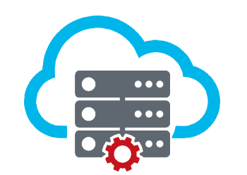





CARC SystemS overview
CARC systems include the Endeavour condo cluster as well as the Discovery shared cluster
Endeavour (Condo Cluster)
Discovery (Shared Cluster)
Artemis: Private Cloud
- Virtual computing platform
- DB, Web server, Docker, etc.
- In production since 09/23
Data Transfer Nodes
hpc-transfer1/2.usc.edu
Applications
Libraries
OS/System Tools
100Gbps
Data Archiving Tape System
- 20PB capacity
- Expandable up to 200PB
Home directory (NFS):
Highly Available, not fast
Installing packages and software
Storing Keys, Config files, etc.
Scratch directory (PFS):
Very fast, not persistent
Massive data generated during simulations
Project directory (PFS):
Very fast, persistent
Long-term storage for
research project data
Login node:
endeavour.usc.edu
Login node:
discovery.usc.edu
200Gbps NDR IB
/home
100 GB/user
/project2
15TB free
($60/TB/Yr)
/scratch1
10TB

Slide 5
HPC Resources
The following table summarizes the resources at CARC.
Category | Function | Descriptions
Discovery general-use cluster | Login nodes | 2 x 40 Gbps nodes
 | Data transfer nodes | 2 x 100 Gbps nodes running GlobusConnect
 | Compute nodes | ~500 nodes, totaling ~18,000 cores
 | GPUs | ~260 GPUs (A100, L40s, A40, V100, P100)
 | Large memory nodes | 4 nodes with 1 TB of memory
Endeavour condo cluster | Login nodes | 2 x 40 Gbps nodes
 | Compute nodes | ~900 nodes, totaling ~22,000 cores
 | GPUs | ~180 GPUs (V100, A40, A100, L40s)
Network | Interconnection | InfiniBand NDR (200 Gpbs)
 | Science DMZ | DTN w/ perfSONAR
Storage file systems | /home1 | 280TB total, 100GB/user ZFS/NFS parallel file system
 | /project2 | Vast project file system
 | /scratch1 | Intended for short term compute
Artemis cloud platform | Compute nodes | 14 nodes, totaling 896 cores
 | GPUs | 6 x A40 GPUs
Recognizing the need for a significant upgrade in USC's current HPC infrastructure to meet the demands of future research, CARC is actively engaged in collaborative efforts with multiple departments across the university, focusing on planning and developing next-generation HPC systems that will deliver the necessary computing power to propel USC's research endeavors forward. These concerted efforts aim to provide optimal support for the the Frontiers of Computing initiative, ensuring that USC remains at the forefront of cutting-edge research and innovation.

Slide 6
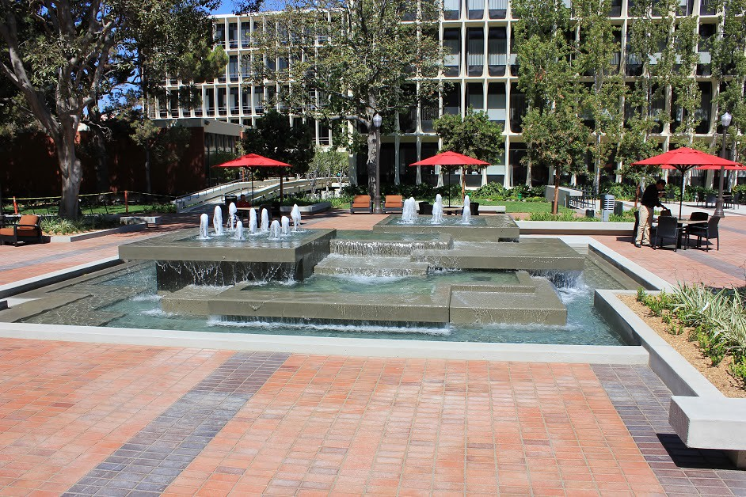
CCP: condo cluster program
The Center for Advanced Research Computing (CARC) launched the Condo Cluster Program (CCP) in December 2020 to allow researchers a flexible way to purchase computing resources for their own dedicated use.
The CCP has two pricing models:
Annual Subscription Model
Allows research groups to subscribe to their selected number of compute resources on a yearly basis
Compute nodes can be requested via CARC User Portal
Allocated nodes get provisioned automatically within a week
Traditional 5-year System Purchase Model
A useful option when research groups need to make a bulk purchase using a research grant or departmental budget
Compute/GPU system configurations by CARC
System purchases can be requested via CARC User Portal

Slide 7
Advanced research computing User services
The Center for Advanced Research Computing (CARC) offers comprehensive user support services
Social Media
news stories
Newsletter
CARC
user
services
Outreach
CARC user tickets
Weekly office hours
Tickets
Proposal Development
System support
Grant Support
knowledgebase
User community engagement
User Portal
Education
User Forum
Project mgmt
allocation mgmt
workshops
TAC 450 Class
NSF CyberTraining
User guides
System info
FAQ
Online Resources
https://www.carc.usc.edu/ (New CARC Website)

Slide 8
USC research computing & data Road Map
The future of CARC looks bright with plans for future improvements, outreach, and collaborations.
‘23
‘25
Regional Cyberinfrastructure
Frontiers of Computing
Network Upgrade
Next-Gen
Supercomputer
CARC is building dedicated CI for under-resourced universities in the Southern California region.
CARC aims to provide optimal support for the the Frontiers of Computing initiative, ensuring that USC remains at the forefront of research and innovation.
We have upgraded our HPC network to a 200 Gbps InfiniBand NDR low-latency interconnection.
This upcoming system will allow researchers to conduct large-scale AI modeling and simulations as well as traditional HPC research.
‘24
& beyond

Slide 9


LAGUNA System overview
USC Research DMZ
Laguna Regional computing
HPC cluster
InCommon
Federated Authentication
Applications
Libraries
OS/System Tools
Login node:
laguna.carc.usc.edu
100Gbps
Caltech/OSN
Object Storage
2PB
/home
100GB/user
/project (400 TB)
5TB per project

Slide 10
Laguna: Regional computing system
Dell HPC system configuration:
Category | Function | Qty | Notes
Public facing | Login node | 1 | Dual AMD EPYC 9354 3.25GHz (32C/64T) w/ 384 GB
Computing | Compute node | 16 | Dual AMD EPYC 9554 3.1GHz (64C/128T, 256M Cache) CPU 384 GB memory per node
 | GPU node | 8 | Dual EPYC 9354 3.25GHz (32C) + Dual Nvidia L40s GPU (18K CUDA cores, 568 Tensor cores, and 48GB GDDR6 mem) w/ 768GB mem
Network | Interconnection | N/A | Mellanox CX-7 InfiniBand NDR (200 Gbps)
Storage | /home & /project | 4 | Dual AMD Epyc 9224 2.5GHz (24C/48T) w/192GB memory 12 x 15TB NVMe SSD (4 x 180TB = 720TB)
System installation update:
System installation completed.
Home FS is being implemented.
NVMe storage system (project FS) is installed.
OSN storage system has been installed, configuration in progress

Slide 11
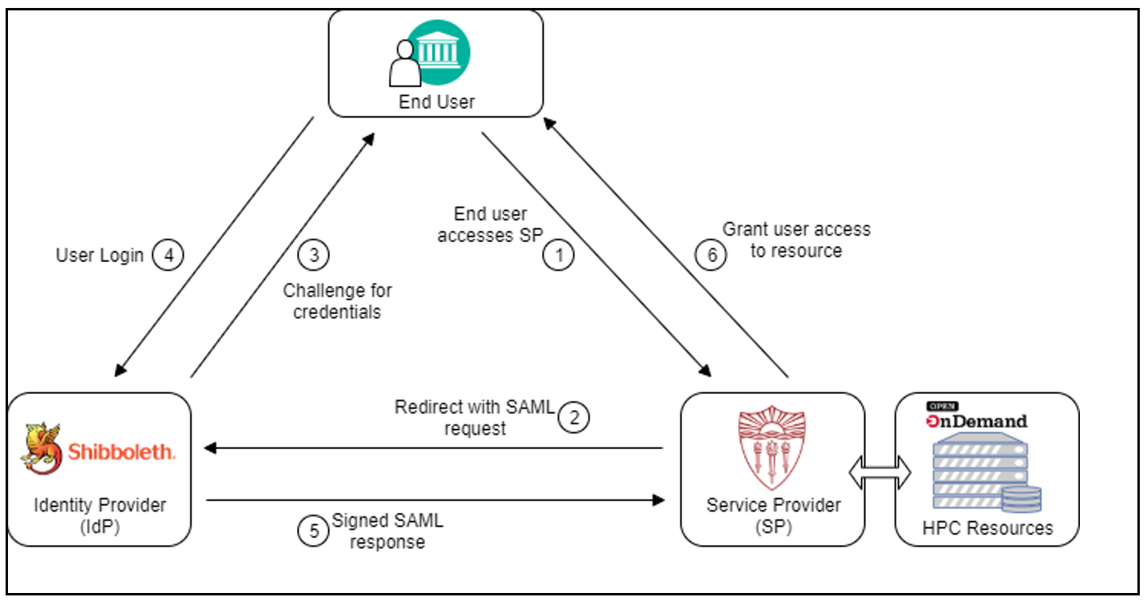
incommon federated authentication
CARC systems include the Endeavour condo cluster as well as the Discovery shared cluster
InCommon Service Provider registration. Registered CARC Shibboleth SP and also for the "Research and Scholarship" category to streamline federation research access.
USC SSO implementation - Deploy InCommon SSO on CARC endpoints.

Slide 12

THANK YOU
& Fight On!

