Slide 1
Macula Densa scRNAseq Project
Jonathan Nelson
3.1.88

Slide 2
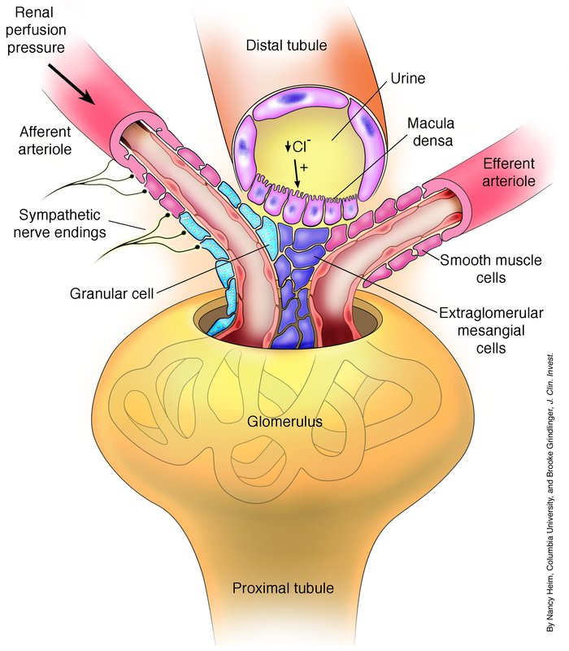
The Macula Densa
The macula densa is a specialized region of the kidney that plays a crucial role in regulating blood pressure and fluid balance.
The primary function of the macula densa is to sense changes in the concentration of sodium chloride (NaCl) in the tubular fluid. When NaCl levels increase, the macula densa signals the juxtaglomerular apparatus (JGA), which is a group of cells located near the glomerulus. The JGA then releases renin, an enzyme that initiates the renin-angiotensin-aldosterone system (RAAS). The RAAS increases blood pressure and fluid retention, which helps to restore the normal salt balance.
PMID: 15372097

Slide 3
Hopeful Outcome
Completely unknown dataset
We’ll discovery something new!
Something to add to your CV/Biosketch
Jeff…we need to start on your biosketch
Poster to present at a research conference?
Locally? Nationally?
Co-authors on a manuscript with Janos and Gina

Slide 4
The Dataset
Macula Densa cells (Nos1-creERT2:tdTomato) sorted cells
Cells, not nuclei (Important!)
Control cells published in
https://pmc.ncbi.nlm.nih.gov/articles/PMC11142747/
This dataset has both control and low-salt treated cells
N=2 for each treatment
We should journal club (the three of us this manuscript)
Intro/Methods
Figures 1-4
Figures 5-9
Additional background reading
Could each of you pick 1-3 other articles about macula densa/low salt treatment for us to review together.

Slide 5
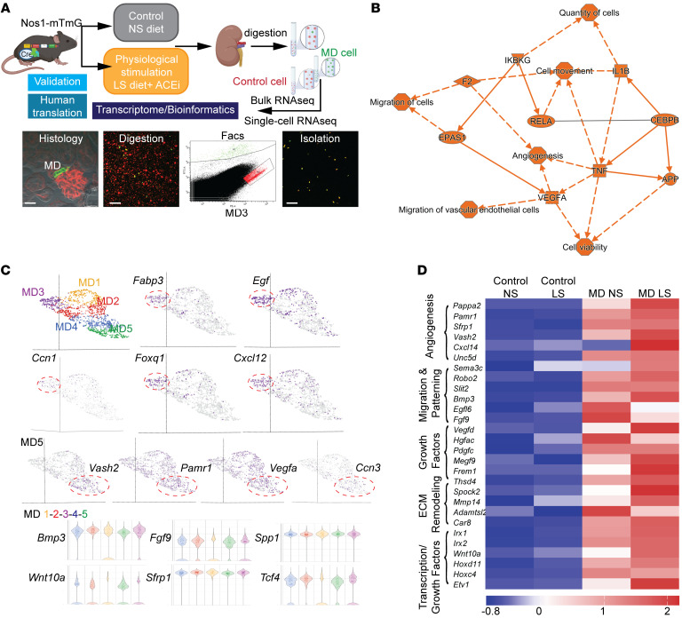
scRNaseq Figure from the Manuscript

Slide 6
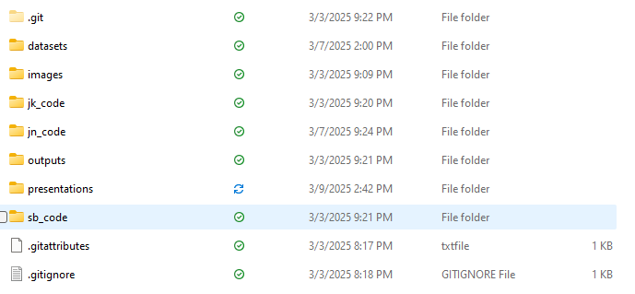
Folder Data structure
Here() will default to where the .git folder is (not where you open the .rmd file from!
See: https://github.com/jennybc/here_here

Slide 7
Github Desktop Usage
You can push and pull code from your folder, please don’t change code in another person folder.
Grab the .h5 and .rds files from me to place into appropriate folder after you’d cloned the repository.
If you knit a file…let me know that you’ve pushed it to Github and I’ll take a look at it on my computer.

Slide 8
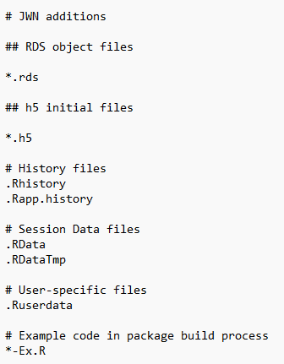
.gitignore
Will not share/update .rds or .h5 files (save space!)
Need to get those some other way:
OneDrive
Physical Hard Drive

Slide 9
Two versions of the dataset
First-processed
Filter counts ==> Viable cells 2nd cut off ==> Filter features ==>gene type is protein coding ==>Normalized counts ==> Filter observations ==> Nos1 and Pappa2 >5
Second Raw
I think just at the first “Filter Counts”
If I’m working with a dataset…I usually want to start out with the raw version to make my own filtering decisions.
I want to question and explore the decisions made/implications with the initial analysis.
Meta.data wrangling!

Slide 10
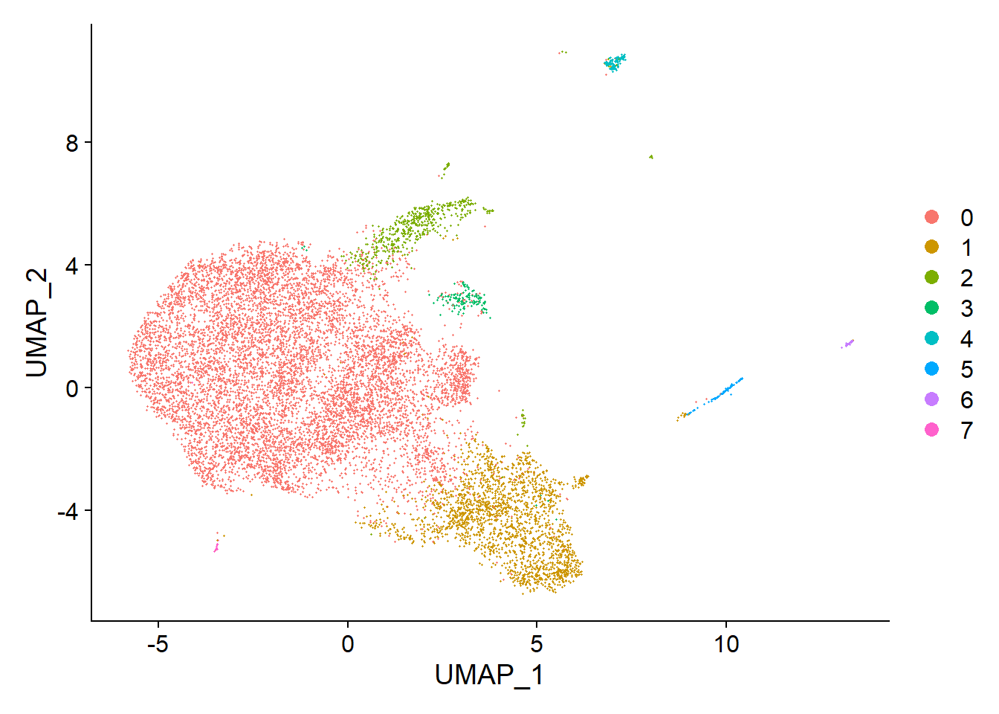
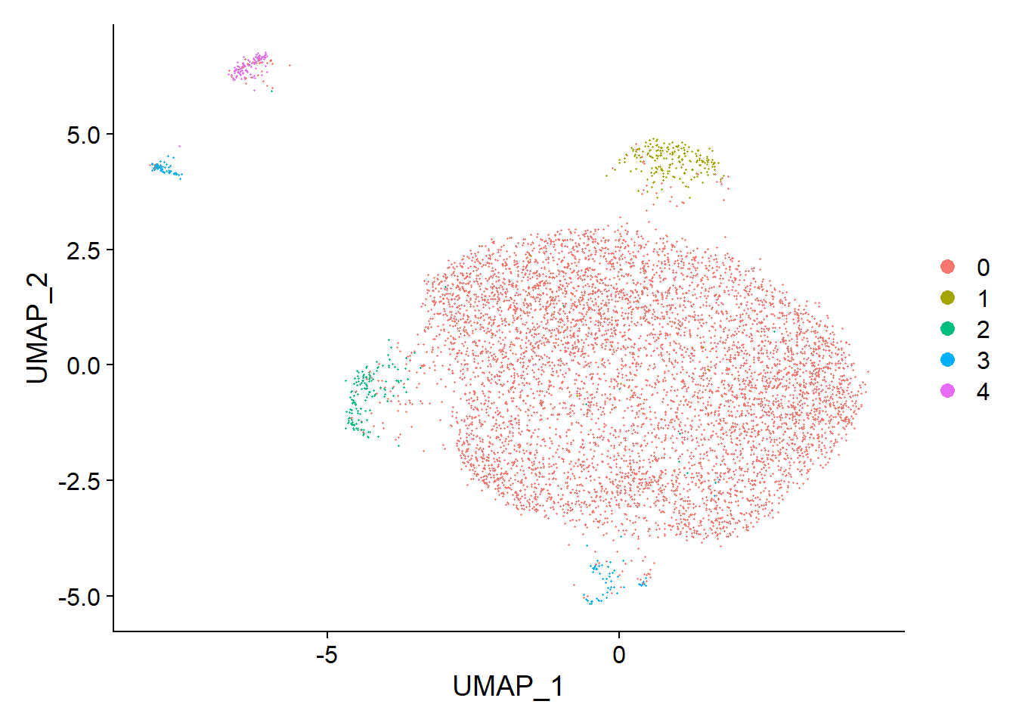
The Dataset(s)
Raw
Filtered

Slide 11
RNA vs. SCT Assay
What’s the difference? When to use them?
Especially within this dataset.
SCT is normalized while “RNA” has not yet been.

Slide 12
What are the questions we want to answer?
Curiosity driven analysis

Slide 13
Expectations
We each are going to analyze this dataset independently
Every coding decision needs to be justified.
I expect each of us to go through our analysis and share it together for constructive critique.
Reproducible code
Eventual Presentation to Dr. Peti-peterdi

Slide 14
Any Questions?

Slide 15
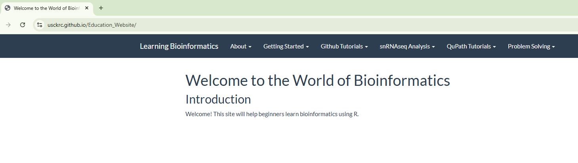
Major update to education website
What do you think of new organization? Maybe missing something on just general work in R?

Slide 16
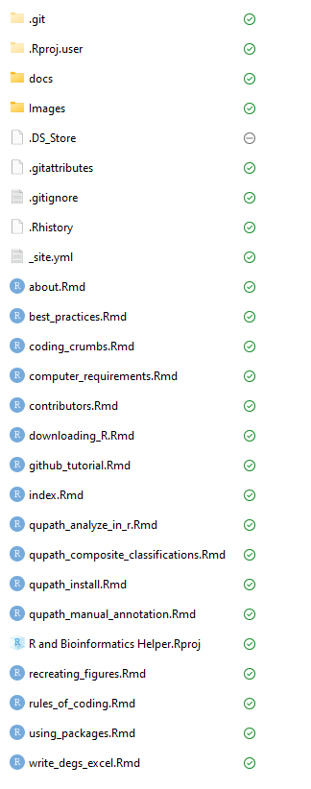
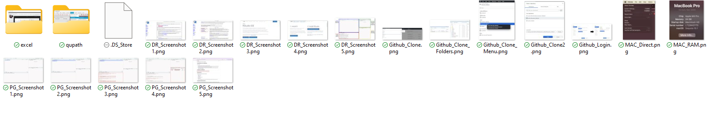
Folder Getting Complicated
Unique folders for new pages (so the image folder doesn’t get crazy)

Slide 17
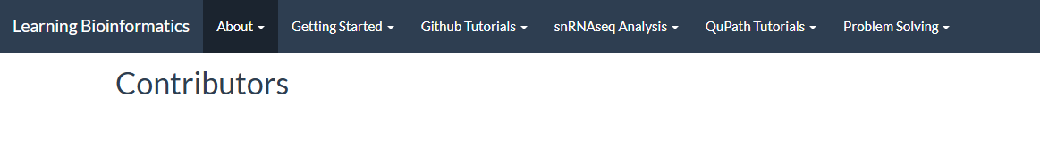
Pic + Bio + Why you like coding/why you like teaching coding
Let’s add authorship to each of the pages.

Slide 18
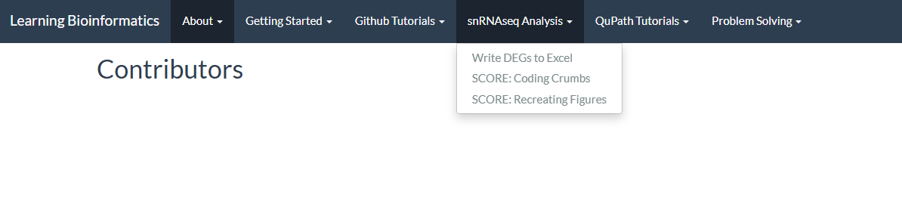
Can one of your organize and update the Coding Crumbs/Recreate figures section from each SCORE as we have it?
Semi complicated because they often require .rds files to run and to keep track of which images are being used for the sections.

Slide 19
Let’s talk branching
Branching is a form of version control. If you are going to make a change, make a new branch and we’ll merge the branches every 2 weeks as we make updates.

