Slide 2
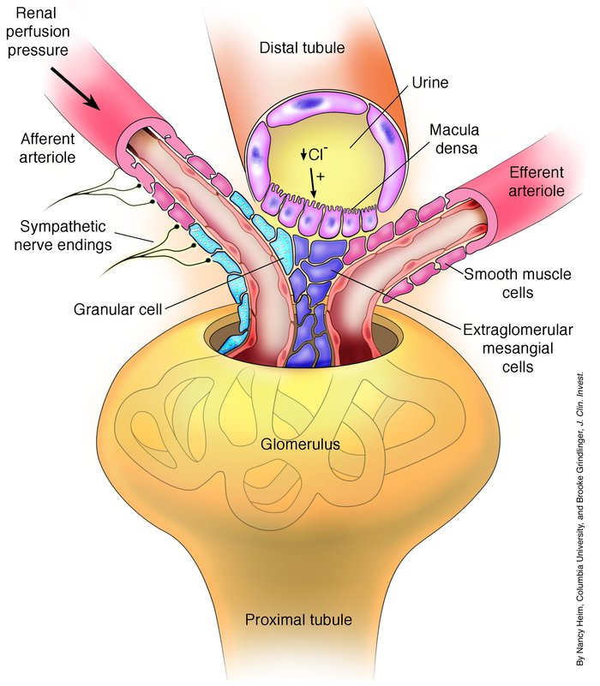
The Macula Densa
The macula densa is a specialized region of the kidney that plays a crucial role in regulating blood pressure and fluid balance.
The primary function of the macula densa is to sense changes in the concentration of sodium chloride (NaCl) in the tubular fluid. When NaCl levels increase, the macula densa signals the juxtaglomerular apparatus (JGA), which is a group of cells located near the glomerulus. The JGA then releases renin, an enzyme that initiates the renin-angiotensin-aldosterone system (RAAS). The RAAS increases blood pressure and fluid retention, which helps to restore the normal salt balance.
PMID: 15372097

Slide 3
Hopeful Outcome

Slide 4
The Dataset
Macula Densa cells (Nos1-creERT2:tdTomato) sorted cells
Cells, not nuclei (Important!)
Control cells published in
https://pmc.ncbi.nlm.nih.gov/articles/PMC11142747/
This dataset has both control and low-salt treated cells
N=2 for each treatment
We should journal club (the three of us this manuscript)
Intro/Methods
Figures 1-4
Figures 5-9
Additional background reading
Could each of you pick 1-3 other articles about macula densa/low salt treatment for us to review together.

Slide 5
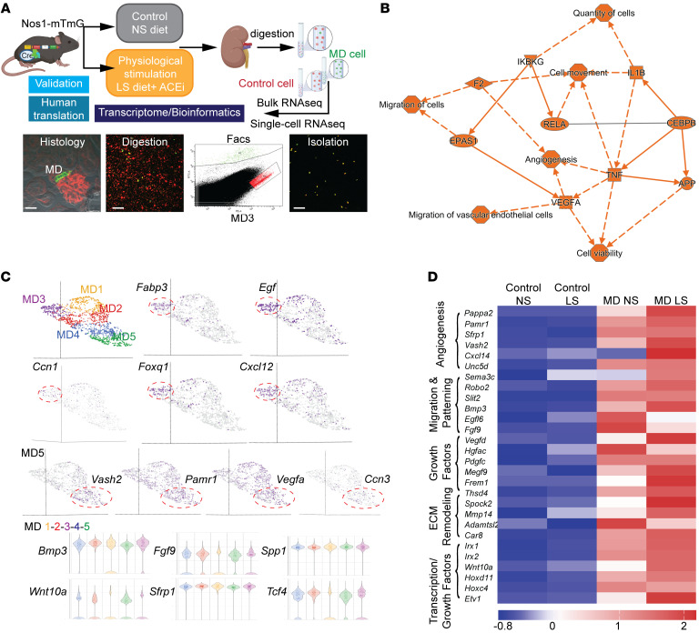

Slide 6
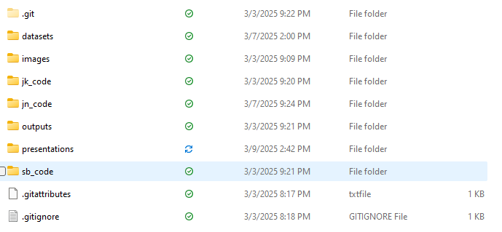
Folder Data structure

Slide 7
Two versions of the dataset
First-processed
Filter counts ==> Viable cells 2nd cut off ==> Filter features ==>gene type is protein coding ==>Normalized counts ==> Filter observations ==> Nos1 and Pappa2 >5
Second Raw
I think just at the first Filter Counts
If I’m working with a dataset…I usually want to start out with the raw version to make my own filtering decisions.
I want to question and explore the decisions made/implications with the initial analysis.
Meta.data wrangling!

Slide 8
What are the questions we want to answer?
Curiosity driven analysis

Slide 9
Expectations
Every coding decision needs to be justified.
I expect each of us to go through our analysis and share it together for constructive critique.
Reproducible code
Eventual Presentation to Dr. Peti-peterdi

Slide 10
Quality Control Steps

