Slide 1
Grap: A command-line plotting tool
Ted Faber
faber@isi.edu
1 May 2014

Slide 2
*roff toolchain for typesetting
Simple typesetting language
  Troff, nroff, ditroff, groff
Pipelined pre-processors
  Tbl for tables
  Pic for diagrams
  Refer for citations
  Eqn for math
  Grap for plots/graphs
GNU *roff – groff – implemented all but grap

Slide 3
Grap: *roff toolchain plotter
“Grap-A Language for Typesetting Graphs, Tutorial and User Manual,” by Jon L. Bentley and Brian W. Kernighan
  http://www.kohala.com/start/troff/cstr114.ps
I gave up on groff late in life
Always wanted to use grap
  So I wrote it...
    http://www.lunabase.org/~faber/Vault/software/grap/
    $ apt-get grap on Ubuntu/Debian

Slide 4
Grap sits in a pipeline to groff
Invocation
  $ grap < file | pic | eqn | groff -ms > file.ps
  $ groff -peG -ms < file > file.ps
Finds grap snippets in the code
Replaces them with pic snippets

Slide 5
Domain Specific Language
Frame and axes
  Log/linear
  Labels and tickmarks
Data to plot
  Line and plot styles
  Colors
Examples...

Slide 6
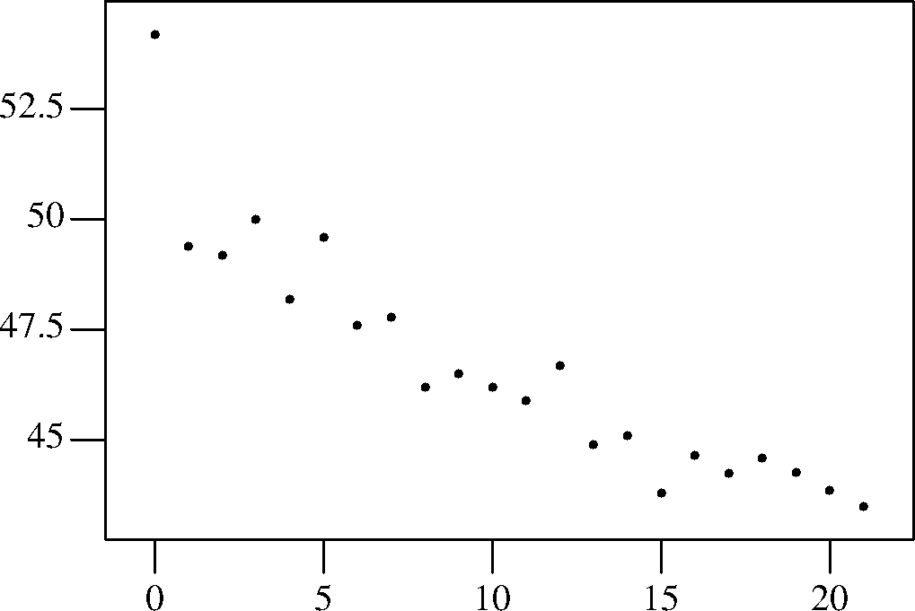
Simplest grap program
.G1
copy "400mtimes.d"
.G2

Slide 7
A More Complex Plot
.G1
frame invis ht 2 wid 3 left solid bot solid
label left "Time (in seconds)"
label bot "Olympic 400 Meter Run: Winning Times"
coord x 1894, 1994 y 42, 56
ticks left out at 44 , 46 "", 48, 50 "", 52, 54 ""
ticks bot in from 1900 to 1980 by 20
draw solid
copy "400mpairs.d" thru {next at $1, $2;}
new dotted
copy "400wpairs.d"
"Women" size -3 at 1958,52
"Men" size -3 at 1910,47
.G2

Slide 8
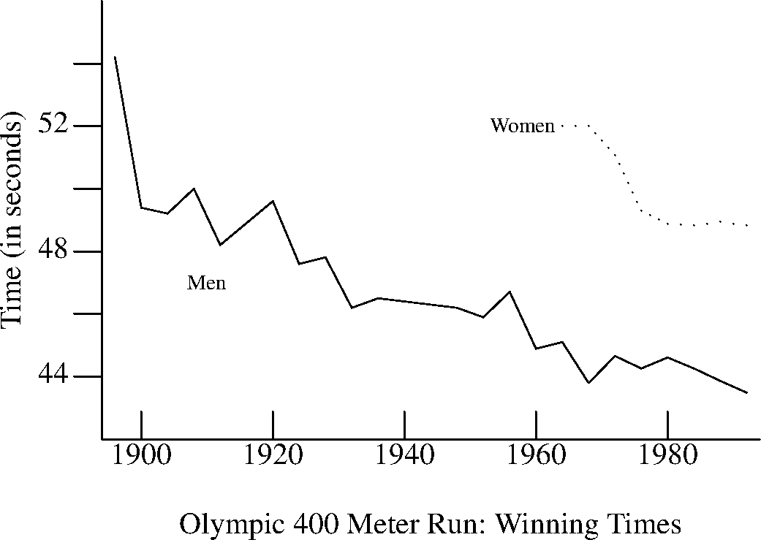
The More Complex Plot

Slide 9
One More Analysis Plot
.EQ
delim $$
.EN
.G1
frame wid 5 ht 4
label left "Rank in Population"
label bot "Population (in Millions)"
label top "$log sub 2$ Population"
coord x .3, 35 y 0, 51 log x
define L { (2.0^$1)/1e6 "$1" }
ticks bot out at .5, 1, 2, 5, 10, 20
ticks left out from 10 to 50 by 10
ticks top out at L(19), L(20), L(21), L(22), L(23), L(24), L(25)
thisy = 50
copy "states.d" thru {
"$1" size -4 at $3/1e6, thisy
thisy = thisy-1
}
line dotted from 15.3,1 to .515, 50
.G2

Slide 10
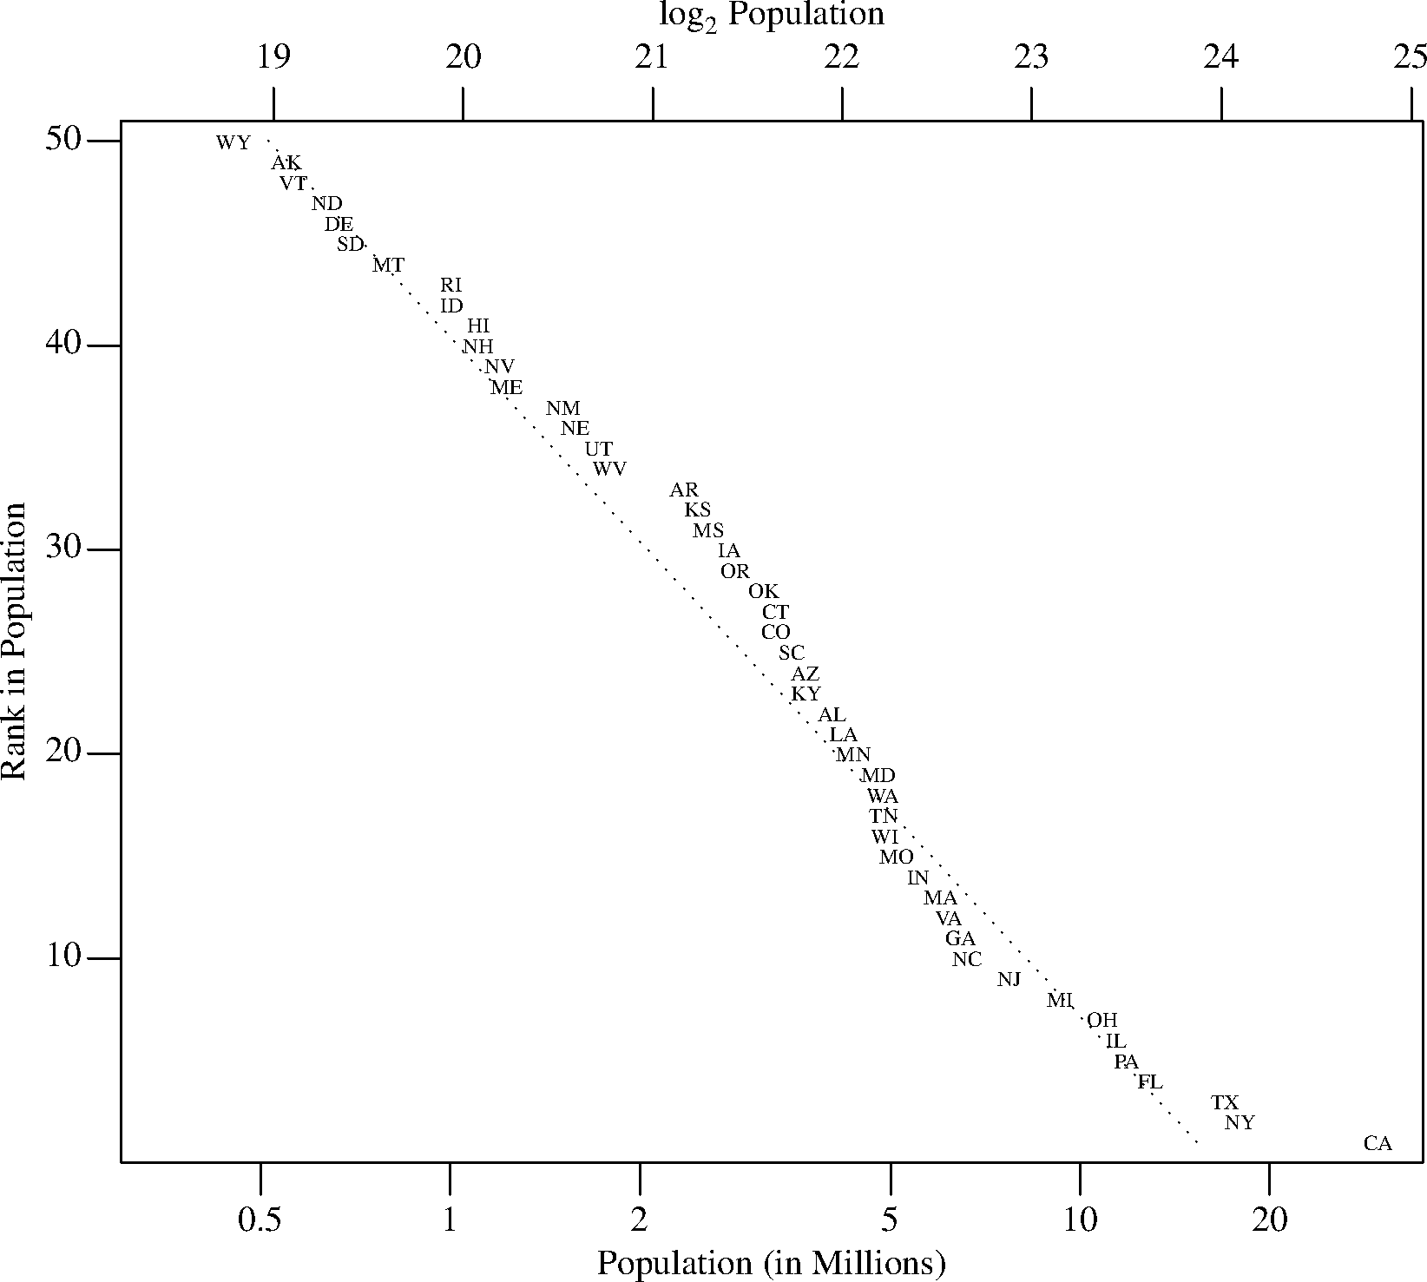
One More Analysis Plot

Slide 11
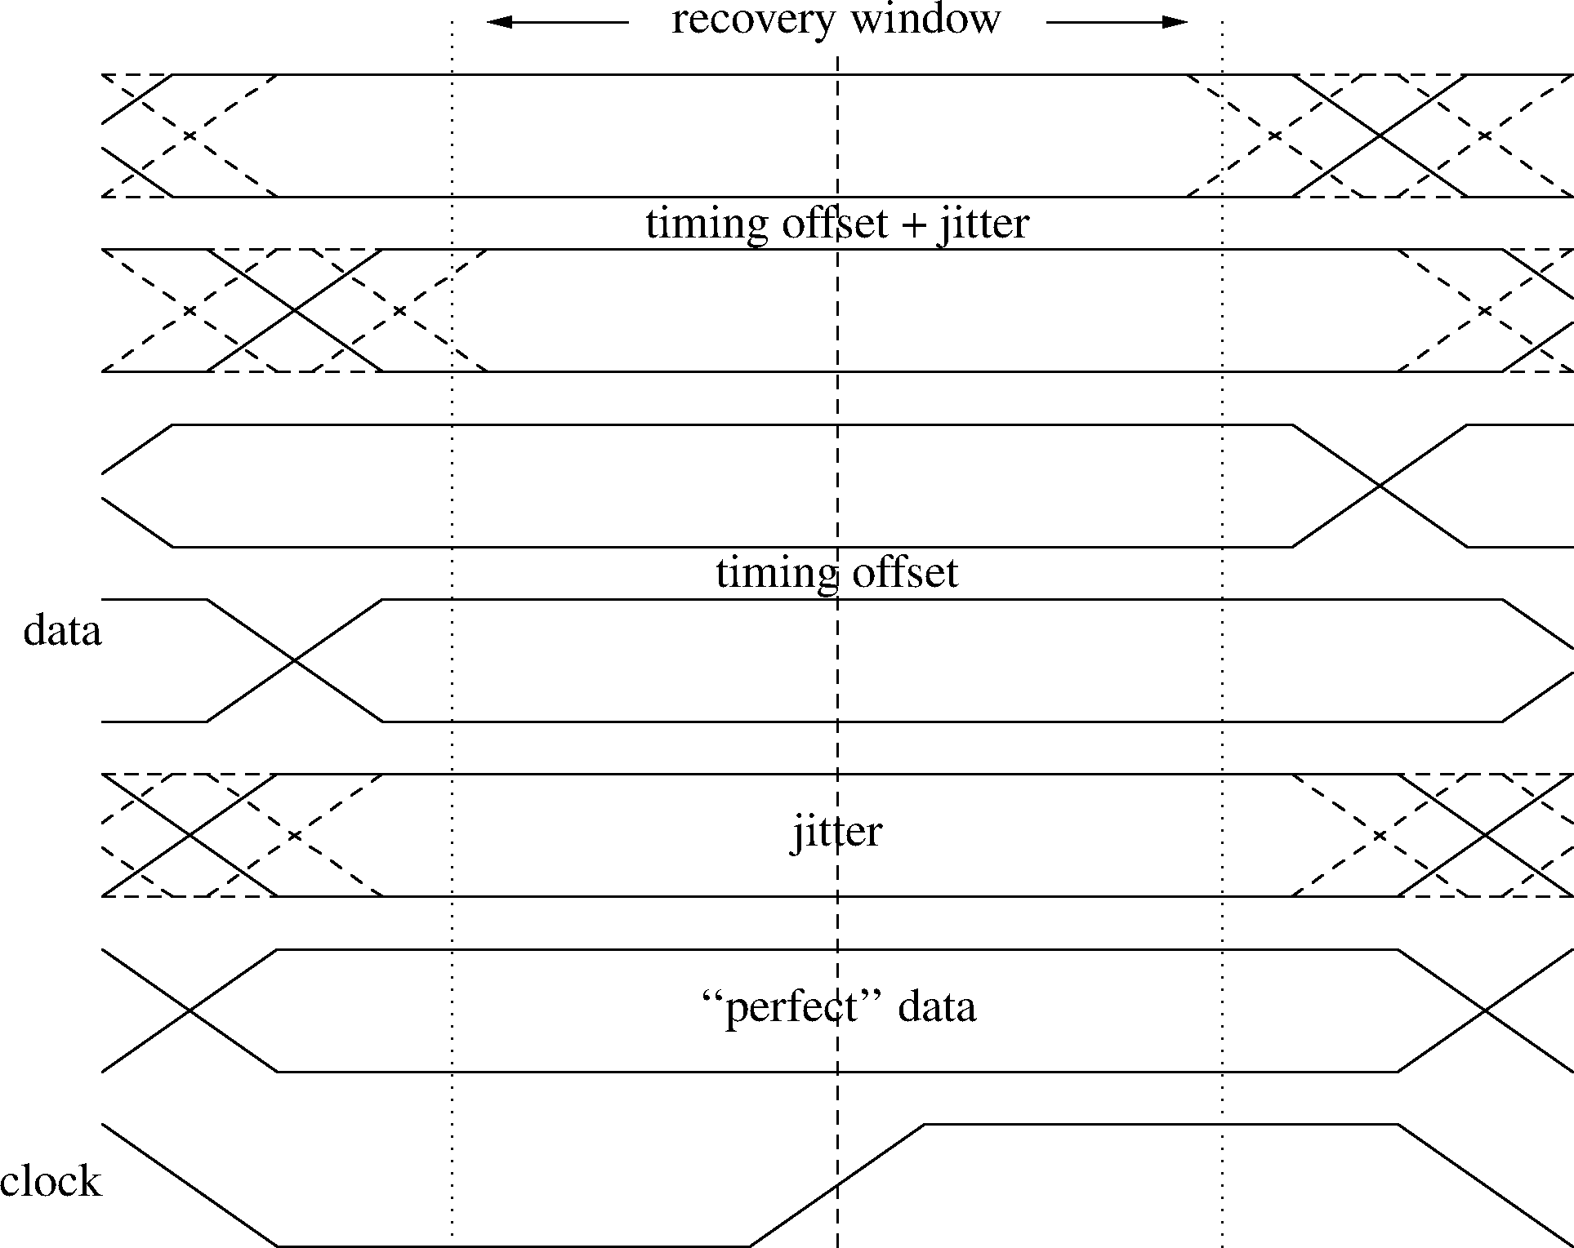
Just Showing Off (Bruce Lilly)

Slide 12
Conclusions
Simple, powerful domain specific language
  Fewer pre-set graphs
  Much more control
Somewhat Archaic Tool Chain
Nice for simple analysis

