Slide 1
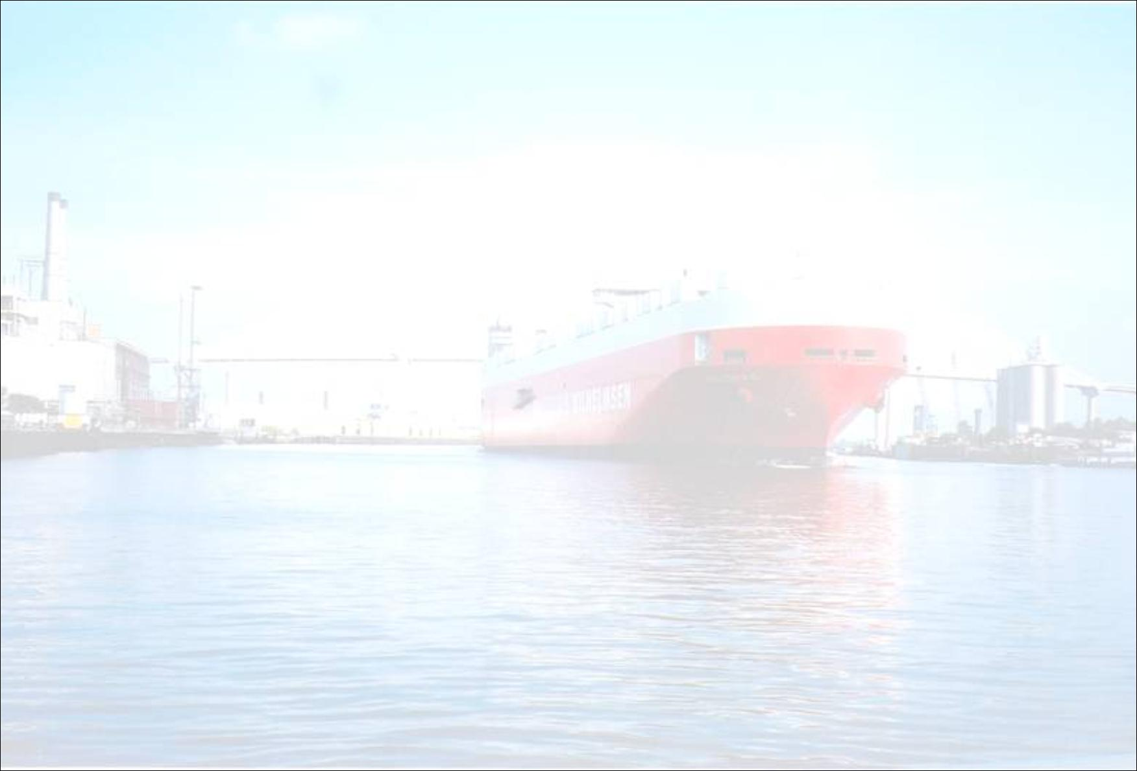
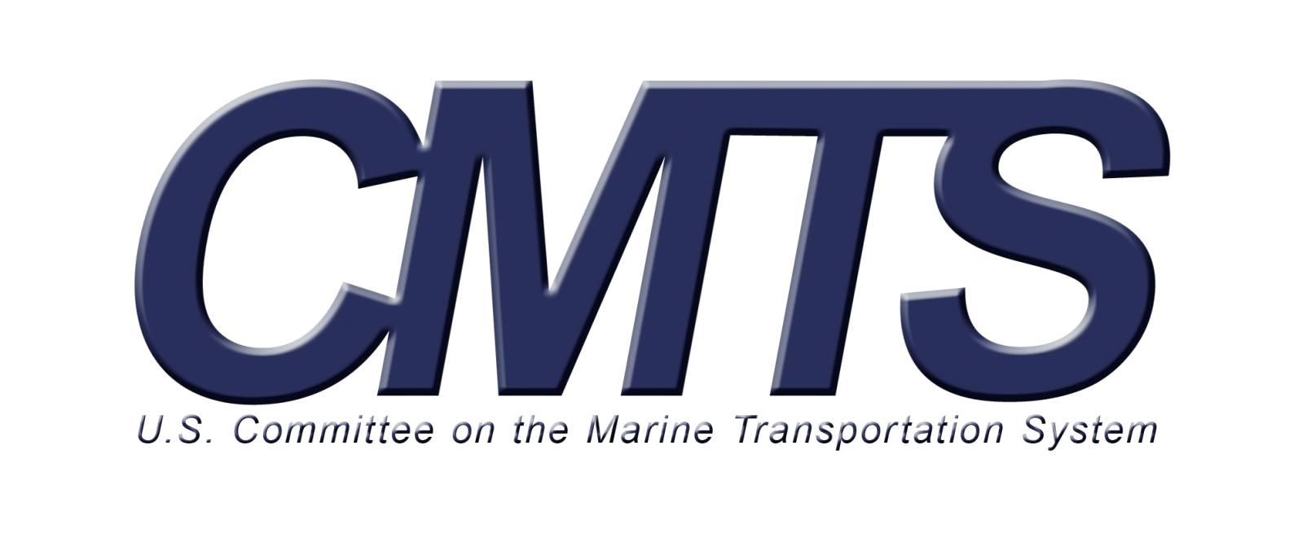
Research & Development
Integrated Action Team
Co-Chairs
Dr. Sandra Knight, NOAA
Jeffrey Lillycrop, USACE

Slide 2

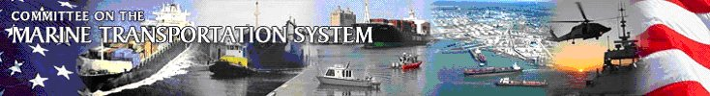
Origins of the CMTS
U.S. Ocean Action Plan, issued,
December 17, 2004, “Supporting Marine Transportation.”
Reaffirmed in the draft National Ocean Policy, September 10, 2009.

Slide 3
Purpose of the CMTS
“To create a partnership of Federal
agencies with responsibility for the
Marine Transportation System (MTS)
- waterways, ports and their
intermodal connections – to ensure
the development and implementation
of national MTS policies consistent
with national needs.” [CMTS Charter]

Slide 4
Membership
Department Secretaries from:
Chairman, Joint Chiefs of Staff;
Administrator, EPA;
Chairman, FMC; and
Head of MTS-related Agencies as designated by the CMTS
Ex-Officios: OMB, CEQ, DHS, DPC, NEC
Transportation (Chair)
Commerce
Defense
Energy
Homeland Security
Treasury
State
Interior
Agriculture
Labor
Justice (Attorney General)

Slide 5
Committee on the Marine Transportation System (CMTS)
Cabinet Secretaries of DOT (chair); DHS; DOC; DOD; etc.
Coordinating Board (CB)
Members: All agencies and Departmental offices with MTS interest. Chair rotates yearly between: NOAA, USCG, USACE and MARAD
Executive Secretariat
Director and dedicated staff to facilitate meetings, coordination, liaison and assistance CMTS, CB and IATs.
Working Group
Interagency staff to assist and complement the Executive Secretariat by providing agency expertise to task teams.
Integrated Action Team
Integrated Action Team
Integrated Action Team
Integrated Action Team
Notes:
Organizational Structure

Slide 6
Research & Development
Integrated Action Team
Approved by Coordinating Board in March, 2009
Goal 1: Develop a Research and Development Strategic Plan to support the MTS strategy
Goal 2: Re-establish bi-annual forum for interagency R&D in the MTS
Membership from USACE, USCG, EPA, Navy, NTSB, SLSDC, ORNL, Volpe Center, USMMA, MARAD

Slide 7
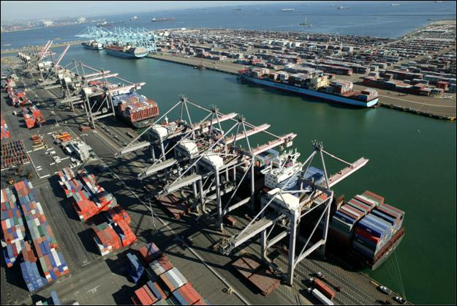
R&D Integrated Action Team
Research Themes and Priorities
Five Priorities:
Capacity
Safety and Security
Environmental Stewardship
Resilience and Reliability
Finance and Economics
National Strategy
for the
Marine Transportation System:
A Framework for Action
By the
Committee on the Marine Transportation System
July 2008
Notes:
National Strategy took 2 years to develop and was approved July 2008
Five Priorities with 34 Actions
Five Priority Areas
Capacity
Addresses capacity, efficiency, & congestion issues
Safety and Security
Strengthen maritime safety & coordinate maritime security
Environmental Stewardship
Protect environmental health of shared resources
Resilience and Reliability
Increase MTS reliability and ability to withstand or recover from disruptive incidents
Finance and Economics
Maintain & improve infrastructure

Slide 8
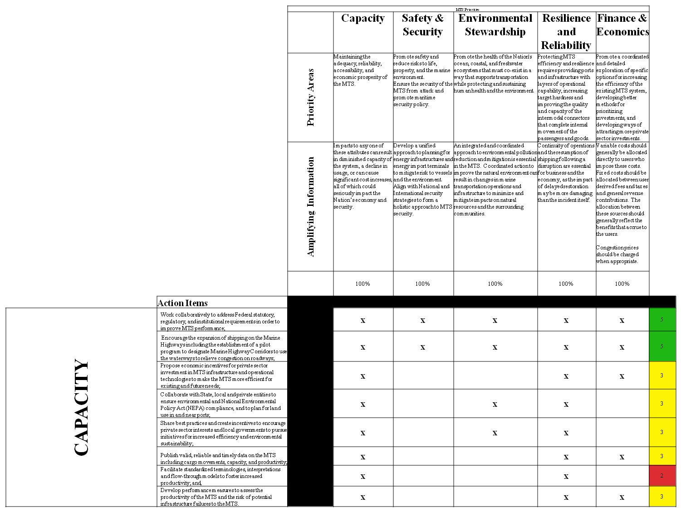
Crosswalk of
34 Action Items
Propose economic incentives for private sector investment in MTS infrastructure and operational technologies to make the MTS more efficient for existing and future needs.
Greening of the MTS
Notes:
Example of our approach of examining the 34 Actions to identify key themes and R&D needs. The following slides go through the ‘hot topics’ we have identified so far (within each priority).

Slide 9
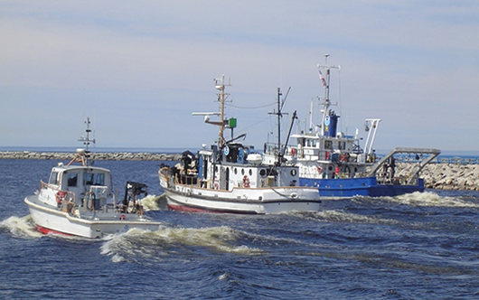
Action Items Crosswalk
Hot Topics
Capacity
  Greening the MTS
  NOAA Green Ship Initiative
  Great Lakes Environmental
  Research Lab
  First federal vessel to run
  completely on
  non-petroleum products.
Notes:
NOAA Green Ship Initiative – over the past 7 yrs, NOAA has been exploring options to convert RVs from petroleum-based fuels to fully renewable and environmentally friendly products. GLERL’s marine diesel powered vessels in the Great Lakes are now fueled by B100 (100%) Soy Biodiesel. All Shipboard systems (mechanical and hydraulic) have been converted to bio-oils and lubricants. Benefits include lower emissions, cleaner injectors, cost savings, improved work environment. By May 2006, all 3 GLERL vessels had transitioned to petroleum free operation.

Slide 10
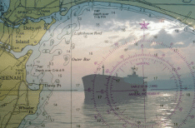
Action Items Crosswalk
Hot Topics
Safety and Security
  Under Keel Clearance
  Electronic Navigation
  (with Navigation
  Technology IAT)
    Test and evaluate
    components for the
    MTS through integrated
    multiagency and
    industry demonstration
Notes:
E-nav with Navigation Technology IAT:
To test and evaluate components of electronic Navigation or “eNavigation” for the Marine Transportation System (MTS) through a multiagency and industry integrated demonstration.

Slide 11
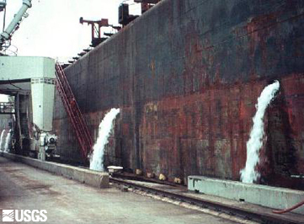
Action Items Crosswalk
Hot Topics
Environmental Stewardship
  Dredge Opportunities
  Invasive Species and Ballast
  Ballast Water Discharge Standard
  Notice of Proposed Rulemaking
  USCG-2001-10486

Slide 12
Ballast Water Discharge Standard
BWDS NPRM establishes:
Phased Approach
  IMO Standard initially
  1000 times more stringent than IMO after 2016
    Practicability Review will determine if 1000x standard can be met.
    If Practicability Review determines 1000x cannot be met, then intermediary standards established.
Type Approval Process
Need for rigorous testing process
Need for new methodology and approach

Slide 13
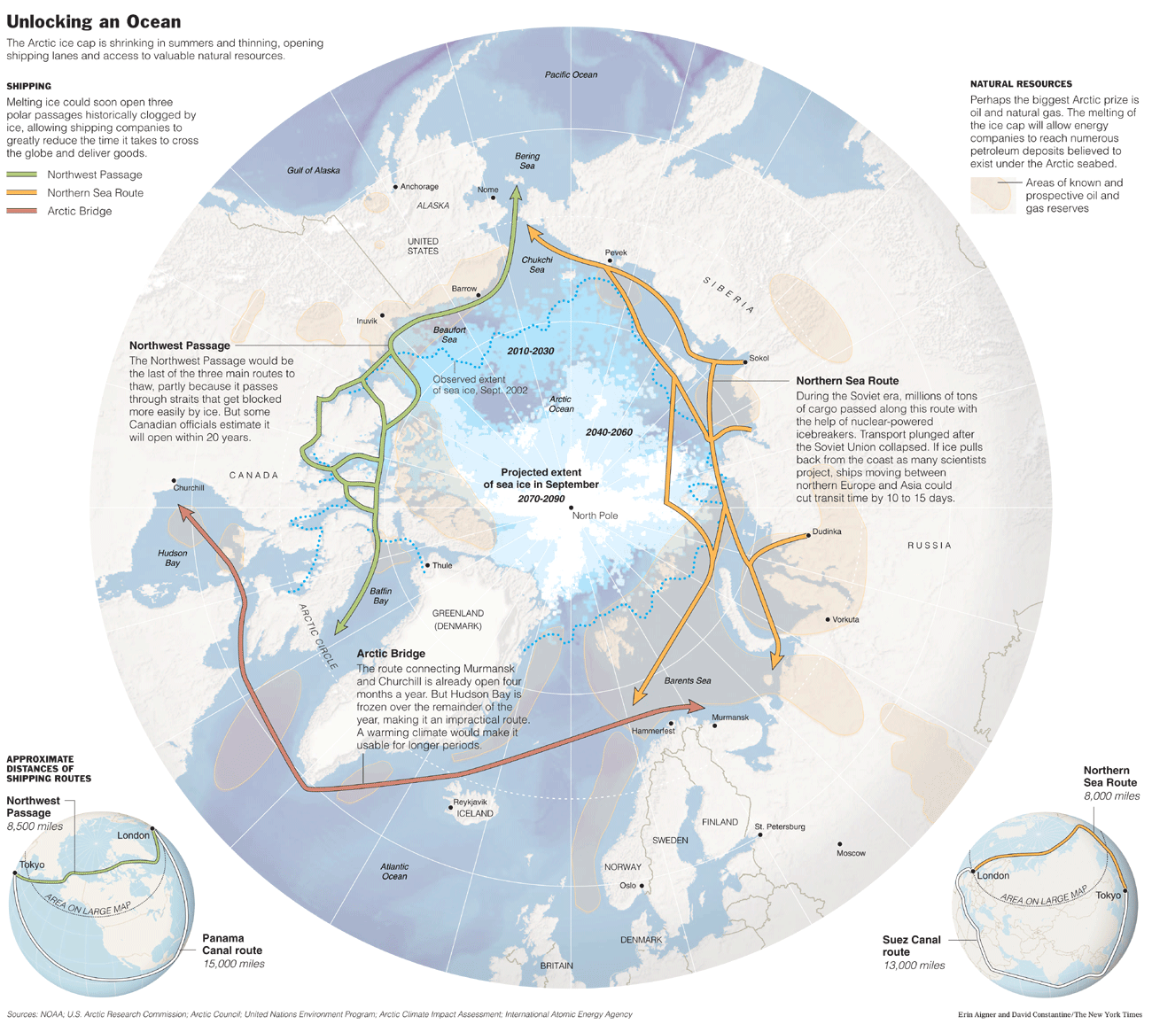
Are we ready for the Next generation of Challenges?
DRIVERS: Climate Change, Energy Demands, Economy
IMPACTS:
Arctic Shipping
Changes in migratory patterns of TES
More severe and frequent storms/droughts
Changing circulation patterns and new challenges for dredging
Air emissions
Infrastructure
Capacity
Greening the MTS
Others?

Slide 14
CMTS R&D Integrated Action Team
Call for Input
What external trends will shape the long-term future of the MTS?
What research and development challenges will the MTS face?
What will the MTS need to know and do to prepare?

Slide 15
QUESTIONS?
Co - Coordinators:
Sandra Knight, NOAA
Sandra.Knight@noaa.gov
Jeff Lillycrop, USACE
Jeff.Lillycrop@usace.army.mil
1200 New Jersey Avenue, SE
Washington, DC 20590
202-366-3612
www.cmts.gov

