Slide 1
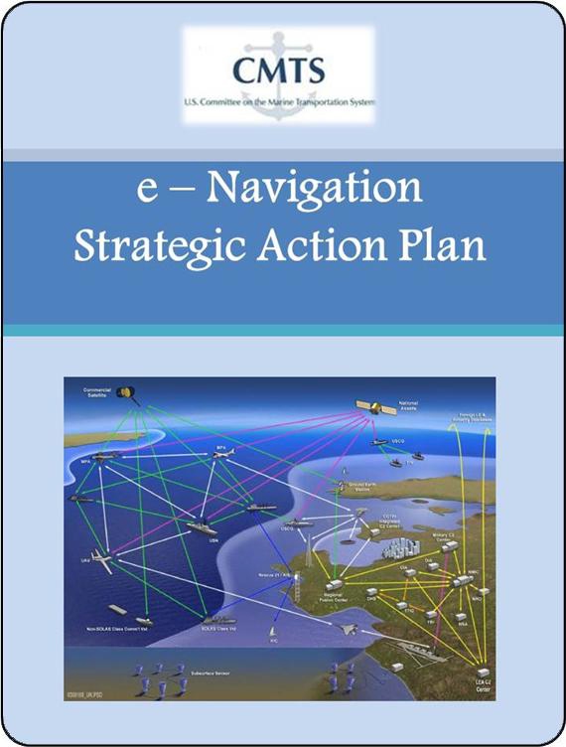
CMTS e-Navigation IAT
E-Navigation Online Dialog
Outreach Activity Report

Slide 2

E-Navigation Online Dialog
Idea Scale
Sponsored by DOT (OST)
Online Interactive Dialog
Used frequently by DOT and other Federal Gov’t (including White House)

Slide 3
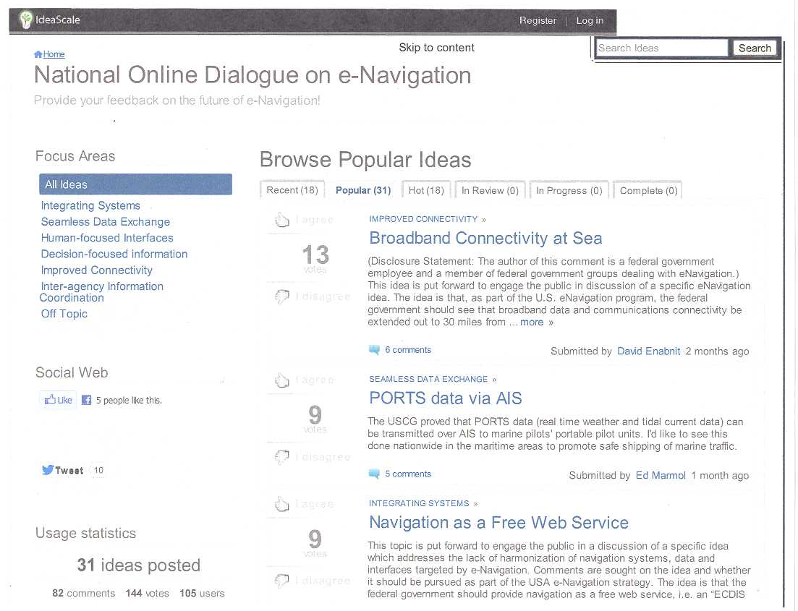

Slide 4
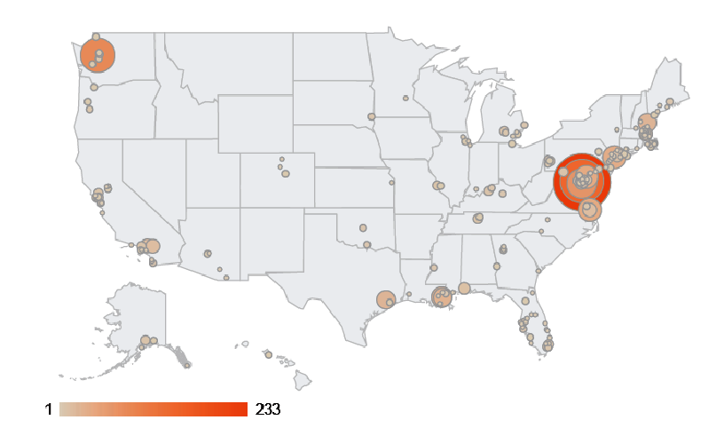
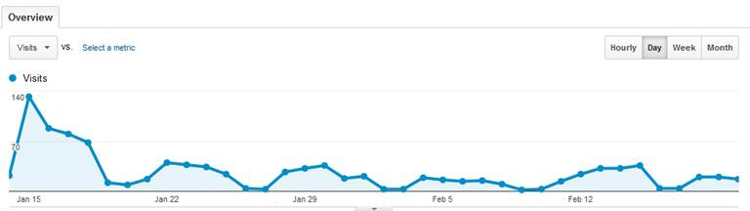
e-Navigation Idea Scale Activity
Duration: 14 JAN – 15 MAR 2013
Initially scheduled for 45 days
Extended 2 weeks
Visited 1,497 times by 803 unique visitors
Visitors have viewed 5,233 pages
Site traffic is generated as follows:
59% direct traffic
36% referral traffic:
CMTS Web page 33%
NOAA Coast Survey 4%
Bryant’s Maritime 5%
eNavigation.org 4%
5% search engine

Slide 5
e-Navigation Ideas
31 Major Ideas; 82 Comments; 144 Votes
Five Most Popular Ideas
Broadband Connectivity at Sea
PORTS Data Transmitted via AIS
Navigation as a Free Web Service
Single Window Reporting
Open Source System Architecture

Slide 6
e-Navigation Idea: Broadband Connectivity at Sea
Broadband Data and Communications Connectivity extended to 30 miles from shore
Broadband Connectivity could support:
Provision of real-time navigation information
Single Window Reporting
Navigation as a Web Service
Alternative Communications to VHF Radio

Slide 7
e-Navigation Idea: PORTS Data Transmitted via AIS
Demonstrated feasibility
Currently operating
Sault Ste. Marie, MI – 2002
Tampa Bay, FL – 2010
Lower Columbia River, OR, WA – late 2011
Current CMTS e-Nav IAT Action Item
Task Team evaluating steps needed to operationalize transmission of PORTS Data over AIS in VTS Areas
Notes:
Users have found this service very useful.

Slide 8

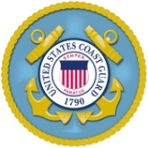
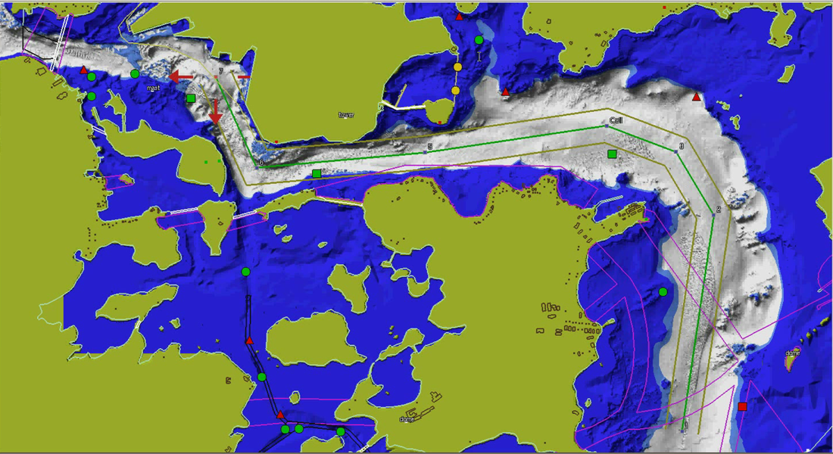
Tide Aware ENC – Concept
PORTS
Automatic Identification System
Tidal Forecast Models
Electronic Navigational Charts

Slide 9
e-Navigation Idea: Navigation as a Free Web Service
Provides common operating picture aboard all ships and ashore
Supports distribution of real-time navigation information
Tides and currents – “Tide Aware ENC” concept
Vessel traffic
Chart updates
Notice to mariners
Notes:
“Tide Aware ENC “ concept prototyped as part of the CMTS Navigation Technology IAT 2006. Actual water levels from NOAA PORTS shown on the electronic navigational chart (ENC). Eliminates the mental gymnastics of calculating tide corrections from the tide tables and doing conversions mentally. User inputs their ship draft and the chart reflects safe water.

Slide 10
e-Navigation Idea: Single Window Reporting
Enable one-time reporting of vessel, cargo and voyage data to Federal Government
Data would be disseminated to various Federal Government Agencies
Reduce reporting burden on industry

Slide 11
e-Navigation Idea: Open Source Architecture
Adopted by automotive and avionics industries
Proponents claim would facilitate:
Interoperability between diverse computing environments onboard and ashore
Accurate metadata for all information sources
Lower cost of ownership

Slide 12
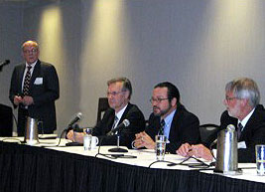
CMTS e-Nav IAT Outreach
Sep 23-28, 2012 | RTCM Annual Meeting/e-Navigation Steering Committee, Orlando, FL
Nov 6-8, 2012 | 2012 e-Navigation Conference, Seattle, WA
Jan 13-17, 2013 | TRB Annual Meeting, Washington, DC
March 5-7, 2013 | Inland Waterway Conference/PIANC-US e-Navigation Working Group, Louisville, KY
April 10-11, 2013 | Navigation Safety advisory Council

Slide 13
Questions?
CMTS e-Navigation IAT
Co-Chairman
Mike Sollosi (USCG)
Dave MacFarland (NOAA)
Brian Tetreault (USACE)
CMTS Staff Lead
Scott Rainey (CMTS)

