Slide 1

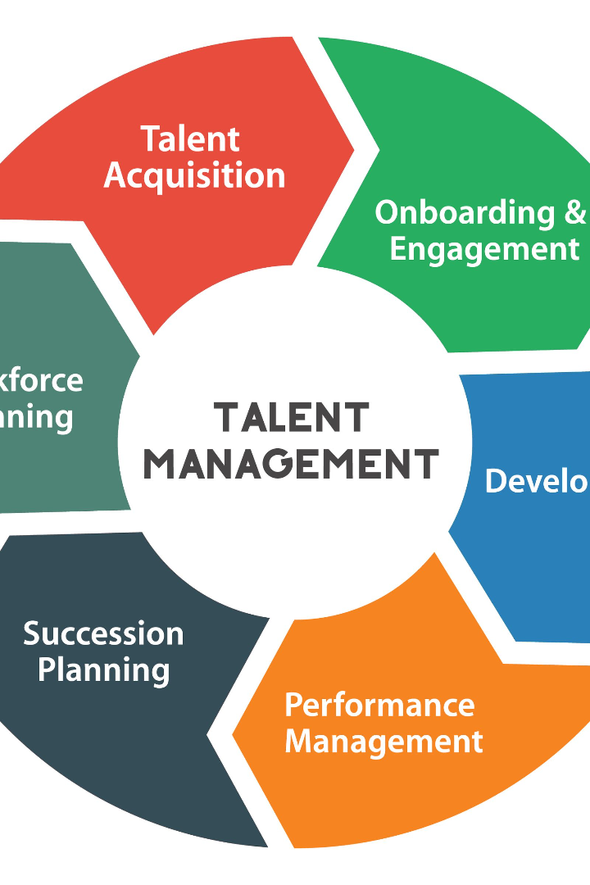

Talent Management and Development Strategy for Data Science Team
We outline a comprehensive talent development and management strategy for a highly skilled and diverse data science team.
by Deepak Mishra

Slide 2
Current State of Talent Management
1
Fragmented Approach
2
Low Retention Rates
3
Limited Development
The Company is struggling with talent gaps due to siloed talent acquisition processes.
The Company is losing high-potential data science employees
There are few opportunities for development and enrichment within the bank.

Slide 3
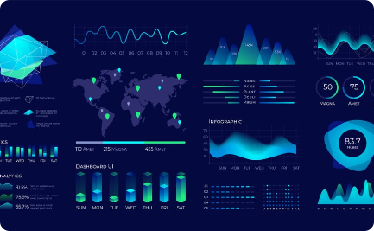

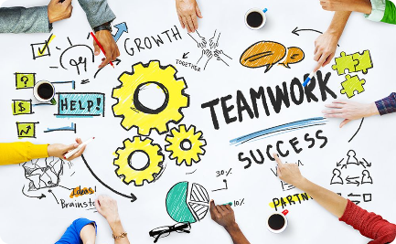
Why Talent Management?
Quality of Work
Employee Retention
Increased Innovation
Effective talent management allows data scientists to focus on the quality of their work.
Retention of top talent leads to more engaged employees who add value to the team.
A culture of innovation arises when talent is managed effectively, leading to better business outcomes.

Slide 4
Development Programs for Data Science Team Members
1
Onboarding
A comprehensive onboarding program to help new hires learn existing systems and workflows.
Technical Training
2
Skills development training with a focus on data science and machine learning.
3
Leadership Development
Opportunities for high-potential data scientists to develop their leadership skills.

Slide 5
Elements of a Successful Talent Management Strategy
Clear Career Paths
Coaching and Feedback
Transparent progression paths lead to higher engagement, retention and commitment.
Regular feedback and coaching creates a culture of continuous development.
Inclusive Culture
Flexible Working Arrangements
Diversity and inclusivity efforts foster a healthy and productive work environment.
A flexible work environment leads to greater work-life balance and increased productivity.

Slide 6
Developing a Talent Management Strategy
1
Identifying Core Competencies
Identify the skills and competencies that are necessary across all data science roles.
2
Building a Talent Pipeline
Identify talent sources, build a talent pipeline, and recruit proactively.
3
Creating a Culture of Continuous Learning
Provide opportunities for continuous learning and development to enhance skills and retain top talent.

Slide 7
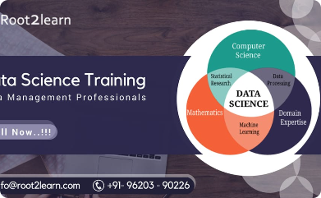
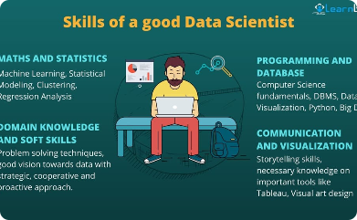
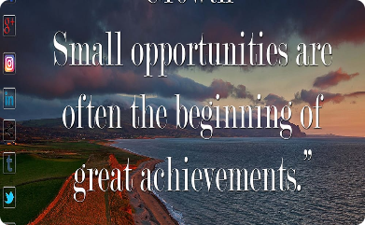
Developing a Learning and Development Program
Identifying Learning Needs and Gaps
Designing Training Programs for Data Science Skills and Domain Knowledge
Providing Growth Opportunities
Develop a training needs assessment that identifies gaps in skills and ensures that training is aligned with business objectives.
Provide opportunities for team members to take on new challenges and lead projects, fostering career growth and development.
Develop a curriculum that covers technical skills, best practices, and business acumen to promote a deeper understanding of the business operations.

Slide 8
How to do it
Assess Current Talent
Identify Career Paths
Identify key strengths, skills gaps, and areas for improvement.
Create clear career paths within each division to help team members grow and set their sight on opportunities to advance.
Encourage Flexibility
Skill Development Programs
Promote flexibility and personal growth by allowing team members to move between divisions based on their interests and skill development goals.
Develop training, workshops, mentorship programs, and on-the-job learning opportunities to promote the development of essential skills and competencies.
Talent Mobility
Cross-Functional Projects
Create a talent mobility program that allows team members to express their interest in moving between divisions
Encourage cross-functional collaboration through initiatives involving members from different divisions and stakeholders.
Leadership Development
Mentoring and Coaching
Invest in grooming future leaders at every level of the organization to identify high-potential individuals and lay out a clear path for growth and development.
Provide regular feedback on employee performance and invest in their development goals through regular coaching sessions.

Slide 9
Develop the Talent Mobility Program
Design the mobility program to meet the needs of organization.
Determine how to evaluate employee interest and qualifications for new positions
How to ensure a smooth transition
How to monitor employee progress.
Coaching and Training for employees who want to move to a new division but may not have all the necessary skills.
Set clear goals and expectations for employees who choose to utilize the talent mobility program.
Collect feedback from employees who have participated in the program to continuously improve and evolve it over time.

Slide 10
Measuring the Effectiveness of the Talent Management Strategy
Engagement Surveys
Retention Rates
Performance Metrics
Analysis of the percentage of employees who choose to stay with the bank over time.
Analytics that measure the performance of data scientists and their contribution to business outcomes.
Regular, anonymous surveys to measure employee satisfaction and engagement.

Slide 11
Execution Plan
Month 1: Initial Assessment and Planning
Begin with an all-hands meeting to introduce the talent management and development strategy.
Form a task force consisting of representatives from each division to assist in strategy implementation.
Conduct a thorough assessment of current talent within each division, focusing on strengths, weaknesses, and skills gaps.
Create a talent mobility program allowing team members to express their interest in switching divisions.
Develop guidelines for talent mobility, considering factors such as skill compatibility, team needs, and potential impact.
Months 1-3: Skill Development and Career Path Definition
Launch skill development programs tailored to each division's specific needs.
Organize individual meetings with team members to discuss their career aspirations and align them with defined career paths.
Hold division-specific workshops to define clear career paths within each division.
Initiate cross-functional knowledge-sharing sessions to promote skill development across divisions.
Months 4-6: Leadership Development and Coaching
Launch leadership development programs aimed at grooming potential leaders within each division.
Identify high-potential individuals and provide them with targeted leadership training.
Implement a mentorship and coaching program pairing experienced team members with those newer to their division.
Hold regular feedback sessions to evaluate the effectiveness of the mentoring program.
Ongoing: Continuous Improvement
Maintain an open line of communication with your team to ensure they feel heard and valued.
Regularly assess the effectiveness of the talent management and development strategy and make adjustments as necessary.
Develop and refine clear performance metrics for each division, aligning them with overall team goals

Slide 12
Roles in Data Science Team
Data Scientist
Data Analyst
Extracts insights from data and designs predictive models.
Processes and interprets data to create actionable insights.
Data Viz-ard
Machine Learning Engineer
Creates visualizations and communicates insights to stakeholders in a compelling and intuitive manner.
Designs and builds scalable machine learning algorithms that can be deployed in production.

