Slide 2
Selecting Right Chart for your Data
SESSION CODE: #####
Purna Duggirala
Chief Excel Officer
Chandoo.org

Slide 3
Today we will,
Why it is important to select the right chart?
How to make the right chart?
Some really cool ideas to play with

Slide 4
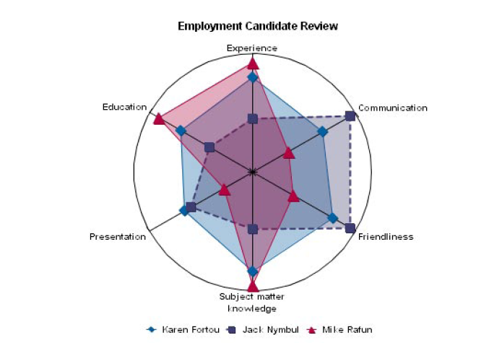
Why is it important?
Source: http://www.perceptualedge.com/articles/Whitepapers/Communicating_Numbers.pdf

Slide 5
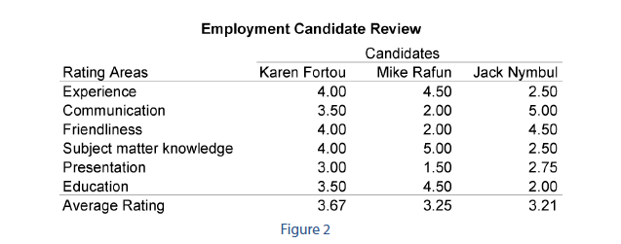
Why is it important?
Right chart ➔ Right decision
vs.
Source: http://www.perceptualedge.com/articles/Whitepapers/Communicating_Numbers.pdf

Slide 6
Why is it important?
Right chart ➔ Faster Interpretation

Slide 7
How to make the right chart?
Step 1: Identify what you want to say
Step 2: (Re)arrange your data accordingly
Step 3: Prepare the chart
Step 4: Remove distracting elements, format

Slide 8
How to make the right chart?
Step 1: Identify what you want to say
Step 2: (Re)arrange your data accordingly
Step 3: Prepare the chart
Step 4: Remove distracting elements, format

Slide 9
What do you want to say?
Ask yourself
What is the message?

Slide 10
Common Messages in Business
Comparison
Trend over time
Distribution
Deviation
Parts to Whole
Relationship

Slide 11
Common Messages in Business
Comparison
Trend over time
Distribution
Deviation
Parts to Whole
Relationship

Slide 12
Common Messages in Business
Comparison
Trend over time
Distribution
Deviation
Parts to Whole
Relationship

Slide 13
Common Messages in Business
Comparison
Trend over time
Distribution
Deviation
Parts to Whole
Relationship

Slide 14
Common Messages in Business
Comparison
Trend over time
Distribution
Deviation
Parts to Whole
Relationship

Slide 15
Common Messages in Business
Comparison
Trend over time
Distribution
Deviation
Parts to Whole
Relationship

Slide 16
Common Messages in Business
Comparison
Trend over time
Distribution
Deviation
Parts to Whole
Relationship

Slide 17
How to make the right chart?
Step 1: Identify what you want to say
Step 2: (Re)arrange your data accordingly
Step 3: Prepare the chart
Step 4: Remove distracting elements, format

Slide 18
(Re)arrange the data
Clean up data
Use Formulas
Use Tables
Use Pivots

Slide 19
How to make the right chart?
Step 1: Identify what you want to say
Step 2: (Re)arrange your data accordingly
Step 3: Prepare the chart
Step 4: Remove distracting elements, format

Slide 20






Prepare the chart
Common Chart Types

Slide 21
Charts for Your Message
Message
Charts Applicable
Comparison

Slide 22
Charts for Your Message
Message
Charts Applicable
Distribution

Slide 23
Charts for Your Message
Message
Charts Applicable
Parts of Whole

Slide 24
Charts for Your Message
Message
Charts Applicable
Trend over Time

Slide 25
Charts for Your Message
Message
Charts Applicable
Deviation

Slide 26
Charts for Your Message
Message
Charts Applicable
Relationship

Slide 27
How to make the right chart?
Step 1: Identify what you want to say
Step 2: (Re)arrange your data accordingly
Step 3: Prepare the chart
Step 4: Remove distracting elements, format

Slide 28
Format the Chart
No non-zero axis scale on bar charts
Make subtle gridlines (or remove them)
Add labels to important points
Add descriptive, bold titles
Position axis, scales at the right places
Use simple, easy colors

Slide 29
Making the Right Chart - Summary
Know the Message
Arrange Data
Prepare Chart
Format

Slide 30
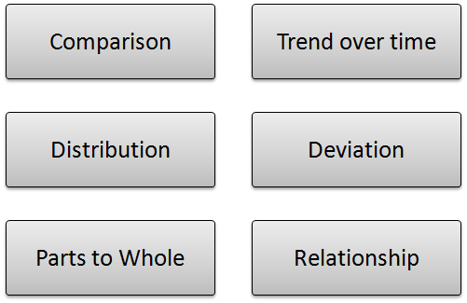
Making the Right Chart - Summary
Know the Message
Arrange Data
Prepare Chart
Format

Slide 31
Making the Right Chart - Summary
Know the Message
Arrange Data
Prepare Chart
Format

Slide 32
Making the Right Chart - Summary
Know the Message
Arrange Data
Prepare Chart
Format

Slide 33
Making the Right Chart - Summary
Know the Message
Arrange Data
Prepare Chart
Format

Slide 34
Some cool tools to help you
Juice Analytics Chart Chooser
http://chartchooser.juiceanalytics.com/
BonaVista Chart Tamer Excel Add-in
http://chandoo.org/wp/2009/05/04/review-chart-tamer/

Slide 35
More Information and Techniques
http://chandoo.org/wp/tag/charting-principles/
http://peltiertech.com/Excel/Charts/index.html
http://www.perceptualedge.com/library.php#Articles
http://www.excelcharts.com/blog/category/popular/

Slide 36
Thank You

Slide 37

© 2008 Microsoft Corporation. All rights reserved. Microsoft, Windows, Windows Vista and other product names are or may be registered trademarks and/or trademarks in the U.S. and/or other countries.
The information herein is for informational purposes only and represents the current view of Microsoft Corporation as of the date of this presentation. Because Microsoft must respond to changing market conditions, it should not be interpreted to be a commitment on the part of Microsoft, and Microsoft cannot guarantee the accuracy of any information provided after the date of this presentation. MICROSOFT MAKES NO WARRANTIES, EXPRESS, IMPLIED OR STATUTORY, AS TO THE INFORMATION IN THIS PRESENTATION.

