Slide 1
Analytical Methods : Regression Methods

Slide 2
Topics
Regression Basics
Linear Regression
Logistic Regression
PROC LOGISTIC
PROC REG
Non Linear Estimation
PROC NLIN
Mixed Regression
PROC MIXED

Slide 3
Regression
Regression is a common terminology used for establishing a relationship between dependent and independent variables
There are various techniques of regression and the user must be careful in selection of the best suited method for each scenario
Most commonly used methods other than failure-time models are :
Logistic – Modeling of events which are discrete in nature like Yes, No, Maybe or like/dislike or paid the bill, not paid the bill
Linear – Modeling of continuous variables like electricity bill, amount financed etc.
Mixed – Modeling of events where the fixed effects and random effects are significant and present
Non-Linear – Modeling of parameter estimates of a defined framework
Other forms are quite similar in nature to one of these and are uncommon

Slide 4
SAS Procedures : Regression
There are a number of SAS Procedures specially designed to handle different types of data and perform related regression
CATMOD : analyzes data that can be expressed in a contingency table
GENMOD : fits generalized linear models with discrete outcomes
GLM : performs simple, polynomial, multiple and weighted regression
LIFEREG : fits parametric model to failure time data
LOGISTIC : Models binomial and ordinal outcomes
NLIN : Non Linear Regression
ORTHOREG : Uses Gentleman-Givens method – ill conditioned data
PLS : partial least square, principal component and reduced rank regression
PROBIT : Used when dependent is dichotomous or polychotomous and independent variables are continuous
REG : Performs linear regression with many capabilities
RSREG : Performs quadratic response surface regression models
TRANSREG : fits univariate and multivariate linear models optionally with spline/other trfms

Slide 5
LINEAR REGRESSION
This regression methods attempts to model the probability of an event by fitting data to a linear curve
Linear regression models are often fitted using the least squares approach, but they may also be fitted in other ways, such as by minimizing the "lack of fit" in some other norm, or by minimizing a penalized version of the least squares loss function as in ridge regression
Certain assumptions in regards to independent variable distribution, error distribution need to be fulfilled in order to have a significant result
Linear Regression for a single independent variable.
Population Y-Intercept
Population Slope
Y
=
β
+
β
X
+
ε
i
0
1
i
i
Random Error
Dependent (Response) Variable (e.g., $Cancels, )
Independent (Explanatory) Variable (e.g., Years as customer, Usage)

Slide 6
Types of Regression Models
Notes:
27

Slide 7
Scatter plot
1. Plot of All (X_{i}, Y_{i}) Pairs
2. Suggests How Well Model Will Fit
Y
60
40
20
0
X
0
20
40
60

Slide 8
Thinking Challenge
How would you draw a line through the points? How do you determine which line ‘fits best’?
Y
60
40
20
0
X
0
20
40
60
Notes:
42

Slide 9
Thinking Challenge
How would you draw a line through the points? How do you determine which line ‘fits best’?
Slope changed
Y
60
40
20
0
X
0
20
40
60
Intercept unchanged
Notes:
43

Slide 10
Thinking Challenge
How would you draw a line through the points? How do you determine which line ‘fits best’?
Slope unchanged
Y
60
40
20
0
X
0
20
40
60
Intercept changed
Notes:
44

Slide 11
Thinking Challenge
How would you draw a line through the points? How do you determine which line ‘fits best’?
Slope changed
Y
60
40
20
0
X
0
20
40
60
Intercept changed
Notes:
45

Slide 12
Least Squares
1. ‘Best Fit’ Means Difference Between Actual Y Values & Predicted Y Values Are a Minimum. But Positive Differences Off-Set Negative ones
Notes:
49

Slide 13
Least Squares
1. ‘Best Fit’ Means Difference Between Actual Y Values & Predicted Y Values is a Minimum. But Positive Differences Off-Set Negative ones. So square errors!
Notes:
50

Slide 14
Least Squares
1. ‘Best Fit’ Means Difference Between Actual Y Values & Predicted Y Values Are a Minimum. But Positive Differences Off-Set Negative. So square errors!
2. LS Minimizes the Sum of the Squared Differences (errors) (SSE)
Notes:
51

Slide 15
Least Squares Graphically
Notes:
52

Slide 16
Coefficient Equations
Prediction equation
Sample slope
Sample Y - intercept

Slide 17
Derivation of Parameters (1)
Least Squares (L-S):
Minimize squared error

Slide 18
Derivation of Parameters (1)
Least Squares (L-S):
Minimize squared error

Slide 19
Computation Table
Notes:
54

Slide 20
Interpretation of Coefficients

Slide 21
Interpretation of Coefficients
^
1. Slope (β₁)
Estimated Y Changes by β₁ for Each 1 Unit Increase in X
If β₁ = 2, then Y Is Expected to Increase by 2 for Each 1 Unit Increase in X
^
^

Slide 22
Interpretation of Coefficients
^
1. Slope (β₁)
Estimated Y Changes by β₁ for Each 1 Unit Increase in X
If β₁ = 2, then Y Is Expected to Increase by 2 for Each 1 Unit Increase in X
2. Y-Intercept (β₀)
Average Value of Y When X = 0
If β₀ = 4, then Average Y Is Expected to Be 4 When X Is 0
^
^
^
^

Slide 23
SAS codes for fitting a simple linear regression
Data BW; /*Reading data in SAS*/
input estriol birthw@@;
cards;
1 1 2 1 3 2 4 2 5 4
;
run;
PROC REG data=BW; /*Fitting linear regression models*/
model birthw=estriol;
run;

Slide 24
Parameter Estimation SAS Computer Output
Parameter Estimates
Parameter Standard
Variable DF Estimate Error t Value Pr > |t|
Intercept 1 -0.10000 0.63509 -0.16 0.8849
Estriol 1 0.70000 0.19149 3.66 0.0354
^
^
β₀
β₁

Slide 25
Parameter Estimation Thinking Challenge
You’re a Vet epidemiologist for the county cooperative. You gather the following data:
Food (lb.) Milk yield (lb.) 4 3.0 6 5.5 10 6.5 12 9.0
What is the relationship between cows’ food intake and milk yield?
© 1984-1994 T/Maker Co.
Notes:
62

Slide 26
Scattergram Milk Yield vs. Food intake*
M. Yield (lb.)
Food intake (lb.)
Notes:
65

Slide 27
Parameter Estimation Solution Table*
Notes:
66

Slide 28
Parameter Estimation Solution*
Notes:
67

Slide 29
Coefficient Interpretation Solution*

Slide 30
Coefficient Interpretation Solution*
^
1. Slope (β₁)
Milk Yield (Y) Is Expected to Increase by .65 lb. for Each 1 lb. Increase in Food intake (X)

Slide 31
Coefficient Interpretation Solution*
^
1. Slope (β₁)
Milk Yield (Y) Is Expected to Increase by .65 lb. for Each 1 lb. Increase in Food intake (X)
2. Y-Intercept (β₀)
Average Milk yield (Y) Is Expected to Be 0.8 lb. When Food intake (X) Is 0
^

Slide 32
Assumptions (or the fine print)
Linear regression assumes that…
1. The relationship between X and Y is linear
2. Y is distributed normally at each value of X
3. The variance of Y at every value of X is the same (homogeneity of variances)
4. The observations are independent

Slide 33
The standard error of Y given X is the average variability around the regression line at any given value of X. It is assumed to be equal at all values of X.
Sy/x
Sy/x
Sy/x
Sy/x
Sy/x
Sy/x

Slide 34

PROC REG
Used for a continuous response variable Y which can be predicted by a linear function where β₀ is the intercept and β₁ is the slope parameter and ε_{i} is the error term
Procedure provides the following flexibilities :
Multiple MODEL statement
Nine model selection method (None, Forward, Backward, Stepwise, MAXR, MINR, Rsquare, AdjRSq, Cp)
Interactive changes

Slide 35
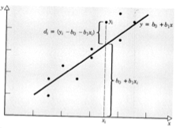
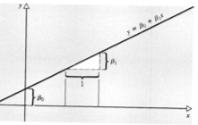
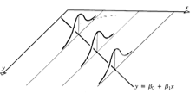

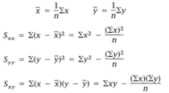


Least Square Estimation

Slide 36
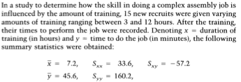

Example OLS

Slide 37

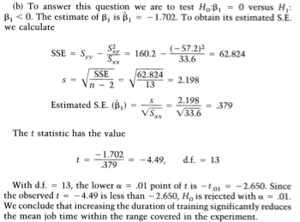

Slide 38




Slide 39
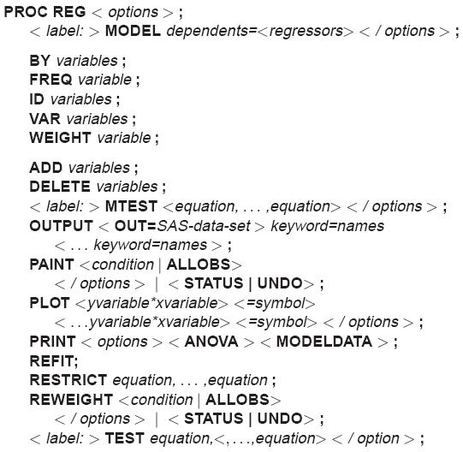
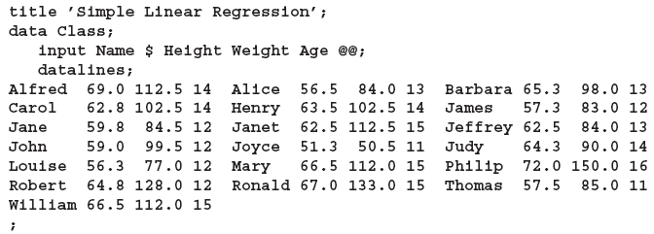
PROC REG
You might use regression analysis to find out how well you can predict
a child’s weight if you know that child’s height. The following data are from a study of nineteen children. Height and weight are measured for each child.

Slide 40

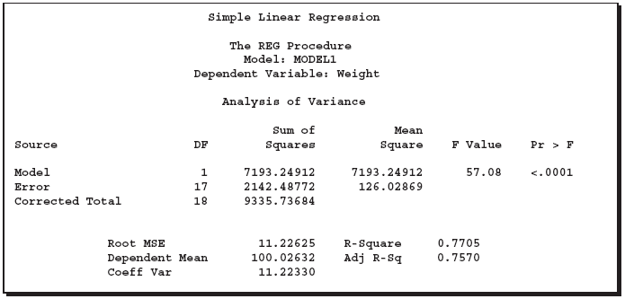
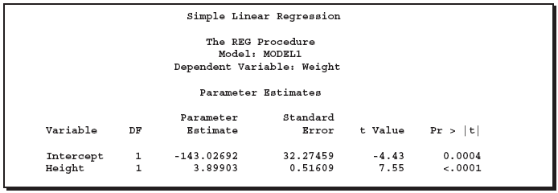
PROC REG
Already explained in the ANOVA section
Parameter estimation is done using least square technique
Parameter Estimate/Standard Error

Slide 41
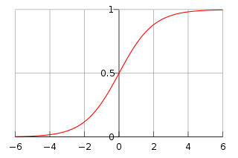


LOGISTIC/LOGIT REGRESSION
This regression methods attempts to model the probability of an event by fitting data to a logistic curve
Logistic Curve :
The model has an equivalent formulation :
where β₀ is called an intercept and β₁, β₂, β₃ are called regression coefficients of x₁,x₂,x₃
The logistic curve also called sigmoid makes sure that the values are bounded

Slide 42


Logistic Regression
Generalized Linear Model with Logit as a link function
Dependent variable assumes only two states
1 – Default
0 – Non-Default
Modeling the conditional probability that firm i defaults and vice versa

Slide 43



Logistic Regression
The odds that firm i defaults:
Score:
Probability of Default:
Estimated by Maximum Likelihood method

Slide 44

PROC LOGISTIC
Used for a ordered response model with the following form
Logistic procedure also enables to choose a link function to model the form
Logistic procedure can also fit a common slope cumulative model for ordinal response variable which is a parallel lines regression model based on cumulative probabilities rather than individual probabilities and has the form
Provides four variable selection methods : Forward, backward, stepwise and best subset

Slide 45





PROC LOGISTIC (Link Function and MLE)
Logit Function is the inverse of cdf
Probit(Normit) Function is the inverse of cumulative standard normal distribution function
The complementary log-log function is the inverse of the cumulative extreme-value function or Gompertz distribution
The likelihood for j^{th} obs.with response y_{j} and independent x_{j}’s is :
where F is as above, α’s are intercept parameters, β’s are slope parameters and 1to k+1 are ordered response of the event

Slide 46
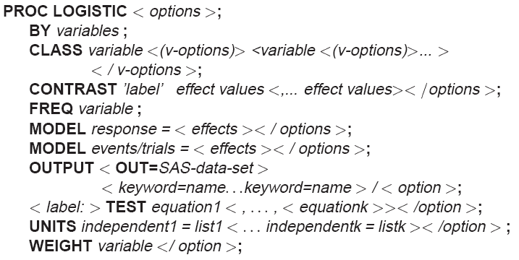
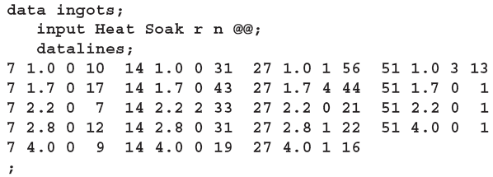
PROC LOGISTIC (Illustration)
The data, taken from Cox and Snell (1989, pp. 10–11), consist of the number, r, of ingots not ready for rolling, out of n tested, for a number of combinations of heating time and soaking time.

Slide 47

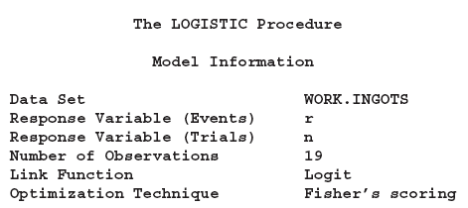

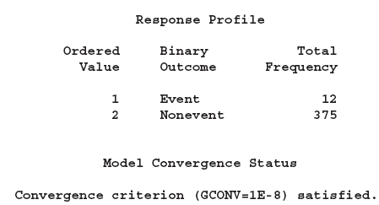
PROC LOGISTIC (Illustration)
r=12
n=389 , n-r=389-12=375

Slide 48
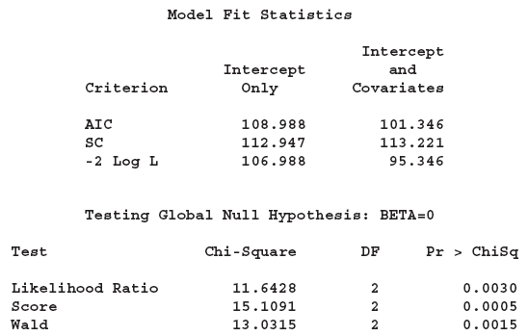
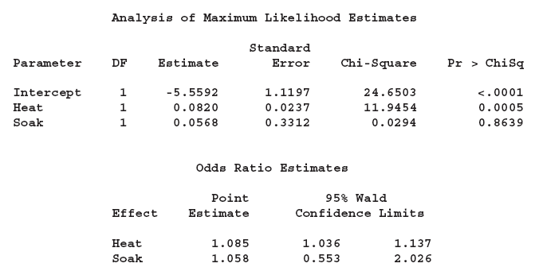
PROC LOGISTIC (Illustration)
Value for Intercept only and with Co-variate (fitted) Model – The lower the better
Akaike Information Criterion
Schwarz Criterion
-2 Log Likelihood
Results of the likelihood ratio test and the efficient score test for testing the joint significance of the explanatory variables (Soak and Heat) are included in this table
Maximum Likelihood Estimates

Slide 49
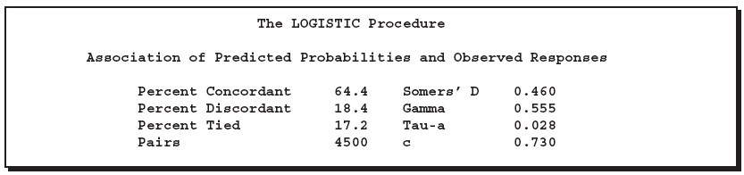
PROC LOGISTIC (Illustration)
# of pairs where event and non event probability are in the same order as response levels
(#concordant-#discordant)/Total Pairs
# of pairs where event and non event probability are in the reverse order as response levels
GoodMan Kruskal Gamma : (#concordant-#discordant)/ (#concordant+#discordant)
Kendall’s Tau -a : (#concordant-#discordant)/ (0.5*#Obs*(#Obs-1))
# of pairs which are neither concordant nor discordant
No of pairs formed by events and non event = r*n
(#concordant+(0.5*#Tied))/#Pairs

Slide 50
Logistic Regression Hosmer-Lemeshow test

Slide 51
Validation Model Power
Measures model’s discriminative power between defaulting and non-defaulting borrowers
Measures used
Cumulative Accuracy Profile (CAP) curve and Gini coefficient
Receiving Operating Characteristics (ROC) and Area Under Curve (AUC)
Kolmogorov-Smirnov (K-S) statistics

Slide 52
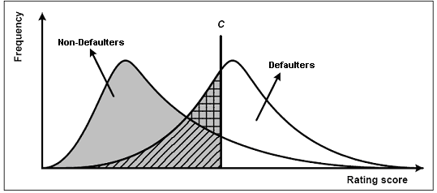
Validation Model Power – ROC and AUC
Source: BCBS (2005b)

Slide 53
Validation Model Power – ROC and AUC
H(C) the number of defaulters classified correctly for a given threshold C
N_{D} the total number of defaulters in the sample
F(C) the number of false alarms
N_{ND} the total number of non defaulters in the sample

Slide 54

Validation Model Power – ROC and AUC
AUC = 0.5 for a random model
AUC = 1 for a perfect model
Source: BCBS (2005b)

Slide 55
Validation Model Power – ROC and AUC
AUC = 63.96%

Slide 56
Validation Model Power – K-S statistics
K-S: 20%

Slide 57
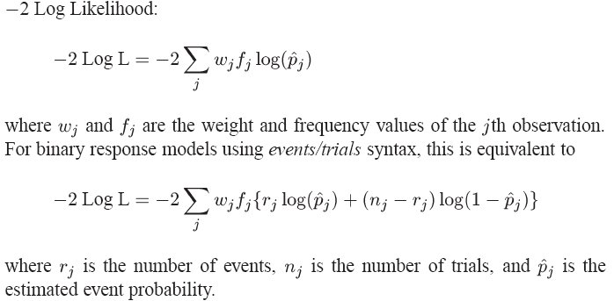
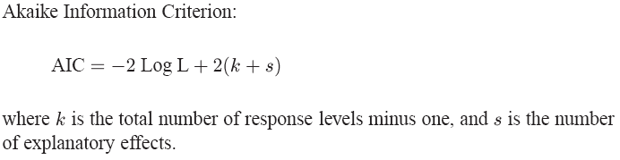
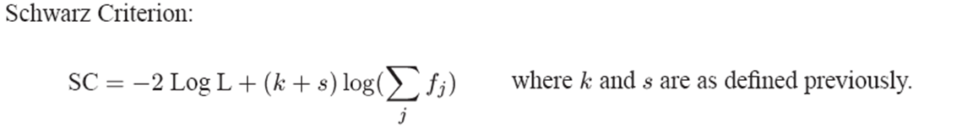
PROC LOGISTIC (Statistics)

Slide 58


Non Linear Estimation
Non-Linear Estimation is a generalized fitting procedure to estimate the relationship between dependent and independent variables
Linearization : Certain Non Linear Problems could be moved into a linear domain by suitable transformation
The use of linearization however must be done with caution due to its influence on data impacting statistical inferences like error/variance

Slide 59

PROC NLIN
This procedure produces least squares or weighted least squares estimates of the parameters of a nonlinear model
There is however no assurance of a successful model fit from the proc
PROC NLIN provides the flexibility to
Confine the ranges of parameter values within certain bounds
Define objective function to be minimized
It has five iterative methods to be used (Gradient, Newton, Gauss-Newton, Marquardt, False Position (DUD))
It can also accommodate array operations, if then else functions, do while operations, data creation steps etc.
It can perform segmented modeling as well for equations like

Slide 60
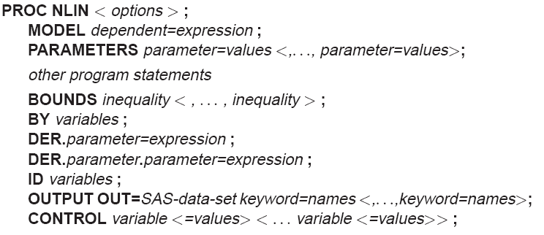
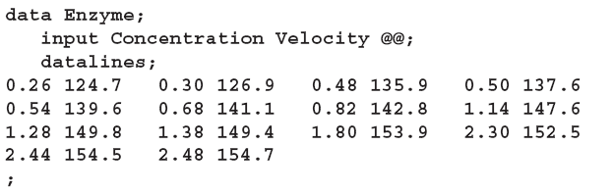

PROC NLIN
Suppose that you want to study the relationship between concentration and velocity for a particular enzyme/substrate pair. You record the reaction rate (velocity) observed at different substrate concentrations. We know from enzyme kinetics that
Where x_{i} is the substrate amount, f the velocity of reaction and θ the rate parameter

Slide 61
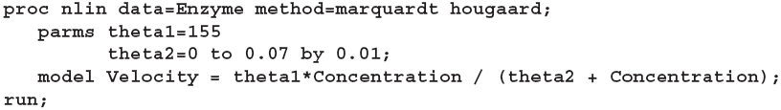
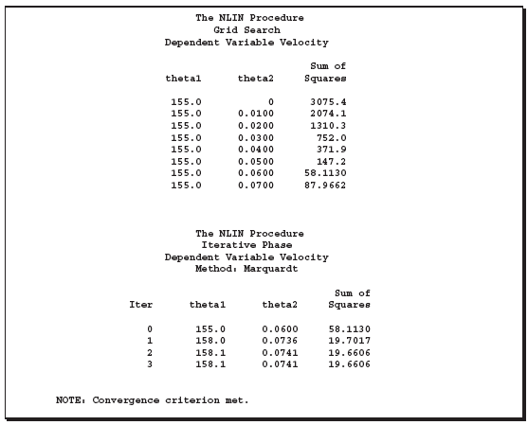
PROC NLIN (Illustration)
Parameters of the model specified by parms start with initial values

Slide 62
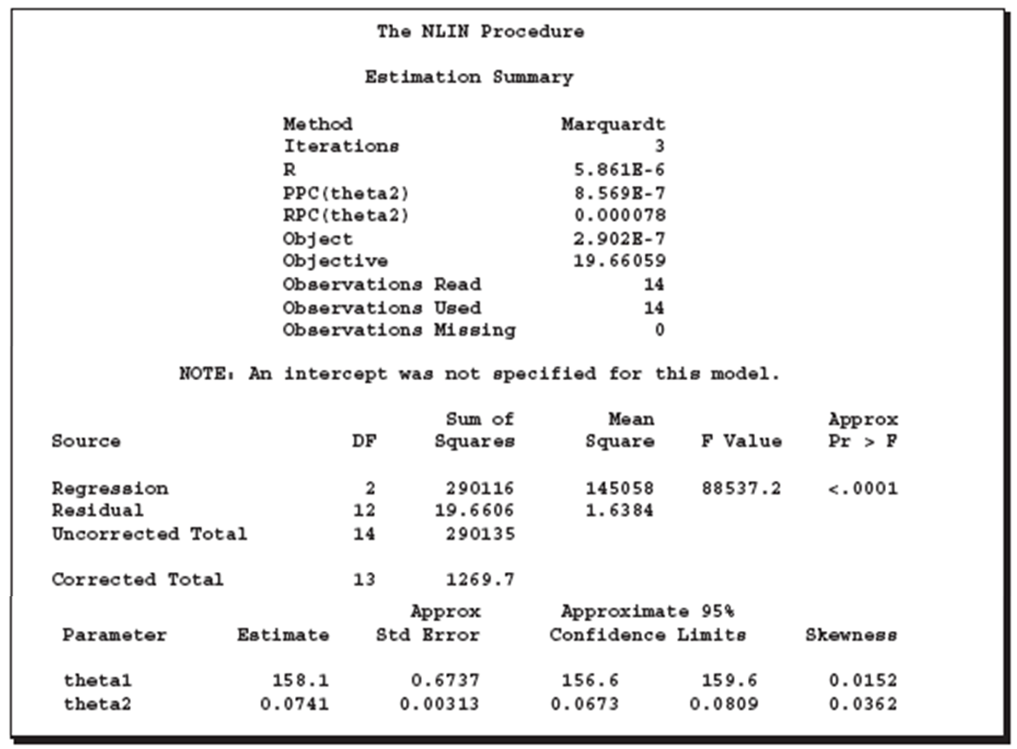
PROC NLIN (Illustration)

Slide 63
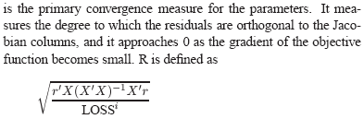
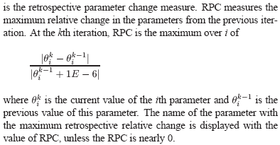
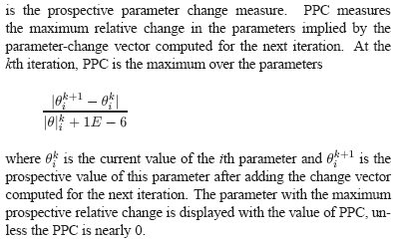
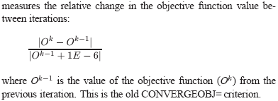
PROC NLIN (Converges Measures)
R
RPC
PPC
OBJECT

Slide 64
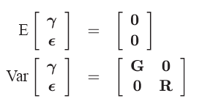
MIXED Regression
It is a generalization of the standard linear model where the data is permitted to have correlation and non constant variability
This technique provides the way to model not only the means of the data – Fixed effects Parameters but also the variance and covariance – Covariance Parameters
The mixed model generalizes the standard linear model as follows:
where γ is an unknown vector of random-effects parameters with known design matrix Z. ε is an unknown random error vector whose elements are no longer required to be independent and homogeneous
A key assumption in the foregoing analysis is that γ and ε are normally distributed with The variance of y is therefore

Slide 65
PROC MIXED
This procedure fits a variety of mixed linear models to data and enables development of statistical inferences from the data
Assumptions to be followed :
Data must be normally distributed
Means are linear in other independent variables
Variance and Co-variance of data are in terms of different set of parameters
It fits the selected structure using the method of restricted/residual maximum likelihood (REML)
Procedure uses Newton Raphson method for iteration and estimation of fixed and random effects

Slide 66
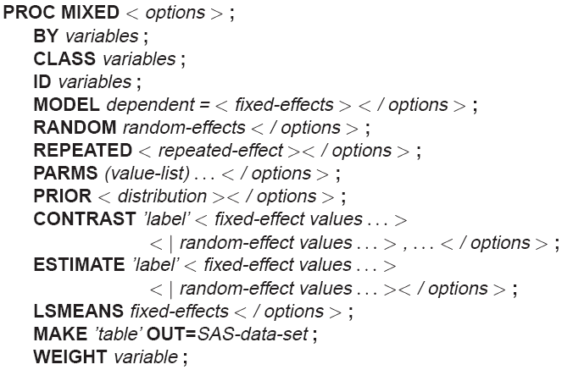
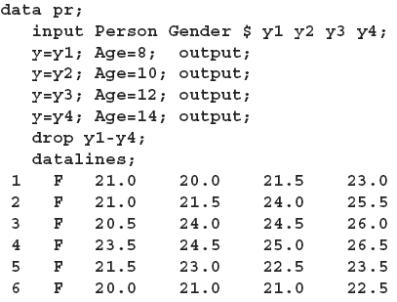
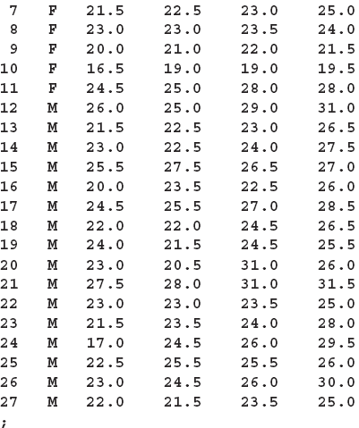
PROC MIXED
The following data are from Pothoff and Roy (1964) and consist of growth measurements for 11 girls and 16 boys at ages 8, 10, 12, and 14. Some of the observations are suspect (for example, the third observation for person 20); however, all of the data are used here for comparison purposes.

Slide 67
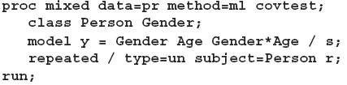
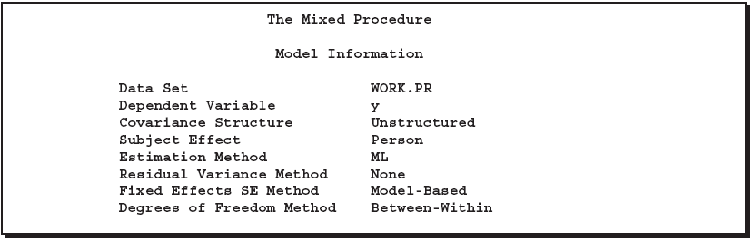
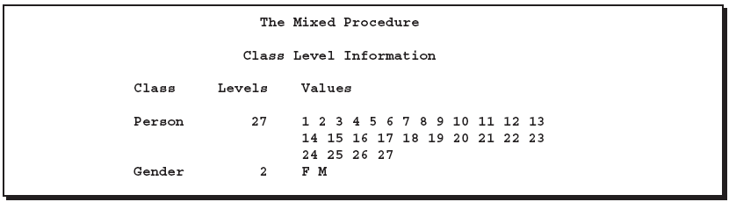
PROC MIXED
Number/Cardinality
Unique Values

Slide 68
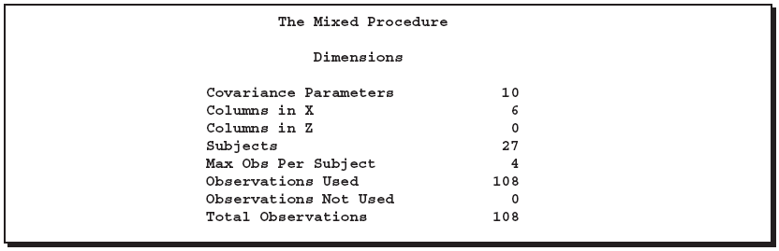
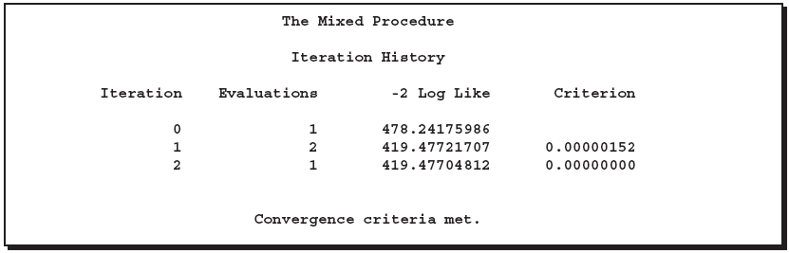

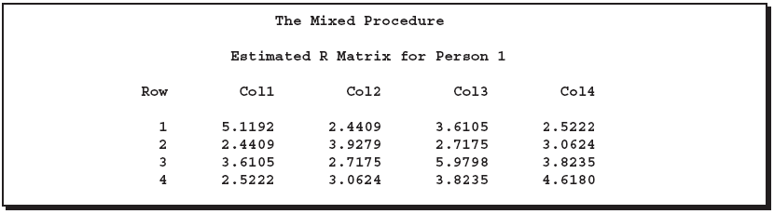
PROC MIXED
4 obs are present per object i.e. 4 ages per person hence Co Var Parameters are ⁴C₂+4 = 10
# of fixed effects : 2 for Gender, One for Age,2 for Age*Gender and One for Intercept, governed by model statement
Random Statement is not specified hence Z matrix is not required
Total # of observations in the data set
Modified Log Likelihood

Slide 69
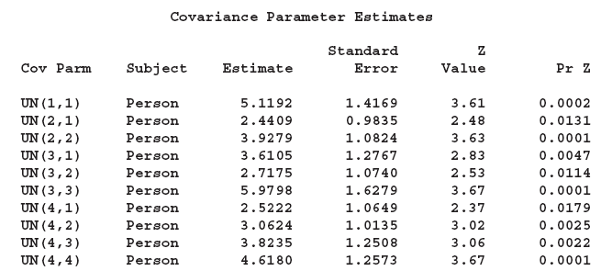
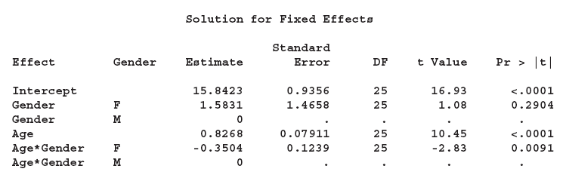
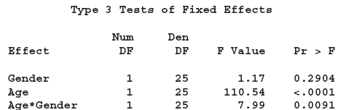
PROC MIXED
Solution for the fixed effects / Linear regression

