Slide 1
Techniques of Data Analysis
(Basic Statistical Theory)
Assoc. Prof. Dr. Abdul Hamid b. Hj. Mar Iman
Former Director
Centre for Real Estate Studies
Faculty of Engineering and Geoinformation Science
Universiti Tekbnologi Malaysia
Skudai, Johor

Slide 2
Objectives
Overall: Reinforce your understanding from the main lecture
Specific:
* Some principles of data analysis
* Some aspects of statistics
* Some uses of statistical methods
* Some exercises on statistical methods
What I will not do:
* To teach every bit and pieces of statistical analysis
techniques

Slide 3
SOME PRINCIPLES OF DATA ANALYSIS
Goal of an data analysis
Basic guides to data analysis
Four elements of data analysis
Data “can’t talk”

Slide 4
Principles of analysis
Goal of an analysis:
* To explain cause-and-effect phenomena
* To relate research with real-world event
* To predict/forecast the real-world
phenomena based on research
* Finding answers to a particular problem
* Making conclusions about real-world event
based on the problem
* Learning a lesson from the problem

Slide 5
Principles of data analysis (contd.)
Basic guide to data analysis:
* “Analyse” NOT “narrate”
* Go back to research flowchart
* Break down into research objectives and
research questions
* Identify phenomena to be investigated
* Visualise the “expected” answers
* Validate the answers with data
* Don’t tell something not supported by
data

Slide 6
Principles of analysis (contd.)
An analysis must have four elements:
* Data/information (what)
* Scientific reasoning/argument (what?
who? where? how? what happens?)
* Finding (what results?)
* Lesson/conclusion (so what? so how?
therefore,…)

Slide 7
Principles of analysis (contd.)
Data can’t “talk”. Thus, analysis must contain
scientific reasoning/argument:
* Define
* Interpret
* Evaluate
* Illustrate
* Discuss
* Explain
* Clarify
* Compare
* Contrast

Slide 8
Principles of data analysis (contd.)
When analysing:
* Be objective
* Accurate
* True
Separate facts and opinion
Avoid “wrong” reasoning/argument. E.g. mistakes in interpretation.

Slide 9
Principles of data analysis (contd.)
Shoppers | Number
Male Old Young | 6 4
Female Old Young | 10 15
More female shoppers than male shoppers
More young female shoppers than young male shoppers
Young male shoppers are not interested to shop at the shopping complex

Slide 10








Slide 11
What is Statistics
“Meaningful” quantities about a sample of objects, things, persons, events, phenomena, etc.
Something to do with “data”
Widely used in various discipline of sciences.
Used to solve simple to complex issues.
Three main categories:
* Descriptive statistics
* Inferential statistics
* Probability theory

Slide 12
Descriptive Statistics
Use sample information to explain/make abstraction of population “phenomena”.
Common “phenomena”:
* Association (e.g. σ_{1,2.3} = 0.75)
* Tendency (left-skew, right-skew)
* Causal relationship (e.g. if X, then, Y)
* Trend, pattern, dispersion, range
Used in non-parametric analysis (e.g. chi-square, t-test, 2-way anova)

Slide 13
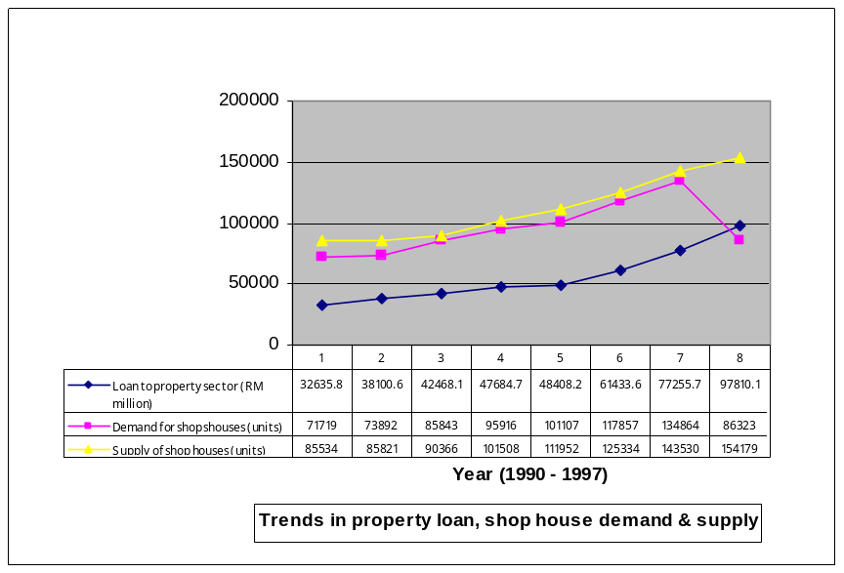
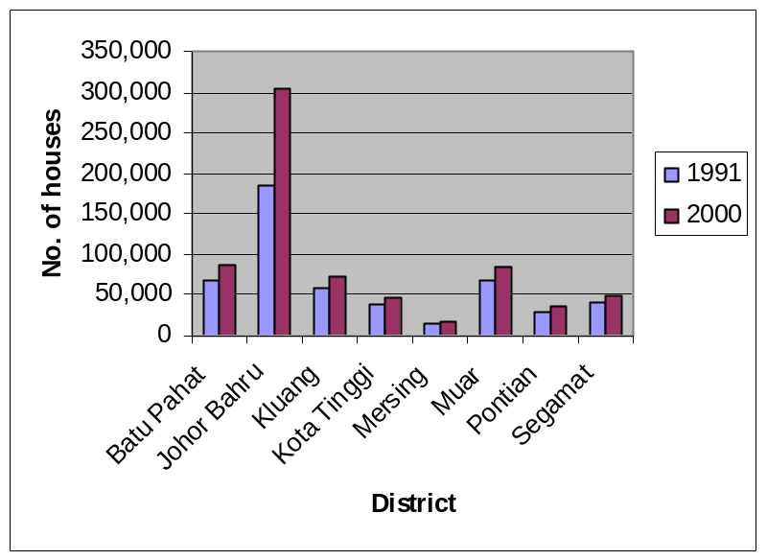
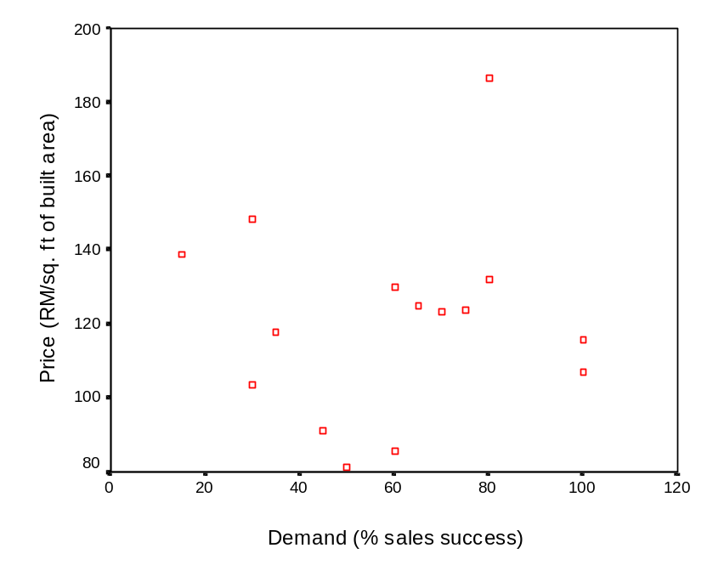
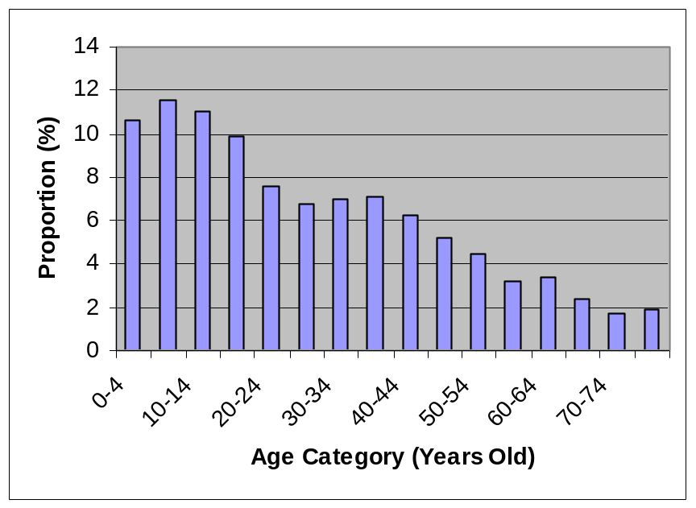
Examples of “abstraction” of phenomena

Slide 14
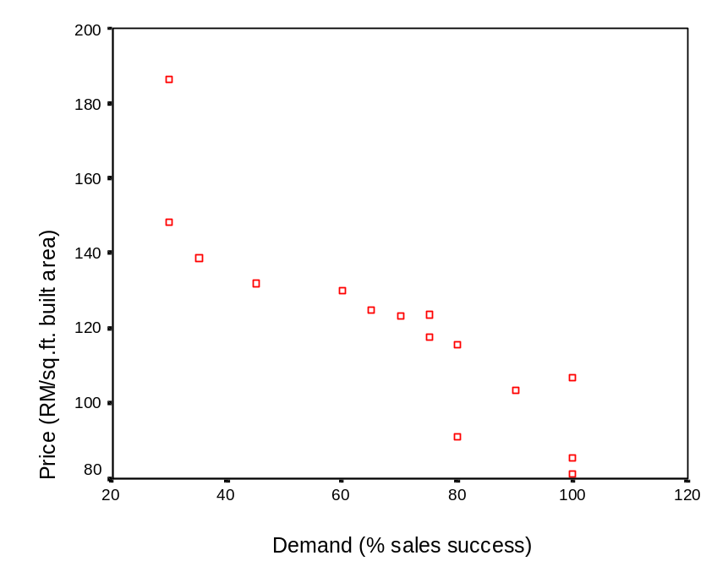
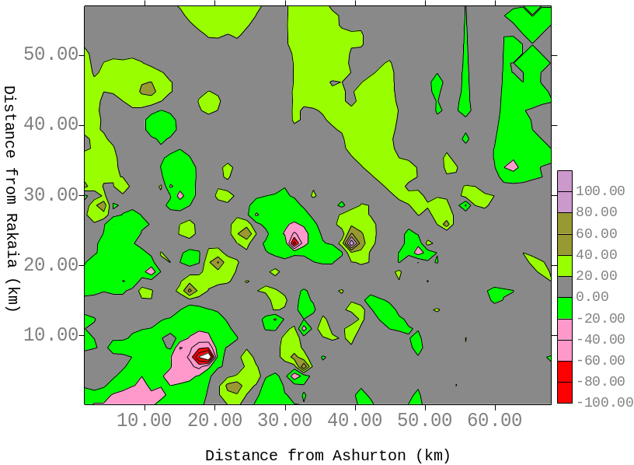
Examples of “abstraction” of phenomena
% prediction error

Slide 15
Inferential statistics
Using sample statistics to infer some “phenomena” of population parameters
Common “phenomena”: cause-and-effect * One-way r/ship
* Multi-directional r/ship
* Recursive
Use parametric analysis (α and β of a regression analysis)
Y = f(X)
Y1 = f(Y2, X, e1)
Y2 = f(Y1, Z, e2)
Y1 = f(X, e1)
Y2 = f(Y1, Z, e2)

Slide 16
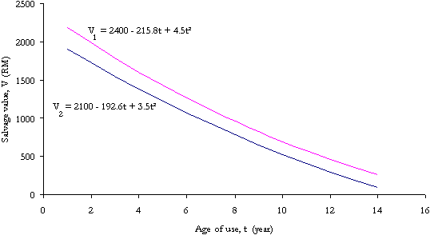
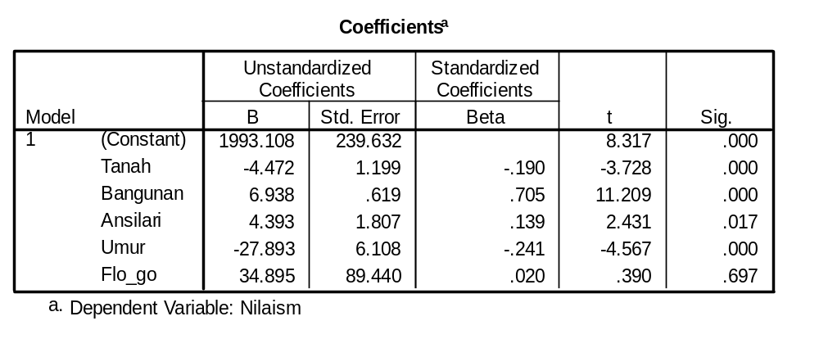
Examples of relationship
Dep=9t – 215.8
Dep=7t – 192.6

Slide 17

Which one to use?
Nature of research
* Descriptive in nature?
* Attempts to “infer”, “predict”, find “cause-and-effect”,
“influence”, “relationship”?
* Is it both?
Research design (incl. variables involved). E.g.
Outputs/results expected
* research issue
* research questions
* research hypotheses
At post-graduate level research, failure to choose the correct data analysis technique is an almost sure ingredient for thesis failure.

Slide 18
Common mistakes in use of statistics
Wrong techniques. E.g.
Infeasible techniques. E.g.
How to design ex-ante effects of KLIA? Development occurs “before” and “after”! What is the control treatment?
Further explanation!
Abuse of statistics. E.g.
Simply exclude a technique
Issue | Data analysis techniques
 | Wrong technique | Correct technique
To study factors that “influence” visitors to come to a recreation site “Effects” of KLIA on the development of Sepang | Likert scaling based on interviews Likert scaling based on interviews | Data tabulation based on open-ended questionnaire survey Descriptive analysis based on ex-ante post-ante experimental investigation
Note: No way can Likert scaling show “cause-and-effect” phenomena!

Slide 19
Common mistakes (contd.) – “Abuse of statistics”
Issue | Data analysis techniques
 | Example of abuse | Correct technique
Measure the “influence” of a variable on another | Using partial correlation (e.g. Spearman coeff.) | Using a regression parameter
Finding the “relationship” between one variable with another | Multi-dimensional scaling, Likert scaling | Simple regression coefficient
To evaluate whether a model fits data better than the other | Using R² | Many – a.o.t. Box-Cox χ² test for model equivalence
To evaluate accuracy of “prediction” | Using R² and/or F-value of a model | Hold-out sample’s MAPE
“Compare” whether a group is different from another | Multi-dimensional scaling, Likert scaling | Many – a.o.t. two-way anova, χ², Z test
To determine whether a group of factors “significantly influence” the observed phenomenon | Multi-dimensional scaling, Likert scaling | Many – a.o.t. manova, regression

Slide 20
How to avoid mistakes - Useful tips
Crystalize the research problem → operability of it!
Read literature on data analysis techniques.
Evaluate various techniques that can do similar things w.r.t. to research problem
Know what a technique does and what it doesn’t
Consult people, esp. supervisor
Pilot-run the data and evaluate results
Don’t do research??

Slide 21

SOME ASPECTS OF STATISTICS
Introductory Statistical Concepts
Basic concepts
Central tendency
Variability
Probability
Statistical Modelling

Slide 22
Basic Concepts
Population: the whole set of a “universe”
Sample: a sub-set of a population
Parameter: an unknown “fixed” value of population characteristic
Statistic: a known/calculable value of sample characteristic representing that of the population. E.g.
μ = mean of population, = mean of sample
Q: What is the mean price of houses in J.B.?
A: RM 210,000
= 300,000
₁
= 120,000
₂
SD
SST
= 210,000
₃
J.B. houses
μ = ?
DST

Slide 23
Basic Concepts (contd.)
Randomness: Many things occur by pure chances…rainfall, disease, birth, death,..
Variability: Stochastic processes bring in them various different dimensions, characteristics, properties, features, etc., in the population
Statistical analysis methods have been developed to deal with these very nature of real world.

Slide 24
“Central Tendency”
Measure | Advantages | Disadvantages
Mean (Sum of all values ÷ no. of values) | ∗ Best known average ∗ Exactly calculable ∗ Make use of all data ∗ Useful for statistical analysis | ∗ Affected by extreme values Can be absurd for discrete data (e.g. Family size = 4.5 person) ∗ Cannot be obtained graphically
Median (middle value) | Not influenced by extreme values Obtainable even if data distribution unknown (e.g. group/aggregate data) Unaffected by irregular class width ∗ Unaffected by open-ended class | Needs interpolation for group/ aggregate data (cumulative frequency curve) May not be characteristic of group when: (1) items are only few; (2) distribution irregular ∗ Very limited statistical use
Mode (most frequent value) | ∗ Unaffected by extreme values ∗ Easy to obtain from histogram ∗ Determinable from only values near the modal class | Cannot be determined exactly in group data ∗ Very limited statistical use

Slide 25




Central Tendency – “Mean”
For individual observations, . E.g.
X = {3,5,7,7,8,8,8,9,9,10,10,12}
= 96 ; n = 12
Thus, = 96/12 = 8
The above observations can be organised into a frequency table and mean calculated on the basis of frequencies
= 96; = 12
Thus, = 96/12 = 8
x | 3 | 5 | 7 | 8 | 9 | 10 | 12
f | 1 | 1 | 2 | 3 | 2 | 2 | 1
Σf | 3 | 5 | 14 | 24 | 18 | 20 | 12

Slide 26
Central Tendency - Mean and Mid-point
Let say we have data like this:
Price (RM ‘000/unit) of Shop Houses in Skudai
Location | Min | Max
Town A | 228 | 450
Town B | 320 | 430
Can you calculate the mean?

Slide 27
Central Tendency - Mean and Mid-point (contd.)
Let calculate as follows:
Town A: (228+450)/2 = 339
Town B: (320+430)/2 = 375
Are these figures means?

Slide 28
Central Tendency - Mean and Mid-point (contd.)
Let say we have price data as follows:
Town A: 228, 295, 310, 420, 450
Town B: 320, 295, 310, 400, 430
Calculate the means?
Town A:
Town B:
Are the results same as previously?
⇒ Be careful about abuse of statistics!

Slide 29

Central Tendency–“Mean of Grouped Data”
House rental or prices in the PMR are frequently tabulated as a range of values. E.g.
What is the mean rental across the areas?
= 23; = 3317.5
Thus, = 3317.5/23 = 144.24
Rental (RM/month) | 135-140 | 140-145 | 145-150 | 150-155 | 155-160
Mid-point value (x) | 137.5 | 142.5 | 147.5 | 152.5 | 157.5
Number of Taman (f) | 5 | 9 | 6 | 2 | 1
fx | 687.5 | 1282.5 | 885.0 | 305.0 | 157.5

Slide 30
Central Tendency – “Median”
Let say house rentals in a particular town are tabulated as follows:
Calculation of “median” rental needs a graphical aids→
Rental (RM/month) | 130-135 | 135-140 | 140-145 | 155-50 | 150-155
Number of Taman (f) | 3 | 5 | 9 | 6 | 2
Rental (RM/month) | >135 | > 140 | > 145 | > 150 | > 155
Cumulative frequency | 3 | 8 | 17 | 23 | 25
Median = (n+1)/2 = (25+1)/2 =13th. Taman
2. (i.e. between 10 – 15 points on the vertical axis of ogive).
3. Corresponds to RM 140-145/month on the horizontal axis
4. There are (17-8) = 9 Taman in the range of RM 140-145/month
5. Taman 13th. is 5th. out of the 9
Taman
6. The rental interval width is 5
7. Therefore, the median rental can
be calculated as:
140 + (5/9 x 5) = RM 142.8

Slide 31
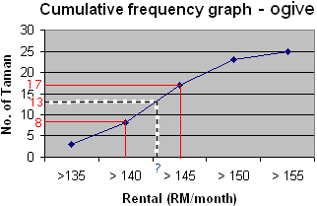
Central Tendency – “Median” (contd.)

Slide 32
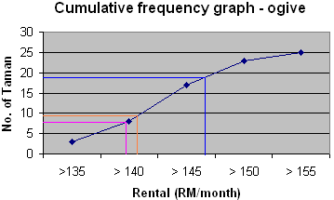
Central Tendency – “Quartiles” (contd.)
Following the same process as in calculating “median”:
Upper quartile = ¾(n+1) = 19.5th. Taman
UQ = 145 + (3/7 x 5) = RM 147.1/month
Lower quartile = (n+1)/4 = 26/4 = 6.5 th. Taman
LQ = 135 + (3.5/5 x 5) = RM138.5/month
Inter-quartile = UQ – LQ = 147.1 – 138.5 = 8.6th. Taman
IQ = 138.5 + (4/5 x 5) = RM 142.5/month

Slide 33




“Variability”
Indicates dispersion, spread, variation, deviation
For single population or sample data:
where σ² and s² = population and sample variance respectively, x_{i} = individual observations, μ = population mean, = sample mean, and n = total number of individual observations.
The square roots are:
standard deviation standard deviation

Slide 34
“Variability” (contd.)
Why “measure of dispersion” important?
Consider returns from two categories of shares:
* Shares A (%) = {1.8, 1.9, 2.0, 2.1, 3.6}
* Shares B (%) = {1.0, 1.5, 2.0, 3.0, 3.9}
Mean A = mean B = 2.28%
But, different variability!
Var(A) = 0.557, Var(B) = 1.367
* Would you invest in category A shares or
category B shares?

Slide 35
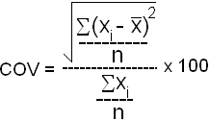
“Variability” (contd.)
Coefficient of variation – COV – std. deviation as % of the mean:
Could be a better measure compared to std. dev.
COV(A) = 32.73%, COV(B) = 51.28%

Slide 36
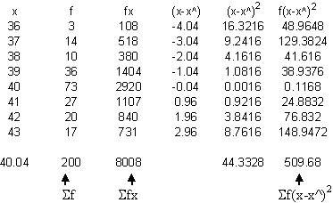




“Variability” (contd.)
Std. dev. of a frequency distribution
The following table shows the age distribution of second-time home buyers:
x^

Slide 37

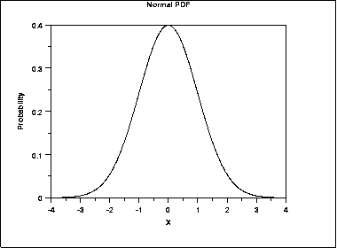
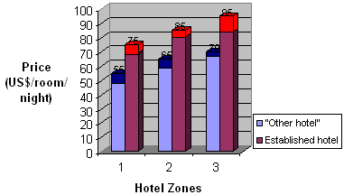
“Probability Distribution”
Defined as of probability density function (pdf).
Many types: Z, t, F, gamma, etc.
“God-given” nature of the real world event.
General form:
E.g.
(continuous)
(discrete)

Slide 38

“Probability Distribution” (contd.)
Dice1 Dice2 | 1 | 2 | 3 | 4 | 5 | 6
1 | 2 | 3 | 4 | 5 | 6 | 7
2 | 3 | 4 | 5 | 6 | 7 | 8
3 | 4 | 5 | 6 | 7 | 8 | 9
4 | 5 | 6 | 7 | 8 | 9 | 10
5 | 6 | 7 | 8 | 9 | 10 | 11
6 | 7 | 8 | 9 | 10 | 11 | 12

Slide 39
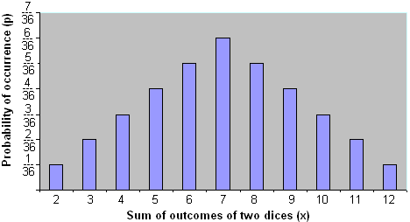
“Probability Distribution” (contd.)
Discrete values
Discrete values
Values of x are discrete (discontinuous)
Sum of lengths of vertical bars Σp(X=x) = 1
all x

Slide 40
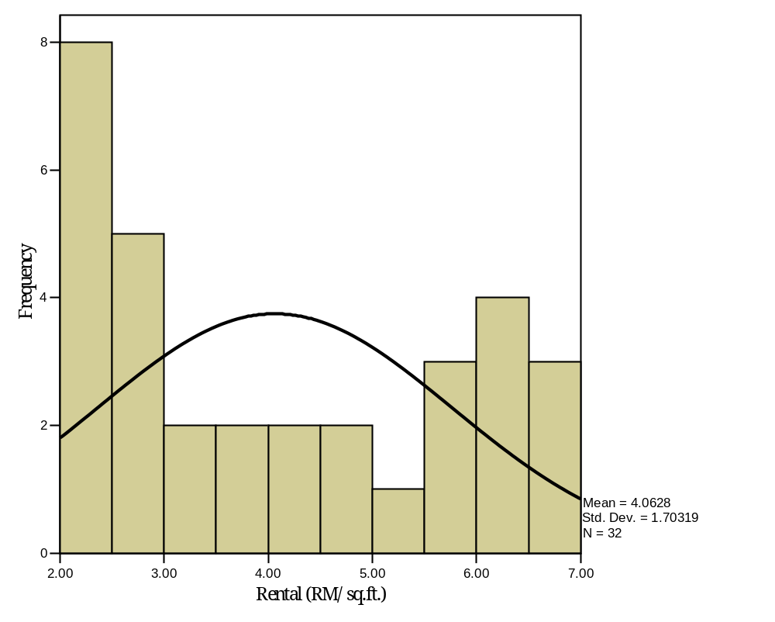
“Probability Distribution” (contd.)
▪ Many real world phenomena
take a form of continuous
random variable
▪ Can take any values between
two limits (e.g. income, age,
weight, price, rental, etc.)

Slide 41
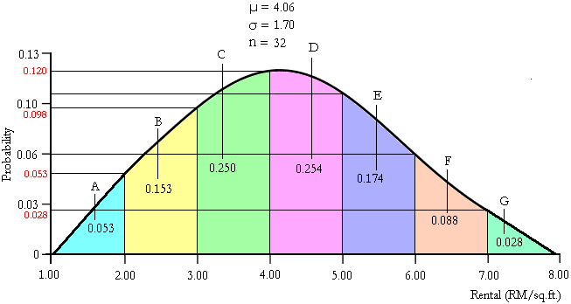
“Probability Distribution” (contd.)
P(Rental = RM 8) = 0 P(Rental < RM 3.00) = 0.206
P(Rental < RM7) = 0.972 P(Rental ≥ RM 4.00) = 0.544
P(Rental ≥ 7) = 0.028 P(Rental < RM 2.00) = 0.053

Slide 42
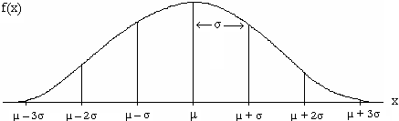

“Probability Distribution” (contd.)
Ideal distribution of such phenomena:
* Bell-shaped, symmetrical
* Has a function of
μ = mean of variable x
σ = std. dev. of x
π = ratio of circumference of a
circle to its diameter = 3.14
e = base of natural log = 2.71828

Slide 43
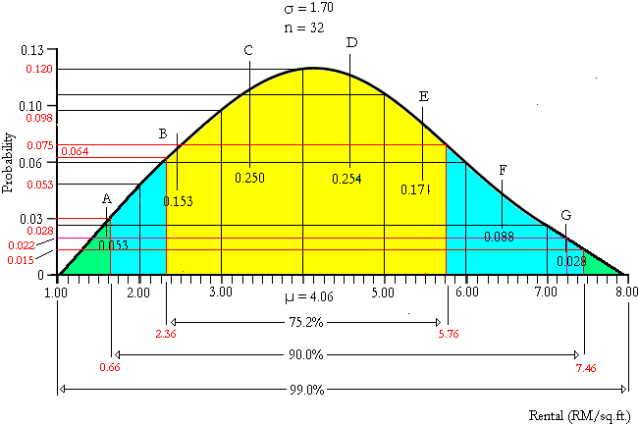
“Probability distribution”
μ ± 1σ = ? = ____% from total observation
μ ± 2σ = ? = ____% from total observation
μ ± 3σ = ? = ____% from total observation

Slide 44
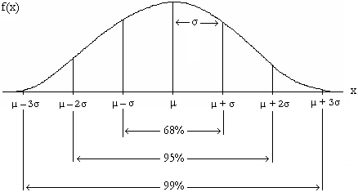
“Probability distribution”
* Has the following distribution of observation

Slide 45
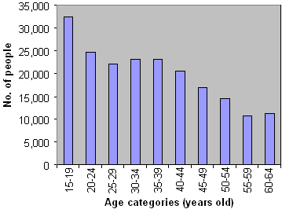
“Probability distribution”
There are various other types and/or shapes of distribution. E.g.
Not “ideally” shaped like the previous one
Note: Σp(AGE=age) ≠ 1
How to turn this graph into a probability distribution function (p.d.f.)?

Slide 46
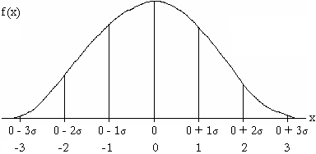
“Z-Distribution”
φ(X=x) is given by area under curve
Has no standard algebraic method of integration → Z ~ N(0,1)
It is called “normal distribution” (ND)
Standard reference/approximation of other distributions. Since there are various f(x) forming NDs, SND is needed
To transform f(x) into f(z):
x - µ
Z = --------- ~ N(0, 1)
σ
160 –155
E.g. Z = ------------- = 0.926
5.4
Probability is such a way that:
* Approx. 68% -1< z <1
* Approx. 95% -1.96 < z < 1.96
* Approx. 99% -2.58 < z < 2.58

Slide 47
“Z-distribution” (contd.)
When X= μ, Z = 0, i.e.
When X = μ + σ, Z = 1
When X = μ + 2σ, Z = 2
When X = μ + 3σ, Z = 3 and so on.
It can be proven that P(X₁ <X< X_{k}) = P(Z₁ <Z< Z_{k})
SND shows the probability to the right of any particular value of Z.
Example

Slide 48
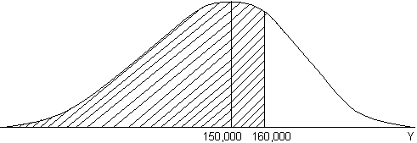
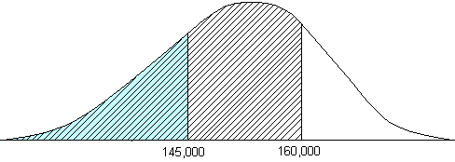
Normal distribution…Questions
Your sample found that the mean price of “affordable” homes in Johor
Bahru, Y, is RM 155,000 with a variance of RM 3.8x10⁷. On the basis of a
normality assumption, how sure are you that:
The mean price is really ≤ RM 160,000
The mean price is between RM 145,000 and 160,000
Answer (a):
P(Y ≤ 160,000) = P(Z ≤ ---------------------------)
= P(Z ≤ 0.811)
= 0.1867
Using , the required probability is:
1-0.1867 = 0.8133
160,000 -155,000
√3.8x10⁷
Z-table
Always remember: to convert to SND, subtract the mean and divide by the std. dev.

Slide 49
Normal distribution…Questions
Answer (b):
Z₁ = ------ = ---------------- = -1.622
Z₂ = ------ = ---------------- = 0.811
P(Z₁<-1.622)=0.0455; P(Z₂>0.811)=0.1867
∴P(145,000<Z<160,000)
= P(1-(0.0455+0.1867)
= 0.7678
X₁ - μ
145,000 – 155,000
σ
√3.8x10⁷
X₂ - μ
160,000 – 155,000
σ
√3.8x10⁷

Slide 50
Normal distribution…Questions
You are told by a property consultant that the
average rental for a shop house in Johor Bahru is
RM 3.20 per sq. After searching, you discovered
the following rental data:
2.20, 3.00, 2.00, 2.50, 3.50,3.20, 2.60, 2.00,
3.10, 2.70
What is the probability that the rental is greater
than RM 3.00?

Slide 51
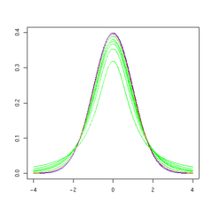

“Student’s t-Distribution”
Similar to Z-distribution:
* t(0,σ) but σ_{n→∞}→1
* -∞ < t < +∞
* Flatter with thicker tails
* As _{n→∞} t(0,σ) → N(0,1)
* Has a function of
where Γ=gamma distribution; v=n-1=d.o.f; π=3.147
* Probability calculation requires information on
d.o.f.

Slide 52
STATISTICS FOR DECISION-MAKING

Slide 53
Test yourselves!
Q1: Calculate the min and std. deviation of the following data:
Q2: Calculate the mean price of the following low-cost houses, in various
localities across the country:
PRICE - RM ‘000 | 130 | 137 | 128 | 390 | 140 | 241 | 342 | 143
SQ. M OF FLOOR | 135 | 140 | 100 | 360 | 175 | 270 | 200 | 170
PRICE - RM ‘000 (x) | 36 | 37 | 38 | 39 | 40 | 41 | 42 | 43
NO. OF LOCALITIES (f) | 3 | 14 | 10 | 36 | 73 | 27 | 20 | 17

Slide 54
Test yourselves! (contd.)
Q3: From a sample information, a population of housing
estate is believed have a “normal” distribution of X ~ (155,
45). What is the general adjustment to obtain a Standard
Normal Distribution of this population?
Q4: Consider the following ROI for two types of investment:
A: 3.6, 4.6, 4.6, 5.2, 4.2, 6.5
B: 3.3, 3.4, 4.2, 5.5, 5.8, 6.8
Decide which investment you would choose.

Slide 55
Test yourselves! (contd.)
Q5: Find:
φ(AGE > “30-34”)
φ(AGE ≤ 20-24)
φ( “35-39”≤ AGE < “50-54”)

Slide 56
Test yourselves! (contd.)
Q6: You are asked by a property marketing manager to ascertain whether
or not distance to work and distance to the city are “equally” important
factors influencing people’s choice of house location.
You are given the following data for the purpose of testing:
Explore the data as follows:
Create histograms for both distances. Comment on the shape of the histograms. What is you conclusion?
Construct scatter diagram of both distances. Comment on the output.
Explore the data and give some analysis.
Set a hypothesis that means of both distances are the same. Make your conclusion.

Slide 57
Test yourselves! (contd.)
Q7: From your initial investigation, you try to establish whether tenants of “low-quality” housing choose to rent particular flat units just to find shelters. In this context, you want to determine whether these groups of people pay much attention to pertinent aspects of “quality life” such as accessibility, good surrounding, security, and physical facilities in the living areas.
(a) Set your research design and data analysis procedure to address the research issue
(b) How are you going to test your hypothesis as follows:
H_{o}: low-income tenants do not perceive “quality life” to be
important in paying their house rentals.
H₁: Ho not true

