Slide 1
Point estimation and interval estimation
learning objectives:
        to understand the relationship between point estimation and interval estimation
        to calculate and interpret the confidence interval

Slide 2
Statistical estimation
Every member of the
population has the
same chance of being
selected in the sample
Population
Parameters
Random sample
estimation
Statistics

Slide 3
Statistical estimation
Estimate
Point estimate
Interval estimate
sample mean
sample proportion
confidence interval for mean
confidence interval for proportion
Point estimate is always within the interval estimate

Slide 4
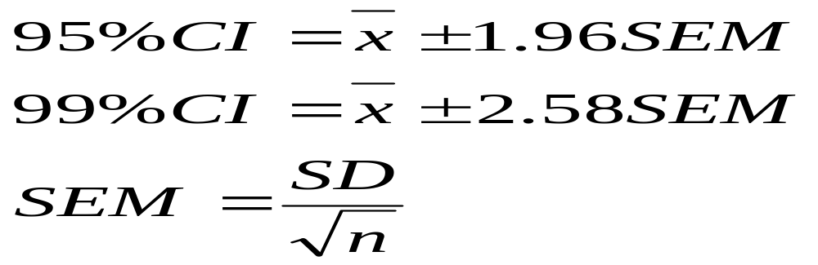
Interval estimation
Confidence interval (CI)
provide us with a range of values that we belive, with a given level of confidence, containes a true value
CI for the poipulation means

Slide 5
Interval estimation
Confidence interval (CI)
34%
34%
14%
14%
2%
2%
z
-3.0 -2.0 -1.0 0.0 1.0 2.0 3.0
-2.58
-1.96
1.96
2.58

Slide 6
Interval estimation
Confidence interval (CI), interpretation and example
50
40
30
Frequency
20
10
0
22.5
27.5
32.5
37.5
42.5
47.5
52.5
57.5
25.0
30.0
35.0
40.0
45.0
50.0
55.0
60.0
Age in years
‾x= 41.0, SD= 8.7, SEM=0.46, 95% CI (40.0, 42), 99%CI (39.7, 42.1)

Slide 7
Testing of hypotheses
learning objectives:
        to understand the role of significance test
        to distinguish the null and alternative hypotheses
        to interpret p-value, type I and II errors

Slide 8
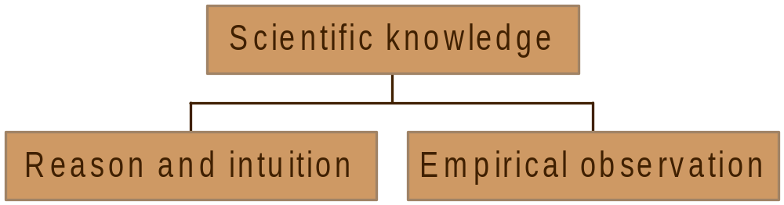
Statistical inference. Role of chance.
Formulate
hypotheses
Collect data to test hypotheses

Slide 9
Statistical inference. Role of chance.
Systematic error
Formulate
hypotheses
Collect data to test hypotheses
C H A N C E
Accept hypothesis
Reject hypothesis
Random error (chance) can be controlled by statistical significance
or by confidence interval

Slide 10
Testing of hypotheses
Significance test
Subjects: random sample of 352 nurses from HUS surgical hospitals
Mean age of the nurses (based on sample): 41.0
Another random sample gave mean value: 42.0.
Question:
Is it possible that the “true” age of nurses from HUS surgical hospitals was 41 years and observed mean ages differed just because of sampling error?
Answer can be given based on Significance Testing.

Slide 11
Testing of hypotheses
Null hypothesis H₀ - there is no difference
Alternative hypothesis H_{A} - question explored by the investigator
Statistical method are used to test hypotheses
The null hypothesis is the basis for statistical test.

Slide 12
Testing of hypotheses
Example
The purpose of the study:
to assess the effect of the lactation nurse on attitudes towards breast feeding among women
Research question:
Does the lactation nurse have an effect on attitudes towards breast feeding ?
H_{A} :
The lactation nurse has an effect on attitudes towards breast feeding.
H₀ :
The lactation nurse has no effect on attitudes towards breast feeding.

Slide 13
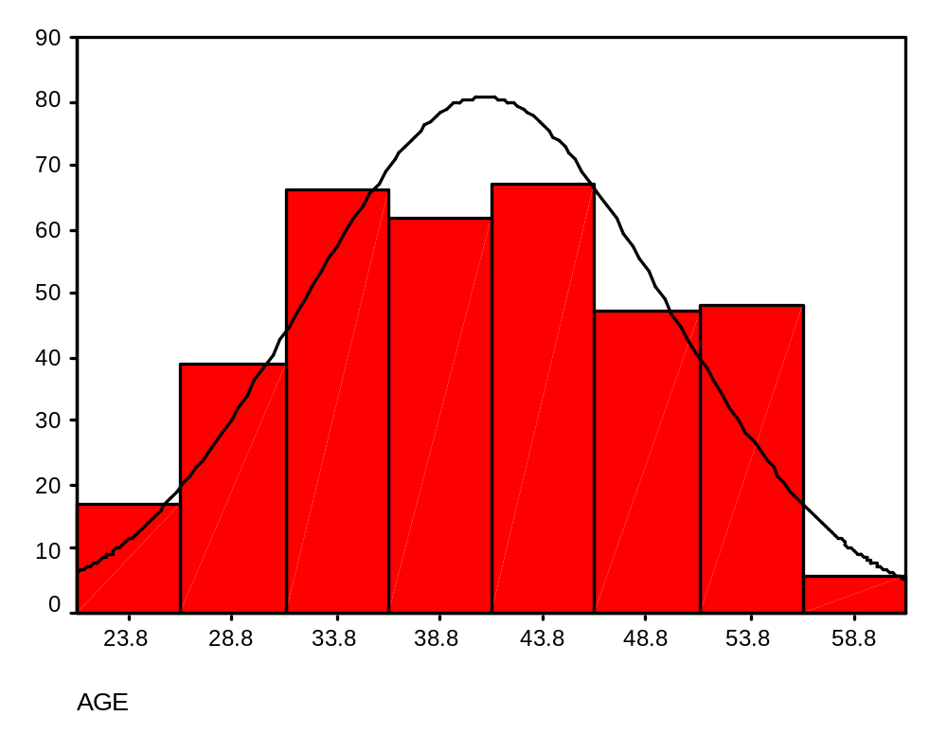
Testing of hypotheses
Definition of p-value.
2.5%
95%
2.5%
If our observed age value lies outside the green lines, the probability of getting a value as extreme as this if the null hypothesis is true is < 5%

Slide 14
Testing of hypotheses
Definition of p-value.
p-value = probability of observing a value more extreme that actual value observed, if the null hypothesis is true
The smaller the p-value, the more unlikely the null hypothesis seems an explanation for the data
Interpretation for the example
If results falls outside green lines, p<0.05,
if it falls inside green lines, p>0.05

Slide 15
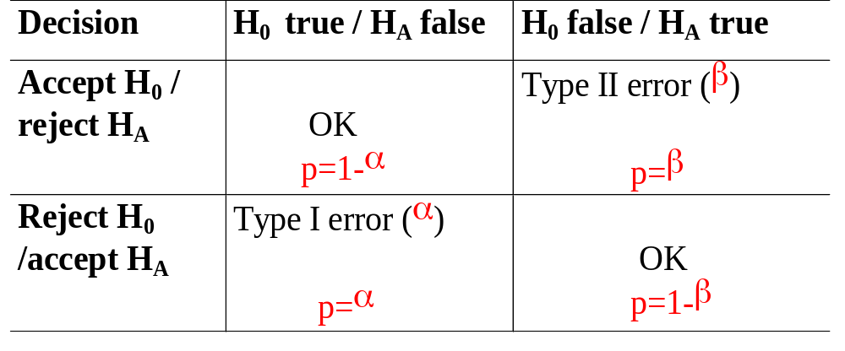
Testing of hypotheses
Type I and Type II Errors
No study is perfect,
there is always the chance for error
α - level of significance
1-β - power of the test

Slide 16
Testing of hypotheses
Type I and Type II Errors
there is only 5 chance in 100 that the result termed "significant" could occur by chance alone
α =0.05
The probability of making a Type I (α) can be decreased by altering the level of significance.
it will be more difficult to find a significant result
the power of the test will be decreased
the risk of a Type II error will be increased

Slide 17
Testing of hypotheses
Type I and Type II Errors
The probability of making a Type II (β) can be decreased by increasing the level of significance.
it will increase the chance of a Type I error
To which type of error you are willing to risk ?

Slide 18
Testing of hypotheses
Type I and Type II Errors. Example
Suppose there is a test for a particular disease.
If the disease really exists and is diagnosed early, it can be successfully treated
If it is not diagnosed and treated, the person will become severely disabled
If a person is erroneously diagnosed as having the disease and treated, no physical damage is done.
To which type of error you are willing to risk ?

Slide 19
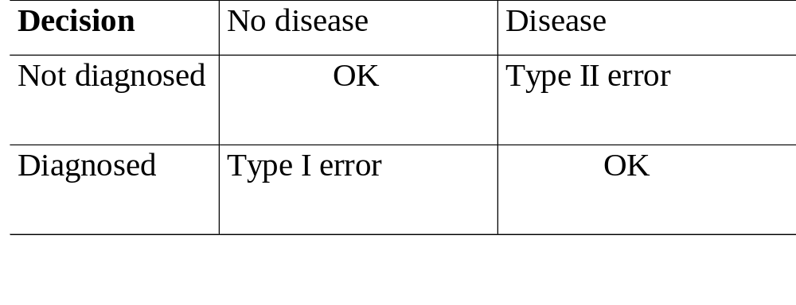
Testing of hypotheses
Type I and Type II Errors. Example.
irreparable damage would be done
treated but not harmed by the treatment
Decision: to avoid Type error II, have high level of significance

Slide 20
Testing of hypotheses
Confidence interval and significance test
Null hypothesis is accepted
A value for null hypothesis within the 95% CI
p-value > 0.05
Null hypothesis is rejected
A value for null hypothesis outside of 95% CI
p-value < 0.05

Slide 21
Parametric and nonparametric tests of significance
learning objectives:
        to distinguish parametric and nonparametric tests of significance
        to identify situations in which the use of parametric tests is appropriate
        to identify situations in which the use of nonparametric tests is appropriate

Slide 22
Parametric and nonparametric tests of significance
Parametric test of significance - to estimate at least one population parameter from sample statistics
Assumption: the variable we have measured in the sample is normally distributed in the population to which we plan to generalize our findings
Nonparametric test - distribution free, no assumption about the distribution of the variable in the population

Slide 23
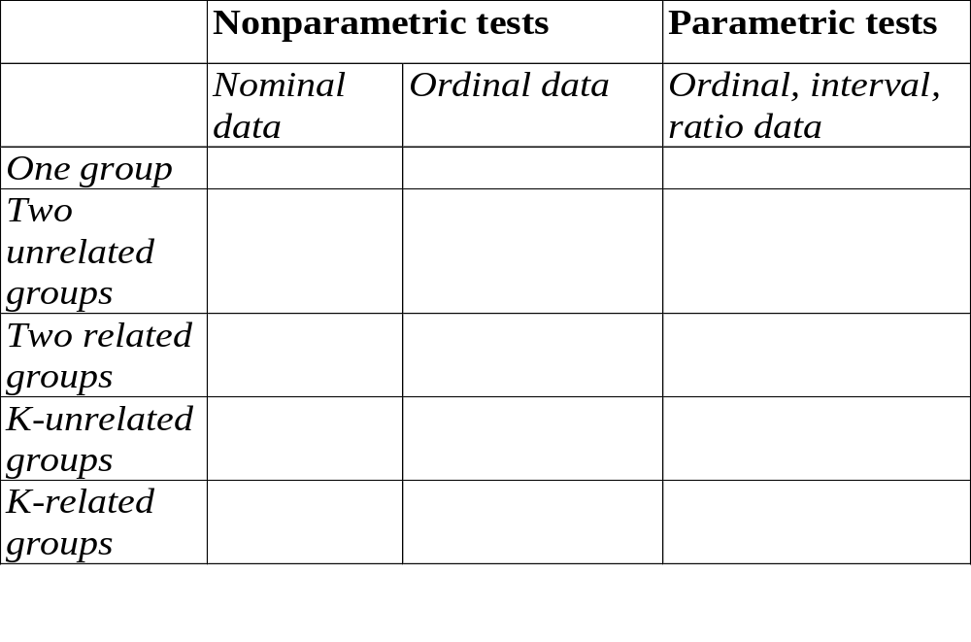
Parametric and nonparametric tests of significance

Slide 24
Some concepts related to the statistical methods.
Multiple comparison
two or more data sets, which should be analyzed
  repeated measurements made on the same individuals
  entirely independent samples

Slide 25
Some concepts related to the statistical methods.
Sample size
number of cases, on which data have been obtained
Which of the basic characteristics of a distribution are more sensitive to the sample size ?
central tendency (mean, median, mode)
variability (standard deviation, range, IQR)
skewness
kurtosis
mean
standard deviation
skewness
kurtosis

Slide 26
Some concepts related to the statistical methods.
Degrees of freedom
the number of scores, items, or other units in the data set, which are free to vary
One- and two tailed tests
one-tailed test of significance used for directional hypothesis
two-tailed tests in all other situations

Slide 27
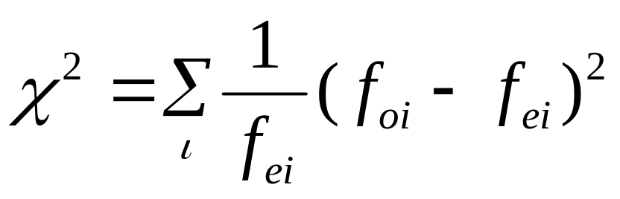
Selected nonparametric tests
Chi-Square goodness of fit test.
to determine whether a variable has a frequency distribution compariable to the one expected
expected frequency can be based on
  theory
  previous experience
  comparison groups

Slide 28
Selected nonparametric tests
Chi-Square goodness of fit test. Example
The average prognosis of total hip replacement in relation to pain reduction in hip joint is
exelent - 80%
good - 10%
medium - 5%
bad - 5%
In our study of we had got a different outcome
exelent - 95%
good - 2%
medium - 2%
bad - 1%
expected
observed
Does observed frequencies differ from expected ?

Slide 29
Selected nonparametric tests
Chi-Square goodness of fit test. Example
f_{e1}= 80, f_{e2}= 10, f_{e3}=5, f_{e4}= 5;
f_{o1}= 95, f_{o2}= 2, f_{o3}=2, f_{o4}= 1;
χ² > 3.841 p < 0.05
χ² > 6.635 p < 0.01
χ² > 10.83 p < 0.001
χ²= 14.2, df=3 (4-1)
0.0005 < p < 0.05
Null hypothesis is rejected at 5% level

Slide 30
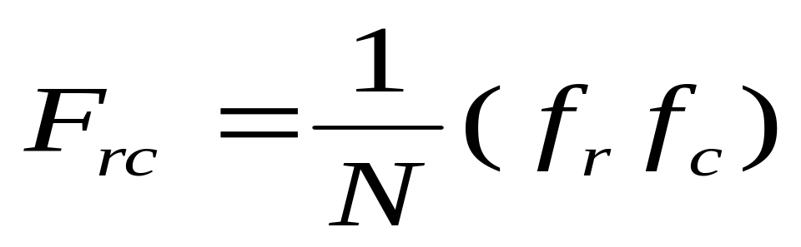
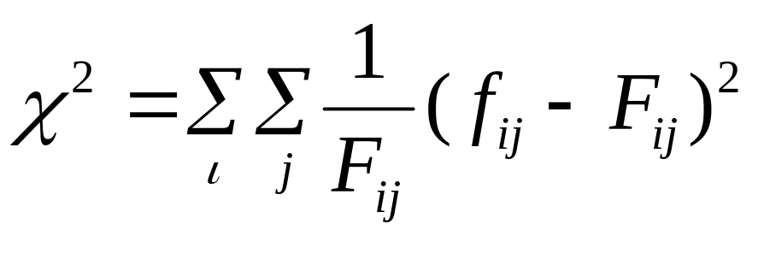
Selected nonparametric tests
Chi-Square test.
Chi-square statistic (test) is usually used with an R (row) by C (column) table.
Expected frequencies can be calculated:
then
df = (f_{r}-1) (f_{c}-1)

Slide 31
Selected nonparametric tests
Chi-Square test. Example
Question: whether men are treated more aggressively for cardiovascular problems than women?
Sample: people have similar results on initial testing
Response: whether or not a cardiac catheterization was recommended
Independent: sex of the patient

Slide 32
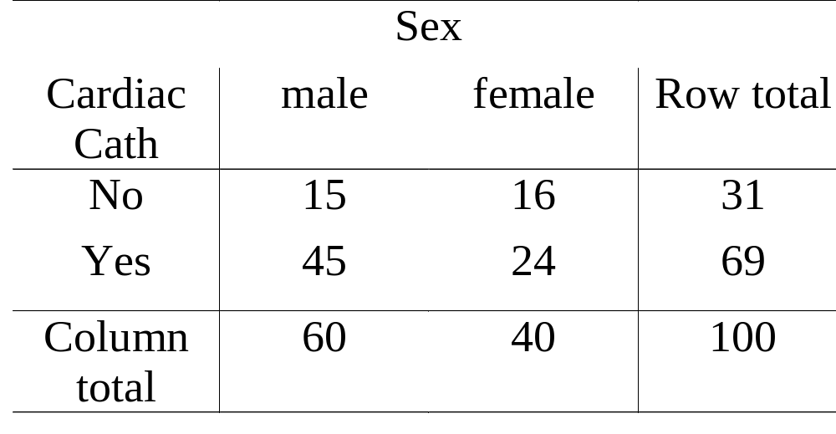
Selected nonparametric tests
Chi-Square test. Example
Result: observed frequencies

Slide 33
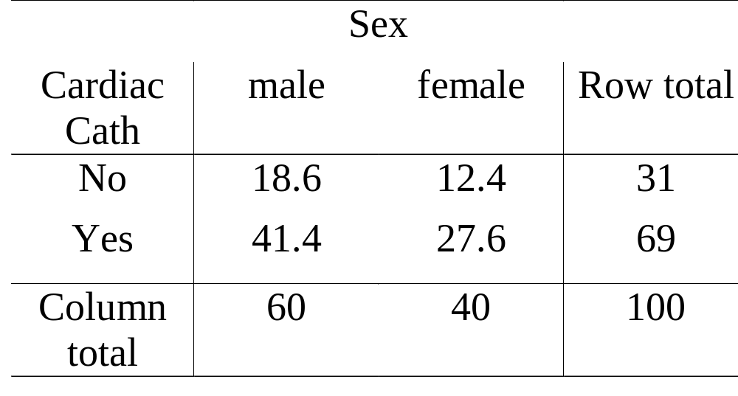
Selected nonparametric tests
Chi-Square test. Example
Result: expected frequencies

Slide 34
Selected nonparametric tests
Chi-Square test. Example
Result:
χ²= 2.52, df=1 (2-1) (2-1)
p > 0.05
Null hypothesis is accepted at 5% level
Conclusion: Recommendation for cardiac catheterization is not related to the sex of the patient

Slide 35
Selected nonparametric tests
Chi-Square test. Underlying assumptions.
Cannot be used to analyze differences in scores or their means
Frequency data
Adequate sample size
Expected frequencies should not be less than 5
Measures independent of each other
No subjects can be count more than once
Theoretical basis for the categorization of the variables
Categories should be defined prior to data collection and analysis

Slide 36
Selected nonparametric tests
Fisher’s exact test. McNemar test.
  For N x N design and very small sample size Fisher's exact test should be applied
  McNemar test can be used with two dichotomous measures on the same subjects (repeated measurements). It is used to measure change

Slide 37
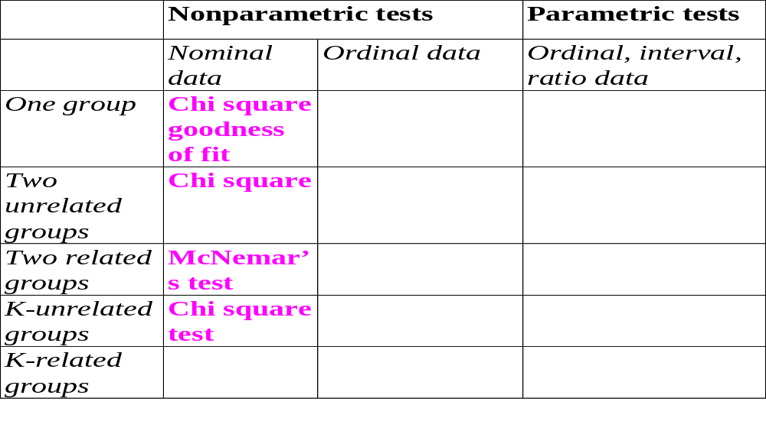
Parametric and nonparametric tests of significance

Slide 38
Selected nonparametric tests
Ordinal data independent groups.
Mann-Whitney U : used to compare two groups
Kruskal-Wallis H: used to compare two or more groups

Slide 39
Selected nonparametric tests
Ordinal data independent groups. Mann-Whitney test
Null hypothesis : Two sampled populations are equivalent in location
The observations from both groups are combined and ranked, with the average rank assigned in the case of ties.
If the populations are identical in location, the ranks should be randomly mixed between the two samples

Slide 40
Selected nonparametric tests
Ordinal data independent groups. Kruskal-Wallis test
k- groups comparison, k ≥ 2
Null hypothesis : k sampled populations are equivalent in location
The observations from all groups are combined and ranked, with the average rank assigned in the case of ties.
If the populations are identical in location, the ranks should be randomly mixed between the k samples

Slide 41
Selected nonparametric tests
Ordinal data related groups.
Wilcoxon matched-pairs signed rank test:
used to compare two related groups
Friedman matched samples:
used to compare two or more related groups

Slide 42
Selected nonparametric tests
Ordinal data 2 related groups Wilcoxon signed rank test
Two related variables. No assumptions about the shape of distributions of the variables.
Null hypothesis : Two variables have the same distribution
Takes into account information about the magnitude of differences within pairs and gives more weight to pairs that show large differences than to pairs that show small differences.
Based on the ranks of the absolute values of the differences between the two variables.

Slide 43
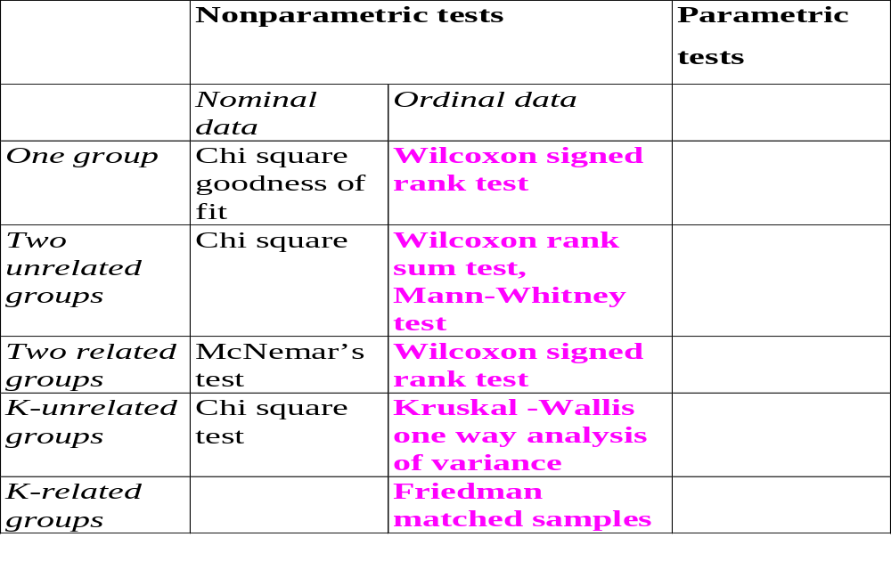
Parametric and nonparametric tests of significance

Slide 44
Selected parametric tests
One group t-test. Example
Comparison of sample mean with a population mean
It is known that the weight of young adult male has a mean value of 70.0 kg with a standard deviation of 4.0 kg.
Thus the population mean, µ= 70.0 and population standard deviation, σ= 4.0.
Data from random sample of 28 males of similar ages but with specific enzyme defect: mean body weight of 67.0 kg and the sample standard deviation of 4.2 kg.
Question: Whether the studed group have a significantly lower body weight than the general population?

Slide 45
Selected parametric tests
One group t-test. Example
population mean, µ= 70.0
population standard deviation, σ= 4.0.
sample size = 28
sample mean, ‾x = 67.0
sample standard deviation, s= 4.0.
Null hypothesis: There is no difference between sample mean and population mean.
t - statistic = 0.15, p >0.05
Null hypothesis is accepted at 5% level

Slide 46
Selected parametric tests
Two unrelated group, t-test. Example
Comparison of means from two unrelated groups
Study of the effects of anticonvulsant therapy on bone disease in the elderly.
Study design:
Samples: group of treated patients (n=55)
group of untreated patients (n=47)
Outcome measure: serum calcium concentration
Research question: Whether the groups statistically significantly differ in mean serum consentration?
Test of significance: Pooled t-test

Slide 47
Selected parametric tests
Two unrelated group, t-test. Example
Comparison of means from two unrelated groups
Study of the effects of anticonvulsant therapy on bone disease in the elderly.
Study design:
Samples: group of treated patients (n=20)
group of untreated patients (n=27)
Outcome measure: serum calcium concentration
Research question: Whether the groups statistically significantly differ in mean serum consentration?
Test of significance: Separate t-test

Slide 48
Selected parametric tests
Two related group, paired t-test. Example
Comparison of means from two related variabless
Study of the effects of anticonvulsant therapy on bone disease in the elderly.
Study design:
Sample: group of treated patients (n=40)
Outcome measure: serum calcium concentration before and after operation
Research question: Whether the mean serum consentration statistically significantly differ before and after operation?
Test of significance: paired t-test

Slide 49
Selected parametric tests
k unrelated group, one -way ANOVA test. Example
Comparison of means from k unrelated groups
Study of the effects of two different drugs (A and B) on weight reduction.
Study design:
Samples: group of patients treated with drug A (n=32)
group of patientstreated with drug B (n=35)
control group (n=40)
Outcome measure: weight reduction
Research question: Whether the groups statistically significantly differ in mean weight reduction?
Test of significance: one-way ANOVA test

Slide 50
Selected parametric tests
k unrelated group, one -way ANOVA test. Example
The group means compared with the overall mean of the sample
Visual examination of the individual group means may yield no clear answer about which of the means are different
Additionally post-hoc tests can be used (Scheffe or Bonferroni)

Slide 51
Selected parametric tests
k related group, two -way ANOVA test. Example
Comparison of means for k related variables
Study of the effects of drugs A on weight reduction.
Study design:
Samples: group of patients treated with drug A (n=35)
control group (n=40)
Outcome measure: weight in Time 1 (before using drug) and Time 2 (after using drug)

Slide 52
Selected parametric tests
k related group, two -way ANOVA test. Example
Research questions:
  Whether the weight of the persons statistically
  significantly changed over time?
Time effect
  Whether the weight of the persons
  statistically significantly differ between the
  groups?
Group difference
  Whether the weight of the persons used
  drug A statistically significantly redused
  compare to control group?
Drug effect
Test of significance: ANOVA with repeated measurementtest

Slide 53
Selected parametric tests
Underlying assumptions.
Cannot be used to analyze frequency
interval or ratio data
Adequate sample size
Sample size big enough to avoid skweness
Measures independent of each other
No subjects can be belong to more than one group
Homoginity of group variances
Equality of group variances

Slide 54
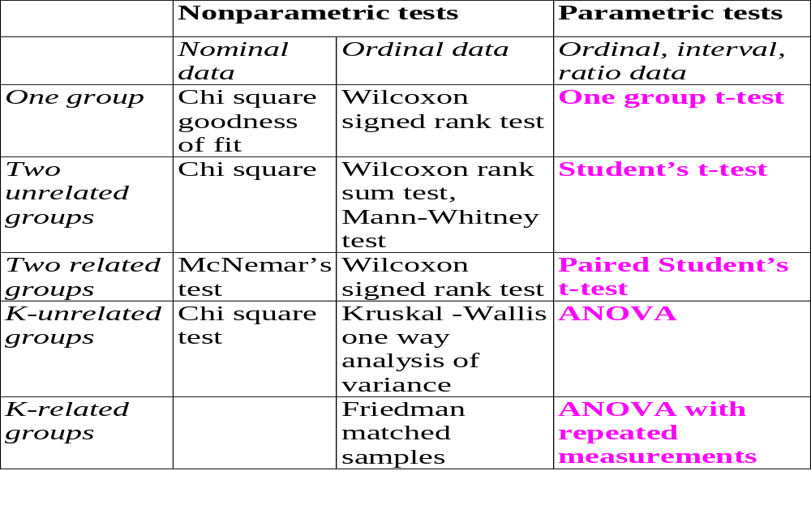
Parametric and nonparametric tests of significance

