Slide 1
BASEL II: Credit Risk Model
Martin KUBÍČEK

Slide 2
Agenda
Data Description
Logistic Regression
Rating Classes Calibration
Validation
Conclusion
Future Research

Slide 3
Data
Data Source: CreditReform
Solvency Index
Data from 1998 - 2004
Necessary Data Cleaning
16 363 Companies
53 489 Observations (CompanyYears)
Default Definition
Default rate: 3.8%
Modeling 1 Year Probability of Default
Modeling Matrix

Slide 4
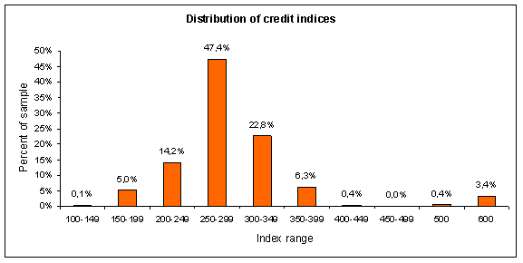
Data
Default if CRFO > 499

Slide 5
Agenda
Data Description
Logistic Regression
Rating Classes Calibration
Validation
Conclusion
Future Research

Slide 6


Logistic Regression
Generalized Linear Model with Logit as a link function
Dependent variable assumes only two states
1 – Default
0 – Non-Default
Modeling the conditional probability that firm i defaults and vice versa

Slide 7



Logistic Regression
The odds that firm i defaults:
Score:
Probability of Default:
Estimated by Maximum Likelihood method

Slide 8
Logistic Regression - Results
Regression Equation:
Results:
Check of Assumptions:
Davidson and MacKinnon test
Robustness/Homoskedasticity
Box-Tidwell test
Linearity
Hosmer-Lemeshow test
Goodness-of-Fit

Slide 9
Logistic Regression Hosmer-Lemeshow test

Slide 10
Agenda
Data Description
Logistic Regression
Rating Classes Calibration
Validation
Conclusion
Future Research

Slide 11
Rating Classes Calibration
Group companies into rating classes
Two calibrations explored
Uniform distribution of firms in rating classes
Linear increase in number of defaults
Calculate PD for particular rating class
Two possible approaches
Average expected PD of all firms within the rating class
Default rate / Cohort Approach

Slide 12
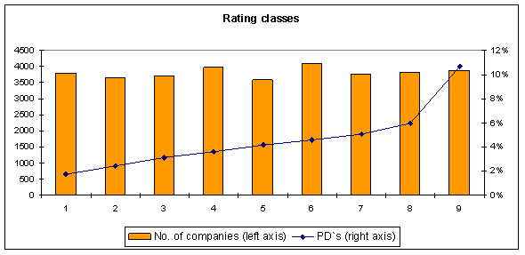
Rating Classes Calibration Uniform distribution

Slide 13
Rating Classes Calibration Uniform distribution

Slide 14
Rating Classes Calibration Linear increase

Slide 15
Rating Classes Calibration Linear increase

Slide 16
Agenda
Data Description
Logistic Regression
Rating Classes Calibration
Validation
Conclusion
Future Research

Slide 17
Validation
Two dimensions of model quality
Model power
Model calibration

Slide 18
Validation Model Power
Measures model’s discriminative power between defaulting and non-defaulting borrowers
Measures used
Cumulative Accuracy Profile (CAP) curve and Gini coefficient
Receiving Operating Characteristics (ROC) and Area Under Curve (AUC)
Kolmogorov-Smirnov (K-S) statistics

Slide 19

Validation Model Power – CAP and Gini
AR = 0 for a random model
AR = 1 for a perfect model
Source: BCBS (2005b)

Slide 20
Validation Model Power – CAP and Gini
AR = 39.11%

Slide 21
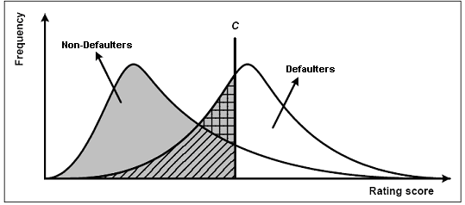
Validation Model Power – ROC and AUC
Source: BCBS (2005b)

Slide 22
Validation Model Power – ROC and AUC
H(C) the number of defaulters classified correctly for a given threshold C
N_{D} the total number of defaulters in the sample
F(C) the number of false alarms
N_{ND} the total number of non defaulters in the sample

Slide 23

Validation Model Power – ROC and AUC
AUC = 0.5 for a random model
AUC = 1 for a perfect model
Source: BCBS (2005b)

Slide 24
Validation Model Power – ROC and AUC
AUC = 63.96%

Slide 25
Validation Model Power – K-S statistics
K-S: 20%

Slide 26
Validation Model Calibration
Measures how well model predictions of PD are in line with actual outcomes
Measures used
Binomial Test
Hosmer-Lemeshow Test

Slide 27
Validation Model Calibration – Binomial test
H₀: PD of a rating class is correct
H₁: PD of a rating class is underestimated
H₀ is rejected if the number of historical defaults k in particular rating category is greater than or equal to a critical value c
i = 1,…,9 represents the rating classes, n_{i} stands for the number of obligors in category i, PD_{i} is the probability of default of class i and is the inverse of standard normal distribution function

Slide 28
Validation Model Calibration – Binomial test

Slide 29

Validation Model Calibration – Hosmer-Lemeshow Test
Test statistics
k = 9 (number of rating classes), n_{i} = number of companies in rating class i, D_{i} is the number of defaulted obligors in class i, p_{i} is the forecasted probability of default for rating class i
Compare with p-value of -test
No critical value of p that could be used to determine whether the estimated PD’s are correct or not
The closer the p-value is to zero the worse the estimation is

Slide 30
Validation Model Calibration – Hosmer-Lemeshow Test
Results
Conclusion:
Uniform distribution model is superior

Slide 31
Agenda
Data Description
Logistic Regression
Rating Classes Calibration
Validation
Conclusion
Future Research

Slide 32
Conclusion
Advantages:
Large set of companies
High number of defaults
No selection Bias
Disadvantages:
Solvency Index

Slide 33
Agenda
Data Description
Logistic Regression
Rating Classes Calibration
Validation
Conclusion
Future Research

Slide 34
Future Research
Financial Ratios approach
Another modeling techniques
Decision Trees
Neural Networks
Variable Classing
Out-of-Sample, Out-of-Time Validation

