Slide 1

Python for Customer Analytics
Deepak Mishra

Slide 2
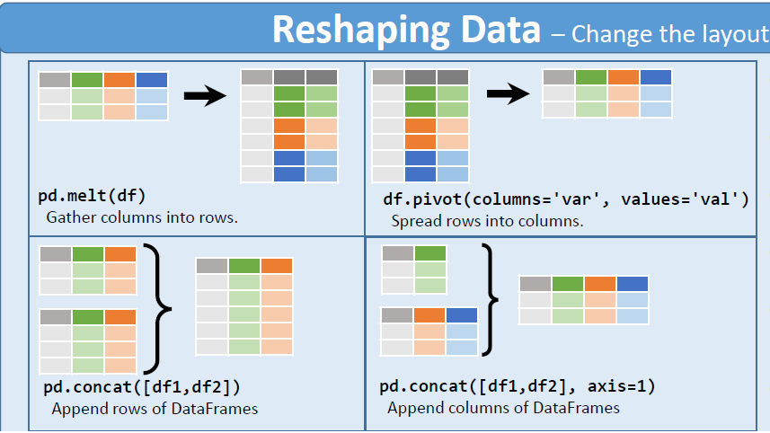
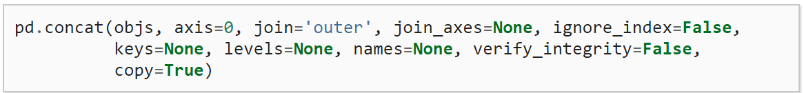
Reshape and Combine

Slide 3
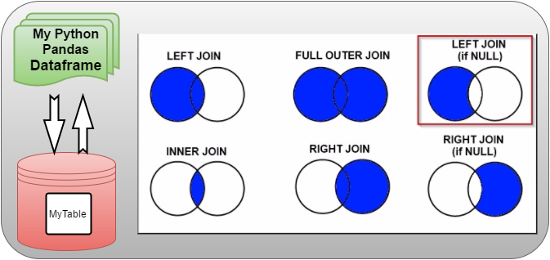
Joining or Merging dataframes

Slide 4
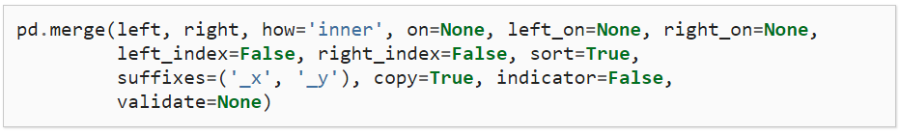
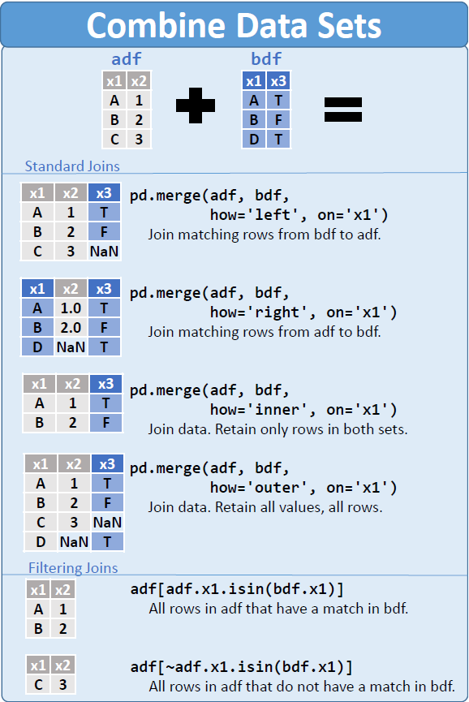
Merging datasets
Merge function arguments
Argument | Description
left | DataFrame to be merged on the left side.
right | DataFrame to be merged on the right side.
how | One of 'inner', 'outer', 'left', or 'right'; defaults to 'inner'.
on | Column names to join on. Must be found in both DataFrame objects. If not specified and no other join keys given, will use the intersection of the column names in left and right as the join keys.
left_on | Columns in left DataFrame to use as join keys.
right_on | Analogous to left_on for left DataFrame.
left_index | Use row index in left as its join key (or keys, if a MultiIndex).
right_index | Analogous to left_index.
sort | Sort merged data lexicographically by join keys; True by default (disable to get better performance in some cases on large datasets).
suffixes | Tuple of string values to append to column names in case of overlap; defaults to ('_x', '_y')(e.g., if 'data' in both DataFrame objects, would appear as 'data_x' and 'data_y' in result).
copy | If False, avoid copying data into resulting data structure in some exceptional cases; by default always copies.
indicator | Adds a special column _merge that indicates the source of each row; values will be 'left_only', 'right_only', or 'both' based on the origin of the joined data in each row.

Slide 5
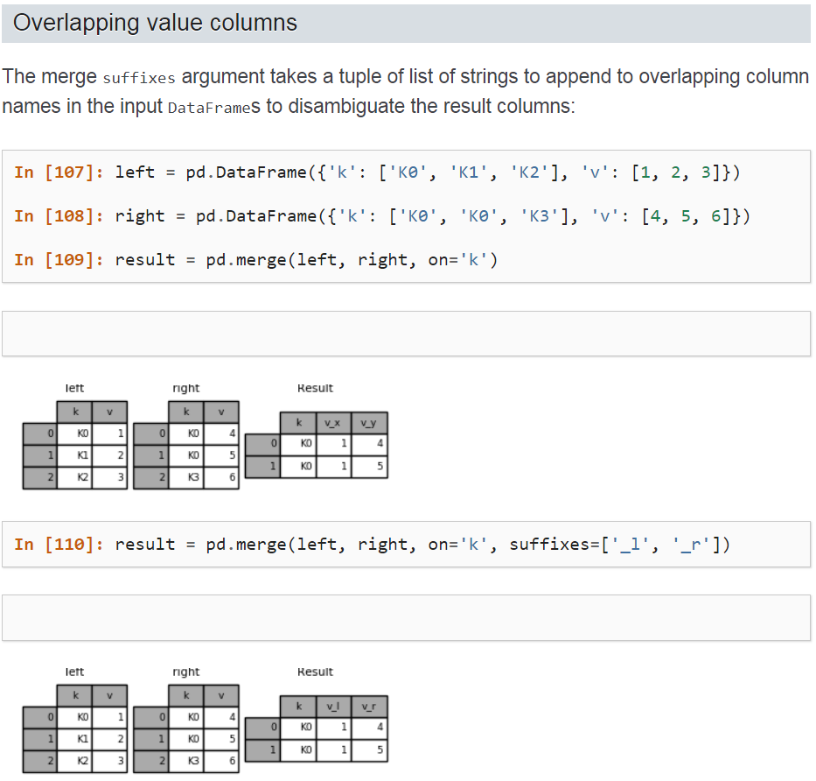
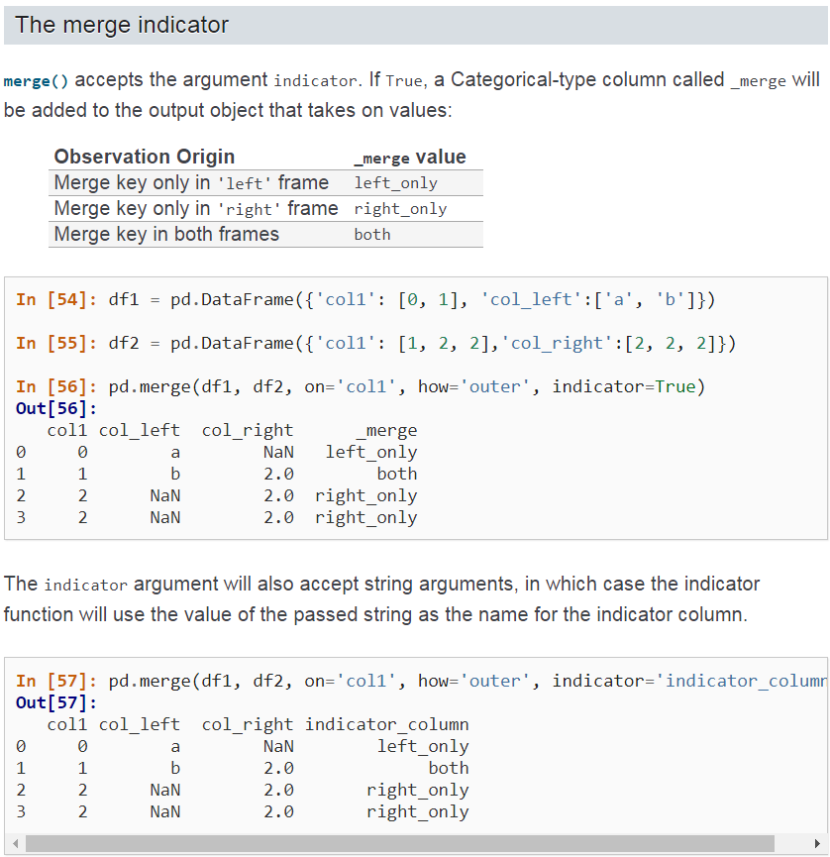

Slide 6
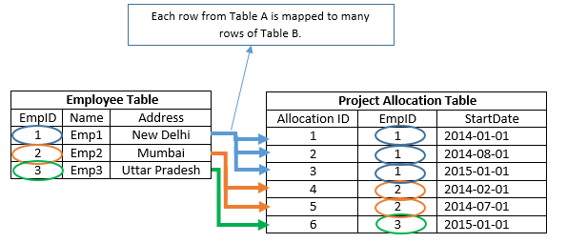
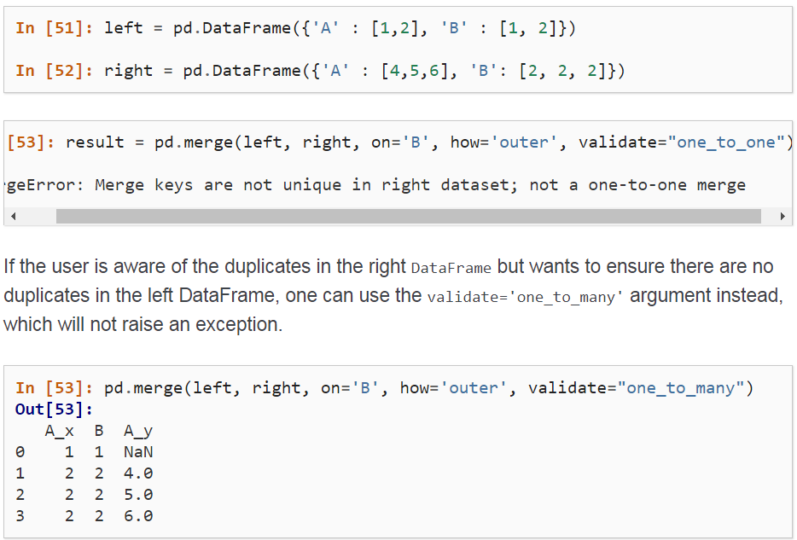
Merge Validate option for *:* matching
df1 |  |  | df2 |  |  | pd.merge(df1, df2, on='key', how='left')
data1 | key |  | data2 | key |  | data1 | key | data2
2 | a |  | 0 | a |  | 2 | a | 0
4 | a |  | 2 | a |  | 2 | a | 2
0 | b |  | 1 | b |  | 4 | a | 0
1 | b |  | 3 | b |  | 4 | a | 2
5 | b |  | 4 | d |  | 0 | b | 1
3 | c |  |  |  |  | 0 | b | 3
 |  |  |  |  |  | 1 | b | 1
 |  |  |  |  |  | 1 | b | 3
 |  |  |  |  |  | 5 | b | 1
 |  |  |  |  |  | 5 | b | 3
 |  |  |  |  |  | 3 | c | NaN

Slide 7
APPENDIX
Edit presentation title on Slide Master using Insert > Header & Footer

Slide 8
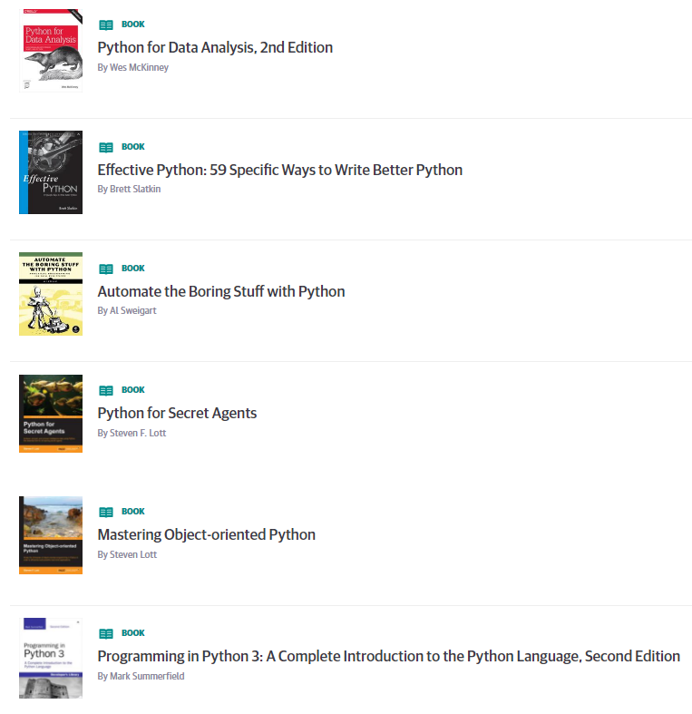
Learning Resources
Books on Safari online (free to use)
https://www.safaribooksonline.com/playlists/dce9eb9c-ceff-4dce-beec-41239c49527d
Internal
Python Series by Zoltan, all recordings on hub
Series 1 https://thehub.thomsonreuters.com/message/443702
Series 2 https://thehub.thomsonreuters.com/thread/163911
Many courses available on Courseera.org
A gallery of interesting Jupyter Notebooks
https://github.com/jupyter/jupyter/wiki/A-gallery-of-interesting-Jupyter-Notebooks
https://www.dataquest.io/blog/jupyter-notebook-tips-tricks-shortcuts/

