Slide 1

Python for Customer Analytics
Deepak Mishra

Slide 2
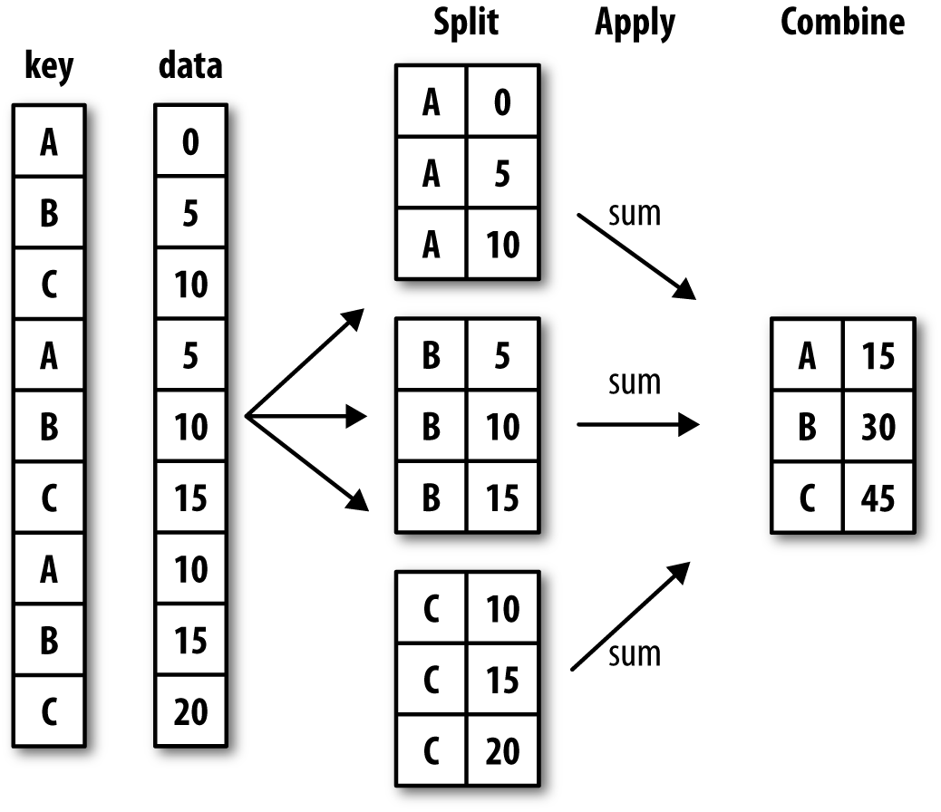
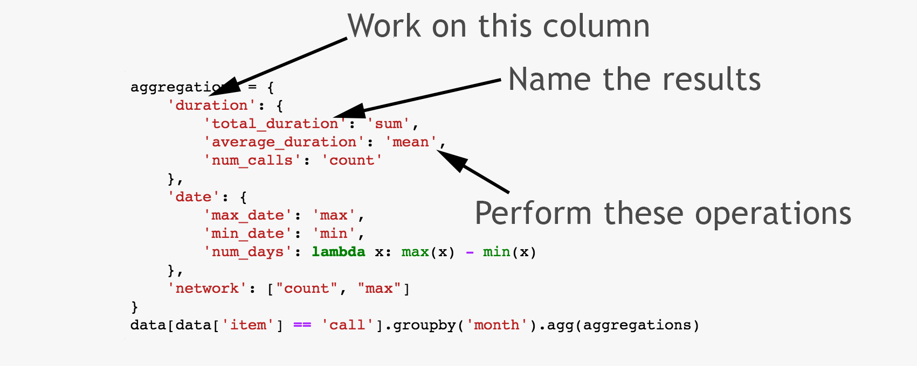
Data Frames groupby method
Using "group by" method we can:
Split the data into groups based on some criteria
Calculate statistics (or apply a function) to each group
Data Frame can be grouped along rows and columns

Slide 3
Data Frames groupby method
groupby performance notes:
No grouping/splitting occurs until it's needed. Creating the groupby object only verifies that you have passed a valid mapping
By default the group keys are sorted during the groupby operation. You may want to pass sort=False for potential speedup:
In [ ]:
#Calculate mean salary for each professor rank:
df.groupby(['rank'], sort=False)[['salary']].mean()

Slide 4
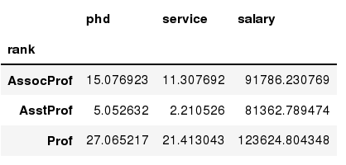
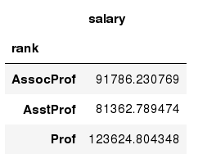
Data Frames groupby method
In [ ]:
#Group data using rank
df_rank = df.groupby(['rank'])
In [ ]:
#Calculate mean value for each numeric column per each group
df_rank.mean()
In [ ]:
#Calculate mean salary for each professor rank:
df.groupby('rank')[['salary']].mean()
Note: If single brackets are used to specify the column (e.g. salary), then the output is Pandas Series object. When double brackets are used the output is a Data Frame

Slide 5
Aggregation Functions in Pandas
Aggregation - computing a summary statistic about each group, i.e.
compute group sums or means
compute group sizes/counts
Common aggregation functions:
min, max
count, sum, prod
mean, median, mode, mad
std, var

Slide 6
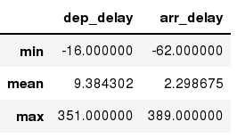
Aggregation Functions in Pandas
agg() method are useful when multiple statistics are computed per column:
In [ ]:
flights[['dep_delay','arr_delay']].agg(['min','mean','max'])
Out[ ]:

Slide 7
Basic Descriptive Statistics
df.method() | description
describe | Basic statistics (count, mean, std, min, quantiles, max)
min, max | Minimum and maximum values
mean, median, mode | Arithmetic average, median and mode
var, std | Variance and standard deviation
sem | Standard error of mean
skew | Sample skewness
kurt | kurtosis

Slide 8
Pivot Tables for Data Aggregation
df.pivot_table('tip_pct', index=['time', 'size', 'smoker'], .....: columns='day', aggfunc='mean', fill_value=0)
Function name | Description
values | Column name or names to aggregate; by default aggregates all numeric columns
index | Column names or other group keys to group on the rows of the resulting pivot table
columns | Column names or other group keys to group on the columns of the resulting pivot table
aggfunc | Aggregation function or list of functions ('mean' by default); can be any function valid in a groupby context
fill_value | Replace missing values in result table
dropna | If True, do not include columns whose entries are all NA
margins | Add row/column subtotals and grand total (False by default)

Slide 9
APPENDIX
Edit presentation title on Slide Master using Insert > Header & Footer

Slide 10

Learning Resources
Books on Safari online (free to use)
https://www.safaribooksonline.com/playlists/dce9eb9c-ceff-4dce-beec-41239c49527d
Internal
Python Series by Zoltan, all recordings on hub
Series 1 https://thehub.thomsonreuters.com/message/443702
Series 2 https://thehub.thomsonreuters.com/thread/163911
Many courses available on Courseera.org
A gallery of interesting Jupyter Notebooks
https://github.com/jupyter/jupyter/wiki/A-gallery-of-interesting-Jupyter-Notebooks
https://www.dataquest.io/blog/jupyter-notebook-tips-tricks-shortcuts/

