Slide 1

Python for Customer Analytics
Deepak Mishra

Slide 2
Regression
Regression is a common terminology used for establishing a relationship between dependent and independent variables
There are various techniques of regression and the user must be careful in selection of the best suited method for each scenario
Most commonly used methods other than failure-time models are :
Logistic – Modeling of events which are discrete in nature like Yes, No, Maybe or like/dislike or paid the bill, not paid the bill
Linear – Modeling of continuous variables like electricity bill, amount financed etc.
Mixed – Modeling of events where the fixed effects and random effects are significant and present
Non-Linear – Modeling of parameter estimates of a defined framework
Other forms are quite similar in nature to one of these and are uncommon

Slide 3
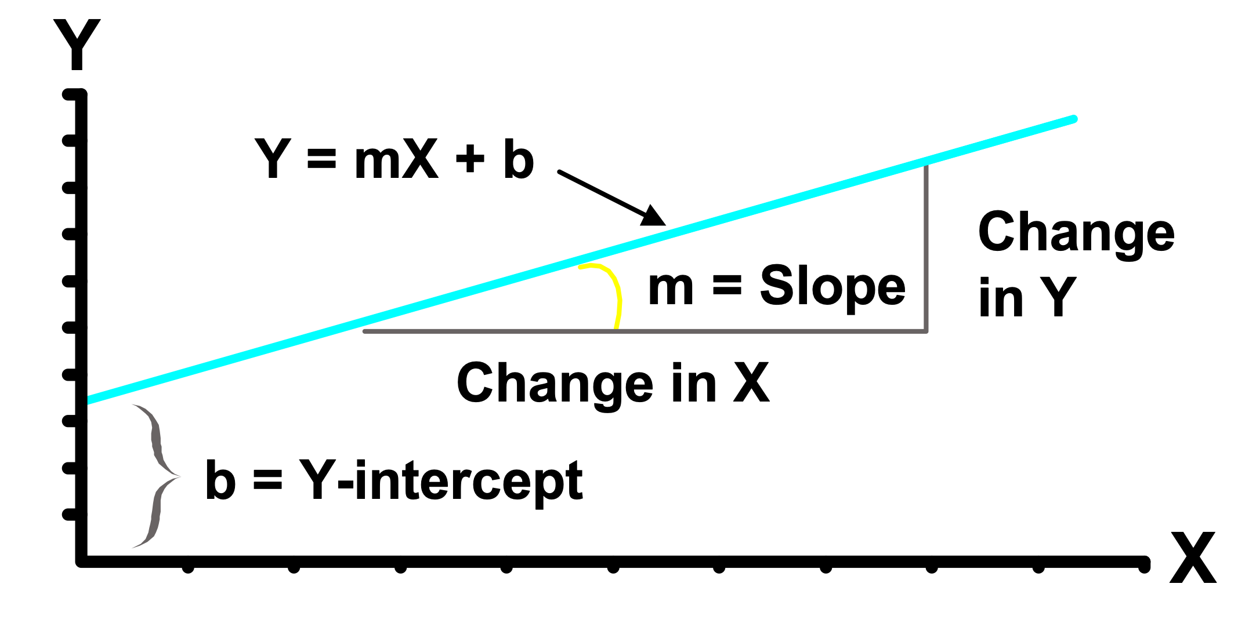
LINEAR REGRESSION
This regression methods attempts to model the probability of an event by fitting data to a linear curve
Linear regression models are often fitted using the least squares approach, but they may also be fitted in other ways, such as by minimizing the "lack of fit" in some other norm, or by minimizing a penalized version of the least squares loss function as in ridge regression
Certain assumptions in regards to independent variable distribution, error distribution need to be fulfilled in order to have a significant result
Linear Regression for a single independent variable.
Population Y-Intercept
Population Slope
Y
=
b
+
b
X
+
e
i
0
1
i
i
Random Error
Dependent (Response) Variable (e.g., $Cancels, )
Independent (Explanatory) Variable (e.g., Years as customer, Usage)

Slide 4
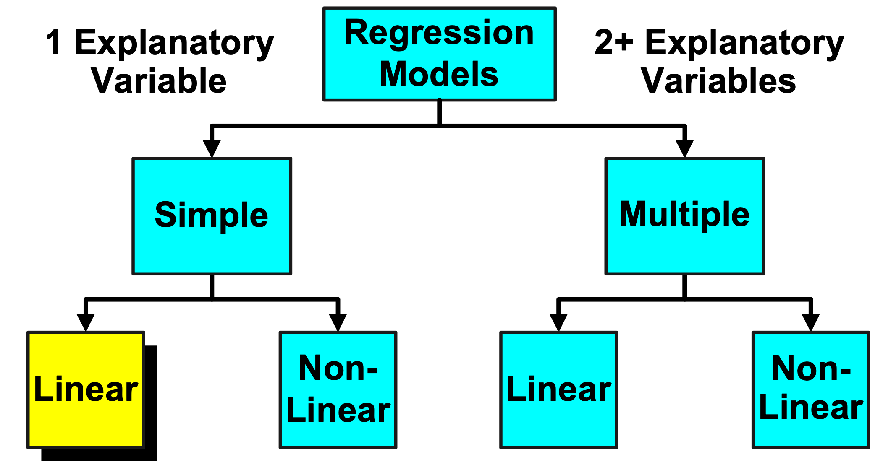
Types of Regression Models

Slide 5
Scatter plot
1. Plot of All (X_{i}, Y_{i}) Pairs
2. Suggests How Well Model Will Fit
Y
60
40
20
0
X
0
20
40
60

Slide 6
Thinking Challenge
How would you draw a line through the points?
How do you determine which line ‘fits best’?
Y
60
40
20
0
X
0
20
40
60

Slide 7
Thinking Challenge
How would you draw a line through the points? How do you determine which line ‘fits best’?
Slope changed
Y
60
40
20
0
X
0
20
40
60
Intercept unchanged

Slide 8
Thinking Challenge
How would you draw a line through the points? How do you determine which line ‘fits best’?
Slope unchanged
Y
60
40
20
0
X
0
20
40
60
Intercept changed

Slide 9
Thinking Challenge
How would you draw a line through the points? How do you determine which line ‘fits best’?
Slope changed
Y
60
40
20
0
X
0
20
40
60
Intercept changed

Slide 10
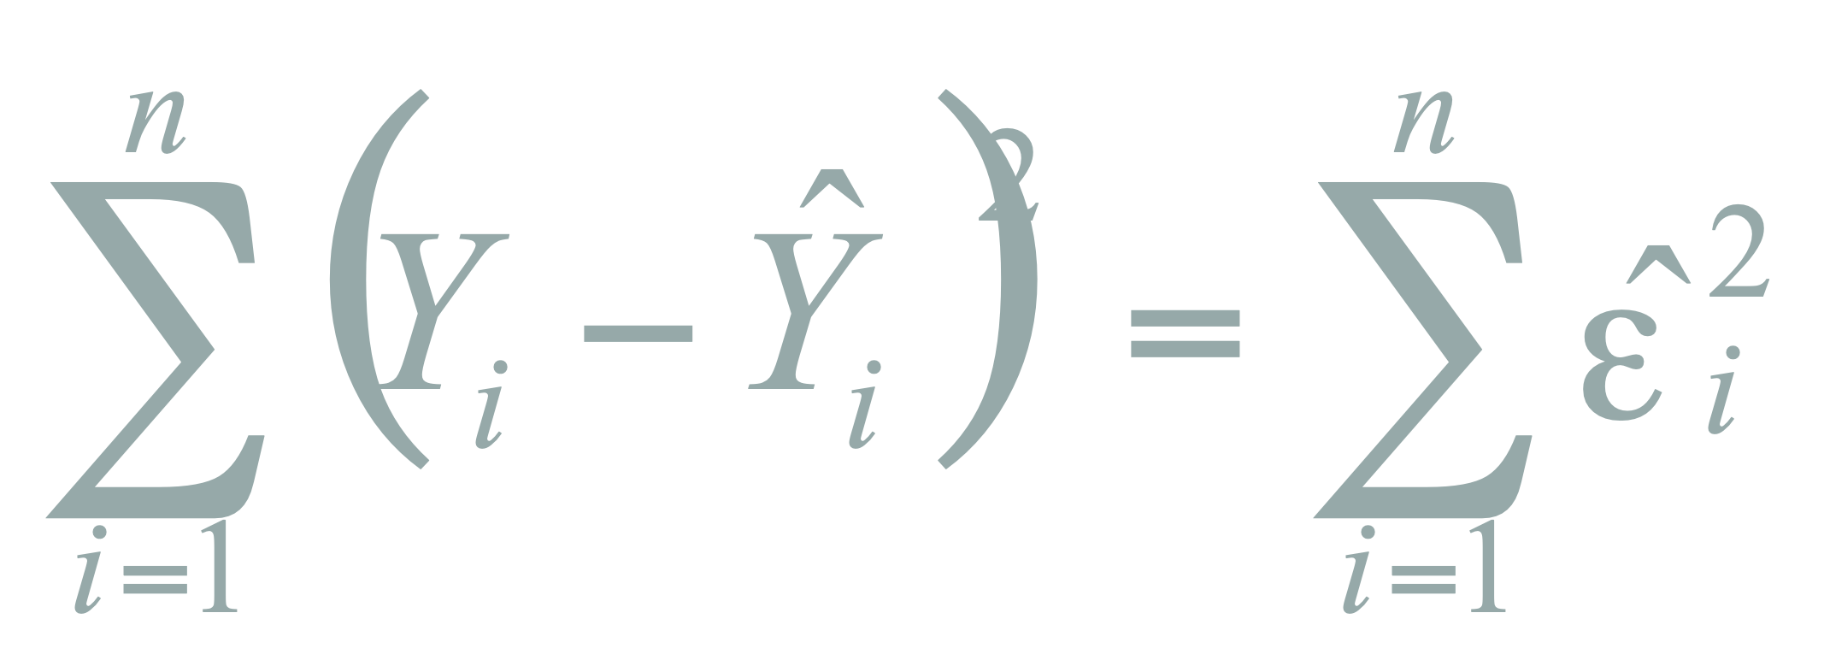
Least Squares
‘Best Fit’ Means Difference Between Actual Y Values & Predicted Y Values Are a Minimum.
But Positive Differences Off-Set Negative. So square errors!
Squaring magnifies the error and hence easy to compare
E1 = e1+e2= 5+ (-5)=0 ; E1abs = |e1|+|e2|= |5|+ |-5|=10 ; E1sq = 5^2+(-5)^2= 25+25=50
E2 = E1 = e3+e4= 9+ (-1)=8 ; E1abs = |e3|+|e4|= |9|+ |-1|=10 ; E1sq = 9^2+(-1)^2= 81+1=82
LS Minimizes the Sum of the Squared Differences (errors) (SSE)
Y
60
e3=9
e1=5
40
e2=-5
20
e4=-1
0
X
0
20
40
60

Slide 11
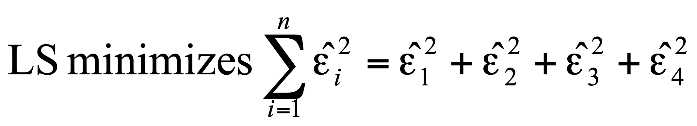
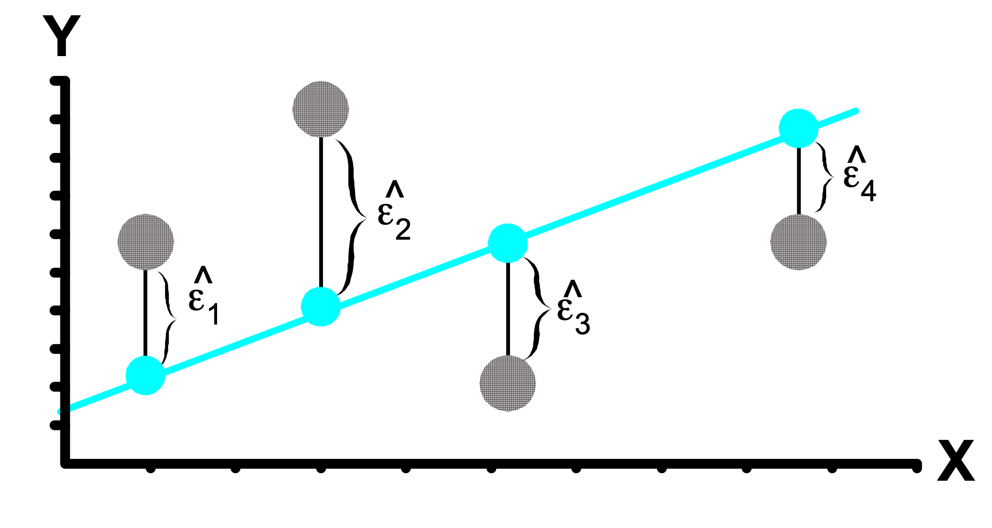
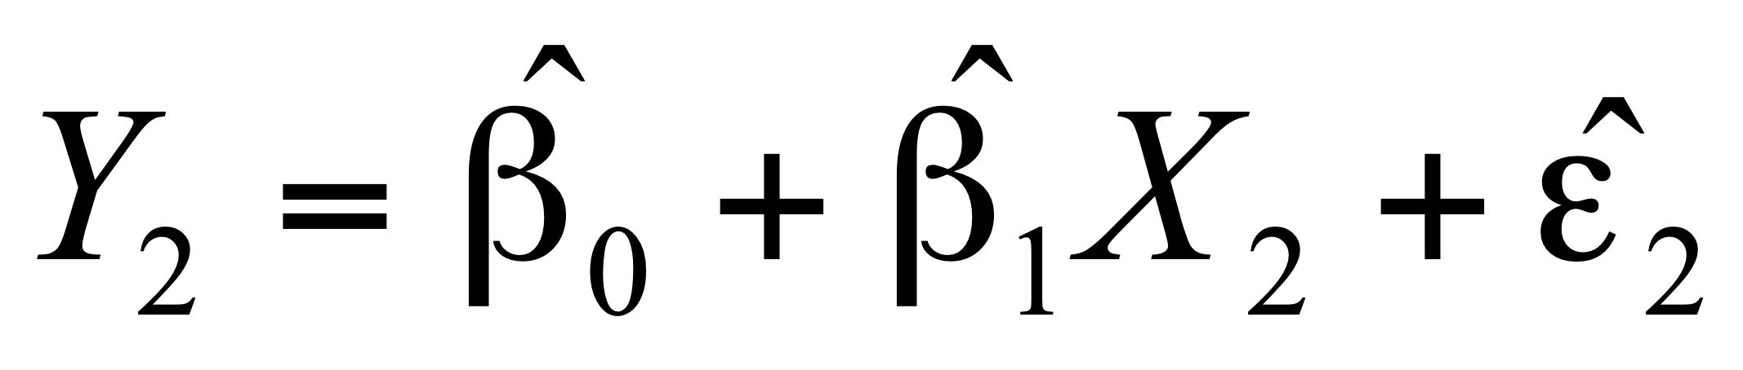
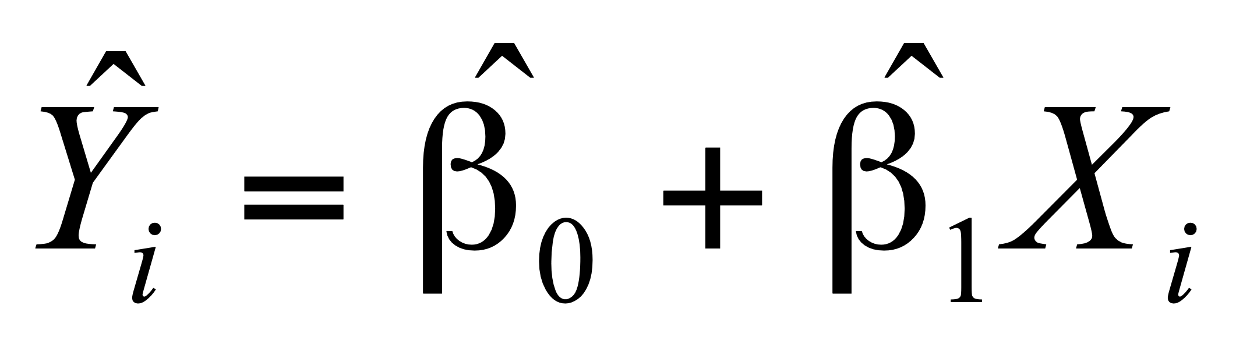
Least Squares Graphically

Slide 12
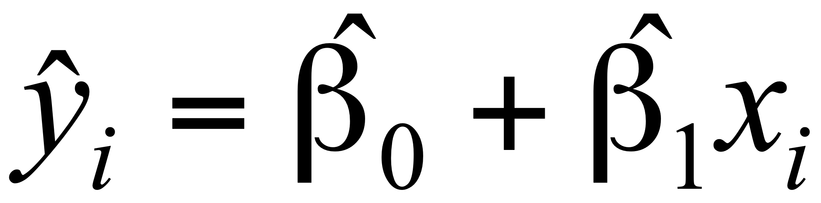
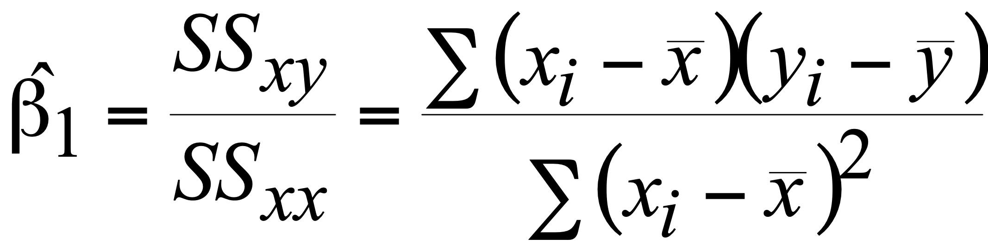
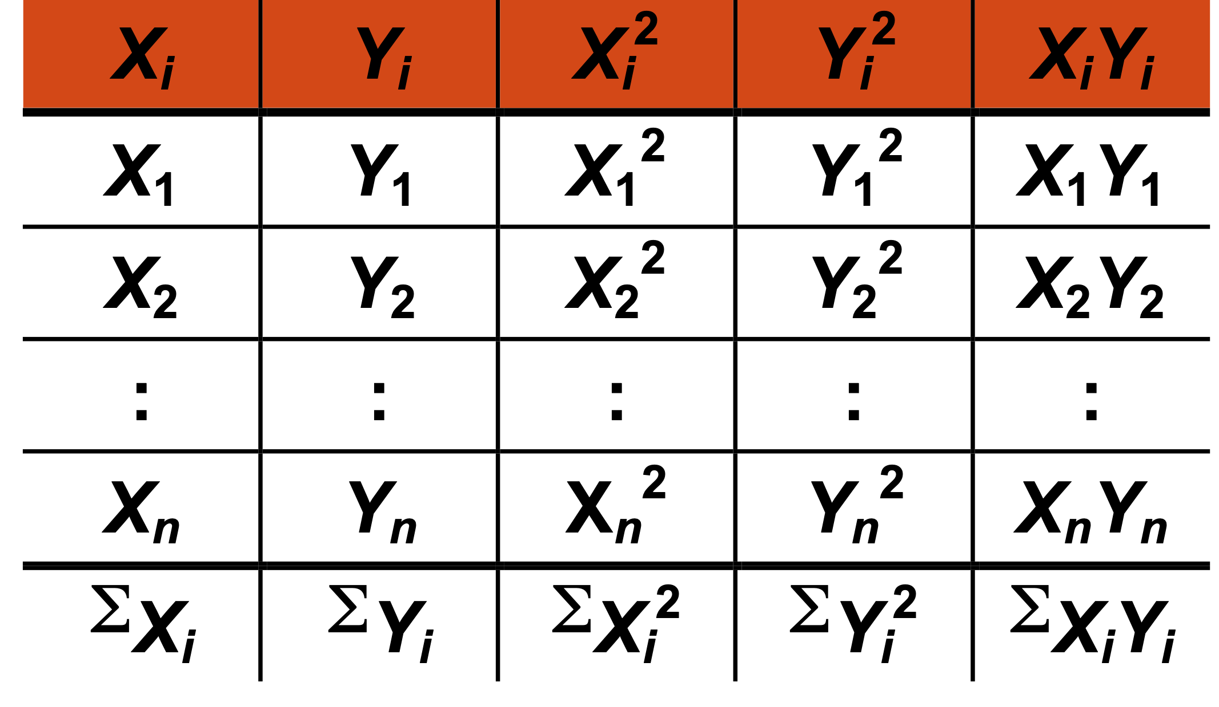
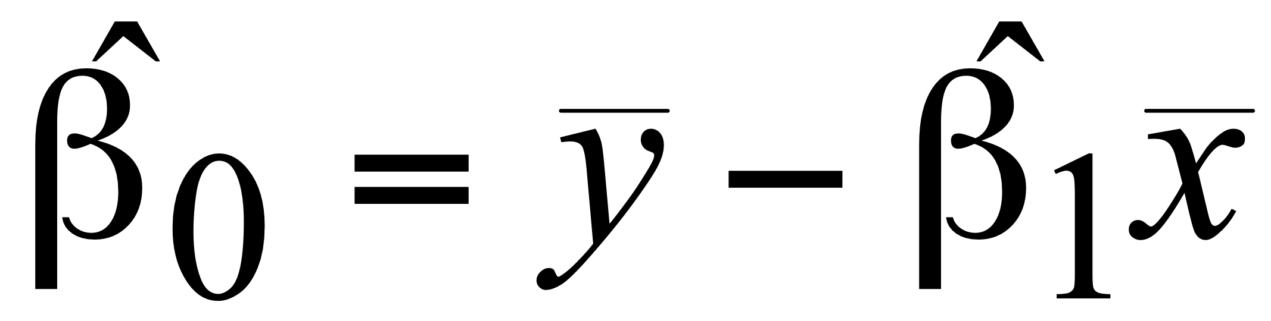
Building the Model : Calculating the Equation
Prediction equation
Sample slope
Sample Y - intercept
Computation Table

Slide 13
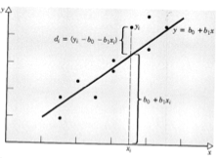
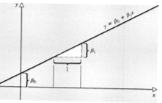
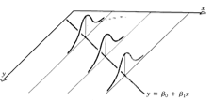

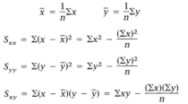


Least Square Estimation

Slide 14

Parameter Estimation Thinking Challenge
You’re a Vet epidemiologist for the county cooperative.
You gather the following data:
Food (lb.) Milk yield (lb.) 4 3.0 6 5.5 10 6.5 12 9.0
What is the relationship between cows’ food intake and milk yield?
M. Yield (lb.)
Food intake (lb.)

Slide 15
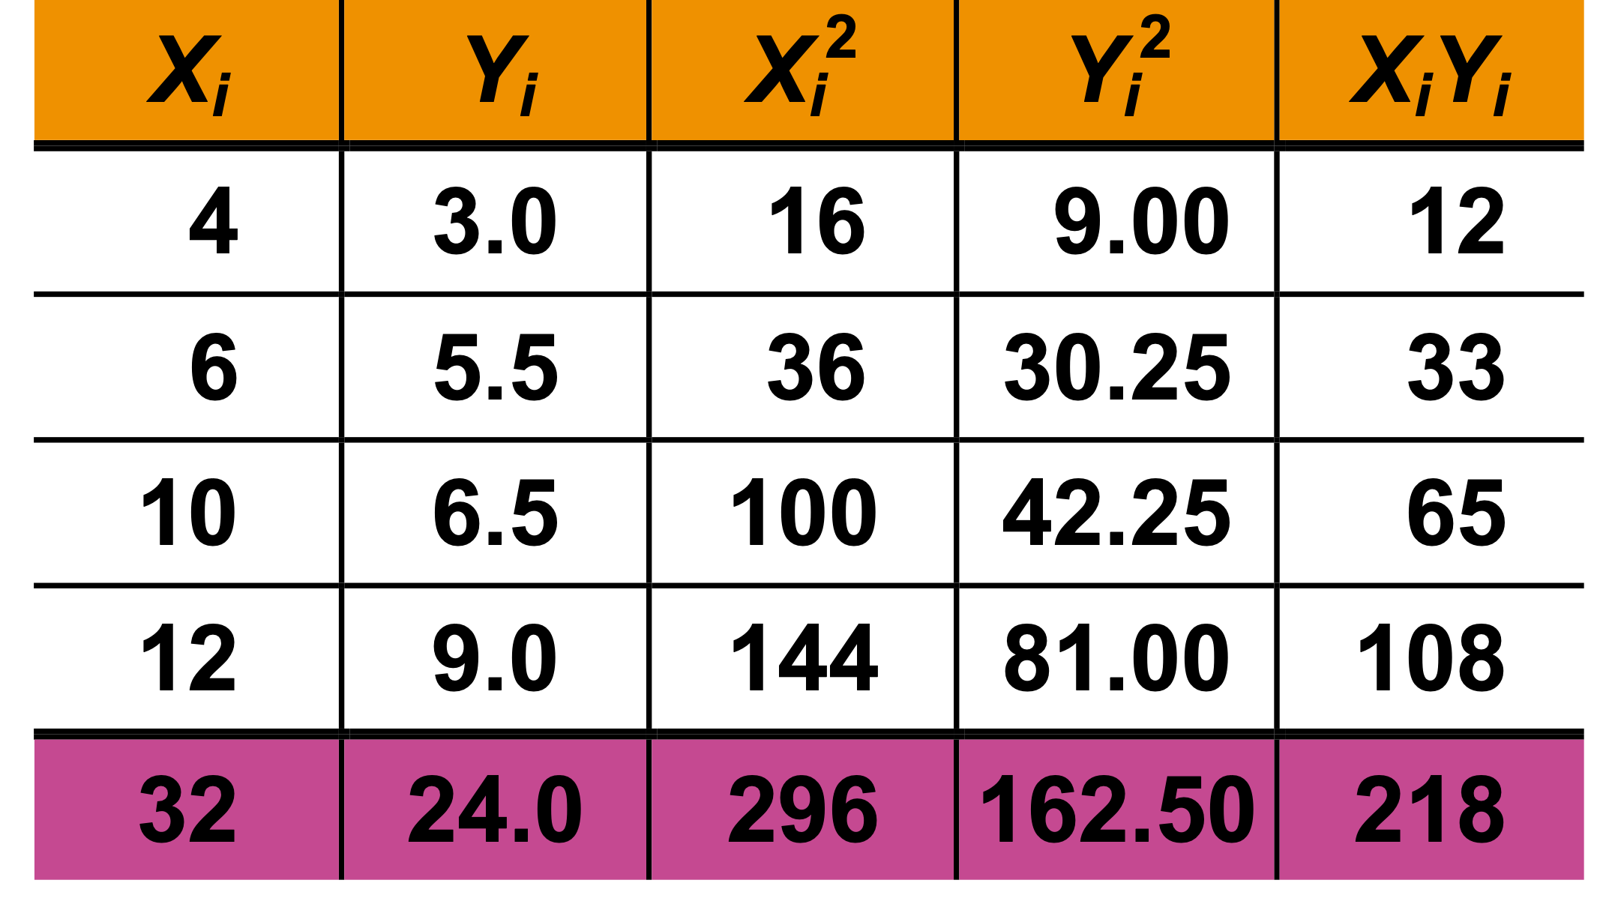
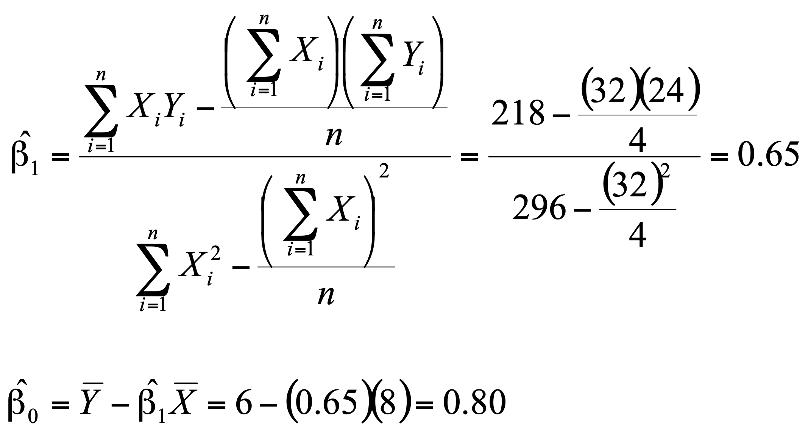
Parameter Estimation Solution

Slide 16
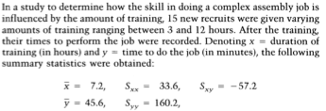

Example OLS

Slide 17

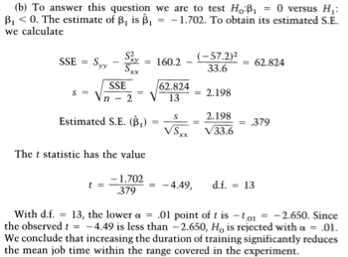

Slide 18




Slide 19
H2o GLM options
glm(x, y, training_frame, model_id = NULL, validation_frame = NULL , nfolds = 0, seed = -1, keep_cross_validation_predictions = FALSE, keep_cross_validation_fold_assignment = FALSE, fold_assignment = c("AUTO", "Random", "Modulo", "Stratified"), fold_column = NULL
, ignore_const_cols = TRUE, score_each_iteration = FALSE
, offset_column = NULL, weights_column = NULL
, family = c("gaussian", "binomial", "quasibinomial", "ordinal", "multinomial", "poisson", "gamma", "tweedie")
, tweedie_variance_power = 0, tweedie_link_power = 1
, solver = c("AUTO", "IRLSM", "L_BFGS", "COORDINATE_DESCENT_NAIVE", "COORDINATE_DESCENT", "GRADIENT_DESCENT_LH", "GRADIENT_DESCENT_SQERR")
, alpha = NULL, lambda = NULL, lambda_search = FALSE, early_stopping = TRUE, nlambdas = -1
, standardize = TRUE
, missing_values_handling = c("MeanImputation", "Skip"), compute_p_values = FALSE
, remove_collinear_columns = FALSE, intercept = TRUE, non_negative = FALSE, max_iterations = -1, objective_epsilon = -1, beta_epsilon = 1e-04, gradient_epsilon = -1
, link = c("family_default", "identity", "logit", "log", "inverse", "tweedie", "ologit", "oprobit", "ologlog")
, prior = -1, lambda_min_ratio = -1, beta_constraints = NULL, max_active_predictors = -1, interactions = NULL, interaction_pairs = NULL, obj_reg = -1
, balance_classes = FALSE, class_sampling_factors = NULL, max_after_balance_size = 5, max_hit_ratio_k = 0, max_runtime_secs = 0, custom_metric_func = NULL)

Slide 20
APPENDIX
Edit presentation title on Slide Master using Insert > Header & Footer

Slide 21
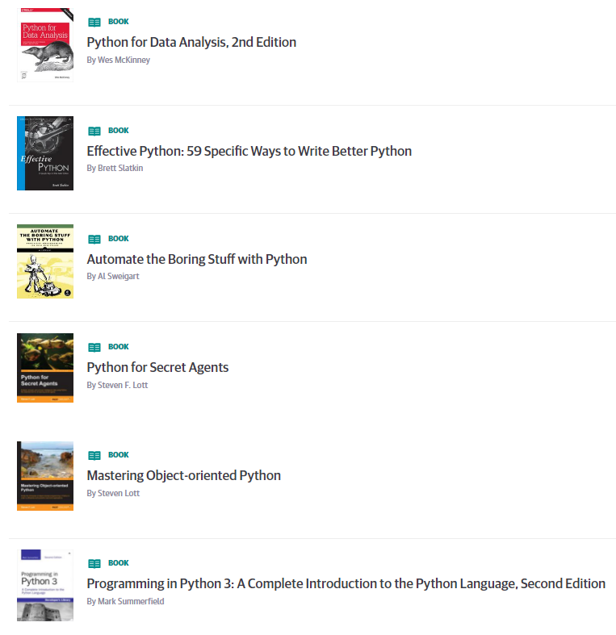
Learning Resources
Books on Safari online (free to use)
https://www.safaribooksonline.com/playlists/dce9eb9c-ceff-4dce-beec-41239c49527d
Internal
Python Series by Zoltan, all recordings on hub
Series 1 https://thehub.thomsonreuters.com/message/443702
Series 2 https://thehub.thomsonreuters.com/thread/163911
Many courses available on Courseera.org
A gallery of interesting Jupyter Notebooks
https://github.com/jupyter/jupyter/wiki/A-gallery-of-interesting-Jupyter-Notebooks
https://www.dataquest.io/blog/jupyter-notebook-tips-tricks-shortcuts/

