Slide 1

Python for Customer Analytics

Slide 2
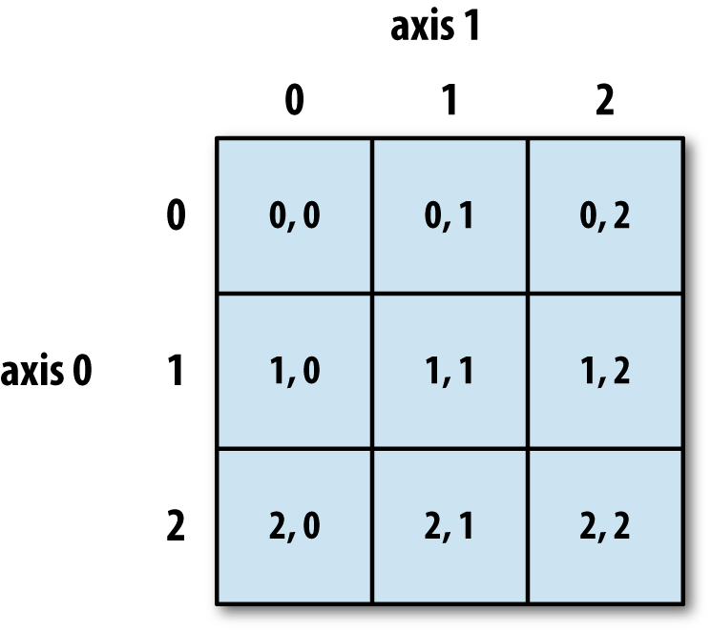
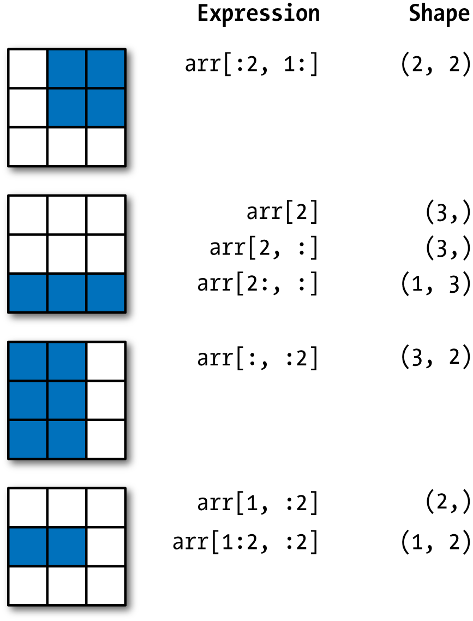
Numpy

Slide 3
Numpy operations
Array set operations
Method | Description
unique(x) | Compute the sorted, unique elements in x
intersect1d(x, y) | Compute the sorted, common elements in x and y
union1d(x, y) | Compute the sorted union of elements
in1d(x, y) | Compute a boolean array indicating whether each element of x is contained in y
setdiff1d(x, y) | Set difference, elements in x that are not in y
setxor1d(x, y) | Set symmetric differences; elements that are in either of the arrays, but not both

Slide 4

Python Libraries for Data Science
Pandas:
Adds data structures and tools designed to work with table-like data (similar to Series and Data Frames in R)
Can read data from various sources like text files, databases etc.
Provides tools for data manipulation: reshaping, merging, sorting, slicing, aggregation etc.
Allows handling missing data
Link: http://pandas.pydata.org/

Slide 5
Reading data using pandas
#Import Python Libraries
import pandas as pd
from pandas import Series, DataFrame
In [ ]:
#Read csv file
df = pd.read_csv("Salaries.csv")
Note: The above command has many optional arguments to fine-tune the data import process.
There is a number of pandas commands to read other data formats:
pd.read_excel('myfile.xlsx',sheet_name='Sheet1', index_col=None, na_values=['NA'])
pd.read_stata('myfile.dta')
pd.read_sas('myfile.sas7bdat')
pd.read_hdf('myfile.h5','df')

Slide 6
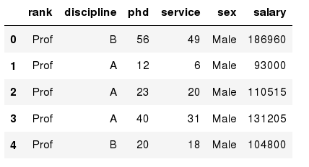
Exploring data frames
In [3]:
#List first 5 records
df.head()
Out[3]:
Try to read the first 10, 20, 50 records;
Can you guess how to view the last few records

Slide 7
Data Frame data types
In [4]:
#Check a particular column type
df['salary'].dtype
Out[4]: dtype('int64')
In [5]:
#Check types for all the columns
df.dtypes
Out[4]:
rank
discipline
phd
service
sex
salary
dtype: object
object
object
int64
int64
object
int64

Slide 8
Data Frames attributes
Python objects have attributes and methods.
df.attribute | description
dtypes | list the types of the columns
columns | list the column names
axes | list the row labels and column names
ndim | number of dimensions
size | number of elements
shape | return a tuple representing the dimensionality
values | numpy representation of the data
Find how many records this data frame has;
How many elements are there?
What are the column names?
What types of columns we have in this data frame?

Slide 9
Data Frames methods
Unlike attributes, python methods have parenthesis.
All attributes and methods can be listed with a dir() function: dir(df)
df.method() | description
head( [n] ), tail( [n] ) | first/last n rows
describe() | generate descriptive statistics (for numeric columns only)
max(), min() | return max/min values for all numeric columns
mean(), median() | return mean/median values for all numeric columns
std() | standard deviation
sample([n]) | returns a random sample of the data frame
dropna() | drop all the records with missing values

Slide 10
Data Frame: filtering
To subset the data we can apply Boolean indexing. This indexing is commonly known as a filter. For example if we want to subset the rows in which the salary value is greater than $120K:
In [ ]:
#Calculate mean salary for each professor rank:
df_sub = df[ df['salary'] > 120000 ]
Any Boolean operator can be used to subset the data:
> greater; >= greater or equal;
< less; <= less or equal;
== equal; != not equal;
#Select only those rows that contain female professors:
df_f = df[ df['sex'] == 'Female' ]
In [ ]:

Slide 11
Data Frames: Slicing
There are a number of ways to subset the Data Frame:
one or more columns
one or more rows
a subset of rows and columns
Rows and columns can be selected by their position or label
When selecting one column, it is possible to use single set of brackets, but the resulting object will be a Series (not a DataFrame):
In [ ]:
#Select column salary:
df['salary']
When we need to select more than one column and/or make the output to be a DataFrame, we should use double brackets:
In [ ]:
#Select column salary:
df[['rank','salary']]

Slide 12
Data Frames: Selecting rows
If we need to select a range of rows, we can specify the range using ":"
In [ ]:
#Select rows by their position:
df[10:20]
Notice that the first row has a position 0, and the last value in the range is omitted:
So for 0:10 range the first 10 rows are returned with the positions starting with 0 and ending with 9

Slide 13
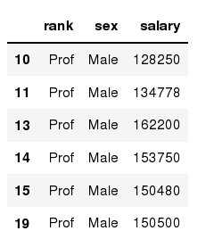
Data Frames: method loc
If we need to select a range of rows, using their labels we can use method loc:
In [ ]:
#Select rows by their labels:
df_sub.loc[10:20,['rank','sex','salary']]
Out[ ]:

Slide 14
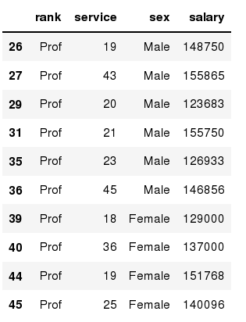
Data Frames: method iloc
If we need to select a range of rows and/or columns, using their positions we can use method iloc:
In [ ]:
#Select rows by their labels:
df_sub.iloc[10:20,[0, 3, 4, 5]]
Out[ ]:

Slide 15
Data Frames: method iloc (summary)
df.iloc[0] # First row of a data frame
df.iloc[i] #(i+1)th row
df.iloc[-1] # Last row
df.iloc[:, 0] # First column
df.iloc[:, -1] # Last column
df.iloc[0:7] #First 7 rows
df.iloc[:, 0:2] #First 2 columns
df.iloc[1:3, 0:2] #Second through third rows and first 2 columns
df.iloc[[0,5], [1,3]] #1st and 6th rows and 2nd and 4th columns

Slide 16
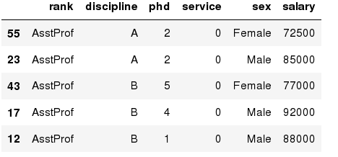
Data Frames: Sorting
We can sort the data by a value in the column. By default the sorting will occur in ascending order and a new data frame is return.
In [ ]:
# Create a new data frame from the original sorted by the column Salary
df_sorted = df.sort_values( by ='service')
df_sorted.head()
Out[ ]:

Slide 17
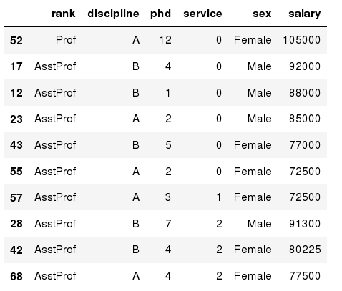
Data Frames: Sorting
We can sort the data using 2 or more columns:
In [ ]:
df_sorted = df.sort_values( by =['service', 'salary'], ascending = [True, False])
df_sorted.head(10)
Out[ ]:

Slide 18
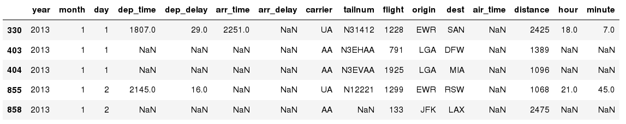
Missing Values
Missing values are marked as NaN
In [ ]:
# Read a dataset with missing values
flights = pd.read_csv("http://rcs.bu.edu/examples/python/data_analysis/flights.csv")
In [ ]:
# Select the rows that have at least one missing value
flights[flights.isnull().any(axis=1)].head()
Out[ ]:

Slide 19
Missing Values
There are a number of methods to deal with missing values in the data frame:
df.method() | description
dropna() | Drop missing observations
dropna(how='all') | Drop observations where all cells is NA
dropna(axis=1, how='all') | Drop column if all the values are missing
dropna(thresh = 5) | Drop rows that contain less than 5 non-missing values
fillna(0) | Replace missing values with zeros
isnull() | returns True if the value is missing
notnull() | Returns True for non-missing values

Slide 20
Missing Values
When summing the data, missing values will be treated as zero
If all values are missing, the sum will be equal to NaN
cumsum() and cumprod() methods ignore missing values but preserve them in the resulting arrays
Missing values in GroupBy method are excluded (just like in R)
Many descriptive statistics methods have skipna option to control if missing data should be excluded . This value is set to True by default (unlike R)

Slide 21
Basic Descriptive Statistics
df.method() | description
describe | Basic statistics (count, mean, std, min, quantiles, max)
min, max | Minimum and maximum values
mean, median, mode | Arithmetic average, median and mode
var, std | Variance and standard deviation
sem | Standard error of mean
skew | Sample skewness
kurt | kurtosis

Slide 22
APPENDIX
Edit presentation title on Slide Master using Insert > Header & Footer

Slide 23
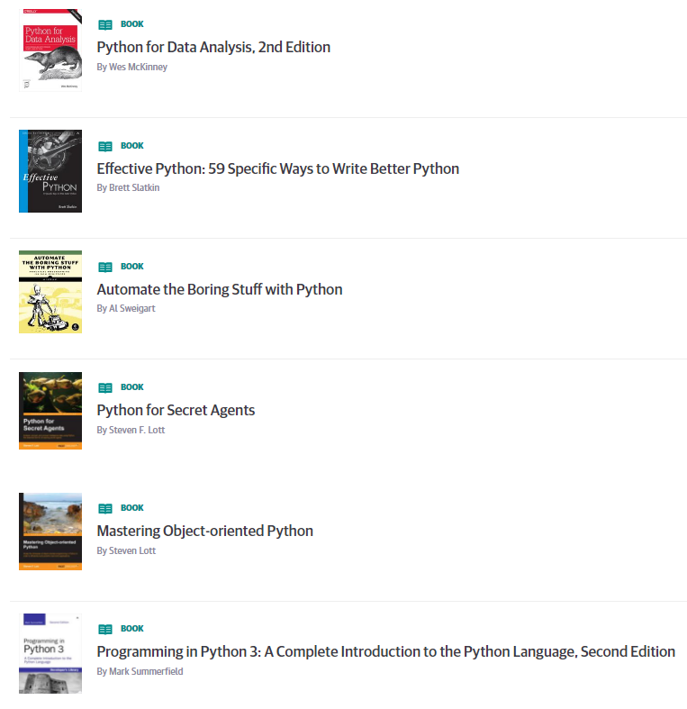
Learning Resources
Books on Safari online (free to use)
https://www.safaribooksonline.com/playlists/dce9eb9c-ceff-4dce-beec-41239c49527d
Internal
Python Series by Zoltan, all recordings on hub
Series 1 https://thehub.thomsonreuters.com/message/443702
Series 2 https://thehub.thomsonreuters.com/thread/163911
Many courses available on Courseera.org
A gallery of interesting Jupyter Notebooks
https://github.com/jupyter/jupyter/wiki/A-gallery-of-interesting-Jupyter-Notebooks
https://www.dataquest.io/blog/jupyter-notebook-tips-tricks-shortcuts/

