Slide 1
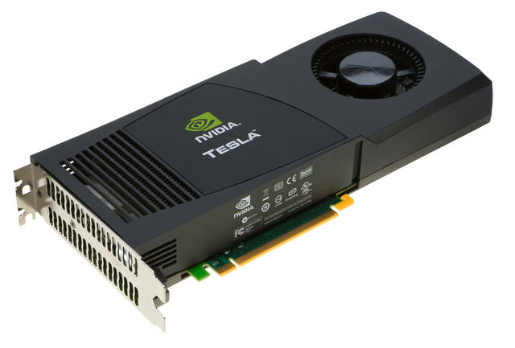
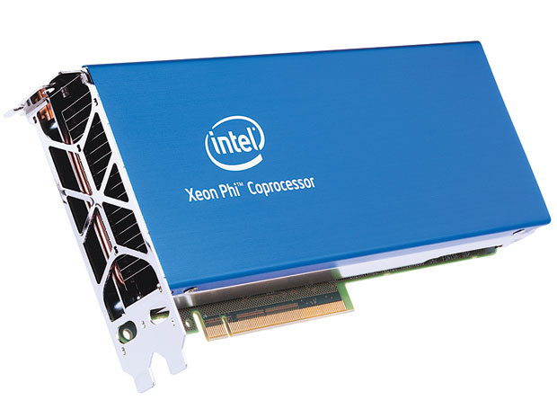
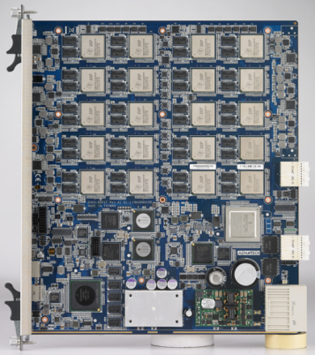
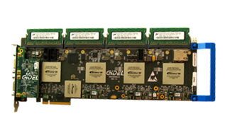
Heterogeneous and Reconfigurable Computing Lab
Mission: Develop practices and tools to harness emerging processing technologies
Emerging technologies address current limitations, e.g.:
100 quadrillion ops/sec limit for large-scale computers
Mobile processors can’t execute computer vision and machine learning tasks in real time while maintaining acceptable power envelope
Manycore Processors:
Digital Signal Processors:
Programmable Logic:

Slide 2
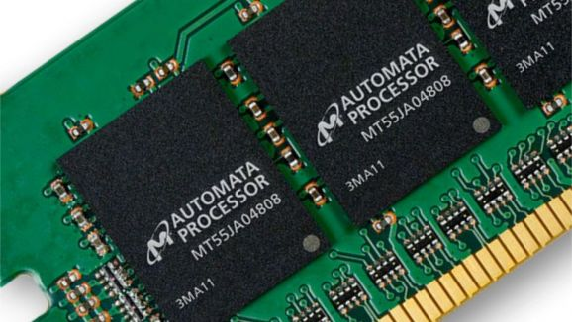
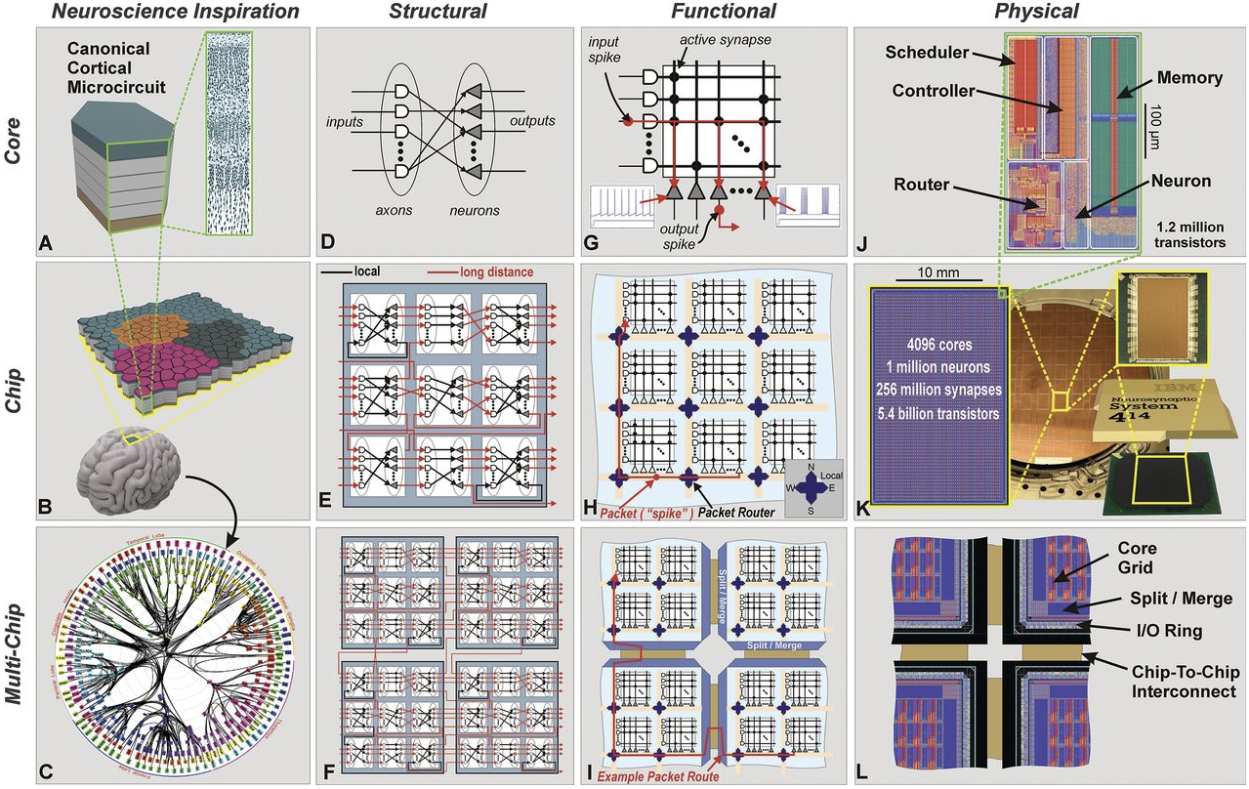
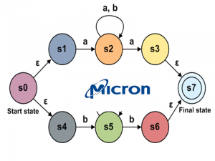
Emerging Technologies
Micron Automata Processor:
IBM Neurosynaptic Processor

Slide 3
Contact Information
Lab:
Swearingen 3D15
Jason D. Bakos:
Swearingen 3A45
jbakos@sc.edu
Current Ph.D. students:
Zheming Jin
Fan Zhang
Yang Gao
Jordan Bradshaw
Konstantin Rubin
Ivan Panchencko
Rasha Karakchi
Subhendu Chakrabarti
Current undergraduate students:
Lacie Cochran
Daniel Clements
Jonathan Freed

