Slide 1
Heterogeneous and Reconfigurable Computing Group
Objective: develop technologies to improve computer performance
Processor Generation | Max. Clock Speed (GHz) | Max. Numberof Cores | Max. RAM Bandwidth (GB/s) | Max. Peak Floating Point (Gflop/s) | Max. L3 cache (MB)
Core (2006) | 3.33 | 4 | 25.6 | 107 | 8
Penryn (2007) | 3.33 | 4 | 25.6 | 107 | 8
Westmere (2010) | 3.60 | 6 | 25.6 | 173 | 12
Ivy Bridge (2013) | 3.70 | 6 | 25.6 | 355 | 15
Broadwell (2015) | 3.80 | 6 | 25.6 | 365 | 30

Slide 2
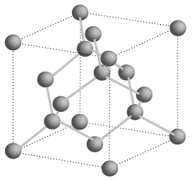
Moore’s Law?
Processor Generation | Transistor size (nm) | Number of transistors (millions)
Core (2006) | 65 | 105
Penryn (2007) | 45 | 228
Westmere (2010) | 32 | 382
Ivy Bridge (2013) | 22 | 624
Broadwell (2015) | 14 | 1300
?? (2020) | 7 | 2600
?? (2025) | 3 | 5200
?? (2030) | 1 | 10400
Si atom spacing = 0.5 nm

Slide 3
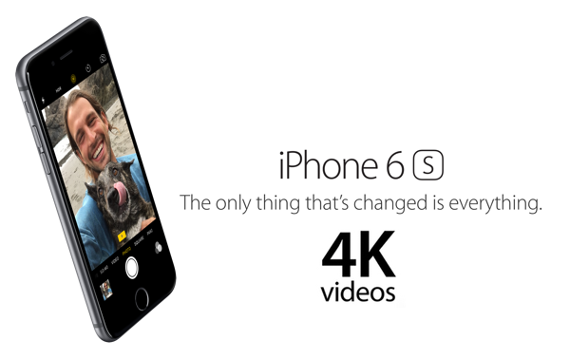

New Capabilities
What about iPhone 6s 4K video?
What about XBox One graphics?

Slide 4
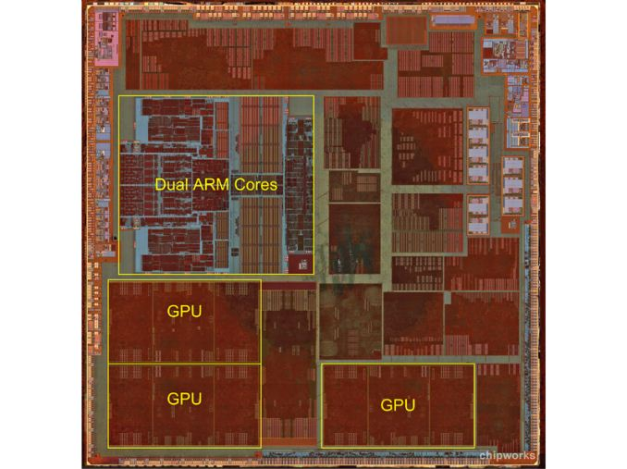
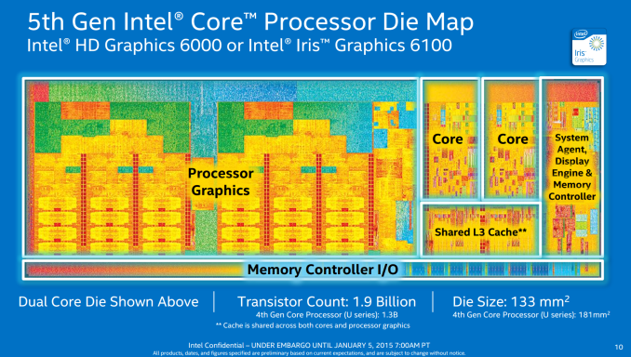
All Modern CPUs are Heterogeneous
Intel Broadwell
Apple A6

Slide 5
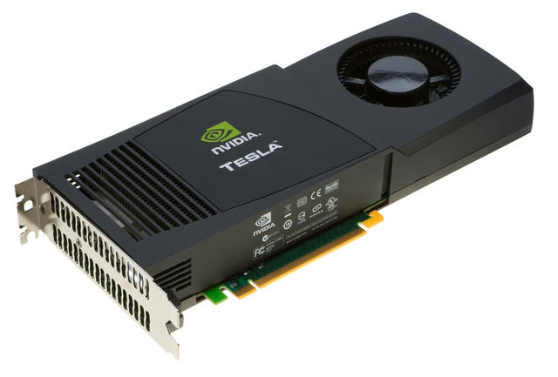
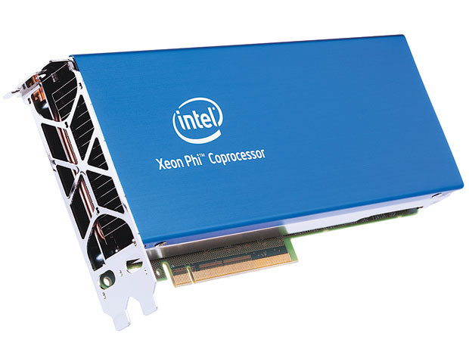
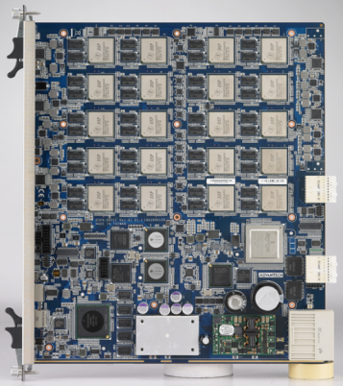
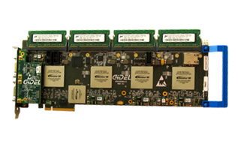
Heterogeneous and Reconfigurable Computing Lab
Manycore Processors:
We’re in good shape for graphics and video
What about scientists, engineers, and computational finance?
For these, we need emerging processing technologies
Digital Signal Processors:
Programmable Logic:

Slide 6
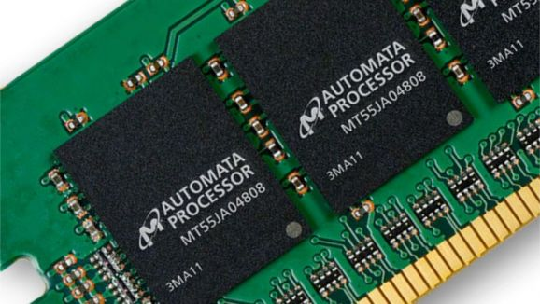
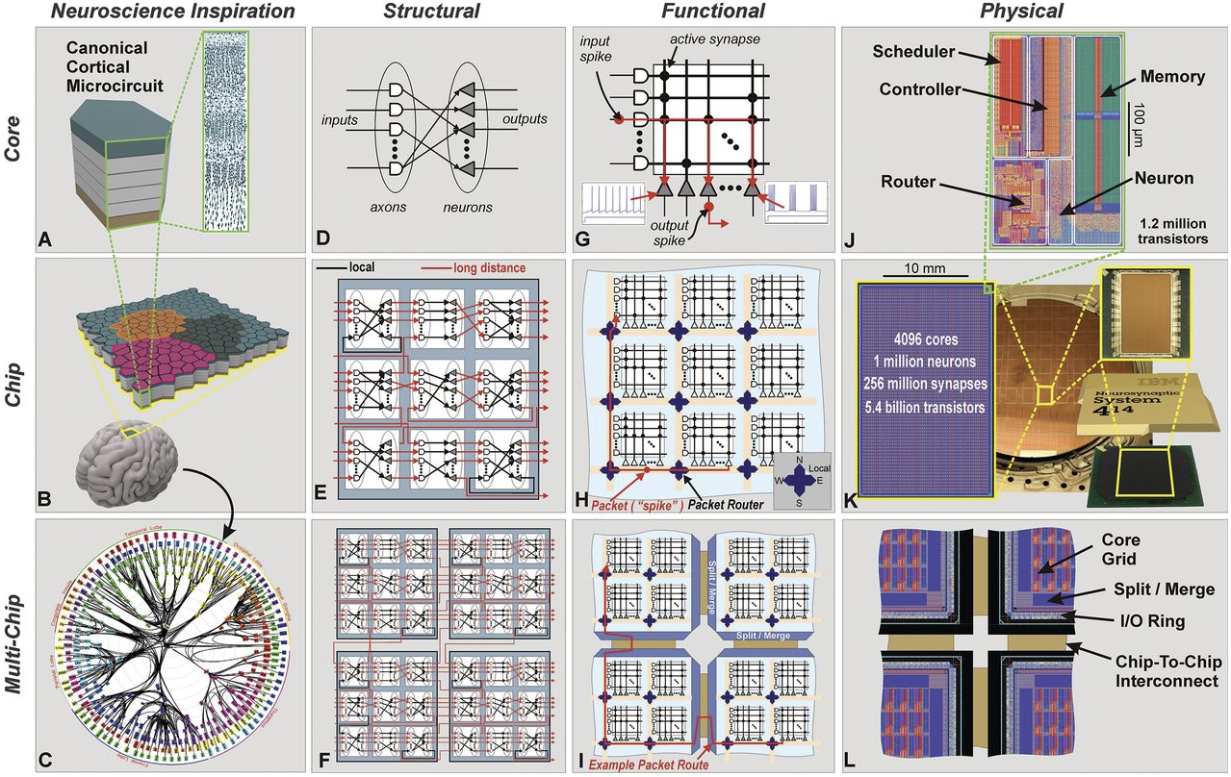
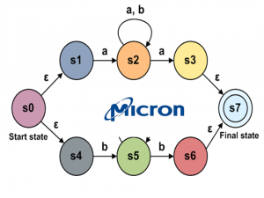
Emerging Technologies
Micron Automata Processor:
IBM Neurosynaptic Processor

Slide 7
Contact Information
Lab:
Swearingen 3D15
Office:
Swearingen 3A45
jbakos@sc.edu
Current Ph.D. students:
Jordan Bradshaw
Konstantin Rubin
Rasha Karakchi
Current undergraduate students:
Lacie Cochran
Jonathan Freed
Charles Daniels
Viraj Patel

