Slide 1
Seven Minute Madness:
Reconfigurable Computing
Dr. Jason D. Bakos

Slide 2
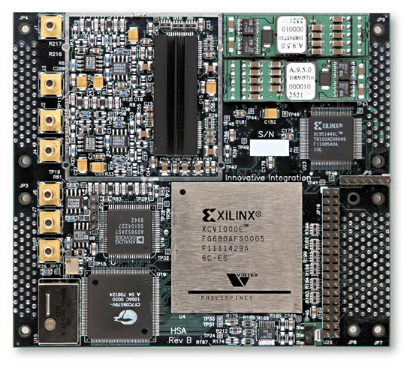
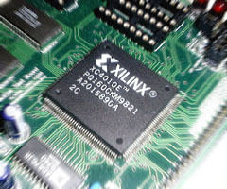
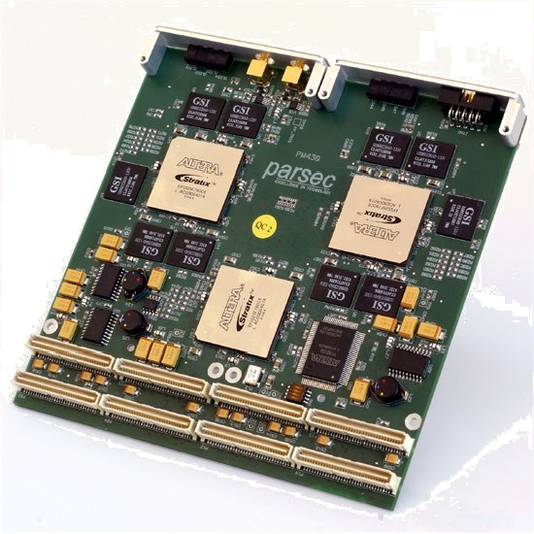
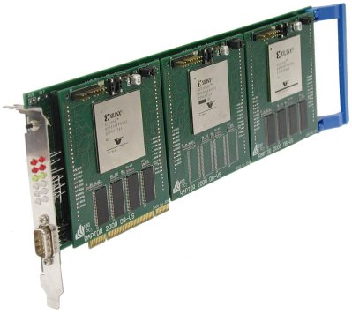
Reconfigurable Computing
Computing with reconfigurable logic, i.e. FPGAs

Slide 3
High-Performance Reconfigurable Computing
instructions executed over time
45% of code
initialization
0.5% of run time
hot loop
99% of run time
10% of code
45% of code
clean up
0.5% of run time

Slide 4
High-Performance Reconfigurable Computing
Move “bottleneck” computations from software to FPGA
  Use FPGA as co-processor
Example:
  Application requires a week of CPU time
  One computation consumes 99% of execution time
Kernel speedup | Application speedup | Execution time
50 | 34 | 5.0 hours
100 | 50 | 3.3 hours
200 | 67 | 2.5 hours
500 | 83 | 2.0 hours
1000 | 91 | 1.8 hours

Slide 5
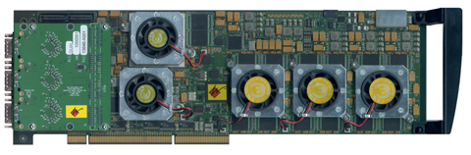
HPRC: Requirements, Pros, Cons
Advantage of HPRC:
  Cost
    FPGA card => ~ $15K
    128-processor cluster => ~ $150K
  + maintenance + cooling + electricity + recycling
Challenges:
  Programming the FPGA
  Identifying bottlenecks
  Optimizing bottleneck for hardware
  Scaling resources

Slide 6
Our Group: Current Research Projects
FPGA accelerators for computational biology
  Achieved 1000X speedup for genome analysis
High-throughput linear algebra
  Solving very large systems of equations
Multi-FPGA interconnection networks
  Inter-FPGA adaptive routing
Design tools
  Dynamic code analysis
  Semi-automatic accelerator generation
Alternative platforms: GPGPU

