Slide 1
Sparse Matrix-Vector Multiply on the Texas Instruments C6678 Digital Signal Processor
Yang Gao and Dr. Jason D. Bakos
Application-Specific Systems, Architectures, and Processors 2013

Slide 2
TI C6678 vs. Competing Coprocessors
Coprocessor | NVIDIA Tesla K20X GPU | Intel Xeon Phi 5110p | TI C66
Peak single precision performance | 3.95 Tflops/s | 2.12 Tflops/s | 128 Gflops/s
Memory bandwidth | 250 GB/s | 320 GB/s | 12.8 GB/s
Power | 225 W | 225 W | 10 W
Primary programming model | CUDA/OpenCL | OpenMP | None, but OpenMP/ OpenCL in development

Slide 3
Why the C6678?
Unique architectural features
8 symmetric VLIW cores with SIMD instructions, up to 16 flops/cycle
No shared last level cache
4MB on-chip shared RAM
L1D and L2 can be configured as cache, scratchpad, or both
DMA engine for parallel loading/flushing scratchpads
Power efficiency
At 45 nm, achieves 12.8 ideal SP Gflops/Watt
Intel Phi [22 nm] is 9.4 Gflops/Watt
NVIDIA K20x [28 nm] is 17.6 Gflops/Watt
Fast on-chip interfaces for potential scalability
4 x Rapid IO(SRIO) 2.1: 20 Gb/s
1 x Ethernet: 1 Gb/s
2 x PCI-E 2.0: 10 Gb/s
HyperLink: 50 Gb/s

Slide 4
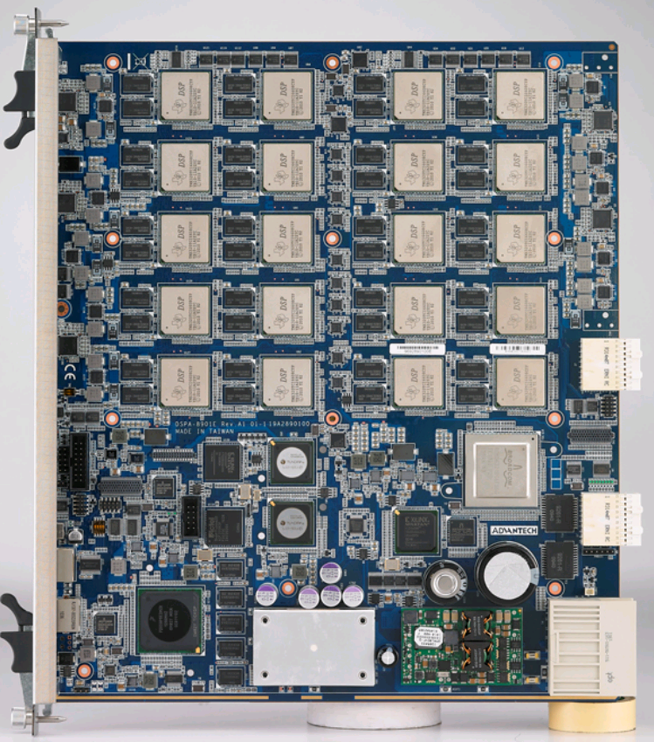
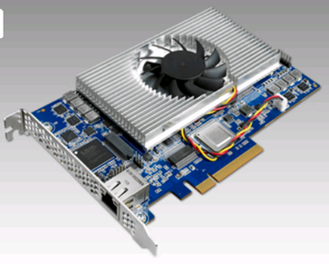
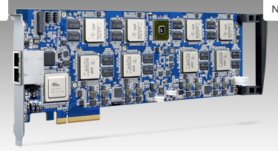
C66 Platforms

Slide 5
Software Pipelining
VLIW architecture requires explicit usage of functional units
C66 compiler uses software pipelining to maximize FU utilization
Conditional prevents SP and lowers utilization
Regular Loop
Software Pipelining
Time
1
1
1
1
2
Prolog
1
1
2
3
Kernel
2
2
3
Epilog
2
3
2
ALU1
ALU2
ALU3

Slide 6
Sparse Matrices
We evaluated the C66 relative using a SpMV kernel
GPUs achieve only 0.6% to 6% of their peak performance with CSR SpMV
Sparse Matrices can be very large but contain few non-zero elements
Compressed formats are often used, e.g. Compressed Sparse Row (CSR)
1 | -1 | 0 | -3 | 0
-2 | 5 | 0 | 0 | 0
0 | 0 | 4 | 6 | 4
-4 | 0 | 2 | 7 | 0
0 | 8 | 0 | 0 | -5
val | (1 | -1 | -3 | -2 | 5 | 4 | 6 | 4 | -4 | 2 | 7 | 8 | -5)
col | (0 | 1 | 3 | 0 | 1 | 2 | 3 | 4 | 0 | 2 | 3 | 1 | 4)
ptr | (0 | 3 | 5 | 8 | 11 | 13)

Slide 7
Sparse Matrix-Vector Multiply
Code for y = Aαx + βy
row = 0
for i = 0 to number_of_nonzero_elements do
if i == ptr[row+1] then row=row+1, y[row]*=beta;
y[row] = y[row] + alpha * A[i] * x[col[i]]
end
conditional execution
reduction
Low arithmetic intensity
(~3 flops / 24 bytes)
Memory bound kernel
indirect indexing

Slide 8
Naïve Implementation
for i = columns assigned to current core
y write back
index
i
ptr buffer
y buffer
val
array
col
array
row
if ptr[row] == i then
row = row +1
y[row] ← y[row] * β
end if
y[row]←y[row]+Acc
x array
α * val * x
product results Acc
0.55 Gflops/s
60.4% of cycles were uncovered memory latency

Slide 9
Double Buffer and DMA
Product Loop
SDRAMbuffer
index
i
val buffer
Val
L2 buffer
col buffer
Col
L2 buffer
DMA
x buffer
α * val * x
DSP
0.78 Gflops/s
28.8% of cycles were uncovered memory latency

Slide 10
Loop Unroll and Predicate Instruction
Accumulate Loop
y write back
i
ptr buffer
y buffer
row
The accumulate loop is manually unrolled by 8
Predicate instructions are applied to replace the if-statements in assembly.
Acc ← Acc + prod[i]
if ptr[row] == i then
row = row +1
y[row] ← y[row] * β
end if
prod buffer
Acc ← Acc + prod[i+1]
if ptr[row] == i then
row = row +1
y[row] ← y[row] * β
end if
Acc ← Acc + prod[i+K]
if ptr[row] == i then
row = row +1
y[row] ← y[row] * β +Acc
end if
1.63 Gflops/s
50.1% cycles were uncovered memory latency

Slide 11
Loop Fission
Product Loop
Accumulate Loop
y write back
index
i
i
ptr buffer
y buffer
val buffer
col buffer
row
Acc ← Acc+prod[i]
if ptr[row] == i then
row = row +1
y[row] ← y[row]*β+Acc
end if
x buffer
prod buffer
α * val * x
product results
2.08 Gflops/s
36.6% cycles were uncovered memory latency

Slide 12
Adaptive Row Pointer
Accumulate Loop
y write back
i
ptr buffer
y buffer
prod buffer
row
if(ptr[row+1]-ptr[row]) >K
Acc ← Acc + prod[i]
Acc ← Acc + prod[i+1]
…
Acc ← Acc + prod[i+K]
Acc ← Acc + prod[i]
if ptr[row] == i then
row = row +1
y[row] ← y[row] * β
end if
Acc ← Acc + prod[i+1]
if ptr[row] == i then
row = row +1
y[row] ← y[row] * β
end if
Acc ← Acc + prod[i+K]
if ptr[row] == i then
row = row +1
y[row] ← y[row] * β
end if

Slide 13
Test Environment
 | i5 650 MKL | GTX680 CUSPARSE | GTX650Ti CUSPARSE | C66
Architecture | Clarkdale | Kepler | Kepler | Shannon
Process(nm) | 32 | 28 | 28 | 45
Memory throughput (GB/s) | 21 | 192.3 | 86.4 | 12.8
TDP (W) | 73 | 195 | 110 | 10
Single precision performance (Gflops) | 26 | 3090 | 1425 | 128

Slide 14
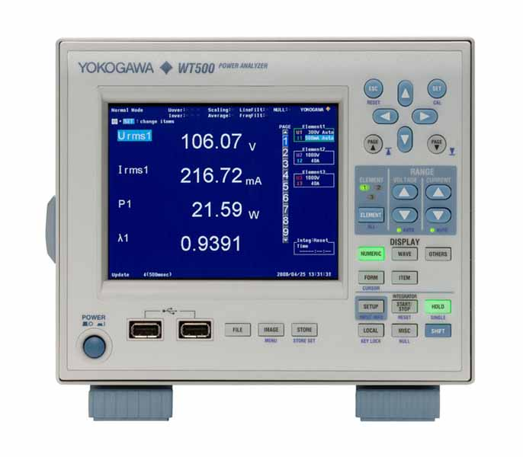
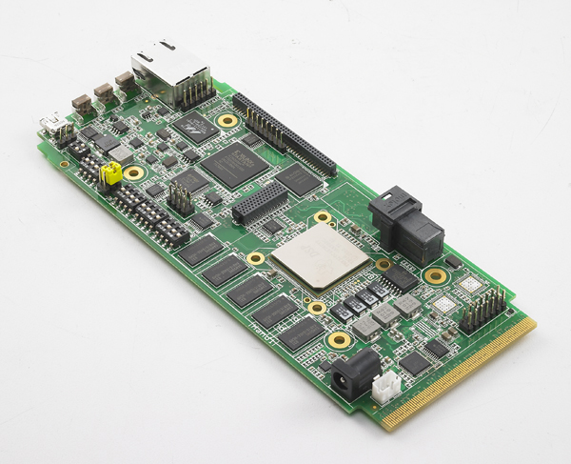
Power Analyzer
Power Socket Provide by WT500
110 V
PSU with EVM board
12 V

Slide 15
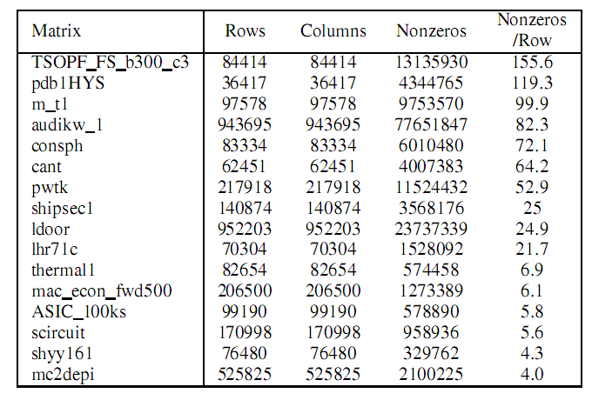
Matrix
Tri-diagonal
N-diagonal
3 - 501
University of Florida sparse matrix collection
Matrix Market
2, 4, 0, 0, 0, 0
5, 4, 7, 0, 0, 0
0, 6, 2, 4, 0, 0
0, 0, 3, 10, 1, 0
0, 0, 0, 4, 6, 8
0, 0, 0, 0, 2, 12

Slide 16
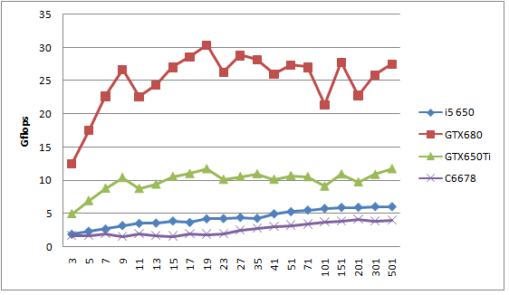
SpMV Performance
N-diagonal Matrix
Generally, the C66 achieves ~2/3 CPU performance

Slide 17
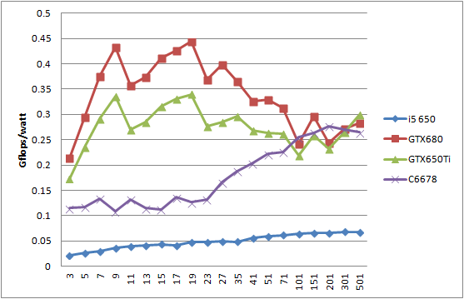
SpMV Gﬂops/Watt
N-diagonal Matrix
C66 is equivalent to GPUs when N > 51

Slide 18
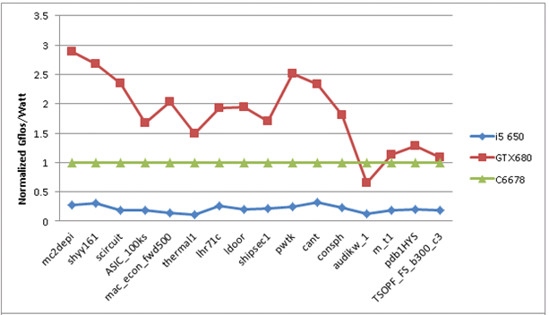
Gflops/Watt for Nonsynthetic Matrices
C66 power efficiency also scales with density for real-world matrices

Slide 19
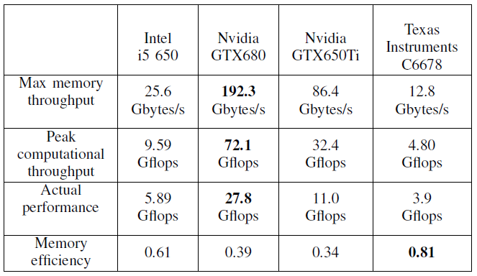
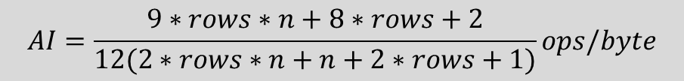

Memory Efficiency
$$AI=\frac{9∗rows∗n+8∗rows+2}{12(2∗rows∗n+n+2∗rows+1)}ops/byte$$
N = 151
rows = 208326
$$AI∗12.8$$

Slide 20
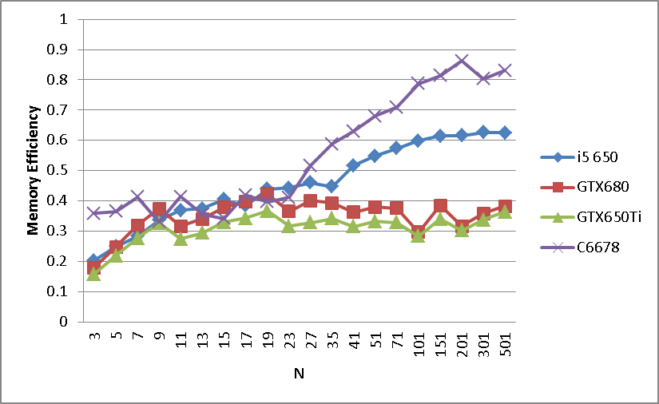
Memory Efficiency

Slide 21
Next Generation
Keystone-II
28 nm
Doubles caches
Increases memory bandwidth by 125%
 | C66 | 66AK2H12 “Keystone-II”
CPU | n/a | 4 x ARM A15
DSP | 8 Cores | 8 Cores
DSP L2 | 512 KB | 1024 KB
DDR3 | 64 bit | 2 x 72 bit
Process | 45 nm | 28 nm
Power | 10 W | ?

Slide 22
Conclusions
TI DSP is a promising coprocessor technology for HPC
Advantages:
Unique architectural features that facilitate automated parallelization (easier to program?)
Inherently power efficient microarchitecture
Equivalent to modern GPUs and Phi despite older process technology
Has advanced memory system for memory bound kernels
Simultaneous DMA and caching to match access pattern of indvidivual arrays
Has advanced onchip interfaces for efficient scalability
Large-scale multi-DSP platforms already exist
Looking forward:
Keystone II will:
Improve efficiency and memory performance (cache + b/w)
Has onboard host CPUs to facilitate runtimes for multi-DSP scaling

Slide 23
Q & A

Slide 24
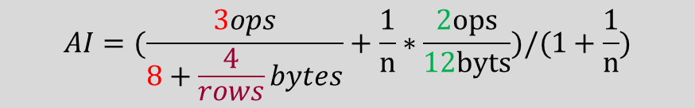
Arithmetic Intensity
y write back
index
i
ptr buffer
y buffer
val buffer
col buffer
4 bytes
4 bytes
row
4 bytes
4 bytes
x buffer
Acc ← Acc+prod[i]
if ptr[row] == i then
row = row +1
y[row] ← y[row]*β+Acc
end if
1 op
4 bytes
4/rows bytes
2 ops
α * val * x
prod buffer
n = average number of non-zero elements per row
2 ops
$$AI=(\frac{3ops}{8+\frac{4}{rows}bytes}+\frac{1}{n}∗\frac{2ops}{12byts})/(1+\frac{1}{n})$$

