Slide 1
Trends in the Infrastructure of Computing: Processing, Storage, Bandwidth
CSCE 190: Computing in the Modern World
Dr. Jason D. Bakos

Slide 2
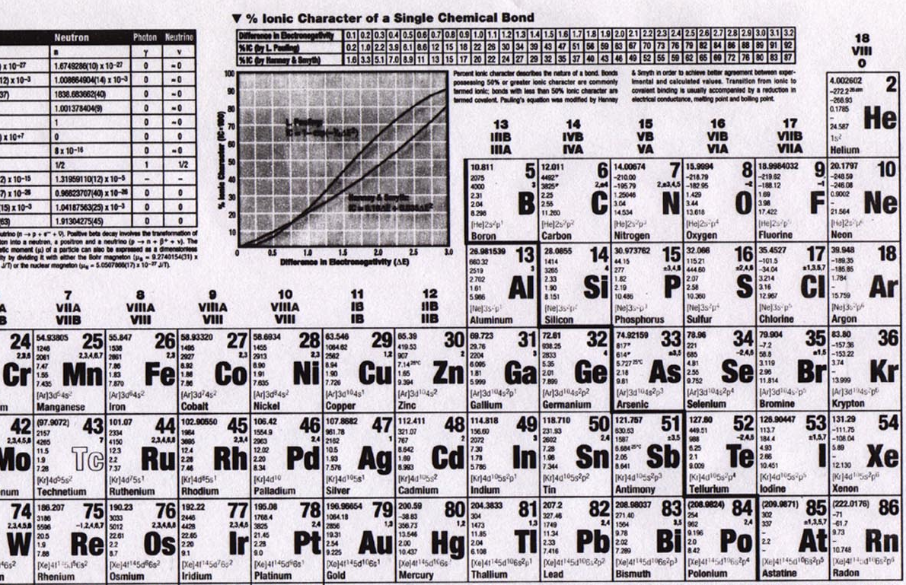
Elements

Slide 3
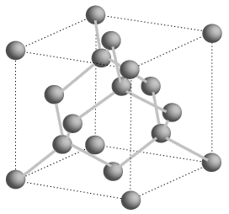
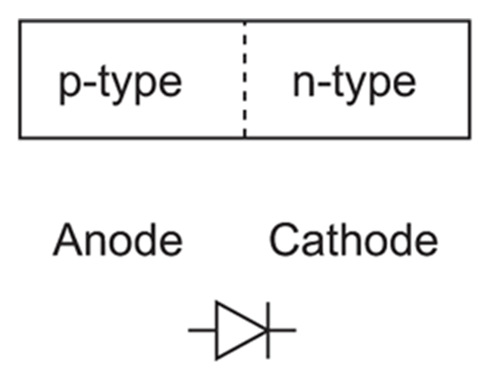
Semiconductors
Silicon is a group IV element (4 valence electrons, shells: 2, 8, 18, 32…)
  Forms covalent bonds with four neighbor atoms (3D cubic crystal lattice)
  Si is a poor conductor, but conduction characteristics may be altered
  Add impurities/dopants (replaces silicon atom in lattice):
    Makes a better conductor
    Group V element (phosphorus/arsenic) => 5 valence electrons
      Leaves an electron free => n-type semiconductor (electrons, negative carriers)
    Group III element (boron) => 3 valence electrons
      Borrows an electron from neighbor => p-type semiconductor (holes, positive carriers)
+
-
-
+
+ + +
+ + +
+ + +
+ + +
- - -
- - -
- - -
- - -
P-N junction
forward bias
reverse bias

Slide 4
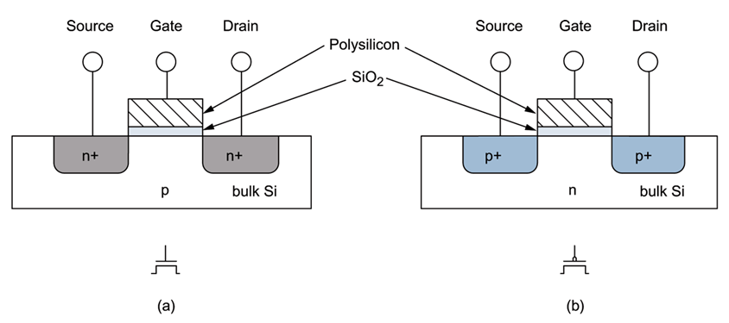
MOSFETs
negative voltage (rel. to body) (GND)
positive voltage (Vdd)
NMOS/NFET
+ + +
- - -
PMOS/PFET
current
- - -
+ + +
current
body/bulk
GROUND
channel
shorter length, faster transistor (dist. for electrons)
body/bulk
HIGH
(S/D to body is reverse-biased)
Metal-poly-Oxide-Semiconductor structures built onto substrate
  Diffusion: Inject dopants into substrate
  Oxidation: Form layer of SiO2 (glass)
  Deposition and etching: Add aluminum/copper wires

Slide 5
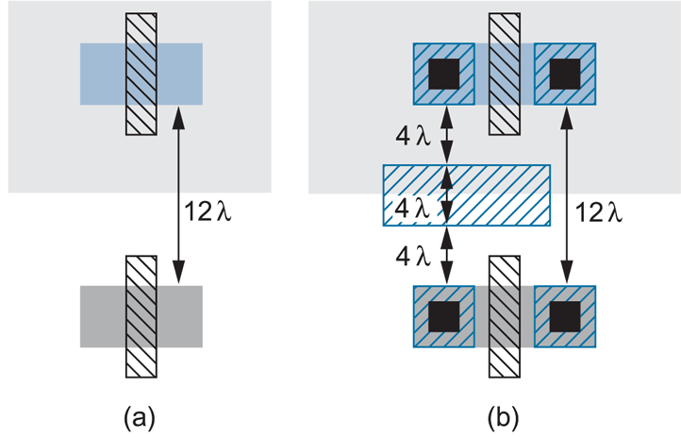
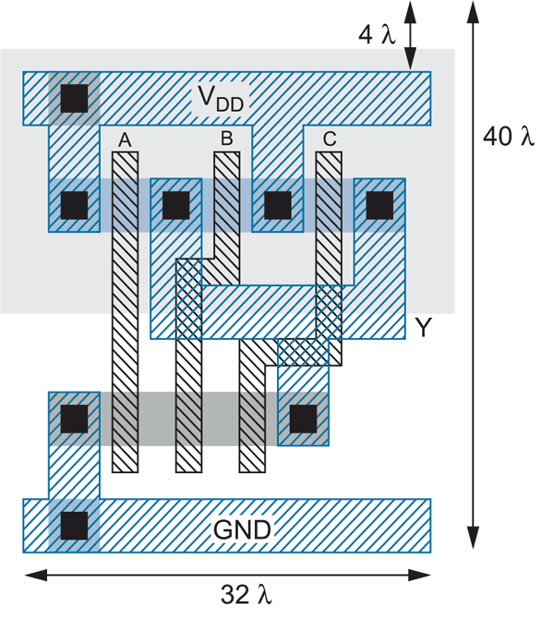
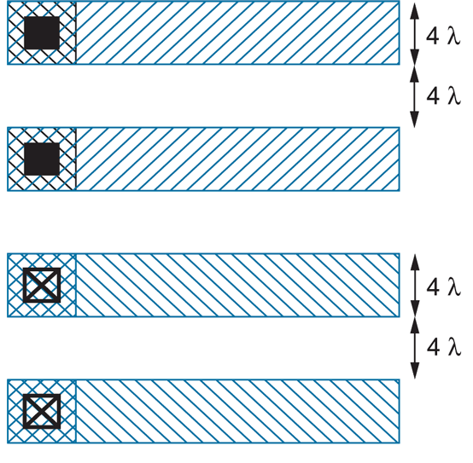
Layout
3-input NAND

Slide 6

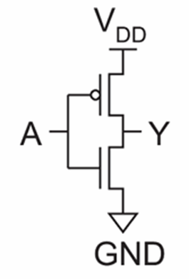


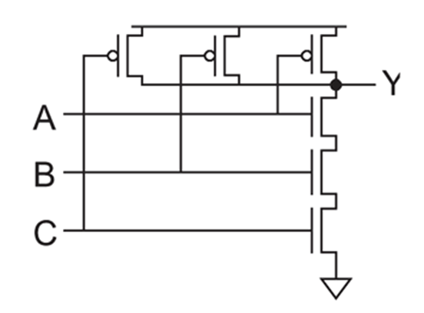
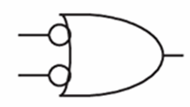
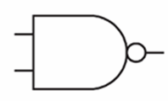
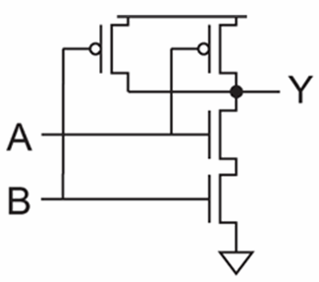
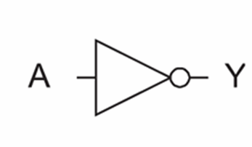

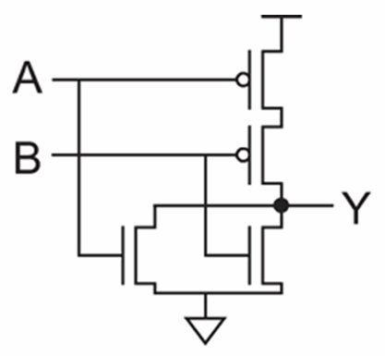
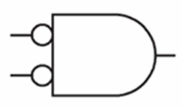

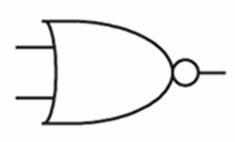
Logic Gates
inv
NAND2
NAND3
NOR2

Slide 7
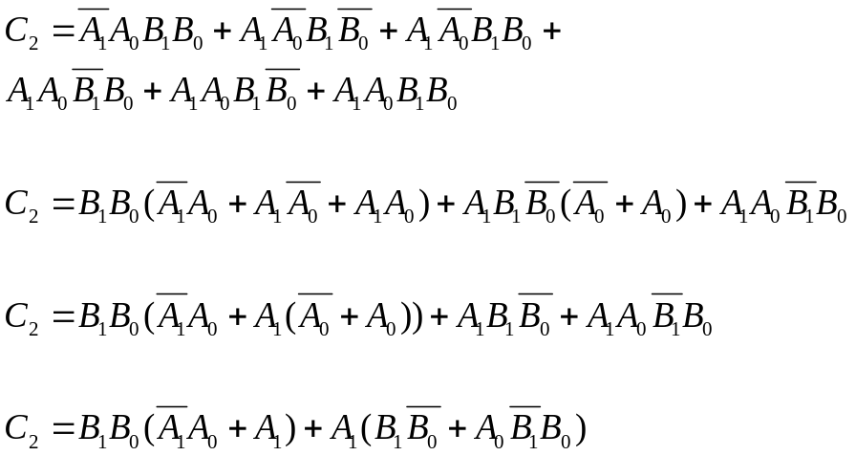
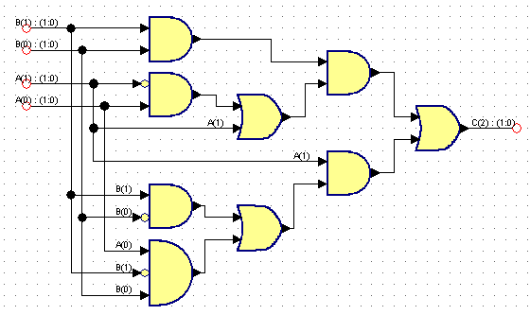
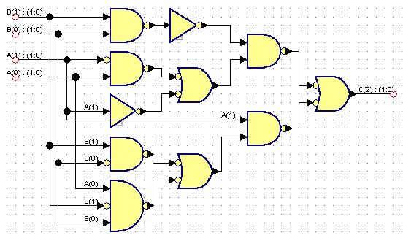
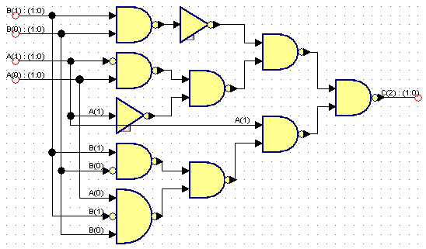
Logic Synthesis
Behavior:
  S = A + B
  Assume A is 2 bits, B is 2 bits, C is 3 bits
A | B | C
00 (0) | 00 (0) | 000 (0)
00 (0) | 01 (1) | 001 (1)
00 (0) | 10 (2) | 010 (2)
00 (0) | 11 (3) | 011 (3)
01 (1) | 00 (0) | 001 (1)
01 (1) | 01 (1) | 010 (2)
01 (1) | 10 (2) | 011 (3)
01 (1) | 11 (3) | 100 (4)
10 (2) | 00 (0) | 010 (2)
10 (2) | 01 (1) | 011 (3)
10 (2) | 10 (2) | 100 (4)
10 (2) | 11 (3) | 101 (5)
11 (3) | 00 (0) | 011 (3)
11 (3) | 01 (1) | 100 (4)
11 (3) | 10 (2) | 101 (5)
11 (3) | 11 (3) | 110 (6)

Slide 8
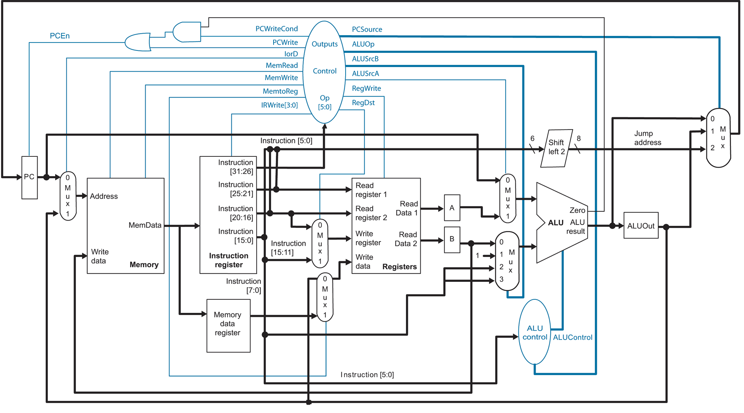
MIPS Microarchitecture

Slide 9
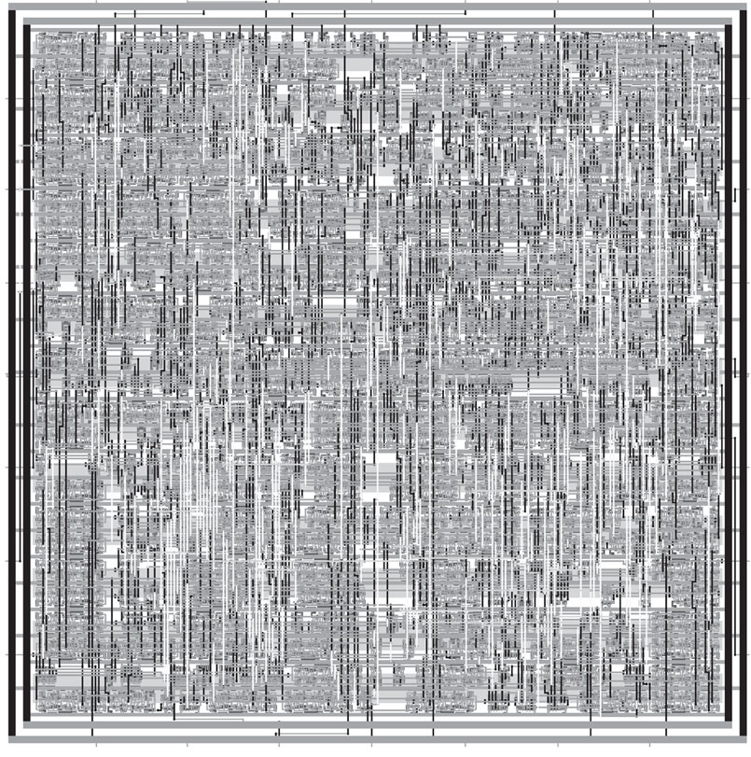
Synthesized and P&R’ed MIPS Architecture

Slide 10
Feature Size
Shrink minimum feature size…
  Smaller L decreases carrier time and increases current
  Therefore, W may also be reduced for fixed current
  C_{g}, C_{s}, and C_{d} are reduced
  Transistor switches faster (~linear relationship)

Slide 11
Minimum Feature Size
Year | Processor | Speed | Process
1982 | i286 | 6 - 25 MHz | 1.5 μm
1986 | i386 | 16 – 40 MHz | 1.5 - 1 μm
1989 | i486 | 16 - 133 MHz | .8 μm
1993 | Pentium | 60 - 300 MHz | .6 - .25 μm
1995 | Pentium Pro | 150 - 200 MHz | .5 - .35 μm
1997 | Pentium II | 233 - 450 MHz | .35 - .25 μm
1999 | Pentium III | 450 – 1400 MHz | .25 - .13 μm
2000 | Pentium 4 | 1.3 – 3.8 GHz | .18 - .065 μm
2005 | Pentium D | 2.66 – 3.6 GHz | .09 - .065 μm
2006 | Core 2 | 1.06 – 3 GHz | .065 μm
Upcoming milestones:
45 nm (Xeon 5400 Nov. 2007),
32 nm (2009-2010), 22 nm (2011-2012), 16 nm (2013)

Slide 12
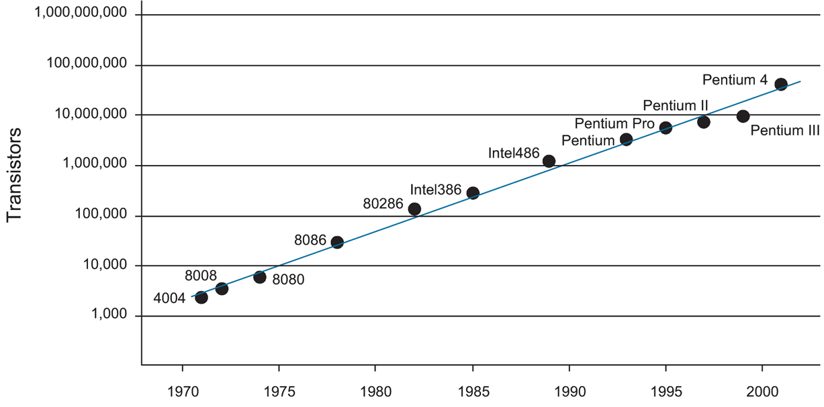
Integration Density Trends (Moore’s Law)
Pentium Core 2 Duo (2007) has ~300M transistors

Slide 13
Microprocessor Technology
Advances in fabrication (lithography, photoresist, metal layers)
…faster transistor switching (faster processor)
…smaller transistors/wires
…higher integration density
…more “real estate”
…architectural improvements!

Slide 14
Parallelism
Decompose a problem into a set of smaller sub-problems
Process multi sub-problems simultaneously
Different techniques:
  Platform:
    Spread problem across multiple CPUs (parallel processing)
    Spread problem across multiple components on a CPU (microarchitectural parallelism)
  Programming:
    Automatically DYNAMIC
    Automatically STATIC
    Programmer using programming model

Slide 15
Parallel Processing
Parallel processing:
  Shared memory
    Symmetric multiprocessing
    Multiple CPUs share a single memory space (usually NUMA)
    Communicate through memory reference
    Each CPU may have local but globally accessible memory
    Requires expensive crossbar switch (16-processor => $500K)
  Message-passing
    No shared memory
    CPUs communicate via explicit messages
    MPI and OpenMP APIs
    COTS processors and high-speed LAN switch
    Scalable:
      NASA Space Exploration Simulator has 10,240 CPUs (Intel Itanium 2) and requires 1 MW (Lake Murray generates 200 MW)
      Laurence Livermore BlueGene/L has 65,536 dual-processor (700 MHz PowerPC) nodes and requires 1.5 MW
  Hybrid systems

Slide 16
Microarchitectural Parallelism
Parallelism => perform multiple operations simultaneously
  Instruction-level parallelism
    Execute multiple instructions at the same time
    Multiple issue
    Out-of-order execution
    Speculation
  Thread-level parallelism (hyper-threading)
    Execute multiple threads at the same time on one CPU
    Threads share memory space and pool of functional units
  Chip multiprocessing
    Execute multiple processes/threads at the same time on multiple CPUs
    Cores are symmetrical and completely independent but share a common level-2 cache

Slide 17
Heterogeneous Computing
General-purpose CPUs strike a balance when allocating real estate:
  on-chip memory (cache) optimized for both sequential and random access
  floating-point units for arithmetic
  multimedia units (SIMD)
  operating system support
Special-purpose processors can accelerate programs
  GPUs (stream processors)
  FPGAs

Slide 18
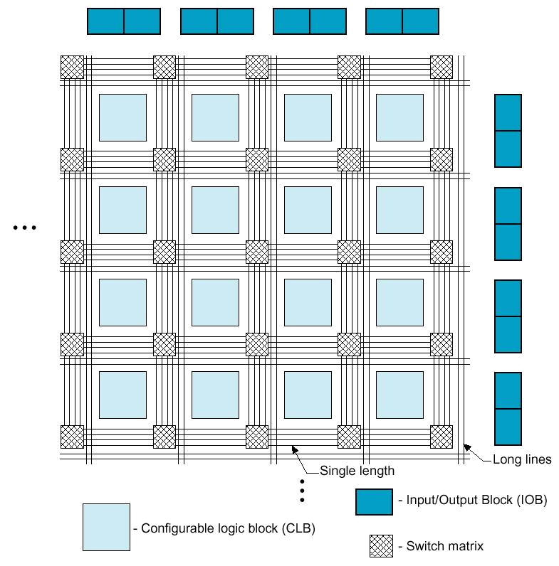
High-Performance Reconfigurable Computing
HPRC:
  Use FPGA as co-processor
Example:
  Application requires a week of CPU time
  One computation consumes 99% of execution time
Kernel speedup | Application speedup | Execution time
50 | 34 | 5.0 hours
100 | 50 | 3.3 hours
200 | 67 | 2.5 hours
500 | 83 | 2.0 hours
1000 | 91 | 1.8 hours
Replaces software
Exploits parallelism

Slide 19
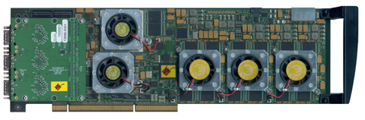
HPRC: Requirements, Pros, Cons
Application criteria:
  computationally expensive
  has a bottleneck computation
  bottleneck computation is parallelizable
  …and has low I/O and storage requirements
Advantages of HPRC:
  Cost
    FPGA card => ~ $15K
    128-processor cluster => ~ $150K
  + maintenance + cooling + electricity + recycling
Disadvantage for HPRC:
  Programming the FPGA

Slide 20
LANs
Peripheral and LAN switched interconnects are merging
LAN
  Fibre Channel
    For storage devices / SAN (1 – 12.75 Gbps)
    16 port 1U 2.12 Gbps is $15K
  Infiniband (copper or fiber)
    2.5 Gbps
    16 port is $10K
  Myrinet (designed for clusters)
    10 Gbps
    16 port for $10K
  1G/10G Ethernet

