Slide 1

High-Performance Heterogeneous Computing for Genomics Applications Dept. of Computer Science and Engineering University of South Carolina
Dr. Jason D. Bakos
Associate Professor
Heterogeneous and Reconfigurable Computing Lab (HeRC)
CUNY NSF Workshop on Accelerators in High Performance Computing
Center for the Arts, College of Staten Island
June 5-6, 2012
This material is based upon work supported by the National Science Foundation under Grant Nos. CCF-0844951 and CCF-0915608.

Slide 2
Lab Objectives
Implement and evaluate various scientific applications on heterogeneous platforms
Emphasis on non-mainstream coprocessor types
FPGA, DSP, some GPU
Emphasis on new applications
Non-regular grid
Use experience to develop development tools and methodologies

Slide 3
Application Areas
Comparative genomics:
GRAPPA: Gene Rearrangement Analysis under Parsimony and other Phylogenetic Algorithms (FPGA)
MrBayes/BEAGLE: Sequence based phylogeny reconstruction (FPGA)
Metagenomics:
Pyrosequencing noise removal (GPU)
Data mining:
Frequent itemset mining (FPGA/GPU)
Clustering (GPU)
Lossless compression:
Logic optimization based compression (GPU)
Sparse linear algebra:
Sparse matrix-vector multiply (FPGA)
Streaming reduction architectures (FPGA)

Slide 4
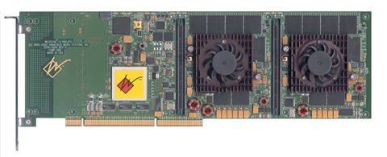
Platforms
Annapolis Micro Systems WILD STAR II Pro:
One Xilinx Virtex-2 Pro 100 (100K gates at 50 MHz)
2 GB/s SRAM b/w
PCI-X host interface

Slide 5
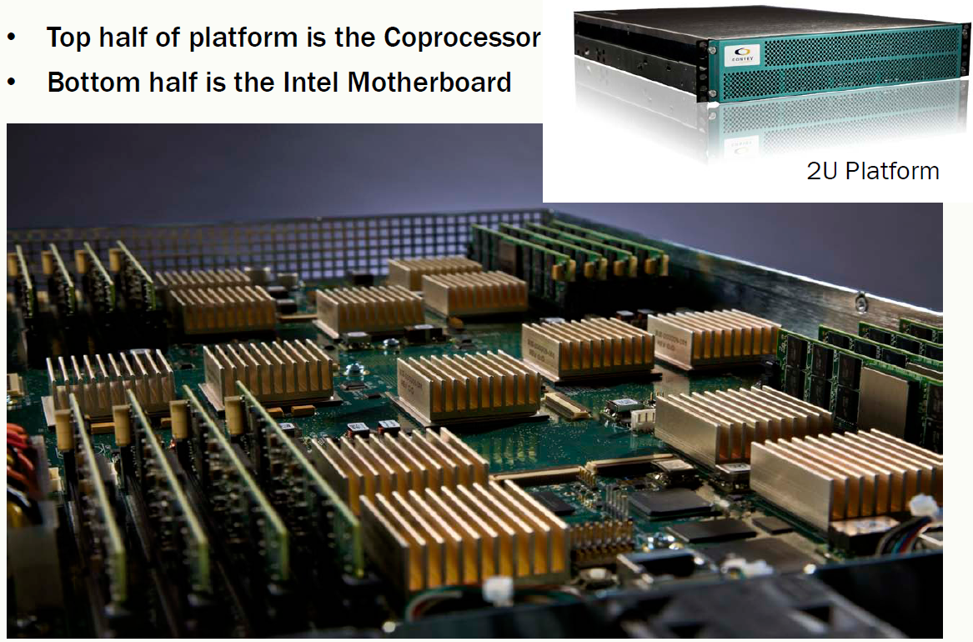
Convey HC-1
Large coprocessor board with FSB interface to host
FSB interface keeps coprocessor memory coherent with host
Four Xilinx-5 LX 330s
~1.32M gates at 150 MHz
Memory is partitioned into eight disjoint regions
Each FPGA has a channel to each of these regions
Max bandwidth 76.8 GB/s
16 GB memory
Compared with WILDSTAR:
13.2 X FPGA resources
28.4 X memory bandwidth
>1000X memory capacity

Slide 6
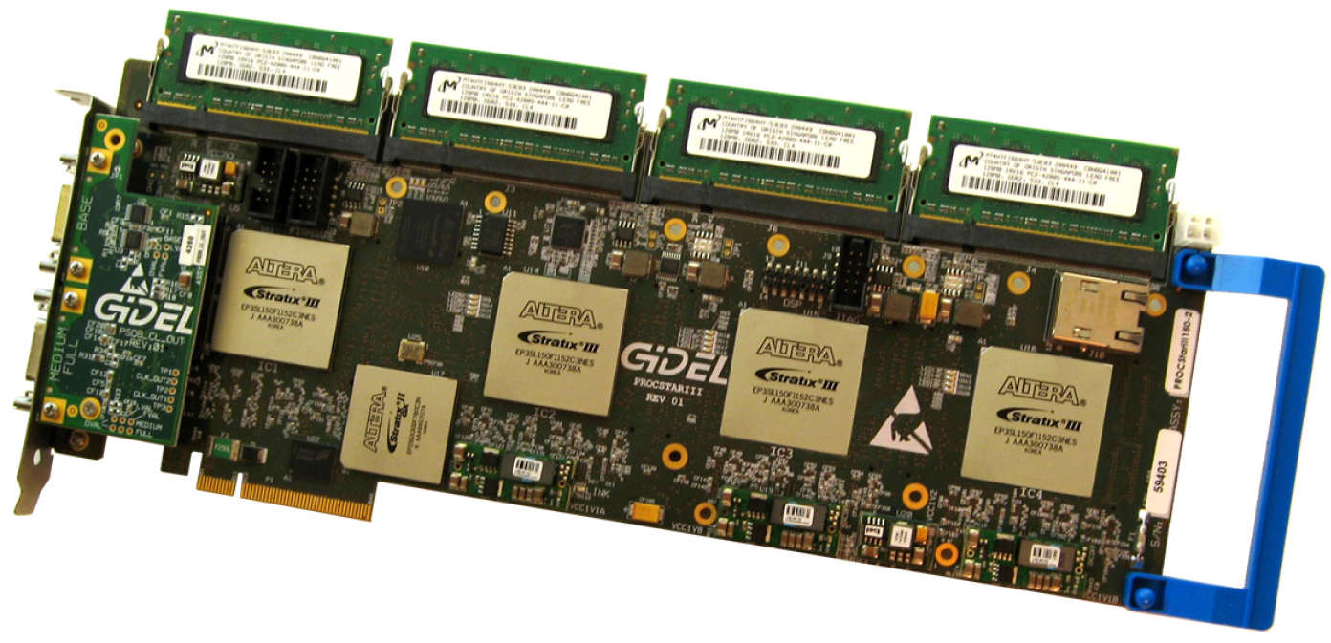
GiDEL PROCSTAR III
8-lane PCIe Gen.2 8-lane
Four Altera Stratix 260 FPGAs
1.04M gates at 250 MHz
Each FPGA has three 64-bit DDR2 memories
4 GB/s on board DRAM / 4 GB/s SODIMM / 2.1 GB/s SODIMM
Aggregate bandwidth 40.4 GB/s
16 GB memory

Slide 7
Genomics Applications
GRAPPA [phylogenetic inference]
Instead of sequences of nucleotides, uses gene order data
Infer evolutionary relationships through gene rearrangement events
Relies on combinatorial search
MrBayes / BEAGLE-Lib [phylogenetic inference]
Traditional sequence-based data
Operates on floating-point vectors
Widely used
AmpliconNoise [metagenomics]
Metagenomics (analysis of mixed DNA)
Reads large set of short reads from 454 sequencer
Objective: remove noise that overestimates # of species
Relies on alignments and clustering

Slide 8
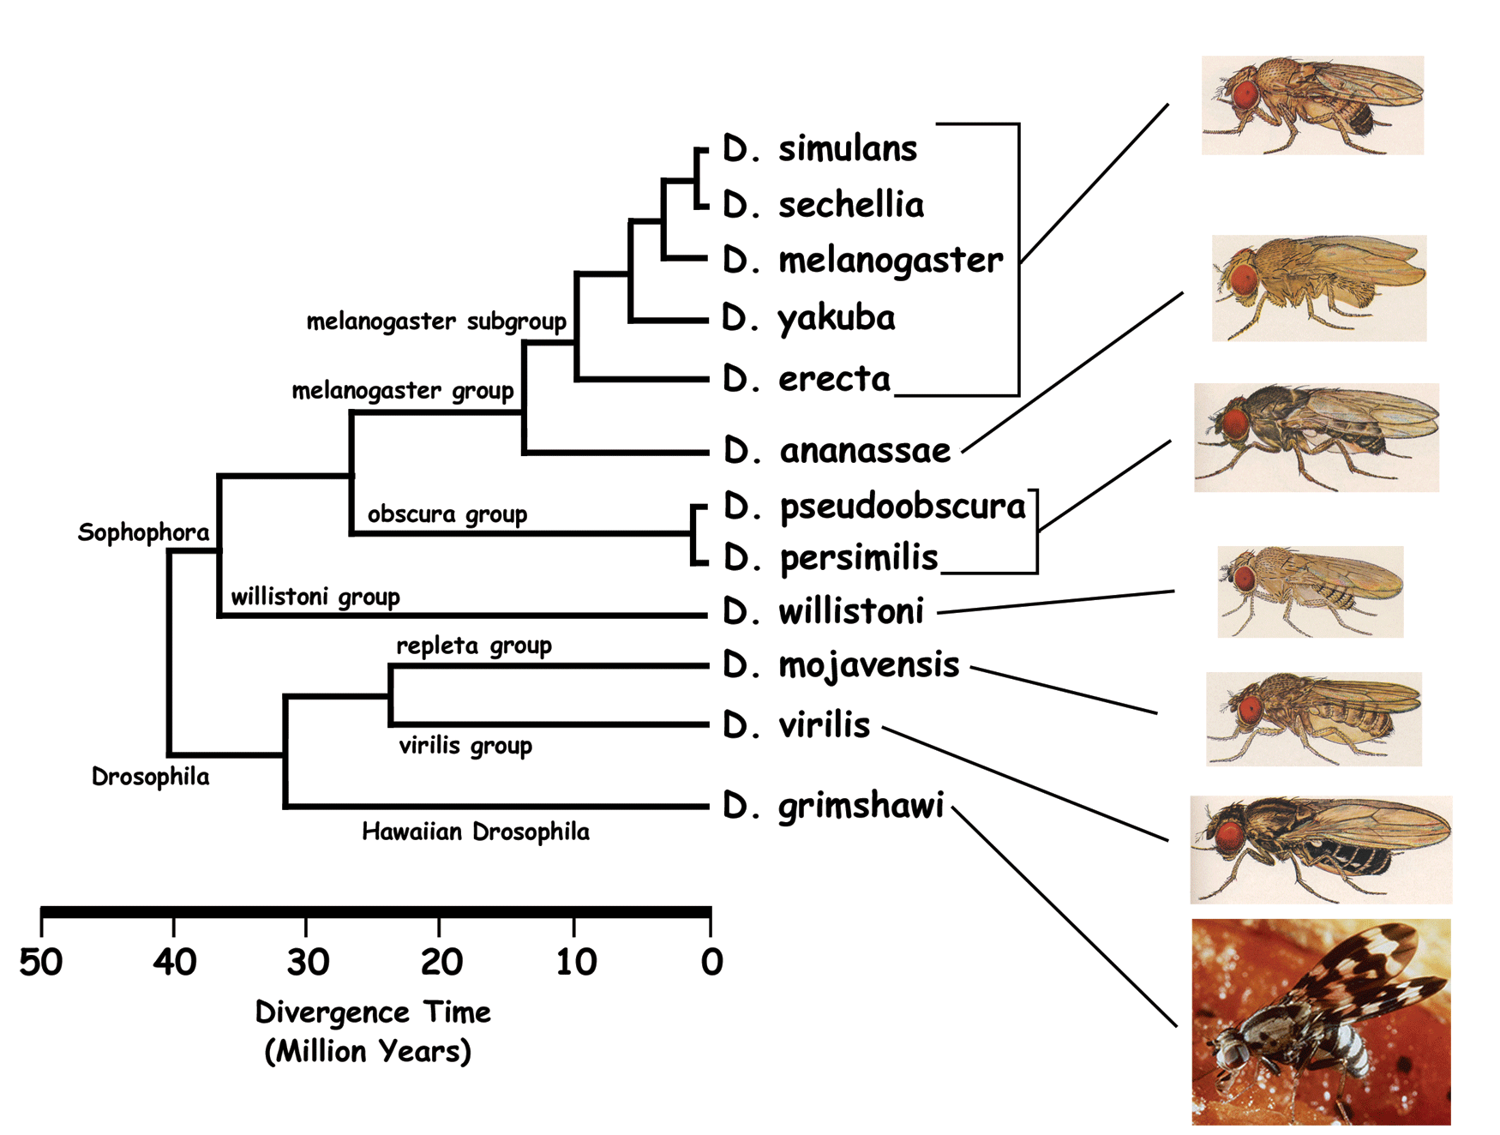
Phylogeny Reconstruction
Evolutionary relatedness among set of input species
Given input species, find accurate evolutionary history

Slide 9
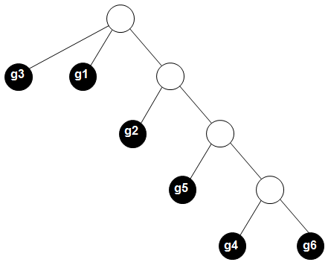
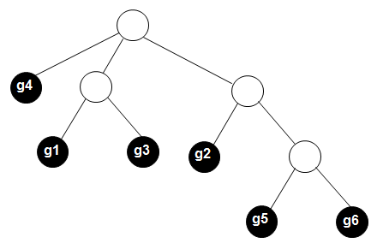
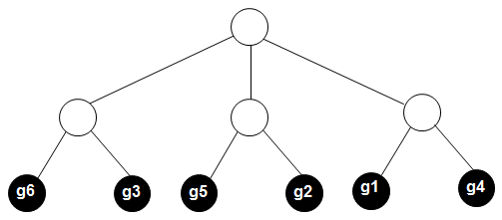
Phylogenies
Possible binary trees with n leaves:
(2n - 5) * (2n - 7) * (2n - 9) * … * 3
16 leaves => 200 trillion trees
50 leaves => 2.8e74 trees (2⁵⁰ = 1.1e15)
Phylogeny reconstruction tools search tree space for most accurate tree
Basic algorithm:
Explore space of all possible trees
When a candidate tree is found, score it
Involves computing ancestral data

Slide 10
GRAPPA: Gene Order Data
Each gene represents a homologous nucleotide sequence
Each gene has a positive or negative orientation
Based on the evolutionary model of gene rearrangements:
Inversion
g₀ g₁ g₂ g₃ g₄ g₅ g₀ g₁ –g₄ –g₃ –g₂ g₅
Transposition
g₀ g₁ g₂ g₃ g₄ g₅ g₀ g₂ g₃ g₄ g₁ g₅
Compared with DNA sequences, gene orders are relatively short
Goal:
Directly estimate ancestral gene orders
Determine number of events along branches in tree

Slide 11
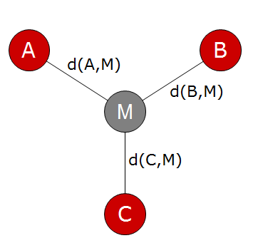
GRAPPA: Median Computation
Each candidate tree: label internal vertices with a median gene order
Find M that optimally minimizes median score
score = d(A,M) + d(B,M) + d(C,M)
Is computational kernel for data sets with high evolution rate

Slide 12
GRAPPA: Breakpoint Median Algorithm
Input gene orders => graph
Perform TSP, tour corresponds to median
A = -1 +2 -4 -3
B = -1 -2 +3 +4
C = -2 +3 +4 +1
Decompose to edges:
-3,4 weight 0
2,3 weight 1
-1,-2 weight 2
1,2 weight 2
-1,-4 weight 2
1,-4 weight 2
-2,-4 weight 2
+
-
+
-
1
2
1
2
weight = -∞
weight = 0
weight = 1
weight = 2
-
+
-
+
+
-
+
-
4
3
4
3
-
+
-
+
Edges not shown have cost = 3
An optimal solution corresponding to genome +1 +2 -3 -4

Slide 13
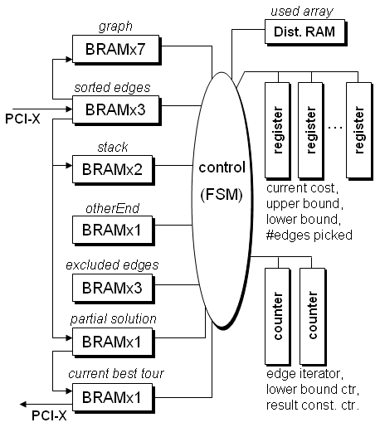
GRAPPA: Hardware Median Core Design
Perform DFS to find every valid combination of edges
For each partial search state, perform lower bound computation
Requires traversal of edge list
Greedily add edges to complete tour
Exclude edges that were pruned in partial state or that would cause cycle
Imp. as controller and on-chip RAMs
No off-chip memory access

Slide 14
GRAPPA: Parallelizing Median
Processing elements are compact
Fine-grain
Replicate onboard RAMs by lower bound by factor of 20X
Perform 20 iterations of lower bound loop in parallel
Coarse-grain
Use multiple median cores for single median computation
Each core uses different ordering of same-weighted edges in edge list

Slide 15
GRAPPA: Median Acceleration Performance
Median performance:
Application performance:
Average Events per Edge | Average Median Speedup
19 | 22
20 | 45
21 | 52
22 | 91
23 | 136
24 | 154
25 | 876
Average Events per Edge | Average Application Speedup
10 | 6
11 | 9
12 | 129
13 | 189

Slide 16
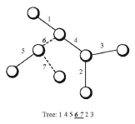
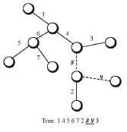
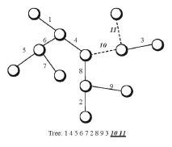
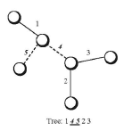
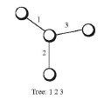
GRAPPA: Branch and Bound for Trees
Also developed PE for bounded DFS search for tree space
Lower bound = F(leaf ordering)
Implement as processing element as FSM controller and on-chip RAMS
FPGA can fit 37 PE instances
Equally divide search space among multiple processing elements

Slide 17
GRAPPA: Tree Generation Performance
Leaves | Trees | Speedup w/1PE | Speedup w/8PEs | Speedup w/16PEs | Speedup w/20PEs
10 | 2e6 | 2 | 7 (x3.6) | 8 (x4.4) | 8 (x4.4)
11 | 3e7 | 3 | 16 (x5.0) | 23 (x7.2) | 23 (x7.3)
12 | 7e8 | 3 | 18 (x5.2) | 26 (x7.8) | 26 (x7.6)
13 | 1e10 | 4 | 19 (x5.5) | 28 (x8.4) | 28 (x8.0)
14 | 3e11 | 5 | 25 (x5.6) | 37 (x8.6) | 37 (x8.2)

Slide 18
MrBayes: Likelihood-Based Inference
Uses DNA data (A,C,G,T)
Represent each character as a likelihood of being A, C, G, or T
At leaves: 4-value vector for each character:
A, G, A, C, A, T =>
(1,0,0,0), (0,0,1,0), (1,0,0,0), (0,1,0,0), (1,0,0,0), (0,0,0,1), …
Internal nodes, calculate each character as non-zero likelihoods:
(0.3, 0.1, 0.4, 0.2), …
To score candidate, traverse all nodes from leaves to root:
Calculate likelihoods for internal nodes as a function of left and right decedents
At root: calculate tree likelihood
Accumulate log of the maximum likelihood for each character

Slide 19
MrBayes: Likelihood-Based Inference
clP
clP[A]=(clL[A]*tipL[AA] + clL[C]*tipL[AC]
+ clL[G]*tipL[AG] + clL[T]*tipL[AT])
* (clR[A]*tipR[AA] + clR[C]*tipR[AC]
+ clR[G]*tipR[AG] + clR[T]*tipR[AT])
clP[C]=…
 | A | C | G | T
1
2
3
P
clL
clR
 | A | C | G | T
1 | .24 | .65 | .10 | .01
2 | .31 | .15 | .32 | .22
3 | .11 | .21 | .38 | .30
 | A | C | G | T
1 | 0 | 1 | 0 | 0
2 | 1 | 0 | 0 | 0
3 | 0 | 0 | 1 | 0
L
leaf
R
 | A | C | G | T
A
C
G
T
 | A | C | G | T
A
C
G
T
tipL
tipR

Slide 20
MrBayes: High Level Synthesis
Requires many operators but no dependences between indices
Requires 10 inputs and generates 6 outputs per “loop iteration”
Performs 130 FP operations per 64 bytes of I/O
Includes polynomial log approximation
38 adds, 55 multiplies, 4 divides, 11 comparisons
Arithmetic intensity = 2.03 flops/byte [memory bandwidth bound]
On Convey HC-1:
Eight independent memory channels on each FPGA
Associate one FP pipeline per channel
Each channel can supply four input values per cycle
Data Introduction Interval (DII) = 10/4 = 3 cycles
Set port constraint
GOAL: assume peak b/w, instance minimal # of FUs = # ops / DII
None of our commercial HLS tools would do this
Developed a port constrained high-level synthesis tool

Slide 21
MrBayes: Port Constrained Synthesis
Objective: for memory-bound kernels…
Generate pipeline having throughput match available input bandwidth
Minimize # functional units, lower bound = # ops / DII
Minimize overhead (muxes and registers) from FU sharing
Algorithm:
Input: DFG of kernel
Instance minimal # of functional units of each type
Loop:
Choose a DFG operator whose inputs have already been scheduled
Attempt to schedule it as early as possible
If there aren’t enough instanced functional units, move it forward in the schedule until there are no conflicts

Slide 22
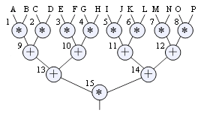
MrBayes: Functional Unit Sharing
Expanded Phylogenetic Likelihood Function for one base:
clP[h] = (tipL[AA]*clL[A] + tipL[AC]*clL[C] +
tipL[AG]*clL[G] + tipL[AT]*clL[T]) * (tipR[AA]*clR[A] + tipR[AC]*clR[C] + tipR[AG]*clR[G] + tipR[AT]*clR[T]);
user
DFG
Node | Slot | Type | FU
1 | 1 | × | mul1
2 | 2 | × | mul1
3 | 3 | × | mul1
4 | 4 | × | mul1
5 | 5 | × | mul1
6 | 6 | × | mul1
7 | 7 | × | mul1
8 | 8 | × | mul1
9 | 10 | + | add1
10 | 12 | + | add1
11 | 14 | + | add1
12 | 16 | + | add1
13 | 25 | + | add1
14 | 29 | + | add1
15 | 42 | × | mul2
+ port constraints
Cal. DII, min. FUs
Schedule FU with heuristic

Slide 23
MrBayes: Data Flow Graph
Natural log approximation:
order-5 polynomial (Chebychev)

Slide 24
Design
Instance 8 pipelines per FPGA = 32 pipelines
In order to get likelihood logic to fit:
Leverage relatively slow clock of HC-1 to reduce latency of FUs:
3-cycle FP add, 3-cycle FP mult [DSP], 11-cycle FP divide
Final design with 8 PEs/FPGA:
93% LUT, 96% FF, 99% slice, 81% BRAM, 79% DSP
Performance potential
2.03 flops/byte x 76.8 GB/s x memory efficiency
50% memory efficiency => 78 GFLOPS/s
Performance results:
3X speedup vs. BEAGLE on Tesla T10 GPU
50X speedup vs. BEAGLE on dual 4-core Xeon 5520

Slide 25
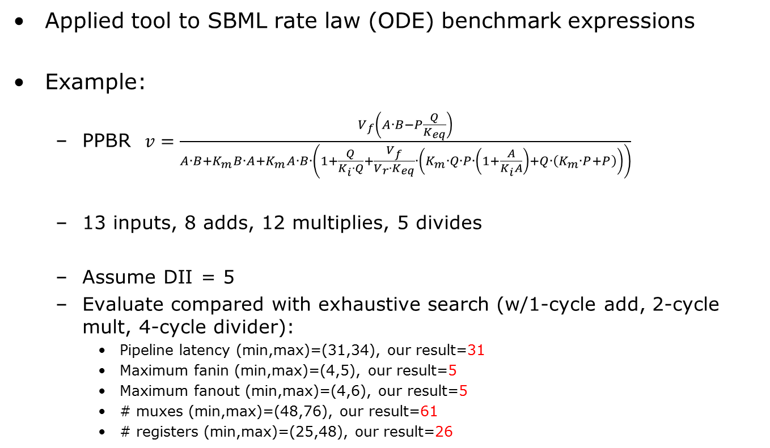
Port Constrained Synthesis of FP Pipelines
Applied tool to SBML rate law (ODE) benchmark expressions
Example:
PPBR $v=\frac{V_{f}\left(A∙B−P\frac{Q}{K_{eq}}\right)}{A∙B+K_{m}B∙A+K_{m}A∙B∙\left(1+\frac{Q}{K_{i}∙Q}+\frac{V_{f}}{V_{r}∙K_{eq}}∙\left(K_{m}∙Q∙P∙\left(1+\frac{A}{K_{i}A}\right)+Q∙\left(K_{m}∙P+P\right)\right)\right)}$
13 inputs, 8 adds, 12 multiplies, 5 divides
Assume DII = 5
Evaluate compared with exhaustive search (w/1-cycle add, 2-cycle mult, 4-cycle divider):
Pipeline latency (min,max)=(31,34), our result=31
Maximum fanin (min,max)=(4,5), our result=5
Maximum fanout (min,max)=(4,6), our result=5
# muxes (min,max)=(48,76), our result=61
# registers (min,max)=(25,48), our result=26

Slide 26
Comparison with Commercial HLS Tools
For same benchmark:
Assume border case with one physical input port, DII=13
Evaluating AutoESL now
 | ImpulseC | SynforaC | Our tool
FUs | 25 | 7 | 3
Total LUTs | 6605 | 4805 | 2236
Total regs | 6453 | 4066 | 1820
Speed | 150.2 MHz | 146.8 MHz | 158.MHz

Slide 27
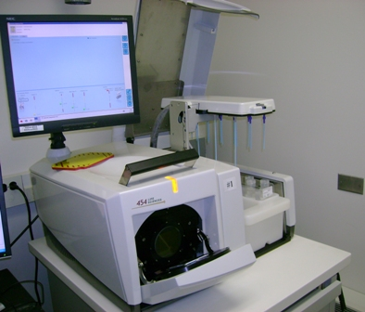
AmpliconNoise: Pyrosequencing Noise Removal
In metagenomics, sequence mixed genomes from different bacterial species
Goal: remove noise to prevent overestimation of # unique genomes
Roche 454 sequencer
Produces a run of
~100K short reads of ~800 length each
Kernel:
Cluster reads to differentiate unique species
Compute pairwise distance matrix
Distances based on global alignment score

Slide 28
AmpliconNoise: Global Alignment
Match similar sequences to each other
Alignment “uncovers” edits (gaps show deletions/insertions):
sequence 1: A G G T C C A G C A T
edits:
A C C T A G C C A G C A T
change
insert
delete
sequence 2:
A C C T A G C C A A T
Aligned sequence 1: A G G T - - C C A G C A T
Aligned sequence 2: A C C T A G C C A - - A T

Slide 29
AmpliconNoise: Score Matrix
Basic idea:
Based on penalties for:
Adding gaps to sequence 1
Adding gaps to sequence 2
Character substitutions (based on table)
Construct a score matrix, where:
Each cell (i,j) represents score for a partial alignment state
Sequence 1
A | B
C | D
Sequence 2
D = best score, among:
Add gap to sequence 1 from B state
Add gap to sequence 2 from C state
Substitute from A state
Final score is in lower-right cell

Slide 30
AmpliconNoise: Global Alignment
Also need to compute move matrix, which records which option was chosen for each cell
Trace back to get for alignment length
AmpliconNoise: Divide score by alignment length
 | A | G | G | T | C | C | A | G | C | A | T
A | D | L | L | L | L | L | L | L | L | L | L | L
C | U | D | D | L | L | L | L | L | L | L | L | L
C | U | U | D | D | D | L | L | L | L | L | L | L
T | U | U | D | D | D | D | L | L | L | L | L | L
A | U | U | U | D | D | D | L | L | L | L | L | L
G | U | U | U | U | U | U | L | L | L | L | L | L
C | U | U | U | U | U | U | D | L | L | L | L | L
C | U | U | U | U | D | D | D | D | L | L | L | L
A | U | U | U | U | U | D | D | D | L | L | L | L
A | U | U | U | U | U | D | D | D | L | L | D | L
T | U | U | U | U | U | U | U | D | L | L | D | D
 | U | U | U | U | U | U | U | U | U | D | D | D
match
substitute
substitute
match
gap s2
gap s2
match
match
match
gap s1
gap s1
match
match

Slide 31
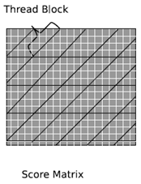
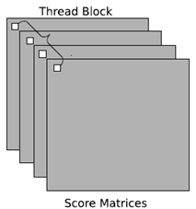
Accelerating AmpliconNoise with GPU
Most previous work:
Assumes local alignment for database search
One large alignment at a time
Associate one thread with each cell in each diagonal of score matrix
Our approach:
Billions of small alignments
One thread to each alignment operation
Interleave sequence data to ensure coalesced loads
Also:
Store substitution matrix in shared memory
Used performance testing to find optimal number of threads

Slide 32
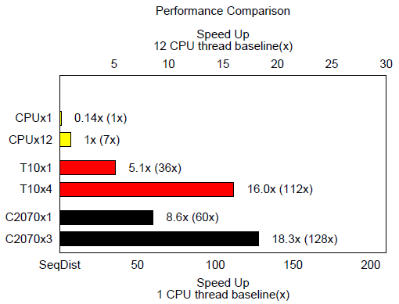
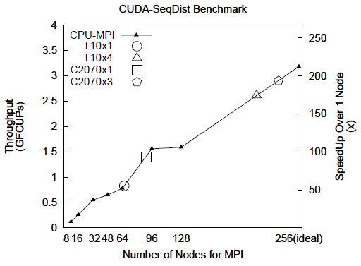
AmpliconNoise: Performance Results
3 Fermi GPUs achieves 18.3X speedup over 12 threads on Sandy Bridge CPU
3 GPUs achieves equivalent performance to 216 MPI ranks
(18 nodes with 12-thread CPUs)

Slide 33
Conclusions
FPGA and GPU coprocessors are a good match for demanding applications and datasets in genomics
Better development tools and methodologies are needed, especially for FPGA-based coprocessors
In particular, system simulators are needed that incorporate host-coprocessor interconnect models and coprocessor memory models needed for design space exploration

