Slide 1
Multi-Bit Differential Signaling Prototype Chip
Student Designers:
Jason D. Bakos, Leo Selavo, Amit Gupta
Faculty Advisor:
Donald M. Chiarulli
University of Pittsburgh

Slide 2
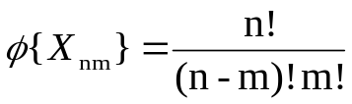

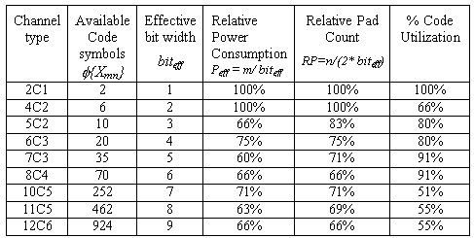
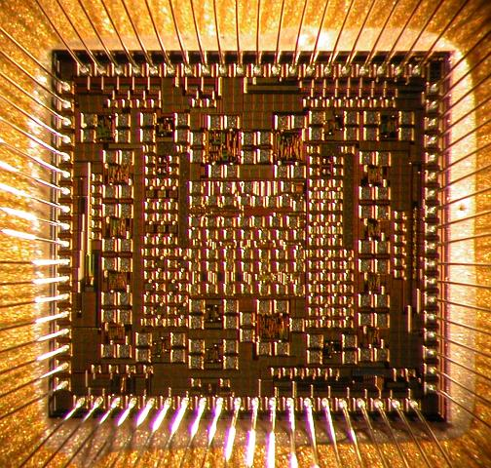
Multi-Bit Differential Signaling (MBDS)
Alternative to Low Voltage Differential Signaling (LVDS)
Code set size
Effective bits
Uses channel encoding
  Data encoded with fixed number of 1’s
  N-choose-M (nCm) encoding
  Example 4c2 code set: {0011}, {0101}, {0110}, {1001}, {1010}, {1100}
Advantages
  Equivalent noise rejection to LVDS
    Low switching noise
    No reference noise
    Coupled transmission lines
    Low voltage swing
  Higher information capacity than LVDS
EXAMPLE: 6c3 MBDS channel
  Equivalent to 8-wire LVDS
  25% fewer pads (8 vs. 6 pads)
  25% less power (4 vs. 3 1-bits)
  125% code capacity (20 codes versus 16)
IBM 5HP

Slide 3
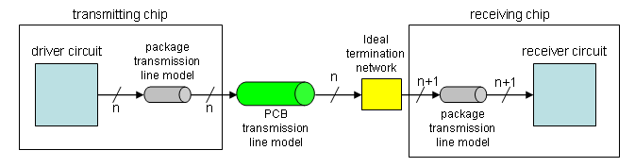
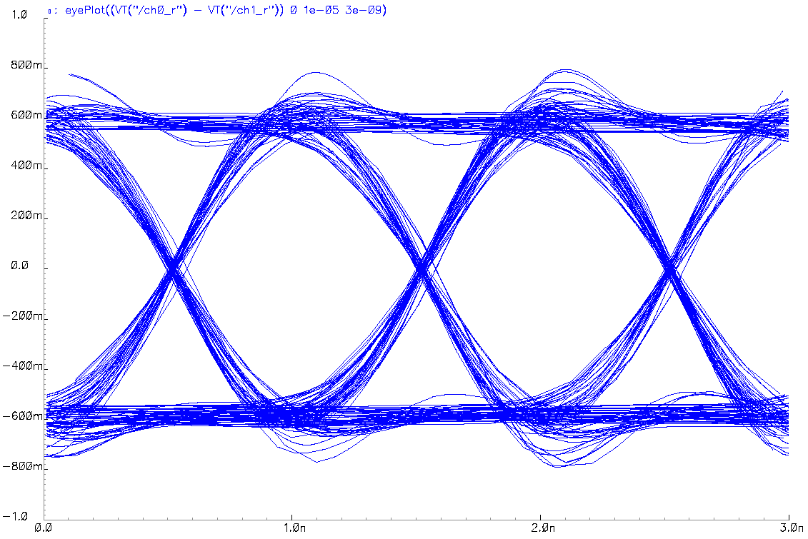
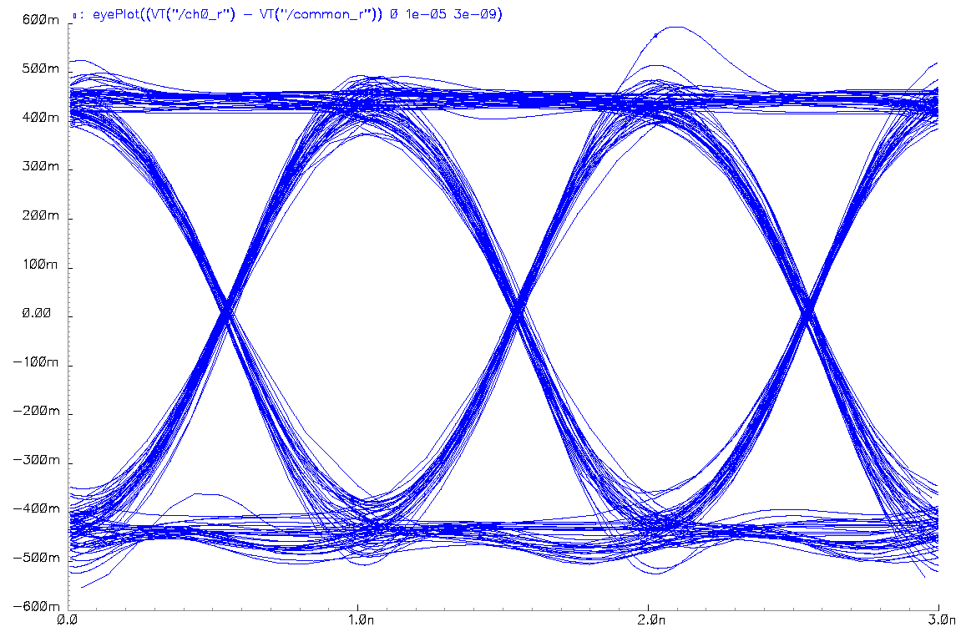
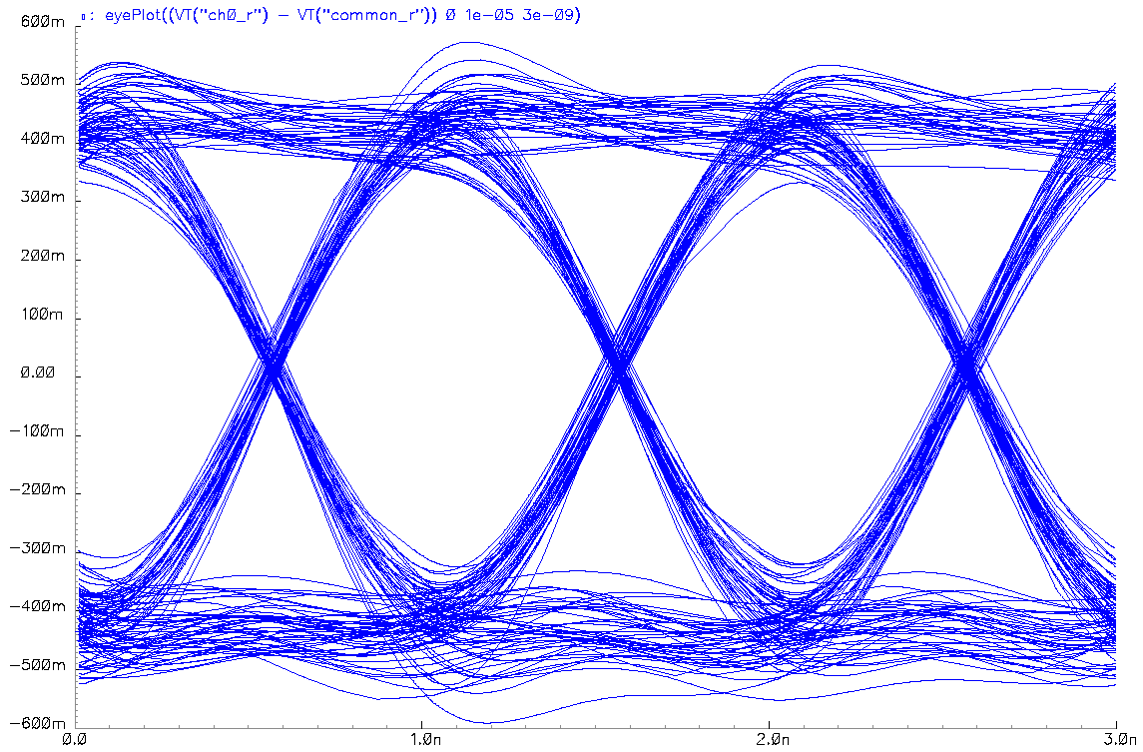
Simulation Setup / Results
Demonstrator chip includes:
  MBDS drivers with widths: 2, 4, 6, 8
  MBDS receivers with widths: 2, 4, 6, 8
Wire bond/solder balls models
Extracted layout
8” coupled striplines
Signals sampled here
Extracted layout
2c1 channel at 1 Gbps, 500 bit times, scale +/- 1 V
4c2 channel at 1 Gbps, 500 bit times, scale +/- 600mV
8c4 channel at 1 Gbps, 500 bit times, scale +/- 600mV

Slide 4
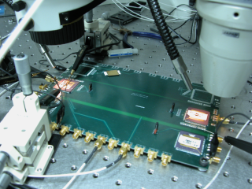
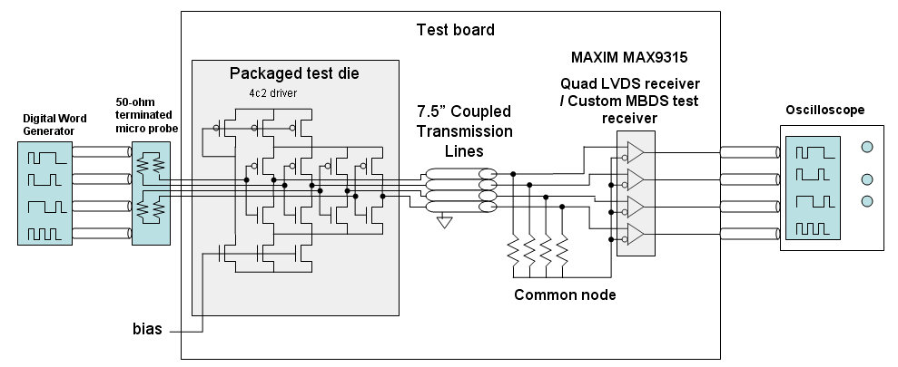
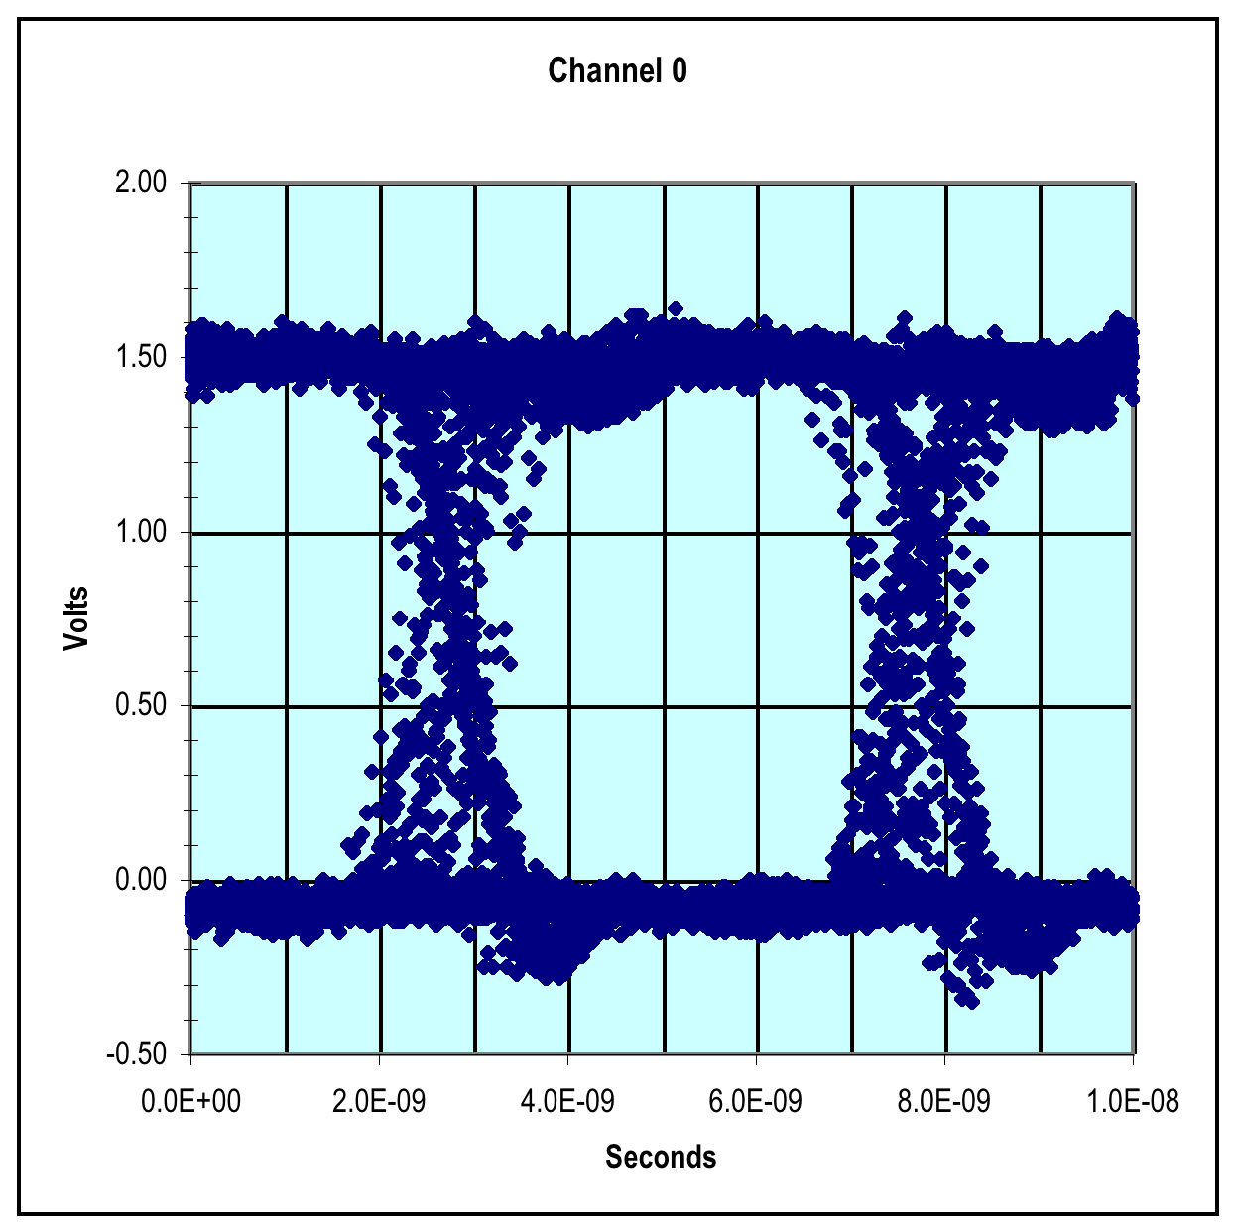
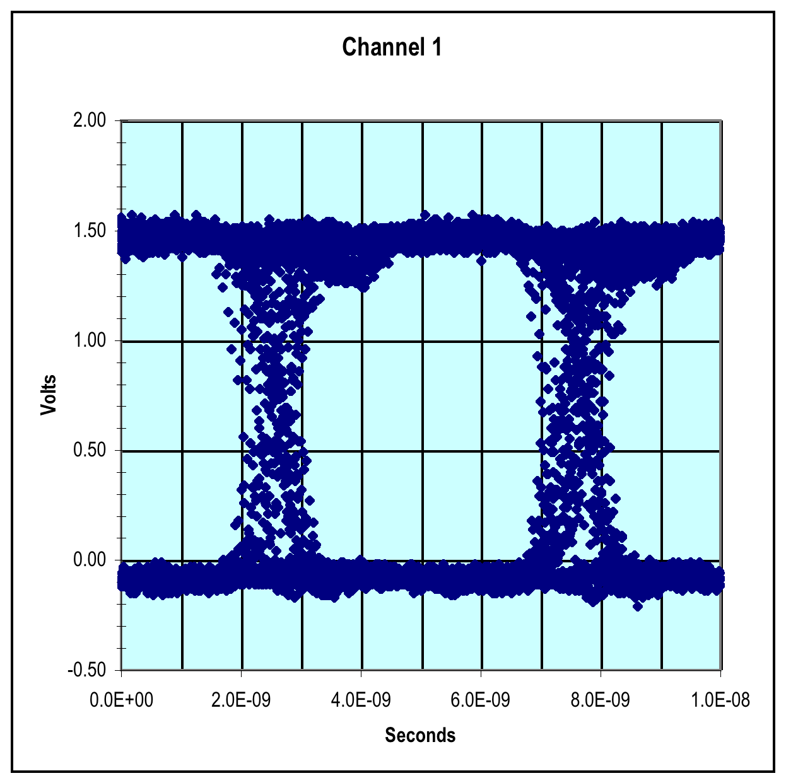
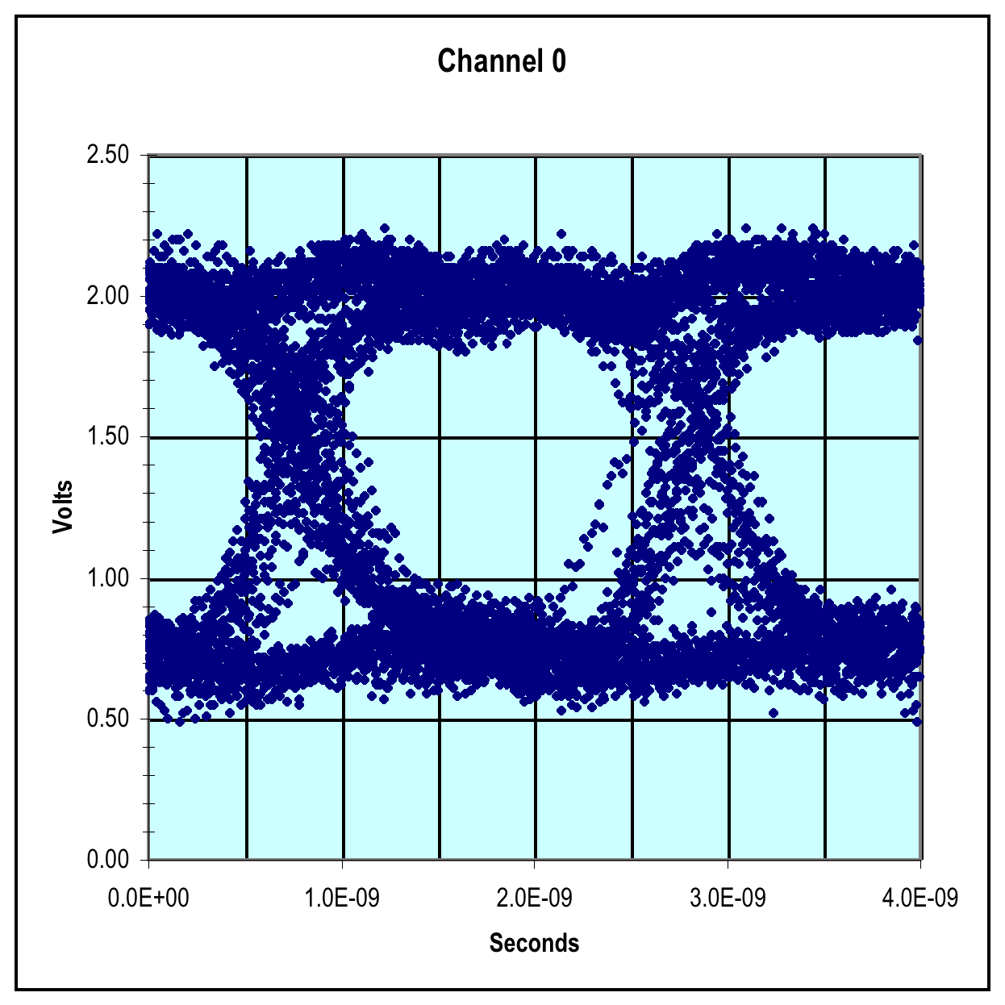
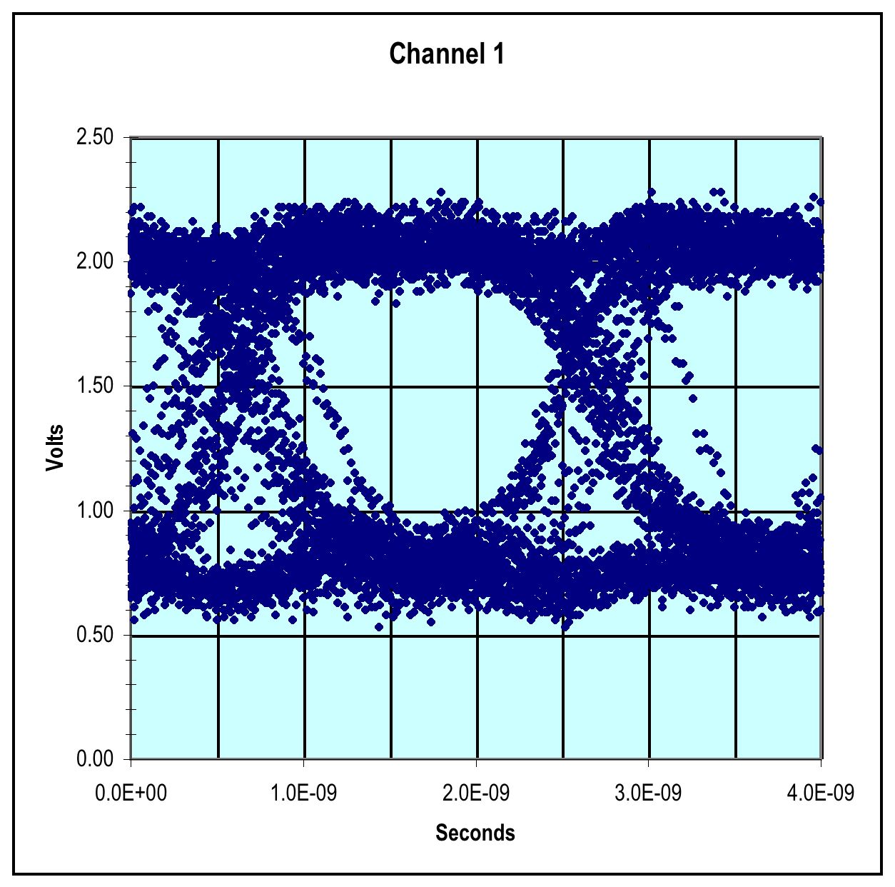
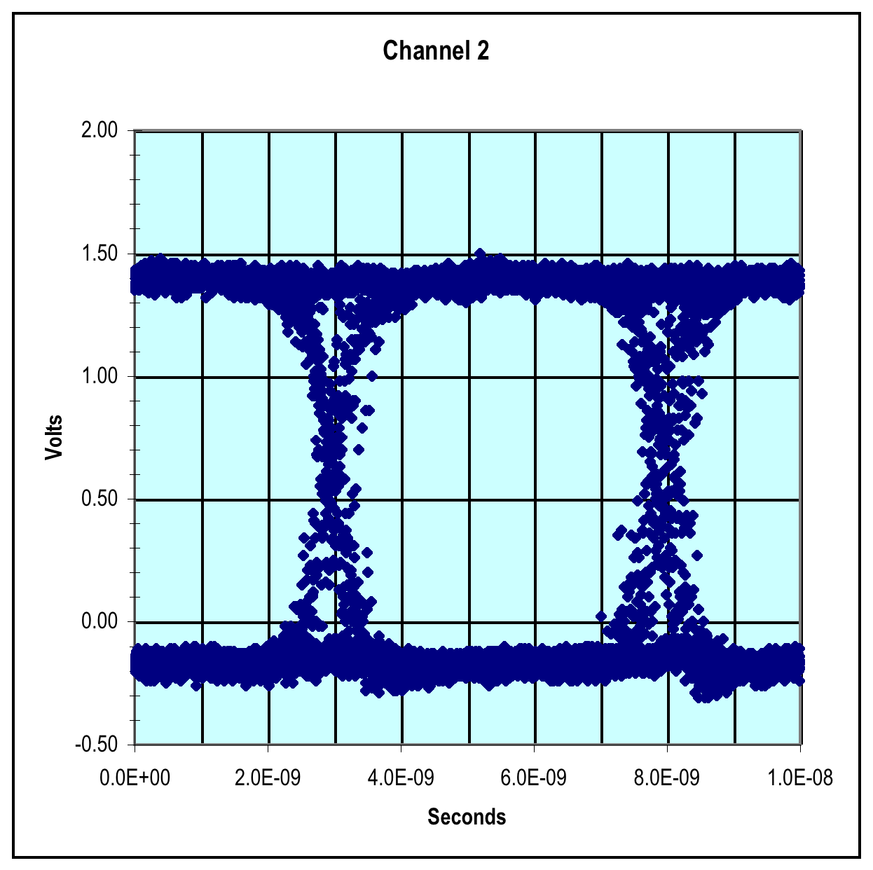
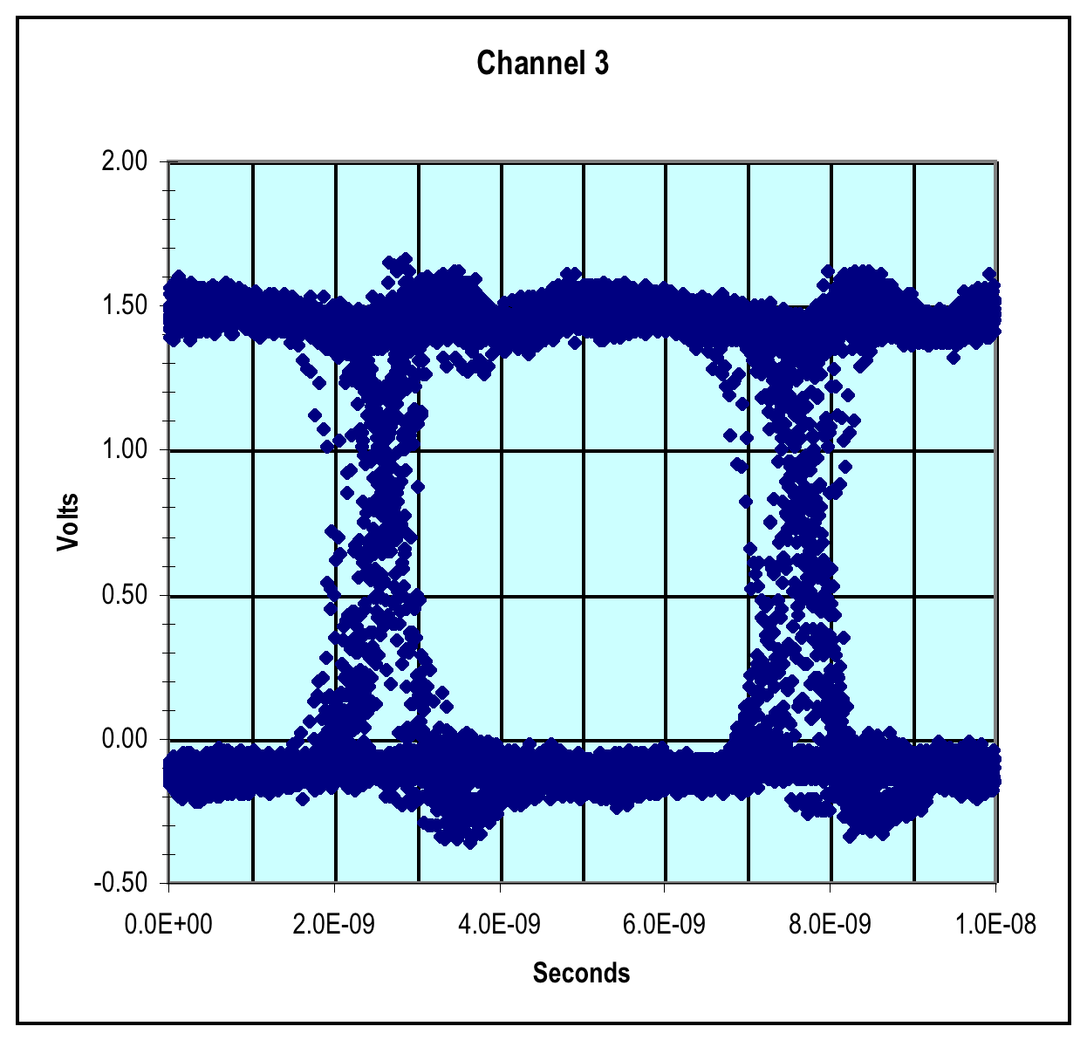
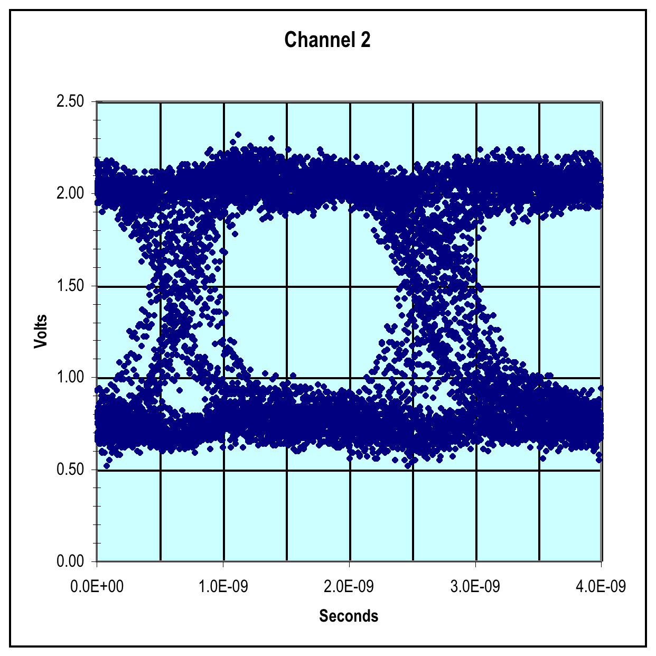
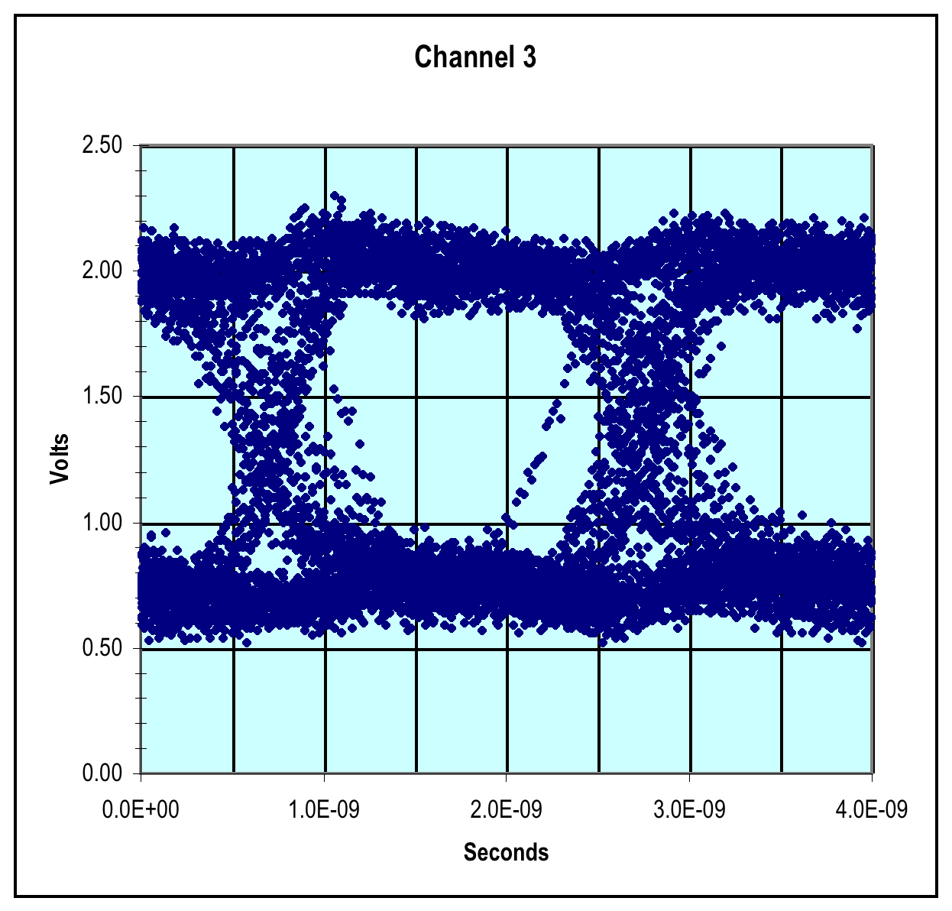
Chip Testing
Termination network at receivers
200 Mbps output with Quad-LVDS Receiver
500 Mbps with Custom LVDS Receivers
Experiment 1:
  Outputs from off-the-shelf LVDS receiver
  Compatibility with LVDS standard
Experiment 2:
  Outputs from LVDS receivers on chip

