Slide 1
Lightweight Hierarchical Error Control Codes for Multi-Bit Differential Channels
Jason D. Bakos
Ph.D. Committee:
Donald M. Chiarulli
Steven P. Levitan
Bruce R. Childers
Patchrawat Uthaisombut

Slide 2
Introduction
New class of error control codes
  “Lightweight Hierarchical Error Control Codes”
  Applicable to system-level interconnect
  Operates over new high-performance system-level interconnect technology
    “Multi-Bit Differential Signaling (MBDS)”
  Uses inherent properties of MBDS to achieve error control while requiring minimal data and logic overhead

Slide 3
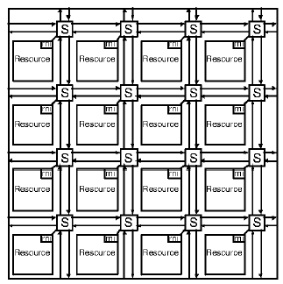
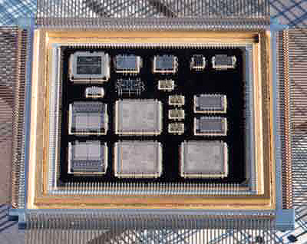
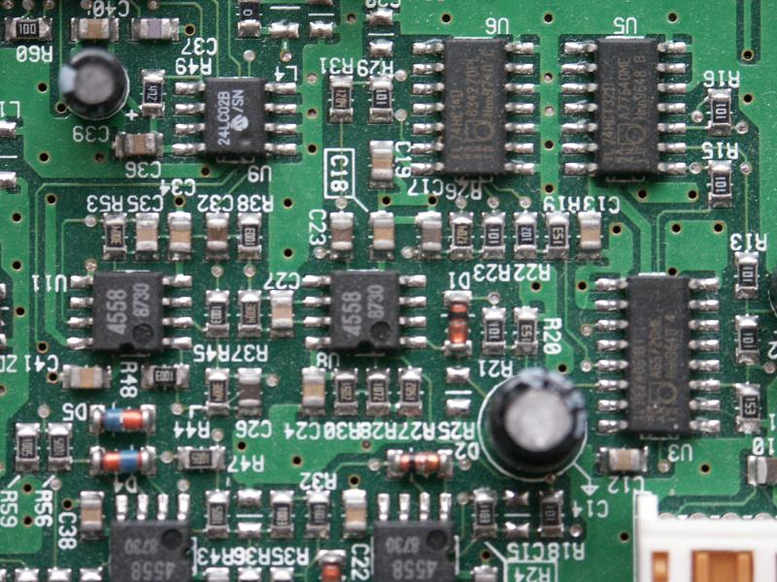
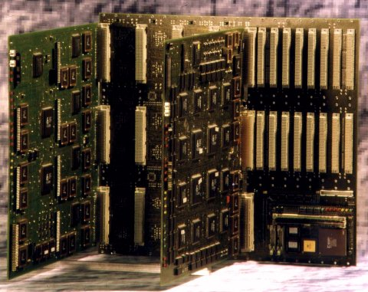
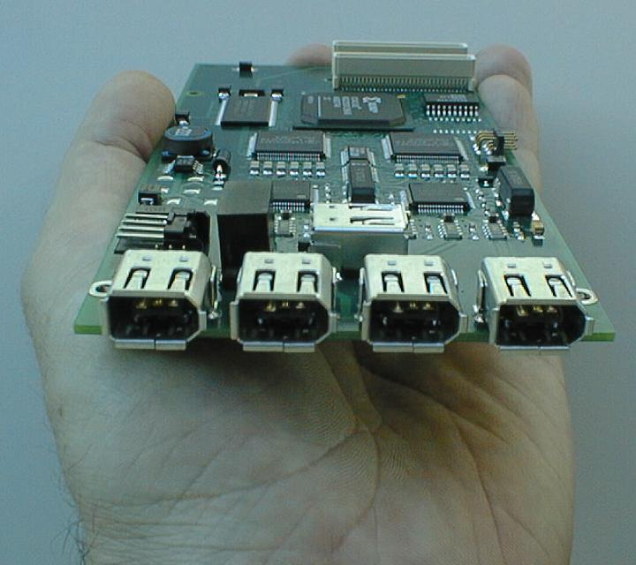
System-Level Interconnect
Network-on-chip
Multi-Chip Modules
System-level interconnect
  Short-haul
  High-speed
Printed circuit boards
Backplanes
Peripherals

Slide 4
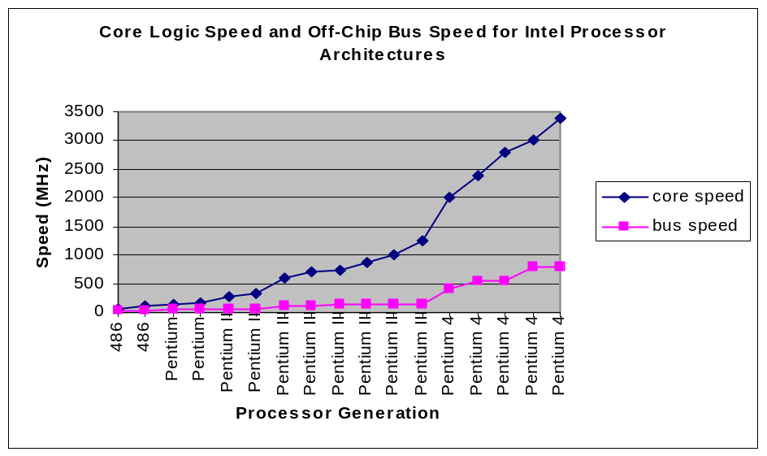
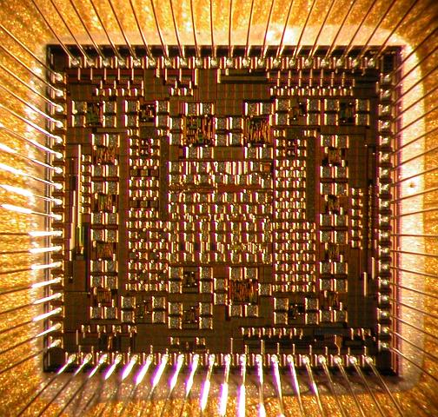
Challenges for System-Level Interconnect
Signal integrity
  Capacitance, inductance
  Noise, crosstalk
  Synchronization/jitter
Area
  I/O pads precious
  Driver size
Packaged chip
Packaged chip
Source: Intel Corporation

Slide 5

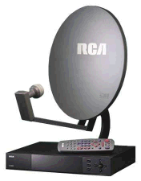
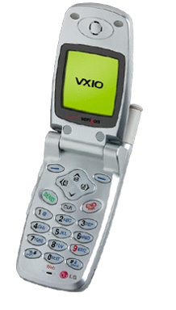
Error Control Codes
Error control codes used to increase signal integrity over noisy channels
Examples:
  Cellular networks, deep-space signaling, digital TV transmission, hard/optical disks
  Low-speed channels
ECC codes require information overhead
  Acceptable for low-speed channels
  Minimize by applying code over large blocks of data
  Example:
    187 bytes for HDTV

Slide 6
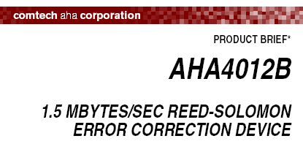
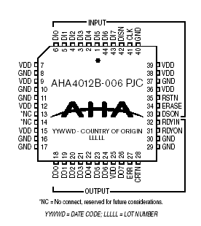
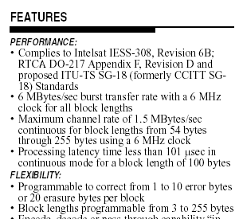

Error Control Codes
ECC over large blocks requires complex decoding
  Memory, latency
  Encoding/decoding logic complexity
Encoding/decoding performed using software or dedicated ASICs
  Performed at Mb/s-speeds
Traditional ECC codes not practical for system-level interconnect
  Encode/decode in small area
  High-throughput (core speed)
Need new class of ECC code for system-level interconnect
  Small block size
  Low overhead

Slide 7
Talk Outline
Multi-Bit Differential Signaling (MBDS)
  “N choose M” data encoding
Lightweight Hierarchical Error Control Codes (LHECC)
Encoder/decoder implementation
Experimental verification
  Link modeling
  Noise modeling
Experimental results
Conclusion

Slide 8
Multi-Bit Differential Signaling (MBDS)
Differential (LVDS) channels
Multi-Bit Differential (MBDS) channel
Current-mode drivers
Data encoded as
  {01} or {10}
Advantages
  Low switching noise
  Large GDP
  Common-mode noise rejection
  EM coupled transmission lines
  Low noise => low voltage swing
Disadvantages
  Wasteful in I/O pads
Scale up LVDS driver
Data encoded with fixed number of ones
“N-choose-M (nCm)” symbols
  {0011}, {0101}, {0110}, {1001}, {1010}, {1100}
Advantages
  Same transmission characteristics as differential
  Higher information capacity

Slide 9
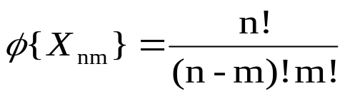

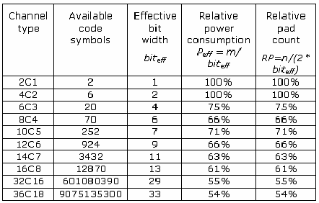
MBDS / “n choose m (nCm)” Encoding
Symbol set size
Effective bits
EXAMPLE
6-wire MBDS channel
20 symbols
effective bits = 4
equivalent to 8-wire differential channel
25% fewer pads (8 versus 6)
25% less power (4 1-bits on versus 3)

Slide 10
nCm Encoding: Unused Symbol Space
Each nCm symbol set has unmapped symbols
4c2 symbols => binary value
0011
00
0101
01
0110
10
1001
11
1010
?
1100
?
6 sym
6 sym
36 combinations
5 bits
Solution #1
  Use multiple MBDS channels in parallel
4c2
4c2
2 bits
2 bits
Solution #2
  Exclude symbols for purposes of ECC

Slide 11
nCm Encoding: Inherent Error Detection
Most types of symbol errors can be detected at receiver
Odd-number of bit errors
1011
1101
0111
1110
0011
0001
1000
0010
0100
1 error
3 errors
Even-number of bit errors
0011
1111
1001
1010
0101
0110
0000
2 errors

Slide 12
nCm Encoding: Inherent Error Detection
Chan | P(detect 2-bit error) | P(detect 4-bit error) | P(detect 6-bit error) | P(detect 8-bit error)
4c2 | 33%
6c3 | 40% | 40%
8c4 | 43% | 49% | 43%
10c5 | 56% | 48% | 48% | 56%

Slide 13
Talk Outline
Multi-Bit Differential Signaling (MBDS)
  “N choose M” data encoding
Lightweight Hierarchical Error Control Codes (LHECC)
Encoder/decoder implementation
Experimental verification
  Link modeling
  Noise modeling
Experimental results
Conclusion

Slide 14
Hierarchical Encoding
LHECC relies on a hierarchical approach to encoding
Binary source data
start with raw binary data
s-data
c-data
Encode portion of data, set rules for nCm symbol selection
high-level code
Symbolic ECC block
Encode remainder of data using nCm symbols
Code word over parallel MBDS channels
low-level code

Slide 15
Low-Level Code
nCm symbol sets have Hamming distance (d) = 2
Correctable bits = floor((d-1)/2)
Set new distance by partitioning into equal-size subsets
  s subsets, c symbols/subset
Example:
4c2, distance=4
Subsets:
  0 => {0011, 1100}
  1 => {0101, 1010}
  2 => {0110, 1001}
If subset is known, bit errors may be corrected
  Example: 0111, subset=2
  Correct to 0110
Performed off-line
1100
0101
1001
0011
0110
1010

Slide 16
Partitioning Operation
Perform search over space of assignments
Must know: distance, # subsets (s), and symbols/subset (c)
Minimize s while maximizing c
Example: 6c3, 4/4, distance=4
000111
subset 0:
subset 1:
001011
001101
0:
1:
2:
3:
Result:
Each nCm symbol becomes associated with an s-data component and a c-data component
Example: 100101
s-data: 1
c-data: 2
000111
011100
101010
110001
0:
1:
2:
3:
001110
001011
010110
100101
111000
010011
010101
010110
011001
011010
011100
subset 2:
subset 3:
100011
100101
100110
0:
1:
2:
3:
001101
011010
100011
110100
0:
1:
2:
3:
101001
001110
010101
101001
110010
101010
101100
110001
110010
110100
111000

Slide 17
High-Level Code: Linear Block Codes
Can correct:
erasures
errors
block size=n
k data symbols
n-k parity symbols
Checksum
  Requires 1 parity symbol
  Can correct 1 erasure
Near-MDS code
  Corrects erasures:
    Number of parity symbols - 1
  Corrects errors:
    (Number of parity symbols – 1) / 2
  Restrictions:
    Symbol base must be prime or power of a prime
    If symbol base = p^{m}, max block size = p^{m+1} - 1
MDS code (Reed-Solomon)
  Can correct erasures within block:
    Number of parity symbols
  Can correct errors within block:
    Number of parity symbols / 2
  Restrictions:
    Symbol base must be prime or power of a prime
    Max block size = symbol base + 1

Slide 18
Encoding LHECC
b bits
01010010010010010100
(s-data)
(c-data)
0101001001
0010010100
base conv. 2->s
base conv. 2->c
Data symbols
Parity symbols
Data as nCm symbols
Parity as nCm symbols

Slide 19
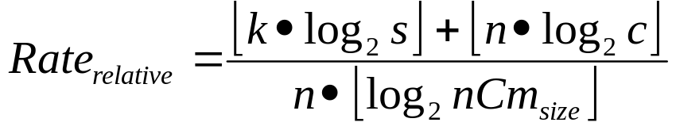
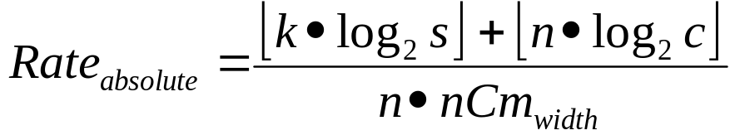

Code Rate and Overhead
LHECC codes are defined as (nCm,n,k,d_{h},s,c,d_{l}) codes
High-level code: k*log₂(s) bits
Low-level code: n*log₂(c) bits
Advantages over traditional block ECC:
  Requires less number of parity symbols for correction
  Parity symbols carry data

Slide 20
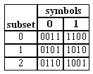
Example #1: Encoding
Assume 3 x 4c2 channels
  Low level
    s=3, c=2
  High level
    (3,2) checksum code
  s-data
    3² = 9 cw (3 bits)
  c-data
    2³ = 8 cw (3 bits)
  6 bits / 12 wires
  rel=1.0, abs=0.5, oh=0
  Can correct one bit error within 1 symbol
Encode 111101…
111₂ = 21₃
2
1
Compute checksum parity…
2
1
0
Encode 101…
bit
1
0
1
sub.
1001
0101
1100
2
1
0

Slide 21
Example #1: Decoding
Decoder:
  If invalid code word is detected
    Determine subset
    Use minimum distance decoder
Assume bit error occurs…
sub.
2
1
0
?
1
0
sym
1001
0101
1100
1101
0101
1100
0 – 1 = 2 (mod 3)
  Symbol in error must be 0110 or 1001
  dist(1101,0110) = 3, dist(1101,1001) = 1
  Corrected symbol is 1001

Slide 22
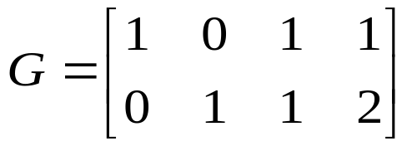
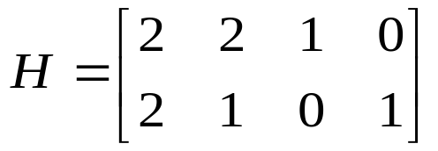
Example #2: Encoding
Assume 4 x 4c2 channels
  s=3, c=2
  (4,2) MDS code
  s-data
    3² = 9 symbols (3 bits)
  c-data
    2⁴ = 16 symbols (4 bits)
  7 bits / 16 wires
  rel=7/8=.88, abs=.44, oh=1 bit
  Can correct one bit error in two symbols
Need MDS generator matrix for encoding
  G = [ I^{k} A^{k x (n-k)} ]
Need MDS parity-check matrix for decoding
  H = [ -A^{T} I^{n-k}]

Slide 23
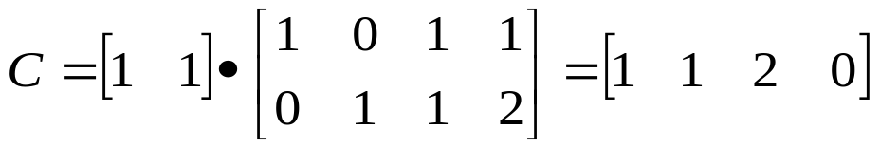
Example #2: Encoding
100
Encode 1001010…
1
1
2
0
Encode 1010...
bit
1
0
1
0
sub.
1
1
1010
0101
2
0
1001
0011

Slide 24
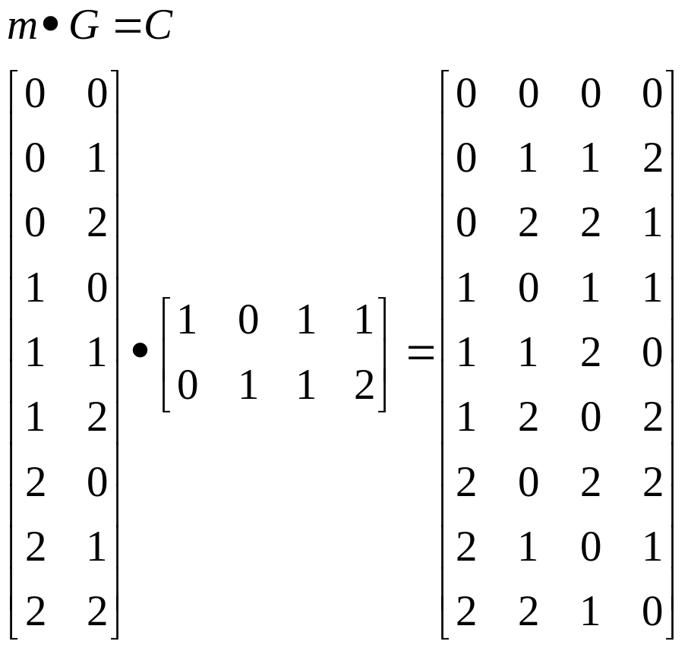
Example 2: Erasure Decoding
0 => {0011, 1100}
1 => {0101, 1010}
2 => {0110, 1001}
1010
0101
1001
0011
1110
0101
1001
0001
sub.
1
1
2
0
sub.
?
1
2
?
1
(recover s-data)
11₃ = 100₂
0
dist(1110,0101)=3
dist(1110,1010)=1
dist(0001,0011)=1
dist(0001,1100)=3
1010
0101
1001
0011
grp.
1
1
2
0
bit
1
0
1
0
(recover c-data)

Slide 25
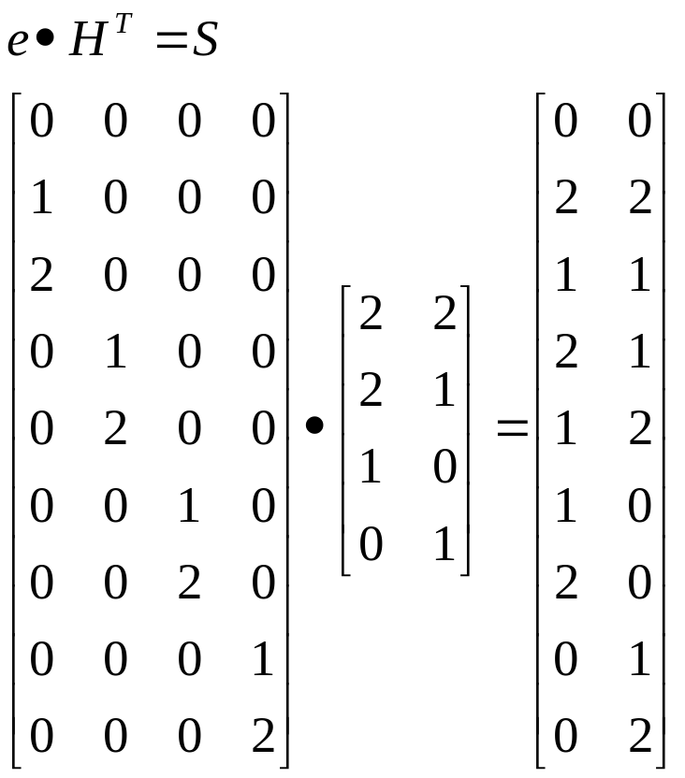

Example 2: Error Decoding
0 => {0011, 1100}
1 => {0101, 1010}
2 => {0110, 1001}
1010
0101
1001
0011
0110
0101
1001
0011
sub.
1
1
2
0
sub.
2
1
2
0
no error
dist(0110,0101)=2
dist(0110,1010)=2
Can’t correct nCm symbol without partitioning for more distance

Slide 26
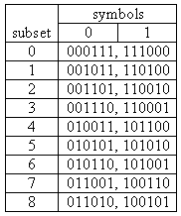
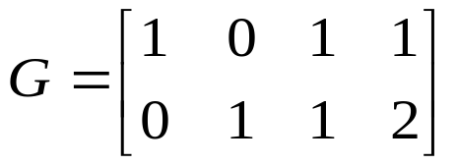
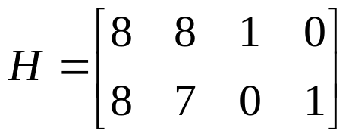
Example 3: Multiple Bit Error Correction
4 x 6c3 channels
9 subsets, 2 sym/subset, distance=6
Assume (4,2,3) MDS code
rel=10/16=.63, abs=10/24=42%
010110
110010
100101
001011
sub.
6
2
8
1
010110
110010
101001
001011
sub.
6
2
6
1
dist(101001,011010)=4
dist(101001,100101)=2
corrected symbol is 100101

Slide 27
LHECC Theory
LHECC is equivalent to binary code space over MBDS channels
Example: LHECC-encoded code word
  high-level distance=2
  low-level distance=4
  Assume inter-subset distance=2
s-data: 111, c-data: 110
0101
0101
0101
Hamming displacement=4
s-data: 111, c-data: 111
0101
0101
1010
Hamming displacement=2
Hamming displacement=2
s-data: 101, c-data: 110
0101
0011
1001

Slide 28
Example Partitionings
symbol set | symbols | subsets (s) | symbols/subset (c) | distance | overhead/parity | relative overhead
4c2 | 6 | 3 | 2 | 4 | 1.5 | .79
6c3 | 20 | 10 | 2 | 6 | 3.3 | .83
6c3 | 20 | 4 | 4 | 4 | 2 | .50
8c4 | 70 | 10 | 7 | 4 | 3.3 | .55
8c4 | 70 | 35 | 2 | 8 | 5.1 | .85
8c4 | 70 | 7 | 9 | 4 | 2.8 | .47
8c4 | 70 | 8 | 8 | 4 | 3 | .50
10c5 | 252 | 8 | 16 | 4 | 3 | .43
10c5 | 252 | 32 | 6 | 6 | 5 | .71
12c6 | 924 | 8 | 64 | 4 | 3 | .33

Slide 29
Talk Outline
Multi-Bit Differential Signaling (MBDS)
  “N choose M” data encoding
Lightweight Hierarchical Error Control Codes (LHECC)
Encoder/decoder implementation
Experimental verification
  Link modeling
  Noise modeling
Experimental results
Conclusion

Slide 30
Encoder/Decoder Implementation
Responsible for binary-to-nCm conversion as well as error detection/correction
Encoders/decoders should be small
Should operate at core speed
  Hierarchical encoding/decoding lends itself to pipelined implementation
Synthesized using standard cell library
  Latch, inverter, 2/3-input NAND, 2/3-input NOR
Example interconnect organization:
driver
receiver
binary
encoder
driver
receiver
decoder
binary
driver
receiver

Slide 31
3x6c3 Encoder Implementation
Implement a 3x6c3 code (1 bit error in 1 symbol)
s-data is 2*log₂(4) = 4 bits
c-data is 3*log₂(4) = 6 bits
Carries 10 bits over 18 wires
Relative code rate = 10 / (3*4) = 83.3%
Absolute code rate = 10 / 18 = 55.6%
Total:
208 gates, 30 latches
EACH:
63 gates
5 gate delays
19 gates
5 gate delays
sa(2)
gen. cw
6c3 (a)
ca(2)
s-data (4 bits)
checksum
checksum (2-bits)
sb(2)
gen. cw
pipeline reg (12 bits)
6c3 (b)
cb(2)
pipeline reg (18 bits)
c-data (6 bits)
ss(2)
gen. cw
cs(2)
6c3 (s)
High-level code
Low-level code

Slide 32
3x6c3 Decoder Implementation
96 gates
6 gate delays
err flags(3)
err flags(3)
err flags(3)
err flags(3)
Total:
830 gates,
128 latches
cwa(6)
nofix
cwb(6)
cw(6)
cw(6)
84 gates
6 gate delays
118 gates
8 gate delays
cws(6)
md_err
cerror
49 gates
7 gate delays
xora (6)
xora (6)
corr_c(2)
6 gates
2 gate delays
c_error(2)
ea
xorb (6)
sa(2)
xorb (6)
s-data (4)
md_decoder stage 1
md_decoder stage 2
6c3
resolver
xorc (6)
xorc (6)
ca(2)
corr_s(2)
corr_s(2)
xord (6)
blk-corrector
xord (6)
md_err
pipeline reg (33 bits)
pipeline reg (22 bits)
pipeline reg (38 bits)
pipeline reg (17 bits)
eb
pipeline reg (18 bits)
s-data (4)
6c3
sb(2)
16 gates
3 gate delays
resolver
cb (2)
blk_error detector
nofix
sa(2)
sa(2)
sa(2)
corr_s(2)
ca(2)
corr_c(2)
es
sb(2)
sb(2)
sb(2)
cb(2)
6c3
47 gates
7 gate delays
corr_s(2)
corr_c(2)
c-data (6)
ss(2)
resolver
c-data(6)
c-data(6)
c-data(6)
cs (2)
cs(2)
nofix
nofix
corr_c(2)
130x3 gates
7 gate delays
High-level code
Low-level code 1
Low-level code 2
24 gates
3 gate delays
Resolver
Routing

Slide 33
Encoder/Decoder Implementations
Itrct | Width | Correction capability | Encoder |  |  | Decoder |  |  | Max latency/stage
 |  |  | Gates | Latches | Stages | Gates | Latches | Stages
3x4c2 | 12 | 1 bit/1 sym | 100 | 28 | 3 | 328 | 66 | 5 | 7
4x4c2 | 16 | 1 bit/2 sym | 144 | 36 | 3 | 804 | 124 | 6 | 8
3x6c3 | 18 | 1 bit/1 sym | 208 | 30 | 2 | 830 | 128 | 6 | 8
3x8c4 | 24 | 1 bit/1 sym | 424 | 44 | 2 | 1246 | 234 | 6 | 8

Slide 34
Talk Outline
Multi-Bit Differential Signaling (MBDS)
  “N choose M” data encoding
Lightweight Hierarchical Error Control Codes (LHECC)
Encoder/decoder implementation
Experimental verification
  Link modeling
  Noise modeling
Experimental results
Conclusion

Slide 35
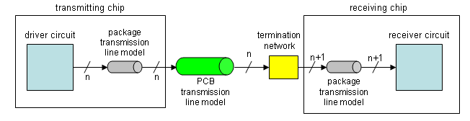
PCB Interconnect Model
CMOS code words in
Single MBDS channel
CMOS code words out
Input is sampled at midpoint
Replicated for each channel forming the interconnect
Driver input
cw_{n-1}
cw_{n}
cw_{n+1}
Outputs sampled at t(input) + latency
Receiver output
cw_{n-1}
cw_{n}
cw_{n+1}
latency

Slide 36
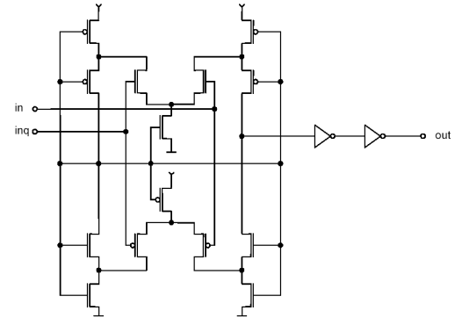
Driver/Receiver Modeling
MOSFET models from TSMC .18 um PDK
Driver circuit
Receiver circuit
4c2 input
4c2 output
source: Stefan Hirsch, Hans-Jörg Pfleiderer, “CMOS receiver circuits for high-speed data transmission according to LVDS-standard,” Proceedings of SPIE Vol. 5117 (2003).
Bias input
Bias current = 7.5 mA mean-abs current per leg

Slide 37
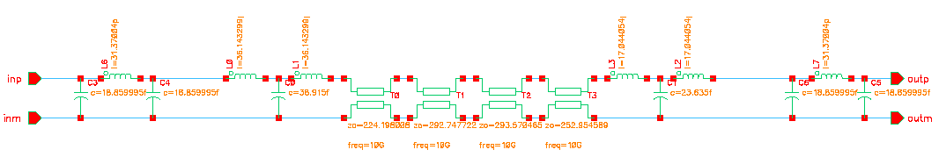
Package Modeling
solder bump model
solder bump model
wire bond model

Slide 38
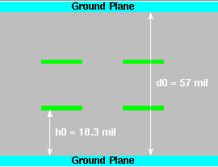
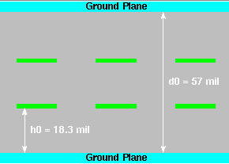
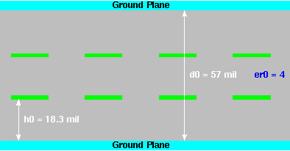
PCB Transmission Line Modeling
Length=7.5”
4c2
6c3
8c4
Fully coupled transmission line models
Ground capacitance, serial inductance
Coupled with mutual capacitance, mutual inductance
FR4 PCB material
Individual t-lines matched to 50 ohms
Width=16 mil, thickness=1.4 mil, distance=16 mil
Layer spacing based on commercial PCB process

Slide 39
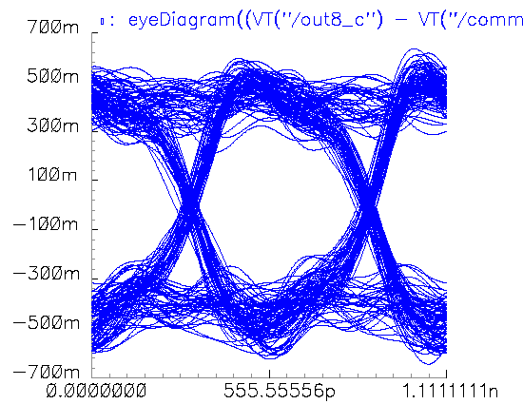
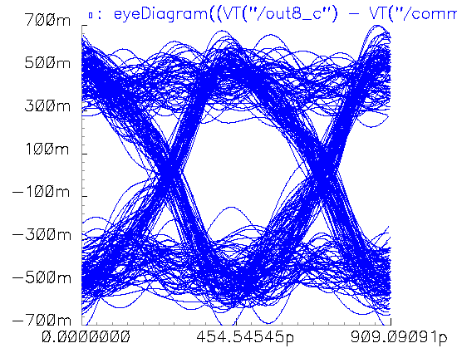
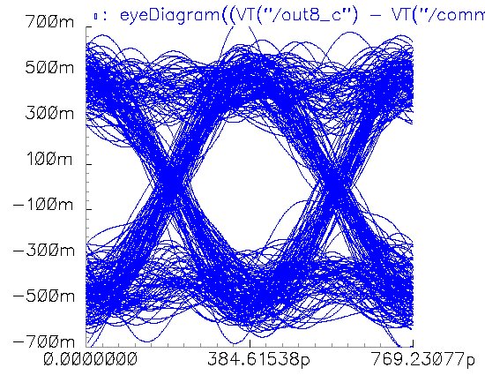
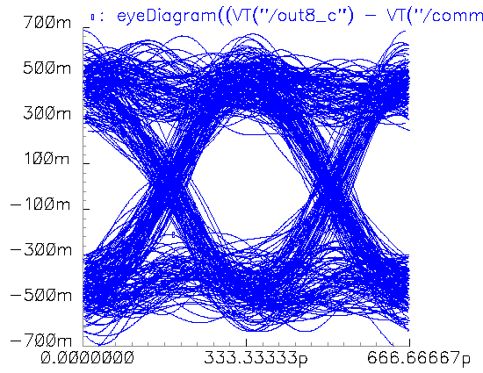
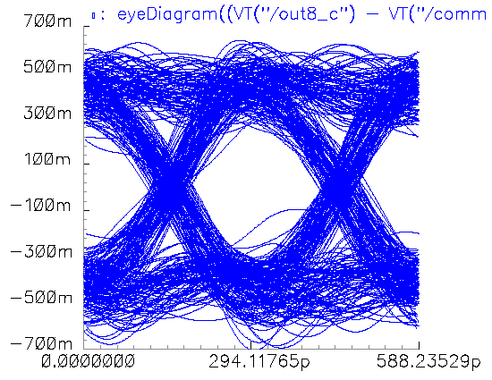
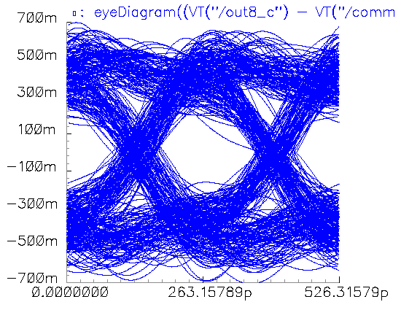
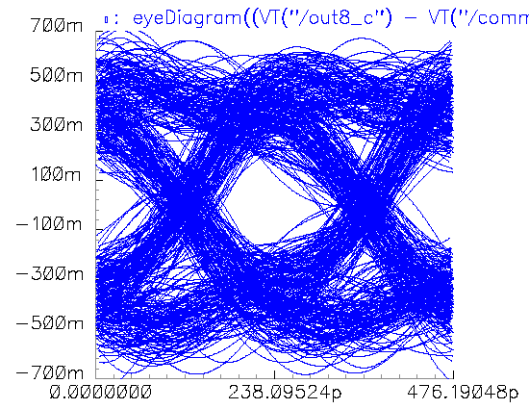
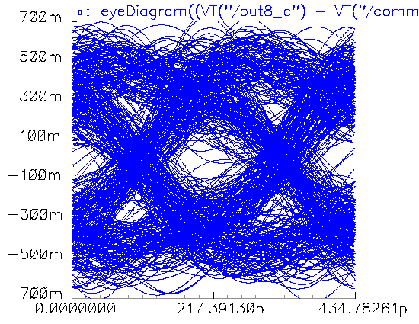
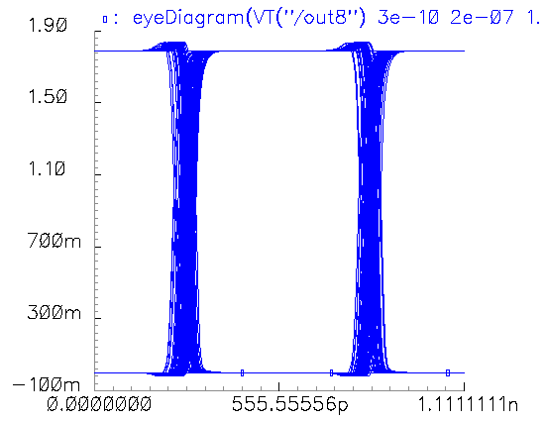
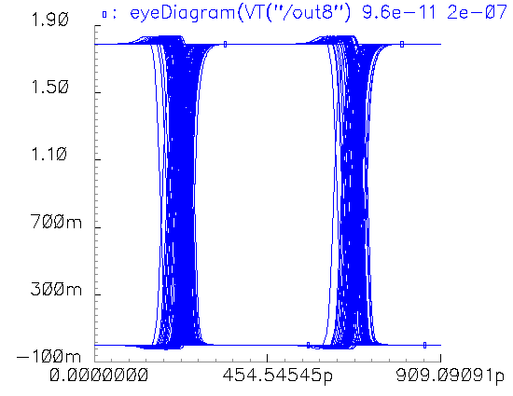
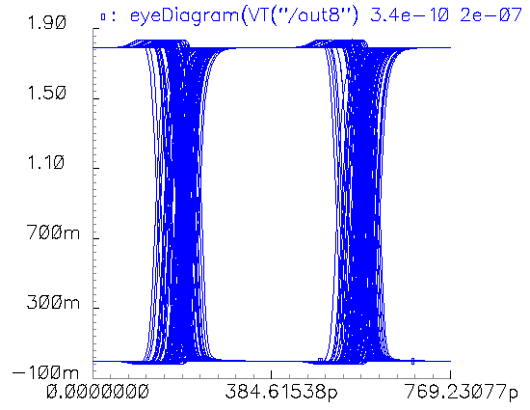
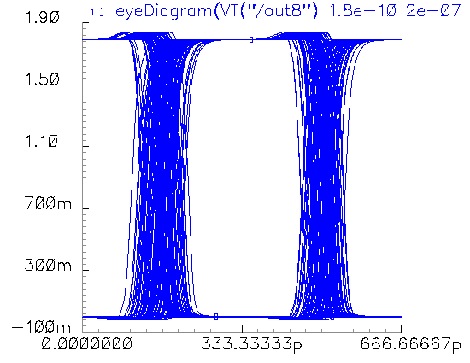
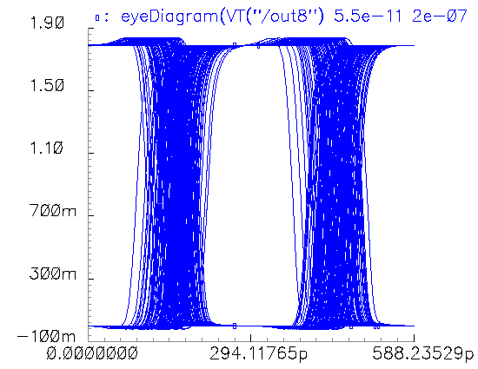
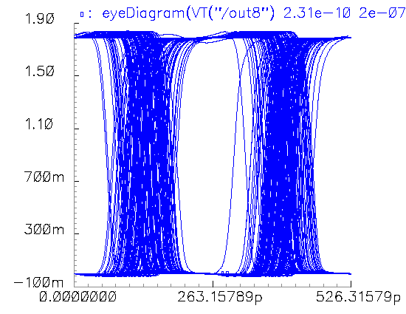
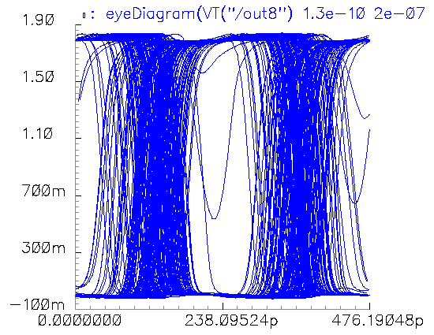
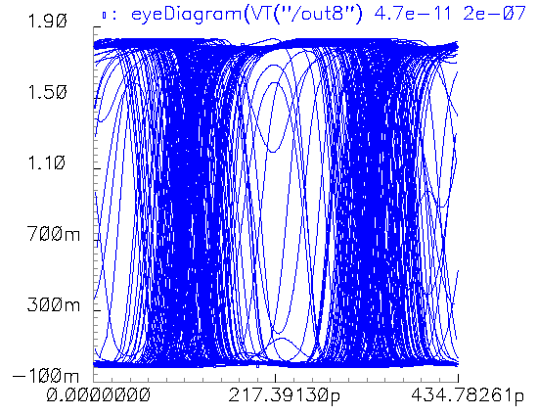
Noise Modeling
Goal: Capture link behavior in the presence of noise
Error sources from link model:
  Transistors: jitter, switching noise
  Transmission lines: frequency-dependant attenuation, crosstalk
Receivers discriminate signal to convert to digital
Input to receiver
1.8 GCW/s
2.2 GCW/s
2.6 GCW/s
3.0 GCW/s
3.4 GCW/s
3.8 GCW/s
4.2 GCW/s
4.6 GCW/s
Receiver output

Slide 40
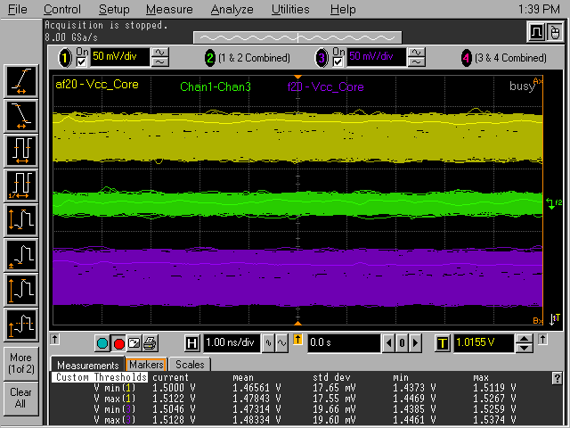
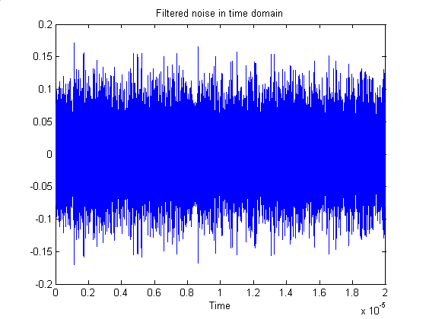
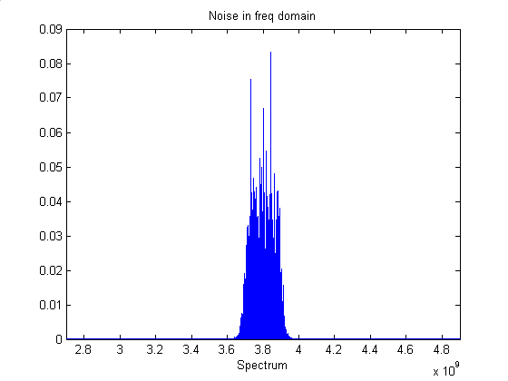
Supply Noise
Intel: Busy 1.5 V Pentium 4 processor:
  Stddev = 17-20 mV
Add independent V_{dd} noise to driver and receiver
To generate:
  Assume links operating at core switching frequency
  Generate white Gaussian noise
    Sampled at 20 GHz for 20 us
  Apply passband filter to noise, 200 MHz band centered on op. frequency
Source: private correspondence with Martin Saint-Laurent, Intel Corporation

Slide 41

Fringe Capacitance in Driver
Fringe capacitance from circuit layouts and packaging add parasitic capacitance effects
  Where it hurts channel most (noise source)
  Adds additional crosstalk

Slide 42
Experimental Verification
Goal: measure amount of improvement in channel performance from the addition of LHECC support to MBDS links
Setup 5 interconnects with various capacities and levels of error control
Simulate interconnects with analog simulator
  Test each link with a random sequence of 100,000 code words transmitted at several code word transmission rates
Measure error rates for each test at the output of receivers for links with and without LHECC support
Determine maximum transmission rate for code word error rate < 10⁻⁵

Slide 43
Experimental Interconnects
Correct 1 symbol containing 1 bit error
Intercnt | width | capacity (no-ecc) | capacity (ecc) | rel. code rate
3x4c2 | 12 | 6/.50 | 6/.50 | 1.00
3x6c3 | 18 | 12/.67 | 10/.56 | .83
3x8c4 | 24 | 18/.75 | 15/.63 | .83
Correct 2 symbols containing 1 bit error
Intercnt | width | capacity (no-ecc) | capacity (ecc) | rel. code rate
4x4c2 | 16 | 8/.50 | 7/.44 | .88
Correct 2 symbols containing 2 bit errors or 1 symbol containing 2 bits where errors yield valid nCm symbol
Intercnt | width | capacity (no-ecc) | capacity (ecc) | rel. code rate
4x6c3 | 24 | 16/.67 | 10/.42 | . 63

Slide 44
Talk Outline
Multi-Bit Differential Signaling (MBDS)
  “N choose M” data encoding
Lightweight Hierarchical Error Control Codes (LHECC)
Encoder/decoder implementation
Experimental verification
  Link modeling
  Noise modeling
Experimental results
Conclusion

Slide 45



Experimental Results: Internal noise sources only (transistor noise, channel crosstalk)
Interconnect | max t-rate (no-ecc) | max t-rate (ecc) | relative increase | relative increase wrt code rate
3x4c2 | 3.4 GHz | 4.2 GHz | 24% | 24%
3x6c3 | 3.0 GHz | 4.0 GHz | 33% | 11%
3x8c4 | 2.8 GHz | 3.8 GHz | 36% | 13%

Slide 46



Experimental Results: P4 supply noise characteristics added
Interconnect | max t-rate (no-ecc) | max t-rate (ecc) | relative increase | relative increase wrt code rate
3x4c2 | 3.2 GHz | 4.0 GHz | 25% | 25%
3x6c3 | 2.8 GHz | 3.8 GHz | 36% | 13%
3x8c4 | 2.6 GHz | 3.8 GHz | 46% | 22%

Slide 47



Experimental Results: Crosstalk from fringe capacitance
Interconnect | max t-rate (no-ecc) | max t-rate (ecc) | relative increase | relative increase wrt code rate
3x4c2 | 2.8 GHz | 3.8 GHz | 36% | 36%
3x6c3 | 2.6 GHz | 3.6 GHz | 38% | 15%
3x8c4 | 2.2 GHz | 3.6 GHz | 64% | 36%

Slide 48


Experimental Results (multi-symbol ECC)
Internal noise sources only
Interconnect | max t-rate (no-ecc) | max t-rate (ecc) | relative increase | relative increase (code rate)
4x4c2 | 3.4 GHz | 4.4 GHz | 29% | 13%
4x6c3 | 2.6 GHz | 4.4 GHz | 69% | 6%

Slide 49


Experimental Results (multi-symbol ECC)
Supply noise characteristics added
Interconnect | max t-rate (no-ecc) | max t-rate (ecc) | relative increase | relative increase (code rate)
4x4c2 | 3.0 GHz | 4.4 GHz | 47% | 28%
4x6c3 | 2.4 GHz | 4.2 GHz | 75% | 9%

Slide 50


Experimental Results (multi-symbol ECC)
Crosstalk from fringe capacitance
Interconnect | max t-rate (no-ecc) | max t-rate (ecc) | relative increase | relative increase (code rate)
4x4c2 | 2.6 GHz | 3.8 GHz | 46% | 28%
4x6c3 | 2.2 GHz | 4.0 GHz | 82% | 14%

Slide 51
Talk Outline
Multi-Bit Differential Signaling (MBDS)
  “N choose M” data encoding
Lightweight Hierarchical Error Control Codes (LHECC)
Encoder/decoder implementation
Experimental verification
  Link modeling
  Noise modeling
Experimental results
Conclusion

Slide 52
Conclusions and Future Work
Conclusions
  LHECC is effective at achieving low overhead error control
  LHECC encoders/decoders viable for system interconnect
    small, fast
  LHECC verified to increase noise immunity for MBDS interconnects
  Greatest benefit from single-symbol ECC
    Steepness of error rate curve for MBDS interconnects
Future Work
  Design and test fabricated LHECC interconnects

