Slide 1
FPGA Acceleration of
Gene Rearrangement Analysis
Jason D. Bakos
Dept. of Computer Science and Engineering
University of South Carolina
Columbia, SC USA

Slide 2
Talk Outline
Application:
  Phylogenetic Reconstruction
  Gene Rearrangement Data
Breakpoint Median Computation
Core Architecture
Extracting Parallelism
Performance Results
  Core Computation Speedup
  Application Speedup
Conclusion and Future Work

Slide 3
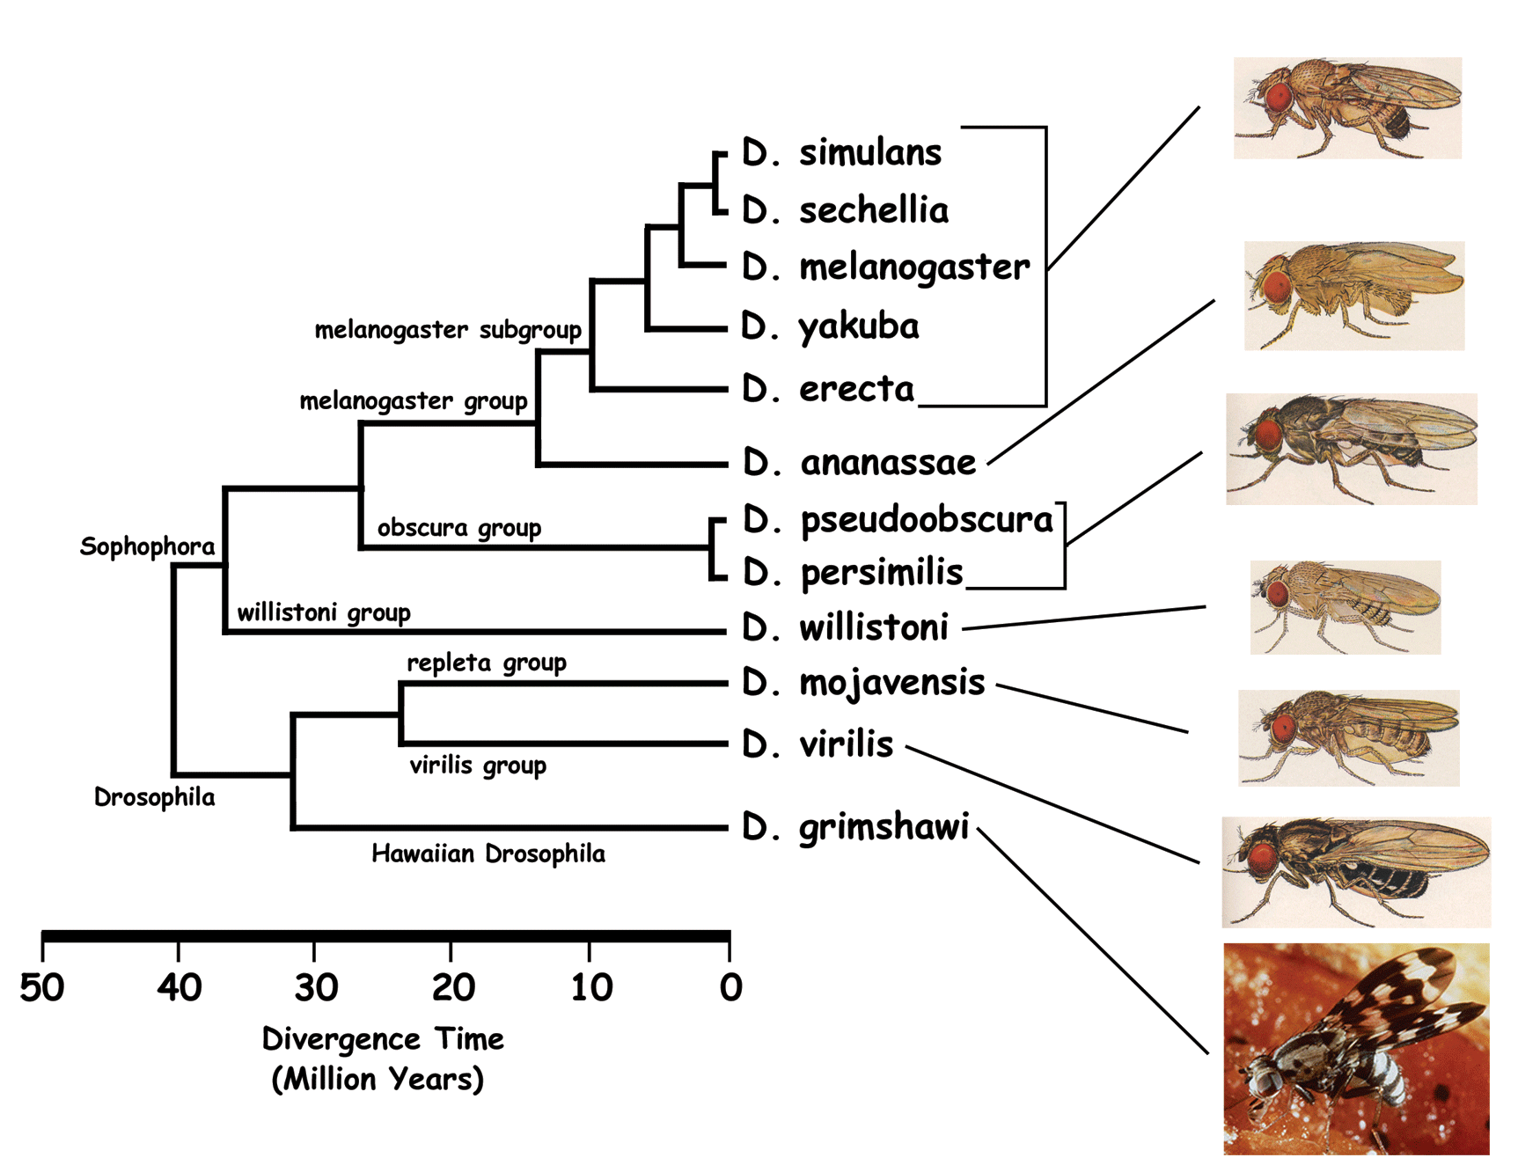
Phylogenies
genus Drosophila

Slide 4
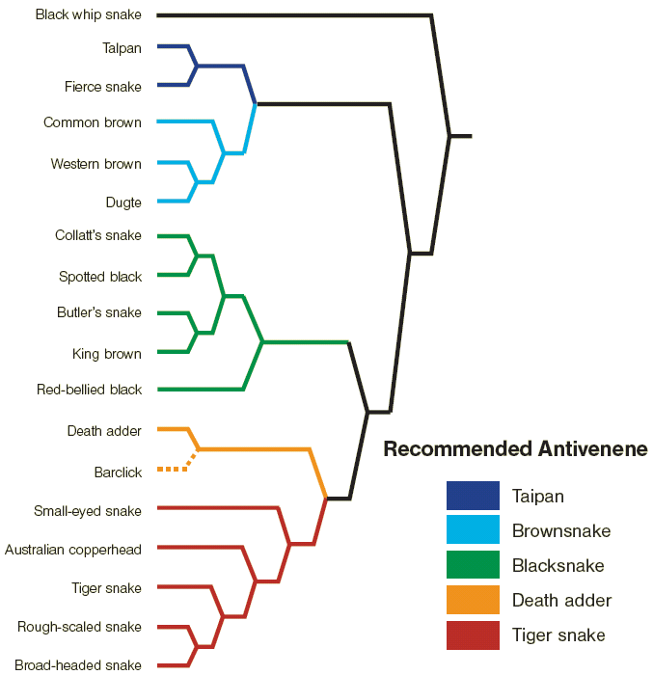
Phylogenetic Analysis
Phylogenies are used to infer common characteristics among related species

Slide 5
Phylogeny Data Structure
g3
g1
g4
g2
g1
g3
g2
g5
g5
g5
g6
g4
g6
Unrooted binary tree
n leaf vertices
n - 2 internal vertices (degree 3)
Tree configurations =
  (2n - 5) * (2n - 7) * (2n - 9) * … * 3
200 trillion trees for 16 leaves
g6
g3
g5
g2
g1
g4
g5

Slide 6
Phylogenetic Reconstruction
Given biological data for a set of species, compute an accurate phylogeny
Distance-based Methods
  Construct tree using pair-wise distances (UPGMA, neighbor-joining)
  Fast but inaccurate
Maximum Parsimony Methods
  Goal: Accuracy
  Construct tree using evolutionary model
  Search for most parsimonious tree
  Candidate trees must be “scored”
    All internal vertices are labeled with ancestral data
    Edge distances are computed between vertex pairs and summed

Slide 7
GRAPPA Performance Bottleneck
GRAPPA
  “Genome Rearrangement Analysis under Parsimony and other Phylogenetic Algorithms”
  Exhaustive branch-and-bound or heuristic search through tree space
  Labeling computation is performance bottleneck
    95+% of execution time is spent computing labels for internal vertices
1
Execution Time Ratio for Labeling
0
Diameter (Ev. Rate) of Inputs

Slide 8
Gene Rearrangement Data
Genome data is represented as a circular ordering of genes
  “Gene orders”
Each gene represents a known nucleotide sequence
  Each gene has a positive or negative orientation
Rare evolutionary events cause gene rearrangements
  Inversion
    g₀ g₁ g₂ g₃ g₄ g₅ g₀ g₁ –g₄ –g₃ –g₂ g₅
  Transposition
    g₀ g₁ g₂ g₃ g₄ g₅ g₀ g₂ g₃ g₄ g₁ g₅
  Inverted Transposition
  g₀ g₁ g₂ g₃ g₄ g₅ g₀ –g₄ –g₃ –g₂ g₁ g₅

Slide 9
Breakpoint Distance Metric
Estimation of number of rearrangement events between gene orders A and B
# of adjacencies:
  g h in A that doesn’t correspond to g h or –h –g in B
Example:
  A = 1 2 3 4 5
  B = -2 -1 -5 -4 3
  Breakpoint distance = 2

Slide 10
Median
Ancestral vertices are computed using a median computation
All internal vertices have degree 3
Find M that optimally minimizes median score
score = d(A,M) + d(B,M) + d(C,M)
Breakpoint median:
  d() is breakpoint distance
A
B
d(A,M)
d(B,M)
M
d(C,M)
C

Slide 11
Breakpoint Median Algorithm as a TSP
Construct a fully connected graph containing all g and –g for each gene
w(g,-g) = -∞
Initialize all other weights to be 3
For each adjacency gh in the three genomes, decrement weight between vertex –g and h
Solve TSP, median is the even-indices of the tour (score = tour cost)
+
-
+
-
1
2
1
2
A = -1 +2 -4 -3
B = -1 -2 +3 +4
C = -2 +3 +4 +1
cost = -∞
cost = 0
cost = 1
cost = 2
-
+
-
+
+
-
+
-
4
3
4
3
-
+
-
+
Edges not shown have cost = 3
An optimal solution corresponding to genome +1 +2 -3 -4

Slide 12
Breakpoint Median Implementation
Optimal TSP is feasible due to small graph
Implemented as a depth-first branch-and-bound search
Upper bound is the current best tour
Lower-bound is computed using a linear greedy algorithm
  Select a set of minimal-weight edges to complete a partially-constructed tour
  To tighten: edges not considered that…
    have been pruned at or above the current level of the search tree
    that would create a cycle not including all cities

Slide 13
Breakpoint Median Algorithm
Edge list:
Search state:
edges
(-3,4,w=0)
(2,3,w=1)
(1,2,w=2)
(-1,-2,w=2)
(1,-2,w=2)
(-2,-4,w=2)
(-1,3,w=2)
(-1,-4,w=2)
(1,-4,w=2)
solution
1 -1
2 -2
3 -3
4 -4
otherEnd
1 => -1
-1 => 1
2 => -2
-2 => 2
3 => -3
-3 => 3
4 => -4
-4 => 4
used
cost=0
excluded

Slide 14
Breakpoint Median Algorithm
Edge list:
Search state:
edges
(-3,4,w=0)
(2,3,w=1)
(1,2,w=2)
(-1,-2,w=2)
(1,-2,w=2)
(-2,-4,w=2)
(-1,3,w=2)
(-1,-4,w=2)
(1,-4,w=2)
solution
1 -1
2 -2
3 -3
4 -4
otherEnd
1 => -1
-1 => 1
2 => -2
-2 => 2
3 => -4
-3 => 3
4 => -4
-4 => 3
used
-3, 4
cost=0
solution
1 -1
2 -2
3 -3
4 -4
stack
excluded
stack
cost=0

Slide 15
Breakpoint Median Algorithm
Edge list:
Search state:
edges
(-3,4,w=0)
(2,3,w=1)
(1,2,w=2)
(-1,-2,w=2)
(1,-2,w=2)
(-2,-4,w=2)
(-1,3,w=2)
(-1,-4,w=2)
(1,-4,w=2)
solution
1 -1
2 -2
3 -3
4 -4
otherEnd
1 => -1
-1 => 1
2 => -2
-2 => -4
3 => -4
-3 => 3
4 => -4
-4 => -2
used
-3, 4,
2, 3
cost=0
solution
1 -1
2 -2
3 -3
4 -4
excluded
solution
1 -1
2 -2
3 -3
4 -4
cost=0
cost=1

Slide 16
Breakpoint Median Algorithm
Edge list:
Search state:
edges
(-3,4,w=0)
(2,3,w=1)
(1,2,w=2)
(-1,-2,w=2)
(1,-2,w=2)
(-2,-4,w=2)
(-1,3,w=2)
(-1,-4,w=2)
(1,-4,w=2)
solution
1 -1
2 -2
3 -3
4 -4
otherEnd
1 => -1
-1 => 1
2 => -2
-2 => -4
3 => -4
-3 => 3
4 => -4
-4 => -2
used
-3, 4,
2, 3
cost=0
solution
1 -1
2 -2
3 -3
4 -4
excluded
solution
1 -1
2 -2
3 -3
4 -4
cost=0
cost=1

Slide 17
Breakpoint Median Algorithm
Edge list:
Search state:
edges
(-3,4,w=0)
(2,3,w=1)
(1,2,w=2)
(-1,-2,w=2)
(1,-2,w=2)
(-2,-4,w=2)
(-1,3,w=2)
(-1,-4,w=2)
(1,-4,w=2)
solution
1 -1
2 -2
3 -3
4 -4
otherEnd
1 => -1
-1 => 1
2 => -2
-2 => 2
3 => -4
-3 => 3
4 => -4
-4 => 3
used
-3, 4
cost=0
solution
1 -1
2 -2
3 -3
4 -4
excluded
(2,3)
stack
cost=0

Slide 18
Breakpoint Median Algorithm
Edge list:
Search state:
edges
(-3,4,w=0)
(2,3,w=1)
(1,2,w=2)
(-1,-2,w=2)
(1,-2,w=2)
(-2,-4,w=2)
(-1,3,w=2)
(-1,-4,w=2)
(1,-4,w=2)
solution
1 -1
2 -2
3 -3
4 -4
otherEnd
1 => -1
-1 => -2
2 => -2
-2 => -1
3 => -4
-3 => 3
4 => -4
-4 => 3
used
-3, 4,
1, 2
cost=0
solution
1 -1
2 -2
3 -3
4 -4
excluded
(2,3)
solution
1 -1
2 -2
3 -3
4 -4
cost=0
cost=2

Slide 19
Breakpoint Median Algorithm
Edge list:
Search state:
edges
(-3,4,w=0)
(2,3,w=1)
(1,2,w=2)
(-1,-2,w=2)
(1,-2,w=2)
(-2,-4,w=2)
(-1,3,w=2)
(-1,-4,w=2)
(1,-4,w=2)
solution
1 -1
2 -2
3 -3
4 -4
otherEnd
1 => -1
-1 => -2
2 => -2
-2 => -1
3 => -4
-3 => 3
4 => -4
-4 => 3
used
-3, 4,
1, 2
cost=0
solution
1 -1
2 -2
3 -3
4 -4
excluded
(2,3)
solution
1 -1
2 -2
3 -3
4 -4
cost=0
cost=2

Slide 20
Breakpoint Median Algorithm
Edge list:
Search state:
edges
(-3,4,w=0)
(2,3,w=1)
(1,2,w=2)
(-1,-2,w=2)
(1,-2,w=2)
(-2,-4,w=2)
(-1,3,w=2)
(-1,-4,w=2)
(1,-4,w=2)
solution
1 -1
2 -2
3 -3
4 -4
otherEnd
1 => -1
-1 => 3
2 => -2
-2 => -1
3 => -1
-3 => 3
4 => -4
-4 => 3
used
-3, 4,
1, 2,
-2, -4
cost=0
solution
1 -1
2 -2
3 -3
4 -4
excluded
(2,3)
solution
1 -1
2 -2
3 -3
4 -4
cost=0
solution
1 -1
2 -2
3 -3
4 -4
cost=2
cost=4

Slide 21
Breakpoint Median Algorithm
Edge list:
Search state:
edges
(-3,4,w=0)
(2,3,w=1)
(1,2,w=2)
(-1,-2,w=2)
(1,-2,w=2)
(-2,-4,w=2)
(-1,3,w=2)
(-1,-4,w=2)
(1,-4,w=2)
solution
1 -1
2 -2
3 -3
4 -4
otherEnd
1 => -1
-1 => 3
2 => -2
-2 => -1
3 => -1
-3 => 3
4 => -4
-4 => 3
used
-3, 4,
1, 2,
-2, -4,
-1, 3
cost=0
solution
1 -1
2 -2
3 -3
4 -4
excluded
(2,3)
solution
1 -1
2 -2
3 -3
4 -4
cost=0
solution
1 -1
2 -2
3 -3
4 -4
solution
1 -1
2 -2
3 -3
4 -4
tour is -1, 1, 2, -2, -4, 4, -3, 3
median is -1, 2, -4, -3
cost=2
cost=4
cost=6

Slide 22
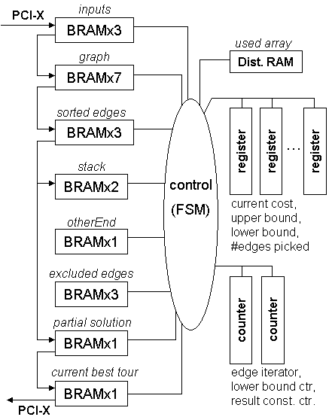
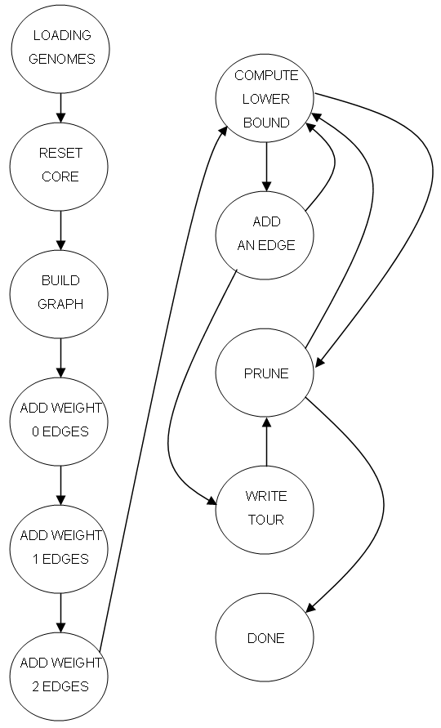
Median Core Architecture
top level
controller
Computation is sequential
add edge
7 cycles
prune edge
2 or 10 cycles
compute lower bound
2n+2 cycles
56 MHz
21/444 BRAMs/core
1% slices/core

Slide 23
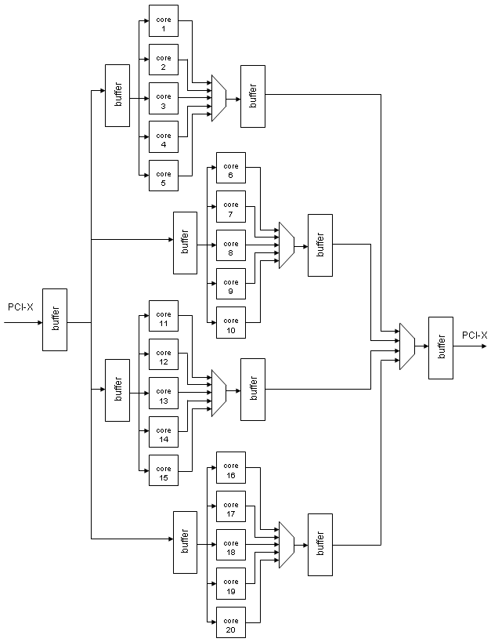
Accelerator Architecture
Fill FPGAs with median cores
Fan-outs and fan-ins are pipelined to meet PCI-X timing
Platform:
  Annapolis Wild-Star II Pro
  Virtex-2 Pro 100 -5
I/O
  Programmed I/O
  Hosts polls each core for state
  Comm. overhead is significant for easy medians

Slide 24
Phylogeny Scoring Steps
Initialize unlabeled tree
Use 3 nearest labels
Initialize upper bound from inputs
g4
g1
g3
g2
g5
g5
g6
Iteratively refine tree to convergence
Use 3 immediate neighbors
Initialize upper bound using score of previous label
g4
g1
g3
g2
g5
g5
g6

Slide 25
Extracting Parallelism: Initialization
A
B
A
B
0
d(A,B)
A, B, C
d(A,B)
0
ub
core 0
A
B
d(A,C)
d(B,C)
ub - 1
core 1
C
C
A
ub - 2
core 2
d(A,C)
C
d(B,C)
0
…
B
C
initial upper bound = ub =
d(A,B) + d(A,C)
d(B,A) + d(B,C)
d(C,A) + d(C,B)
ub - n - 1
core n-1
Core with a lower initial upper bound will converge on solution fastest

Slide 26
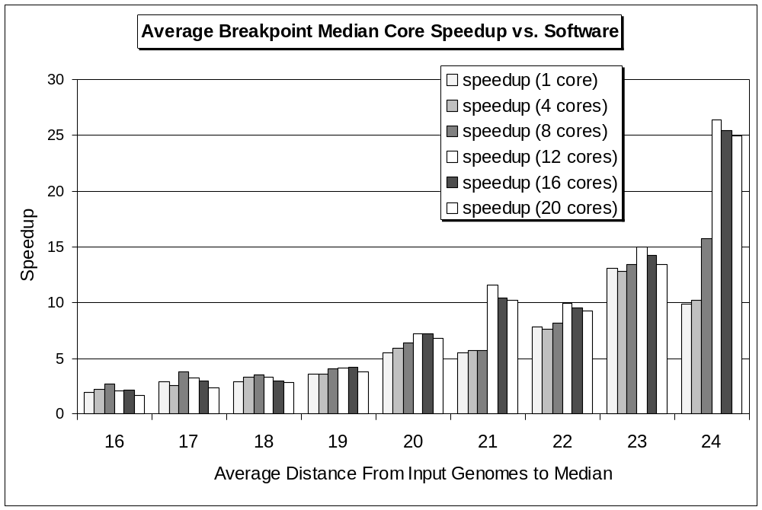
Performance Results: Median Computation
Average over 1000 median computations
12 cores =>
25X speedup

Slide 27
Extracting Parallelism: Re-Labeling
All medians are dispatched in parallel for each iteration
Score of previous median used as initial upper bound
g4, m1, m2
score(m0)
core 0
m0, g1, g3
score(m1)
core 1
m0
m0, g2, m3
score(m2)
core 2
g4
m1
m2
m2, g5, g6
core 3
score(m3)
g1
g3
g2
g5
m3
g5
g6

Slide 28
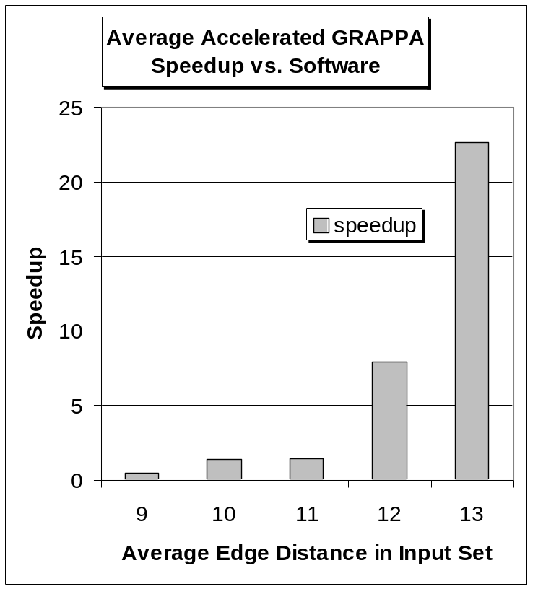
Performance Results: Accelerated GRAPPA
Replace software median with driver for FPGA card
Initialization phase:
  Use 12 median cores
Re-labeling phase:
  Parallel labeling
  Use n - 2 median cores
Average over 10 GRAPPA runs

Slide 29
Conclusions
Breakpoint median computation: combinatorial optimization algorithm
  Control-dependent, memory-intensive
Median core consistently achieves speedup over software and only requires 4% of FPGA resources
Initial results show that median-level parallelism can be achieved (take advantage of hardware)
Up to 25X application speedup

Slide 30
Future Work
More efficient technique to parallelize median computation
Inversion median core
Design tree generation and bounding cores
  Bottleneck for larger input sets
  Initial design requires only 2 BRAMs
Develop and package library of phylogenetic cores
Develop tool that generates architecture based on characteristics of the input set

Slide 31
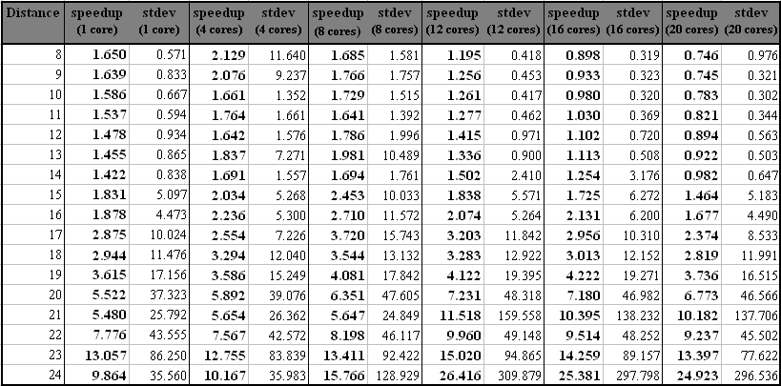
Raw Data for Median Core

Slide 32
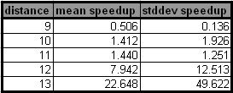
Raw Data for Accelerated-GRAPPA

