Slide 1
Sparse Matrix-Vector Multiply on the Keystone II Digital Signal Processor
Yang Gao, Fan Zhang and Dr. Jason D. Bakos
2014 IEEE High Performance Extreme Computing Conference(HPEC ‘14)

Slide 2
Heterogeneous Computing on Embedded Platforms
GPU/FPGA/DSP(KeyStone)
ARM + Embedded GPUs/FPGA/DSP(KeyStone II)
 | Embedded GPU |  |  | FPGA | DSP
Platforms | PowerVR SGX 544MP3 | PowerVR G6430 | GK20A (Kepler) | Zynq-7000 | KeyStone II
 | Exynos 5 Octa | Apple A7 | Tegra K1(Jetson) | 7Z045 | TCI6638
Theoretical Peak Performance (Gflops) | 51.1 | 115.2 | @864 MHz 331 | 65 | @1.35GHz 172.8
Notes:
Summarize the table,

Slide 3
Key Features of KeyStone II
In-order execution, static scheduled VLIW processor
8 symmetric VLIW cores with SIMD instructions, up to 16 flops/cycle
No shared last level cache
6MB on-chip shared RAM (MSMC)
L1D and L2 can be configured as cache, scratchpad, or both
DMA engine for parallel loading/flushing scratchpads
High performance, Low power consumption design
Notes:
Unique processor, hard to program

Slide 4
VLIW and Software Pipeline
for i = 0 to n
$1 = load A[i]
add $2,$2,$1
A[i] = store $2
endfor
Regular Loop
After Schedule
L
L
7 cycles
A
L
A
Load 3 cycles
Add 3 cycles
S
S
A
L
3
cycles
Store 1 cycles
S
A
Software Pipeline Restrictions:
Not friendly to conditional code inside loop body
Register Limitations
Rely on compiler to exert the optimization in low level
VLIW Software
Pipelined Loop with static scheduler
Out-of-order Processor with dynamic scheduler
S
Notes:
Practical limitation, branches, register, assembly(parallel not happen obviously, lower level than C), 3 cycles add

Slide 5
DSP Memory Hierarchy
 | Size (KB) | Cache Capacity(KB)
L1P | 32 | 0/4/8/16/32
L1D | 32 | 0/4/8/16/32
L2 | 1024 | 0/32/64/128/256/512/1024
MSMC | 6144 | 0
SPRAM
Cache
SPRAM
Cache
SPRAM
Cache
1024K Level 2 SRAM
Notes:
Text book style simple cache
Cache could also be SPM
Share memory could be SPM

Slide 6
SPM Method and Double Buffer
Time
Load 0
Load 1
Load 0
EDMA
DSP
Corepac
Compute 0
Compute 1
Compute 0
Notes:
2 stages could be pipelined
Loop tilling + double buffer is basic optimization strategy in the DSP platform.

Slide 7
Sparse Matrices
We evaluated the Keystone II using a SpMV kernel
Sparse Matrices can be very large but contain few non-zero elements
Compressed formats are often used, e.g. Compressed Sparse Row (CSR)
1 | -1 | 0 | -3 | 0
-2 | 5 | 0 | 0 | 0
0 | 0 | 4 | 6 | 4
-4 | 0 | 2 | 7 | 0
0 | 8 | 0 | 0 | -5
val | (1 | -1 | -3 | -2 | 5 | 4 | 6 | 4 | -4 | 2 | 7 | 8 | -5)
col | (0 | 1 | 3 | 0 | 1 | 2 | 3 | 4 | 0 | 2 | 3 | 1 | 4)
ptr | (0 | 3 | 5 | 8 | 11 | 13)
Notes:
3 arrays, one simple example

Slide 8
Sparse Matrix-Vector Multiply
Code for y = Aαx + βy
row = 0
for i = 0 to number_of_nonzero_elements do
if i == ptr[row+1] then row=row+1, y[row]*=beta;
y[row] = y[row] + alpha * A[i] * x[col[i]]
end
conditional execution
reduction
Low arithmetic intensity
(~3 flops / 24 bytes)
Memory bound kernel
indirect indexing
Notes:
Indirect indexing: load dependence.
Utilization 6ALU+2L/S
Dependency
Software pipelining

Slide 9
DDR arrays
DDR arrays
DMA Double buffer
DMA Circular buffer
for i = elements assigned to current core
Product Loop
Loop Fission
Accumulation Loop
i
i
prod buffer
ptr buffer
y
buffer
ptr array
y
array
val array
col array
val buffer
col buffer
x array
row
if(ptr[row+1]-ptr[row])>K
if ptr[row] = i then
row = row+1
y[row]←y[row]*β
endif
y[row]←y[row]+acc
acc ← acc+prod[i]
if ptr[row] = i then
row = row+1
y[row]←y[row]*β+acc
endif
Adaptive Row Pointer
acc ← acc+prod[i+1]
if ptr[row] = i then
row = row+1
y[row]←y[row]*β+acc
endif
α*val*x
acc ← acc+prod[i+k]
if ptr[row] = i then
row = row+1
y[row]←y[row]*β+acc
endif
acc ← acc+prod[i]
acc ← acc+prod[i+1]
…
acc ← acc+prod[i+k]
Predicate Instruction
Assembly Optimization
Manually Unrolled Loop

Slide 10
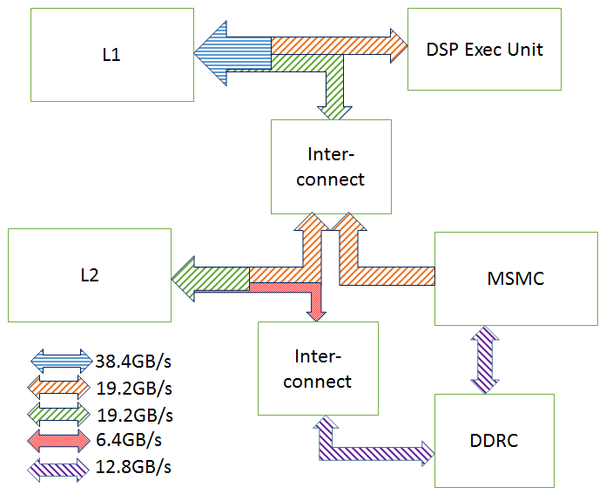
Buffer Location and Performance
Buffer
val
col
ptr
y
prod
Locations
L2
MSMC
cache
map?
L1
L2
MSMC
cache
Notes:
Data is provided by TI, information is public
Data path is decided by allocation

Slide 11
Matrix
Tri-diagonal
N-diagonal
3, 151
2, 4, 0, 0, 0, 0
5, 4, 7, 0, 0, 0
0, 6, 2, 4, 0, 0
0, 0, 3, 10, 1, 0
0, 0, 0, 4, 6, 8
0, 0, 0, 0, 2, 12

Slide 12
Buffer Location and Performance
Non-zeros per row | val | col | ptr | y | prod | Gflops | Norm. Perf | Note
3 | S S L2 C | L2 L2 L2 C | L2 L2 C C | L2 L2 C C | L1 L2 S C | 2.26 1.84 1.23 1.44 | 1.57 1.28 0.85 1 | Best Median Worst² All cache
151 | L2 S C C | S C C C | L2 L2 C C | L2 L2 C C | L2 S L2 C | 3.76 3.55 2.66 2.51 | 1.50 1.41 1.06 1 | Best Median Worst² All cache
L1: level 1 SPRAM, L2:level 2 SPRAM, S:MSMC, C:cache
1: The results are normalized to the all cache configuration
2: The worst amongst the configurations with SPRAM
Notes:
Matrix: synthetic matrix, dense and sparse
Variance, mapping is important
Cache is not worst.
Not the kernel, the input data is also important

Slide 13
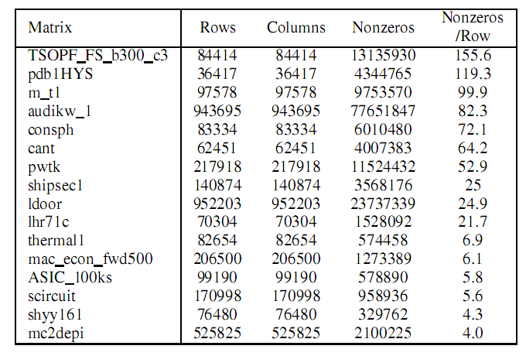
Matrix
Tri-diagonal
N-diagonal
3, 151
University of Florida sparse matrix collection
Matrix Market
2, 4, 0, 0, 0, 0
5, 4, 7, 0, 0, 0
0, 6, 2, 4, 0, 0
0, 0, 3, 10, 1, 0
0, 0, 0, 4, 6, 8
0, 0, 0, 0, 2, 12

Slide 14
Testing Platforms
 | Intel i7 3770K MKL | NVIDIA GTX 680 cuSparse | NVIDIA Tegra K1 cuSparse | TI 6638K2K
Arch | Ivy Bridge | Kepler | Kepler | KeyStone II
Memory B/W(GB/s) | 25.6 | 192.3 | 17.1 | 12.8
SPRAM KB/core | n/a | 64/64¹ | 64/64¹ | 32/1024/768²
Single Precision Peak Throughput (Gflops) | 448 | 3090 | 365 | @1.35GHz 172.8(DSP) 44.8(ARM)
TDP(W) | 77 | 195 | ~10 | ~15
Register file/allocable share memory or L1
L1 SRAM / L2 SRAM / MSMC per core
Notes:
Very different in M/B and performance

Slide 15
Close Comparison to NVIDIA Tegra K1
 | Tegra K1 | TI 6638K2K
Architecture | Cortex A15 + Kepler GPU | Cortex A15 + Keystone II DSP
CPU | 4 Cores, 2.2 GHz 32K+32K L1 2M L2 | 4 Cores, 1.4 GHz 32K+32K L1 4M L2
Co-processor | 192 CUDA cores @864 MHz 331 Gflops (SP peak) | 8 DSP cores @ 1.35GHz 172.8 Gflops (SP peak)
Memory Bandwidth | 17.1 GB/s(DDR3-2133) | 12.8 GB/s(DDR3-1600)
Power | ~ 10 W | ~ 15 W
Notes:
Most recent GPU

Slide 16
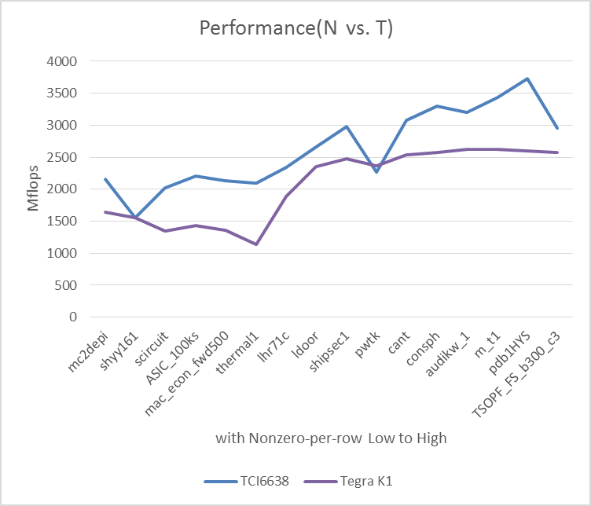
Performance Comparison vs. Nvidia TK1

Slide 17
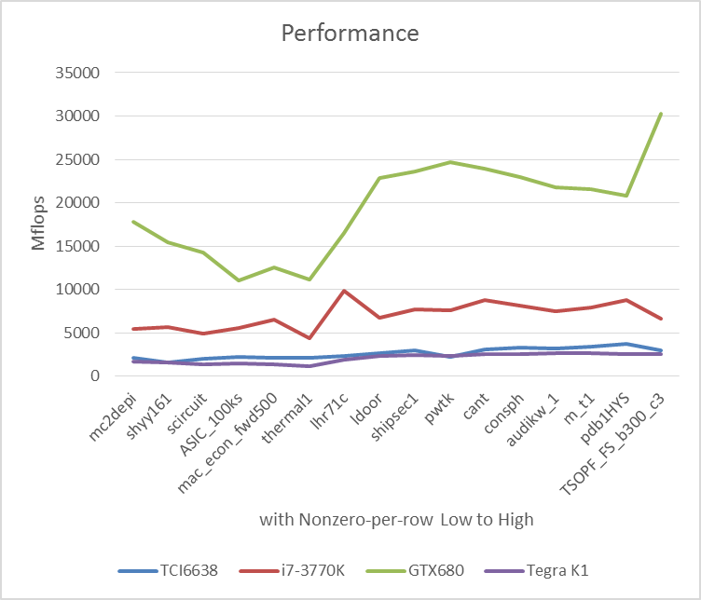
Performance Comparison

Slide 18

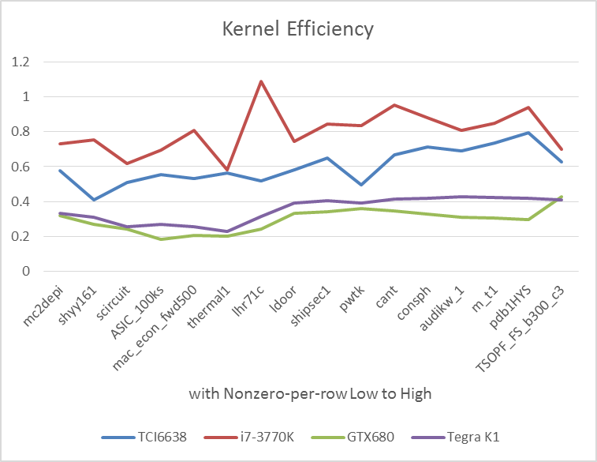
Kernel/Memory Efficiency
efficiency =
observed performance/((Arithmetic Intensity) X (Memory Bandwidth))

Slide 19
Conclusion
Significant performance gain with loop tuning and SPM optimizations
Despite the mobile GPU’s higher theoretical SP performance and memory bandwidth, the DSP outperforms it with our SpMV implementation.
Auto-decided SPM buffer allocation/mapping by a model of data access pattern.
Notes:
*carefully loop tuning and scratchpad optimization
*higher performance than Tegra, despite the GPU’s spec is better
*the mapping optimization could be abstracted by a model, auto allocation

Slide 20
Q & A

