Slide 1
Hierarchical Error Correction Codes over Multi-Bit Differential Signaling
Jason D. Bakos

Slide 2
Goals
High performance electrical chip-to-chip signaling
chip 2
PCB traces
PCB traces
chip 3
chip 1
  Processor-Memory interconnect
  Other chip-to-chip interconnect
    High-resolution digital displays
    Storage devices
    High-speed sensors

Slide 3
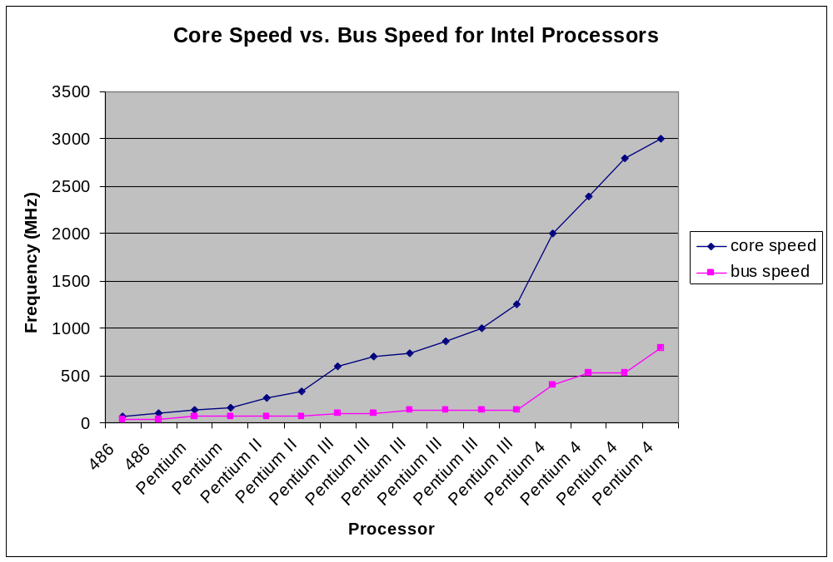
The Off-Chip Signaling Problem
Growing gap between on-chip core logic speed and off-chip signaling speed
Source: Intel Corporation

Slide 4
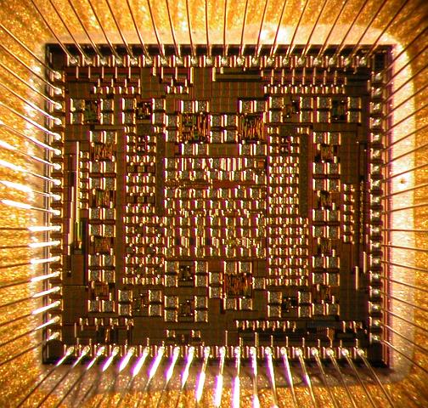
Challenges for Off-chip Signaling
Packaged chip
Packaged chip
Integrity of high-speed off-chip signals
  capacitance, inductance (METAL)
  effect of noise
  synchronization
PCB trace
Ground plane
High-speed links must be narrow
  I/O pads are a precious resource in chip design
  Skin effect causes high-speed drivers to be large
Solution:
  Couple data encoding to circuit design

Slide 5
Multi-Bit Differential Signaling (MBDS)
Differential signaling (LVDS)
MBDS
Data encoded as
  {01} or {10}
Advantages
  Low driver switching noise
  No reference noise
  Coupled transmission lines
  Low voltage swing (low noise)
Disadvantages
  Two wires for each bit
  Code rate = bits / channels
Data encoded with fixed number of ones
  N-choose-M (nCm)
  {0011}, {0101}, {0110}, {1001}, {1010}, {1100}
Advantages
  Same SNR as differential
  Higher code rate than differential

Slide 6
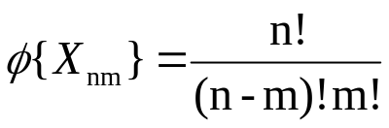
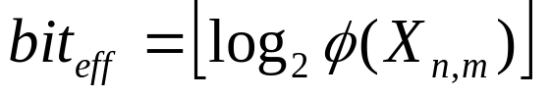
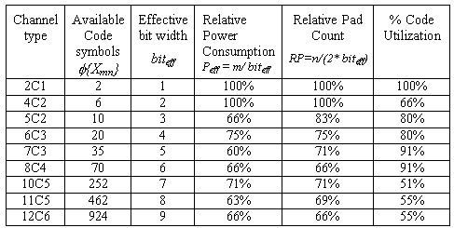
nCm Coding
EXAMPLE
6-wire MBDS channel
code size = 20 codes
effective bits = 4
equivalent to 8-wire differential channel
25% fewer pads (8 versus 6)
25% less power (4 1-bits on versus 3)
125% code capacity (20 codes versus 16)
Code set size
Effective bits

Slide 7
Outline
Use of extra code space for “free” error control mechanism
Sources of channel errors
Introduction to linear block codes
Hierarchical error correction codes
  nCm code set partitioning
  Encoding mechanism
  Decoding mechanism
  Code rate computation for HECC codes
  Analysis of single-channel correcting codes
  Analysis of multiple-channel correcting codes
Future Work

Slide 8
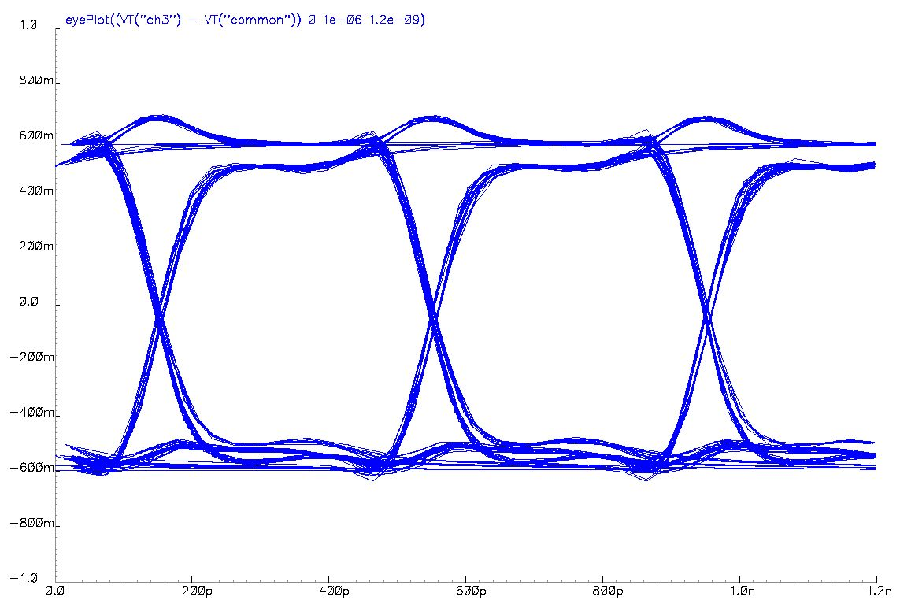
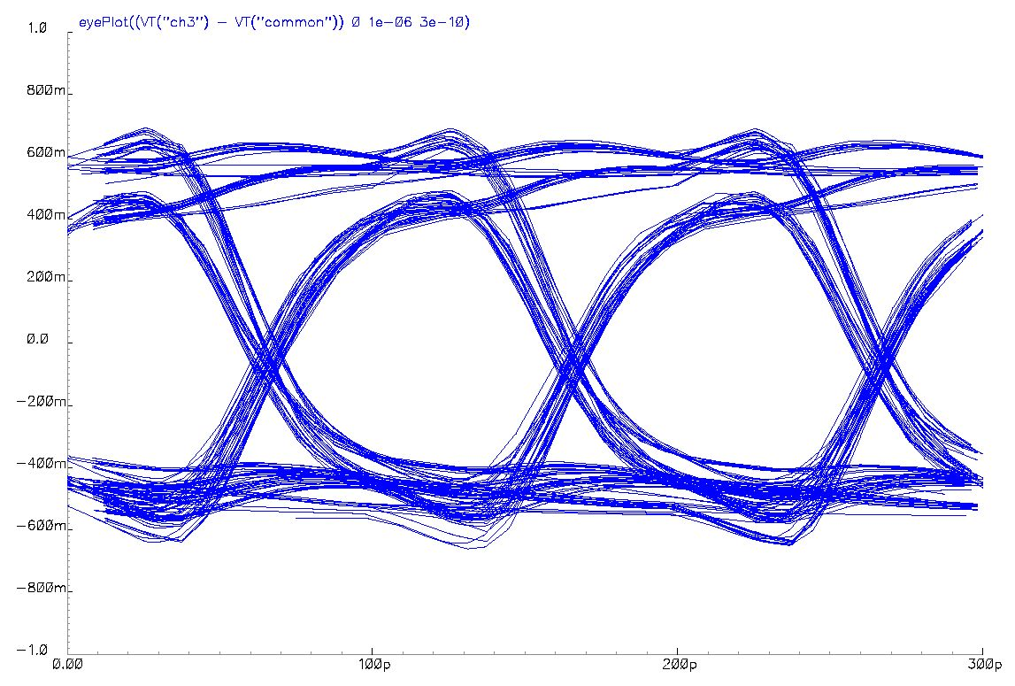
Sources of Channel Errors
Jitter and channel noise cause channel errors at high transmission rates
Need a way to recover from channel errors
4c2 channel at 2.5 Gb/s
4c2 channel at 10 Gb/s

Slide 9
nCm Codes: Natural Error Detection
nCm codes have inherent error detection
  Odd-number of channel errors
1011
1101
0111
1110
0011
0001
1000
0010
0100
1 error
3 errors
  Even-number of channel errors
0011
1111
1001
1001
1010
0101
0110
0000

Slide 10
nCm Codes: Extra Code Words
Each nCm code set has unmapped code words
  Example
    4c2 (base-6 value) => binary value
0011
00
0101
01
0110
10
1001
11
1010
?
1100
?
Exploit by using 2 nCm drivers in parallel as bus
6 cw
6 cw
36 combinations
5 bits
4c2
4c2
2 bits
2 bits

Slide 11
Linear Block Codes
Use (n,k,q) linear block code
  n symbols in block, over base-q alphabet
  k data symbols
  n-k parity symbols
  Can correct erasures and symbol errors
  Example (4,3,q) code:
base-q data symbols
base-q parity
Problems:
  Application over nCm symbols too detrimental to overall code rate
  Doesn’t take advantage of inherent error detection ability
  Lookup table for data too large

Slide 12
Partitioning nCm Code Sets
nCm code sets have distance=2
Increase distance by partitioning into “distance subsets”
  Example
    4c2, distance=4 (correct 1 bit, = floor((distance-1)/2))
Subsets:
  0 => {0011, 1100}
  1 => {0101, 1010}
  2 => {0110, 1001}
1100
0101
If the subset is known, channel errors may be corrected
First level of hierarchy
1001
0011
0110
1010

Slide 13
Partitioning Problem
How to partition large nCm code sets into distance subsets?
  Graph coloring is too complex for large code sets ( > 6c3)
  Good news:
    Done off-line
    Won’t go beyond 8c4 code set
  Use heuristic…
    Based on pruning depth-first search over space of code word subset assignment

Slide 14
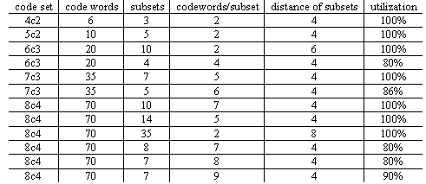
Partitioning Problem

Slide 15
Encoding Hierarchical Block Codes
b bits
01010010010010010100
b_{block} bits
b_{symbol} bits
0101001001
0010010100
Data as subset values
Parity as subset value(s)
Data as code words
Parity as code words

Slide 16
Example Encoding
Assume 3 x 4c2 drivers
  s=3, c=2
  (3,2,3) checksum code
  “data” portion
    s^{k} = 9 cw (3 bits)
  code word decisions,
    c^{n} = 8 cw (3 bits)
  code rate = 6 bits / 12 channels = 50%
  Can correct one channel error
Encode 111101…
111
2
1
Compute checksum parity…
2
1
0
Encode 101…
  0 => {0011, 1100}
  1 => {0101, 1010}
  2 => {0110, 1001}
1001
0101
1100

Slide 17
Decoding HECC Codes
Decoder:
  If invalid code word is detected
    Determine subset of code word in error
    Use minimum distance decoder to determine correct codeword
Assume error occurs…
2
1
0
?
1
0
1001
0101
1100
1101
0101
1100
0 – 1 = 2 (mod 3)
  Symbol in error must be 0110 or 1001
  dist(1101,0110) = 3, dist(1101,1001) = 1
  Corrected symbol is 1001

Slide 18
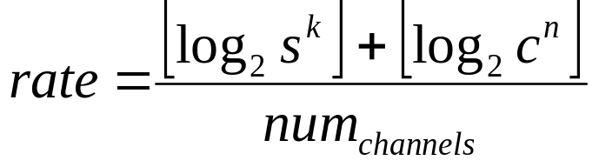
Computing Code Rate for HECC
Code rate is defined as
  Number of data bits / number of channels
In this context, must add data bits encoded into
  subset choices
  code word choices
We “break even” when code rate matches differential at 50%

Slide 19
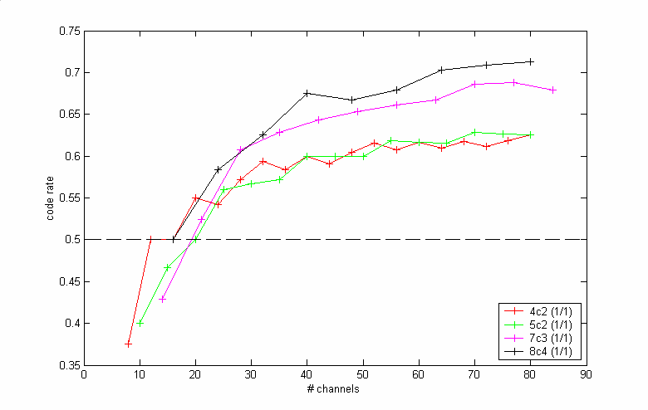
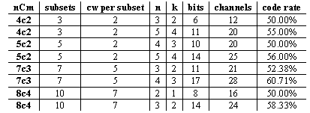
Analysis of Checksum-Based Codes
HECC codes defined as
  nCm code set
  # of parallel drivers
  (s,c)
  (n,k)
Checksum-based codes can correct one channel error
Fully utilized partitioning
  s*c = cw

Slide 20
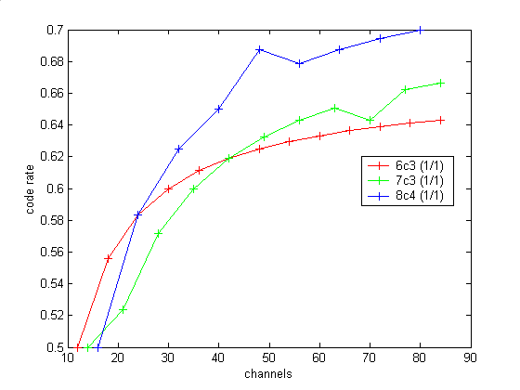

Analysis of Checksum-Based Codes
Under-utilized partitionings
  s * c < cw

Slide 21
Block Codes for Correcting Errors
MDS code (Reed-Solomon)
  Can correct subset errors:
    Number of parity symbols / 2
  Can correct erasures:
    Number of parity symbols
  Restrictions:
    Number of subsets must be prime or power of a prime
Can correct
  1 error
  2 erasures
Data
Parity

Slide 22
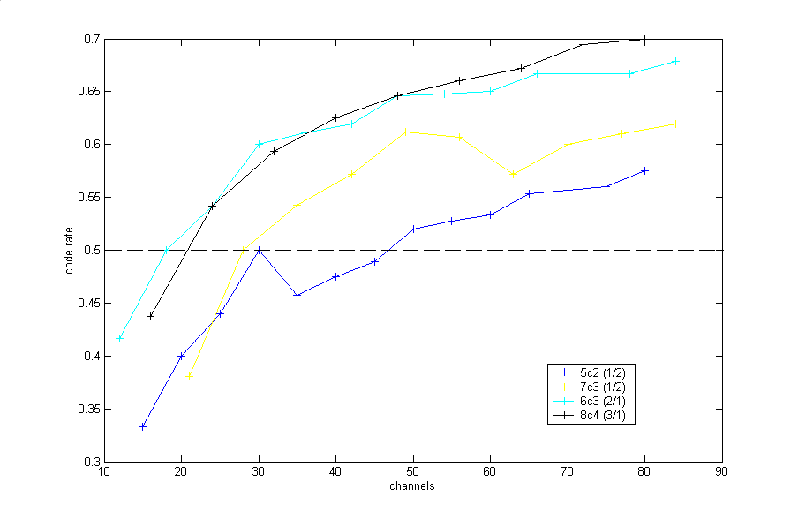

Analysis of Multiple Channel-Error Codes
5c2, 7c3
  2 parity symbols used
  MDS-code used until reached limit
  After MDS limit, NMDS code used
6c3
  Code set distance is 6 (t=2)
  One parity symbol
8c4
  Code set distance is 8 (t=3)
  One parity symbol

Slide 23
Future Work
Find better codes => higher code rate
Design efficient implementation of encoding / decoding logic

Slide 24
Acknowledgements
Donald Chiarulli, advisor (CS Department)
Steven Levitan, advisor (EE Department)

