Slide 1
Predictive Load Balancing
Reconfigurable Computing Group

Slide 2
Topics in System-Level Direct Networks
Routing
  Effects on end-to-end performance
Partitioning / mapping / PE implementation
  Effects on end-to-end performance
Network microarchitecture (implementation)
Applications
  Matrix operations (DoE)
  Signal processing (DARPA)
  Bioinformatics (NIH)
Multi-FPGA (large-scale) vs. NoC

Slide 3
Routing
Currently interested in routing wormhole-switched meshes
  Routing performance affects communication latency
  Communication latency affects overall end-to-end performance (for communication-bound applications)
  High router complexity / latency may negate benefits from aggressive routing techniques
    Router latency
    Area overhead (NoC and FPGA)

Slide 4
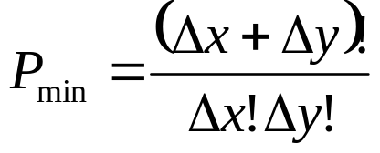
Routing
Number of possible minimal paths
Deterministic routing
  Packets follow one possible route from any given source to any given destination
  Low complexity
Semi-adaptive routing
  Packets may follow subset of possible paths
  Higher complexity (decision logic)
Fully-adaptive routing
  Packets may follow any path
  Highest complexity

Slide 5
Semi-Adaptive Routing
Turn-based model to avoid deadlock
Possible turns = {NW, NE, SW, SE, WN, WS, EN, ES}
Disallow >= 2 turns
XY routing only allows turns from X to Y {EN, ES, WN, WS}
West-first routing prohibits turns to west {NW, SW}
  Offers full adaptiveness to paths that route east
  Not fair to all paths

Slide 6
Odd-Even Routing
when routing east and dest is in even col…
even
odd
even
even
odd
even
Relative destination | Possible turns
NE | SE, WN
NW | SW, EN
SE | NE, WS
SW | NW, ES
S
D
even col
X
X
X
D
S
X
odd col
(don’t go into dest. col unless row matches)
when routing west…
even
odd
even
even
odd
even
D
S
On average, 2 routing options once for every 5 routes
(1.2 opt/route)
S
D
(don’t go N/S in odd col)

Slide 7
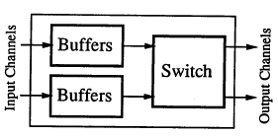
Virtual Channel Routing
Originally conceived as a way to improve network throughput
  Time multiplex virtual channels onto physical channels
  Assume deterministic routing
S0
S1
D2
S2
D0
D1

Slide 8
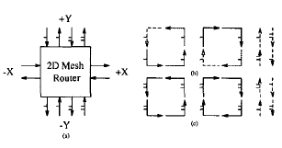
Fully Adaptive Routing with VCs
Can achieve fully adaptive routing with VCs
  Problem: minimize required number of VCs
  Virtual channel 1 for N and S can only be used if the message no longer needs to be routed west (west-first)
  Load balancing: VBMAR

Slide 9
Virtual Channel Routing
Components of a virtual channel router…
  V * N input buffers
  Arbitration logic
  Larger internal crossbar
  Output VC allocators
Routing latency
Not practical for FPGAs and NoCs
Not even practical for multicomputers?

Slide 10
Load Balancing
Idea:
  Uniformly distribute traffic across idle channels in network
  Exploit adaptivity to choose routing paths that do not lead to blocks
  Routers don’t have knowledge of state of network
    Current and future conjestion downstream?

Slide 11
Load Balancing
S
decision
hotspot
D

Slide 12
Predictive Load Balancing
Assuming:
  application has periodic behavior
  predefined, regular traffic patterns
Routers can gather historical information of block/route behavior on each output port
  Crossbar allocation (route)
  Forwarding flits
Two approaches:
  Keep a record of blocks when routing and forwarding
  Keep a record of routes to each output
When there’s two routing choices (allowable and available), give priority to output with lowest count
  Variation: voluntary blocking

Slide 13
Variations on Predictor Cache
 | # blocks from input
output | north | south | east | west
north |  |  | 87 | 87
south |  |  | 11 | 2
east | 918 | 23
west | 12 | 11
 | # blocks on output
rel. dest | north | south | east | west
(2,3) |  | 23 | 12
(-1,4) |  | 111 |  | 22
(3,-2) | 3411 |  | 123
(-4, -5) | 4 |  |  | 22
(2, 6) |  | 2 | 97
output | count
north | 12
south | 2
east | 65
west | 12
output port
correlated output port
dest-based output port
Results:
voluntary blocking is bad
nothing beats block counting
nothing beats output port history

Slide 14
Predictive Load Balancing
Idea: each router keeps track of blocks on its output ports
  Internal/external blocks
  Allows routers to collect information on network state
  Algorithm:
    Increment block count for output port on local/global block
    Decrement block count for output port on successful route/forward
    When routing, give priority to outputs that have lowest block count when two directions are allowable and available

Slide 15
Traffic Patterns
fan-in
linear fan-in
linear
diamond

Slide 16
System Model
16 x 16 mesh
8 graphs, 32 tasks/graph
random task mapping
Tested OEN and OEA

Slide 17
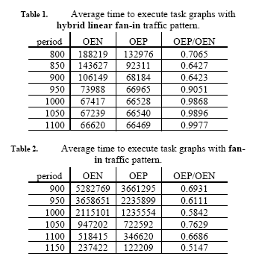
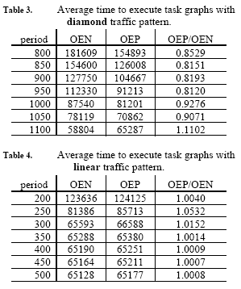
Results

Slide 18
Publications
FPL06 – “Predictive Load Balancing for Interconnected FPGAs”
  FPGA array
SOCC – “Lightweight Load Balancing for Network-on-Chip”
  Going out 4/14

