Slide 1
Lightweight Hierarchical Error Control Codes for Multi-Bit Differential Channels
Jason D. Bakos
Ph.D. Proposal

Slide 2
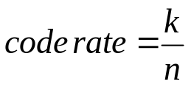
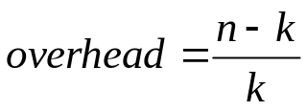
Introduction
New type of error control code
  Operate over existing channel encoding mechanism
  Lightweight
    Requires less code overhead relative to traditional ECC codes
      Exploit inherent properties of underlying channel code
Traditional ECC codes:
…
Raw data stream
…
…
…
…
blocks
k
k
k
…
…
…
…
code blocks
n
n
n

Slide 3
Talk Outline
Motivation
  High-speed signaling technology
  Multi-Bit Differential Signaling (MBDS)
  Characteristics of the nCm channel code
Approach
  Hierarchical Encoding for Error Control
  Computing code rate of LHECC codes
  Encoding/decoding examples
  Analysis of LHECC codes
  Sample decoder architecture
Experimental results
  Simulation setup
  Simulation results
Future Work

Slide 4
Talk Outline
Motivation
  High-speed signaling technology
  Multi-Bit Differential Signaling (MBDS)
  Characteristics of the nCm channel code
Approach
  Hierarchical Encoding for Error Control
  Computing code rate of LHECC codes
  Encoding/decoding examples
  Analysis of LHECC codes
  Sample decoder architecture
Experimental results
  Simulation setup
  Simulation results
Future Work

Slide 5
Motivation
High performance electrical chip-to-chip signaling
chip 2
PCB traces
PCB traces
chip 3
chip 1
  Processor-Memory interconnect
  Other chip-to-chip interconnect
    High-resolution digital displays
    Storage devices
    High-speed sensors

Slide 6
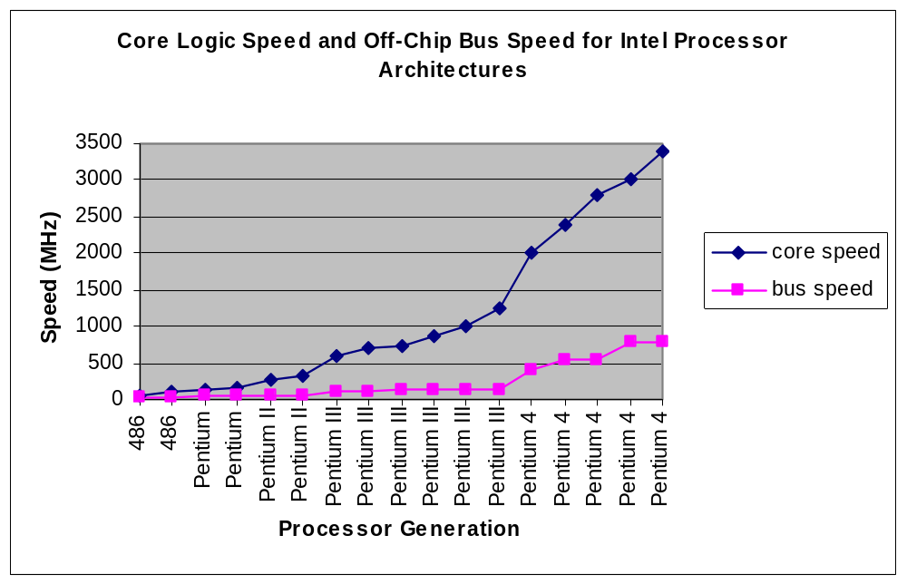
Need for High-Speed Off-Chip Signaling
Growing gap between on-chip signaling speed and off-chip signaling speed
Source: Intel Corporation

Slide 7
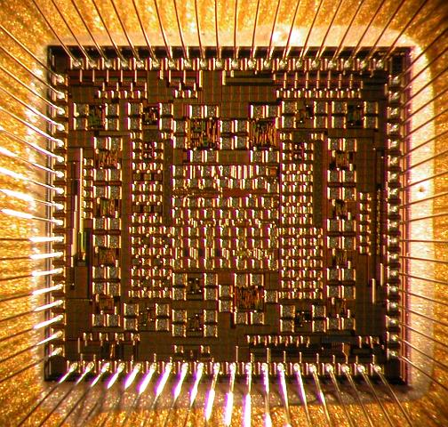
Challenges for Off-Chip Signaling
Packaged chip
Packaged chip
Integrity of high-speed off-chip signals
  capacitance, inductance
  additional noise
  synchronization / timing
PCB trace
Ground plane
High-speed links must be narrow
  I/O pads are a precious resource in chip design
  High-speed drivers are large due to skin effect
Solution:
  Couple data encoding to circuit design
    Increase signal integrity
    Recover from signal errors

Slide 8
Multi-Bit Differential Signaling (MBDS)
Differential signaling (LVDS)
MBDS
Data encoded as
  {01} or {10}
Advantages
  Low switching noise
  No reference noise
  Coupled transmission lines
  Low noise => low voltage swing
Disadvantages
  Two connections for each bit
  Wasteful in I/O pads
Data encoded with fixed number of ones
  N-choose-M (nCm)
  {0011}, {0101}, {0110}, {1001}, {1010}, {1100}
Advantages
  Same noise rejection as differential
  Higher information capacity

Slide 9
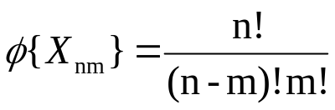
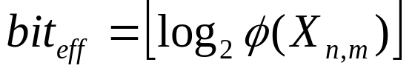
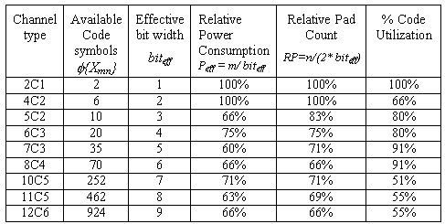
nCm Coding
EXAMPLE
6-wire MBDS channel
code size = 20 codes
effective bits = 4
equivalent to 8-wire differential channel
25% fewer pads (8 versus 6)
25% less power (4 1-bits on versus 3)
125% code capacity (20 codes versus 16)
Code set size
Effective bits

Slide 10
Properties of nCm Code Sets
Inherent error detecting ability
  Receivers can detect invalid code words
Extra code words
  For mapping code words to binary values

Slide 11
nCm Codes: Inherent Error Detection
Most types of bit errors result in invalid code words
Word is invalid if unequal number of 1 and 0 bits are flipped
  Odd-number of bit errors
1011
1101
0111
1110
0011
0001
1000
0010
0100
1 error
3 errors
  Even-number of bit errors
0011
1111
1001
2 errors
1001
1010
0101
0110
0000

Slide 12

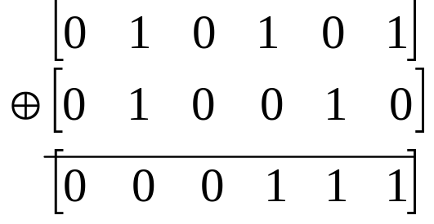

nCm Codes: Even Number of Bit Errors
What is the probability of detecting an even number of bit errors?
Example:
  6c3
  2 errors
Assume q errors (q is even)
Create error vector that indicates which bits are flipped
bits flipped in code word
6c3 code word
error vector
error vectors
result

Slide 13

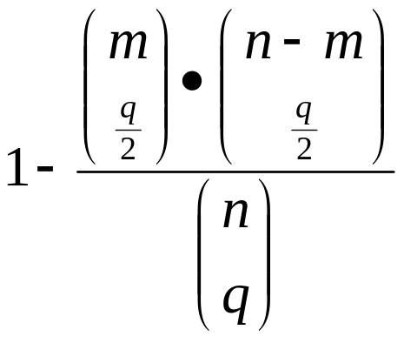
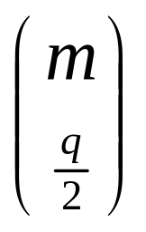
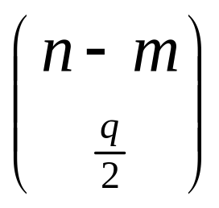
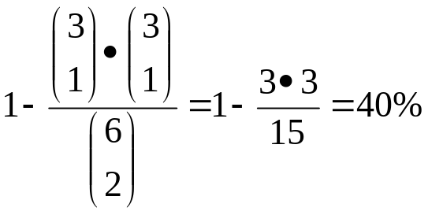
nCm Codes: Even Number of Bit Errors
For errors resulting in valid code words
  q errors
  assume separate error vectors for 1-bits and 0-bits
  size error vector for 1-bits: m
  size of error error for 0-bits: n-m
error vectors for 1-bits
Probability for detecting q errors
error vectors for 0-bits
Example: 6c3 with 2 bit errors
error vectors that yield valid code word
*

Slide 14
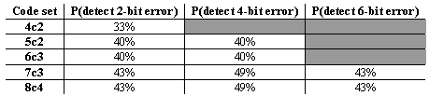
nCm Codes: Even Number of Bit Errors

Slide 15
nCm Codes: Extra Code Words
Each nCm code set has unmapped code words
Use to offset overhead for error control
4c2 code set => binary value
0011
00
0101
01
0110
10
1001
11
1010
?
1100
?
  Exploit by using 2 MBDS channels in parallel as bus
6 cw
6 cw
36 combinations
5 bits
4c2
4c2
2 bits
2 bits

Slide 16
Exploiting Extra Code Words
Fractional bits =
  log₂(cw) – floor(log₂(cw))
Therefore, need 1 / (fractional bits) channels in parallel to gain additional bit
Example:
  6c3 => 20 cw => log₂(20) = 4.3219 bits
  ceiling(1 / .3219) = 4 channels
2^{4.3}
*
2^{4.3}
*
2^{4.3}
*
2^{4.3}
6c3
6c3
6c3
6c3
.3 + .3 + .3 + .3 = 1.2 additional bits

Slide 17
Talk Outline
Motivation
  High-speed signaling technology
  Multi-Bit Differential Signaling (MBDS)
  Characteristics of the nCm channel code
Approach
  Hierarchical Encoding for Error Control
  Computing code rate of LHECC codes
  Encoding/decoding examples
  Analysis of LHECC codes
  Sample decoder architecture
Experimental results
  Simulation setup
  Simulation results
Future Work

Slide 18
Approach
Need to build error control code:
  Works over nCm code set
  Takes advantage of nCm properties

Slide 19
Hierarchical Encoding for ECC
Start with block of binary data
raw binary data
Encode portion of data into symbolic ECC block
Sets rules for nCm selection
Symbolic ECC block
Higher-Level Code
Encode remainder of data by choosing valid nCm codes governed by rules set by symbolic block
nCm block
Lower-Level Code

Slide 20
Lower-Level: Partitioning nCm Code Sets
nCm code sets have distance=2
Not enough for bit correction, t = floor((d-1) / 2)
Increase distance by partitioning into “distance subsets”
Example:
4c2, distance=4
Subsets:
  0 => {0011, 1100}
  1 => {0101, 1010}
  2 => {0110, 1001}
1100
0101
IDEA: If the subset is known, bit errors may be corrected
1001
0011
0110
1010

Slide 21
Partitioning Problem
Partitioning operation is not trivial
  Graph coloring is too complex for large code sets ( > 6c3)
  Good news:
    Done off-line
    Won’t go beyond 8c4 code set
  Use heuristic…
    Based on pruning depth-first search over space of code word subset assignment

Slide 22
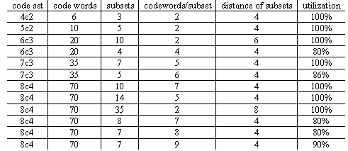
nCm Partitionings
Trade-off between code rate and ECC
minimize subsets for higher code rate
minimize cw/subset for higher ECC

Slide 23
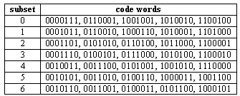
Example Partitioning
Example partitioning
7c3 code set
7 groups (subsets)
5 code words per subset
distance=4

Slide 24
Upper Level: Linear Block Codes
block size=n
Can correct:
erasures
errors
k data symbols
n-k parity symbols
Checksum
  Requires 1 parity symbol
  Can correct 1 erasure
MDS code (Reed-Solomon)
  Can correct erasures:
    Number of parity symbols
  Can correct errors:
    Number of parity symbols / 2
  Restrictions:
    Symbol base must be prime or power of a prime
    Max block size = symbol base + 1
Near-MDS code
  Can correct erasures:
    Number of parity symbols - 1
  Can correct subset errors:
    (Number of parity symbols – 1) / 2
  Restrictions:
    Symbol base must be prime or power of a prime
    If symbol base = p^{m}
      Max block size = p^{m+1} - 1

Slide 25
Encoding Hierarchical Block Codes
b bits
01010010010010010100
(s-data)
(c-data)
0101001001
0010010100
base conv. 2->s
base conv. 2->c
Data symbols
Parity symbols
Data as code words
Parity as code words

Slide 26
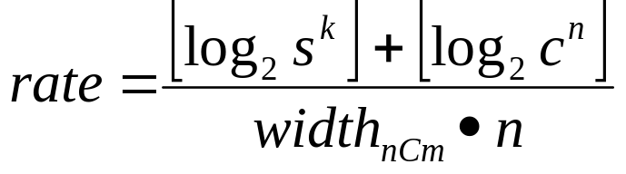
Computing Code Rate for LHECC
Code rate
  Defines information capacity vs. bits
  code rate = number of data bits / total code word bits (wires)
Block code parameters (n,k)
Partition parameters (s,c)
High level (s-data)
  s^{k} total values
Low level (c-data)
  c^{n} total values
We “break even” when code rate matches differential at 50%

Slide 27

Example #1: Encoding
Assume 3 x 4c2 channels
  Low level => s=3, c=2
  (3,2) checksum code
  s-data
    s^{k} = 9 cw (3 bits)
  c-data
    c^{n} = 8 cw (3 bits)
  code rate = 6 bits / 12 channels = 50%
    “Free” ECC
  Can correct one bit error within 1 code word
Encode 111101…
111₂ = 21₃
2
1
Compute checksum parity…
2
1
0
Encode 101…
bit
1
0
1
grp.
2
1001
1
0101
0
1100

Slide 28
Example #1: Decoding
Decoder:
  If invalid code word is detected
    Determine subset of code word in error
    Use minimum distance decoder to determine correct codeword
Assume bit error occurs…
grp.
2
1
0
?
1
0
cw
1001
0101
1100
1101
0101
1100
0 – 1 = 2 (mod 3)
  Symbol in error must be 0110 or 1001
  dist(1101,0110) = 3, dist(1101,1001) = 1
  Corrected symbol is 1001

Slide 29
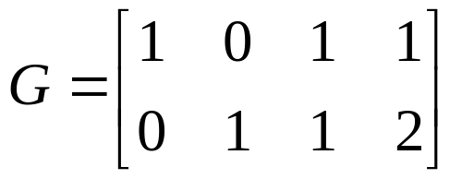
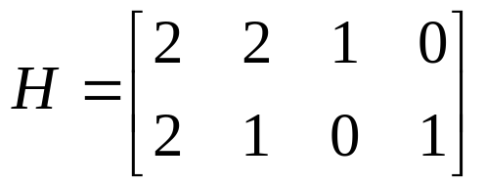
Example #2: Encoding
Assume 4 x 4c2 channels
  s=3, c=2
  (4,2) MDS code
  s-data
    s^{k} = 9 cw (3 bits)
  c-data
    c^{n} = 16 cw (4 bits)
  code rate = 7 bits / 16 channels = 44%
  Can correct one bit error in two code words
Need MDS generator matrix for encoding
  G = [ I^{k} A^{k x (n-k)} ]
Need MDS parity-check matrix for decoding
  H = [ -A^{T} I^{n-k}]

Slide 30
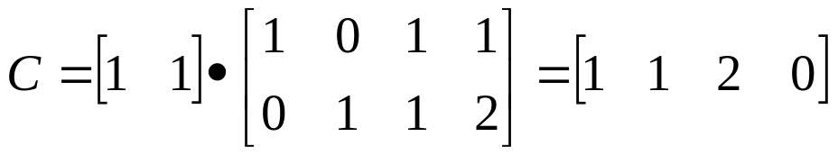
Example #2: Encoding
Encode 1001010…
100
1
1
2
0
Encode 1010...
bit
1
0
1
0
grp.
1
1
1010
0101
2
0
1001
0011

Slide 31
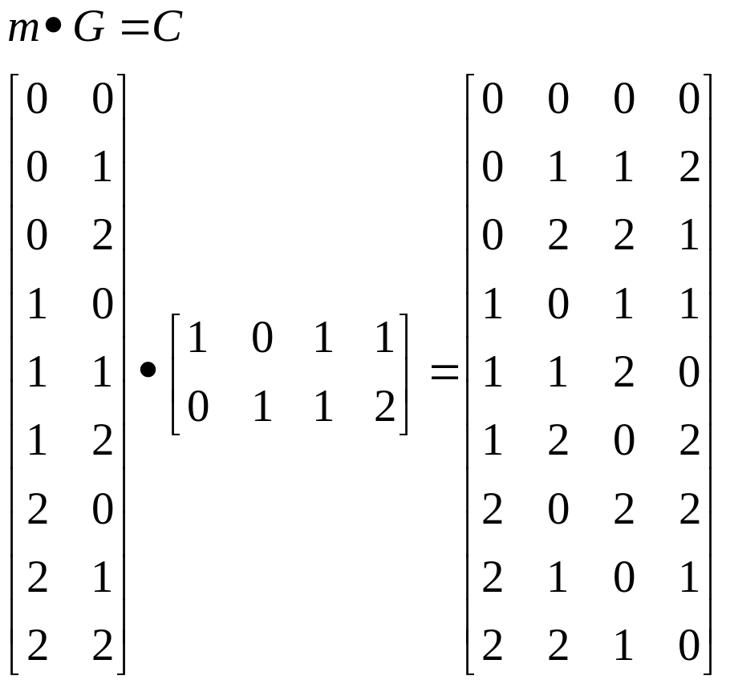
Example 2: Erasure Decoding
0 => {0011, 1100}
1 => {0101, 1010}
2 => {0110, 1001}
2 erasures!
1010
0101
1001
0011
1110
0101
1001
0001
grp.
1
1
2
0
grp.
?
1
2
?
1
(recover s-data)
11₃ = 100₂
0
dist(1110,0101)=3
dist(1110,1010)=1
dist(0001,0011)=1
dist(0001,1100)=3
1010
0101
1001
0011
grp.
1
1
2
0
bit
1
0
1
0
(recover c-data)

Slide 32
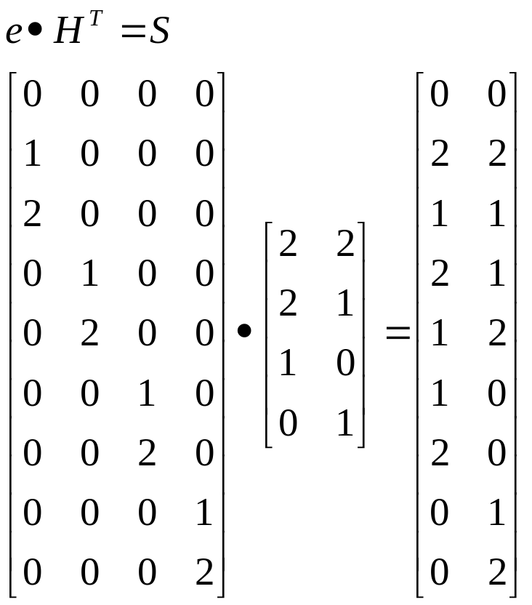
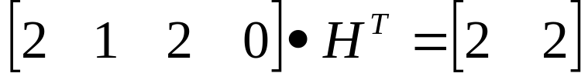
Example 2: Error Decoding
0 => {0011, 1100}
1 => {0101, 1010}
2 => {0110, 1001}
1010
0101
1001
0011
0110
0101
1001
0011
grp.
1
1
2
0
grp.
2
1
2
0
no error
dist(0110,0101)=2
dist(0110,1010)=2
Can’t correct nCm code word without partitioning for more distance
Can decode s-data

Slide 33
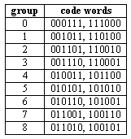
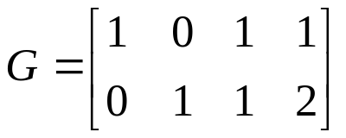
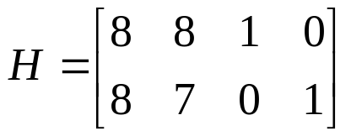
Example 3: Multiple Bit Error Correction
4 x 6c3 channels
9 subsets, 2 cw/subset, distance=6
Assume (4,2,9) MDS code
Code rate
  =[log₂(81)+log₂(16)]/24=10/24=42%
010110
110010
100101
001011
grp.
6
2
8
1
010110
110010
101001
001011
grp.
6
2
6
1
dist(101001,011010)=4
dist(101001,100101)=2
corrected code word is 100101

Slide 34
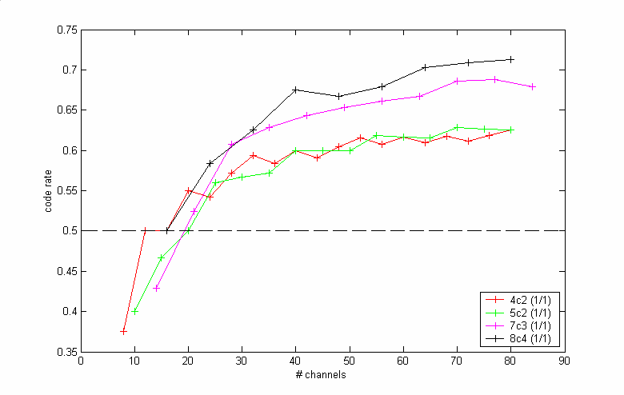
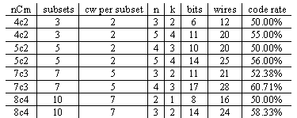
Analysis of Checksum-Based Codes
LHECC codes defined as
  nCm code set
  (s,c,d)
  (n,k,d)
Fully utilized partitioning
  s*c = cw
  1/1 correction
code rate
original code rates
4c2 => 2/4 = 50%
5c2 => 3/5 = 60%
7c3 => 5/7 = 71%
8c4 => 6/8 = 75%
# wires

Slide 35
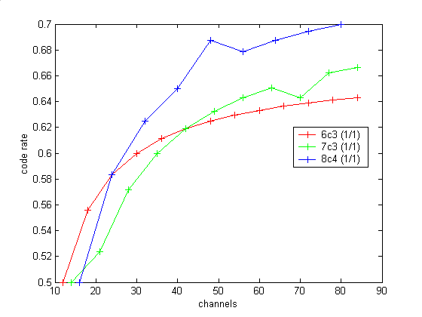

Analysis of Checksum-Based Codes
Under-utilized partitionings
  s * c < cw
code rate
original code rates
6c3 => 4/6 = 66%
7c3 => 5/7 = 71%
8c4 => 6/8 = 75%
# wires

Slide 36
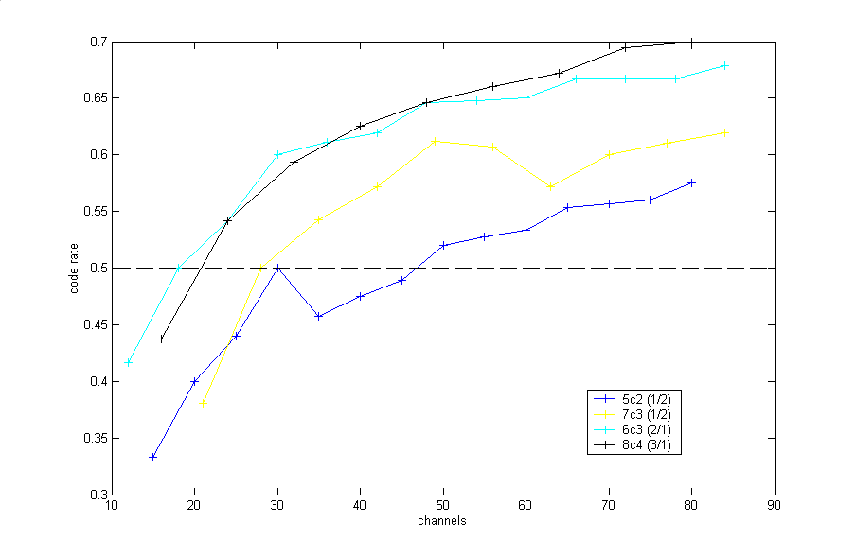

Analysis of Multiple Bit-Correcting Codes
5c2, 7c3
  2 parity symbols used
  MDS-code used until reached limit
  After MDS limit, NMDS code used
6c3
  Code set distance is 6 (t=2)
  One parity symbol
8c4
  Code set distance is 8 (t=3)
  One parity symbol
code rate
# wires

Slide 37
Example Implementation
non-binary MDS decoder (need good block MDS codes)
cw resolvers
RS decoder
grp. values lookup
Example (8,6) symbol decoder
binary output
MBDS receiver input
cw selection lookup
cw fixers
color legend:
nCm code words
s-values
c-values
fixes code word based on recv’d code word and group value
cw resolvers: determine s/c data from nCm code word (make simpler with good partitioning)
base translation lookup tables

Slide 38
Talk Outline
Motivation
  High-speed signaling technology
  Multi-Bit Differential Signaling (MBDS)
  Characteristics of the nCm channel code
Approach
  Hierarchical Encoding for Error Control
  Computing code rate of LHECC codes
  Encoding/decoding examples
  Analysis of LHECC codes
  Sample decoder architecture
Experimental results
  Simulation setup
  Simulation results
Future Work

Slide 39
Simulation Setup
Provide realistic simulation setup
Simulate sources of errors
  Transmission line low-pass filtering
  Common-mode noise
  Jitter

Slide 40
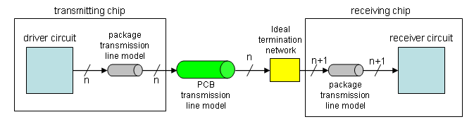
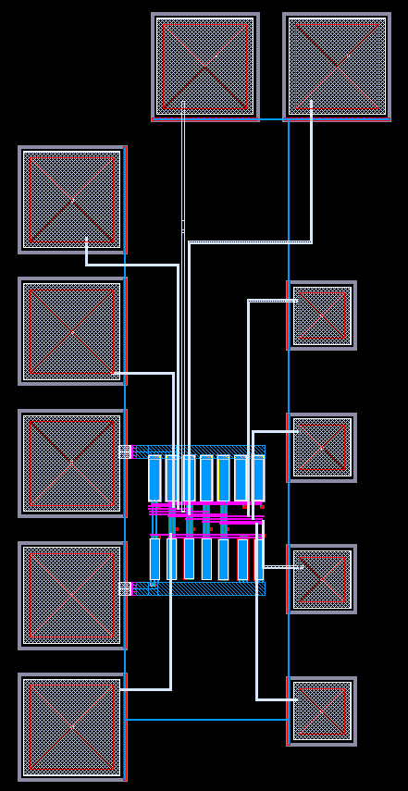
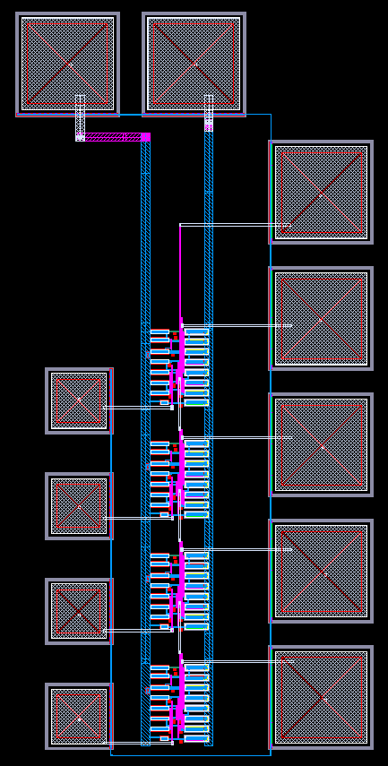
Simulation Setup

Slide 41
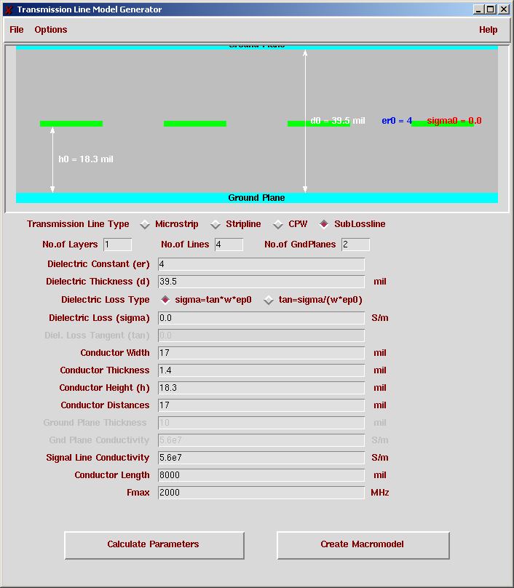
Simulation Testbench
PCB transmission line model
Lumped LC model
4-way coupled
Matched to 50 ohm characteristic impedance
  Match termination network

Slide 42
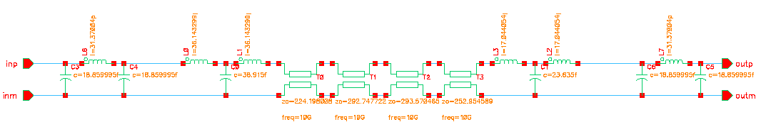
Simulation Testbench
Sample voltages relative to common here
random valid nCm code words
(CMOS digital)
CMOS code words out
solder bump model
solder bump model
wire bond model

Slide 43
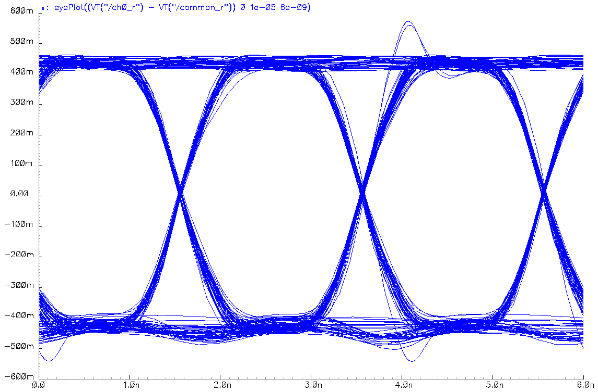
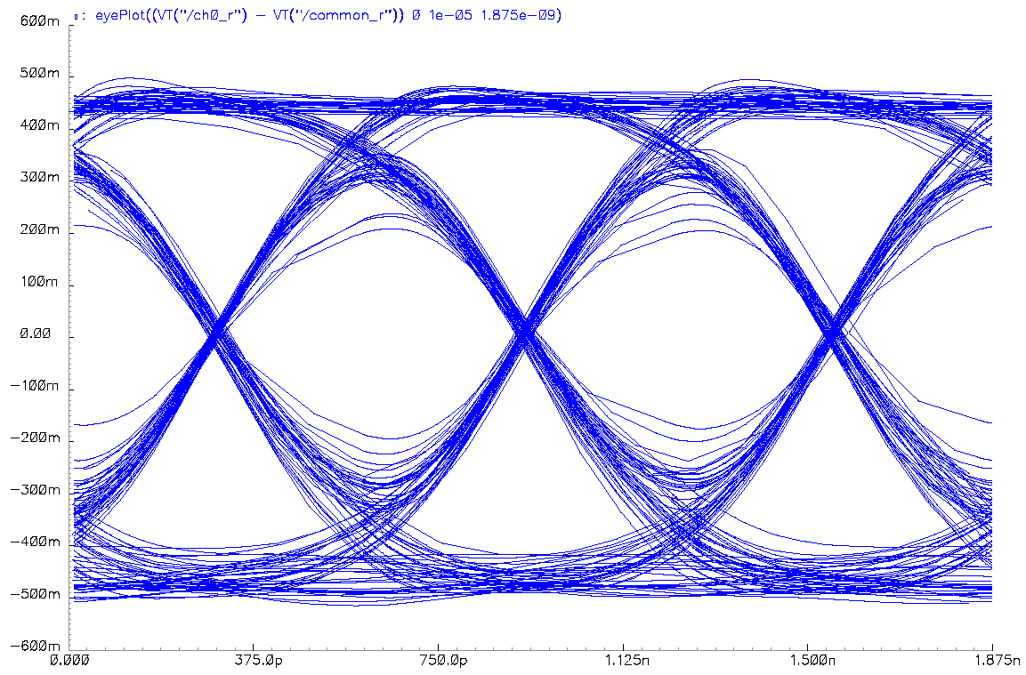
Experiment #1: Eye Plots
Transmission lines cause signal degredation at high speeds
  Filters out high frequencies
4c2 channel at 500 Mb/s
500 bit times
4c2 channel at 1.6 Gb/s
500 bit times

Slide 44
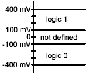
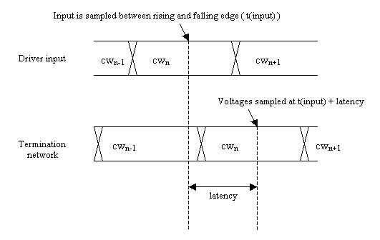
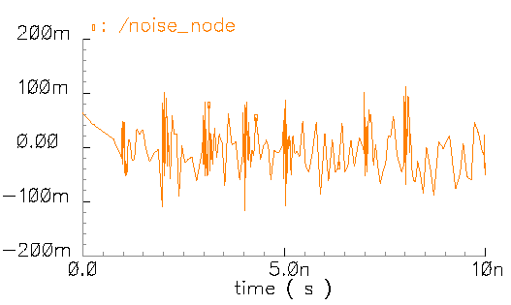
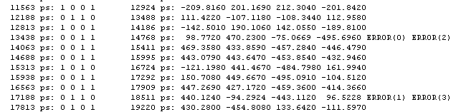
Experiment #2: Common-Mode Noise
Inject AWGN(0,1)*0.04 into each wire
1.6 Gbps
1300 ps latency

Slide 45
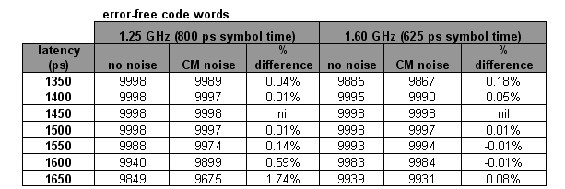
Experiment 2: Common-Mode Noise
Code word in error if any bits are in error
Simulation run for 10,000 bit times
  (cw_correct_{no_noise} – cw_correct_{noise}) / total_codewords
Ran simulation for 1.25 Gbps and 1.60 Gbps

Slide 46
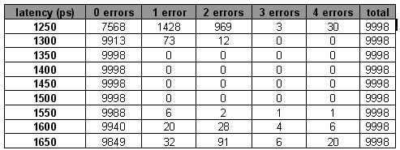
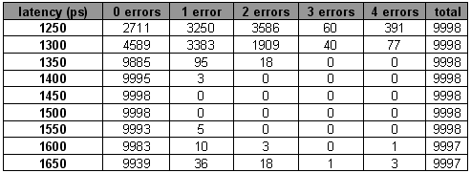
Experiment 3: Code Word Bit Error Rates
Bit error rates for 1.25 Gb/s and 1.6 Gb/s
Optimal latency
(jitter margin)
1.25 Gb/s
Infrequent bit errors occur
1.6 Gb/s

Slide 47
Talk Outline
Motivation
  High-speed signaling technology
  Multi-Bit Differential Signaling (MBDS)
  Characteristics of the nCm channel code
Approach
  Hierarchical Encoding for Error Control
  Computing code rate of LHECC codes
  Encoding/decoding examples
  Analysis of LHECC codes
  Sample decoder architecture
Experimental results
  Simulation setup
  Simulation results
Future Work

Slide 48
Future Work
Show that LHECC codes are optimal for MBDS channels
  MDS codes optimal for symbolic codes
  Show that LHECC codes make the best use of nCm properties to absorb ECC penalty

Slide 49
Future Work
Design efficient implementation
LHECC encoding/decoding logic should fit into reasonable space and operate at I/O speed
4 x 4c2 MBDS drivers
4 x 4c2 MBDS receivers

Slide 50
Future Work
Design accurate simulation environment with LHECC logic to show effectiveness of LHECC codes
  Add accurate error sources
    Circuits
    Transmission lines

Slide 51
Acknowledgements
Thank you!
Ph.D. committee
  Dr. Donald Chiarulli (CS Department)
  Dr. Steven Levitan (EE Department)
  Dr. Bruce Childers (CS Department)
  Dr. Patchrawat Uthaisombut (CS Department)

