Slide 1
Heterogeneous Computing
Dr. Jason D. Bakos

Slide 2
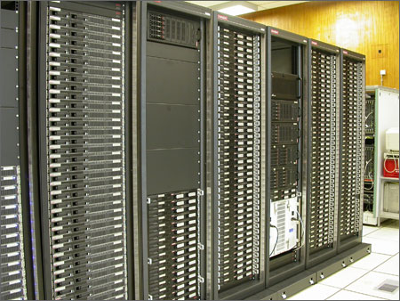
“Traditional” Parallel/Multi-Processing
Large-scale parallel platforms:
  Individual computers connected with a high-speed interconnect
  Programs are dispatched from a head node
Upper bound for speedup is n, where n = # processors
  How much parallelism in program?
  System, network overheads?

Slide 3
Heterogeneous Computing
Computer system made up of interconnected parallel processors of mixed types
Generally includes:
  One or more general-purpose processor(s)
    Acts as the “host”
  One or more special-purpose processor(s)
    Acts as the “co-processors”
Advantage:
  Accelerates each general-purpose processor by a factor of 10 to 1000
  One co-processor add-in board can replace 10s to 1000s of processors in a traditional parallel computer

Slide 4
Heterogeneous Execution Model
instructions executed over time
49% of code
initialization
0.5% of run time
co-processor
“hot” loop
99% of run time
1% of code
49% of code
clean up
0.5% of run time

Slide 5
Heterogeneous Computing: Performance
Move “bottleneck” computations from software to FPGA
  Use FPGA as co-processor
Example:
  Application requires a week of CPU time
  One computation consumes 99% of execution time
Kernel speedup | Application speedup | Execution time
50 | 34 | 5.0 hours
100 | 50 | 3.3 hours
200 | 67 | 2.5 hours
500 | 83 | 2.0 hours
1000 | 91 | 1.8 hours

Slide 6
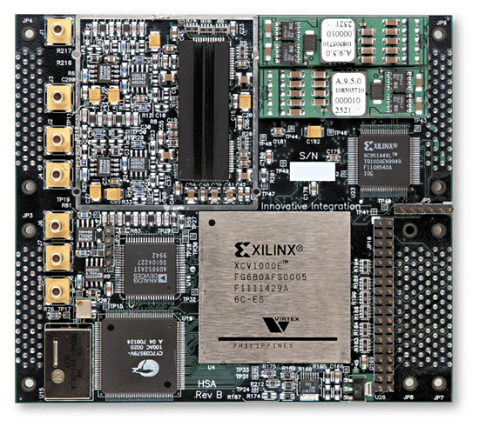
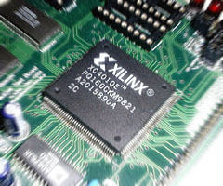
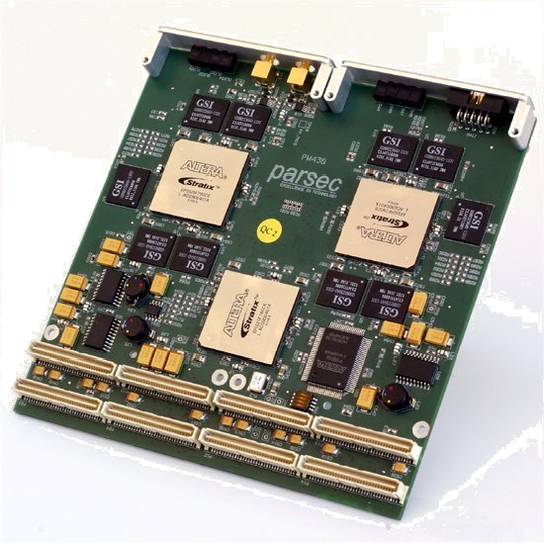
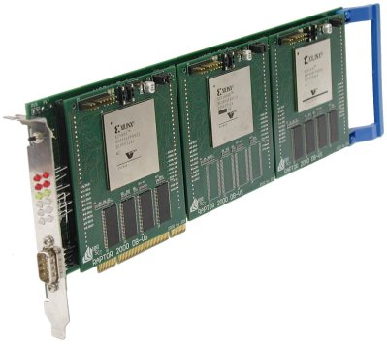
High-Performance Reconfigurable Computing
Heterogeneous computing with reconfigurable logic, i.e. FPGAs

Slide 7
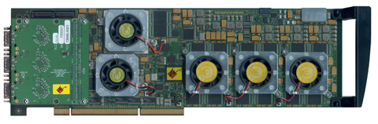
High-Performance Reconfigurable Computing
Advantage of HPRC:
  Cost
    FPGA card => ~ $15K
    128-processor cluster => ~ $150K
  + maintenance + cooling + electricity + recycling
Challenges:
  Programming the FPGA
  Identifying kernels
  Optimizing accelerator design

Slide 8
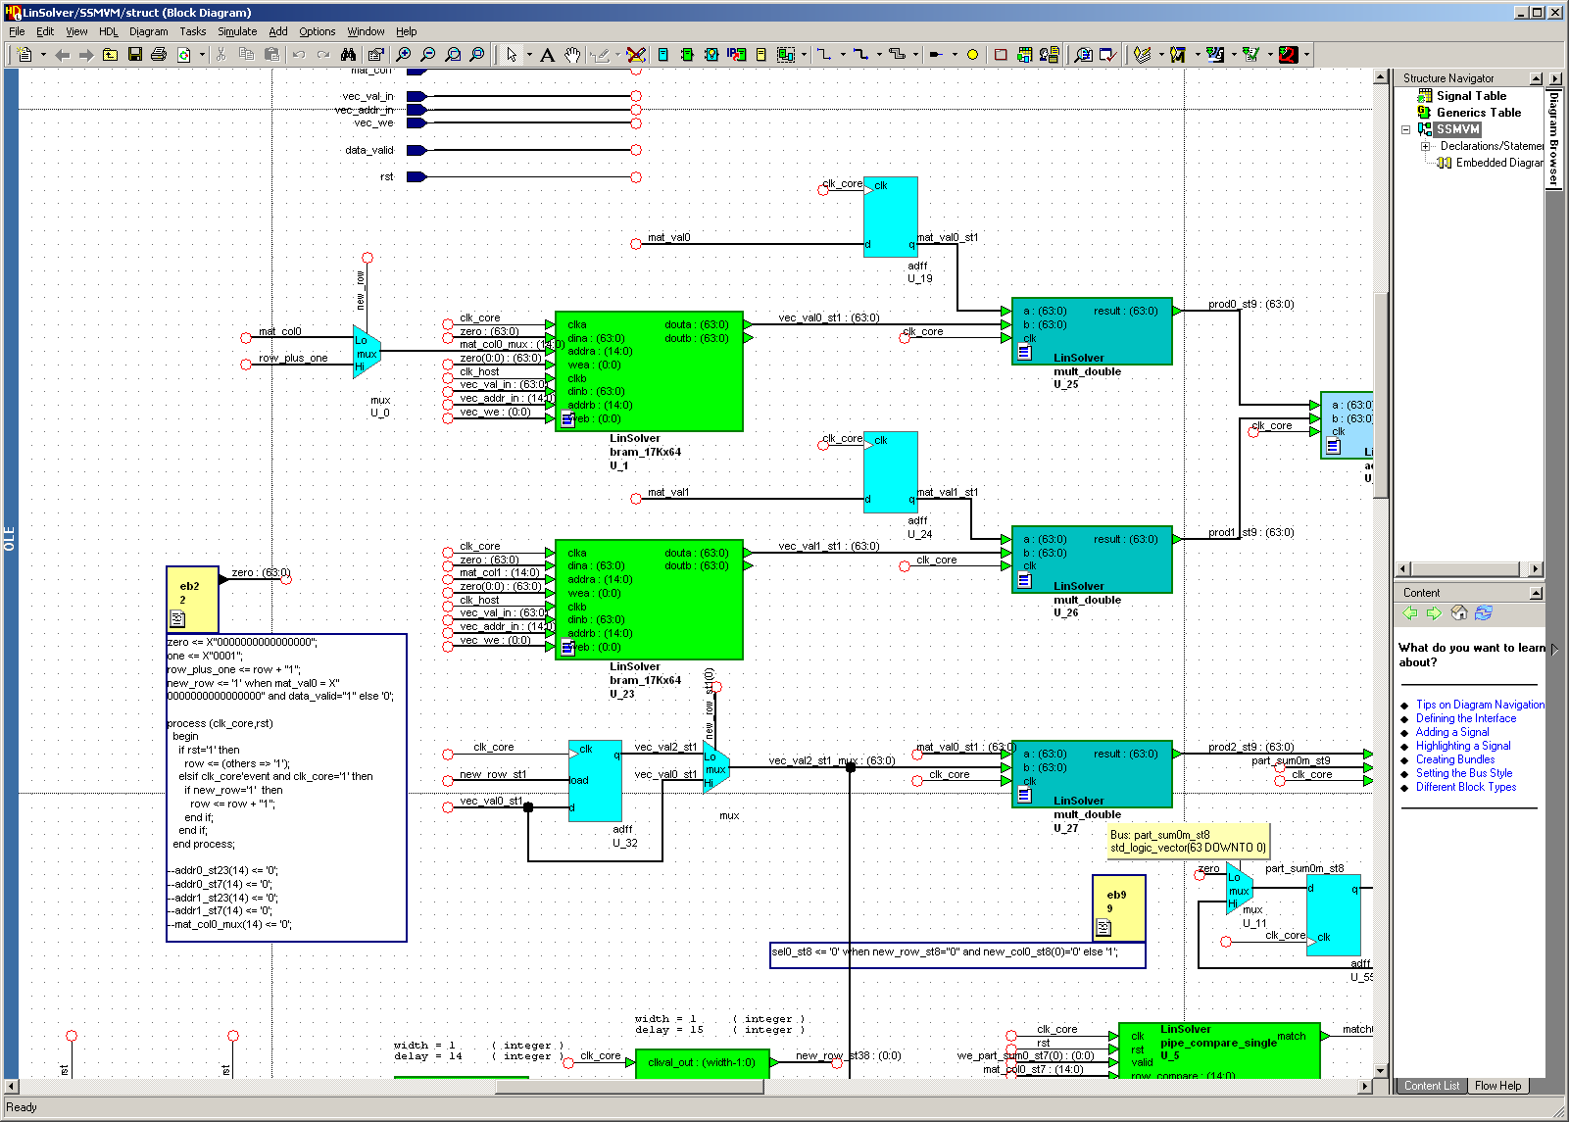
Programming FPGAs

Slide 9
Heterogeneous Computing with GPUs
Graphics Processor Unit (GPU)
  Contains hundreds of small processor cores grouped hierarchically
  Has high bandwidth to on-board memory and to host memory
  Became “programmable” about two years ago
  Gained hardware double precision about one year ago
Examples: IBM Cell, nVidia GeForce, AMD FireStream
Advantage over FPGAs:
  Easier to program
  Less expensive (gamers drove high volumes, decreasing cost)
Drawbacks:
  Can only do floating point fast (computations that map well to shaders)?

Slide 10
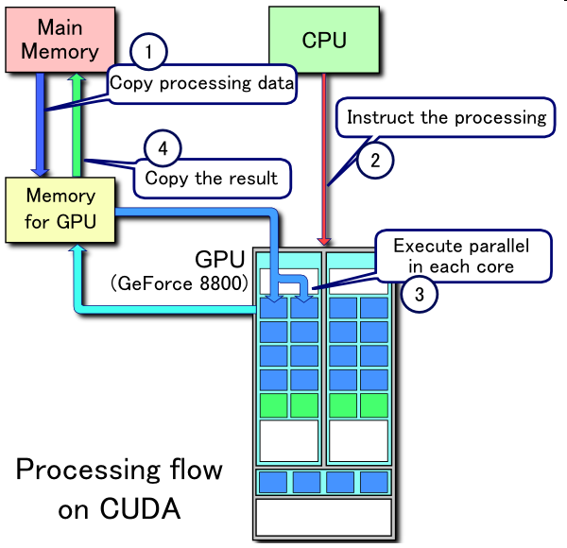
Heterogeneous Computing with GPUs

Slide 11
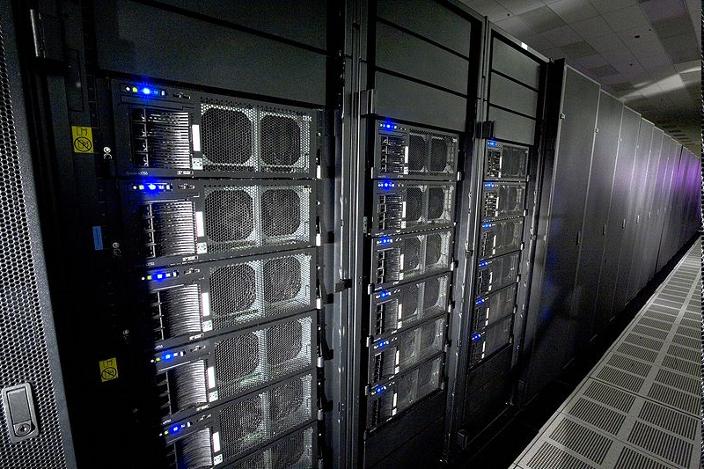
Heterogeneous computing is mainstream:
IBM Roadrunner
Los Alamos, fastest computer in the world
6,480 AMD Opteron (dual core) CPUs
12,960 PowerXCell 8i GPUs
Each blade contains 2 Operons and 4 Cells
296 racks
1.71 petaflops peak (1.7 billion million fp operations per second)
2.35 MW (not including cooling)
  Lake Murray hydroelectric plant produces ~150 MW (peak)
  Lake Murray coal plant (McMeekin Station) produces ~300 MW (peak)
  Catawba Nuclear Station near Rock Hill produces 2258 MW

Slide 12
Open Questions
What characteristics make a particular program amenable to acceleration?
Are FPGA-based co-processors better suited for some types of computations than GPU-based co-processors?
How can we develop efficient and effective methodologies for adapting general-purpose codes to heterogeneous systems?

Slide 13
Our Group
Past projects:
  Custom FPGA accelerators:
    computational biology
    linear algebra
  Multi-FPGA interconnection networks:
    interface abstractions
    adaptive routing algorithms
    on-chip router designs
Current projects:
  Design tools
    Dynamic code analysis
    Semi-automatic accelerator generation
  Assessing GPU accelerators versus FPGA accelerators for various computations
  Accelerators for solving large systems of ODEs

