Slide 1
GPU Acceleration of Pyrosequencing Noise Removal Dept. of Computer Science and Engineering University of South Carolina
Yang Gao, Jason D. Bakos
Heterogeneous and Reconfigurable Computing Lab (HeRC)
SAAHPC’12

Slide 2
Agenda
Background
Needleman-Wunsch
GPU Implementation
Optimization steps
Results

Slide 3

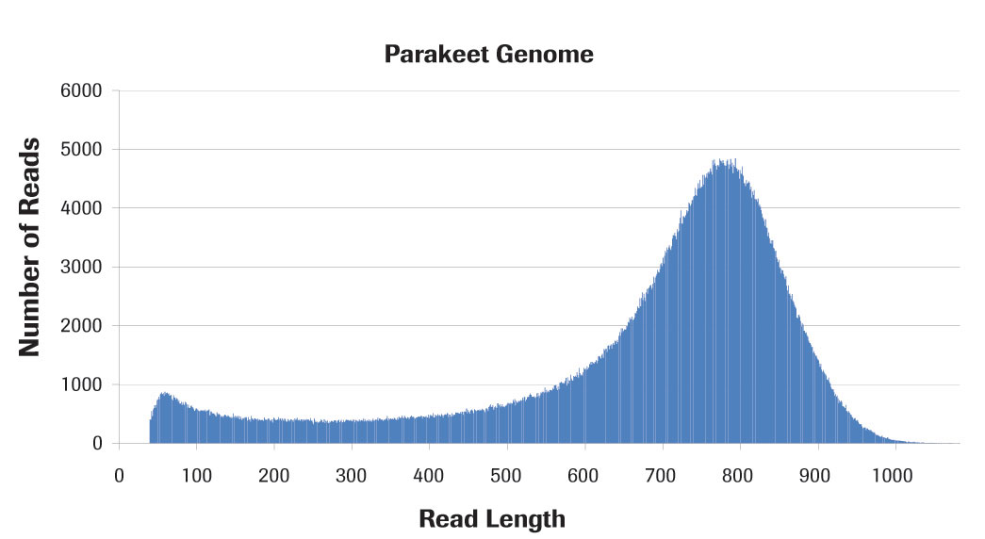
Roche 454
GS FLX Titanium XL+
Typical Throughput | 700 Mb
Run Time | 23 hours
Read Length | Up to 1,000 bp
Reads per Run | ~1,000,000 shotgun

Slide 4





From Genomics to Metagenomics

Slide 5
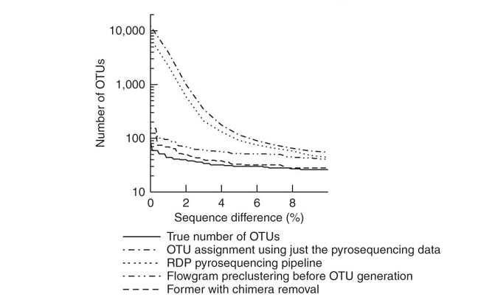
Why AmpliconNoise?
454 Pyrosequencing in Metagenomics has no consensus sequences
--------→
Overestimation of the number of operational taxonomic units (OTUs)
C. Quince, A. Lanzn, T. Curtis, R. Davenport, N. Hall,I. Head, L.Read, and W. Sloan, “Accurate determination of microbial diversity from 454 pyrosequencing data,” Nature Methods, vol. 6, no. 9, pp. 639–641, 2009.

Slide 6
SeqDist
Clustering method to “merge” the sequences with minor differences
SeqDist
How to define the distance between two potential sequences?
Pairwise Needleman-Wunsch and Why?
short sequences number
Sequence Alignment Between two short sequences
 | 1 | 2 | 3 | 4 | 5 | 6 | … | n
1 | - | C | C | C | C | C | C | C
2 | - | - | C | C | C | C | C | C
3 | - | - | - | C | C | C | C | C
4 | - | - | - | - | C | C | C | C
5 | - | - | - | - | - | C | C | C
6 | - | - | - | - | - | - | C | C
… | - | - | - | - | - | - | - | C
n | - | - | - | - | - | - | - | -
c
sequence 1: A G G T C C A G C A T
sequence 2: A C C T A G C C A A T
C: Sequences Distance Computation

Slide 7
Agenda
Background
Needleman-Wunsch
GPU Implementation
Optimization steps
Results

Slide 8
Needleman-Wunsch
sequence 1: A G G T C C A G C A T
sequence 2: A C C T A G C C A A T
Based on penalties for:
Adding gaps to sequence 1
Adding gaps to sequence 2
Character substitutions (based on table)
sequence 1: A _ _ _ _ G G T C C A G C A T
sequence 2: A C C T A G C C A A T
sequence 1: A G G T C C A G C A T
 | A | G | C | T
A | 10 | -1 | -3 | -4
G | -1 | 7 | -5 | -3
C | -3 | -5 | 9 | 0
T | -4 | -3 | 0 | 8
sequence 2: A _ _ _ C C T A G C C A A T
sequence 1: A G G T C C A G C A T
sequence 2: A C C T A G C C A A T

Slide 9
Needleman-Wunsch
Construct a score matrix, where:
Each cell (i,j) represents score for a partial alignment state
Sequence 1
A | B
C | D
Sequence 2
 |  | A | G | G | T | C | C | A | G | C | A | T
 |  |  |  |  |  | A | B
A |  |  |  |  |  | C | D
C
C
T
A
G
C
C
A
A
T
D = best score, among:
Add gap to sequence 1 from B state
Add gap to sequence 2 from C state
Substitute from A state
Final score is in lower-right cell

Slide 10
Needleman-Wunsch
 |  | A | G | G | T | C | C | A | G | C | A | T
 | D | L | L | L | L | L | L | L | L | L | L | L
A | U | D | D | L | L | L | L | L | L | L | L | L
C | U | U | D | D | D | L | L | L | L | L | L | L
C | U | U | D | D | D | D | L | L | L | L | L | L
T | U | U | U | D | D | D | L | L | L | L | L | L
A | U | U | U | U | U | U | L | L | L | L | L | L
G | U | U | U | U | U | U | D | L | L | L | L | L
C | U | U | U | U | D | D | D | D | L | L | L | L
C | U | U | U | U | U | D | D | D | L | L | L | L
A | U | U | U | U | U | D | D | D | L | L | D | L
A | U | U | U | U | U | U | U | D | L | L | D | D
T | U | U | U | U | U | U | U | U | U | D | D | D
Compute move matrix, which records which option was chosen for each cell
Trace back to get for alignment length
AmpliconNoise: Divide score by alignment length
match
substitute
substitute
match
gap s2
gap s2
match
match
match
gap s1
gap s1
L: left
match
U: upper
D: diagnal
match
Notes:
legend

Slide 11
Needleman-Wunsch
Computation Workload
~(800x800) N-W Matrix Construction
~(400 to 1600) steps N-W Matrix Trace Back
About (100,000 x 100,000)/2 Matrices

Slide 12
Agenda
Background
Needleman-Wunsch
GPU Implementation
Optimization steps
Results

Slide 13
Previous Work
Finely parallelize single alignment into multiple threads
One thread per cell on the diagonal
Disadvantages:
Complex kernel
Unusual memory access pattern
Hard to trace back
1 | 2 | 3 | 4 | 5 | 6 | 7 | 8 | 9
2 | 3 | 4 | 5 | 6 | 7 | 8 | 9 | 10
3 | 4 | 5 | 6 | 7 | 8 | 9 | 10 | 11
4 | 5 | 6 | 7 | 8 | 9 | 10 | 11 | 12
5 | 6 | 7 | 8 | 9 | 10 | 11 | 12 | 13
6 | 7 | 8 | 9 | 10 | 11 | 12 | 13 | 14
7 | 8 | 9 | 10 | 11 | 12 | 13 | 14 | 15
8 | 9 | 10 | 11 | 12 | 13 | 14 | 15 | 16
9 | 10 | 11 | 12 | 13 | 14 | 15 | 16 | 17
Block Wave Line

Slide 14
Our Method: One Thread/Alignment
1 | 2 | 3 | 4 | 5 | 6
7 | 8 | 9 | 10 | 11 | 12
13 | 14 | 15 | 16 | 17 | 18
19 | 20 | 21 | 22 | 23 | 24
25 | 26 | 27 | 28 | 29 | 30
31 | 32 | 33 | 34 | 35 | 36
Block Stride
1 | 2 | 3 | 4 | 5 | 6
7 | 8 | 9 | 10 | 11 | 12
13 | 14 | 15 | 16 | 17 | 18
19 | 20 | 21 | 22 | 23 | 24
25 | 26 | 27 | 28 | 29 | 30
31 | 32 | 33 | 34 | 35 | 36
1 | 2 | 3 | 4 | 5 | 6
7 | 8 | 9 | 10 | 11 | 12
13 | 14 | 15 | 16 | 17 | 18
19 | 20 | 21 | 22 | 23 | 24
25 | 26 | 27 | 28 | 29 | 30
31 | 32 | 33 | 34 | 35 | 36
1 | 2 | 3 | 4 | 5 | 6
7 | 8 | 9 | 10 | 11 | 12
13 | 14 | 15 | 16 | 17 | 18
19 | 20 | 21 | 22 | 23 | 24
25 | 26 | 27 | 28 | 29 | 30
31 | 32 | 33 | 34 | 35 | 36
1 | 2 | 3 | 4 | 5 | 6
7 | 8 | 9 | 10 | 11 | 12
13 | 14 | 15 | 16 | 17 | 18
19 | 20 | 21 | 22 | 23 | 24
25 | 26 | 27 | 28 | 29 | 30
31 | 32 | 33 | 34 | 35 | 36
Memory access pattern
Block Wave Line

Slide 15
Grid Organization
Example:
320 sequences
Block size=32
n = 320/32 = 10 threads/block
(n²-n)/2 = 45 blocks
Objective:
Evaluate different block sizes
Block 0
Sequences
0-31
Sequences
32-63
…
…
Block 1
Sequences
0-31
Sequences
64-95
…
…
…
…
Block 44
Sequences
256-
287
Sequences
288-
319
…
…

Slide 16
Agenda
Background
Needleman-Wunsch
GPU Implementation
Optimization steps
Results

Slide 17
Optimization Procedure
Optimization Aim: to have more matrices been built concurrently
Available variables
Kernel size(in registers)
Block size(in threads)
Grid size(in block or in warp)
Constraints
SM resources(max schedulable warps, registers, share memory)
GPU resources(SMs, on-board memory size, memory bandwidth)

Slide 18
Kernel Size
Make sure the kernel as simple as possible (decrease the register usage)
→ our final outcome is a 40 registers kernel.
Fixed Parameters
Kernel Size | 40
Block Size | -
Grid Size | -
Constraints
max support warps
registers
share memory
SMs
on-board memory
memory bandwidth

Slide 19
Block Size
Block size alternatives
Fixed Parameters
Kernel Size | 40
Block Size | 64
Grid Size | -
Constraints
max support warps
registers
share memory
SMs
on-board memory
memory bandwidth

Slide 20
Grid Size
The ideal warp number per SM is 12
W/30 SMs => 360 warps
In our grouped sequence design
the warps number has to be multiple of 32.
Fixed Parameters
Kernel Size | 40
Block Size | 64
Grid Size | 160
Blocks | Warps | Time(s)
160 | 320 | 11.3
192 | 384 | 12.7
224 | 448 | 12.2
Constraints
max support warps
registers
share memory
SMs
on-board memory
memory bandwidth

Slide 21
Stream Kernel for Trace Back
Aim: To have both matrix construction and trace back working simultaneously without losing performance when transferring.
This strategy is not adopted due to lack of memory
Trace-back is performed on GPU
GPU
BUS
CPU
MC
TR
TB
Constraints
max support warps
registers
share memory
SMs
on-board memory
memory bandwidth
TIME
Stream1
MC
TR
TB
Stream2
MC
TR
TB
Stream1
MC
TR
TB

Slide 22
Register Usage Optimization
How to decrease the register usage
Ptxas –maxregcount
Low performance reason:
overhead for register spilling
Fixed Parameters
Kernel Size | 32
Block Size | 64
Grid Size | 192
Kernel Size | 40→32
Grid Size | 160→192
Occupancy | 37.5%→50%
Performance Improvement | <2%
Constraints
max support warps
registers
share memory
SMs
on-board memory
memory bandwidth

Slide 23
Other Optimizations
Multiple-GPU
4-GPU Implementation
MPI flavor multiple GPU compatible
Share Memory
Save previous “move” in the left side
Replace one global memory read
by shared memory read
A | B
C | D

Slide 24
Agenda
Background
Needleman-Wunsch
GPU Implementation
Optimization steps
Results

Slide 25
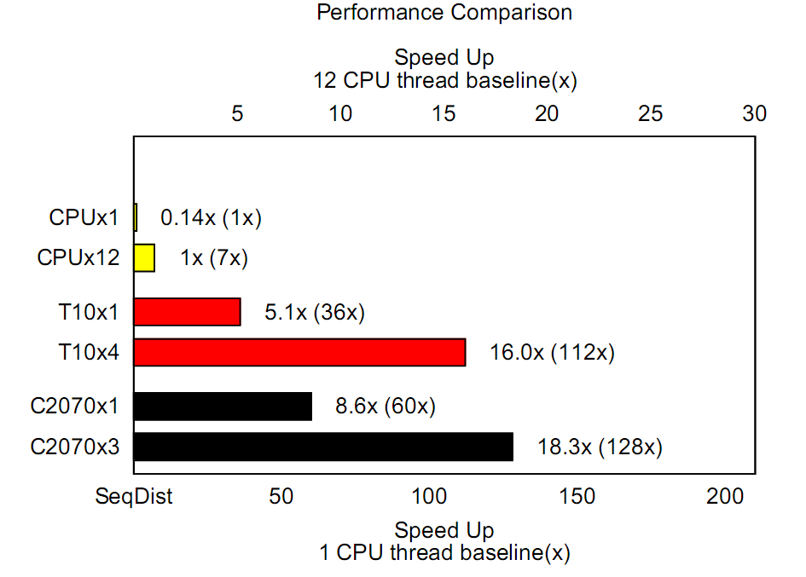
Results
CPU: Core i7 980

Slide 26
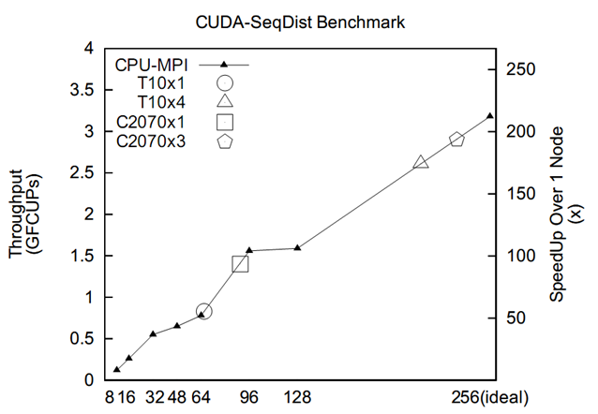
Results
FCUPs:
floating point cell update per second
Cluster: 40Gb/s Inifiniband
Xeon X5660
Number of Ranks in our cluster

Slide 27
Conclusion
GPUs are a good match for performing high throughput batch alignments for metagenomics
Three Fermi GPUs achieve equivalent performance to 16-node cluster, where each node contains 16 processors
Performance is bounded by memory bandwidth
Global memory size limits us to 50% SM utilization

Slide 28
Thank you!
Questions?
Yang Gao gao36@email.sc.edu
Jason D. Bakos jbakos@cse.sc.edu

