Slide 1




Computer Vision Tasks on the Texas Instruments C6678 Digital Signal Processor
Fan Zhang
Jason D. Bakos (presenter)
Yang Gao
Benjamin Morgan
Supercomputing 2013
Emerging Technologies
This material is based upon work supported by Texas Instruments and the National Science Foundation under Grant No. 0844951.

Slide 2
TI C66 DSP vs. Other Processors
 | NVIDIA Tesla K20X GPU 28 nm | Intel Xeon Phi 5110p 22 nm | Intel i7 Ivy Bridge 22 nm | TI C6678 Keystone 45 nm | NVIDIA Tegra 4 28 nm | Intel i3 Ivy Bridge 22 nm | ARM Cortex A15 Samsung Exynos 5 Octa (no GPU) 28 nm
Peak single precision throughput | 3.95 Tflops | 2.12 Tflops | 448 Gflops | 128 Gflops | 75 Gflops | 42 Gflops | 878 Mflops
TDP | 225 W | 225 W | 77 W | 10 W | 8 W | 55 W | ?
DRAM bandwidth | 250 GB/s | 320 GB/s | 25.6 GB/s Dual Channel DDR3 | 12.8 GB/s Single Channel DDR3 | 12.8-14.9 GB/s Single Channel DDR3 | 25.6 GB/s Dual Channel DDR3 | 12.8-14.9 GB/s Single Channel DDR3
Ideal power efficiency | 17.6 Gflops/ Watt | 9.4 Gflops/ Watt | 5.8 Gflops/ Watt | 12.8 Gflops/ Watt | 9.4 Gflops/ Watt | < 1 Gflops/ Watt | < 1 Gflops/ Watt

Slide 3
Why the C6678?
Unique architectural features
Eight cores
8-wide VLIW ISA (Itanium 9500 is 12-wide VLIW w/8 cores)
Shared memory, but no shared last level cache
Program controlled scratchpads
DMA engine for managing scratchpad memory
On-chip interfaces for potential scalability
4 x 5 Gb/s Serial Rapid IO 2.1
1 x 10 Gb/s Ethernet
2 x 5 Gb/s PCI-E 2.0
1 x 50 Gb/s HyperLink

Slide 4
Software Pipelining
The C66 relies on compiler to pipeline loops
Compiler relies on programmer for compiler directives and basic loop transformations
Regular Loop
Software Pipelining
Time
1
1
1
1
2
Prolog
1
1
2
3
Kernel
2
2
3
Epilog
2
3
2
ALU1
ALU2
ALU3

Slide 5
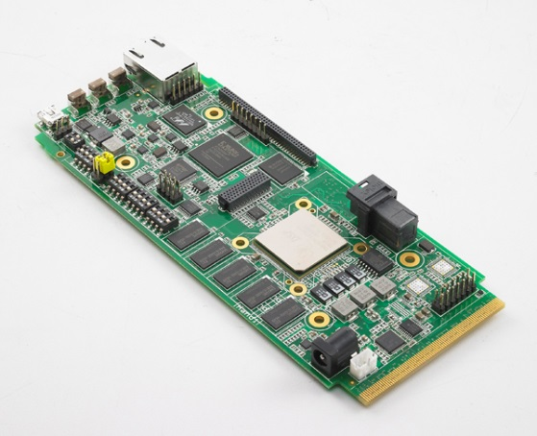
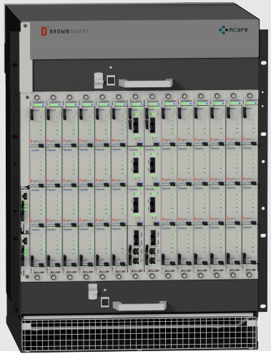
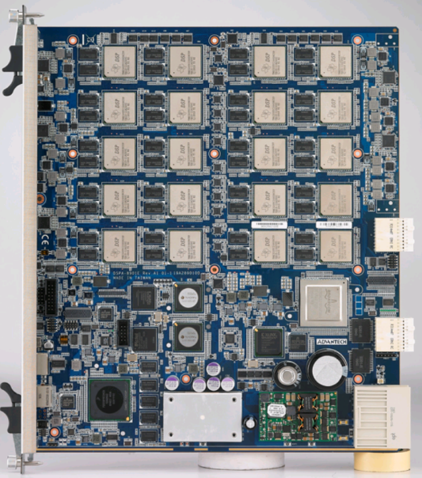
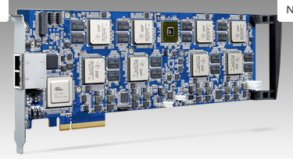
C66 Platforms
Development and evaluation: High Performance Computing:

Slide 6
Results from Previous Work
Single precision CSR sparse matrix vector multiply kernel (SpMV):
Memory bound (~0.25 flops/byte)
Control dependent
Achieves 0.7 raw performance vs. Intel MKL on Ivy Bridge-i7
Achieves 0.1 raw performance vs. NVIDIA CUBLAS on GTX680 Keplar
Achieves 5X Gflops/Watt vs. Intel Ivy Bridge-i7
Achieves equal Gflops/Watt vs. NVIDIA GTX680 Keplar
Uses 50% more of its peak DRAM b/w (.6 to .9) vs. Intel Sandy Bridge-i7
Uses 3X more of its peak DRAM b/w (.3 to .9) vs. NVIDIA GTX680
Yang Gao, Jason D. Bakos, "Sparse Matrix-Vector Multiply on the Texas Instruments C6678 Digital Signal Processor," Proc. The 24th IEEE International Conference on Application-specific Systems, Architectures and Processors, Washington D.C., June 5-7, 2013.

Slide 7
SpMV Software Optimizations
Technique | Performance | Speedup
Naïve | 0.55 Gflops
Double buffer in scratchpad using DMA | 0.78 Gflops | 1.4X
Fine grain loop transformations Assembly language Loop unroll Predicated instructions | 1.63 Gflops | 2.1X
Coarse grain loop transformation Loop fission | 2.08 Gflops | 1.3X
Total optimization effort |  | 3.8 X
On chip memory optimizations: 1.4 X
Loop pipelining: 2.7 X

Slide 8
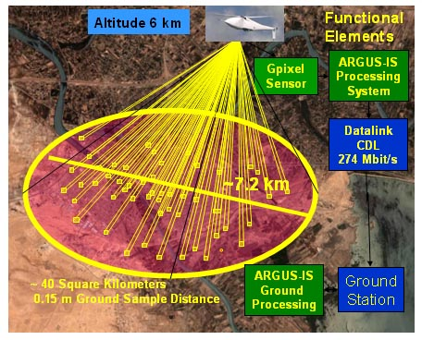
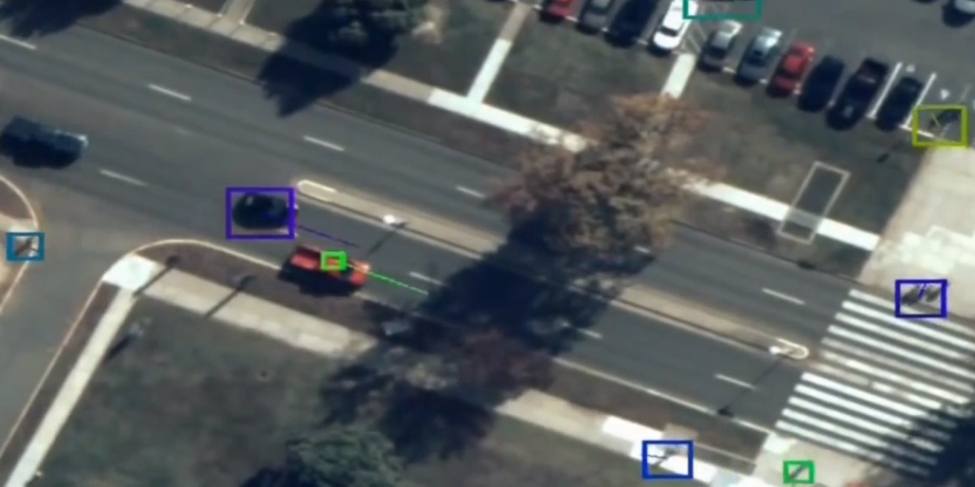
Computer Vision Kernels
Objective: evaluate C66 for
Computer vision kernels
Operate in standalone embedded platform

Slide 9

Dense Optical Flow
Objective:
Convert each frame into a flow field
Cluster pixels based on velocity magnitude to detect and track objects
Assume pixel intensity constraint:
Taylor expansion implies:
$$I\left(x,y,t\right)=I(x+∆x,y+∆y,t+∆t)$$
computed from frame n
computed from frame n and n+1
$$\frac{δI}{δx}V_{x}+\frac{δI}{δy}V_{y}=−\frac{δI}{δt}$$
solve for

Slide 10
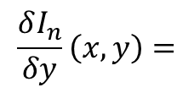
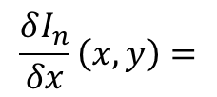
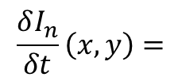
Derivative Calculation
$$\frac{δI_{n}}{δx}\left(x,y\right)=$$
Δx
+Δx
/4
+Δx
+Δx
frame n
frame n+1
$$\frac{δI_{n}}{δy}\left(x,y\right)=$$
Δy
+Δy
/4
+Δy
+Δy
frame n
frame n+1
$$\frac{δI_{n}}{δt}\left(x,y\right)=$$
Δt
+Δt
/4
+Δt
+Δt
frame n
frame n+1

Slide 11
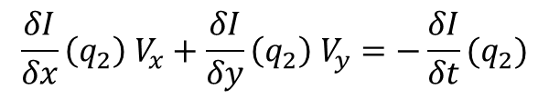
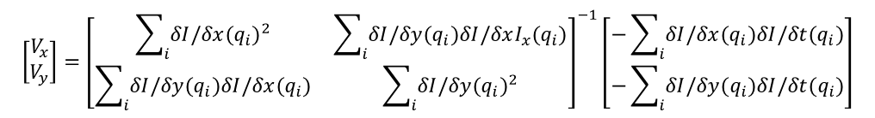
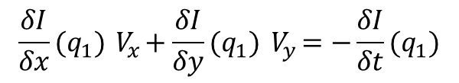


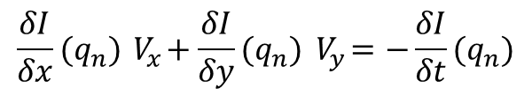
Lucas-Kanade Optical Flow
Assume pixels in a “neighborhood” have the same V_{x}, V_{y}:
Larger windows allow for faster movement but at lower resolution of flow field
Solve:
$$\frac{δI}{δx}(q_{1}){ V}_{x}+\frac{δI}{δy}(q_{1}){ V}_{y}=−\frac{δI}{δt}(q_{1})$$
$$Av=b$$
$$\frac{δI}{δx}\left(q_{2}\right) V_{x}+\frac{δI}{δy}\left(q_{2}\right) V_{y}=−\frac{δI}{δt}(q_{2})$$
Using LSM:
$$\left[\begin{matrix}V_{x} \\ V_{y}\end{matrix}\right]={\left[\begin{matrix}\sum_{i}{δI/δx({q_{i})}^{2}} & \sum_{i}{δI/δy(q_{i})δI/δxI_{x}{(q}_{i})} \\ \sum_{i}{δI/δy(q_{i})δI/δx{(q}_{i})} & \sum_{i}{δI/δy({q_{i})}^{2}}\end{matrix}\right]}^{−1}\left[\begin{matrix}−\sum_{i}{δI/δx(q_{i})δI/δt{(q}_{i})} \\ −\sum_{i}{δI/δy(q_{i})δI/δt{(q}_{i})}\end{matrix}\right]$$
…
$$\frac{δI}{δx}(q_{n}){ V}_{x}+\frac{δI}{δy}(q_{n}){ V}_{y}=−\frac{δI}{δt}(q_{n})$$
Overall method steps:
Gaussian blur
Derivative calculation
LSM
$$v=\left[\begin{matrix}v_{x} \\ v_{y}\end{matrix}\right]$$
A
b

Slide 12
Lucas-Kanade Optical Flow Summary
Objective:
Designed for stationary camera, search for small moving objects
Calculate movement vector for 16x16 neighborhoods
Cluster pixels with similar movement vectors to detect and track
Our implementation requires:
~200M single precision flops per 1920x1080 frame
6 Gflops sustained for 30 fps (in addition to other overheads)
Our implementation theoretical max = 46 fps (9.2 Gflops)
Ideally would like to scale to larger resolutions and more accuracy with more DSPs
Fun exercise:
ARGUS-IS is 1.8 Gpixels @ 15 fps
Assuming perfect scalability for our implementation => 2.7 Tflops, 6.8 KW
Global Hawk UAV generator produces 17.5 KW of electrical power

Slide 13
Previous Work on Lucas-Kanade
Authors | Platform | Proc. Power | Comments | Reported Results | Scaled to 1920x1080
Marzat et al. (2009) | NVIDIA Tesla C870 GPU | 171 Watts | Pyramidal method | 640x480 at 15 fps | 2 fps
Monson et al. (2013) | Xilinx Zynq 7020 FPGA | 6.5 Watts | Pyramidal method | 720x480 at 42 fps (ARM+FPGA) | 7 fps
Diaz et al. (2008) | Xilinx Virtex FPGA | n/a | Uses fixed point except for matrix inversion | 800x600 at 171 fps | 39 fps
Anguita et al. (2009) | Intel Core 2 Quad Q9550 | 65 Watts | Pyramidal method | 1280x1016 at 69 fps | 43 fps
Our kernel | TI C6678 DSP | 10 Watts |  | 1920x1080 at 46 fps

Slide 14
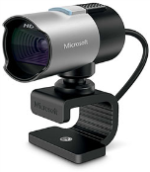
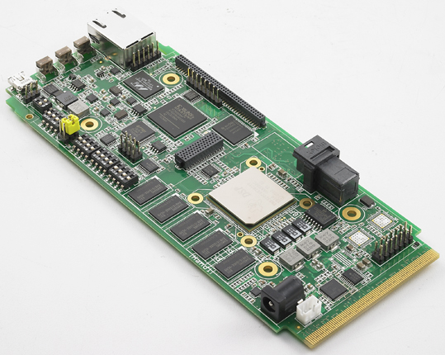
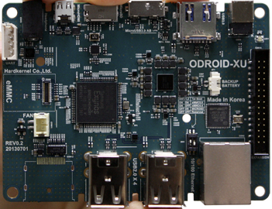
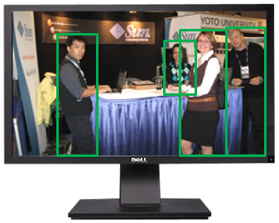
Platform
TMS320C6678
EVM
ODROID
Samsung Exynos 5
quad-ARM A15
USB/
jpeg
1GbE/
jpeg,
tracks
HDMI
“Hardware”
JPEG decoding
Software
JPEG decoding

Slide 15
DSP Performance Results (7 cores)
Kernel | Flops per byte | % total frame time | C66 eff. IPC per DSP core | C66 eff. Gflops (7 cores) | C66 Scratchpad eff. b/w (/112) | C66 DRAM eff. b/w
Jpeg decode |  | 33%
Copy blocks on chip |  | 5% |  |  |  | 5.6 GB/s
Gaussian blur | 0.41 | 16% | 3.9 / 8 | 16.8 | 42 GB/s
Derivative | 0.59 | 7% | 4.2 / 8 | 20.3 | 35 GB/s
Least square method | 0.33 | 23% | 2.5 / 8 | 10.5 | 29 GB/s
Copy blocks off chip |  | 13% |  |  |  | 5.6 GB/s
Clustering |  | 2%
One core used for network stack
EVM consumes 16 Watts (21 Watts with emulator)

Slide 16
Summary of Optimizations
Technique | Speedup
Cache prefetching | 1.4 X
DMA/scratchpad | 1.2 X
SIMD instructions | 1.1 X
Directives and loop transforms to maximize loop pipelining | 6.0 X
Total | 11.1 X
On chip memory optimizations => 1.7 X
VLIW optizations => 6.0 X

Slide 17
Conclusions
C6678 DSP achieves real-time optical-flow based object detection and tracking for 1920x1080 @30 fps for 16 Watts
To demonstrate, we added an ARM-based video interface board
Our plan is to scale up the system to support higher resolution, higher optical flow accuracy, and add dedicated tracking algorithms

