Slide 1

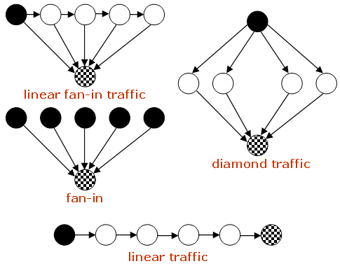
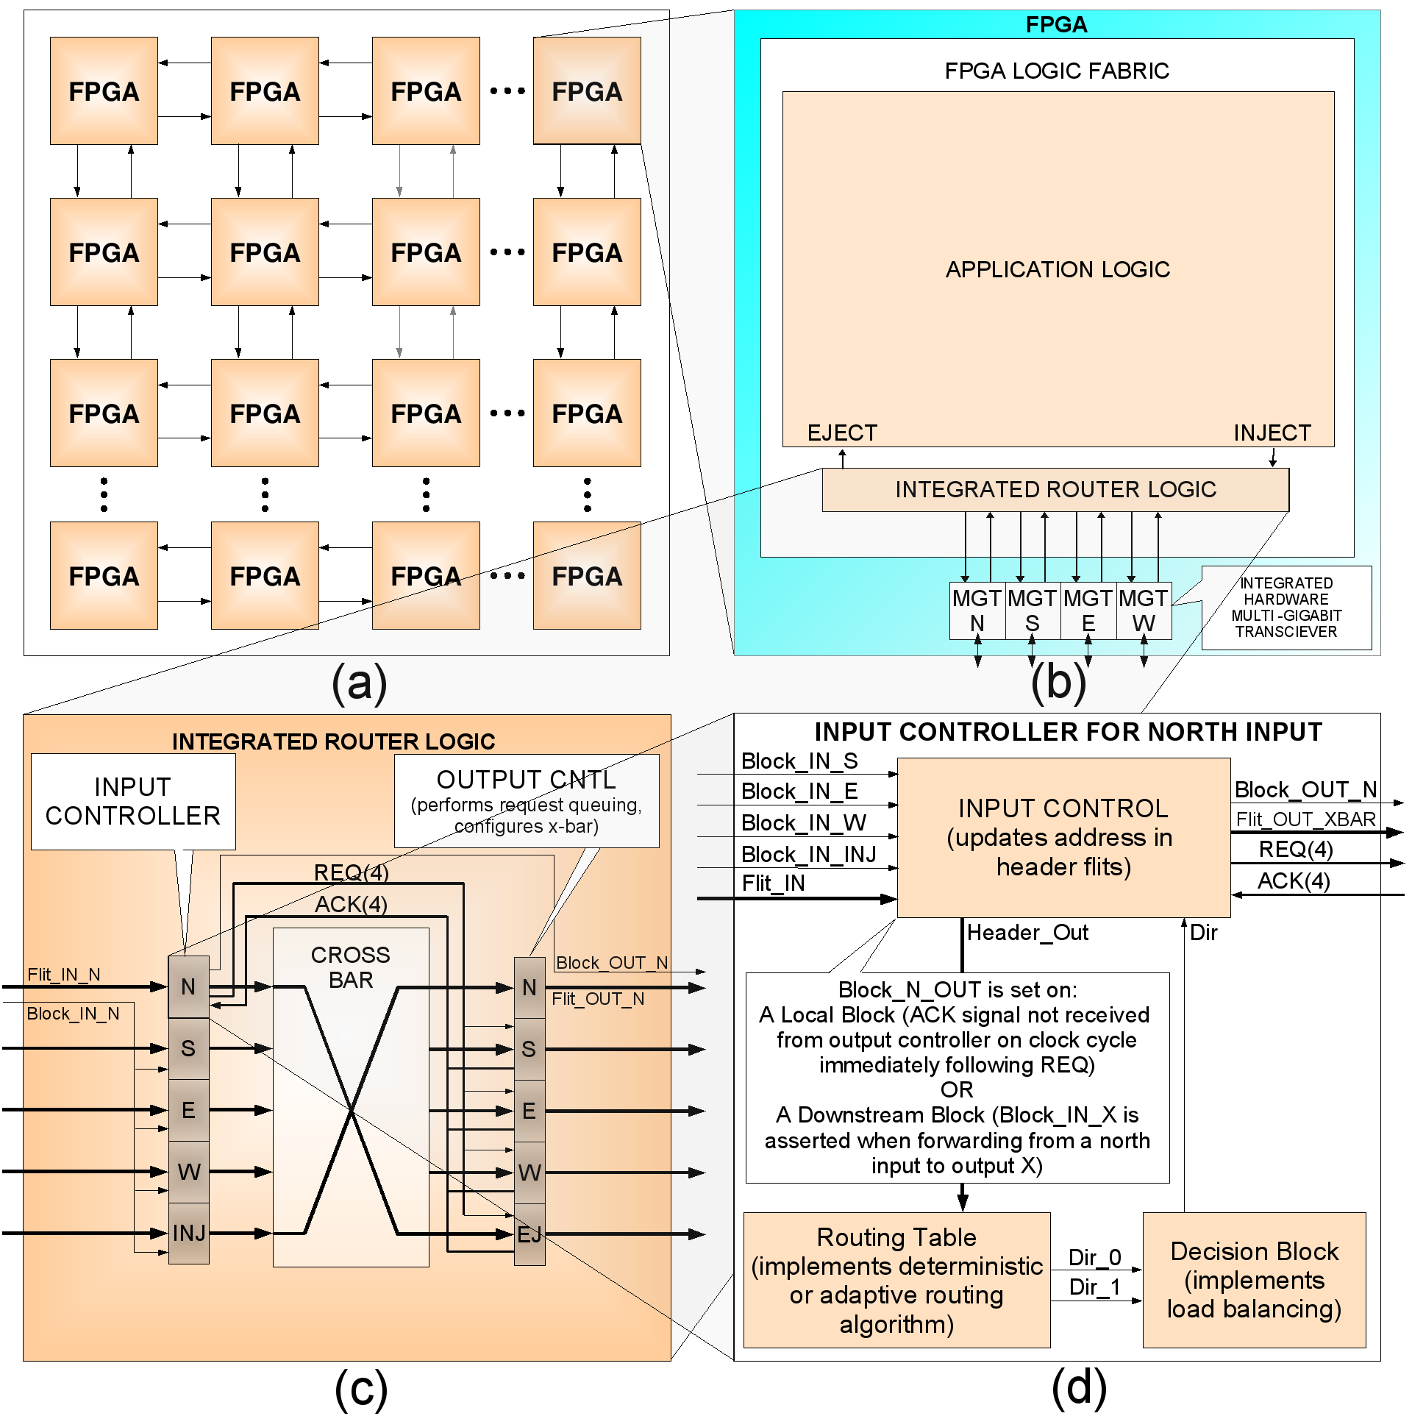
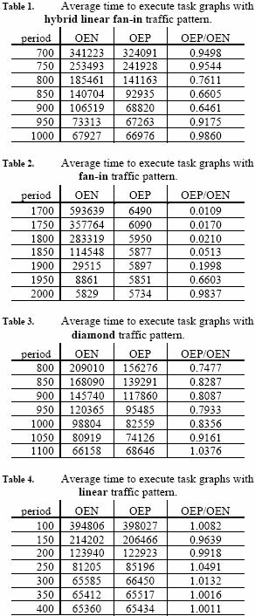
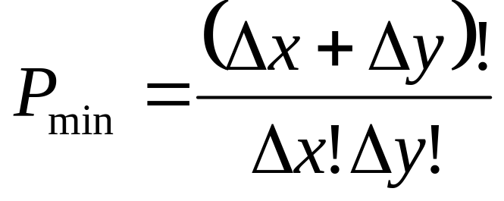
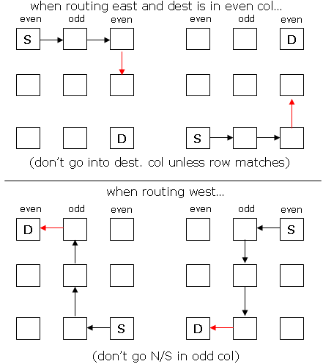
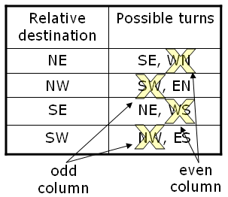
Predictive Load Balancing for Interconnected FPGAs
Jason D. Bakos, Charles L. Cathey, E. Allen Michalski, University of South Carolina, USA
E-mail: {jbakos, catheyc, michalsk}@cse.sc.edu
Motivation
- Construction of a general-purpose interconnect for a class of multi-FPGA distributed processing architectures that is abstracted from application, linearly scalable, and high-capacity
Approach
- Directly connect FPGAs in a 2D mesh topology
- Use integrated hard-core multi-gigabit transceivers to form physical channels
- Use integrated soft-core routers to create a multi-hop network
- Design routers to be…
high-speed (one clock tick for a routing or forwarding operation)
low-area (< 5% of logic resources per FPGA)
…using a 2D mesh topology (req’s 5x5 crossbar internal to each router), wormhole-switching (req’s minimal input buffering), and semi-adaptive routing (exploits the exponential number of minimum-hop paths relative to X and Y offset without the need for the complexity of virtual channel flow control)
The Problem
- Packet blocking behavior caused by localized areas of network congestion decreases effective interconnect capacity, but routing and load-balancing techniques decrease blocking and increase network capacity
The Solution
- Predictive Load Balancing (analogous to branch predictors)
Basic idea: evenly distribute traffic across the network by maintaining block counters for each output port -- increment for internal crossbar blocks and downstream blocks and decrement for successful routes and forwards
The Algorithm
procedure route (allowed_directions_OE[2], block_history[outputs], flit)
if there are two entries in allowed_directions_OE then
if block_history[allowed_directions_OE[0]] <
block_history[allowed_directions_OE[1]] then
pref_direction = allowed_directions_OE[0]
non_pref_direction = allowed_directions_OE[1]
else
pref_direction = allowed_directions_OE[1]
non_pref_direction = allowed_directions_OE[0]
else
pref_direction = allowed_directions_OE[0]
if crossbar output req’d by pref_direction is available and unblocked then
decrement block_history[pref_direction]
configure crossbar for pref_direction and route the packet
else
increment block_history[pref_direction]
if non_pref_direction exists then
if output req’d by non_pref_direction is available and unblocked then
decrement block_history[non_pref_direction]
configure crossbar for non_pref_direction and route the packet
else
increment block_history[non_pref_direction]
end procedure
procedure forward (block_history[outputs])
for each configured crossbar output i do
attempt to move flit from corresponding input port
if move fails due to downstream block then
increment block_history[i]
else
decrement block_history[i]
end procedure
Prior State-of-the-Art:
Wormhole Switching
- In wormhole switching, variable-length packets are subdivided into fixed-length units called flits
- Flits forming each packet travel across the network using store-and-forward
- Advantages: Input buffers need only be as wide as a single flit, packet transmission is pipelined making transmission latency independent of hop count
- Disadvantages: Packets occupy input buffers and channels of multiple hops, causing blocking behavior (contention for crossbars, channels, input buffers) and routing must include deadlock avoidance
Experimental Setup and Results
The Architecture
Up to 1.56X improvement in interconnect capacity
Prior State-of-the-Art:
Odd-Even Routing
- Non-virtual-channel-based minimum-path semi-adaptive routing with deadlock avoidance
- Based on the turn model
Up to 100X improvement in interconnect capacity
# minimal paths w/o turn rest.
Dead-end route restrictions
Up to 1.35X improvement in interconnect capacity
Turn restrictions
No improvement in interconnect capacity

