Slide 1
Seven Minute Madness:
Special-Purpose Parallel Architectures
Dr. Jason D. Bakos

Slide 2
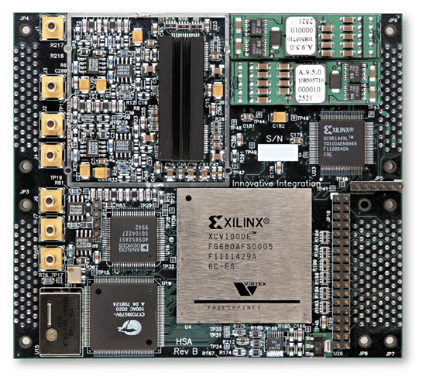
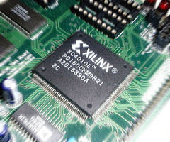
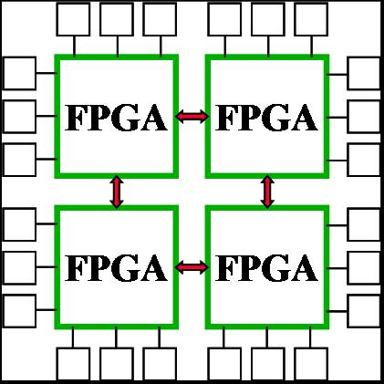
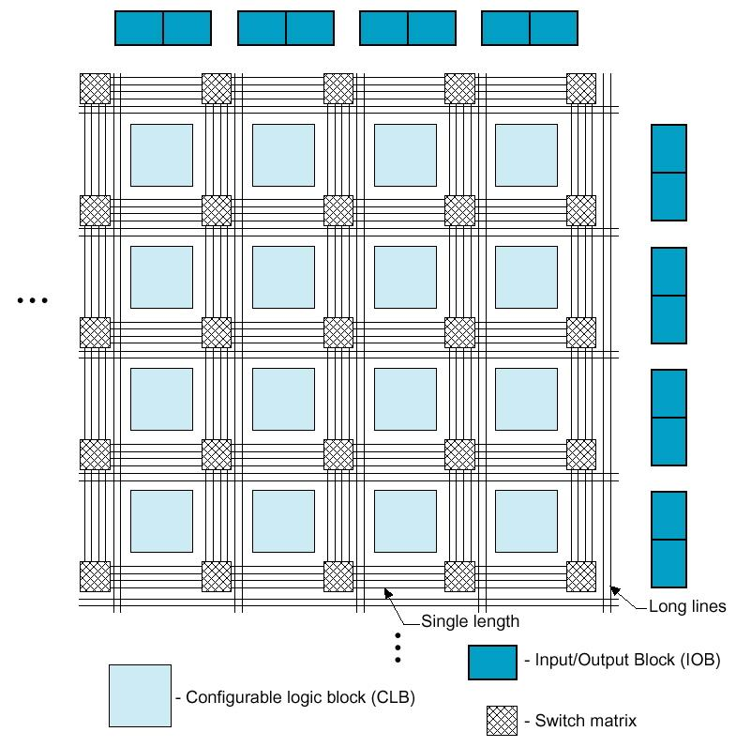
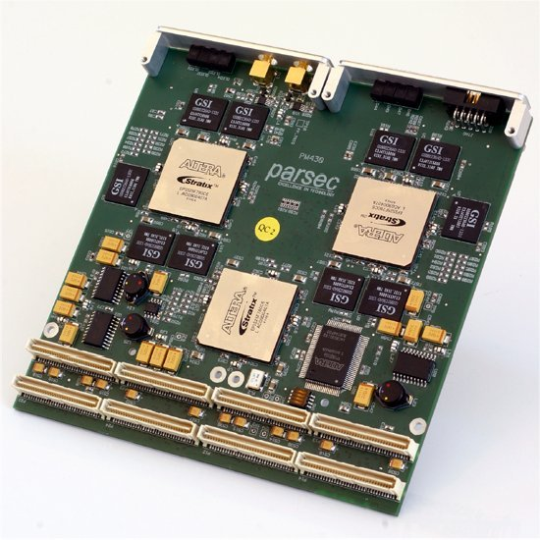
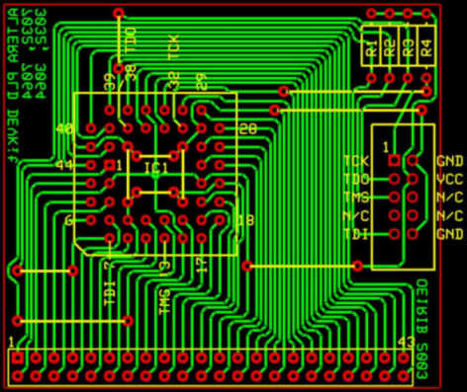
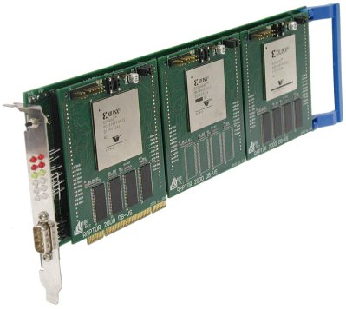
Field Programmable Gate Arrays
Implement special-purpose architectures for specific computations
Expoit more parallelism than general-purpose microprocessors
  Software => hardware

Slide 3
Example Special-Purpose Architecture
Example:
  Matrix multiplication: (a x b) x (b x c)
  a x c independent dot product computations (in parallel)
  Each dot product:
    b independent multiplications (in parallel)
    log₂b dependent levels of addition
  An ideal special-purpose parallel architecture:
    a x b x c multipliers and a x (b-1) x c adders
  Would require only 1 + log₂b “time units” (clock ticks) of latency
    May be pipelined
  Would seem “instantaneous” compared to a microprocessor

Slide 4
Limiting Factors
1. I/O capacity:
  Receive operands and transmit results from off-chip
  Addressed by FPGA manufacturers
    Multi-gigabit serial transceivers
2. Logic resources:
  What happens if we need more (have more) FPGA logic?
  Our work:
    System-level architecture for multiple FPGAs to act as one
    GOALS:
      General-purpose
      Scalable
      Extremely high internal interconnect capacity (share resources transparently)

Slide 5
Scalable Reconfigurable Distributed Fabric
north
FPGA
FPGA
FPGA
FPGA Logic Fabric
FPGA
FPGA
FPGA
FPGA
FPGA
Application logic core
FPGA
FPGA
FPGA
FPGA
west
Lightweight Router
east
FPGA
FPGA
FPGA
FPGA
south

Slide 6
Scalable Reconfigurable Distributed Fabric
General-purpose point-to-point network (and network interfaces)
Linearly scalable topology (channels, switching logic)
High capacity interconnect
  # of multi-hop paths increase exponentially
  Req’s lightweight routing and load balancing
Best for applications with extremely high parallelism
Recent publications:
  IEEE Sym. of Field Programmable Custom Comp. Machines (FCCM), Apr. 2006
  Field Programmable Logic and its Applications (FPL), Aug. 2006

Slide 7
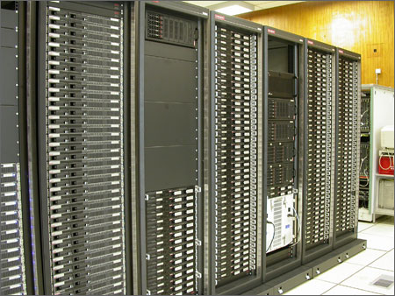
Application Work
Demo this architecture by accelerating applications in bioinformatics
Target applications:
  Complex but highly parallel
  Normally need HPC cluster
  Collaboration with Dr. Tang: phylogenetic reconstruction
For these, primitive operations exhibit high degree of control dependency
  Not traditional FPGA applications
Use FPGA array to implement enough primitive operations in parallel to gain massive speedup over single processor
X

Slide 8
System Architecture
Goal:
  Associate each multi-FPGA accelerator with each node in a small cluster
  Achieve high efficiency
SWITCH
FPGA
FPGA
…
FPGA
FPGA
FPGA
…
FPGA
FPGA
FPGA
…
FPGA
FPGA
FPGA
…
FPGA
FPGA
FPGA
…
FPGA
…
FPGA
FPGA
…
FPGA
processing node
processing node
processing node
…
…
…
…
…
…
…
…
…
FPGA
FPGA
…
FPGA
FPGA
FPGA
…
FPGA
FPGA
FPGA
…
FPGA
phylogeny-accelerator
phylogeny-accelerator
phylogeny-accelerator

