Slide 1
Seven Minute Madness:
Reconfigurable Computing
Dr. Jason D. Bakos

Slide 2
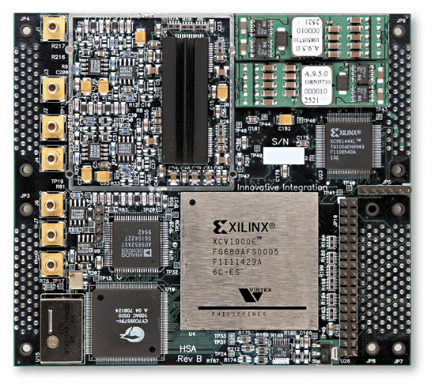
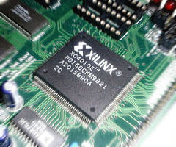
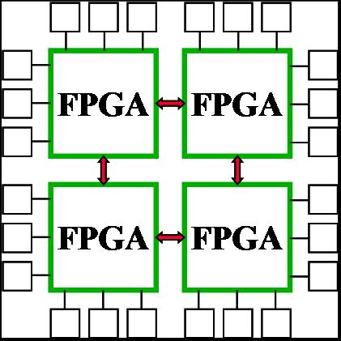
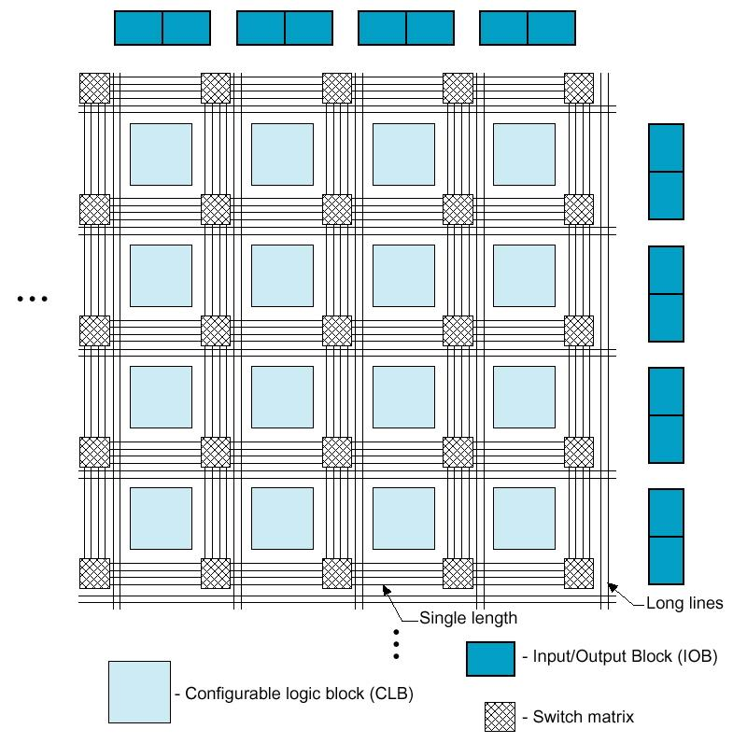
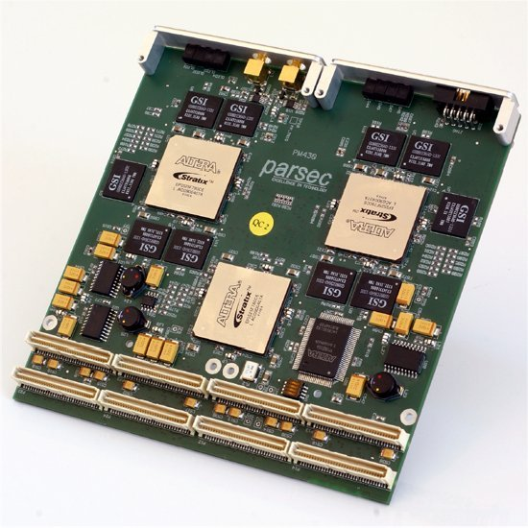
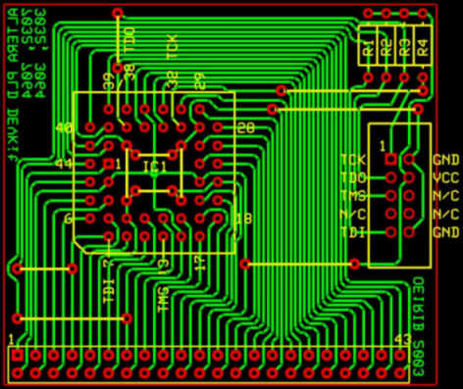
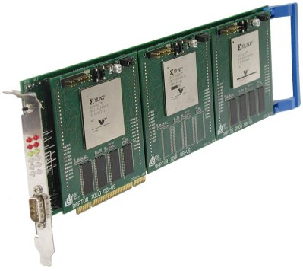
Reconfigurable Computing
Computing with reconfigurable logic, i.e. FPGAs
  Configured to implement arbitrary logic
  Used for embedded systems and high-performance computing

Slide 3
High-Performance Reconfigurable Computing
Move expensive bottleneck computations from software to FPGA
Achieve speedup through high parallelism
Expect 50 – 100X speedup over software
X
+
X
+
1,1
X
+
n x m
m x o
X
X
+
X
X
+
1,2
X
+
X

Slide 4
High-Performance Reconfigurable Computing
Limitations:
  Amount of parallelism in computation
  FPGA resources
  I/O capacity
Example HPRC applications:
  Perform computation that keeps up with 40 Gbps fiber
    Secure hashing, encryption
    Intrusion detection
  Molecular dynamics
  High precision signal processing
  Data mining applications

Slide 5
HPRC Today
Programming
  FPGA design is digital design
    Generally requires hardware description language and simulation
  C, FORTRAN, and other compilers exist, but are inefficient
  Bottom line
    Programming an FPGA is at least as difficult as traditional parallel programming
Much of FPGA research involves:
  Designs for applications
  Tool development

Slide 6
My Current Research
Apply HPRC to computational biology
  Current target application: genome analysis
  Algorithms are control-dependent
  Execution behavior depends on data characteristics
Goals:
  Develop library of hardware designs for core computations
  Finely parallelize cores to achieve high performance
  New design automation tool
    Customize architecture for data
    Easy-to-use

Slide 7
Recent Achievements
Accelerated phylogeny reconstruction for gene order data:
  Implemented and parallelized breakpoint median computation
  First generation design:
    26X speedup for computation
    24X speedup for application
    Jason D. Bakos, “FPGA Acceleration of Gene Rearrangement Analysis,” IEEE Symposium on Field-Programmable Custom Computing Machines (FCCM 2007), April 23-25, 2007.
  Second generation design:
    876X speedup for computation
    189X speedup for application
    Jason D. Bakos, Panormitis E. Elenis, Jijun Tang, "FPGA Acceleration of Phylogeny Reconstruction for Whole Genome Data," 7th IEEE International Symposium on Bioinformatics & Bioengineering, Boston, MA, 14-17 Oct. 2007.
  Currently working to accelerate tree generation

Slide 8
Future Work
Continue developing library of cores
  Challenges: finely parallelize algorithms across FPGA logic
Development of design automation tool
  Challenges: find connection between data characteristics and execution behavior and expoit
Develop demonstrator HPRC system containing a multi-FPGA accelerator system
  Challenges: inter-FPGA network, application mapping

