Slide 1
Integrated Circuit Design and Fabrication
Dr. Jason D. Bakos

Slide 2
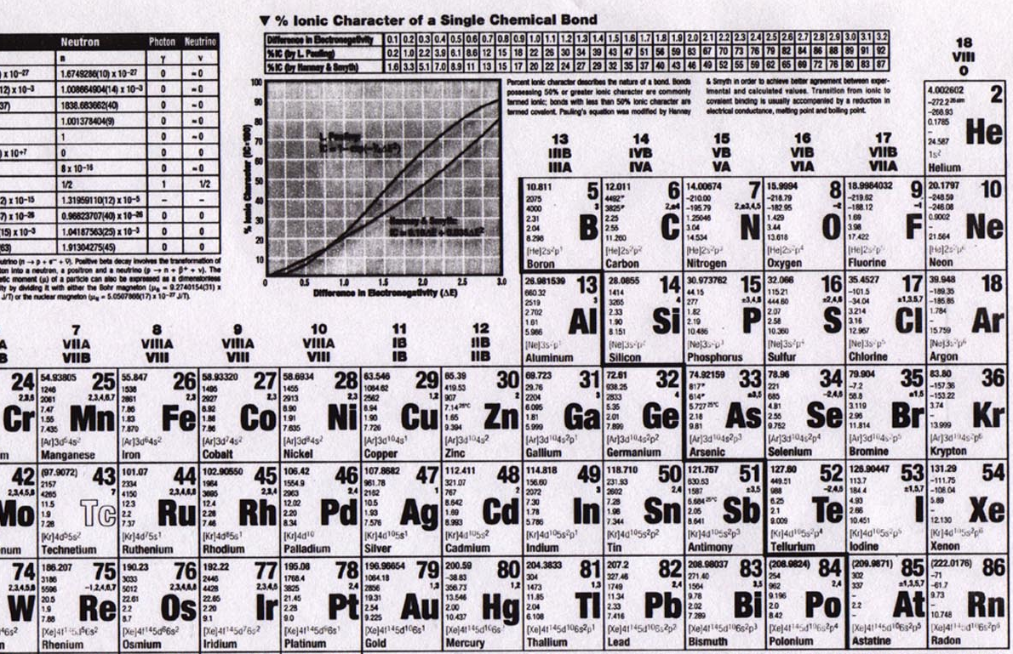
Elements

Slide 3
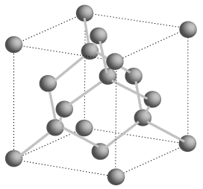
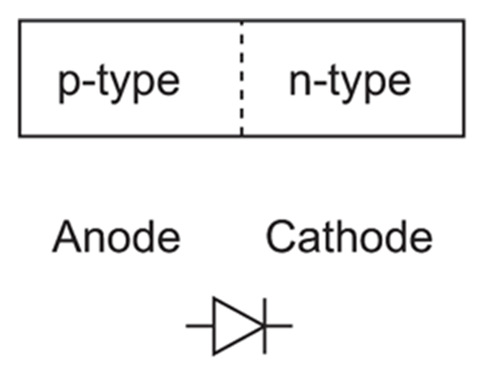
Semiconductors
+
-
-
+
+ + +
+ + +
+ + +
+ + +
- - -
- - -
- - -
- - -
P-N junction
forward bias
reverse bias

Slide 4
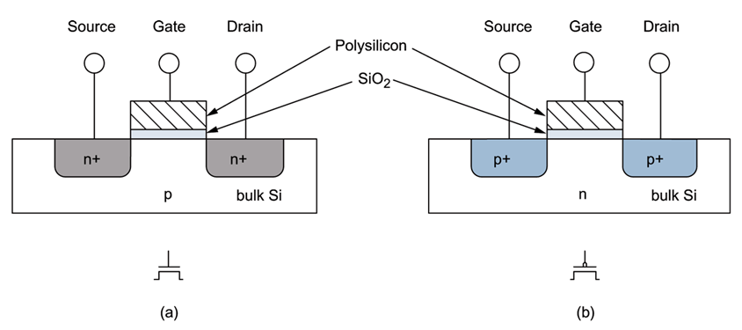
MOSFETs
negative voltage (rel. to body) (GND)
positive voltage (Vdd)
NMOS
+ + +
- - -
PMOS
current
- - -
+ + +
current
body/bulk
GROUND
channel
shorter length, faster transistor (dist. for electrons)
body/bulk
HIGH

Slide 5

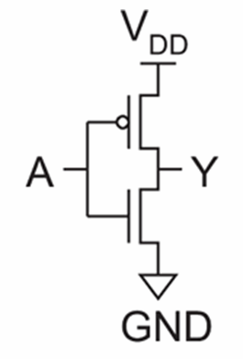

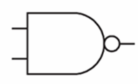
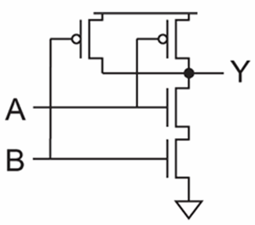
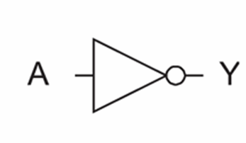
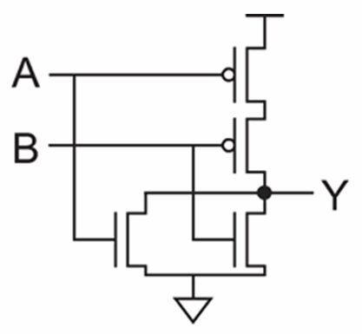

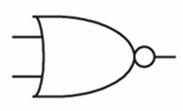
Logic Gates
inv
NAND2
A | B | Y
0 | 0 | 1
0 | 1 | 1
1 | 0 | 1
1 | 1 | 0
A | Y
0 | 1
1 | 0
NOR2
A | B | Y
0 | 0 | 1
0 | 1 | 0
1 | 0 | 0
1 | 1 | 0

Slide 6
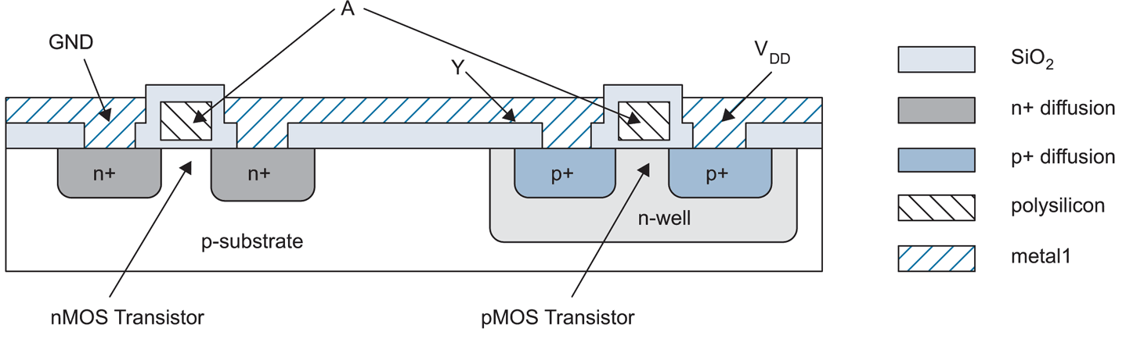
IC Fabrication
Inverter cross-section
field oxide

Slide 7
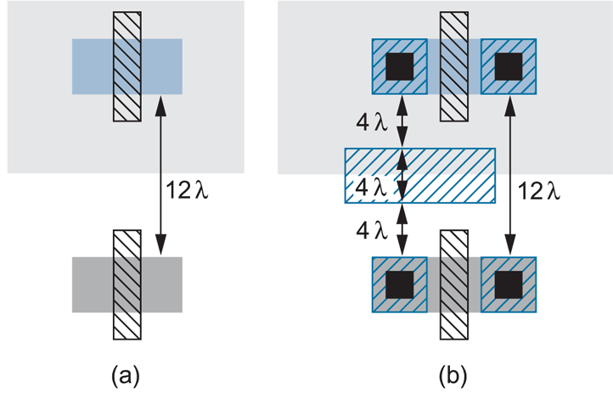
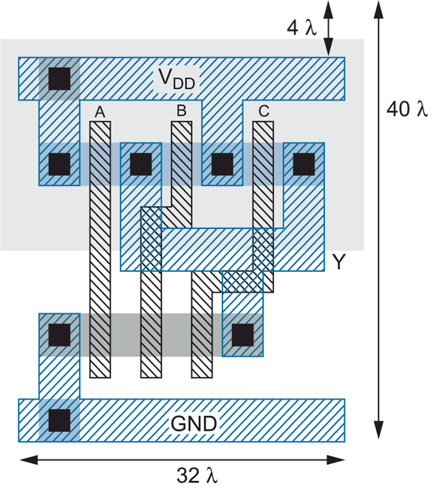
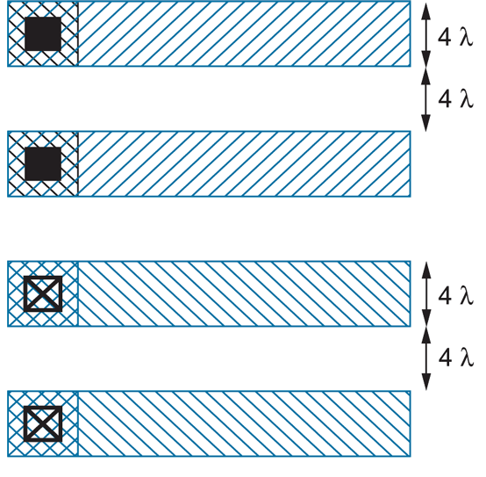
Layout
3-input NAND

Slide 8
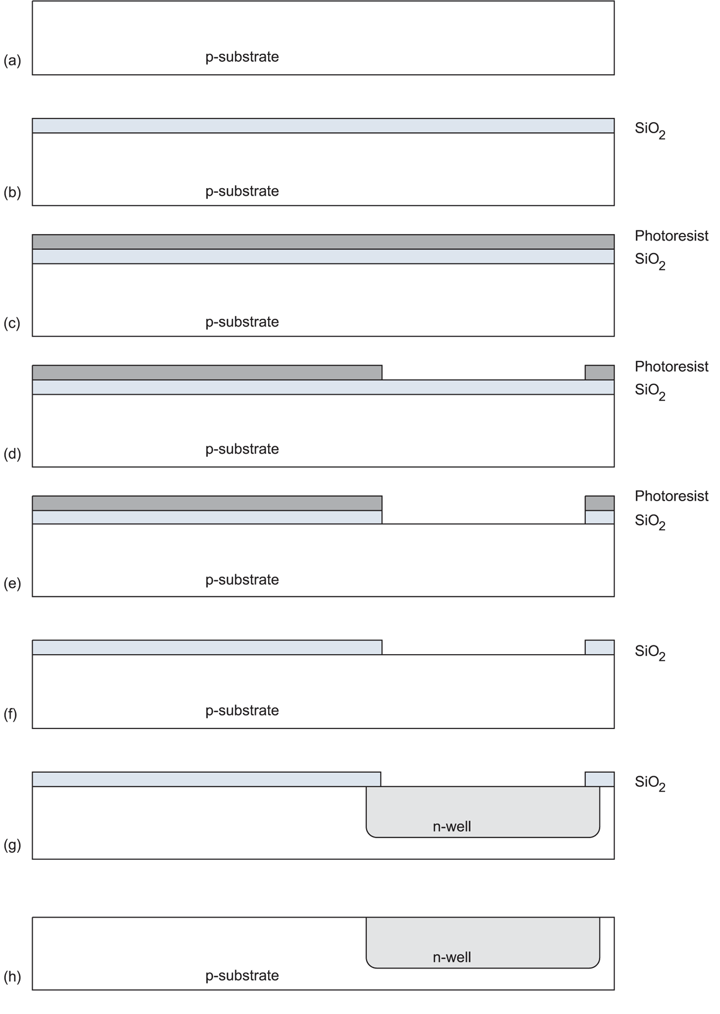
IC Fabrication
Furnace used to oxidize (900-1200 C)
Mask exposes photoresist to light, allowing removal
HF acid etch
piranha acid etch
diffusion (gas) or ion implantation (electric field)
HF acid etch

Slide 9
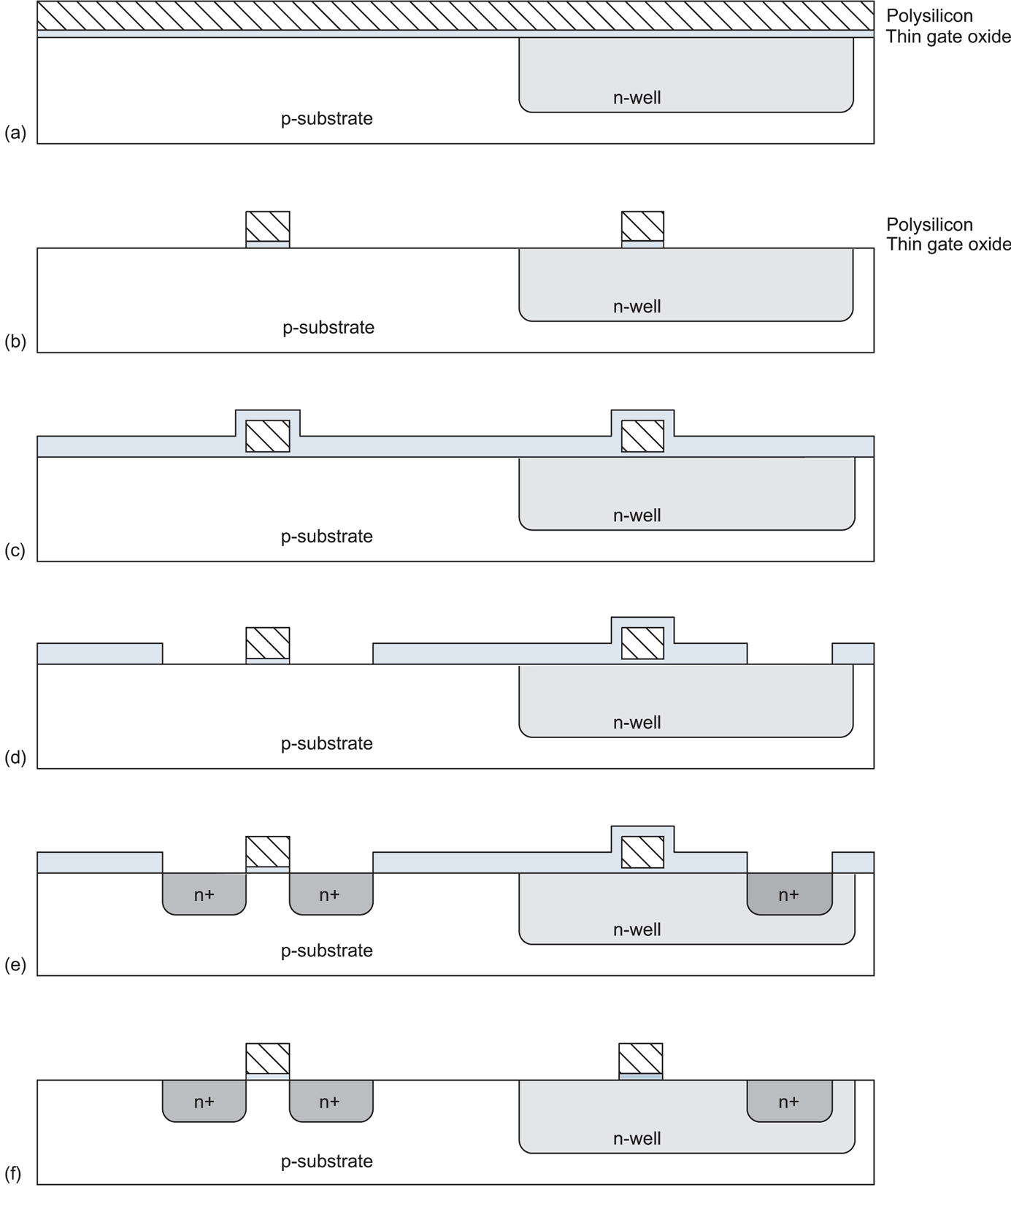
IC Fabrication
Heavy doped poly is grown with gas in furnace (chemical vapor deposition)
Masked used to pattern poly
Poly is not affected by ion implantation

Slide 10
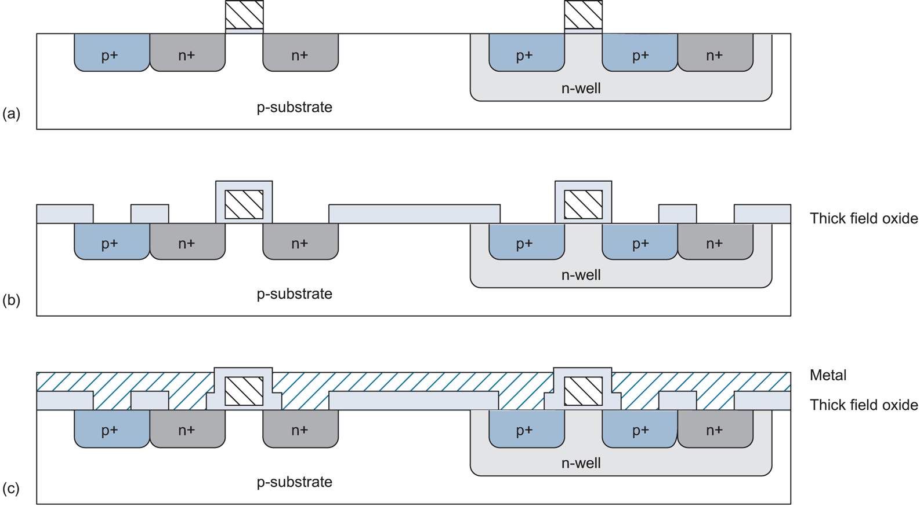
IC Fabrication
Metal is sputtered (with vapor) and plasma etched from mask

Slide 11
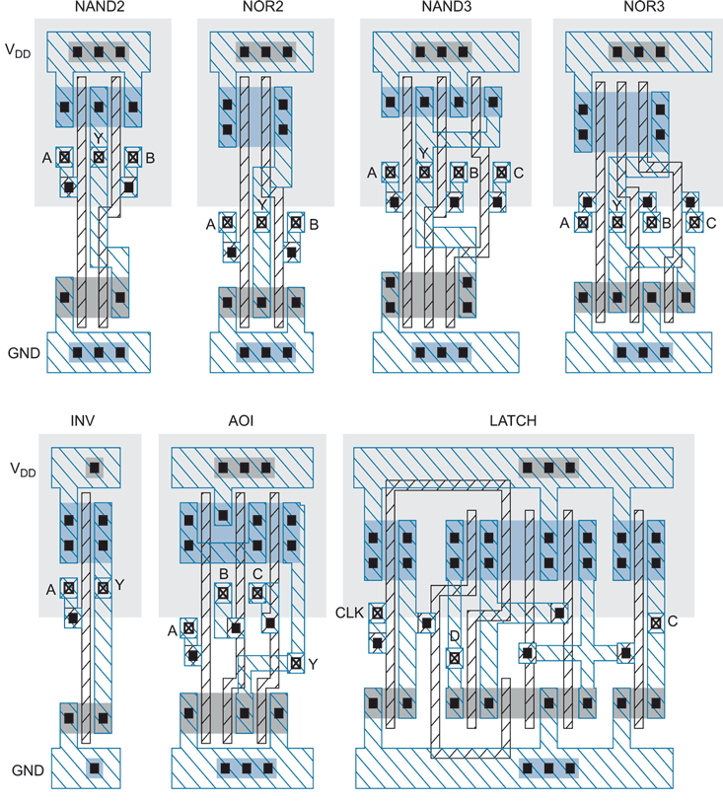
Cell Library (Snap Together)
Layout

Slide 12
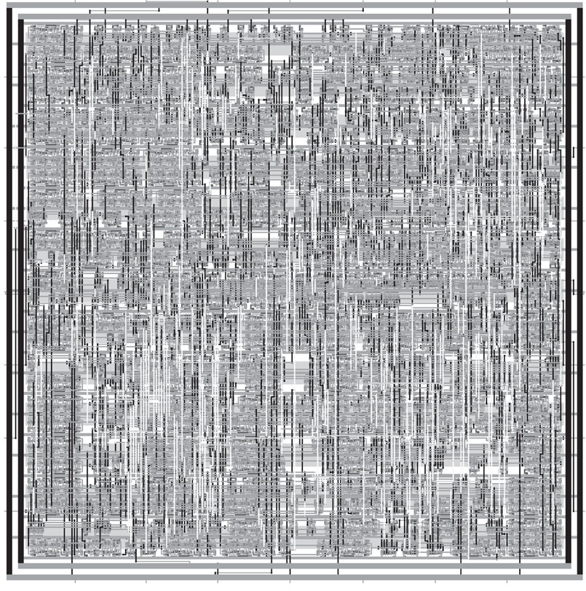
Synthesized and P&R’ed MIPS Architecture

Slide 13
Feature Size
Shrink minimum feature size…
  Smaller L decreases carrier time and increases current
  Therefore, W may also be reduced for fixed current
  C_{g}, C_{s}, and C_{d} are reduced
  Transistor switches faster (~linear relationship)

Slide 14
Minimum Feature Size
Year | Processor | Speed | Process
1982 | i286 | 6 - 25 MHz | 1.5 μm
1986 | i386 | 16 – 40 MHz | 1.5 - 1 μm
1989 | i486 | 16 - 133 MHz | .8 μm
1993 | Pentium | 60 - 300 MHz | .6 - .25 μm
1995 | Pentium Pro | 150 - 200 MHz | .5 - .35 μm
1997 | Pentium II | 233 - 450 MHz | .35 - .25 μm
1999 | Pentium III | 450 – 1400 MHz | .25 - .13 μm
2000 | Pentium 4 | 1.3 – 3.8 GHz | .18 - .065 μm
2005 | Pentium D | 2.66 – 3.6 GHz | .09 - .065 μm
2006 | Core 2 | 1.06 – 3 GHz | .065 μm
Upcoming milestones:
45 nm (Xeon 5400 Nov. 2007),
32 nm (2009-2010), 22 nm (2011-2012), 16 nm (2013)

Slide 15
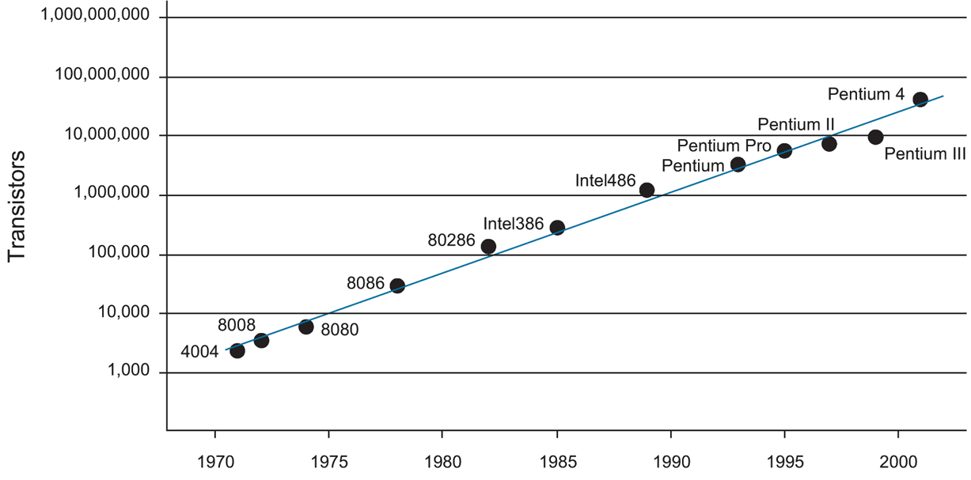
Integration Density Trends (Moore’s Law)
Pentium Core 2 Duo (2007) has ~300M transistors

Slide 16
Microarchitectural Parallelism
Parallelism => perform multiple operations simultaneously
  Instruction-level parallelism
    Execute multiple instructions at the same time
    Multiple issue
    Out-of-order execution
    Speculation
  Chip multiprocessing
    Execute multiple threads at the same time on one CPU
    Execute multiple threads at the same time on multiple processors

