Slide 1

A Sparse Matrix Personality for the Convey HC-1 Dept. of Computer Science and Engineering University of South Carolina
Krishna K Nagar, Jason D. Bakos
Heterogeneous and Reconfigurable Computing Lab (HeRC)
http://herc.cse.sc.edu
This material is based upon work supported by the National Science Foundation under Grant Nos. CCF-0844951 and CCF-0915608.

Slide 2
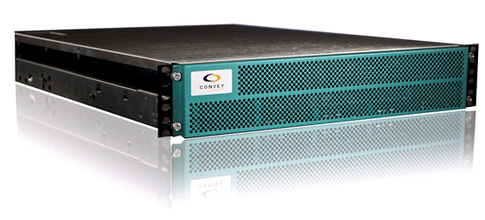
Introduction
Convey HC-1: A turnkey reconfigurable computer
Personality: A configuration of the user programmable FPGAs that works within the HC-1’s execution and programming model
This paper introduces a sparse matrix personality for Convey HC-1

Slide 3
Outline
Convey HC-1
Overview of system
Shared coherent memory model
High-performance coprocessor memory
Personality design for sparse matrix vector multiply
Indirect addressing of vector data
Streaming double precision reduction architecture
Results and comparison with NVIDIA Tesla

Slide 4
Convey HC-1
HC-1 Coprocessor
16 GB Scatter-Gather DDR2 DRAM
Virtex-5 LX 330
Virtex-5 LX 330
Virtex-5 LX 330
Virtex-5 LX 330
Intel Server Motherboard
application engines (AEs)
24 GB DRAM
Intel Xeon
Socket 1
Socket 2

Slide 5
Coprocessor Memory System
16 GB
SG-DIMM
Each AE connected to 8 MCs through a full crossbar
Address space partitioned across all 16 DIMMs
High-performance memory
Organized in 1024 banks
Crossbar parallelism gives 80 GB/s aggregate bandwidth
Relaxed memory model
Smallest contiguous unit of data that can be read at full bandwidth = 512 BYTES
AE0
2.5 GB/s
5 GB/s
MC0
MC1
AE1
MC2
MC3
AE2
MC4
MC5
AE3
MC6
MC7
AE Hub
Host

Slide 6
HC-1 Execution Model
Host Action
Host Memory State
Host
Input
Output
Invokes coprocessor; Sends pointers to memory blocks
Application code invoked
Input data written to memory
Write results from memory block
Shared
Exclusive
Shared
Blocked
Invalid
Invalid
Coprocessor Action
Coprocessor Memory State
Updates coprocessor memory
Input
Output
Read contents of memory block
Idle
Idle
Write to a memory block; Finish!
Invalid
Shared
Exclusive
Shared
Invalid
Coproc

Slide 7
Convey Licensed Personalities
Soft-core vector processor
Includes corresponding vectorizing compiler
Supports single and double precision
Supports hardware instructions for transcendental and random number generation
Smith-Waterman sequence alignment personality
No sparse matrix personality

Slide 8
Outline
Convey HC-1
Overview of system
Shared coherent memory
High-performance coprocessor memory
Personality design for sparse matrix vector multiply
Indirect addressing of vector data
Streaming double precision reduction architecture
Results and comparison with NVIDIA CUSPARSE on Tesla and Fermi

Slide 9
Sparse Matrix Representation
Sparse Matrices can be very large but contain few non-zero elements
Compressed formats are often used, e.g. Compressed Sparse Row (CSR)
1 | -1 | 0 | -3 | 0
-2 | 5 | 0 | 0 | 0
0 | 0 | 4 | 6 | 4
-4 | 0 | 2 | 7 | 0
0 | 8 | 0 | 0 | -5
val | (1 | -1 | -3 | -2 | 5 | 4 | 6 | 4 | -4 | 2 | 7 | 8 | -5)
col | (0 | 1 | 3 | 0 | 1 | 2 | 3 | 4 | 0 | 2 | 3 | 1 | 4)
ptr | (0 | 3 | 5 | 8 | 11 | 13)

Slide 10
Sparse Matrix-Vector Multiply
Code for Ax = b
row = 0
for i = 0 to number_of_nonzero_elements do
if i == ptr[row+1] then row=row+1, b[row]=0.0
b[row] = b[row] + val[i] * x[col[i]]
end
NVIDIA GPUs achieve only 0.6% to 6% of their peak double precision performance with CSR SpMV
N. Bell, M. Garland, "Implementing Sparse Matrix-Vector Multiplication on Throughput- Oriented Processors," Proc. Supercomputing 2009.
Low arithmetic intensity
(1 FLOP / 10 bytes)
indirect indexing
recurrence (reduction)

Slide 11
Indirect Addressing
Coprocessor Memory
val/col
val
X
Σ
col
vec
Vector cache
(64KB)
vec
b[row] = b[row] + val[i] * x[col[i]]

Slide 12
Data Stream
Coprocessor Memory
Matrix cache to get contiguous data
Shifter loads matrix data in parallel and delivers serially to MAC
Matrix Cache
1024
4096
4096 bit Shifter
val
X
Σ
col
vec
Vector Cache
vec
PE
AE

Slide 13

Top Level Design and Scaling
Coprocessor Memory
Matrix Cache (64 KB)
Shifter
X
Σ
vec
PE1
X
Σ
PE2
X
Σ
PE3
X
Σ
AE
PE8
Notes:
@150 MHz, 2FLOPs 300MFLOPS per PE
Peak capacity = 9.6 GFLOPs

Slide 14
Outline
Convey HC-1
Overview of system
Shared coherent memory
High-performance coprocessor memory
Personality design for sparse matrix vector multiply
Indirect addressing of vector data
Streaming double precision reduction architecture
Results and comparison with NVIDIA CUSPARSE on Tesla and Fermi

Slide 15
The Reduction Problem
(Ideally) New values arrive every clock cycle
Partial sums of different accumulation sets become intermixed in the deeply pipelined adder pipeline
Data hazard
Partial sums
Adder Pipeline
From multiplier

Slide 16
Resolving Reduction Problem
Custom architecture to dynamically schedule concurrent reduction operations
Control
MEM
MEM
Group | Adders | Reduction BRAM
Prasanna ’07 | 2 | 3
Prasanna ’07 | 1 | 6
Gerards ’08 | 1 | 9
This Work | 1 | 3

Slide 17
Our Approach
Built around 14 stage double precision adder
Rule based approach
Governs the routing of incoming values and adder output
Decides inputs to the adder
Applied based on current state of the system
Goal
Maximize the adder utilization
Minimize the required number of buffers
Used software model to design rules and find required number of buffers

Slide 18
Reduction Circuit
+
Adder inputs based on row ID of:
Incoming value
Buffered values
Adder output
Rule 1
buf_{n}.rowID = adderOut. rowID
Rule 2
buf_{i}.rowID= buf_{j}.rowID
Rule 3
input. rowID = adderOut. rowID
Rule 4
buf_{n}. rowID = input. rowID
Rule 5
addIn1 = input
addIn2 = 0
Rule 5 Special Case
addIn1 = adderOut
addIn2 = 0
FIFO
Rule 1
FIFO
+
Rule 2
buf1
FIFO
buffers
+
Rule 3
0
buf2
0
+
+
buf2
+
+
+
FIFO
+
addIn1
FIFO
FIFO
FIFO
FIFO
FIFO
+
From Multiplier
FIFO
FIFO
+
addIn2
Rule 4
buf3
0
+
FIFO
Rule 5
buf4
0
+
FIFO
Special Case

Slide 19
Outline
Convey HC-1
Overview of system
Shared coherent memory
High-performance coprocessor memory
Personality design for sparse matrix vector multiply
Indirect addressing of vector data
Streaming double precision reduction architecture
Results and comparison with NVIDIA CUSPARSE on Tesla

Slide 20
SpMV on GPU
GPUs widely used for accelerating scientific applications
GPUs generally have more mem bandwidth than FPGAs, so do better for computations with low arithmetic intensity
Target: NVIDIA Tesla S1070
Contains four Tesla T10 GPUs
Each GPU has 50% more memory bandwidth than all 4 AEs on Convey HC-1 combined
Implementation using NVIDIA CUDA CUSPARSE library
Supports Sparse BLAS routines for various sparse matrix representations including CSR
Can run only on single GPU for single SpMV computations

Slide 21
Experimental Results
Test matrices from Matrix Market and UFL Matrix collection
Throughput = 2 * nz / (Execution Time)
Matrix | Application | r * c | nz | nz/row
dw8192 | Electromagnetics | 8192*8192 | 41746 | 5.10
t2d_q9 | Structural | 9801*9801 | 87025 | 8.88
epb1 | Thermal | 14734*14734 | 95053 | 6.45
raefsky1 | Computational fluid dynamics | 3242*3242 | 294276 | 90.77
psmigr_2 | Economics | 3140*3140 | 540022 | 171.98
torso2 | 2D model of a torso | 115967*115967 | 1033473 | 8.91

Slide 22
Performance Comparison
1.5x
1.4x
0.4x
2.7x
3.2x
3.4x

Slide 23
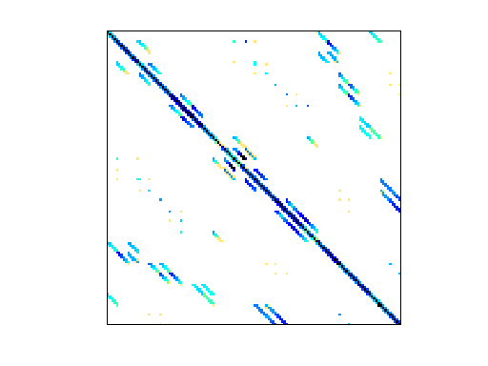
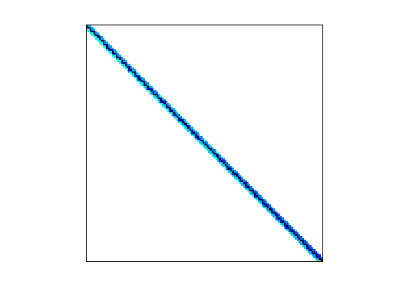
Test Matrices
torso2
epb1

Slide 24
Final Word
Conclusions
Described a SpMV personality tailored for Convey HC-1 built around new streaming reduction circuit architecture
FPGA outperforms GPU
Custom architectures have the potential for achieving high performance for kernels with low arithmetic intensity
Future Work
Analyze design tradeoffs between vector cache and functional units
Improve the vector cache performance
Multi-GPU implementation

Slide 25
About Us
Heterogeneous and Reconfigurable Computing Lab
The University of South Carolina
Visit us at http://herc.cse.sc.edu
Thank You!

Slide 26
Resource Utilization
PEs | Slices | BRAM | DSP48E
4 per AE (Overall 16) | 26055 / 51840 (50%) | 146 / 288 (50%) | 48 / 192 (25%)
8 per AE (Overall 32) | 38225 / 51840 (73%) | 210 / 288 (73%) | 96 / 192 (50%)

Slide 27
Set ID Tracking Mechanism
Three dual ported memories with respective counters
Write Port
Counter1 always increments associated incoming value setID
Counter2 always decrements associated adder input setID
Counter 3 decrements when number of associated active values reach one setID
Read Port
Outputs current value for associated setID
Set is completely reduced and output when count1 + count2 + count3 = 1
input.set
wr
Mem1
count1
adderOut.set
+
rd
adderIn.set
wr
Mem2
count2
numActive(set)
adderOut.set
_
rd
adderOut.set
wr
Mem3
count3
adderOut.set
_
rd

