Slide 1
Lucas Kanade Optical Flow Estimation on the TI C66x Digital Signal Processor
Fan Zhang, Yang Gao and Jason D. Bakos
2014 IEEE High Performance Extreme Computing Conference(HPEC ‘14)

Slide 2

What is Optical Flow
Evaluates the pixel movement in video stream
Represented as a dense 2D fields
Many applications need to apply real-time optical flow
Robotic vision
Augmented reality
Computationally intensive

Slide 3
TI C66x Multicore DSP
Unique architectural features
Eight cores
Statically scheduled VLIW/SIMD instructions
2 register files and 8 functional units per core
 | Tesla K20X GPU | Intel i7 Ivy Bridge | TI C6678 Keystone | NVIDIA Tegra K1
 | Server GPU | Server CPU | Embedded | Embedded
Peak single precision throughput | 3.95 Tflops | 448 Gflops | 160 Gflops | 327 Gflops
Peak Power | 225 W | 77 W | <10 W | <20 W
DRAM bandwidth | 250 GB/s | 25.6 GB/s | 12.8 GB/s | 17.1 GB/s

Slide 4
Why using DSP?
Low power consumption
High performance floating point arithmetic
Strong potential for computer vision tasks
1D vs 2D (signal processing vs image processing)

Slide 5



Gradient-based Optical Flow Solver
.
.
Optical flow evaluation
First-order approximation
(x, y, t)
(x + Δx, y + Δ y, t + Δt)
Frame t
Frame t + Δt
Gradient of pixel in x, y and t direction, known
One formula with two unknowns
Optical flow, unknown

Slide 6
Lucas Kanade Method
If we assume the pixel adjacent to the center has the same optical flow as the center
x-1,y-1 | x,y-1 | x+1,y-1
x-1,y | x,y | x+1,y
x-1,y+1 | x,y+1 | x+1,y+1
Let
Least Square Method

Slide 7
Image Derivative Computation
A
B
(A – B + C – D) / 2
C
D
frame n
A
B
(A – C + B – D) / 2
C
D
frame n
A
B
A - B
frame n
frame n+1
7

Slide 8
Lucas Kanade Method
Input: Frame n, frame n+1, window size w
Output: Optical flow field F
For each pixel x, y
Compute x,y,t derivative matrices Dx, Dy, Dt
for its neighbor window
Compute optical flow by the least square
method

Slide 9
Derivative Computation (Example)
Image n
10 | 10 | 10 | 10
10 | 30 | 10 | 10
10 | 10 | 10 | 10
10 | 10 | 10 | 10
Image n + 1
10 | 10 | 10 | 10
10 | 10 | 10 | 10
10 | 10 | 30 | 10
10 | 10 | 10 | 10
-10 | 10 | 0
-10 | 10 | 0
0 | 0 | 0
-10 | -10 | 0
10 | 10 | 0
0 | 0 | 0
0 | 0 | 0
0 | 20 | 0
0 | 0 | -20

Slide 10
Least Square Method Example (Neighbor Window Size = 3)
-10 | 10 | 0
-10 | 10 | 0
0 | 0 | 0
-10 | -10 | 0
10 | 10 | 0
0 | 0 | 0
0 | 0 | 0
0 | 20 | 0
0 | 0 | -20

Slide 11
Optimize Lucas Kanade Method on DSP
Derivative computation
SIMD arithmetic
Data interleaving
Least square method
Loop unrolling
SIMD load & arithmetic

Slide 12
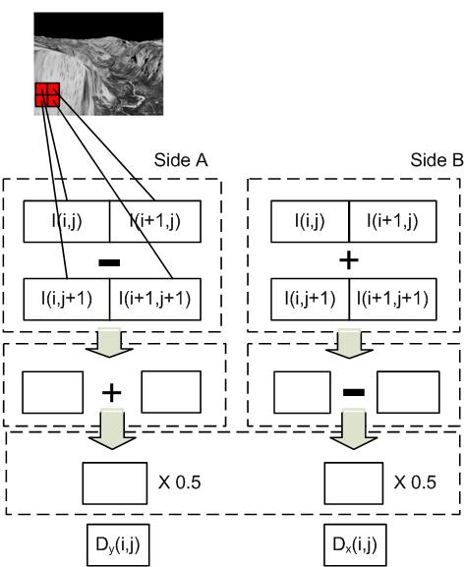
Derivative Computation
10 | 10 | 10 | 10
10 | 30 | 10 | 10
10 | 10 | 10 | 10
10 | 10 | 10 | 10
Derivative Computation (Dx, Dy)
-10 | 10 | 0
-10 | 10 | 0
0 | 0 | 0
-10 | -10 | 0
10 | 10 | 0
0 | 0 | 0
Cycle 1
Cycle 2
Interleave
-10 | -10 | 10 | -10 | 0 | 0
-10 | 10 | 10 | 10 | 0 | 0
0 | 0 | 0 | 0 | 0 | 0
Cycle 3

Slide 13
Least Square Method
Required computations
Dx
Dy
Dt
Multiplication x 5
DxDx
DxDy
DyDy
DxDt
DyDt
Accumulation x 5
Map to device
Dx
Dy
Dt
Dt
Complex Mul
2-way SIMD Mul
DxDy
-DyDy
DxDt
DyDt
DyDx
DxDx
(a+bj)(c+dj) = (ac-bd) + (ad+bc)j

Slide 14
Least Square Method
Unrolled 2x
Group up loads into SIMD operation
Load DxDy
Load Dt
Complex MUL
SIMD MUL
SIMD ADD
DxDy
Dt
-10 | -10 | 10 | -10 | 0 | 0
-10 | 10 | 10 | 10 | 0 | 0
0 | 0 | 0 | 0 | 0 | 0
0 | 0 | 0
0 | 20 | 0
0 | 0 | -20
(Dx,Dy,Dt)
200
0
200
0
0
(DxDx,DxDy,DyDy,DxDt,DyDt)
200
-10 | -10 | 0
-10
-10
0
100 | 100 | 100 | 0 | 0
100
100
100
0
0
0
+
200
(Dx,Dy,Dt)
(DxDx,DxDy,DyDy,DxDt,DyDt)
0
10 | -10 | 0
10
-10
0
100 | -100 | 100 | 0 | 0
100
-100
100
0
0
0

Slide 15
Loop Flattening
Software Pipelining
TI’s compiler technique to allow independent loop iterations be executed in parallel
The consecutive iterations are packed and executed together so that the arithmetic functional units are fully utilized
for (i = 0; i < m; ++i)
for (j = 0; j < n; ++j)
for (k = 0; k < m * n; ++k)
…
Update i, j;
j = 0
j = 1
j = 0
j = 1
Pipeline prologue/epilogue overhead

Slide 16
Multicore Utilization
Core 0
Core 1
Core 2
…
Derivative Computation
Least Square Method
Least Square Method
Least Square Method
…
Row [0, k)
Row [k, 2k)
Row [2k, 3k)
k = numRows / numCores
Cache sync

Slide 17
Accuracy Improvement
Cannot catch movement larger than window size
Gaussian Pyramid
A coarse to fine strategy for optical flow computation
Catches large movements
First order approximation may not be accurate
Iterative refinement
Iteratively process and offset pixels until the computed optical flow is converged
Introduce data random access

Slide 18
Experiment Setup
Platform | #Cores | Implementation | Power Measurement
TI C6678 DSP | 8 | Our Implementation | TI GPIO-USB Module
ARM Cortex A9 | 2 | Our Implementation | YOKOGAWA WT500 Power Analyzer
Intel i7-2600 | 4 | Our Implementation | Intel RAPL
Tesla K20 GPU | 2688 | OpenCV | NVIDIA SMI

Slide 19
Results and Analysis
Highest Performance
Tesla K20
Lowest Power
Cortex A9
Best Power Efficiency
TI C66x DSP
Platform | C66x | CortexA9 | Intel i7-2600 | K20
Actual Gflops/ Peak Gflops | 12% | 7% | 4% | 3%
Gflops | 15.4 | 0.7 | 17.1 | 108.6
Power (W) | 5.7 | 4.8 | 52.5 | 79.0
Gflops/W | 2.69 | 0.2 | 0.3 | 1.4

Slide 20
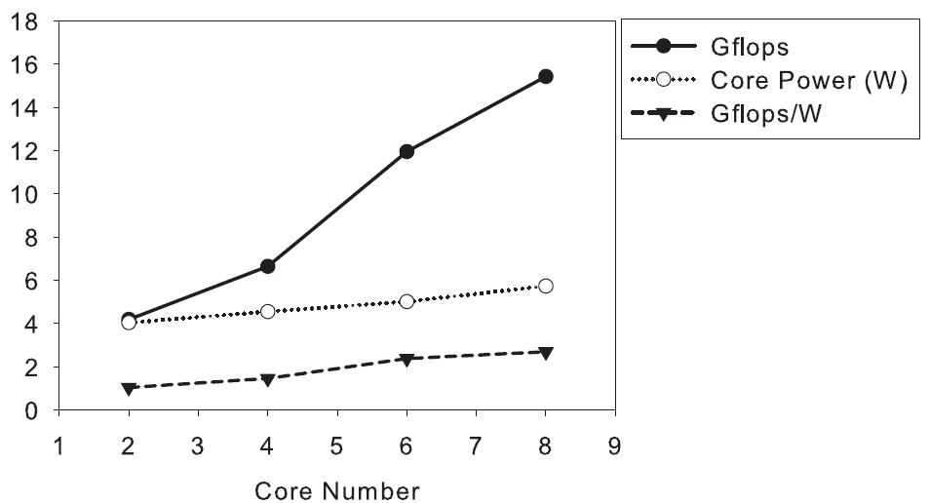
Results and Analysis
We achieve linear scalability on multi-cores
The power efficiency of the DSP is low when its cores are partially utilized
Static power consumption

Slide 21
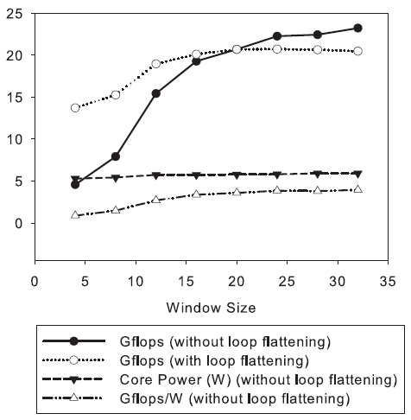
Results and Analysis
Performance are related with window size
Software pipeline performance
Loop flattening is able to improve performance significantly on small window size

Slide 22
Conclusion
First research work on DPS accelerated Lucas Kanade method
Achieve higher energy efficiency and device utilization than GPU and CPU

Slide 23
Q & A

Slide 24
Kernels of Pyramidal Lucas Kanade Method
Gaussian Blur
Derivative Computation
Least Square Method
Flow Field Bilinear Interpolation
28 flop/pixel
8 flop/pixel
Window Size = 16, Pyramid Level = 4, Iteration = 10
10⁵ flop/pixel
3 flop/pixel

