Slide 1

An Integrated Reduction Technique for a Double Precision Accumulator
Krishna Nagar, Yan Zhang, Jason Bakos
Dept. of Computer Science and Engineering
University of South Carolina

Slide 2
Double Precision Accumulation
Many kernels targeted for acceleration include
For large datasets, values delivered serially to an accumulator
Σ
G+H+I,
set 3
D+E+F,
set 2
A+B+C,
set 1
I,
set 3
H,
set 3
G,
set 3
F,
set 2
E,
set 2
D,
set 2
C,
set 1
B,
set 1
A,
set 1

Slide 3
The Reduction Problem
+
Partial sums
Control
Mem
Mem

Slide 4
Reduction-Based Accumulator: Previous Work
Paper | # d.p. adder IP (~1000 slices/ea) | Reduc’n Logic | Reduc’n BRAM | # DSP48 | D.p. adder speed | Accumulator speed | Out-of-order outputs
Prasanna DSA ’07 (Virtex 2P) | 2 | 2215 slices | 3 | n/a | 170 MHz | 142 MHz | Yes
Prasanna SSA ’07 (Virtex 2P) | 1 | 1804 slices | 6 | n/a | 170 MHz | 165 MHz | Yes
Gerards ’08 (Virtex 4) | 1 | 2722 slices | 9 | 3 (from d.p. adder) | 324 MHz | 200 MHz | No
This work (Virtex 5) | 0 | < 1000 slices | 0 | 3 | 355 MHz | 300+ MHz | No

Slide 5
Approach
Reduction complexity scales with the latency of the core operation
Reduce latency of double precision add?
IEEE 754 adder pipeline (assume 4-bit significand):
Compare exponents
De-normalize smaller value
Add 53-bit mantissas
Round
Re-normalize
Round
1.1011 x 2²³
1.1110 x 2²¹
1.1011 x 2²³
0.01111 x 2²³
10.00101 x 2²³
10.0011 x 2²³
1.00011 x 2²⁴
1.0010 x 2²⁴

Slide 6
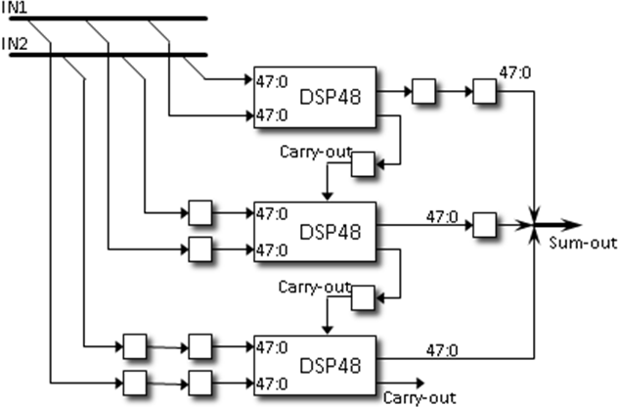
Adder Pipeline
Mantissa addition
Cascaded, pipelined DSP48 adders
Scales well, operates fast
De-normalize
Exponent comparison and a variable shift of one significand
Xilinx IP uses a DSP48 for the 11-bit comparison (waste)

Slide 7
Base Conversion
Previous work in s.p. MAC designs base conversion
Idea:
Shift both inputs to the left by amout specified in low-order bits of exponents
Reduces size of exponent, requires wider adder
Example:
Base-8 conversion:
1.01011101, exp=10110 (1.36328125 x 2²² => ~5.7 million)
Shift to the left by 6 bits…
1010111.01, exp=10 (87.25 x 2^{8*2} = > ~5.7 million)

Slide 8
Exponent Compare vs. Adder Width
Base | Exponent Width | Denormalize speed | Adder Width | #DSP48s
16 | 7 | 119 MHz | 54 | 2
32 | 6 | 246 MHz | 86 | 2
64 | 5 | 368 MHz | 118 | 3
128 | 4 | 372 MHz | 182 | 4
256 | 3 | 494 MHz | 310 | 7
denorm
DSP48
DSP48
DSP48
renorm

Slide 9
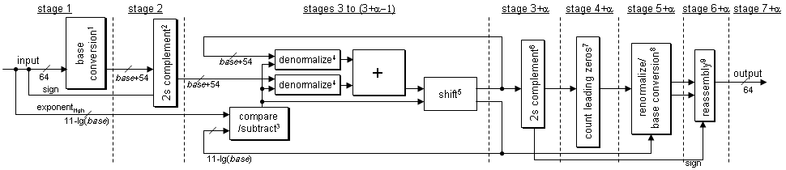
Accumulator Design

Slide 10
Three-Stage Reduction Architecture
Input
Output
buffer
“Adder” pipeline
Input
buffer

Slide 11
Three-Stage Reduction Architecture
Input
Output
buffer
“Adder” pipeline
B1
α3
α2
α1
0
Input
buffer

Slide 12
Three-Stage Reduction Architecture
Input
Output
buffer
“Adder” pipeline
B2
B1
α3
α2
α1
Input
buffer

Slide 13
Three-Stage Reduction Architecture
Input
Output
buffer
“Adder” pipeline
B3
α1+α2
B1
α3
Input
buffer
B2

Slide 14
Three-Stage Reduction Architecture
Input
Output
buffer
“Adder” pipeline
B4
B2+B3
α1+α2
B1
α3
Input
buffer

Slide 15
Three-Stage Reduction Architecture
Input
Output
buffer
“Adder” pipeline
B5
B1+B4
B2+B3
α1+α2
α3
Input
buffer

Slide 16
Three-Stage Reduction Architecture
Input
Output
buffer
“Adder” pipeline
B6
α1+α2+α3
B1+B4
B2+B3
Input
buffer
B5

Slide 17
Three-Stage Reduction Architecture
Input
Output
buffer
“Adder” pipeline
B7
B2+B3+B6
α1+α2+α3
B1+B4
Input
buffer
B5

Slide 18
Three-Stage Reduction Architecture
Input
Output
buffer
“Adder” pipeline
B8
B1+B4+B7
B2+B3+B6
α1+α2+α3
Input
buffer
B5

Slide 19
Three-Stage Reduction Architecture
Input
Output
buffer
“Adder” pipeline
C1
B5+B8
B1+B4+B7
B2+B3+B6
0
Input
buffer

Slide 20
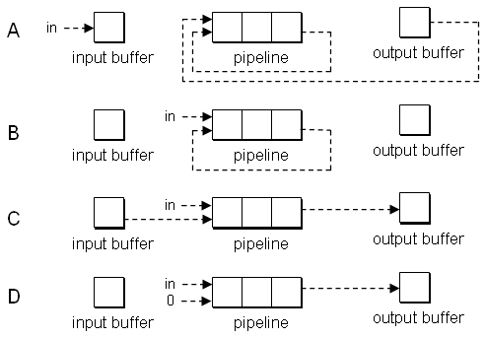
Minimum Set Size
Four “configurations”:
Deterministic control sequence, triggered by set change:
D, A, C, B, A, B, B, C, B/D
Minimum set size is 8

Slide 21
Use Case: Sparse Matrix-Vector Multiply
0
1
2
3
4
5
6
7
8
9
10
A
0
0
0
B
0
val
A
B
C
D
E
F
G
H
I
J
K
0
0
0
C
0
D
E
0
0
0
F
G
col
0
4
3
5
0
4
5
0
2
4
3
H
0
0
0
0
0
0
0
I
0
J
0
ptr
0
2
4
7
8
10
11
0
0
0
K
0
0
Group vol/col
Zero-terminate
(A,0) (B,4) (0,0) (C,3) (D,4) (0,0)…

Slide 22
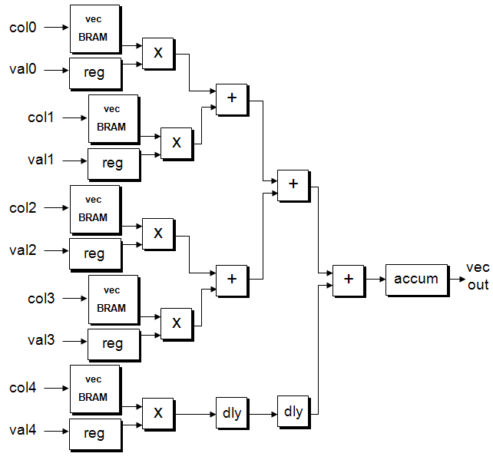
SpMV Architecture
Enough memory bandwidth to read:
5 val/col pairs (80 x 5 bits) per cycle
~15-20 GB/s
Requires minimum number of entries per row:
5 x 8 = 40
Many sparse matrices don’t have this many values per row
Zero padding will degrade performance for many matrices

Slide 23
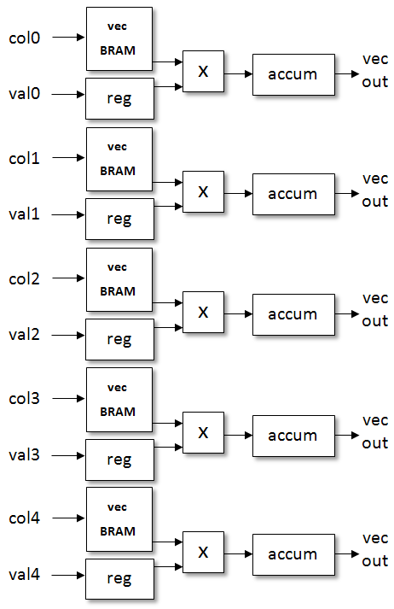
New SpMV Architecture
Delete tree, replicate accumulator, schedule matrix data:
400 bits
val_{0,0} | col_{0,0} | val_{1,0} | col_{1,0} | val_{2,0} | col_{2,0} | val_{3,0} | col_{3,0} | val_{4,0} | col_{4,0}
val_{0,1} | col_{0,1} | val_{1,1} | col_{1,1} | val_{2,1} | col_{2,1} | val_{3,1} | col_{3,1} | val_{4,1} | col_{4,1}
val_{0,2} | col_{0,2} | val_{1,2} | col_{1,2} | val_{2,2} | col_{2,2} | val_{3,2} | col_{3,2} | val_{4,2} | col_{4,2}
val_{0,3} | col_{0,3} | val_{1,3} | col_{1,3} | val_{2,3} | col_{2,3} | val_{3,3} | col_{3,3} | val_{4,3} | col_{4,3}
val_{0,4} | col_{0,4} | val_{1,4} | col_{1,4} | val_{2,4} | col_{2,4} | val_{3,4} | col_{3,4} | val_{4,4} | col_{4,4}
val_{0,5} | col_{0,5} | val_{1,5} | col_{1,5} | val_{2,5} | col_{2,5} | val_{3,5} | col_{3,5} | val_{4,5} | col_{4,5}
val_{0,6} | col_{0,6} | 0.0 | 0.0 | val_{2,6} | col_{2,6} | val_{3,6} | col_{3,6} | val_{4,6} | col_{4,6}
val_{0,7} | col_{0,7} | 0.0 | 5 | val_{2,7} | col_{2,7} | val_{3,7} | col_{3,7} | val_{4,7} | col_{4,7}
val_{0,8} | col_{0,8} | val_{5,0} | col_{5,0} | val_{2,8} | col_{2,8} | val_{3,8} | col_{3,8} | val_{4,8} | col_{4,8}

Slide 24
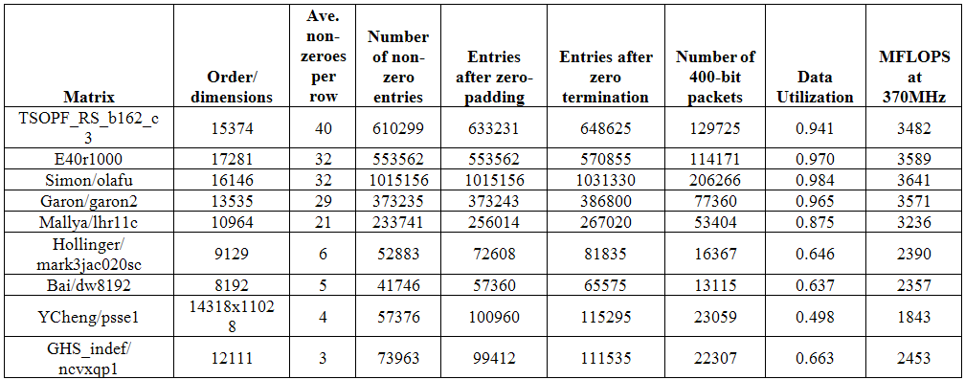
Performance Results

Slide 25
Conclusions
Developed serially-delivered accumulator using base-conversion technique
Limited to shallow pipelines
Deeper pipelines require large minimum set size
4 -> 11, 5 -> 19, 6 -> 23
Goal: new reduction circuit to support deeper pipelines with no minimum set size
Acknowledgements:
NSF awards CCF-0844951, CCF-0915608

