Slide 1
Sample Undergraduate Lecture:
MIPS Instruction Set Architecture
Jason D. Bakos
Optics/Microelectronics Lab
Department of Computer Science
University of Pittsburgh

Slide 2
Outline
Instruction Set Architecture
MIPS ISA
  Instruction set
  Instruction encoding/representation
  Example code
Pipelining
  Concepts
  Hazards
Pipeline enhancements: performance

Slide 3
Instruction Set Architecture
Instruction Set Architecture (ISA)
  Usually defines a “family” of microprocessors
    Examples: Intel x86 (IA32), Sun Sparc, DEC Alpha, IBM/360, IBM PowerPC, M68K, DEC VAX
  Formally, it defines the interface between a user and a microprocessor
ISA includes:
  Instruction set
  Rules for using instructions
    Mnemonics, functionality, addressing modes
  Instruction encoding
ISA is a form of abstraction
  Low-level details of microprocessor are “invisible” to user

Slide 4
Instruction Set Architecture
ISA => abstraction is a misnomer
Many processor implementation details are revealed through ISA
Example:
  Motorola 6800 / Intel 8085 (1970s)
    1-address architecture: ADDA <addr>
    (A) = (A) + (addr)
  Intel x86 (1980s)
    2-address architecture: ADD EAX, EBX
    (A) = (A) + (B)
  MIPS (1990s)
    3-address architecture: ADD $2, $3, $4
    ($2) = ($3) + ($4)
  Advancements in fabrication technology

Slide 5
MIPS Architecture
Design “philosophies” for ISAs: RISC vs. CISC
Execution time =
  instructions per program * cycles per instruction * seconds per cycle
MIPS is implementation of a RISC architecture
MIPS R2000 ISA
  Designed for use with high-level programming languages
    small set of instructions and addressing modes, easy for compilers
  Minimize/balance amount of work (computation and data flow) per instruction
    allows for parallel execution
  Load-store machine
    large register set, minimize main memory access
  fixed instruction width (32-bits), small set of uniform instruction encodings
    minimize control complexity, allow for more registers

Slide 6



MIPS Instructions
MIPS instructions fall into 5 classes:
  Arithmetic/logical/shift/comparison
  Control instructions (branch and jump)
  Load/store
  Other (exception, register movement to/from GP registers, etc.)
Three instruction encoding formats:
  R-type (6-bit opcode, 5-bit rs, 5-bit rt, 5-bit rd, 5-bit shamt, 6-bit function code)
  I-type (6-bit opcode, 5-bit rs, 5-bit rt, 16-bit immediate)
  J-type (6-bit opcode, 26-bit pseudo-direct address)

Slide 7
MIPS Addressing Modes
MIPS addresses register operands using 5-bit field
  Example: ADD $2, $3, $4
MIPS addresses branch targets as signed instruction offset
  relative to next instruction (“PC relative”)
  in units of instructions (words)
  held in 16-bit offset in I-type
  Example: BEQ $2, $3, 12
Immediate addressing
  Operand is help as constant (literal) in instruction word
  Example: ADDI $2, $3, 64

Slide 8
MIPS Addressing Modes (con’t)
MIPS addresses jump targets as register content or 26-bit “pseudo-direct” address
  Example: JR $31, J 128
MIPS addresses load/store locations
  base register + 16-bit signed offset (byte addressed)
    Example: LW $2, 128($3)
  16-bit direct address (base register is 0)
    Example: LW $2, 4092($0)
  indirect (offset is 0)
    Example: LW $2, 0($4)

Slide 9
Example Instructions
ADD $2, $3, $4
  R-type A/L/S/C instruction
  Opcode is 0’s, rd=2, rs=3, rt=4, func=000010
  000000 00011 00100 00010 00000 000010
JALR $3
  R-type jump instruction
  Opcode is 0’s, rs=3, rt=0, rd=31 (by default), func=001001
  000000 00011 00000 11111 00000 001001
ADDI $2, $3, 12
  I-type A/L/S/C instruction
  Opcode is 001000, rs=3, rt=2, imm=12
  001000 00011 00010 0000000000001100

Slide 10
Example Instructions
BEQ $3, $4, 4
  I-type conditional branch instruction
  Opcode is 000100, rs=00011, rt=00100, imm=4 (skips next 4 instructions)
  000100 00011 00100 0000000000000100
SW $2, 128($3)
  I-type memory address instruction
  Opcode is 101011, rs=00011, rt=00010, imm=0000000010000000
  101011 00011 00010 0000000010000000
J 128
  J-type pseudodirect jump instruction
  Opcode is 000010, 26-bit pseudodirect address is 128/4 = 32
  000010 00000000000000000000100000

Slide 11
Pseudoinstructions
Some MIPS instructions don’t have direct hardware implementations
  Ex: abs $2, $3
    Resolved to:
      bgez $3, pos
      sub $2, $0, $3
      j out
      pos: add $2, $0, $3
      out: …
  Ex: rol $2, $3, $4
    Resolved to:
      addi $1, $0, 32
      sub $1, $1, $4
      srlv $1, $3, $1
      sllv $2, $3, $4
      or $2, $2, $1

Slide 12
MIPS Code Example
for (i=0;i<n;i++) a[i]=b[i]+10;
xor $2,$2,$2 # zero out index register (i)
lw $3,n # load iteration limit
sll $3,$3,2 # multiply by 4 (words)
li $4,a # get address of a (assume < 2¹⁶)
li $5,b # get address of b (assume < 2¹⁶)
loop: add $6,$5,$2 # compute address of b[i]
lw $7,0($6) # load b[i]
addi $7,$7,10 # compute b[i]=b[i]+10
add $6,$4,$2 # compute address of a[i]
sw $7,0($6) # store into a[i]
addi $2,$2,4 # increment i
blt $2,$3,loop # loop if post-test succeeds

Slide 13
Pipeline Implementation
Idea:
  Goal of MIPS: CPI <= 1
  Some instructions take longer to execute than others
  Don’t want cycle time to depend on slowest instruction
  Want 100% hardware utilization
  Split execution of each instruction into several, balanced “stages”
  Each stage is a block of combinational logic
  Latency of each stage fits within 1 clock cycle
  Insert registers between each pipeline stage to hold intermediate results
  Execute each of these steps in parallel for a sequence of instructions
  “Assembly line”
This is called pipelining

Slide 14
MIPS ISA
MIPS pipeline stages
  Fetch (F)
    read next instruction from memory, increment address counter
    assume 1 cycle to access memory
  Decode (D)
    read register operands, resolve instruction in control signals, compute branch target
  Execute (E)
    execute arithmetic/resolve branches
  Memory (M)
    perform load/store accesses to memory, take branches
    assume 1 cycle to access memory
  Write back (W)
    write arithmetic results to register file

Slide 15
Hazards
Hazards are data flow problems that arise as a result of pipelining
  Limits the amount of parallelism, sometimes induces “penalties” that prevent one instruction per clock cycle
  Structural hazards
    Two operations require a single piece of hardware
    Structural hazards can be overcome by adding additional hardware
  Control hazards
    Conditional control instructions are not resolved until late in the pipeline, requiring subsequent instruction fetches to be predicted
      Flushed if prediction does not hold (make sure no state change)
    Branch hazards can use dynamic prediction/speculation, branch delay slot
  Data hazards
    Instruction from one pipeline stage is “dependant” of data computed in another pipeline stage

Slide 16
Hazards
Data hazards
  Register values “read” in decode, written during write-back
    RAW hazard occurs when dependent inst. separated by less than 2 slots
    Examples:
      ADD $2,$X,$X (E) ADD $2,$X,$X (M) ADD $2,$3,$4 (W)
      ADD $X,$2,$X (D) … …
      … ADD $X,$2,$X (D) …
      … … ADD $X,$2,$3 (D)
  In most cases, data generated in same stage as data is required (EX)
    Data forwarding
      ADD $2,$X,$X (M) ADD $2,$X,$X (W) ADD $2,$3,$4 (out-of-pipe)
      ADD $X,$2,$X (E) … …
      … ADD $X,$2,$X (E) …
      … … ADD $X,$2,$3 (E)

Slide 17
“Load” Hazards
Stalls required when data is not produced in same stage as it is needed for a subsequent instruction
  Example:
    LW $2, 0($X) (M)
    ADD $X, $2 (E)
When this occurs, insert a “bubble” into EX state, stall F and D
    LW $2, 0($X) (W)
    NOOP (M)
    ADD $X, $2 (E)
  Forward from W to E

Slide 18
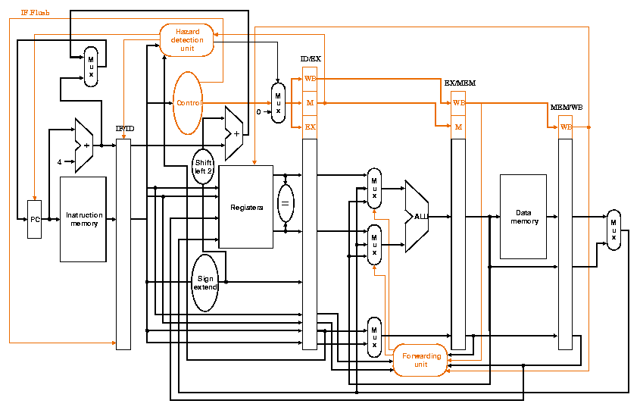
Pipelined Architecture
fetch
decode
execute
memory
write back

Slide 19
Example
1
2
3
4
5
6
7
8
9
10
11
12
13
14
15
add $6,$5,$2
lw $7,0($6)
addi $7,$7,10
add $6,$4,$2
sw $7,0($6)
addi $2,$2,4
blt $2,$3,loop
add $6,$5,$2
F
D
E
M
W
F
D
E
M
W
F
D
E
M
W
F
D
E
M
W
F
D
E
M
W
F
D
E
M
W
F
D
E
M
W
F
D
E
M
W
8 instructions, 15 - 4 cycles, CPI = .73

Slide 20
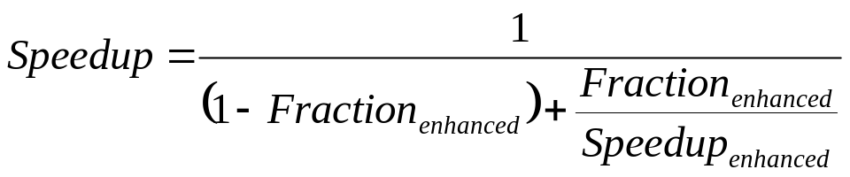
Pipeline Enhancements
Assume we add branch predictor
  Branch predictor success rate = 85%
  Penalty for bad prediction = 3 cycles
  Profiler tells us that 10% of instructions executed are branches
  Branch speedup
    = (cycles before enhancement) / (cycles after enhancement)
    = 3 / [.15(3) + .85(1)] = 2.3
  Amdahl’s Law:
  Speedup = 1 / (.90 + .10/2.3) = 1.06
  6% improvement

Slide 21
Summary
Instruction Set Architecture
  ISA is revealing (fabrication technology, architectural implementation)
  MIPS ISA
Pipelining
  Pipeline concepts
  Hazards
  Example

