Slide 1
Issues in System-Level Direct Networks
Jason D. Bakos

Slide 2
Research Space
Marculescu (CMU) formally defines space for NoC design…
  Communication infrastructure synthesis
    Network topology
      Ex: mesh, torus, cube, butterfly, tree
      Affects everything: latency, throughput, area, fault-tolerance, power consumption
      Depends mostly on floorplan and communication structure
        Grid floorplans lend to mesh, but assumes cores are regular
        Meshs keep wire lengths uniform
    Floorplanning
      Coupled with topology
      Biggest issues: regular or irregular core sizes, matching floorplan to topology
    Channel width
      BW = f_{ch} x W
      Larger W reduces message latency (worm length)
      Affects area (wiring, buffers)
      Serial links are good for electrical reasons
    Buffer size
      Depends on switching (store-and-forward, cut-through, circuit switching, wormhole)
      Has great effect on router complexity/size

Slide 3
Research Space
Communication paradigm
  Routing (and flow control)
    Affects latency, network throughput, and network utilization
    Types of routing
      Deterministic
        PROs: Avoids deadlock, livelock, and indefinite postponement
        CONs: Bad for latency and throughput/utilization
      Adaptive
        PROs: Good for latency and throughput/utilization
        CONs: Difficult to avoid deadlock, livelock, and indefinite postponement
      Partially adaptive
        PROs: Good for latency and throughput/utilization
        CONs: Doesn’t exploit full network throughput
      Flow control:
        Virtual channels: originally for deadlock avoidance, but now used to increase throughput
  Switching
    Ex: circuit switching, store-and-forward, cut-through, wormhole
    Wormhole better for data networks with dynamic traffic
    Circuit switching is easier to achieve guaranteed service operation (and better for application-specific NoCs)

Slide 4
Research Space
Application mapping optimization
  Scheduling
    Have a set of tasks, now find a schedule for cores (static, dynamic)
    Traditional scheduling doesn’t account for network latency
  IP mapping
    Assume floorplan and topology is fixed, map cores to placeholders to minimize energy (hops)
    Perform search over space of assignments

Slide 5
Deterministic Wormhole Routing
Deterministic
  Ex: Dimension-ordered routing
  One possible path for any S and D
  Worm stops when header encounters a locked destination channel (router output port)
    Locks all channels along its path
  Routers are small and simple
    Each input port of each router requires buffer for one flit
  Guarantees shortest hop count (energy) and prevents deadlock, livelock, and indef. postponement
  BAD: High latency (blocking)

Slide 6
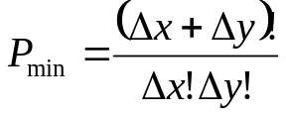
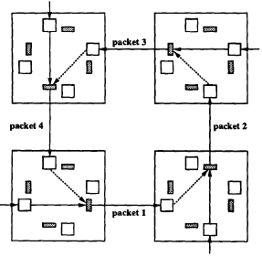
Adaptive Wormhole Routing
Adaptive
  Many paths between any S and any D
  Worm follows a set path until it reaches a block, then routes around it
  If the shortest possible remaining path is allowed, then is it fully adaptive
  Lower latency, higher throughput
  Susceptible to deadlock
  Packets may arrive out-of-order

Slide 7


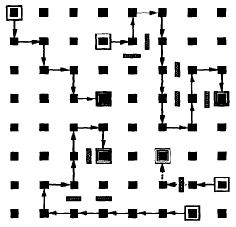
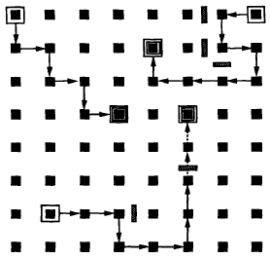
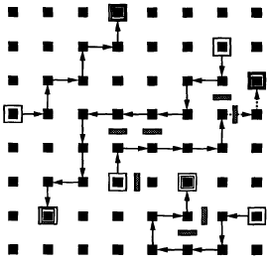
Partially Adaptive Wormhole Routing
Partially adaptive routing
  Deadlock avoidance
Eliminate a quarter of the turns to avoid deadlock
fully adaptive, 8 turns
XY routing, 4 turns
west-first, 6 turns
north-last, 6 turns
negative-first, 6 turns

Slide 8
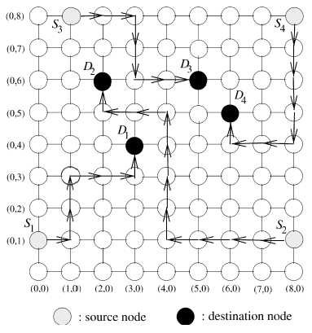
Odd-Even Wormhole Routing
In above methods, at least half of S/D pairs are restricted to having one minimal path, while full adaptiveness is provided to the others
  Unfair!
Odd-even turn routing offers solution:
  Even column: no EN or ES turn
  Odd column: no NW or SW turn

Slide 9
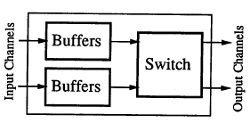
Virtual Channel Routing
Originally conceived as a way to improve network throughput
  Time multiplex virtual channels onto physical channels
  Assume deterministic routing
S0
S1
D2
S2
D0
D1

Slide 10
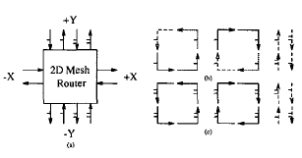
Fully Adaptive Routing with VCs
Can achieve fully adaptive routing with VCs
  Problem: minimize required number of VCs
  Virtual channel 1 for N and S can only be used if the message no longer needs to be routed west (west-first)

Slide 11
Where to go from here…
NoC
  Channels are wide and fast => lots of bandwidth
  Routers should be FAST (core speed) and SMALL
  Channels don’t require a lot of power
Array of FPGAs
  Routers cannot be fast, but can be large and complex
  Channels are serial and require a LOT of power (differential)
  Minimum hop count is important for low power (assuming you can shut down links)

Slide 12
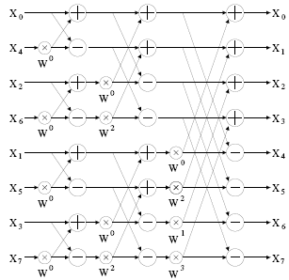
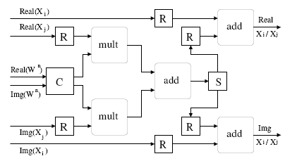
Applications
For both FPGAs and NoCs:
  Some/most/? signal processing algorithms can be realized as wide and/or deep dataflow graphs

Slide 13
Applications
FPGAs implement a sea of logic blocks interconnected in data-flow fashion
  Slow for arbitrary logic due to wiring overheads (e.g. more latency and area per gate vs. ASIC)
How about design an ASIC with an array of high-speed double-precision floating point units, interconnected in a NoC?
  TRIPS-like, but allows reuse of functional units within the same DFG
  Introduces scheduling issues

Slide 14
NoC-based General Purpose Streaming Data Flow Architecture
input 0
+
0
input 1
0
input 2
*
1
+
2
input 3
*
out
+ in0 in1 0
* 0 in2 1
+ 0 1 2
* 2 in3 mem[0]
DFG
C
*
*
*
+
+
mem
+
D

Slide 15
NoC-based General Purpose Streaming Data Flow Architecture
input 0
+
0
input 1
0
input 2
*
1
+
2
input 3
*
out
+ in0 in1 0
* 0 in2 1
+ 0 1 2
* 2 in3 mem[0]
in 0
C
*
*
*
+
+
mem
+
D

Slide 16
NoC-based General Purpose Streaming Data Flow Architecture
input 0
+
0
input 1
0
input 2
*
1
+
2
input 3
*
out
+ in0 in1 0
* 0 in2 1
+ 0 1 2
* 2 in3 mem[0]
in 1
C
*
*
*
+
+
mem
+
D

Slide 17
NoC-based General Purpose Streaming Data Flow Architecture
input 0
+
0
input 1
0
input 2
*
1
+
2
input 3
*
out
+ in0 in1 0
* 0 in2 1
+ 0 1 2
* 2 in3 mem[0]
in 2
C
*
*
*
+
+
mem
+
D

Slide 18
NoC-based General Purpose Streaming Data Flow Architecture
input 0
+
0
input 1
0
input 2
*
1
+
2
input 3
*
out
+ in0 in1 0
* 0 in2 1
+ 0 1 2
* 2 in3 mem[0]
in 3
C
*
*
*
+
+
mem
+
D

Slide 19
NoC-based General Purpose Streaming Data Flow Architecture
input 0
+
0
input 1
0
input 2
*
1
+
2
input 3
*
out
+ in0 in1 0
* 0 in2 1
+ 0 1 2
* 2 in3 mem[0]
in 0
C
*
*
*
+
+
mem
+
D

Slide 20
NoC-based General Purpose Streaming Data Flow Architecture
input 0
+
0
input 1
0
input 2
*
1
+
2
input 3
*
out
+ in0 in1 0
* 0 in2 1
+ 0 1 2
* 2 in3 mem[0]
in 1
C
*
*
0
0
*
+
+
mem
+
D

Slide 21
NoC-based General Purpose Streaming Data Flow Architecture
input 0
+
0
input 1
0
input 2
*
1
+
2
input 3
*
out
+ in0 in1 0
* 0 in2 1
+ 0 1 2
* 2 in3 mem[0]
in 2
C
0
*
*
0
*
+
+
mem
+
D

Slide 22
NoC-based General Purpose Streaming Data Flow Architecture
input 0
+
0
input 1
0
input 2
*
1
+
2
input 3
*
out
+ in0 in1 0
* 0 in2 1
+ 0 1 2
* 2 in3 mem[0]
in 3
C
*
*
1
0
*
+
+
mem
+
D

Slide 23
NoC-based General Purpose Streaming Data Flow Architecture
input 0
+
0
input 1
0
input 2
*
1
+
2
input 3
*
out
+ in0 in1 0
* 0 in2 1
+ 0 1 2
* 2 in3 mem[0]
in 0
C
*
*
0
*
1
+
+
mem
+
D

Slide 24
Other Ideas
Marculescu recently looked at mapping strategies for regular tile-based NoCs…
  He handwaved away the possibility of adaptive VC-based routing, due to complex routers
  In class, we read about a pipelined VC router design… didn’t seem that complex
  How about we evaluate the trade-offs between router complexity and network throughput?
Apply data-flow architecture to FPGA array?

