Slide 1
Reconstructing Phylogenies from Gene-Order Data
Overview

Slide 2
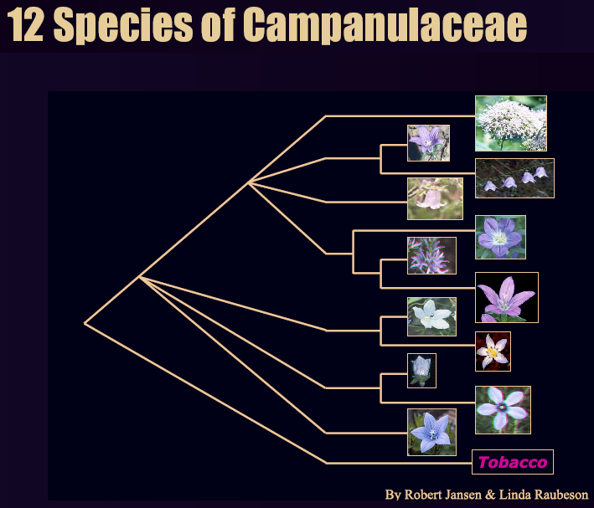
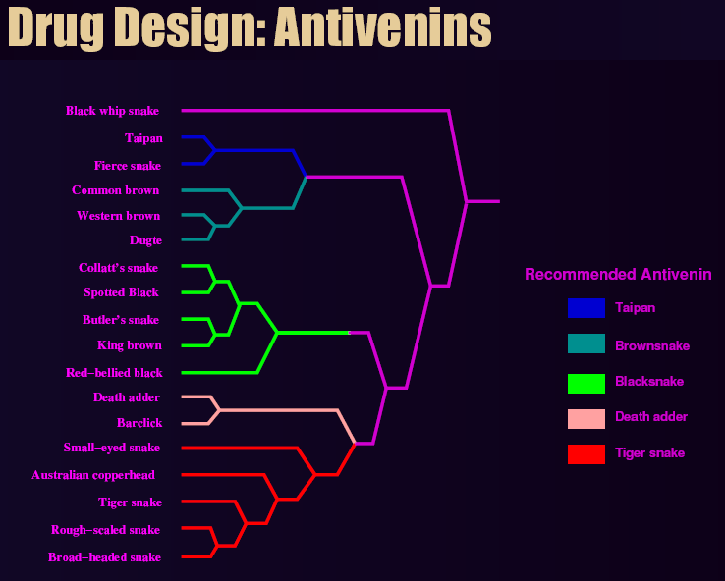
What are Phylogenies?
“Tree of Life”
A UAG representing evolution of species

Slide 3
Phylogenic Analysis Used For…
Phylogenies help biologists understand and predict:
  functions and interactions of genes
  genotype => phenotype
  host/parasite co-evolution
  origins and spread of disease
  drug and vaccine development
  origins and migrations of humans
  RoundUp herbicide was developed with the help of phylogenetic analysis

Slide 4
Gene-Level Phylogeny
Nadeau-Taylor model of evolution
  Assume discrete set of genes
    Each gene represents a sequence of nucleic acids
    Genes have polarity (a, -a)
  A species genome is a sequence of genes
  Rare evolutionary events cause changes in genome
    Inversion: (a b c d) => (a –c –b d)
    Transposition: (a b c d) => (a c d b)
    Inverted transposition: (a b c d) => (a –d –c b)
    Insertion: (a b c d) => (a e b c d)
    Deletion: (a b c d) => (a c d)

Slide 5
Goal of Phylogenetics
Given a set of observed genomes, reconstruct an evolutionary tree
  Leaves are the observed genomes
  Internal nodes are evolutionary steps (“missing link” genomes)
  Edges may contain multiple events
Fundamentally impossible to solve without a time machine
  Fossils?
However:
  Of the set of valid trees that include all observed genomes as leaf nodes, tree containing the minimum number of events (sum of edge weights) is closest to actual
  “Maximum parsimony”

Slide 6
Tree Construction Techniques
Three primary methods:
  Criterion-based (NP-HARD optimization)
    Relies on an evolutionary model
    Examples:
      Breakpoint phylogeny
      Maximum-likelihood, maximum-parsimony, minimum evolution
    Provides good accuracy but intractable for larger sets of genomes
  Ad hoc / distance-based
    Relies on pair-wise distances
    Example:
      Neighbor-joining
    Runs in polynomial time but very inaccurate for large sets of genomes
  Meta-methods
    Ex: disk-covering, quartet-based methods
    Divide-and-conquer approach

Slide 7
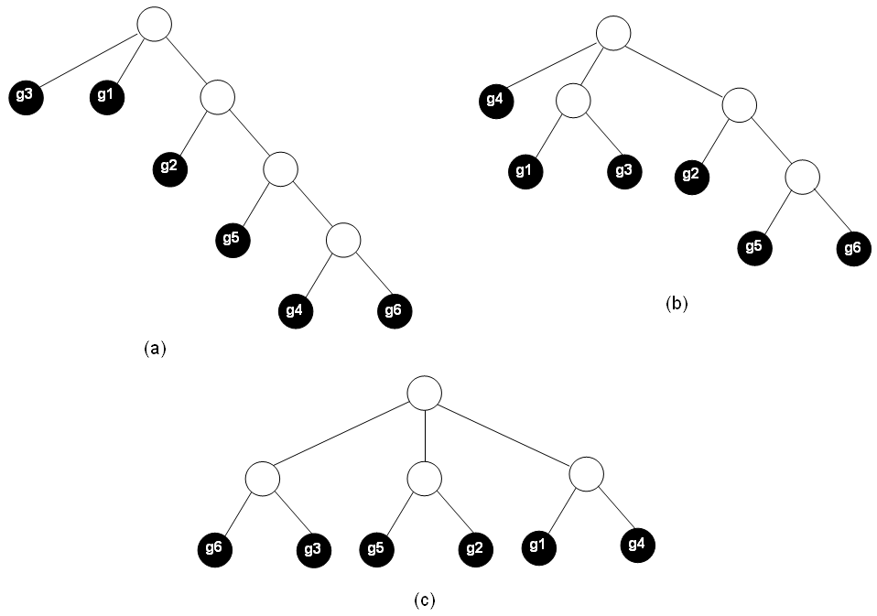
Breakpoint Phylogeny Method
Sankoff-Blanchette Technique
  Assume an unrooted, binary tree topology, where leaves are genomes
  Basic algorithm:
    For each circular ordering of genomes…
    From bottom up, label each of the 2N-2 internal nodes with a genome that has minimal distance to each of its neighbors
    The tree with the minimal sum of edge-weights (height) is the most parsimonious
  First problem with S-B: exponential number of genome orderings
(n-1)! possible circular orderings:
G1 G2 G3 G4
is equivalent to…
G2 G3 G4 G1
Topology (and thus length) of tree depends solely on gene ordering

Slide 8
Breakpoint Distance
S-B use “breakpoint distance” to estimate distance between two genomes
  Approximates number of evolutionary events
  Assumes consistent gene set and sequence length
  Given genomes G₁ and G₂
  If a and b are adjacent in genome G1 but not in G2, then bp_distance++
  Example: {a b c d} and {a c d b} have two breakpoints
  Must also take polarity into account…
    No breakpoint between {a b} and {-b –a}
    Example: {a b c d} and {-b –a c d}
      Breakpoint distance is 1

Slide 9
“Median Problem for Breakpoints”
S-B labels internal nodes by finding a median among 3 genomes, such that:
  D(S,A) + D(S, B) + D(S,C) is minimal
Performed using a TSP:
  Build fully-connected graph with an edge for each polarity of each gene
  Edge weights assigned as 3-(number of times each pair of genes are adjacent)
  Run TSP
  Path of salesman specifies medium

Slide 10
Example Median
Assume gene set={A, B, C, D}
Assume genomes:
  A B C D
  B D -A -C
  -D C B A
u(A,B)=0 u(A,-B)=1 u(A,C)=0 u(A,-C)=1 u(A,D)=0 u(A,-D)=0
u(-A,B)=1 u(-A,-B)=0 u(-A,C)=0 u(-A,-C)=0 u(-A,D)=0 u(-A,-D)=1
u(B,C)=0 u(B,-C)=1 u(B,D)=0 u(B,-D)=0
u(-B,C)=1 u(-B,-C)=0 u(-B,D)=1 u(-B,-D)=0
u(C,D)=1 u(C,-D)=0
u(-C,D)=1 u(-C,-D)=0
2
weight=3-(adjacencies)
-1
A
-A
If solution to TSP is s₁,-s₁,s₂,-s₂,…,s_{n},-s_{n}
then median is s₁,s₂,…,s_{n}
(include signs)
B
2
2
D
-1
2
-1
2
-B
2
-D
2
2
C
-1
-C
2
edges not shown have weight 3

Slide 11
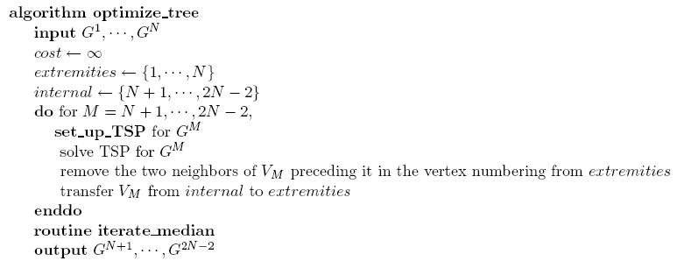
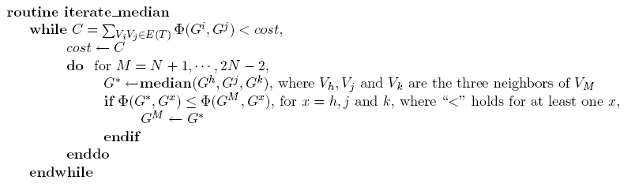
S-B Algorithm
N+2N-2
label initialization
only when nodes have changed

Slide 12
S-B Algorithm
S and B propose three different methods for initializing the TSPs for achieving global optimum
Second problem with S-B:
  Each tree requires the solving of multiple TSPs, which themselves are NP-HARD
  Initial labeling: 2N-2 TSPs
  Repeats this process an unknown number of times to optimize internal nodes

Slide 13
Neighbor Joining
A polynomial-time heuristic for tree construction
Given the distances between each pair of genomes (distance matrix)…
Grow a complex tree structure, starting from a star
Basic algorithm:
  Begin with a star-topology
  Choose pairs of leaves that are closely related
  Remove these leaves and join them with a new internal node
  Join this new internal node somewhere into the old tree
  Do this until all N-3 internal nodes have been created

Slide 14
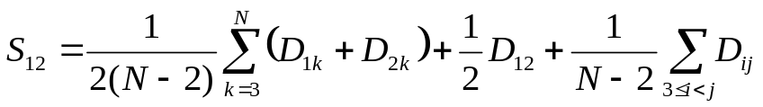

Neighbor-Joining
N(N-2)/2 possibilities
D | 1 | 2 | 3 | 4
2 | 4
3 | 5 | 3
4 | 6 | 2 | 3
5 | 6 | 5 | 7 | 4
3
1
2
1
X
Y
4
X
2
5
3
4
5
S₀=(Σ D)/(N-1) = 45/4 = 11.25
S | 1 | 2 | 3 | 4
2 | 9.50
3 | 11 | 11.17
4 | 12 | 10.17 | 11
5 | 10.83 | 11.50 | 11.83 | 10.83
S | 1-2 | 3 | 4
3
4
5

Slide 15
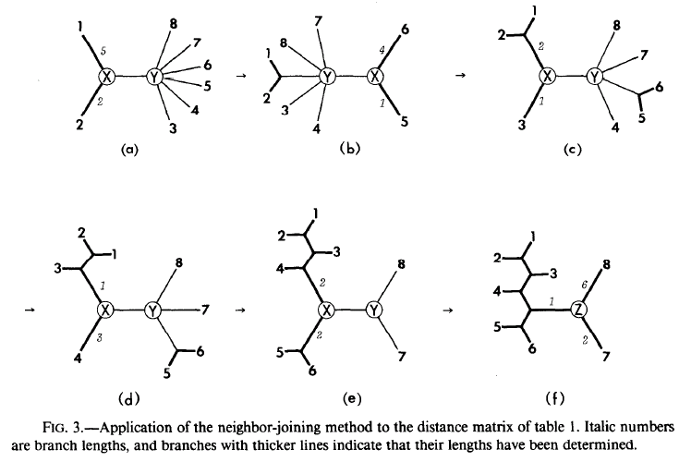
Neighbor-Joining

Slide 16
Neighbor-Joining
Edges weight approximations can be computed with neighbor-joining
However, it is more accurate to label the internal nodes as with S-B and measure edge lengths based on this
  “Scoring”

Slide 17
Moret’s Distance Estimators
IEBP estimator
  Approximates event distance from
    breakpoint distance
    weights: inversion, transposition, inverted transposition
  Fast but not accurate
Exact-IEBP
  Returns the exact value
  Slow but exact
EDE
  Correction function to improve accuracy of IEBP
EDE used to build distance matrix
  Set up NJ
  Finding lower bound
  Scoring

Slide 18
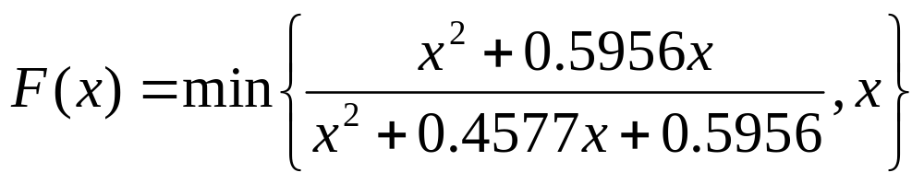
EDE
Distance correction
Non-negative inverse of
F(x) defines minimum inversion distance, x defines actual inversions

Slide 19
Bounding
Given a distance matrix, lower bound can be determined
  “Tree is at least this size”
  Use “twice around the tree”
  Length of tree (sum of edges) is .5 * (d₁₂, d₂₃, …, d_{n1})
Given a constructed tree, upper bound can be determined
  Label internal nodes
  Sum up all edges using distance calculator

Slide 20
GRAPPA
Optimizations
  Gene ordering
    Given a circular gene ordering
    Build a S-B tree
    Swap internal leaf orderings, changing the order
    Upper bound stays constant (no relabeling), while lower bound changes

Slide 21
GRAPPA
Layered search:
  Build EDE distance matrix
  Build and score NJ tree (provides initial upper bound)
  Enumerate all genome orderings
  For each:
    Compute lower bound using “twice around the tree”
    If LB < UB, add ordering to queue, sorted by LB
      Requires too much disk space
  Score each tree from queue in order:
    Keep track of lowest upper bound
    Allows for more pruning

Slide 22
GRAPPA
Without layered search:
  Build EDE distance matrix
  Build and score NJ tree (initial upper bound)
  For each genome ordering:
    Compute lower bound
    If lower bound < UB
    Score tree and compute new upper bound (may do swap-as-you-go to eliminate redundant orderings)
    If new upper bound < old upper bound, set new upper bound

Slide 23
FPGA Implementation
Software can perform NJ, since that’s only done once
Software can enumerate valid genome orderings
Scoring should be done in hardware
EDE can be performed via BRAM/CLB lookup table
Need to implement TSP in hardware
GRAPPA uses specialized version of TSP
  As opposed to chained and simple versions of Lin-Kernighan heuristic – O(n³)
Most important question:
  Map to multi-FPGA architecture?

Slide 24
GRAPPA Version of S-B Algorithm
Iterative refinement
  Only refine internal nodes when one of the neighbors has changed in the refinement iteration
Condenasation
  Gene reduction to speed up TSP for shared subsequences
  Not used by default
Exact TSP algorithm
Initial labeling
  Uses second approach in S-B paper (“nearest neighbors/trees of TSPs”)

Slide 25
Parallelism?
Scoring is very parallel
  TSP only depends on three nearest nodes
  Can overlap iterations
GRAPPA is parallelized for cluster
  Compute, not communication bound
Achieve finer-grain parallelism with FPGAs
  Problem may turn communication-bound
Research Plan
  GRAPPA analysis (drill-down)
  Get preliminary results for TSP over FPGA
    SRC implementation (Charlie)
    Determine granularity vs. communication

Slide 26
Possible HPRC Approach
I1
I2
I3
I6
I4
I5
I4
I5
I6
I1
I2
I3
G1
G2
G3
G4
wrap-around –
one TSP core
buffered requests

Slide 27
Possible HPRC Approach
input species
ancesteral group 1
ancesteral group 2
g5
g5
g5
g5

Slide 28
HPRC
FPGAs
  Comp. density
    Cost
  Granularity
Mesh
  Load balancing

