Slide 1
Accuracy, Cost, and Performance Trade-offs for Floating Point Accumulation
Krishna K. Nagar and Jason D. Bakos
Univ. of South Carolina

Slide 2
Floating Point Accumulation
Problem:
For floating point accumulation, high throughput and high accuracy are competing design goals
Motivation:
Fully pipelined, streaming d.p. f.p. accumulator
Accepts one new value and set ID on every clock cycle
Exploits parallelism both within and across accumulation sets
Based on dynamically scheduling inputs to a single floating point adder
However, accuracy was inconsistent and data dependent
ReConFig 2013 Ph.D. Forum 2

Slide 3
High Throughput Accumulation
Buffers
Accumulator Input
c₂
Adder Pipeline
?
d₁
?
?
c₁
B_{sum}
A_{sum}
?
c₃
Dynamically schedule:
Adder inputs
Next input value
Output of adder
…based on datapath priorities and the set IDs
ReConFig 2013 Ph.D. Forum 3

Slide 4
Accumulator Design
Rule 2
c₂
d₁
c₁
B_{sum}
A_{sum}
c₃
Rule 4
d₁
d₂
c₂+c₃
c₁
B_{sum}
ReConFig 2013 Ph.D. Forum 4

Slide 5
Accumulator Design
Rule 5
d₃
D1+d2
C2+c3
c₁
0
Rule 1
c₁
d₄
d₃
d₁+d₂
c₂+c₃
ReConFig 2013 Ph.D. Forum 5

Slide 6
Inaccuracies in Floating Point Addition
Floating point addition has inherent rounding error
Shift, round, cancellation
F.p. addition is not associative
For the accumulator, the total error is data dependent
We’ve seen as many as 50% of mantissa bits being in error after accumulating large synthetic data sets
In general, to improve accuracy:
multiple passes over dataset (sorting),
multiple operations per input (additional dependencies), or
increased precision (lower clock rate, higher latency)
…each reduces throughput
ReConFig 2013 Ph.D. Forum 6

Slide 7
Compensated Summation
Compensated summation
Preserve the rounding error from each addition
Incorporate the errors into the final result
Three strategies:
Incorporate rounding errors from previous addition into subsequent addition
Accumulate the error separately and incorporate total error into the final result
Use extended precision adder (80- and 128-bit)
Error Free Transformation
a + b = x + e, x = fl(a ⊕ b)

Slide 8
Error Extraction
Relies on custom floating point adder that produces the roundoff error as a second output
Design | Slices | Latency | %Change Slices
64-bit FP adder | 1130 | 14
64-bit “error producing“ adder | 2310 | 14 | +104.4%
80-bit FP adder | 1715 | 19 | +51.7%
128-bit FP adder | 3327 | 26 | +194.4%
ReConFig 2013 Ph.D. Forum 8

Slide 9
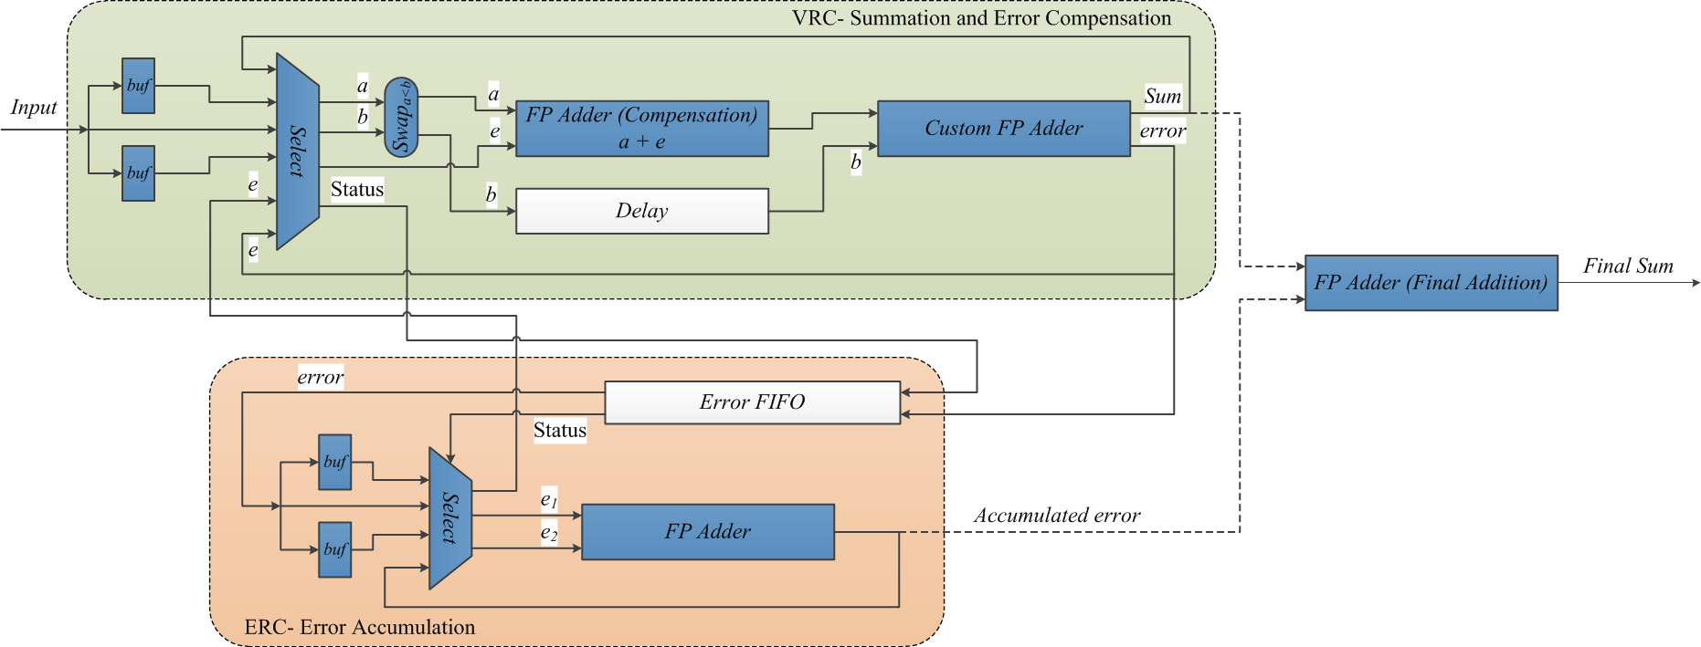
Adaptive Error Compensation in Subsequent Addition (AECSA)
ReConFig 2013 Ph.D. Forum 9

Slide 10
Accumulated Error Compensation
Accumulate the extracted error, compensate in the end
Value Reduction Circuit (VRC)
Sum
a
Select
Custom Adder
Input FIFO
b
Error Set Status
FP Adder
Final Result
Error FIFO
Input Error
e₁
Error
Select
FP Adder
e₂
Error Reduction Circuit (ERC)
ReConFig 2013 Ph.D. Forum 10

Slide 11
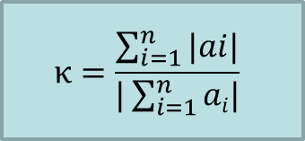
Preview of Results
Varying к and Exp. Range = 32, Set Size = 100
$$κ=\frac{\sum_{i=1}^{n}{|ai|}}{|\sum_{i=1}^{n}{ai|}}$$
Number of LSBs in Mantissa in Error
(Compared with infinite precision)
Exp. Range | к | Red. Ckt. | AECSA | AEC | EPRC80 | EPRC128
32 | 10.0 | 1.6 | 0 | 0 | 0 | 0
32 | 95.0 | 3.5 | 0.3 | 0.3 | 0.2 | 0.2
32 | 800.0 | 4.2 | 0.7 | 0.6 | 0.3 | 0.3
32 | 1600.0 | 7.7 | 0.9 | 0.7 | 0.4 | 0.4
32 | 6000.0 | 7.9 | 1.4 | 1.1 | 1.1 | 0.9
32 | 11000.0 | 8.3 | 2.5 | 1.6 | 1.4 | 1.4
ReConFig 2013 Ph.D. Forum 11

