Slide 1



High-Level Synthesis of a Genomic Database Search Engine
Rasha Karakchi, Jordan Bradshaw, Jason D. Bakos
This material is based upon work supported by the National Science Foundation under Grant No. 1421059.
Heterogeneous and Reconfigurable Computing Group

Slide 2

Motivation
Genomic databases large and growing fast
NCBI BLAST widely used for database search
Must scan perform entire database for each query
I/O (disk) bound
Query
Downstream processing
Database
Database’
kernel

Slide 3
Background
BLAST Filter:
1) Decompose query
2) Identify seeds
AACBBAV
AAC
ACB
CBB
BBA
BAV
3) Identify High Scoring Pairs (HSPs):
AAC
ACB
CBB
BBA
BAV
4) Look for HSPs of the same total length in each DB record
Existing FPGA implementations are direct implementations of software

Slide 4
Our Approach
Database
Preprocess
BRAM
DRAM
Disk
Pattern match: HSPs
Indices of likely matches
Downstream processing
Query
FPGA+DRAM
CPU+disk

Slide 5
Filter Design
Index
(List of HSPs in database)
Table of Contents
Suffix Table
HSP / Length | Start | Length
ACBC-8 | 0 | 1
ACCV-9 | 1 | 1
CBBC-6 | 2 | 1
CBCV-7 | 3 | 1
Record | Start
0 | 2
0 | 2
0 | 4
0 | 4
 | AC | BC | CB | CV
AC | 0 | 1 | 0 | 1
BC | 0 | 0 | 0 | 0
CB | 0 | 1 | 0 | 1
CV | 0 | 0 | 0 | 0
Disk
(10X size of DB)
On-chip
(1 Mb)
DRAM
(160 MB)

Slide 6
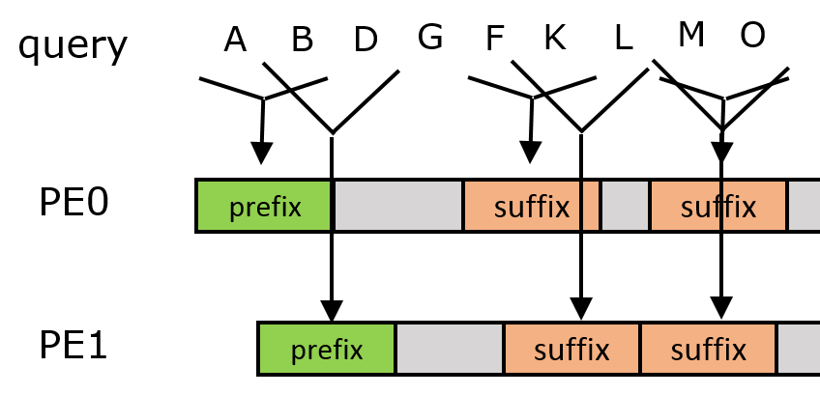
Filter Design
Synthesized with Vivado HLS
Multiple PEs
When found, schedule access to DRAM
All PEs together synthesized as single pipeline
Performs at WCET
Detects HSP patterns within fixed windows

Slide 7
Results
FPGA Performance
# PEs | II | Pipeline Depth | Throughput (Mchars/s)
12 | 12 | 40 | 9.2
16 | 16 | 44 | 8.4
20 | 20 | 48 | 7.7
24 | 24 | 52 | 7.1
28 | 28 | 56 | 6.6
32 | 32 | 60 | 6.2
36 | 36 | 64 | 5.8
40 | 40 | 68 | 5.4
44 | 44 | 72 | 5.1
CPU Baseline Performance
Threads | upper bound Thrp't. (Mc/s) | lower bound Thrp't. (Mc/s)
1 | 8.7 | 2.4
2 | 11.5 | 3.9
3 | 8.3 | 4.6
4 | 7.0 | 4.6
5 | 6.1 | 3.7
6 | 5.0 | 3.6
7 | 4.7 | 3.4
8 | 4.2 | 3.1
Faster for high-hit rate queries despite having less than half DRAM b/w

Slide 8
Thank you!
See our poster in the next poster session

