Slide 1
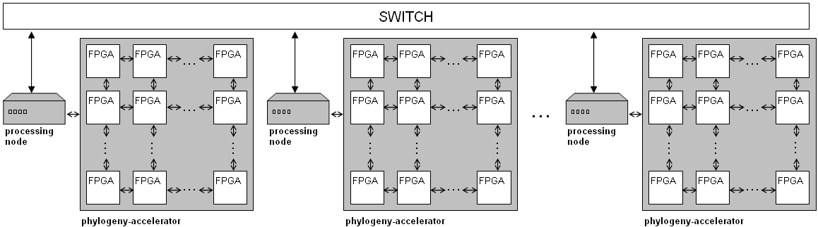
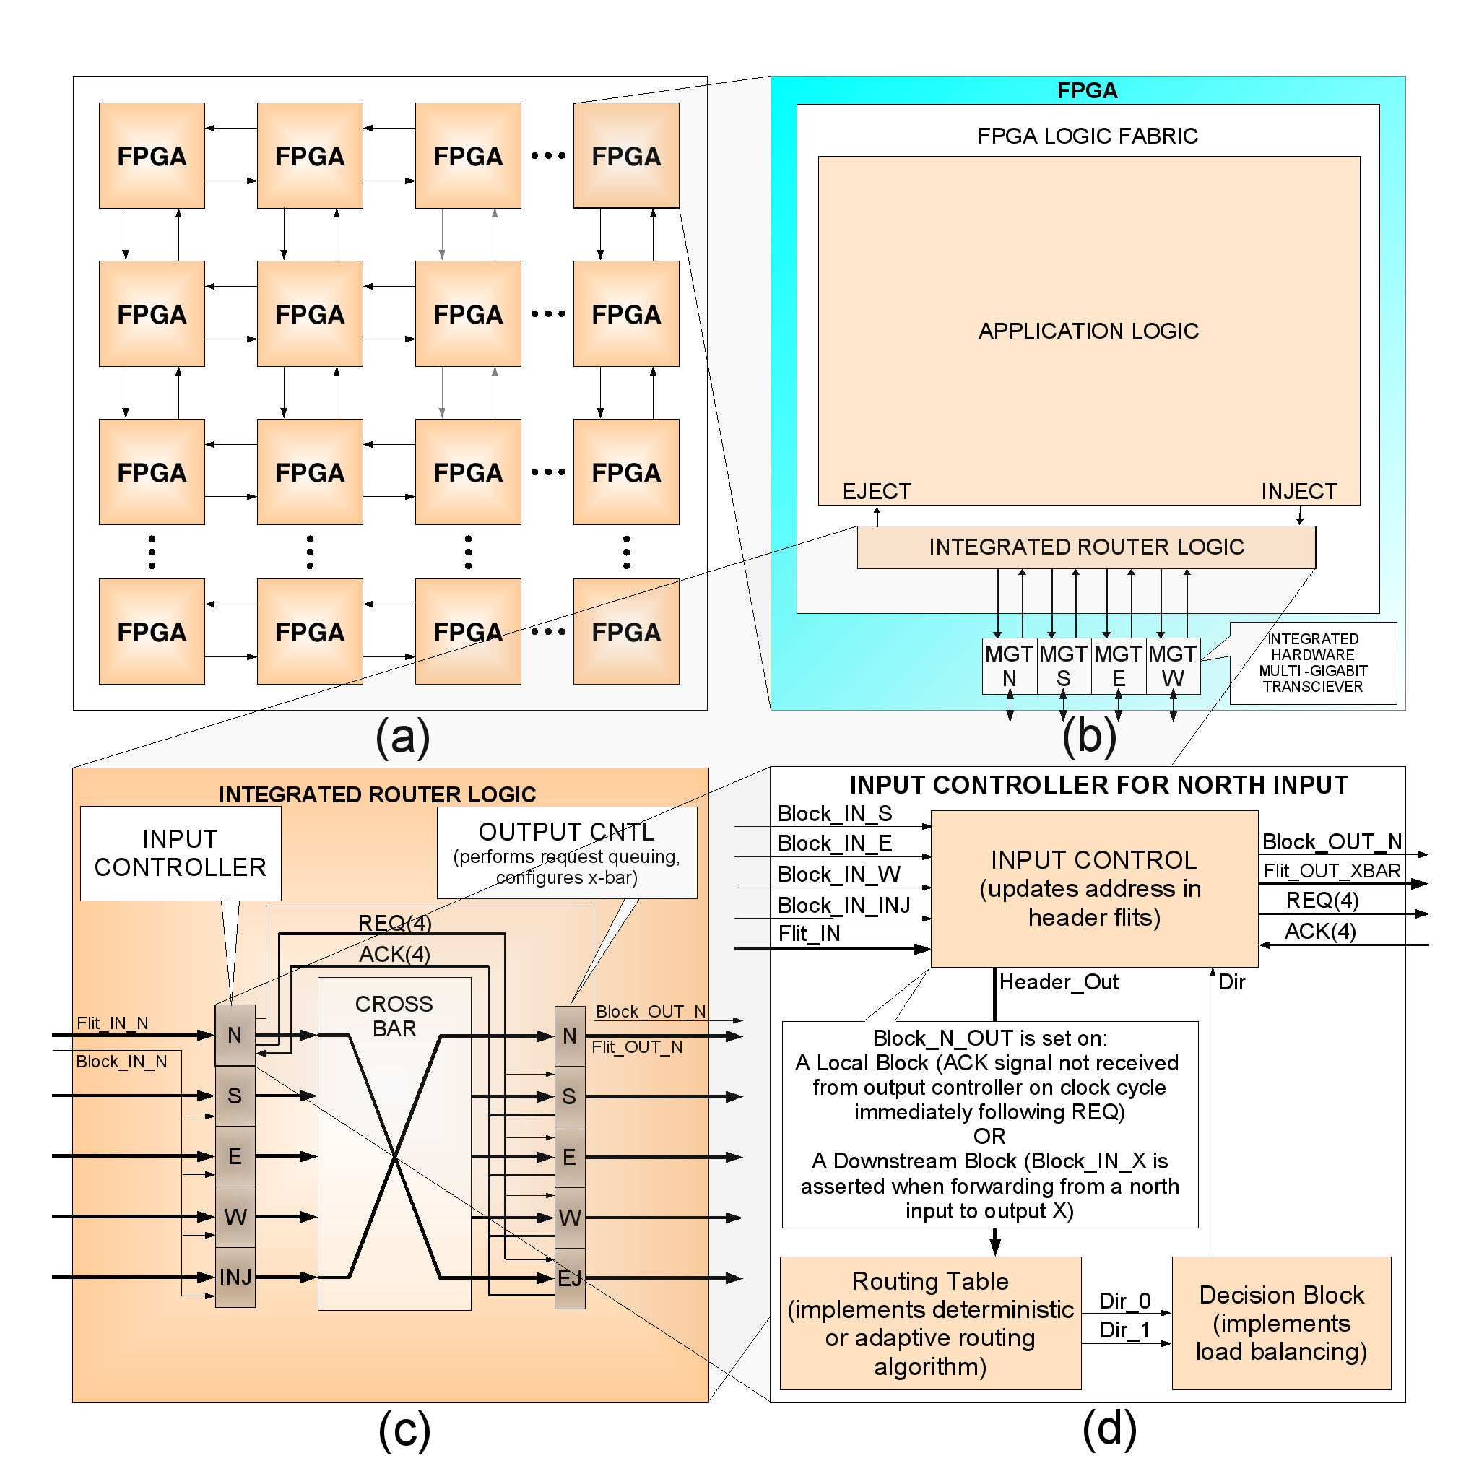
High-Performance Reconfigurable Computing
Multi-FPGA architectures
  Interconnecting FPGA devices using a high-speed serialized micro-network
  Advantages:
    General-purpose
    Scalable
    High-performance (supercomputer-class computational throughput)
    High-efficiency (cost, power, volume)
Current work:
  Novel routing and mapping techniques
  Development of standardized network interface
  Lightweight integrated router designs
  Signal error recovery for chip-to-chip channels
  Application implementation:
    Combinatorial optimization algorithms for bioinformatics
    Accurate phylogenetic reconstruction

