Slide 1
Reconfigurable Computing in the Undergraduate Curriculum
Jason D. Bakos
Dept. of Computer Science and Engineering
University of South Carolina

Slide 2
Our Courses
CSCE 611: Advanced Digital Design
  My course
  Behavioral design with VHDL
CSCE 313: Embedded Systems Design
  Gang Quan’s course
  Use EDK and XUP boards to design embedded systems
CSCE 491: Capstone System Design
  Rotating instructors
  Use XUP boards to design something
  Last Fall I used System Generator for DSP to design active noise cancelation system

Slide 3
Course Goals
CSCE 611: Advanced Digital Design
Teach students:
  design methodology
    design automation
    design flow
    design hierarchy
    simulation, verification, test benching
  computer architecture
    design and verify an actual computer system
    explore design trade-offs through implementation
  Industry-standard CAD tools
    Mentor FPGA Advantage, Xilinx ISE
  FPGA design

Slide 4
Course Goals
More specifically:
  Manage design complexity of large-scale digital systems
    VHDL
    Graphical design for VHDL generation
  Microarchitecture design
    MIPS instruction set architecture / assembly language programming
    MIPS CPU architecture
    Memory hierarchy, cache
    Bus functional models / memory interface design
    Exceptions and interrupts

Slide 5
Course Outline
Class times divided between lectures and supervised lab
Tutorials used to teach the tools and design flow
  Yields the ALU design
Projects:
  ALU testbench design
  Multi-cycle CPU design
    tested against testbench provided by instructor
  Memory interface and bus design
    tested against memory model containing significant comprehensive test program
  Test processor on FPGA
  Pipelined CPU, I/D cache, testbenches, synthesis and test
Originally used Annapolis FPGA PCI card with off-chip DRAM
Currently working on new design flow:
  integrate student processor into EDK
  target XUP system
  develop software framework (drivers, MIPS cross-gcc, etc.)
  debug with ChipScope

Slide 6
Future Course
Extend processor design:
  FP units
  out-of-order execution
CMP and Level-2 cache
Run parallelized code and performance testing

Slide 7
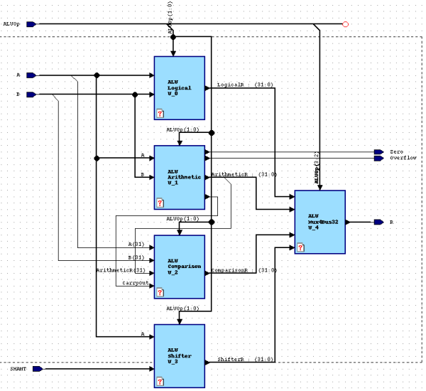
FPGA Advantage

Slide 8
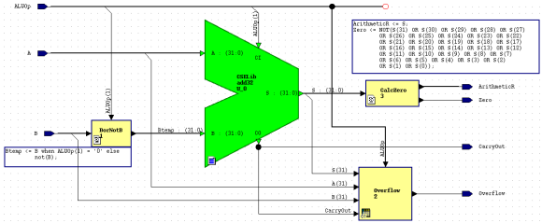
FPGA Advantage

Slide 9
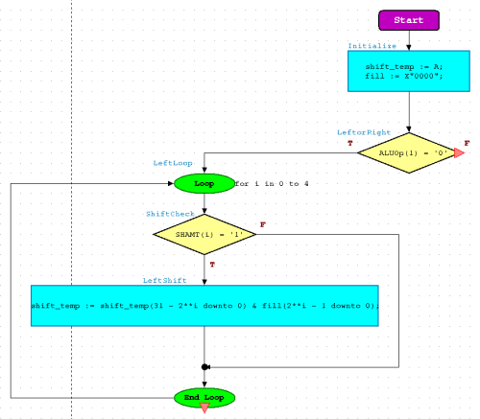
FPGA Advantage

Slide 10
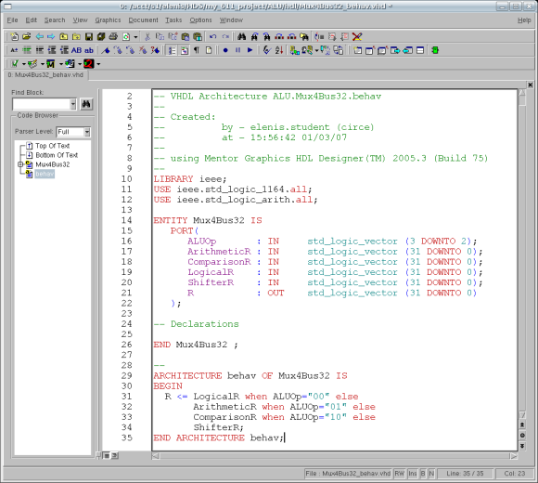
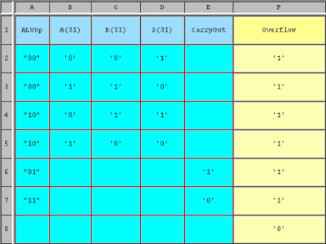
FPGA Advantage

Slide 11
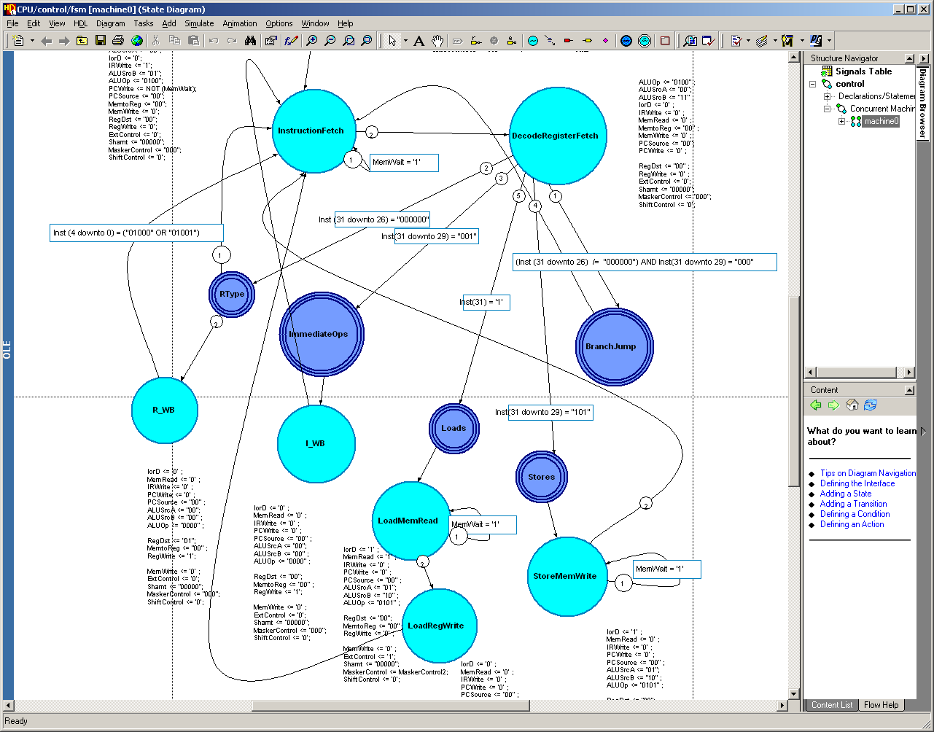
FPGA Advantage

