Slide 1

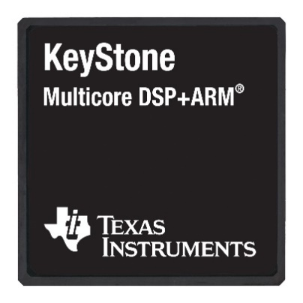

Carving New Niches for Keystone: Research in General Purpose DSP Computing at the University of South Carolina
Jason D. Bakos, Konstantin Rubin
Former students: Fan Zhang (Ph.D. 2014), Yang Gao (Ph.D. 2014)
Shaun Gause (M.S. 2013)

Slide 2
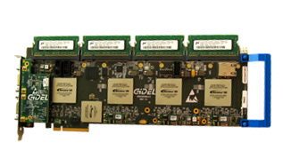
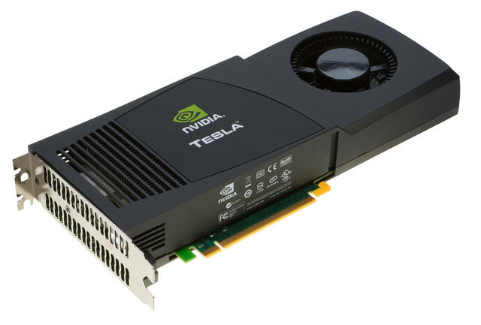
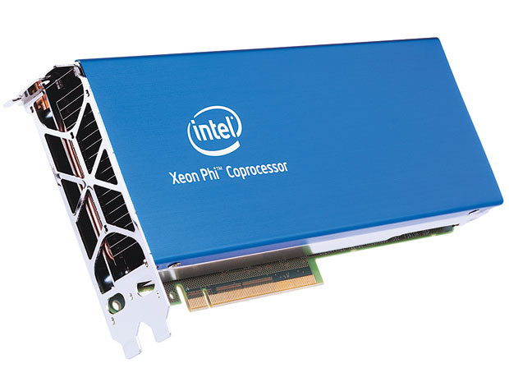
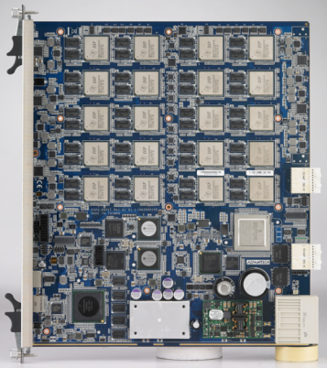
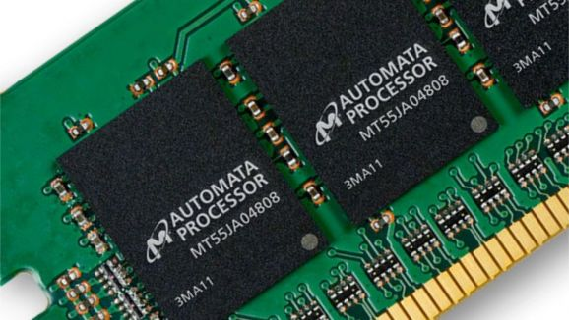
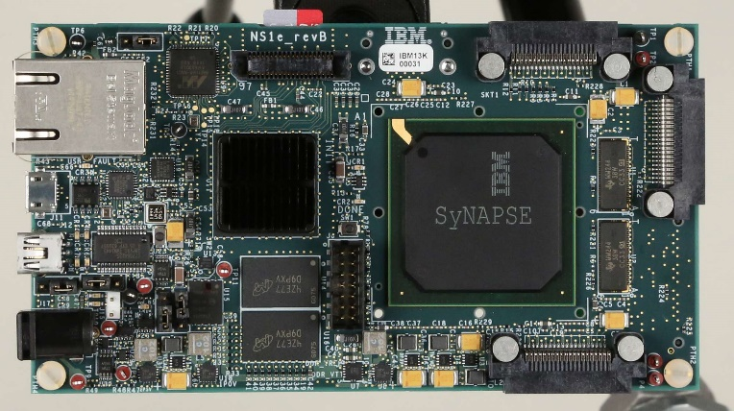
Heterogeneous and Reconfigurable Computing Lab
FPGAs:
Manycore/GPU:
DSP:
Automata Processor:
Neurosynaptic Processor

Slide 3
Heterogeneous and Reconfigurable Computing Group
Despite Moore’s Law, CPU performance has been stalled for >10 years…
Last five Intel desktop CPU “ticks” (shrinks):
Processor Generation | Feature size (nm) | Transistors (millions)
Core (2006) | 65 | 105
Penryn (2007) | 45 | 228 (X2.2)
Westmere (2010) | 32 | 382 (X1.7)
Ivy Bridge (2013) | 22 | 624 (X1.6)
Broadwell (2015) | 14 | 1300 (X2.1)
Max. Clock Speed (GHz) | Max. Numberof Cores | Max. RAM Bandwidth (GB/s) | Max. Peak Floating Point (Gflop/s) | Max. L3 cache (MB)
3.33 | 4 | 25.6 | 107 | 8
3.33 (+0%) | 4 (+0%) | 25.6 (+0%) | 107 (+0%) | 8 (+0%)
3.60 (+8%) | 6 (+50%) | 25.6 (+0%) | 173 (+62%) | 12 (+50%)
3.70 (+3%) | 6 (+0%) | 25.6 (+0%) | 355 (+105%) | 15 (+25%)
3.80 (+3%) | 6 (+0%) | 25.6 (+0%) | 365 (+3%) | 30 (X2)
Cannonlake (2017) | 10 | 2600 (X2?)
?? (2019) | 7 | 5200 (X2?)
?? (2021) | 5 | 10400 (X2?)

Slide 4


New Capabilities
What about iPhone 6s 4K video?
What about XBox One graphics?

Slide 5
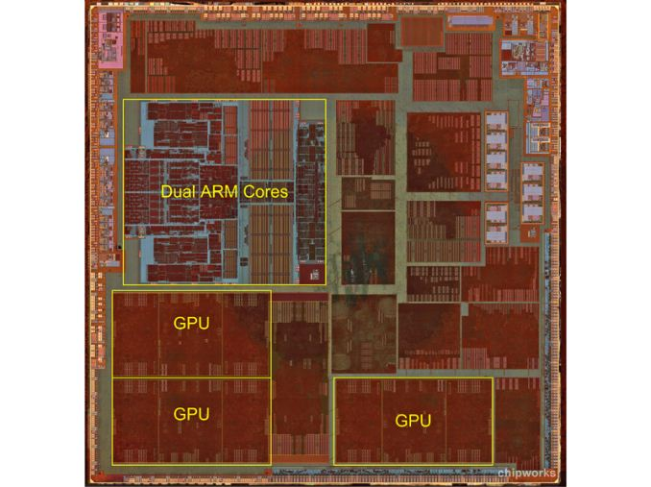
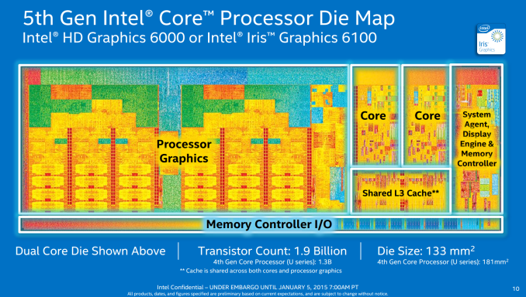
All Modern CPUs are SoC/Heterogeneous
Intel Broadwell
Apple A6

Slide 6
Keystone vs. Other Processors
 | NVIDIA Tesla K20X GPU 28 nm | Intel Xeon Phi 5110p 22 nm | Intel i7 Ivy Bridge 22 nm | NVIDIA Tegra TK1 28 nm | Keystone 1/2 45/28 nm | Imagination PowerVR G6430 (Apple A7) 28 nm | Intel i3 Ivy Bridge 22 nm
Peak single precision throughput | 3.95 Tflops | 2.12 Tflops | 365 Gflops | 331 Gflops @ 864 MHz | 160 Gflops @ 1.25 GHz | 115.2 Gflops | 42 Gflops
TDP | 225 W | 225 W | 77 W | 25+ W ? | 10 W | ? | 55 W
DRAM bandwidth | 250 GB/s | 320 GB/s | 25.6 GB/s Dual Channel DDR3 | 17.1 GB/s Single Channel DDR3 | 12.8 GB/s Single Channel DDR3 | 12.8-14.9 GB/s Single Channel DDR3 | 25.6 GB/s Dual Channel DDR3
Ideal power efficiency | 17.6 Gflops/ Watt | 9.4 Gflops/ Watt | 4.7 Gflops/ Watt | 13.2 Gflops/ Watt | 16.0 Gflops/ Watt | ? | < 1 Gflops/ Watt

Slide 7
Keystone Applications
Kernels that scales well against compute or bandwidth bound; cannot compete against GPUs:
Dense Linear Algebra
Spectral Methods
Dynamic Programming
Not (generally) floating point (speculative superscalar):
MapReduce
Combinational Logic
Graph Traversal
Backtrack and Branch-and-Bound
Graphical Models
Finite State Machines
“Low efficiency” floating point kernels (keystone possibly a contender)
Sparse Linear Algebra (does well with pipelined parallelism and hardware addressing capabilities)
N-Body Methods (fast multipole, same as above)
Unstructured Grids (same as above)
Structured Grids / STENCILS (due to flexibility of on-chip memory; scratchpad better than cache)

Slide 8
Outline
Main practical challenges of Keystone:
Code optimizations to avoid loop disqualification, minimize loop II, use SIMD
On-chip memory allocation and management
Optimizing inter-core communication
Talk outline:
Sparse matrix-vector mutliply (SpMV)
Automated scratchpad allocation
Computer vision and optical flow
Domain-specific language for stencils
Automatic tile geometry detection and allocation

Slide 9
Sparse Matrices
Very large (rows,cols) but contain few non-zero elements
<10%, often ~3 elems/row
Compressed Sparse Row (CSR) format:
1 | -1 | 0 | -3 | 0
-2 | 5 | 0 | 0 | 0
0 | 0 | 4 | 6 | 4
-4 | 0 | 2 | 7 | 0
0 | 8 | 0 | 0 | -5
val | (1 | -1 | -3 | -2 | 5 | 4 | 6 | 4 | -4 | 2 | 7 | 8 | -5)
col | (0 | 1 | 3 | 0 | 1 | 2 | 3 | 4 | 0 | 2 | 3 | 1 | 4)
ptr | (0 | 3 | 5 | 8 | 11 | 13)
Notes:
3 arrays, one simple example

Slide 10
Sparse Matrix-Vector Multiply
Code for y = αAx + βy
row = 0
for i = 0 to number_of_nonzero_elements-1 do
if i == ptr[row+1] then row=row+1, y[row]*=beta;
y[row] += alpha * val[i] * x[col[i]]
end
Limited by memory b/w: 3 flops for ~20 bytes (val, col, x, y, ptr)
Requires at least two cycles per iteration
3 flops per 2 cycles/core, gives upper bound of 14.4 Gflops at 1.2 GHz (<10% utilization)
Conditional disqualifies inner loop
Indirect addressing leads to compiler uncertainty (for symmetric)
Notes:
Indirect indexing: load dependence.
Utilization 6ALU+2L/S
Dependency
Software pipelining

Slide 11
Eliminate If-Statement
Implementation #1:
for i = 0 to number_of_nonzero_elements-1 do
prod[i] = alpha * val[i] * x[col[i]]
end
row = 0
for i = 0 to number_of_nonzero_elements-1 do
if i == ptr[row+1] then row=row+1, y[row]*=beta;
y[row] += prod[i]
end
Implementation #2:
for i = 0 to num_rows-1 do
for j = ptr[i] to ptr[i+1]-1 do
y[row] += alpha * val[j] * x[col[j]]
end
end

Slide 12
Performance Results

Slide 13
Testing Platforms
 | Intel i7 3770K MKL | NVIDIA GTX 680 cuSparse | NVIDIA Tegra TK1 cuSparse | TI 6638K2K
Arch | Ivy Bridge | Kepler | Kepler | KeyStone II
Memory B/W(GB/s) | 25.6 | 192.3 | 17.1 | 12.8
SPRAM KB/core | n/a | 64/64¹ | 64/64¹ | 32/1024/768²
Single Precision Peak Throughput (Gflops) | 448 | 3090 | 365 | @1.35GHz 172.8(DSP) 44.8(ARM)
TDP(W) | 77 | 195 | ~25 | ~15
Register file/allocable share memory or L1
L1 SRAM / L2 SRAM / MSMC per core
Notes:
Very different in M/B and performance

Slide 14
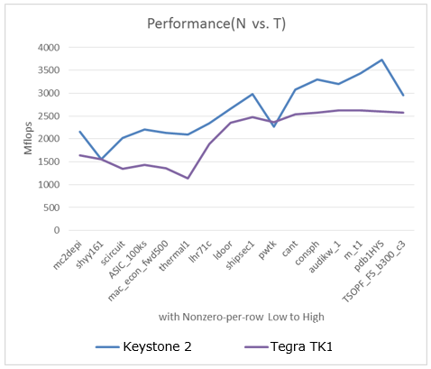
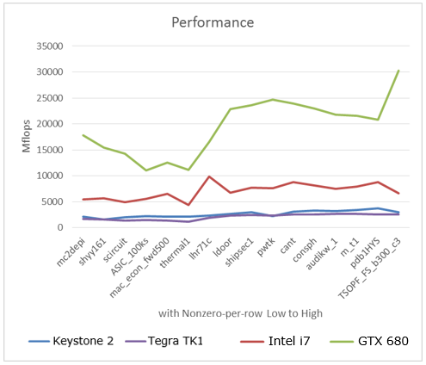
Performance Comparison

Slide 15
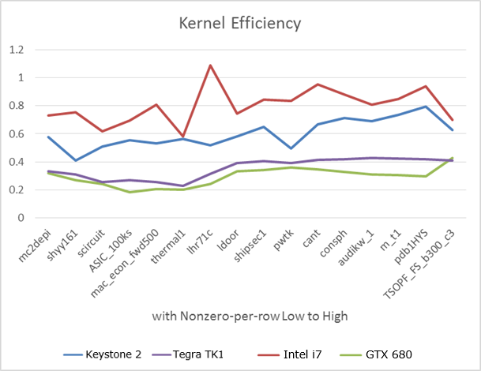


Efficiency
$$AI=\frac{3×nnz+2×rows flops}{8×nnz+12×rows+4×cols}$$
$$efficiency=\frac{observed performance}{AI∙peak bandwidth}$$

Slide 16
Symmetric SpMV
A
B
A is on the diagonal, does not have the image
for (i = 0; i < number_of_rows_per_core; i++)
{
for(j = ptr[i]; j < ptr[i+1]; j++)
{
y[i] += val[j]*x[col[j]];
if(i != col[j]) // if not on diagonal
y[col[j]] += val[j] * x[i];
}
}
+2 flops/iteration (poss. requires x and y access)
Bimage

Slide 17
Symmetric SpMV
for (i = 0; i < number_of_rows_per_core; i++)
{
for(j = ptr[i]; j < ptr[i+1]; j++)
{
y[i] += val[j]*x[col[j]];
if(i != col[j]) // if not on diagonal
y[col[j]] += val[j] * x[i];
}
}
false inner-loop dependency

Slide 18
Symmetric SpMV
for (i = 0; i < number_of_rows_per_core; i++)
{
for(j = ptr[i]; j < ptr[i+1]; j++)
{
y[i] += val[j]*x[col[j]];
if(i != col[j]) // if not on diagonal
y_alias[col[j]] += val[j] * x[i];
}
}

Slide 19
Symmetric SpMV
for (i = 0; i < number_of_rows_per_core; i++)
{
for(j = ptr[i]; j < ptr[i+1]; j++)
{
y[i] += val[j]*x[col[j]];
if(i != col[j]) // if not on diagonal
y_alias[col[j]] += val[j] * x[i];
}
}
loop carried dependency
no way to determine distance between consecutive accesses to y_alias
Causes II to increase from 3 to 17
y[i] += val[j]*x[col[j]];
if(i != col[j]) // if not on diagonal
y_alias[col[j]] += val[j] * x[i];

Slide 20
Multicore Symmetric SpMV
for (i = 0; i < number_of_rows_per_core; i++)
{
for(j = ptr[i]; j < ptr[i+1]; j++)
{
y[i] += val[j]*x[col[j]]; // no conflict, different rows (i’s per core)
if(i != col[j]) //the val is not at the diagonal
lock(y_alias[col[j]]);
y_alias[col[j]] += val[j] * x[i];
unlock(y_alias[col[j]]);
}
}

Slide 21
Lock?
void lock(volatile __global int* locks_array, int lock_id)
{
while (*((volatile unsigned int *)(SEM_DIRECT)+lock_id)!=1);
}
void unlock(volatile __global int* locks_array, int lock_id)
{
__mfence(); // complete transactions to y-array
*((volatile unsigned int *)(SEM_DIRECT)+lock_id)=1;
}
requires >49 cycles
requires ~3 cycles

Slide 22
Non-Locking Approach
Each core maintains local copy of Y on L2S without locks
Barrier after loop: use hardware semaphores to impl. multi-workgroup barrier
Setup global pointers to other core’s L2S
for (i=0;i<cores;i++) y_dsp[i]=0x10820000 + 0x1000000*i;
y_dsp[global_id]=0x820000;
Add local copies of Y into final value in parallel
for (i = row_offset; i < row_limit; i++)
for (j=0;j<cores;j++) y_global[i] += y_dsp[j][i];
Saturated on-chip network

Slide 23
Tiled Approach
Pre-process CSR to decompose matrix into 36 tiles
Each tile is processed exclusively among the 7 to 14 other tiles on the same row and col
Perform dynamic workload balancing
Track tile state in shared memory

Slide 24
Performance Results
Matrix | Obs. performance: Nonsymmetric | Obs. performance: locking imp. | Obs. performance: nonlocking imp. | Obs. Performance: tiled imp.
pdb1HYS | 3.06 Gflops | 15.5 Mflops | 145.9 Mflops | 2.1 Gflops
m_t1 | 3.36 Gflops | 15.3 Mflops | 147.8 Mflops | 2.0 Gflops
Consph | 2.82 Gflops | 15.0 Mflops | 134.2 Mflops | 2.0 Gflops
Cant | 3.29 Gflops | 15.3 Mflops | 136.7 Mflops | 2.2 Gflops
pwtk | 3.20 Gflops | 15.6 Mflops | Not enough L2 SP memory | 2.1 Gflops

Slide 25
Conclusions
SpMV on Keystone beats Tegra
Despite Tegra having more b/w (17.1 GB/s vs 12.8 GB/s)
Keystone can achieve higher memory efficiency
Room for improvement, especially for symmetric SpMV
Need to find way to deal with indirectly-addessed l-value
Specialized data structures are necessary and their cost can be offset in many applications

Slide 26
Memory Allocation: Empirical Testing
SpMV: 5 arrays
val, col, ptr, y, prod
4 allocation targets
L1S, L2S, MSMC, cache
4⁵=1024 possible configurations
Non-zeros per row | val | col | ptr | y | prod | Gflops | Norm. Perf | Note
3 | S S L2 C | L2 L2 L2 C | L2 L2 C C | L2 L2 C C | L1 L2 S C | 2.26 1.84 1.23 1.44 | 1.57 1.28 0.85 1 | Best Median Worst² All cache
151 | L2 S C C | S C C C | L2 L2 C C | L2 L2 C C | L2 S L2 C | 3.76 3.55 2.66 2.51 | 1.50 1.41 1.06 1 | Best Median Worst² All cache
L1: level 1 SPRAM, L2:level 2 SPRAM, S:MSMC, C:cache
1: The results are normalized to the all cache configuration
2: The worst amongst the configurations with SPRAM
Notes:
Matrix: synthetic matrix, dense and sparse
Variance, mapping is important
Cache is not worst.
Not the kernel, the input data is also important

Slide 27
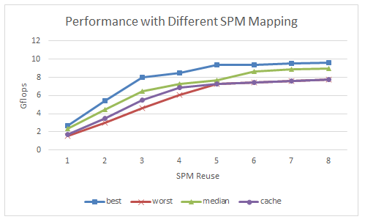
Allocation: Empirical Testing
float op2 (void * restrict input1,
void * restrict input1,
int cnt, int offset1, int offset2) {
int i;
float accu=0;
_nassert((int)cnt%8==0);
_nassert((int)input1%8==0);
_nassert((int)input2%8==0);
for (i=0;i<cnt;i++)
acct += input1[i+offset1]*array2[i+offset2];
return accu;
}
array1 and array2 => {L2S, MSMC, cache}
9 combinations

Slide 28
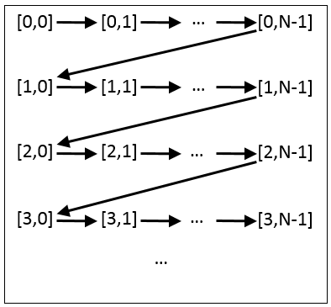
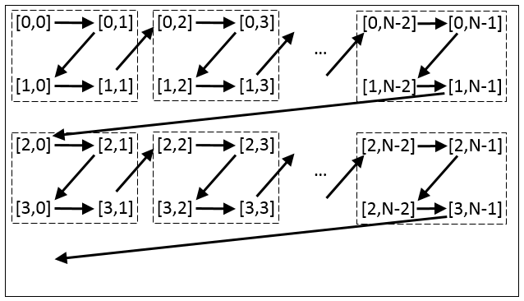
Guided Scratchpad Allocation?
Use existing polyhedral tools to tile affine loops (PLUTO):
for (i=0;i<N;i++) for (j=0;j<N;j++) C[i,j] = …
for (i=0;i<N;i+=2) for (j=0;j<N;j+=2) for (ii=i;i<min(i+2,N);i++) for (jj=j;jj<min(j+2,N);jj++) C[ii,jj] = …

Slide 29
Performance Model
Intelligent allocation requires performance model
Must reconcile uncertainties the the SoC:
Effective DRAM bandwidth depends on contention among cores and DMA controllers
Cache performance (miss rate) under a given access pattern
Prefetch performance under a given access pattern
Also, assume simplistic allocation:
L2S, MSMC, L1D cache only

Slide 30
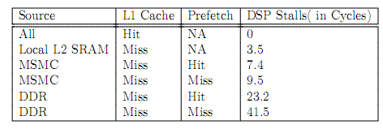
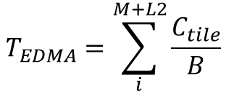

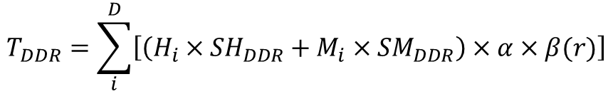
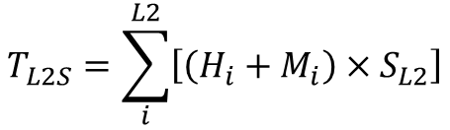
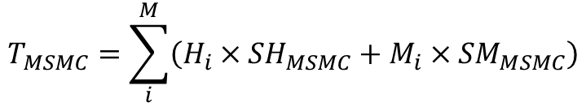
Performance Model
Model construction:
$$T_{all}=T_{compute}+T_{EDMA}$$
Run sampling runs and collect XMC counters for each array
$$T_{compute}=T_{pure}+T_{MSMC}+T_{L2S}+T_{DDR}$$
Data from datasheet:
$$T_{MSMC}=\sum_{i}^{M}{\left(H_{i}×{SH}_{MSMC}+M_{i}×{SM}_{MSMC}\right)}$$
$$T_{L2S}=\sum_{i}^{L2}{\left[\left(H_{i}+M_{i}\right)×S_{L2}\right]}$$
$$T_{DDR}=\sum_{i}^{D}{\left[\left(H_{i}×{SH}_{DDR}+M_{i}×{SM}_{DDR}\right)×α×β(r)\right]}$$
Use microbenchmark to measure effective DRAM b/w through cache under core contention as a function of references per iteration
$$T_{EDMA}=\sum_{i}^{M+L2}{\frac{C_{tile}}{B}}$$
Use microbenchmark to measure eff. EDMA b/w as a function of cache/DMA throughput ratio
Use microbenchmark to determine tile size to equalize EDMA/compute

Slide 31
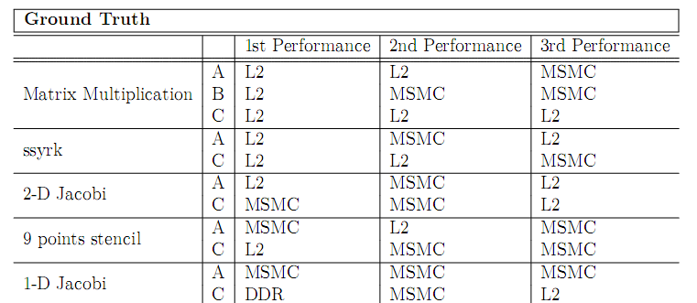
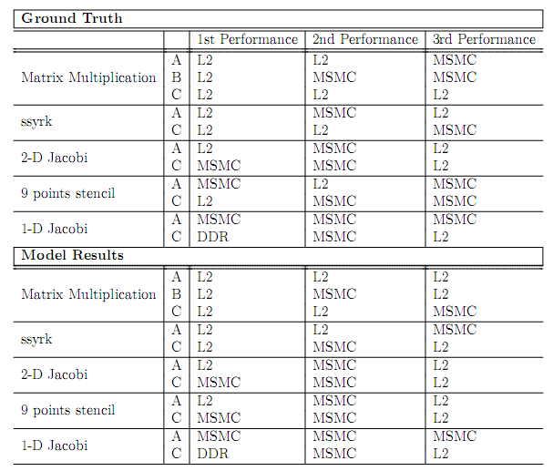
Best Mappings

Slide 32
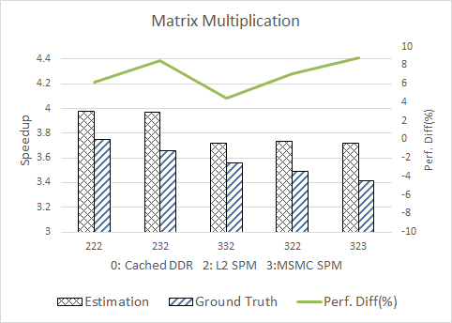
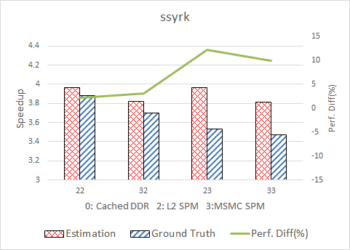
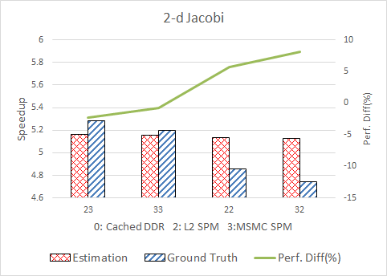
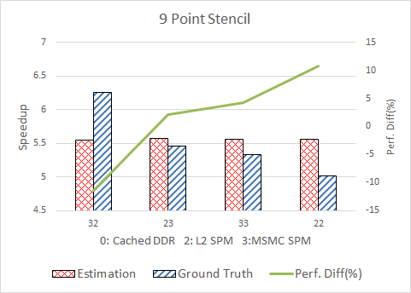
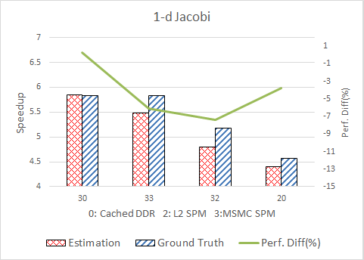
Speed-up Over Cache

Slide 33
Conclusions
Allocation can make a substantial performance impact
Not practical for the programmer to do this manually

Slide 34
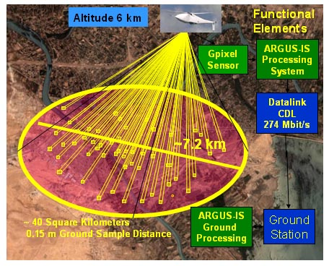
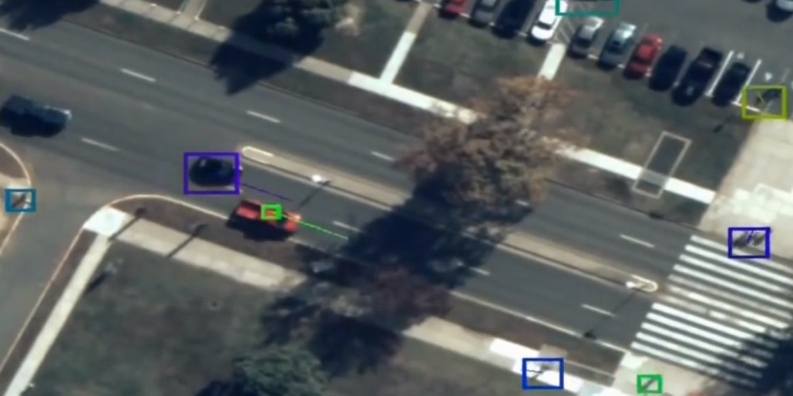
Computer Vision Kernels
Fun exercise:
ARGUS-IS is 1.8 Gpixels @ 15 fps
Assuming perfect scalability for our implementation => 2.7 Tflops, 6.8 KW
Global Hawk UAV generator produces 17.5 KW of electrical power

Slide 35



Gradient-Based Optical Flow Solver
.
.
Optical flow evaluation
First-order approximation
(x, y, t)
(x + Δx, y + Δ y, t + Δt)
Frame t
Frame t + Δt
Gradient of pixel in x, y and t dimension, known
Optical flow, unknown

Slide 36
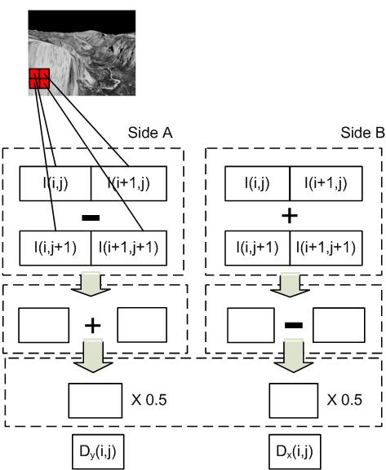
Image Derivative Computation
A
B
(A – B + C – D) / 2
C
D
Derivative Computation (Dx, Dy)
frame n
-10 | 10 | 0
-10 | 10 | 0
0 | 0 | 0
-10 | -10 | 0
10 | 10 | 0
0 | 0 | 0
A
B
(A – C + B – D) / 2
C
D
frame n
Interleave
-10 | -10 | 10 | -10 | 0 | 0
-10 | 10 | 10 | 10 | 0 | 0
0 | 0 | 0 | 0 | 0 | 0
A
B
A - B
frame n
frame n+1
36

Slide 37
Lucas Kanade Method
If we assume the pixel adjacent to the center has the same optical flow as the center
x-1,y-1 | x,y-1 | x+1,y-1
x-1,y | x,y | x+1,y
x-1,y+1 | x,y+1 | x+1,y+1
Let
Least Square Method

Slide 38
Least Square Method
Required computations
Dx
Dy
Dt
Multiplication x 5
DxDx
DxDy
DyDy
DxDt
DyDt
Accumulation x 5
Map to device
Dx
Dy
Dt
Dt
Complex Mul
2-way SIMD Mul
DxDy
-DyDy
DxDt
DyDt
DyDx
DxDx
(a+bj)(c+dj) = (ac-bd) + (ad+bc)j

Slide 39
Loop Flattening
Flatten small 2D loop nests to improve impact of pipelinining
for (i = 0; i < m; ++i)
for (j = 0; j < n; ++j)
for (k = 0; k < m * n; ++k)
…
Update i, j;
j = 0
j = 1
j = 0
j = 1
Pipeline prologue/epilogue overhead

Slide 40
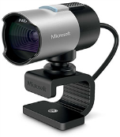
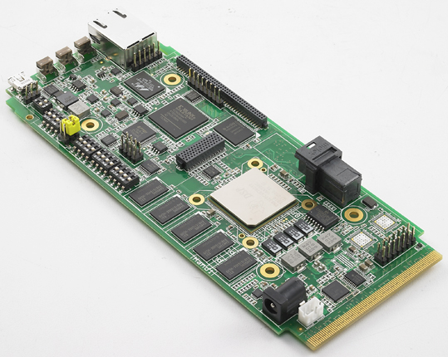
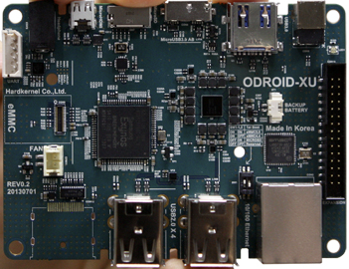
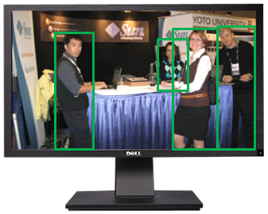
Platform
TMS320C6678
EVM
ODROID
Exynos 5
USB/
jpeg
1GbE/
jpeg,
tracks
HDMI
GPU
JPEG decoding
Software
JPEG decoding

Slide 41
Results and Analysis
Platform | #Cores | Implementation | Power Measurement
TI C6678 DSP | 8 | Our Implementation | TI GPIO-USB Module
ARM Cortex A9 | 2 | Our Implementation | YOKOGAWA WT500 Power Analyzer
Intel i7-2600 | 4 | Our Implementation | Intel RAPL
Tesla K20 GPU | 2688 | OpenCV | NVIDIA SMI
Platform | C66x | CortexA9 | Intel i7-2600 | K20
Actual Gflops/ Peak Gflops | 12% | 7% | 4% | 3%
Gflops | 15.4 | 0.7 | 17.1 | 108.6
Power (W) | 5.7 | 4.8 | 52.5 | 79.0
Gflops/W | 2.69 | 0.2 | 0.3 | 1.4

Slide 42
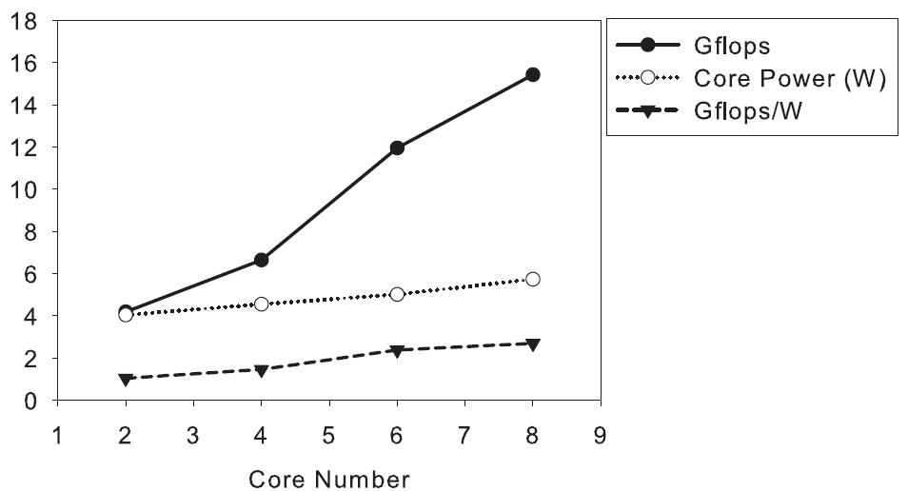
Results and Analysis

Slide 43
Conclusions
Again we achieved higher efficiency than GPU
Keystone might be better suited for embedded computer vision than supercomputing
Keystone needs better dynamic power management

Slide 44

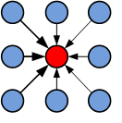

Stencil Loop/Structured Grids
Performed on arrays, matrices or multi-dimensional grids
Update array elements from their neighbors
Input
3
6
9
6
3
B[i] =(A[i-1] + A[i] + A[i+1]) / 3
3 point mean filter
Output
6
7
6
1D horizontal
(A)
1D vertical
(B)
2D
(C)

Slide 45
Motivation
Loop tuning is time-consuming and requires specialized knowledge to the DSP’s hardware architecture
Loop tuning often gives significant performance improvement
 | Code size, DSP C code, #lines |  | Speed up
 | Naïve | Optimized
Mean Filter | 6 | 140 | 3.1x
Gaussian | 18 | 108 | 2.8x
Harris Corner | 20 | 98 | 4.4x
Examples from our previous research on TI C66x DSP

Slide 46
Benchmarks
 | Input/output | m/c ratio | Complexity
Matrix Add | 1/1 | 3.0 | Very Low
Mean Filter | 1/1 | 1.3 | Low
Jacobi Kernel | 1/1 | 1.1 | Low
Gaussian Filter | 1/1 | 0.6 | Medium
Sobel Filter | 1/2 | 1.3 | Medium
Harris Corner Detector | 2/1 | 0.4 | Heavy
Lucas Kanade Method | 3/1 | 0.3 | Heavy

Slide 47
Stencil Design Flow on TI C66x DSP
Normal design flow
Our design flow:
C code
Assembly Code
Executable
Manual
Domain Specific Language
LLVM IR
Assembly Code
Executable
Automatic

Slide 48
Position Independent Arithmetic (PIA)
Simpler grammar makes it easier to auto-tune
void matrix_add(float* A, float* B, float* C, int N) {
for (i = 0; i < N; ++i) {
for (j = 0; j < N; ++j) {
C[i * size_x + j] =
A[i * size_x + j] + B[i * size_x + j];
}
}
}
STENCIL(foo)
$t = A[-1,0] * @c1 +
A[0,0] * @c2 +
A[0,1] * @c3;
C = 1.0 / $t;
END
C code
Input
Parameter
Local Variable
STENCIL(matrix_add)
C = A[0,0] + B[0,0];
END
PIA code
Output

Slide 49
PIA
Domain Specific Language
LLVM IR
Assembly Code
Executable
Automatic
Evaluate impact on II from:
Loop unroll factors
SIMD binding (use of SIMD LLVM operations)
Detect unaligned SIMD loads/stores (convert LDNDW to LDDW)

Slide 50
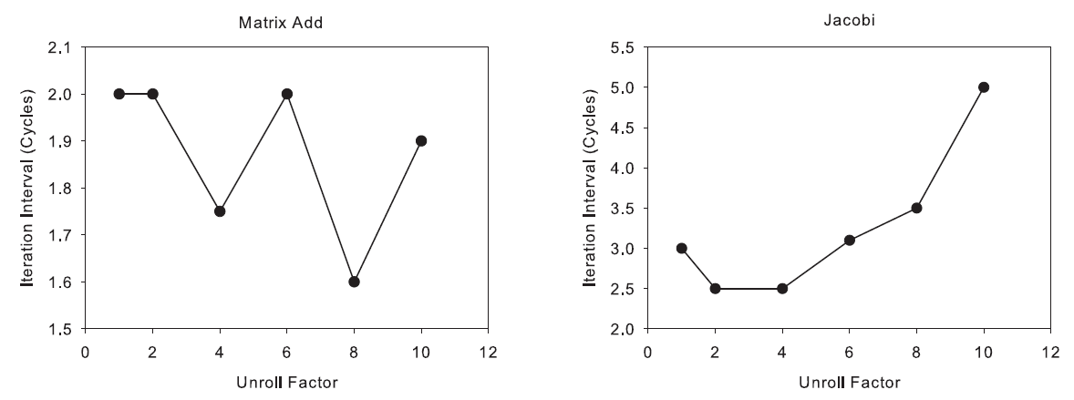
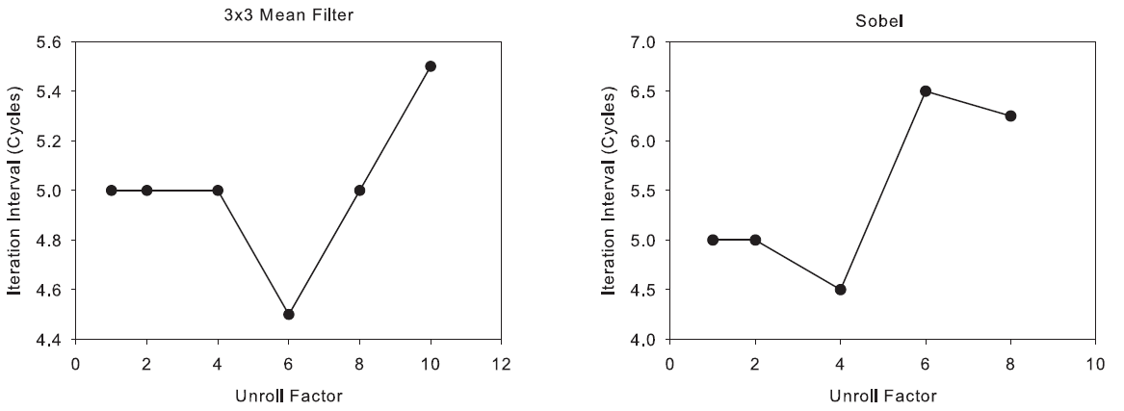
Results of Loop Unrolling

Slide 51
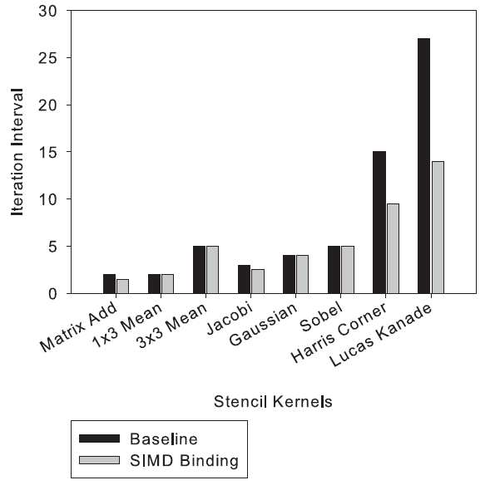
Results of SIMD Binding
Provide up to 2x speed up
More efficient on complex loops

Slide 52
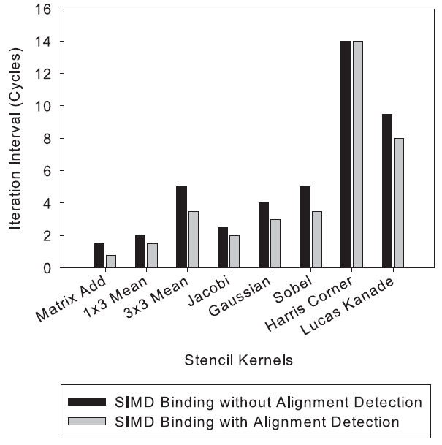
Results of Alignment Detection
Reduce up to 30% of II

Slide 53
Results of Iterative Optimization
 | Baseline II | Optimized II | Strategy
Matrix Add | 2 | 1.5 | Unroll 2x+SIMD
1x3 Mean | 2 | 2
3x3 Mean | 5 | 4.5 | Unroll 6x
Jacobi | 3 | 2.5 | Unroll 2x or 4x
Gaussian | 4 | 4
Sobel | 5 | 4.25 | Unroll 8x
Harris Corner | 27 | 14 | Unroll 2x+SIMD
Lucas Kanade | 15 | 9.5 | Unroll 2x+SIMD

Slide 54
Conclusions
Statically-scheduled architectures make it easy to iteratively refine kernels
DSLs needed to do this

Slide 55



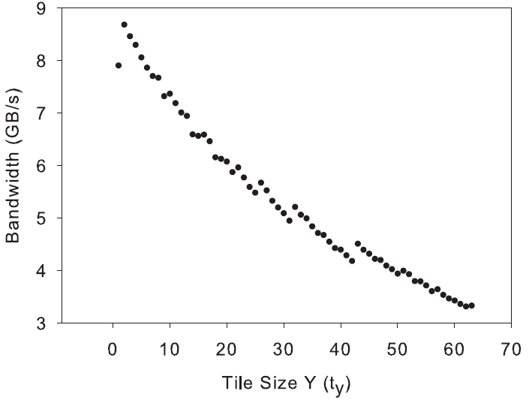
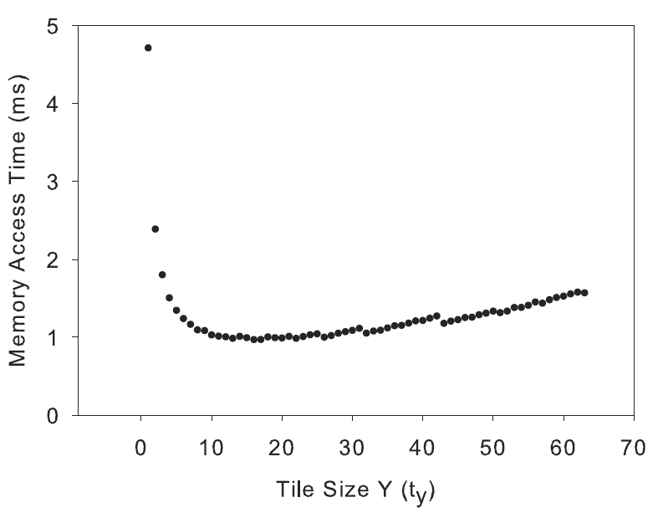
Tiling Geometry Optimization
Best tile geometry?
Narrower tiles (less width) results in lower EDMA bandwidth:
But wider tiles result in more vertical overlap for between tiles:

Slide 56
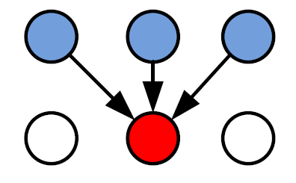
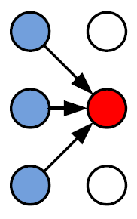
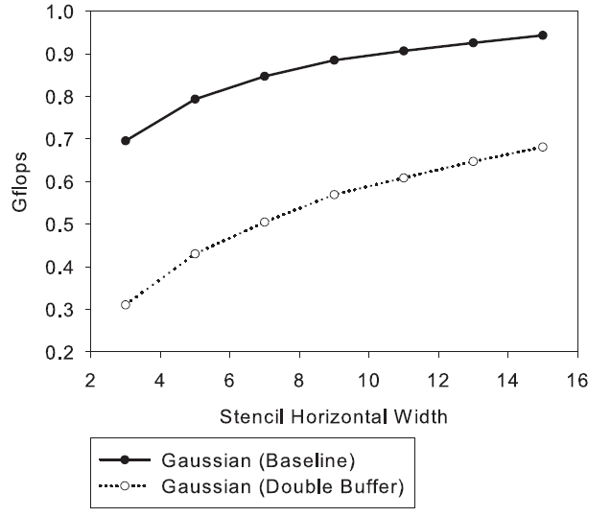
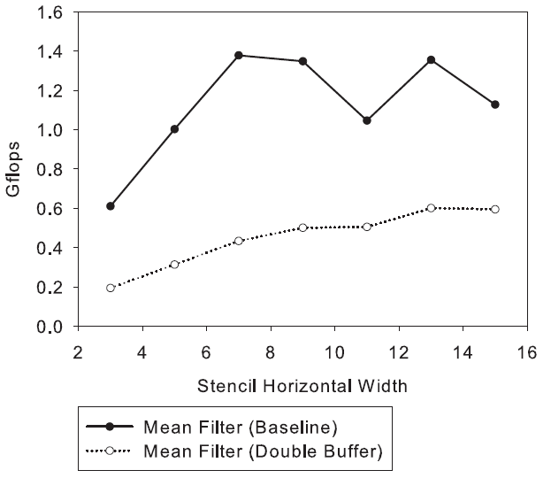
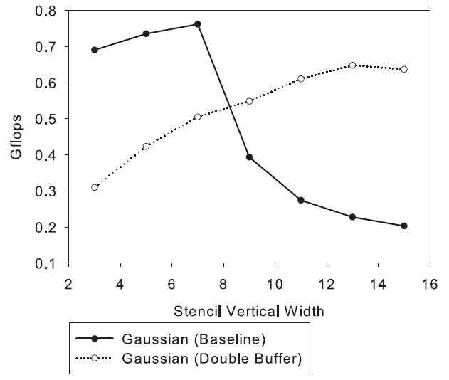
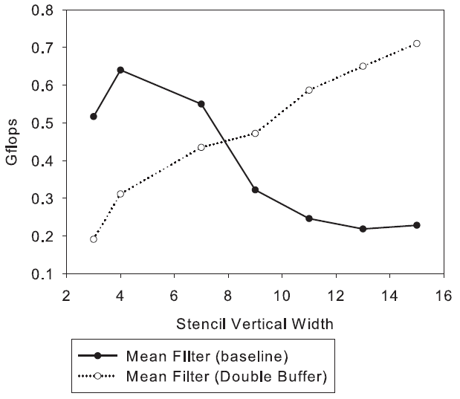
Cache vs. Scratchpad
Horizontal stencils:
Vertical stencils:

Slide 57
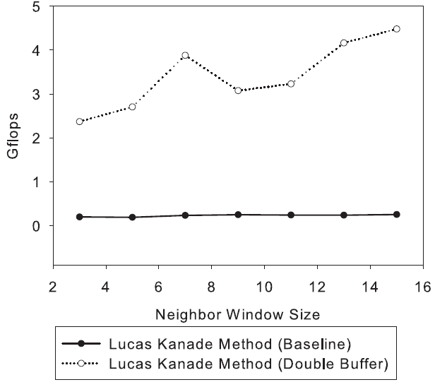
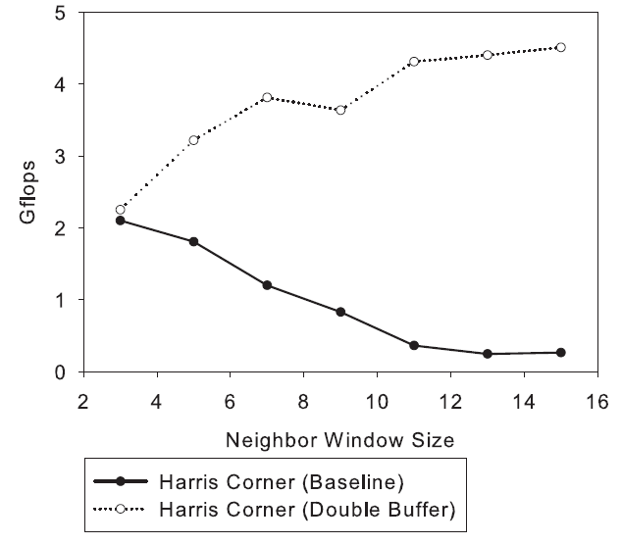
Results of Double Buffer Tiling
Double buffer
Achieves over 10x speed up on complex stencils such as Lucas Kanade and Harris Corner method

Slide 58
Conclusions
Keystone’s cache needs improvement (more associativity)
Until then, complex stencils benefit significantly from intelligenct tile size selection

Slide 59
Conclusions
Loop and memory allocation tuning gives ~50% improvement on memory bound kernels such as SpMV and up to 10X improvement for compute bound kernels such as complex stencils
From software perspective, we need:
Best practices for programmers
Tools for scratchpad allocation and tile sizing
Domain specific languages
From the hardware perspective, we need:
More DRAM bandwidth
Multi-DSP (at least 32 per module) platforms
High-end GPUs have 20X peak performance and DRAM b/w

Slide 60
Thank you

Slide 61
Lock?
void lock(volatile __global int* locks_array, int lock_id)
{
int my_val = 1;
do
{
atom_xchg((volatile __global int*)&locks_array[lock_id], my_val);
}
while (my_val == 1);
}
void unlock(volatile __global int* locks_array, int lock_id)
{
int my_val = 0;
atom_xchg((volatile __global int*)&locks_array[lock_id], my_val);
}

Slide 62

Microbenchmark: Cache B/W
float accu_f3 (void * restrict input1,
void * restrict input2,
void * restrict input3,
int cnt, int t) {
int i,j;
float accu=0;
_nassert ((int)cnt % 8 == 0);
_nassert ((int)input1 % 8 == 0);
_nassert ((int)input2 % 8 == 0);
_nassert ((int)input3 % 8 == 0);
for ( j = 0 ; j < t ; j++)
for ( i = 0 ; i < cnt ; i++)
accu += array1[i] + array2[i] + array3[i];
return accu;
}
For memory intensive (3 words/iteration):
Per-core b/w is 60% when executing on 8 cores vs 1 core

Slide 63


Microbenchmarking: Cache and EDMA B/W
for ( k = 1 ; k <= 100; k++) {
// EDMA load
for ( j = 1 ; j <= n ; j++) {
edma_trans ( l2spm , ddr1 , Sa , DMA_channel) ;
edmaWait4Completion ( 0 ) ;
}
// computation
for ( j = 1 ; j <= m; j++)
fop ( ddr2 , Sb , 1);
}

Slide 64

Microbenchmark: Selecting EDMA Size
for ( k = 1 ; k <= 100; k++) {
// EDMA load
for ( j = 1 ; j <= b ; j++) {
edma_trans ( l2spm , ddr1 , Sa , DMA_channel) ;
edmaWait4Completion ( 0 ) ;
}
// computation
for ( j = 1 ; j <= a ; j++)
fop ( l1spm , Sb , 1);
}

Slide 65

Kernels

Slide 66
Output Arrays
Programmatic copying:
 | Read Bandwidth (1 core) | Read Bandwidth (8 cores) | Write Bandwidth (1 core) | Write Bandwidth (8 cores)
DRAM (WT) | 2.0 GB/s | 1.38 GB/s | 5.6 GB/s | 0.68GB/s
MSMC | 3.7 GB/s | 3.7 GB/s | 11.6 GB/s | 11.2 GB/s
Copying with EDMA:
 | Read Bandwidth (1 core) | Read Bandwidth (8 cores) | Write Bandwidth (1 core) | Write Bandwidth (8 cores)
DRAM (WT) | 4.96 GB/s | 1.48 GB/s | 5.64 GB/s | 1.25GB/s
MSMC | 5.9 GB/s | 2.97 GB/s | 5.9 GB/s | 2.9 GB/s

Slide 67
DSP Performance Results (7 cores)
Kernel | Flops per byte | % total frame time | C66 eff. IPC per DSP core | C66 eff. Gflops (7 cores) | C66 Scratchpad eff. b/w (/112) | C66 DRAM eff. b/w
Jpeg decode |  | 33%
Copy blocks on chip |  | 5% |  |  |  | 5.6 GB/s
Gaussian blur | 0.41 | 16% | 3.9 / 8 | 16.8 | 42 GB/s
Derivative | 0.59 | 7% | 4.2 / 8 | 20.3 | 35 GB/s
Least square method | 0.33 | 23% | 2.5 / 8 | 10.5 | 29 GB/s
Copy blocks off chip |  | 13% |  |  |  | 5.6 GB/s
Clustering |  | 2%
EVM consumes 16 Watts (21 Watts with emulator)

Slide 68
Summary of Optimizations
Technique | Speedup
Cache prefetching | 1.4 X
DMA/scratchpad | 1.2 X
SIMD instructions | 1.1 X
Directives and loop transforms to maximize loop pipelining | 6.0 X
Total | 11.1 X
On chip memory optimizations => 1.7 X
VLIW optizations => 6.0 X

Slide 69

Results and Analysis
Performance are related with window size
Software pipeline performance
Loop flattening is able to improve performance significantly on small window size

Slide 70
Loop Unrolling
Loop Analysis
Find the loop induce variables, phi node instructions and loop condition instructions
Duplicate loop induce variable
Duplicate load, store and arithmetic instructions
Update loop condition instructions
Generate middle block

Slide 71
Loop Structure in LLVM IR
%size_x = N loop:
%j = phi i32 [ 0, %beforeloop ], [ %next_j, %loop]
%1 = add i32 %j, %0 %I0a = getelementptr inbounds float* %I0, i32 %1 %I0v = load float* %I0a, align 4 %I1a = getelementptr inbounds float* %I1, i32 %1 %I1v = load float* %I1v, align 4 %r = fadd float %I0v, %I1v %O0a = getelementptr inbounds float* %O0, i32 %1 store float %r, float* %O0a, align 4
%next_j= add i32 %j, 1 %2 = icmp slt i32 %next_j, %size_x br i1 %2, label %loop label %afterloop afterloop:
Header
Phi Node
for ( j = 0; j < N; j++ ) {
O0[j] = I0[j] + I1[j]
}
Body
Latch

Slide 72
Loop Unrolling
loop: | Operand Registration List | loop
%j = phi i32 [ 0, %beforeloop ], [ %next_j, %loop] | Induce Variable %j -> %j1, %j2 | %j1 = phi i32 [0, beforeloop][ %next_j , %loop], %j2 = add i32 %j1, 1
%1 = add i32 %j, %0 | %1 -> %11, %12 | %11 = add i32 %j1, %0 %12 = add i32 %j2, %0
%I0a = getelementptr inbounds float* %I0, i32 %1 | %I0a -> %I0a1, %I0a2 | %I0a1= getelementptr inbounds float* %I0, i32 %11 %I0a2 = getelementptr inbounds float* %I0, i32 %12
%I0v = load float* %I0a, align 4 | %I0v -> %I0v1, %I0v2 | %I0v1= load float* %I0a1, align 4 %I0v2 = load float* %I0a2, align 4
%I1a = getelementptr inbounds float* %I1, i32 %1 | %I1a -> %I1a1, %I1a2 | %I1a1= getelementptr inbounds float* %I1, i32 %11 %I1a2 = getelementptr inbounds float* %I1, i32 %12
%I1v = load float* %I1v, align 4 | %I1v -> %I1v1, %I1v2 | %I1v1= load float* %I1a1, align 4 %I1v2 = load float* %I1a2, align 4
%r = fadd float %I0v, %I1v | %r -> %r1, %r2 | %r1 = fadd float %I0v1, %I1v1 %r2 = fadd float %I0v2, %I1v2
%O0a = getelementptr inbounds float* %O0, i32 %1 | %O0a -> %O0a1, O0a2 | %O0a1= getelementptr inbounds float* %O0, i32 %11 %O0a2 = getelementptr inbounds float* %O0, i32 %12
store float %r, float* %O0a, align 4 |  | store float %r1, float* %O0a1, align 4 store float %r2, float* %O0a2, align 4
%next_j= add i32 %j, 1 | Induce Variable Update | %next_j= add i32 %j1, 2
%2 = icmp slt i32 %next_j, %size_x br i1 %2, label %loop label %afterloop | Latch Operations | %2 = icmp slt i32 %next_j, %size_x br i1 %2, label %loop label %afterloop

Slide 73
SIMD Binding
loop: | Operand Registration List | Loop:
%j1 = phi i32 [0, beforeloop][ %next_j , %loop], %j2 = add i32 %j1, 1 | Induce Variable %j -> %j1, %j2 | %j1 = phi i32 [0, beforeloop][ %next_j , %loop], %j2 = add i32 %j1, 1 %jh= insertelement <2 x i32> 0, i32 %j1, i32 0 %j = insertelement <2 x i32> %jh, i32 %j2, i32 1
%11 = add i32 %j1, %1 %12 = add i32 %j2, %1 | %1 -> %11, %12 | %1 = add <2 x i32> %j, <2 x i32> %0
%I0a1= getelementptr inbounds float* %I0, i32 %11 %I0a2 = getelementptr inbounds float* %I0, i32 %12 | %I0a -> %I0a1, %I0a2 | %I0a1= getelementptr inbounds float* %I0, i32 %1 %I0a = bitcast float* %I0a1, <2 x float>*
%I0v1= load float* %I0a1, align 4 %I0v2 = load float* %I0a2, align 4 | %I0v -> %I0v1, %I0v2 | %_I0a = call <2 x float>* @ti_llvm..mem8, <2 x float>* I0a %I0v= load <2 x float>* %_I0a, align 8
%I1a1= getelementptr inbounds float* %I1, i32 %11 %I1a2 = getelementptr inbounds float* %I1, i32 %12 | %I1a -> %I1a1, %I1a2 | %I1a1= getelementptr inbounds float* %I1, i32 %1 %I1a = bitcast float* %I1a1, <2 x float>*
%I1v1= load float* %I1a1, align 4 %I1v2 = load float* %I1a2, align 4 | %I1v -> %I1v1, %I1v2 | %_I1a = call <2 x float>* @ti_llvm..mem8, <2 x float>* I1a %I1v= load <2 x float>* %_I1a, align 8
%r1 = fadd float %I0v1, %I1v1 %r2 = fadd float %I0v2, %I1v2 | %r -> %r1, %r2 | %r = fadd <2 x float> %I0v, %I1v
%O0a1= getelementptr inbounds float* %O0, i32 %11 %O0a2 = getelementptr inbounds float* %O0, i32 %12 | %O0a -> %O0a1, O0a2 | %O0a1= getelementptr inbounds float* %O0, i32 %1 %O0a = bitcast float* %O0a1, <2 x float>*
store float %r1, float* %O0a1, align 4 store float %r2, float* %O0a2, align 4 |  | %_O0a = call <2 x float>* @ti_llvm..mem8, <2 x float>* O0a store <2 x float > %r, <2 x float>* %O0a, align 8
%next_j= add i32 %j1, 2 | Induce Variable Update | %next_j= add i32 %j1, 2
%2 = icmp slt i32 %next_j, %size_x br i1 %2, label %loop label %afterloop | Latch Operations | %2 = icmp slt i32 %next_j, %size_x br i1 %2, label %loop label %afterloop

Slide 74
Iterative Optimization
Starting from SIMD = No, Unroll = No
Iterate through {SIMD, Unroll} {No, Yes} X {No, 2x, 4x, …}
Generate LLVM IR from {SIMD, Unroll} (PIA compiler)
Generate assembly code from LLVM IR (TI cl6x tool)
Read the performance metrics from assembly code
Keep the {SIMD, Unroll} and optimized code that achieves the best performance
When do we stop increasing Unroll
Performance metrics converges
Register usage exceeds hardware limitation
Optimized loop disqualifies software pipeline

