Slide 1
High-Performance Reconfigurable Computing for Genome Analysis
Jason D. Bakos
Dept. of Computer Science and Engineering
University of South Carolina
Columbia, SC USA

Slide 2
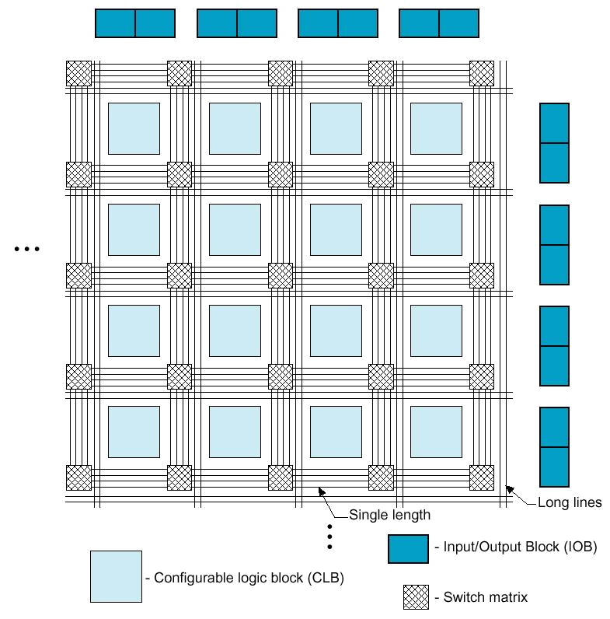
High-Performance Reconfigurable Computing
Use FPGA as co-processor
Example:
  Application requires a week of CPU time
  One computation consumes 99% of execution time
Kernel speedup | Application speedup | Execution time
50 | 34 | 5.0 hours
100 | 50 | 3.3 hours
200 | 67 | 2.5 hours
500 | 83 | 2.0 hours
1000 | 91 | 1.8 hours

Slide 3
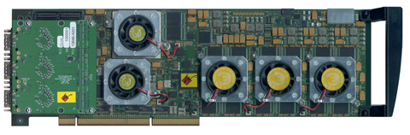
HPRC: Requirements, Pros, Cons
Application criteria:
  computationally expensive
  bottleneck computation…
    fits on FPGA
    finely parallelizable
    has low I/O and storage requirements
    (relative to computation)
Advantage of HPRC:
  Cost
    FPGA card => ~ $15K
    128-processor cluster => ~ $150K
  + maintenance + cooling + electricity + recycling
Disadvantage of HPRC:
  Programming the FPGA

Slide 4
Programming
Requires large-scale digital logic design
Must finely parallelize algorithm across FPGA resources
  Especially difficult for control-dependent computations
Our goal:
  Identify, characterize, and accelerate applications in computational biology
Our strategy:
  Develop a library of optimized, parameterizable kernel designs for common applications
  Develop a design automation tool to generate accelerator architectures

Slide 5
FPGA Acceleration of Computational Biology
Aho-Corasick string set matching
  Bit-sliced state machines
    Dandass et al, Mississippi State Univ.
Sequence alignment
  BLASTP, Smith-Waterman, Needleman-Wunsch
  Systolic array
  Examples:
    Chamberlain et al., WUSTL
    Herbordt et al, Boston University
    Sotiriades et al, Univ. of Crete
    Knowles et al, Flinders Univ.
    Benkrid et al., Univ. of Edinburgh
    Underwood, Sass et al.
    etc…

Slide 6
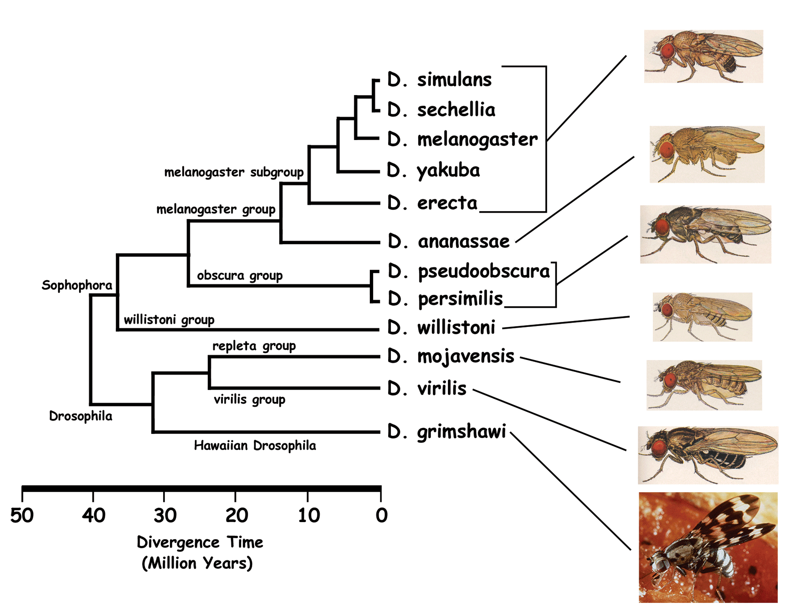
Computational Phylogenetics
genus Drosophila

Slide 7
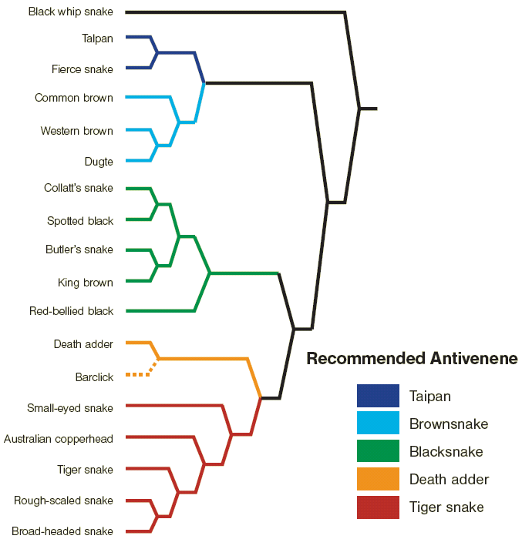
Phylogenetic Analysis
Phylogenies are used to infer common characteristics among related species

Slide 8
Phylogenic Analysis
Phylogenies help biologists understand and predict:
  functions and interactions of genes
  genotype => phenotype
  host/parasite co-evolution
  origins and spread of disease
  drug and vaccine development
  origins and migrations of humans

Slide 9
Phylogeny Data Structure
g3
g1
g4
g2
g1
g3
g2
g5
g5
g5
g6
g4
g6
Unrooted binary tree
n leaf vertices
n - 2 internal vertices (degree 3)
Tree configurations =
  (2n - 5) * (2n - 7) * (2n - 9) * … * 3
200 trillion trees for 16 leaves
g6
g3
g5
g2
g1
g4
g5

Slide 10
Phylogenetic Reconstruction
Given input genomes, reconstruct an evolutionary tree
  Leaves are inputs, internal nodes are common ancestors
  Edges represent evolutionary lineage
Several methods exist:
  Distance-based (clustering) methods: clustering technique based on pairwise distances
  Bayesian methods: maximizes the likelihood of a phylogenetic tree based on probabalistic models
  Maximum parsimony: minimizes sum of edge lengths

Slide 11
Reconstruction Method
Maximum parsimony:
  Goal: Accuracy
  Relies on a direct evolutionary model
  Search for tree with minimum total edge lengths
Direct-optimization method:
  To evaluate a fixed tree…
    Label all internal vertices with gene orders
      Initialize and iteratively refine until the labels converges
    Measure edge lengths using distance estimator
…
,
,
…

Slide 12
Gene Rearrangement Data
Gene rearrangement analysis
  Evolution analysis using gene order data
Assumes gene-rearrangement model for evolution, i.e.:
  Inversion
  g₀ g₁ g₂ g₃ g₄ g₅ g₀ g₁ –g₄ –g₃ –g₂ g₅
  Transposition
  g₀ g₁ g₂ g₃ g₄ g₅ g₀ g₂ g₃ g₄ g₁ g₅
  Transversion
  g₀ g₁ g₂ g₃ g₄ g₅ g₀ –g₄ –g₃ –g₂ g₁ g₅

Slide 13
Breakpoint Distance Metric
Estimation of number of rearrangement events between gene orders A and B
# of adjacencies:
  g h in A that doesn’t correspond to g h or –h –g in B
Example:
  A = 1 2 3 4 5
  B = -2 -1 -5 -4 3
  Breakpoint distance = 2

Slide 14
Median
Ancestral vertices are computed using a median computation
All internal vertices have degree 3
Find M that optimally minimizes median score
score = d(A,M) + d(B,M) + d(C,M)
Breakpoint median:
  d() is breakpoint distance
A
B
d(A,M)
d(B,M)
M
d(C,M)
C

Slide 15
Breakpoint Median Implementation
Optimal TSP is feasible due to small graph
Implemented as a depth-first branch-and-bound search
Upper bound is the current best tour
Lower-bound is computed using a linear greedy algorithm
  Select a set of minimal-weight edges to complete a partially-constructed tour
  To tighten: edges not considered that…
    have been pruned at or above the current level of the search tree
    that would create a cycle not including all cities

Slide 16
Execution Behavior
1
Execution Time Ratio for Medians
0
Evolution Rate of Inputs
Application behavior depends on evolution rate of inputs
Execution time ratio for median computations:
  Asymptotically approaches 100% with diameter of input set
Median adopted as kernel computation

Slide 17
Breakpoint Median
Construct a fully connected graph containing all g and –g for each gene
  w(g,-g) = -∞
  Initialize all other weights to be 3
  For each adjacency gh in the three genomes, decrement weight between vertex –g and h
Solve TSP
+
-
+
-
1
2
1
2
A = -1 +2 -4 -3
B = -1 -2 +3 +4
C = -2 +3 +4 +1
cost = -∞
cost = 0
cost = 1
cost = 2
-
+
-
+
+
-
+
-
4
3
4
3
-
+
-
+
Edges not shown have cost = 3
An optimal solution corresponding to genome +1 +2 -3 -4

Slide 18
Breakpoint Median Algorithm
Optimal solution is feasible due to small graph
Algorithm:
  Represent TSP graph as a list of edges
  Test every possible valid combination of edges
Implemented as a branch-and-bound search
Upper bound is the best tour found so far
Lower bound is computed using a greedy algorithm
  Loop that inspects each vertex in TSP graph
  Accumulates lower bound value (based on search state)
  Performed each time an edge is added or deleted from solution state
  Requires nearly 100% of median execution time (bottleneck)

Slide 19
Example Breakpoint Median
sorted edge list:
(-3,4,w=0)
(2,3,w=1)
(1,2,w=2)
(-1,-2,w=2)
(1,-2,w=2)
(-2,-4,w=2)
(-1,3,w=2)
(-1,-4,w=2)
(1,-4,w=2)
used
1 => 0
-1 => 0
2 => 0
-2 => 0
3 => 0
-3 => 0
4 => 0
-4 => 0
otherEnd
1 => -1
-1 => 1
2 => -2
-2 => 2
3 => -3
-3 => 3
4 => -4
-4 => 4
1 -1
2 -2
3 -3
4 -4
cost = 0
used
1 => 0
-1 => 0
2 => 0
-2 => 0
3 => 0
-3 => 1
4 => 1
-4 => 0
otherEnd
1 => -1
-1 => 1
2 => -2
-2 => 2
3 => -4
-3 => 3
4 => -4
-4 => 3
1 -1
2 -2
3 -3
4 -4
pruned
used
1 => 0
-1 => 0
2 => 1
-2 => 0
3 => 1
-3 => 1
4 => 1
-4 => 0
otherEnd
1 => -1
-1 => 1
2 => -2
-2 => -4
3 => -4
-3 => 3
4 => -4
-4 => -2
cost = 0
1 -1
2 -2
3 -3
4 -4
cost = 1

Slide 20
Example Breakpoint Median
sorted edge list:
(-3,4,w=0)
(2,3,w=1)
(1,2,w=2)
(-1,-2,w=2)
(1,-2,w=2)
(-2,-4,w=2)
(-1,3,w=2)
(-1,-4,w=2)
(1,-4,w=2)
used
1 => 0
-1 => 0
2 => 0
-2 => 0
3 => 0
-3 => 0
4 => 0
-4 => 0
otherEnd
1 => -1
-1 => 1
2 => -2
-2 => 2
3 => -3
-3 => 3
4 => -4
-4 => 4
1 -1
2 -2
3 -3
4 -4
cost = 0
used
1 => 0
-1 => 0
2 => 0
-2 => 0
3 => 0
-3 => 1
4 => 1
-4 => 0
otherEnd
1 => -1
-1 => 1
2 => -2
-2 => 2
3 => -4
-3 => 3
4 => -4
-4 => 3
used
1 => 1
-1 => 0
2 => 1
-2 => 0
3 => 0
-3 => 1
4 => 1
-4 => 0
otherEnd
1 => -1
-1 => -2
2 => -2
-2 => -1
3 => -4
-3 => 3
4 => -4
-4 => 3
1 -1
2 -2
3 -3
4 -4
exclude edge (2,3)
1 -1
2 -2
3 -3
4 -4
cost = 0
cost = 2
used
1 => 1
-1 => 0
2 => 1
-2 => 1
3 => 0
-3 => 1
4 => 1
-4 => 1
otherEnd
1 => -1
-1 => 3
2 => -2
-2 => -1
3 => -1
-3 => 3
4 => -4
-4 => 3
used
1 => 1
-1 => 1
2 => 1
-2 => 1
3 => 1
-3 => 1
4 => 1
-4 => 1
otherEnd
1 => -1
-1 => 3
2 => -2
-2 => -1
3 => -1
-3 => 3
4 => -4
-4 => 3
1 -1
2 -2
3 -3
4 -4
1 -1
2 -2
3 -3
4 -4
cost = 4
cost = 6
tour is -1, 1, 2, -2, -4, 4, -3, 3
median is -1, 2, -4, -3

Slide 21
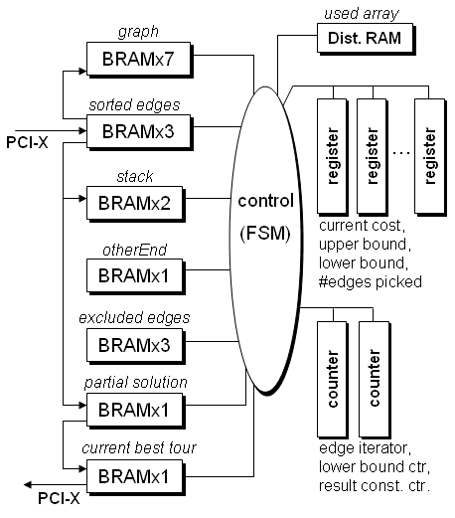
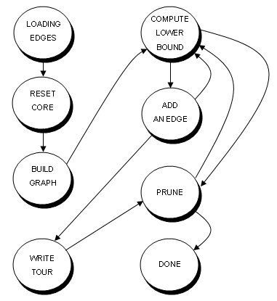
Hardware Median Core Design
Top-Level
Controller

Slide 22
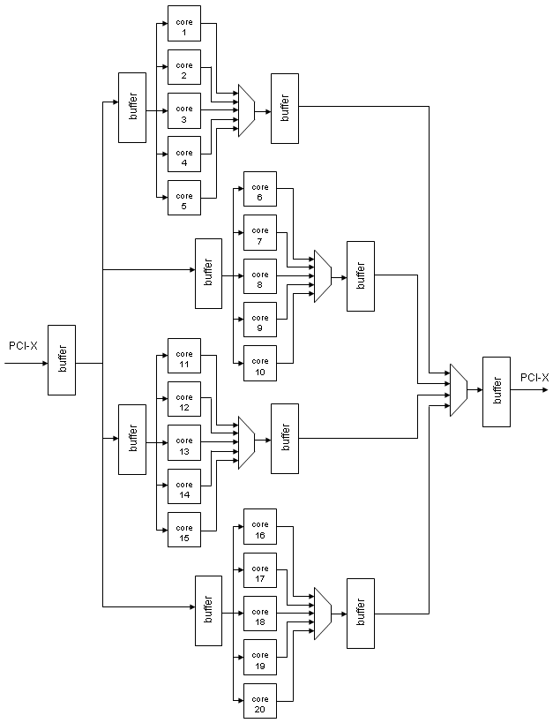
Accelerator Architecture
Fill FPGAs with median cores
Fan-outs and fan-ins are pipelined to meet PCI-X timing
Platform:
  Annapolis Wild-Star II Pro
  Virtex-2 Pro 100 -5
I/O
  Programmed I/O
  Hosts polls each core for state
  Comm. overhead is significant for easy medians

Slide 23
Phylogeny Scoring Steps
Initialize unlabeled tree
Use 3 nearest labels
Initialize upper bound from inputs
g4
g1
g3
g2
g5
g5
g6
Iteratively refine tree to convergence
Use 3 immediate neighbors
Initialize upper bound using score of previous label
g4
g1
g3
g2
g5
g5
g6

Slide 24
First Approach for Parallelization
A
B
A
B
0
d(A,B)
A, B, C
d(A,B)
0
ub
core 0
A
B
d(A,C)
d(B,C)
ub - 1
core 1
C
C
A
ub - 2
core 2
d(A,C)
C
d(B,C)
0
…
B
C
initial upper bound = ub =
d(A,B) + d(A,C)
d(B,A) + d(B,C)
d(C,A) + d(C,B)
ub - n - 1
core n-1
Core with a lower initial upper bound will converge on solution fastest

Slide 25
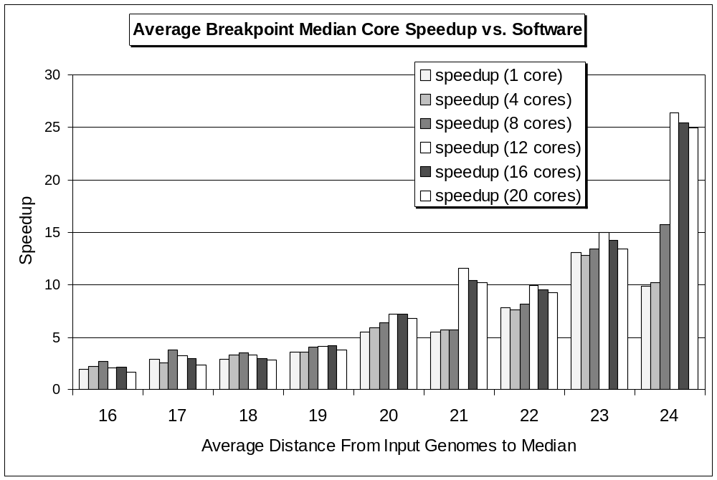
Performance Results: Median Computation
Average over 1000 median computations
12 cores =>
25X speedup

Slide 26
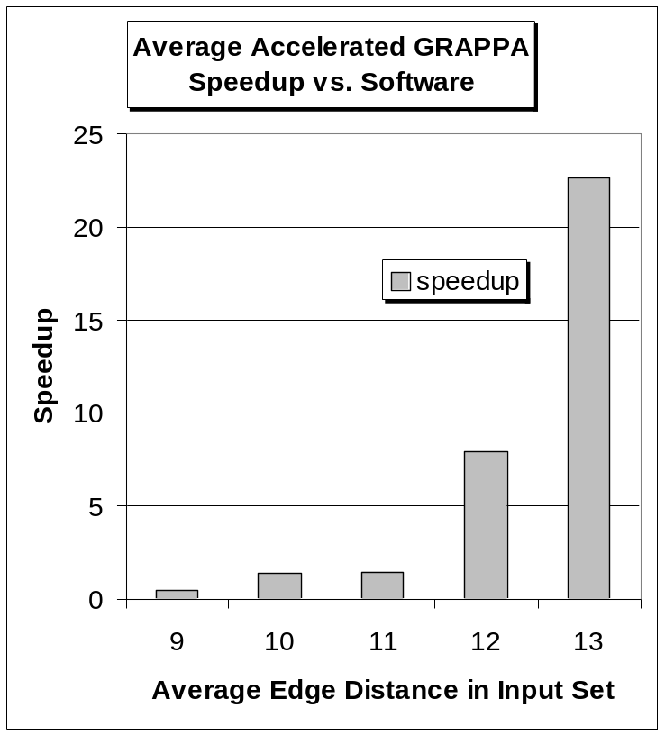
Performance Results: Accelerated GRAPPA
Replace software median with driver for FPGA card
Initialization phase:
  Use 12 median cores
Re-labeling phase:
  Parallel labeling
  Use n - 2 median cores
Average over 10 GRAPPA runs

Slide 27
Second Approach for Parallelization
Exploit both fine- and coarse- grain parallelism
Fine-grain
  Unroll loop for lower bound computation
  Perform multiple iterations in parallel
Coarse-grain
  Use parallel median cores for single median computation
  Partition search space

Slide 28
Fine-Grain Parallelism
Lower bound unit:
v=2
e₀=11
e₁=-19
e₂=-49
used
table
used(v)
used(e₀)
used(e₁)
used(e₂)
if used(v) = 0 then
VALID_WEIGHTS= φ
for i = 0 to edge_count(v) - 1
if used(e_{i}) = 0 and
otherEnd(v) != e_{i} and
excluded_{i}(v) != 1 then
add weight_{i} to VALID_WEIGHTS
end if
end loop
if VALID_WEIGHTS is empty
lower_bound = lower_bound + 3
else
lower_bound = min(VALID_WEIGHTS)
end if
TSP graph representation:
1 (1,-4),w=0
-1 (-1,9),w=1 (-1,25),w=2
2 (2,11),w=2 (2,-19),w=2 (2,-49),w=2
-2 (-2,17),w=2 (-2,20),w=1
.
.
.
-19 (-19,2),w=2 (-19,-4),w=2 (-19,10),w=2
.
.
.
otherEnd
table
v=2
otherEnd(v)
v=2
excluded
table
excluded₀(v)
excluded₁(v)
excluded₂(v)
v=2
edge_count
table
3
11
-19
weight₀
weight₁
weight₂
2
2
2
2
2
2
2
-49

Slide 29
Coarse-Grain Parallelism
Parallelize search => partition TSP search space
  Problems:
    High amount of state information (communication overhead)
    Dynamic load balancing would be complex (control overhead)
Solution: “virtually” partition the TSP search space
  Search order determined by ordering of edge list
  Use parallel median cores
  Each core uses unique search order
  All cores share a global upper bound value

Slide 30
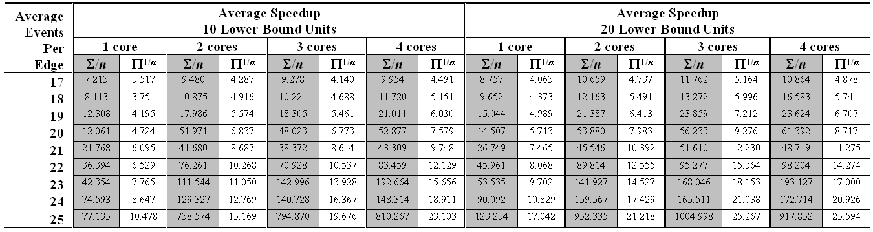
Experimental Results: Median Acceleration
Average speedup for 1000 median computations

Slide 31
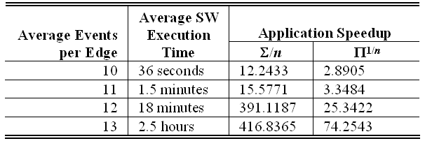
Experimental Results: Application Acceleration
Perform end-to-end reconstruction procedure
Dispatch all median computations to FPGA
Average speedup for 10 end-to-end reconstructions

Slide 32
Tree Generation Accelerator
Generate trees in hardware, score in software
Core generates and bounds trees
  Given number of leaves, step, and offset
  Upper bound is global and updates are broadcast
Currently operating 64 cores in parallel on FPGA
Core array is scanned and the core with the lowest lower bound is scored first
Currently achieving 10X speedup

Slide 33
Future Work
In Progress:
  Additional kernel designs
    tree generation complete, but working to increase speedup to 100X
  Implement heterogeneous mix of kernels on the FPGA according to evolution rate of input set
  Design automation tool

