Slide 1

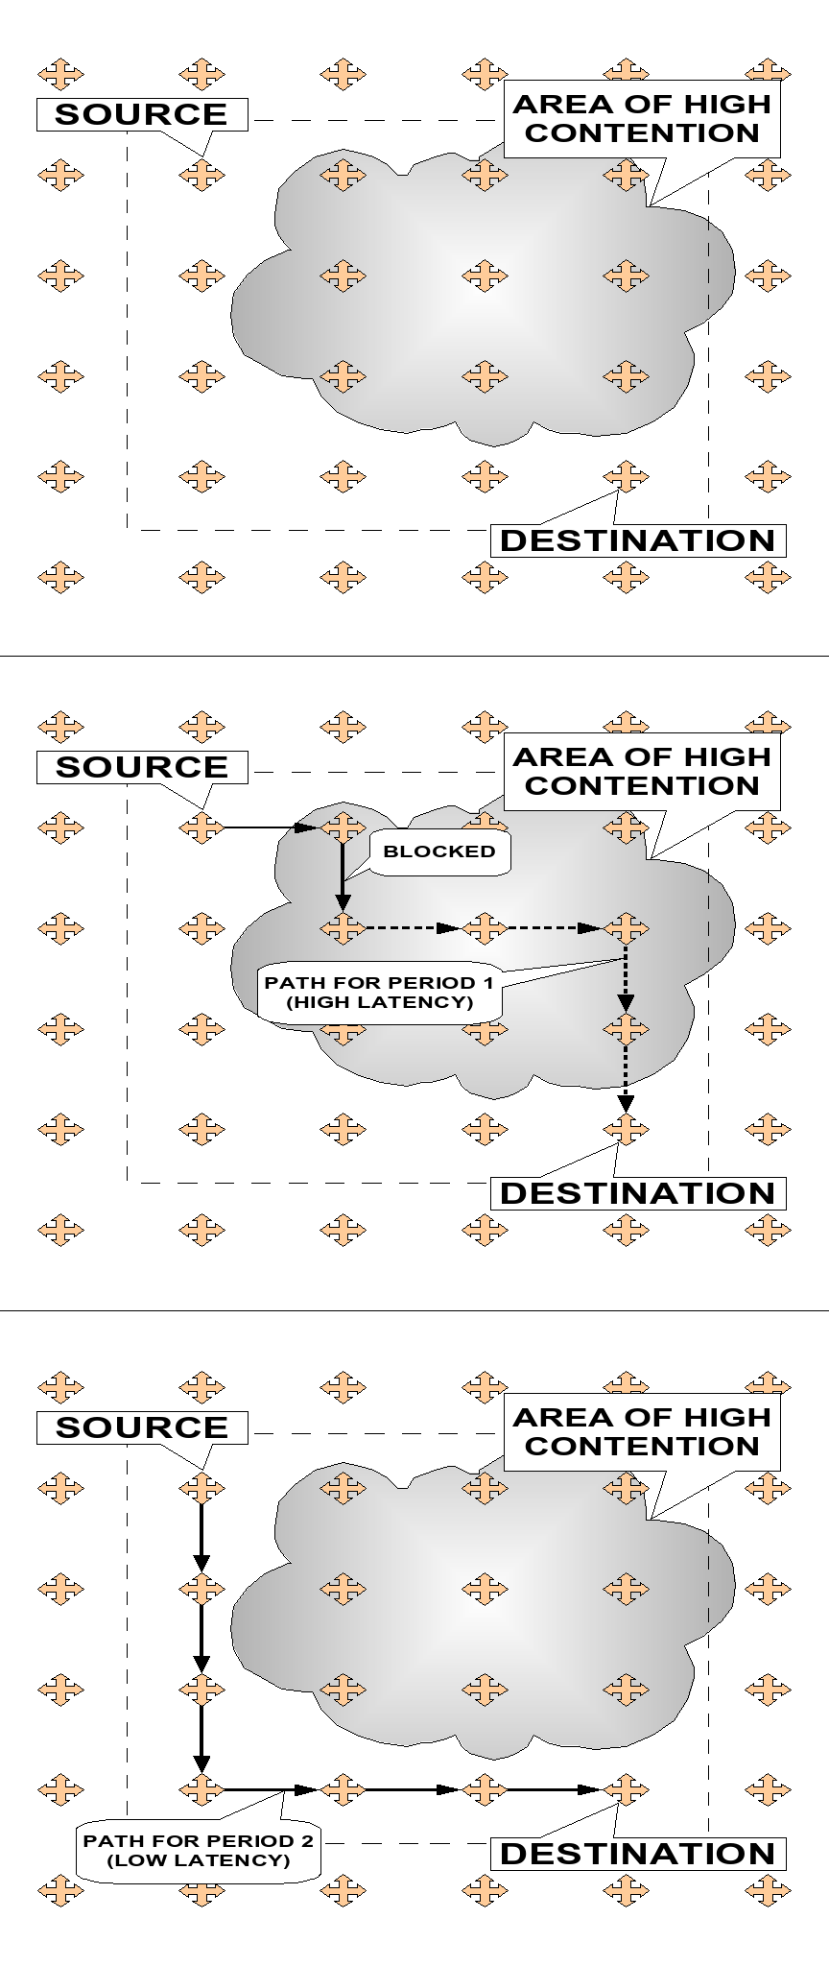
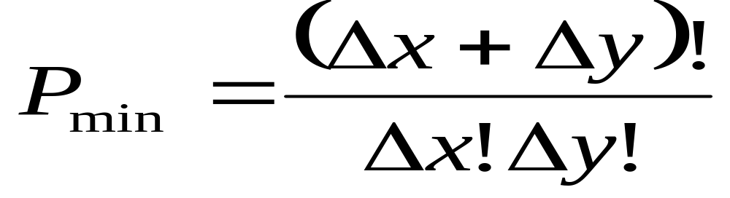
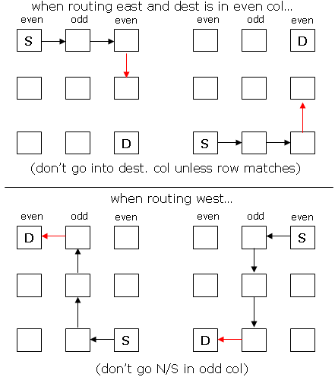
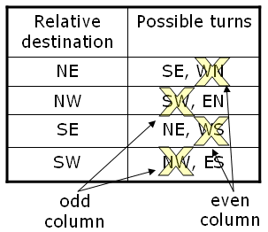
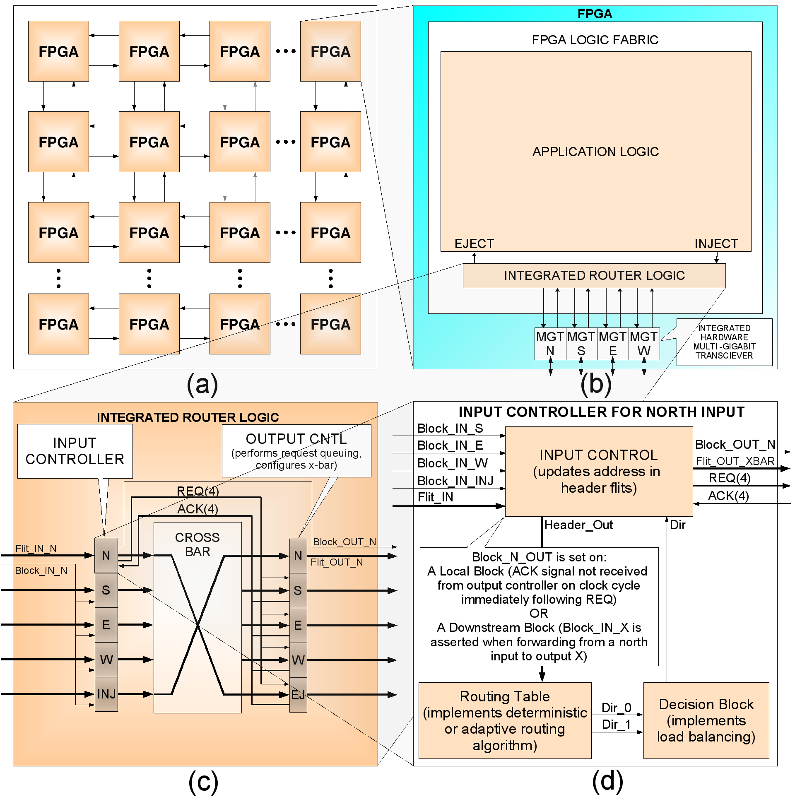
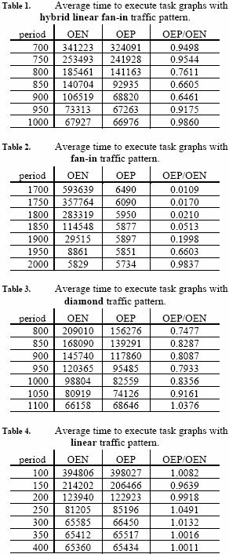
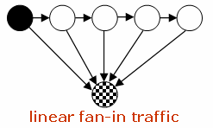
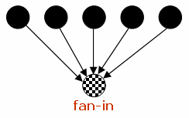
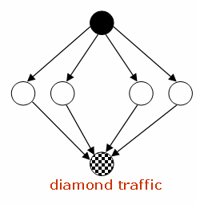

Aggressive Network Interface And Router Designs For Special Purpose Scalable Distributed Processing Systems
Shaun Gause
E-mail: gause3@cse.sc.edu
Motivation
- Construction of a general-purpose interconnect for a class of multi-FPGA distributed processing architectures that is abstracted from application, linearly scalable, and high-capacity
Approach
- Directly connect FPGAs in a 2D mesh topology
- Use integrated hard-core multi-gigabit transceivers to form physical channels
- Use integrated soft-core routers to create a multi-hop network
- Design routers to be…
high-speed (4.5 ns clock tick for a routing or forwarding operation)
low-area (< 7% of logic resources per FPGA)
…using a 2D mesh topology, wormhole-switching, and semi-adaptive routing
The Problem
- Packet blocking behavior caused by localized areas of network congestion decreases effective interconnect capacity, but routing and load-balancing techniques decrease blocking and increase network capacity
The Solution
Predictive Load Balancing (analogous to branch predictors)
No additional routing latency
4% cost in logic resources
Basic idea:
- Evenly distribute traffic across the network by maintaining block counters for each output port
- Increment for internal crossbar blocks and downstream blocks
- Decrement for successful routes and forwards
Prior State-of-the-Art:
Wormhole Switching
- In wormhole switching, variable-length packets are subdivided into fixed-length units called flits
- Flits forming each packet travel across the network using store-and-forward
- Advantages: Input buffers need only be as wide as a single flit, packet transmission is pipelined making transmission latency independent of hop count
Disadvantages: Packets occupy input buffers and channels of multiple hops, causing blocking behavior (contention for crossbars, channels, input buffers) and routing must include deadlock avoidance
The Algorithm
Prior State-of-the-Art:
Odd-Even Routing
- Non-virtual-channel-based minimum-path semi-adaptive routing with deadlock avoidance
- Based on the turn model
# minimal paths w/o turn rest.
Dead-end route restrictions
Turn restrictions
The Architecture
Experimental Setup and Results
Up to 1.56X improvement in interconnect capacity
Up to 100X improvement in interconnect capacity
Up to 1.35X improvement in interconnect capacity
No improvement in interconnect capacity

