Slide 1

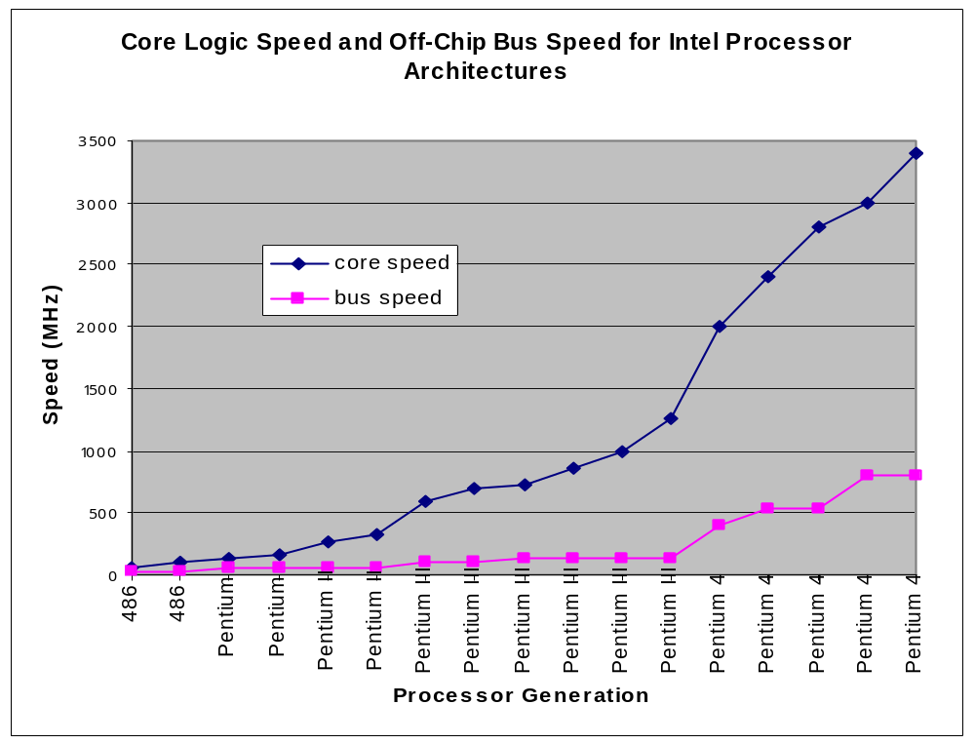
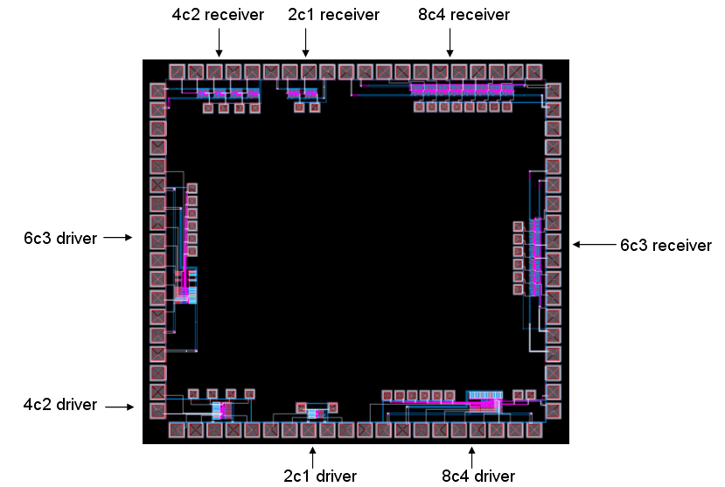
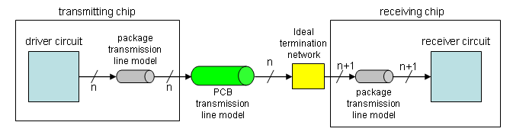
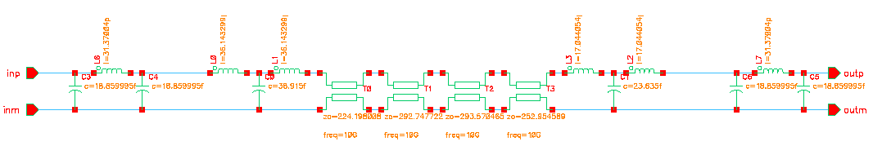
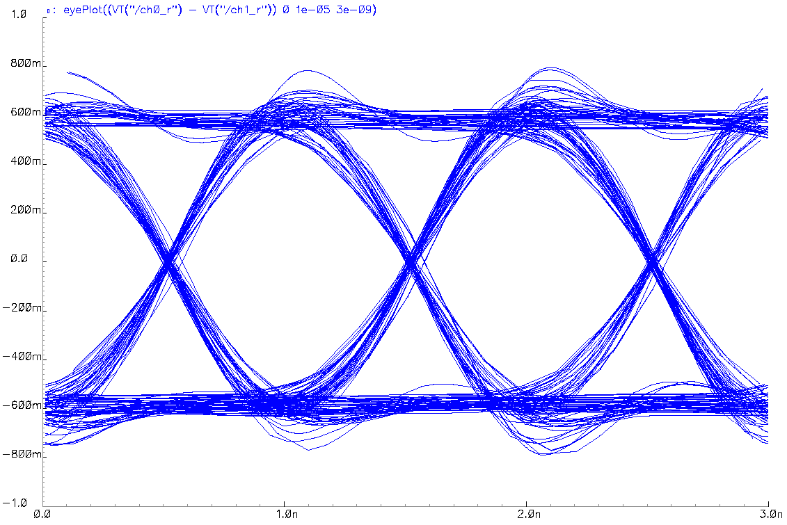
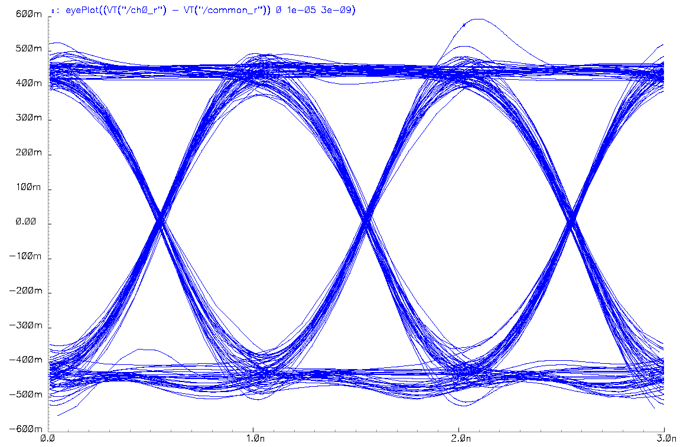
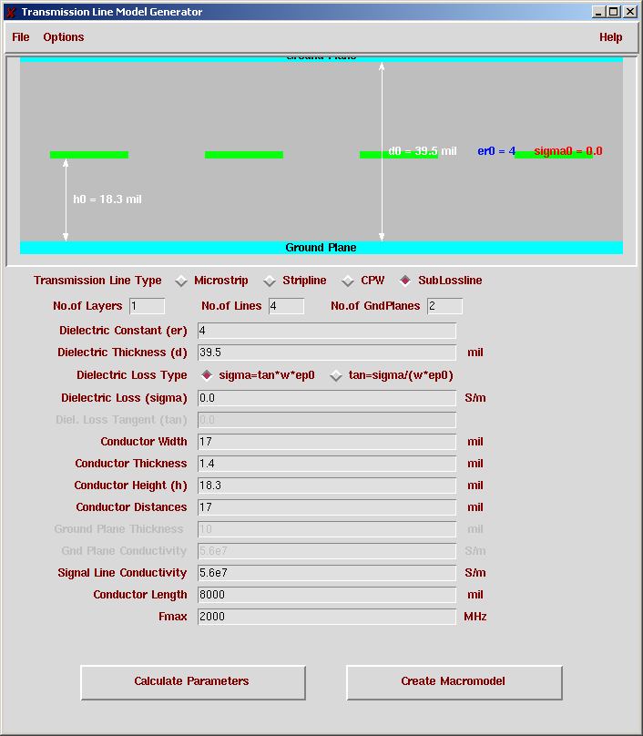
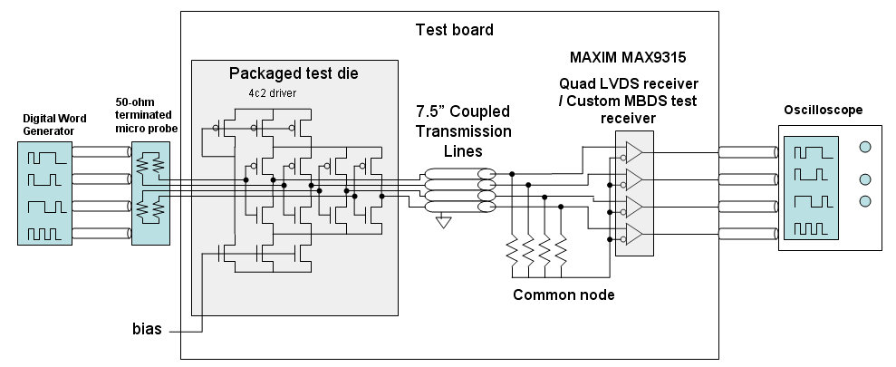
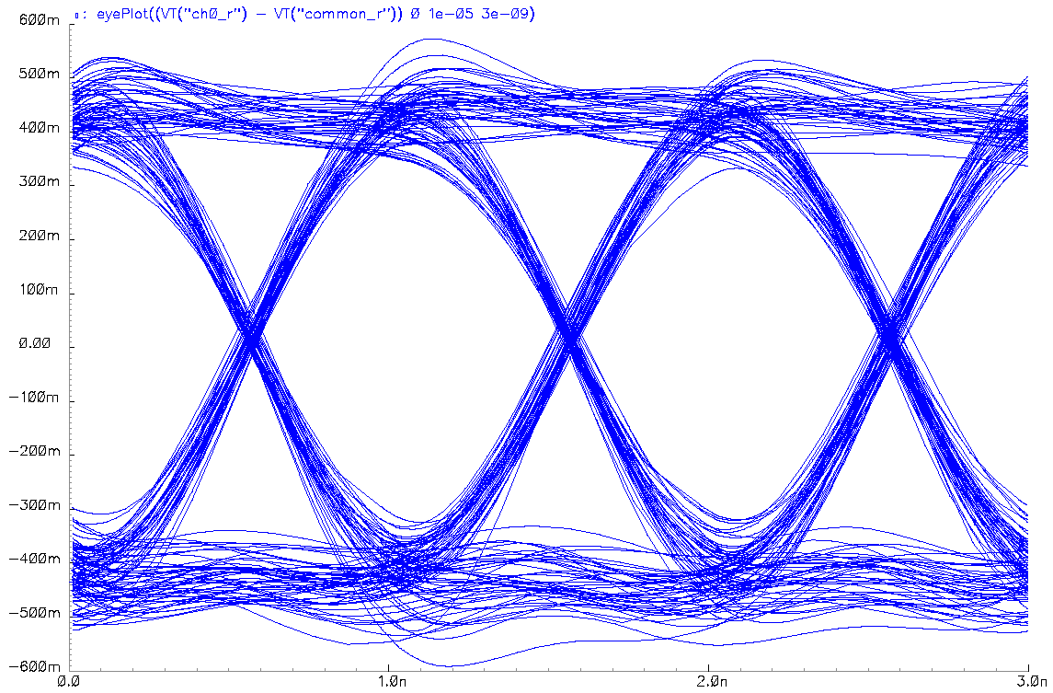
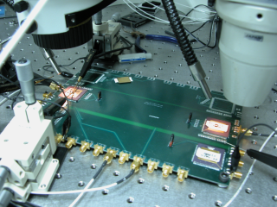
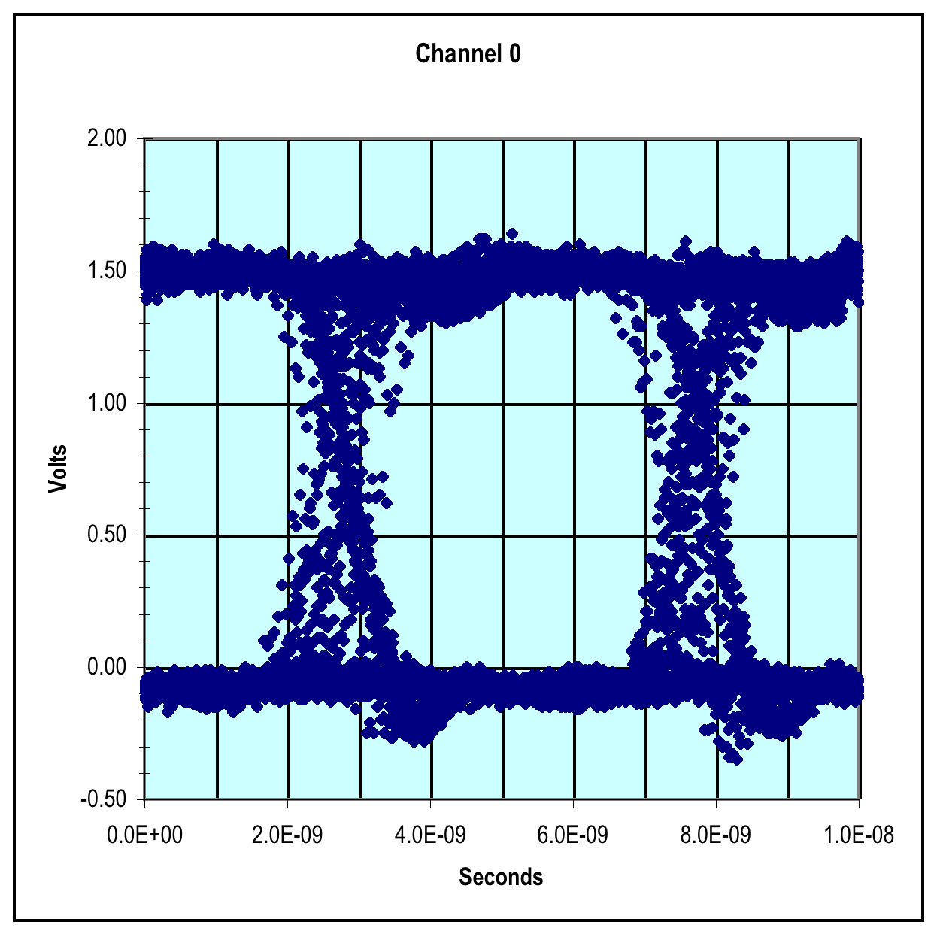
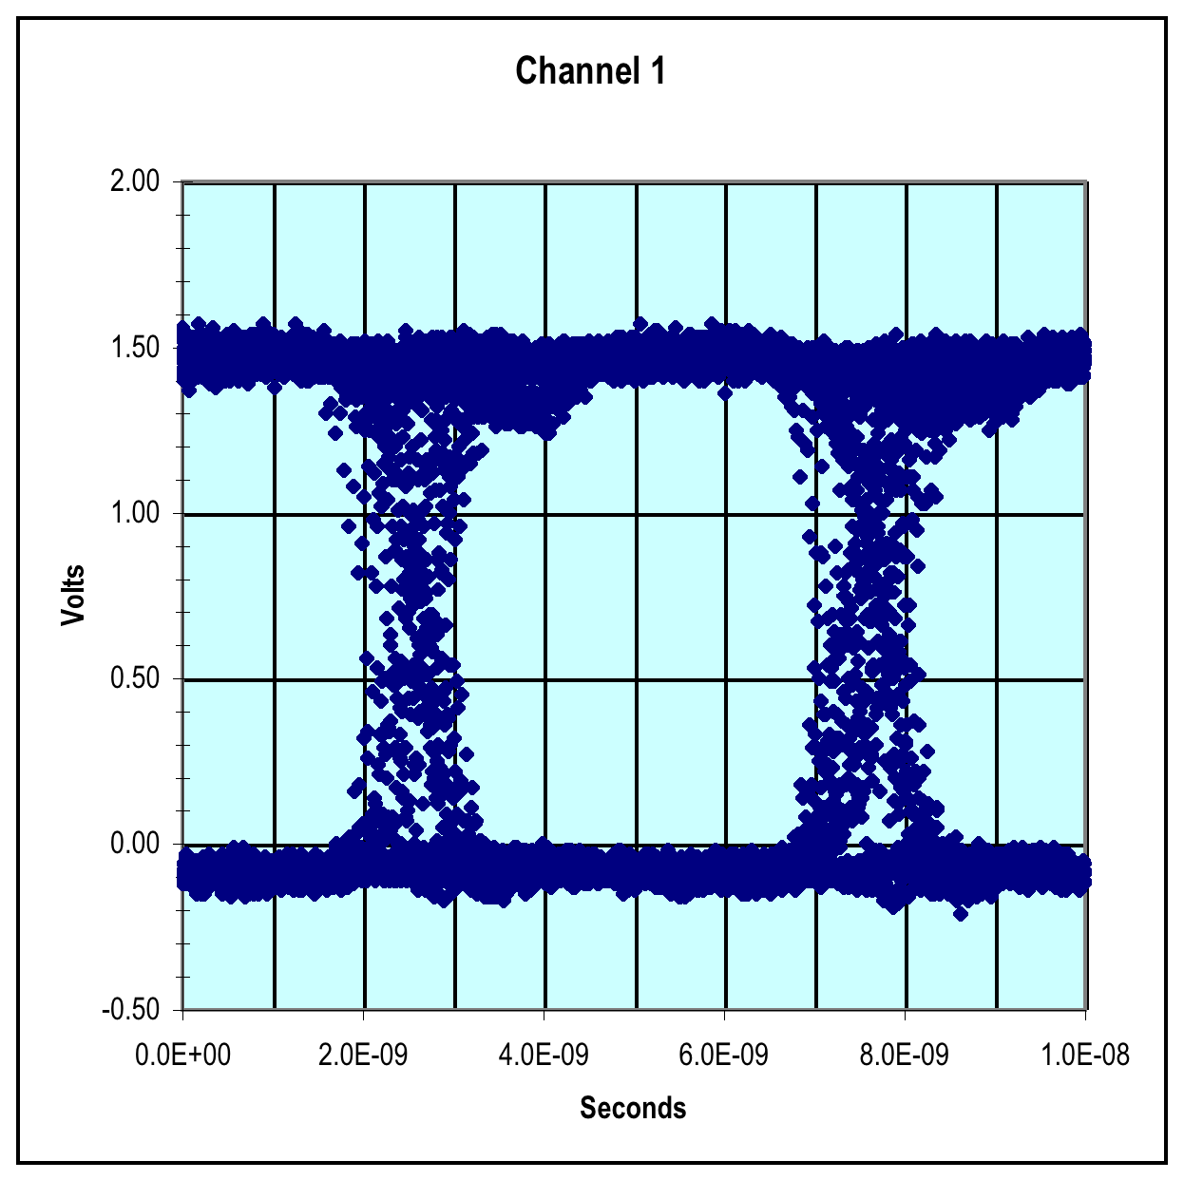
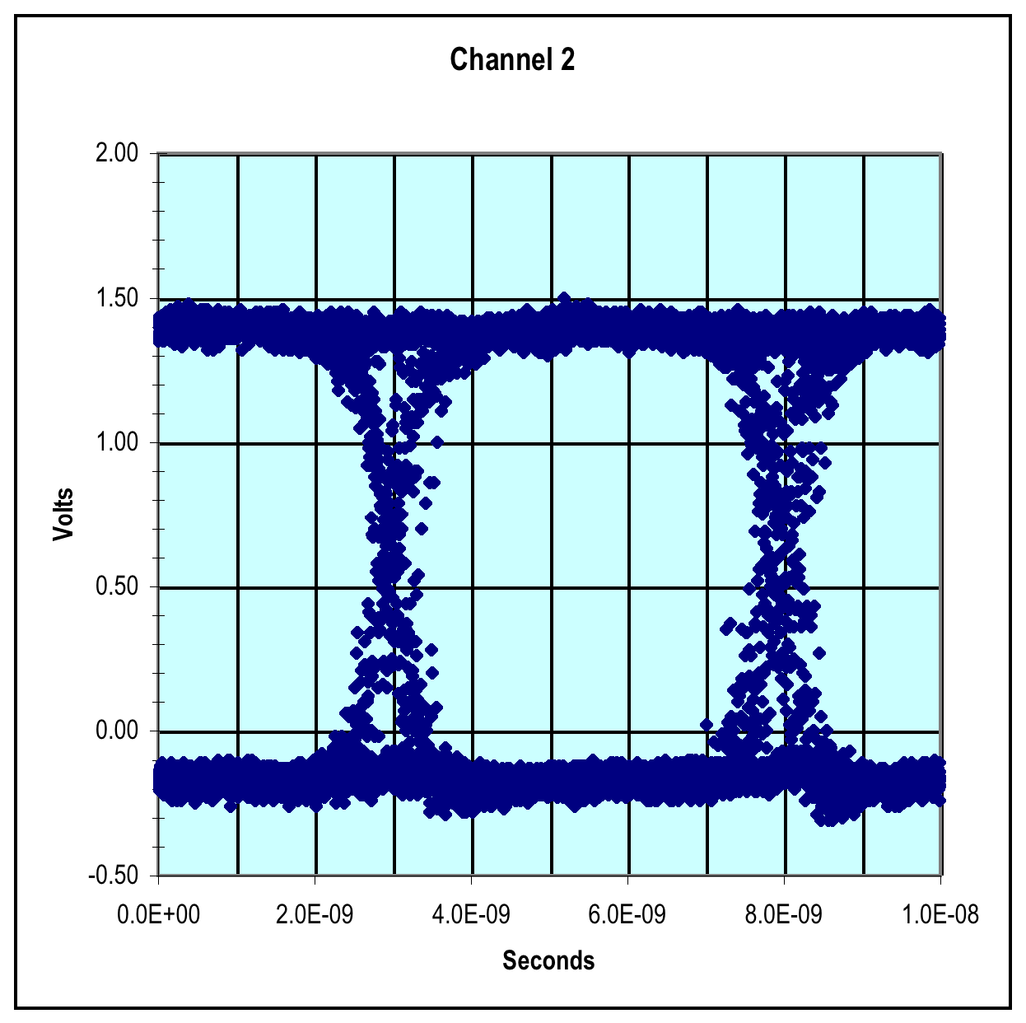
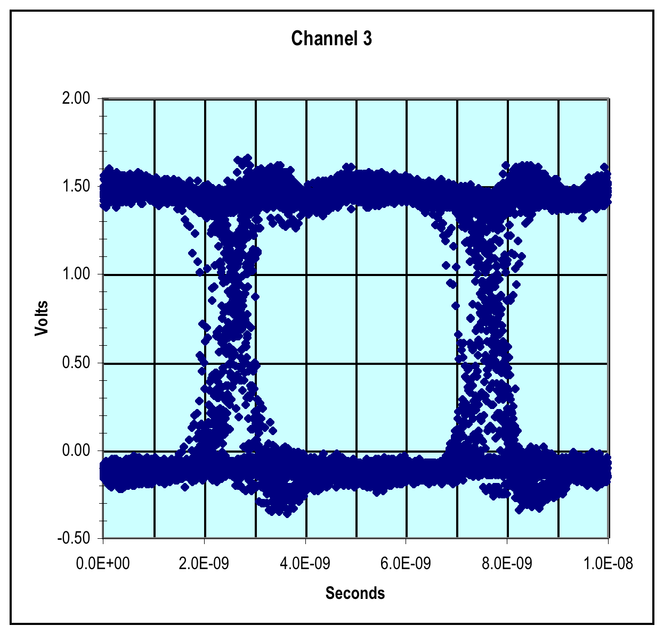
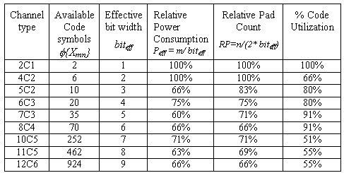
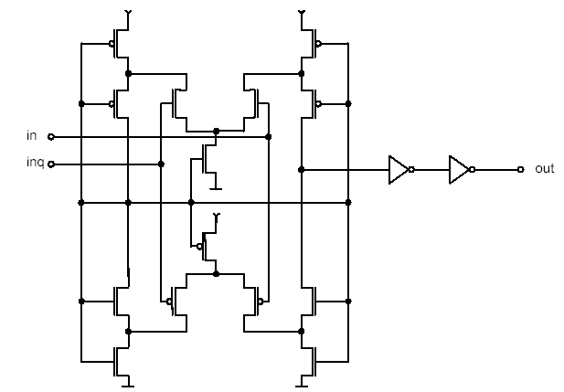
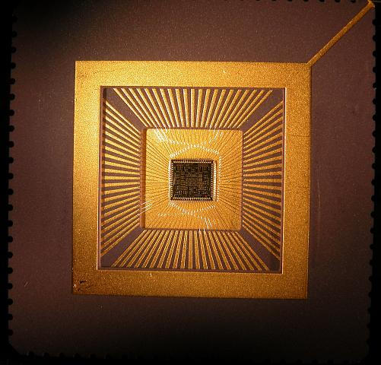
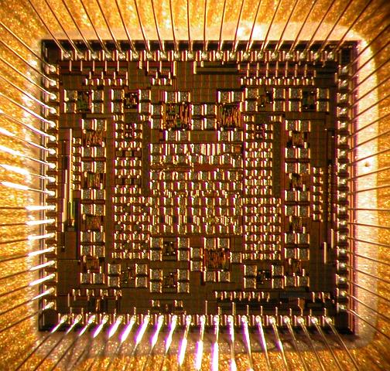
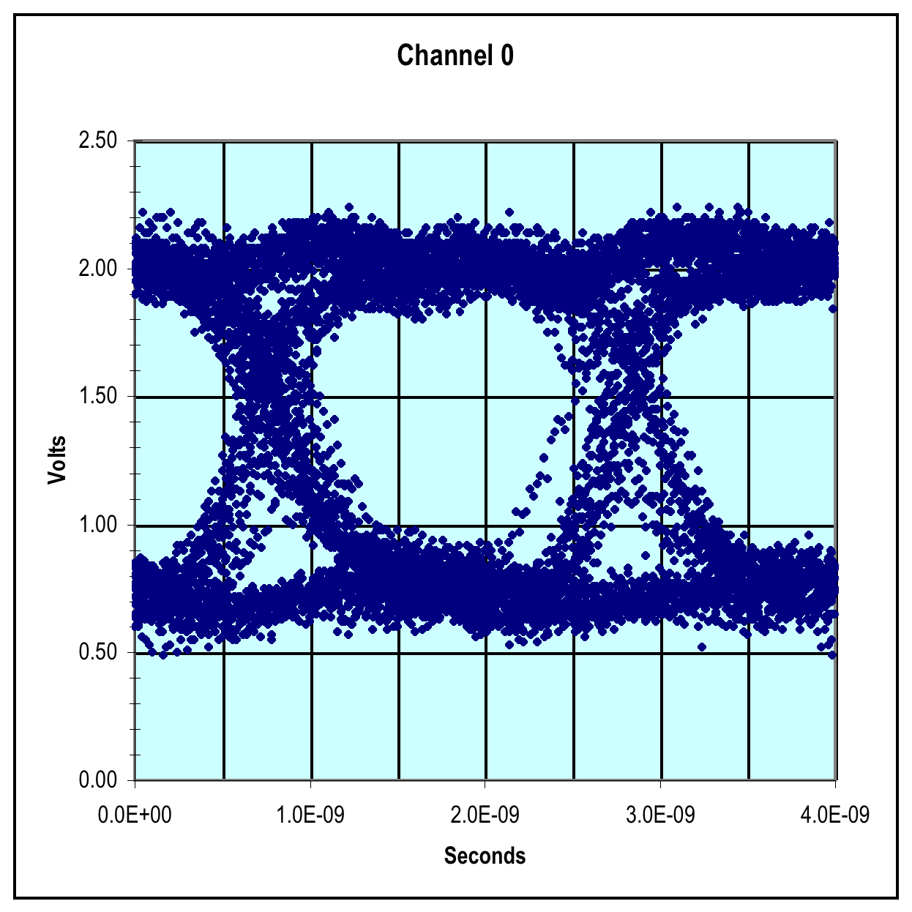
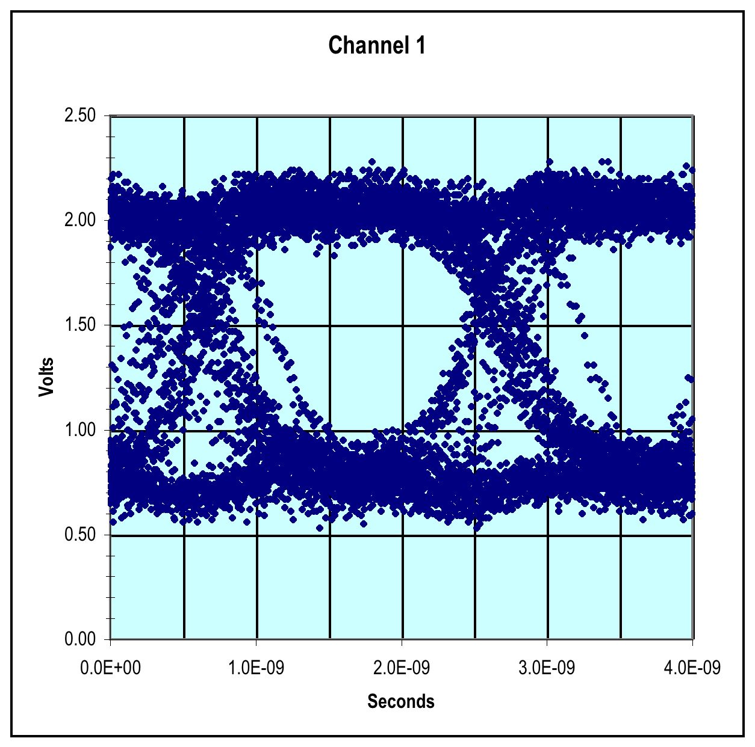
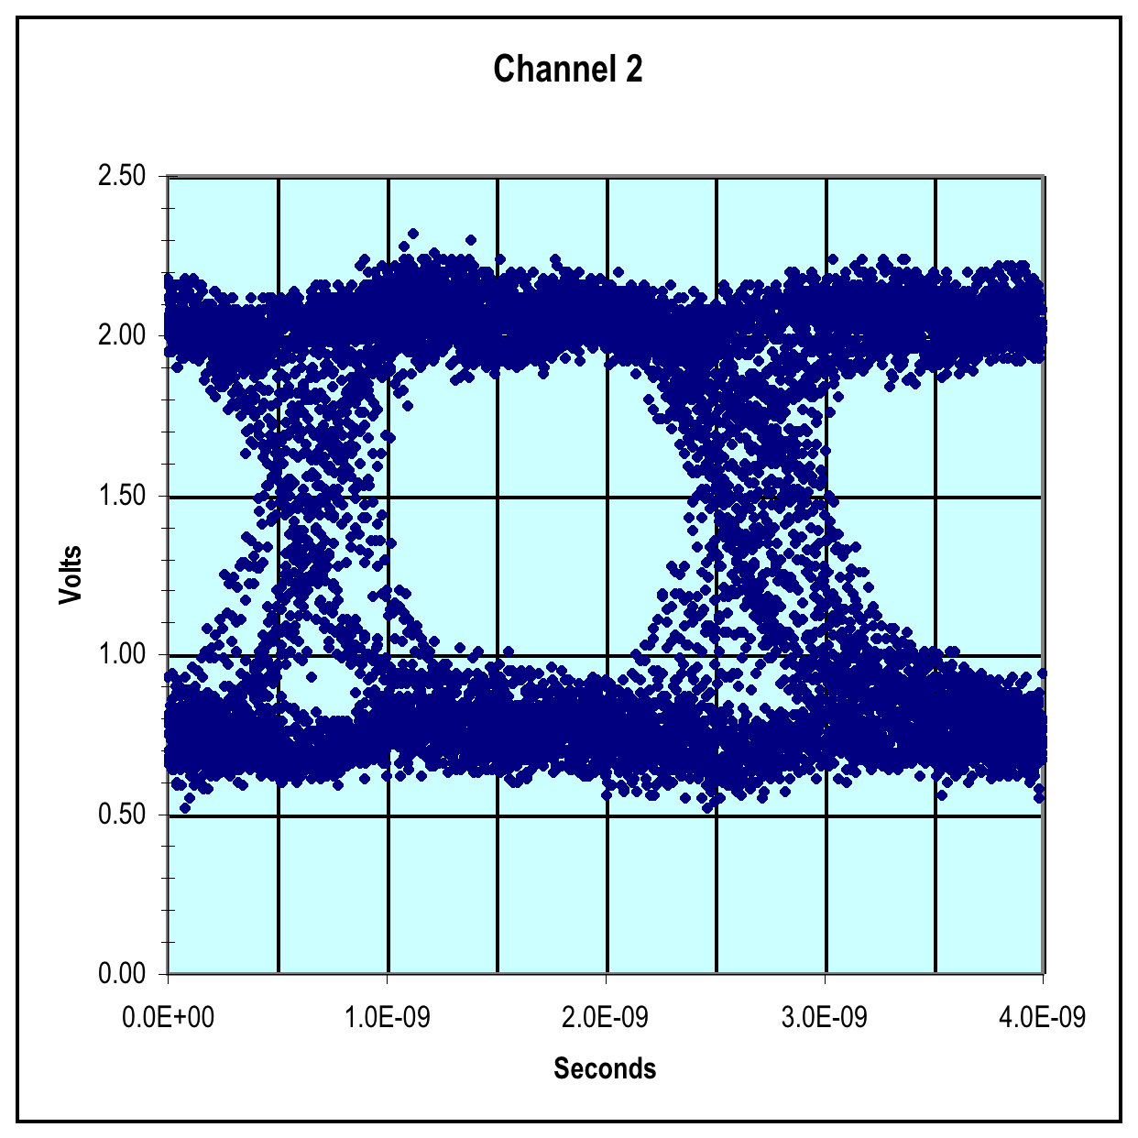
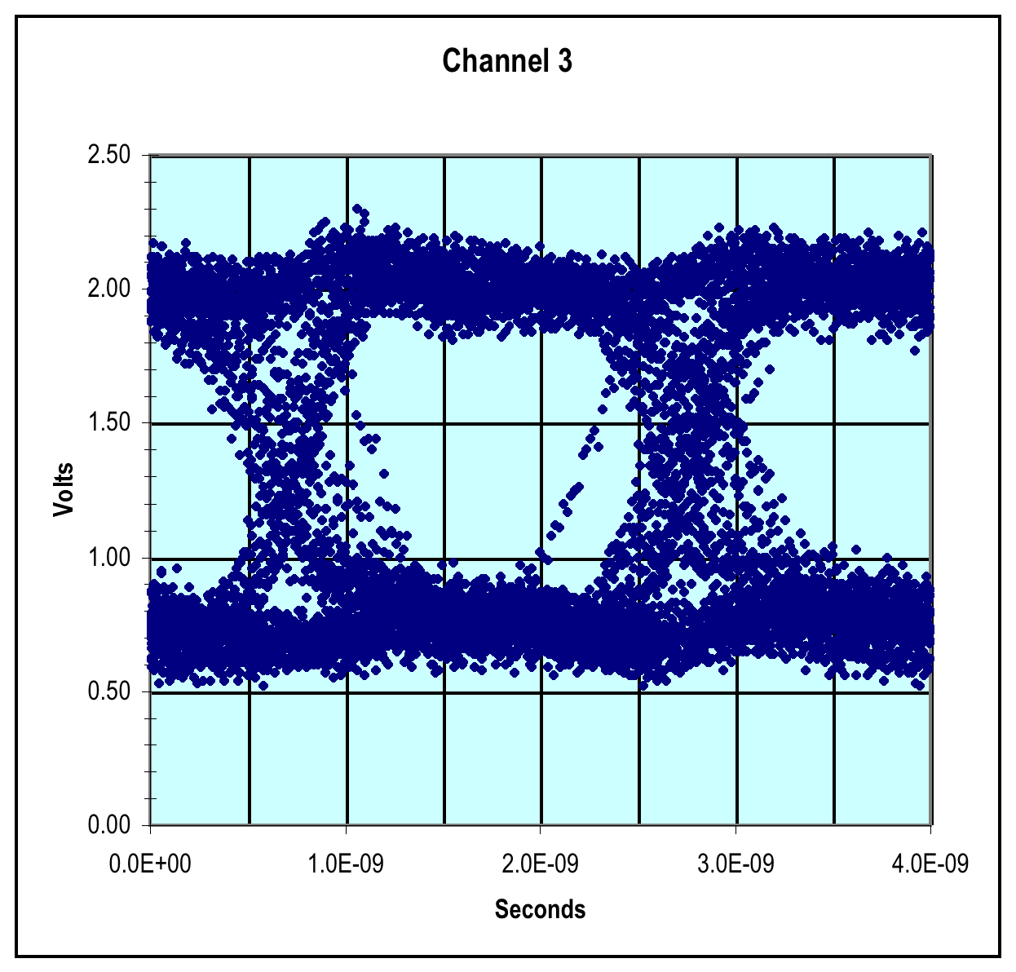

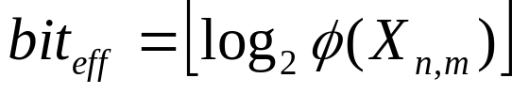
Multi-Bit Differential Signaling (MBDS) for Next Generation Off-Chip Interconnect
Jason Bakos, Donald M. Chiarulli
University of Pittsburgh
Need Solutions for High-Performance Off-Chip Signaling
MBDS Extends Differential Signaling Technology for Higher Channel Code Density
Layout of MBDS Test Die
Simulation Setup / Results
Extracted netlists
Extracted netlists
Low Voltage Differential Signaling (LVDS)
Multi-Bit Differential Signaling (MBDS)
Sample inputs
Data encoded as
  {01} or {10}
Advantages
  Low switching noise
  No reference noise
  Coupled transmission lines
  Noise rejection => low voltage swing
Disadvantages
  Two connections for each bit
  Wasteful in I/O pads
Data encoded with fixed number of one-bits
  N-choose-M (nCm)
  Example: 4c2 code set:
    {0011}, {0101}, {0110}, {1001}, {1010}, {1100}
Advantages
  Same noise rejection as differential
  Higher information capacity
solder bump model
wire bond model
solder bump model
Source: Intel Corporation
Chip Package Model
Challenges for Next Generation High Performance Off-Chip Signaling
Packaged chip
Packaged chip
Test Setup
PCB trace
2c1 channel at 1 Gbps, 500 bit times, scale +/- 1 V
4c2 channel at 1 Gbps, 500 bit times, scale +/- 600mV
Ground plane
Eye plots show no significant loss of signal integrity as MBDS channel width is scaled up
Example Chip-to-Chip Interconnect
Signal integrity issues
  High metal content of off-chip signaling paths contain capacitance and inductance creating low-pass frequency response
  Off-chip signals highly susceptible to noise
  Synchronization difficult for high-speed signals due to skew/jitter
Off-chip channels must be narrow / serial
  I/O pads a precious resource
  High-speed drivers must be large due to skin effect (real estate)
Extending Current-Steering LVDS drivers to Support Arbitrary Channel Widths
PCB Transmission Line Model Parameters
8c4 channel at 1 Gbps, 500 bit times, scale +/- 600mV
2c1 input
2c1 output
4c2 input
4c2 output
Bias input
Bias input
2-wire Differential (2c1) Driver
4-wire MBDS (4c2) Driver
Test Results
“N choose M” Channel Encoding
EXAMPLE
6-wire MBDS channel
code size = 20 codes
effective bits = 4
equivalent to 8-wire differential channel
25% fewer pads (8 versus 6)
25% less power (4 1-bits on versus 3)
125% code capacity (20 codes versus 16)
LVDS Receiver
Outputs from Off-the-Shelf LVDS Receiver, 200 Mbps
LVDS receiver design from:
Stefan Hirsch, Hans-Jörg Pfleiderer, “CMOS receiver circuits for high-speed data transmission according to LVDS-standard,” Proceedings of SPIE Vol. 5117 (2003).
Code set size
Effective bits
Images of fabricated and packaged die
Outputs from MBDS Receiver, 500 Mbps

